Slide 1
Fruit classification
Group 2

Slide 2



RESEARCH BACKGROND
Reasons
Significance
1. An important component of human daily diet, a crucial role in the food industry
1. Indistinguishable categories
2. A good starting point for building more complex projects.
2. Further apply:
automated fruit sorting, supermarket automatic replenishment ...

Slide 3
Challenges of Fruit Classification
Interference from external environment
Light effects
Simultaneous presence of multiple fruits
Data set diversity
Imbalanced fruit varieties
overfitting issue with small samples
tendency to recognize common categories while ignoring rare categories
Fruit ripeness and appearance variations

Slide 4
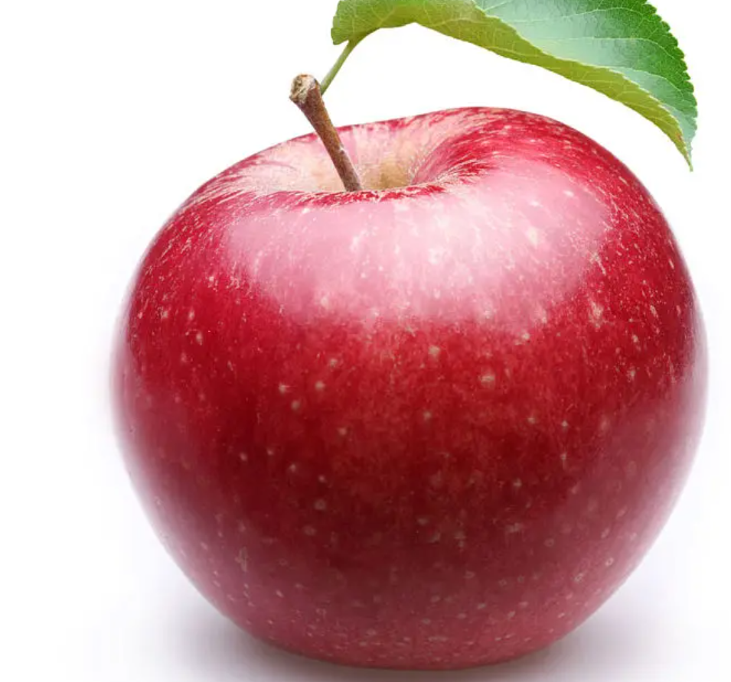
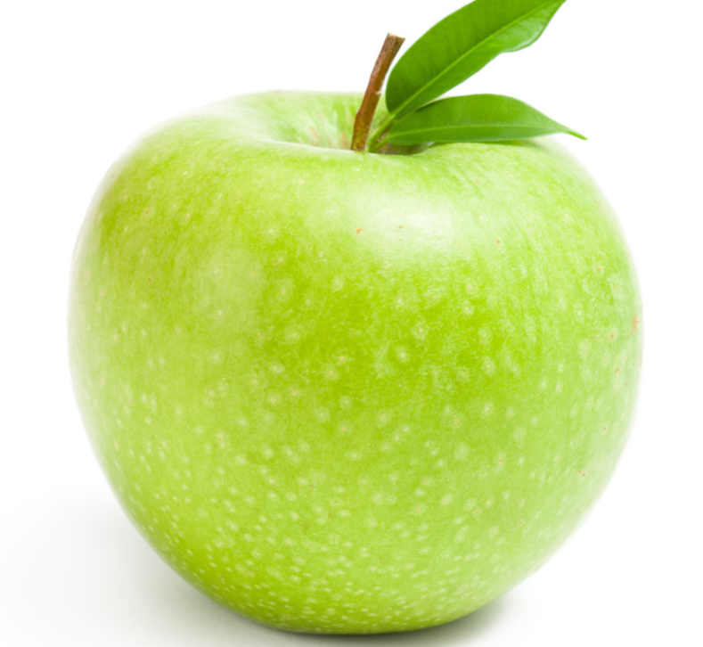
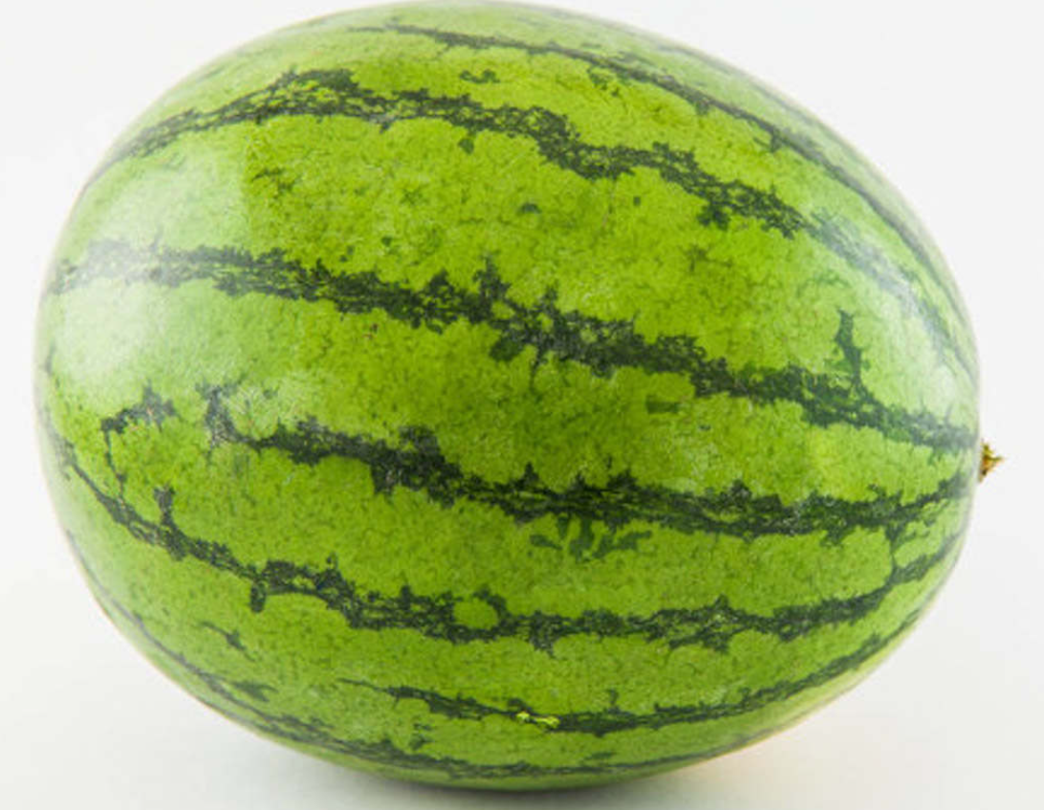
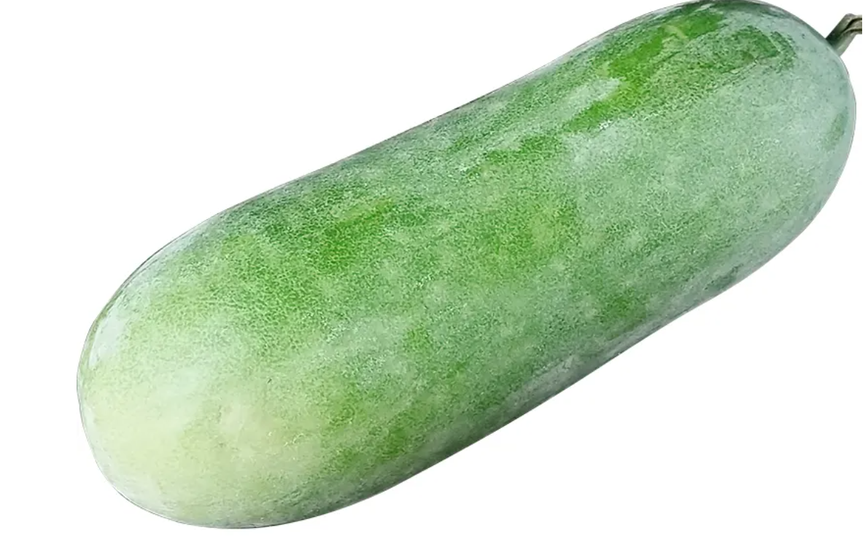
SVM
Introduction: The core idea of SVM is to find an optimal hyperplane to separate different classes of samples.
linearly separable-> hard margin
linearly inseparable -> soft margin
Advantage: efficient classification in high-dimensional Spaces
Different color
Different size

Slide 5
KNN
Introduction: The core idea of the KNN algorithm is that if most of the k closest samples in the feature space belong to a certain category, the sample also belongs to that category and has the characteristics of the samples in that category.
Advantage: Due to the fact that the KNN method mainly relies on limited neighboring samples around it, rather than relying on the method of discriminating class domains to determine the category it belongs to, the KNN method is more suitable for sample sets with more overlapping or overlapping class domains.

Slide 6
Definition of distance: As long as it satisfies non negative, reflexive, and triangular inequalities, it can be called distance. There are several distance calculation methods: Markov distance (Minkowski distance), Euclidean distance, Manhattan distance and Chebyshev distance.
Markov distance
Euclidean distance
Manhattan distance
Chebyshev distance

Slide 7
About data set
Total number
Training set size: 67,692 images
Test set size: 22,688 images
(one fruit or vegetable per image)
Image size: 100x100 pixels.
How to extract fruit
Flood fill type: We start at each edge of the image, label all pixels there, and then we label all pixels found near the labeled pixels whose colors are less than a specified value apart. We repeat the previous step until we can't label any more pixels.

Slide 8
THANK YOU

