Slide 2
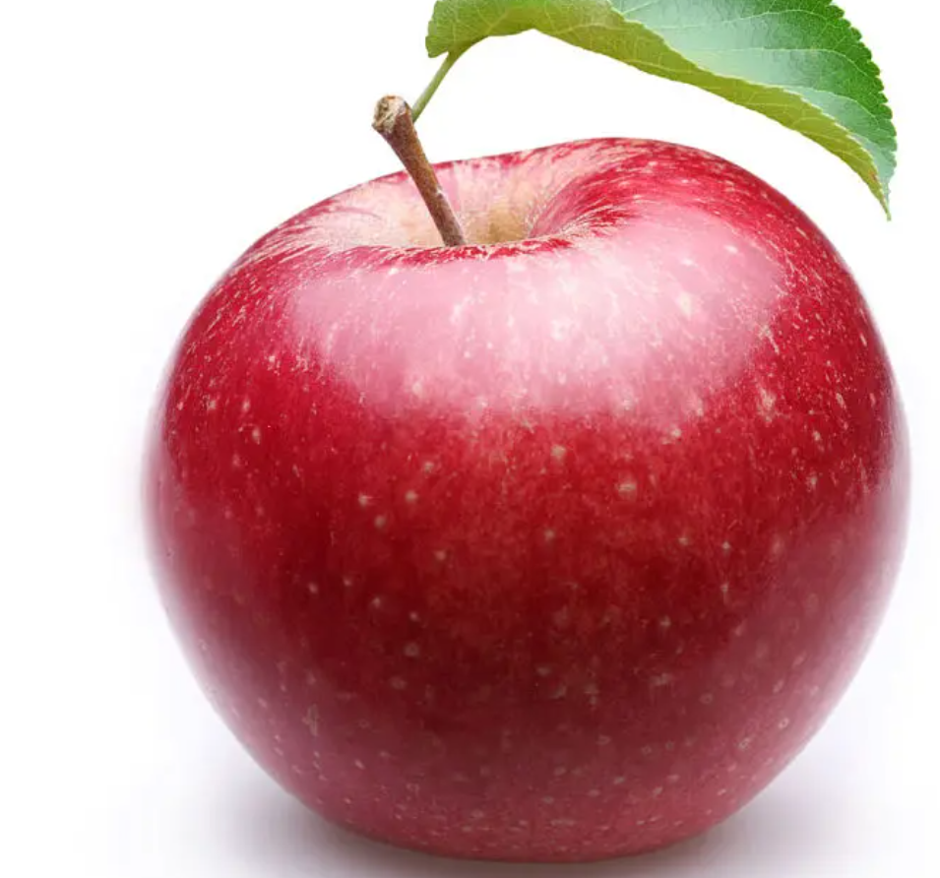
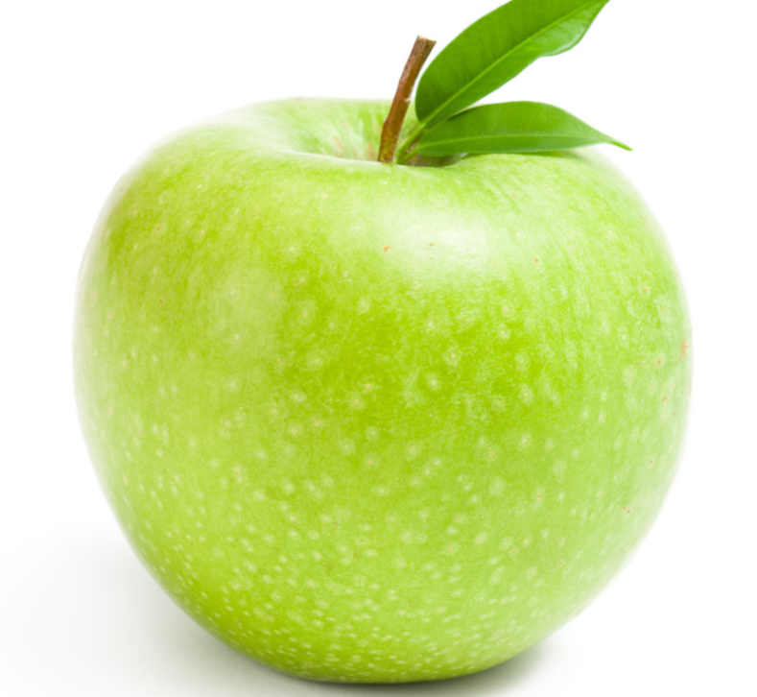
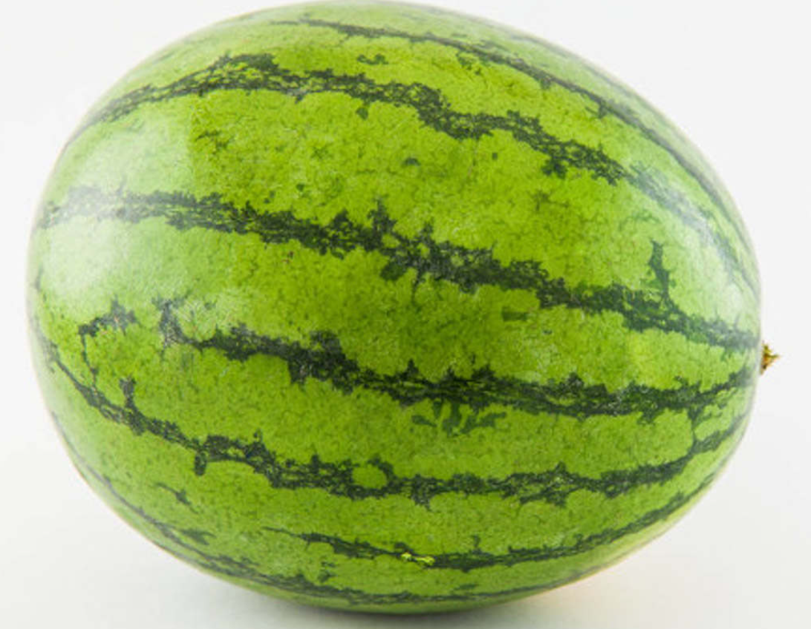
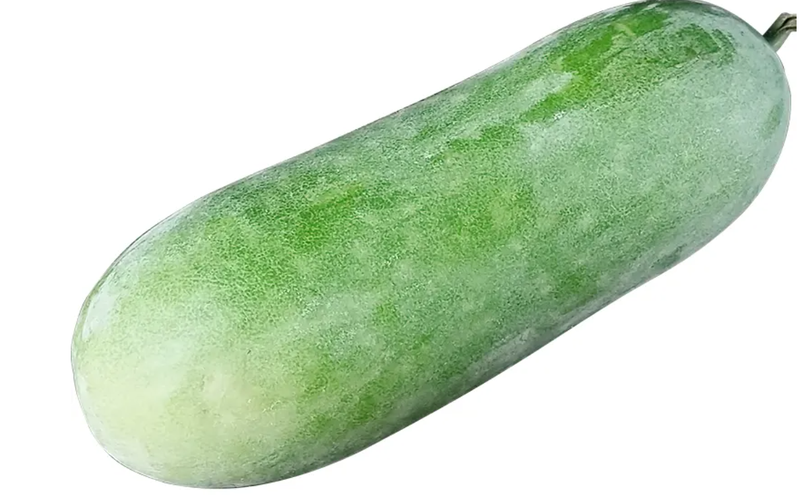
SVM
Introduction: The core idea of SVM is to find an optimal hyperplane to separate different classes of samples.
linearly separable-> hard margin
linearly inseparable -> soft margin
Advantage: efficient classification in high-dimensional Spaces
Different color
Different size

