Slide 1
Scrum-Agile: An Overview
By Lincon Woodruff

Slide 2

Scrum-Agile: Team Roles
Product Owner
Prioritizes the product backlog
Represents customer and business needs
Ensures development focuses on high-value features
Scrum Master
Removes development obstacles
Supports team communication
Helps maintain Scrum process workflow
Development Team
Designs, codes, and tests software
Works collaboratively to complete sprint goals

Slide 3

Importance of Agile Roles
Scrum roles help organize development responsibilities
Encourages collaboration instead of hierarchy
Supports faster problem solving
Improves project productivity

Slide 4
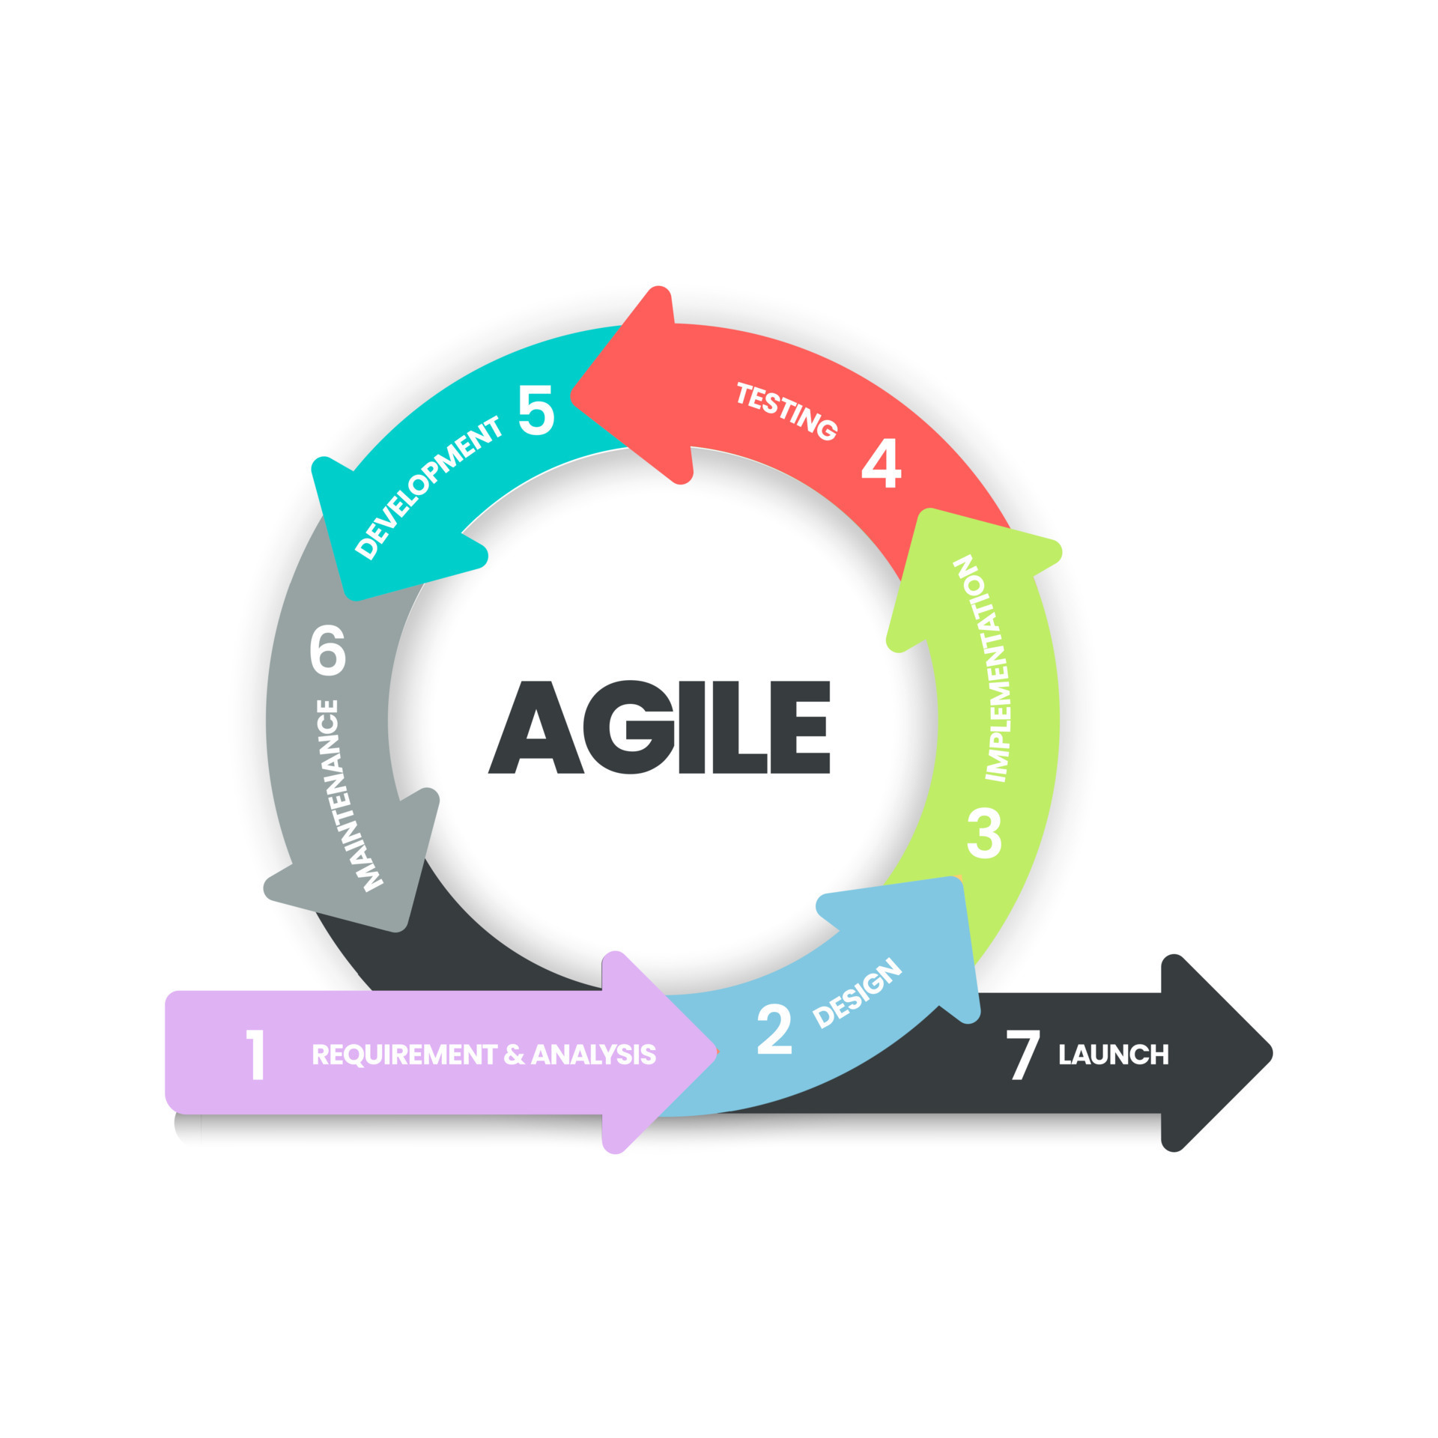
Agile SDLC Phases
Requirements → User Stories
Requirements are collected continuously
Planning → Sprint Planning
Tasks are selected from product backlog
Development and Testing
Coding and testing occur during each sprint
Review and Feedback
Stakeholders evaluate working software
Retrospective
Team improves development process

Slide 5

Importance of Agile Phases
Allows continuous improvement of software
Reduces risk by identifying errors early
Supports changing customer requirements
Produces working software quickly

Slide 6
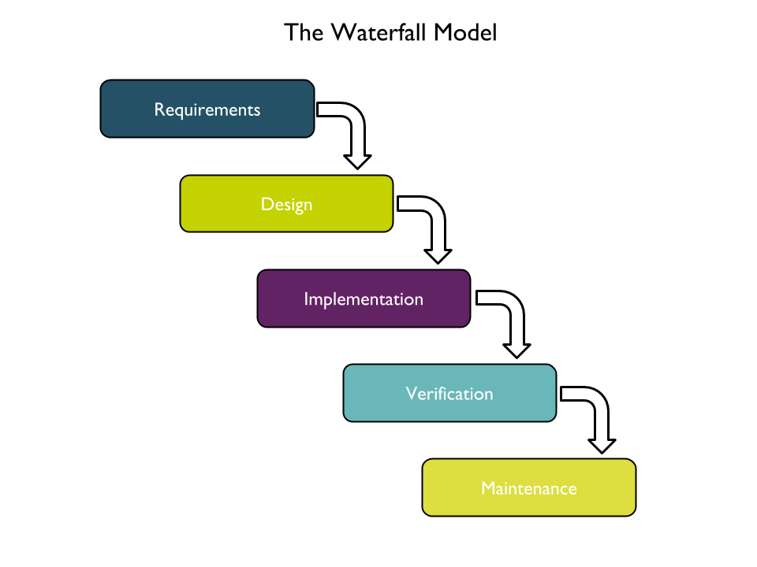
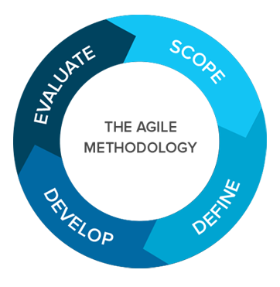
Waterfall vs Agile Development
Waterfall
Agile
Development follows sequential phases
Requirements are defined early
Design → Implementation → Testing → Deployment occurs step-by-step
Changes are difficult after development begins
Development is iterative
Feedback is continuous
Requirements can change during project
Testing happens throughout development

Slide 7

Choosing Between Waterfall and Agile
Factors to consider when selecting methodology:
Project requirement clarity
Expected frequency of changes
Stakeholder feedback needs
Team communication ability
Development timeline

Slide 8
Resources
Image Sources:
Team stock photos, royalty-free images, vectors, video
Waterfall Model What Is Waterfall Methodology: Everything You Need To
Agile planning software | Lucidspark
Confused Pose PNG Transparent Images Free Download | Vector Files | Pngtree
Resources:
Schwaber, K., & Sutherland, J. (2020). The Scrum Guide.
Agile Alliance. (2020). Agile methodology overview.
VersionOne. (2020). State of Agile report.
IEEE Xplore Digital Library articles on Agile software development.

