Slide 1

Context Retrieval on SQuAD
Tom Mery
30.03.2023

Slide 2
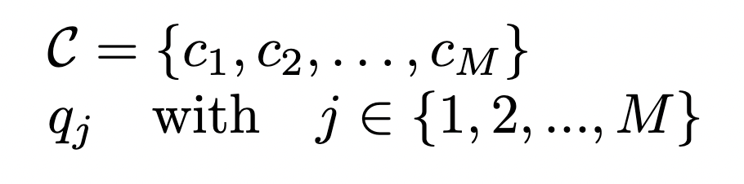
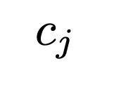
Motivation
The motivation of context retrieval for question answering is to efficiently identify relevant passages that contain the answer to a given question. In this repository, retriever based on TF-IDF, OKAPI BM25 and BERT models are implemented and tested on SQuAD dataset.
Problem statement:
Retriever

Slide 3
Methods
Traditional methods:
TF-IDF
OKAPI BM25
Deep learning methods:
BERT

Slide 4
SQuAD (Stanford Question Answering Dataset)
SQuAD 1.1: Contains 100,000+ question-answer pairs on 500+ articles.
Context: SQuAD consists of a large collection of Wikipedia articles which serve as a context for a set of questions and their respective answers.
Questions: The dataset contains a set of questions related to each context article.
Answers: For each question, SQuAD provides a corresponding answer.

Slide 5
SQuAD JSON Format
{
"data": [
{
"title": "Super_Bowl_50",
"paragraphs": [
{
"context": "Super Bowl 50 was an American football game...",
"qas": [
{
"question": "What day was the game played on?",
"id": "56be4db0acb8001400a502ec",
"answers": [
{
"text": "February 7, 2016",
"answer_start": 403
}
]
},
]
}
]
}
]
}

Slide 6
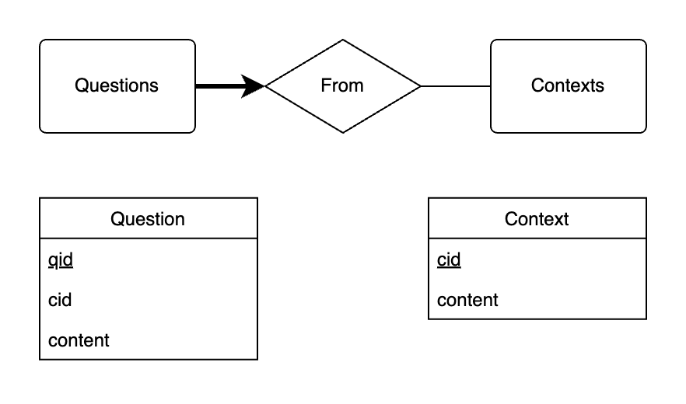
Extracted Data from JSON
contexts: [string] = [“content”, …]
questions: [(int, string)] = [(cid, “content”), …]

Slide 7
Data pre-processing
“What site is located in the San Francisco Bay Area?”
Lower case
Punctuation removal
Stop words removal
Stemming
Tokenization
“what site is located in the san francisco bay area?”
“what site is located in the san francisco bay area”
“site located san francisco bay area”
“site locat san francisco bay area”
[“site”, “locat”, “san”, “francisco”, “bay”, “area”]

Slide 8
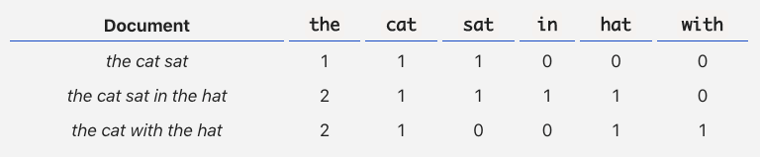
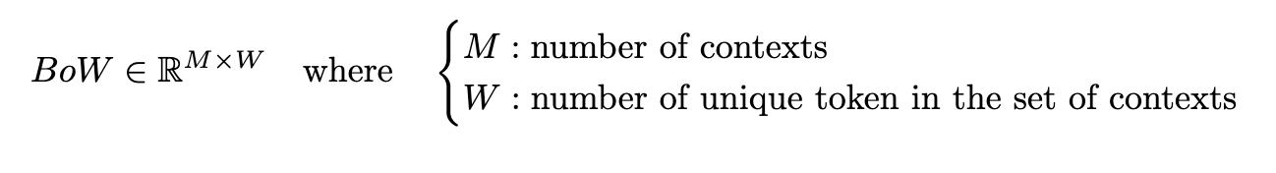
Traditional Retriever = Bag Of Words (BOW)
Documents <=> Contexts
https://towardsdatascience.com/a-simple-explanation-of-the-bag-of-words-model-b88fc4f4971

Slide 9
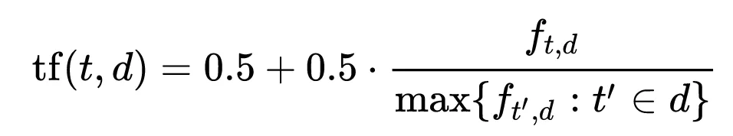
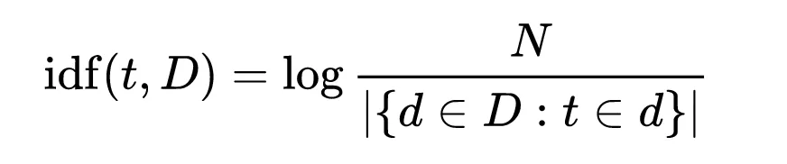
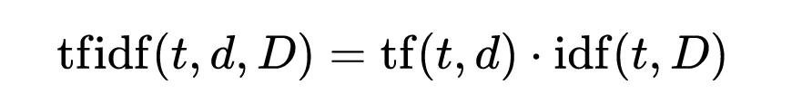
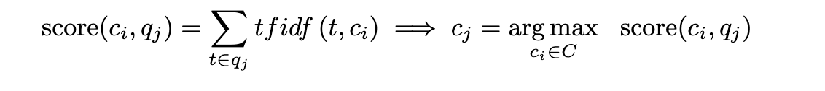
TF-IDF Based Retriever
Term frequency:
Inverse document frequency:

Slide 10
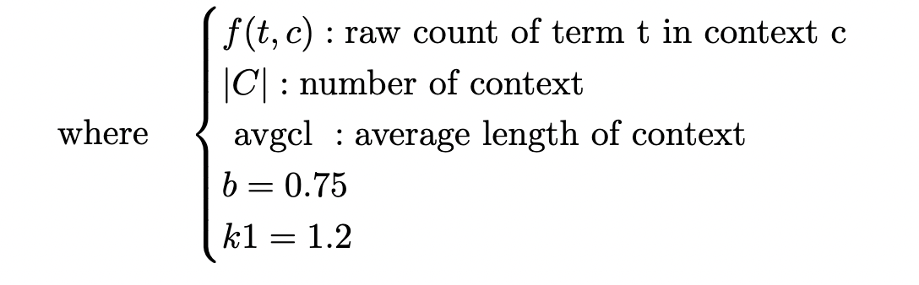
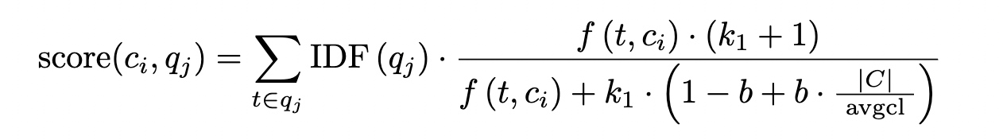
OKAPI BM25 Based Retriever

Slide 11
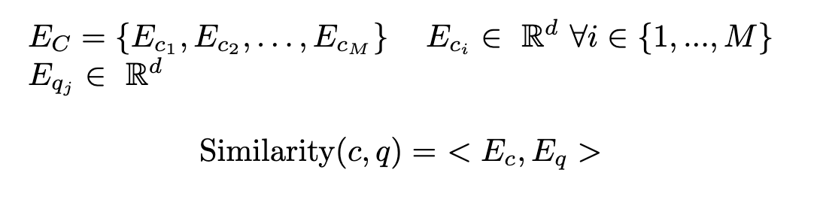
BiEncoder Retriever
Original paper: “Dense Passage Retrieval for Open-Domain Question Answering”, Vladimir Karpukhin and al., 2020
Question
Encoder
Context
Encoder

Slide 12
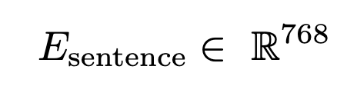
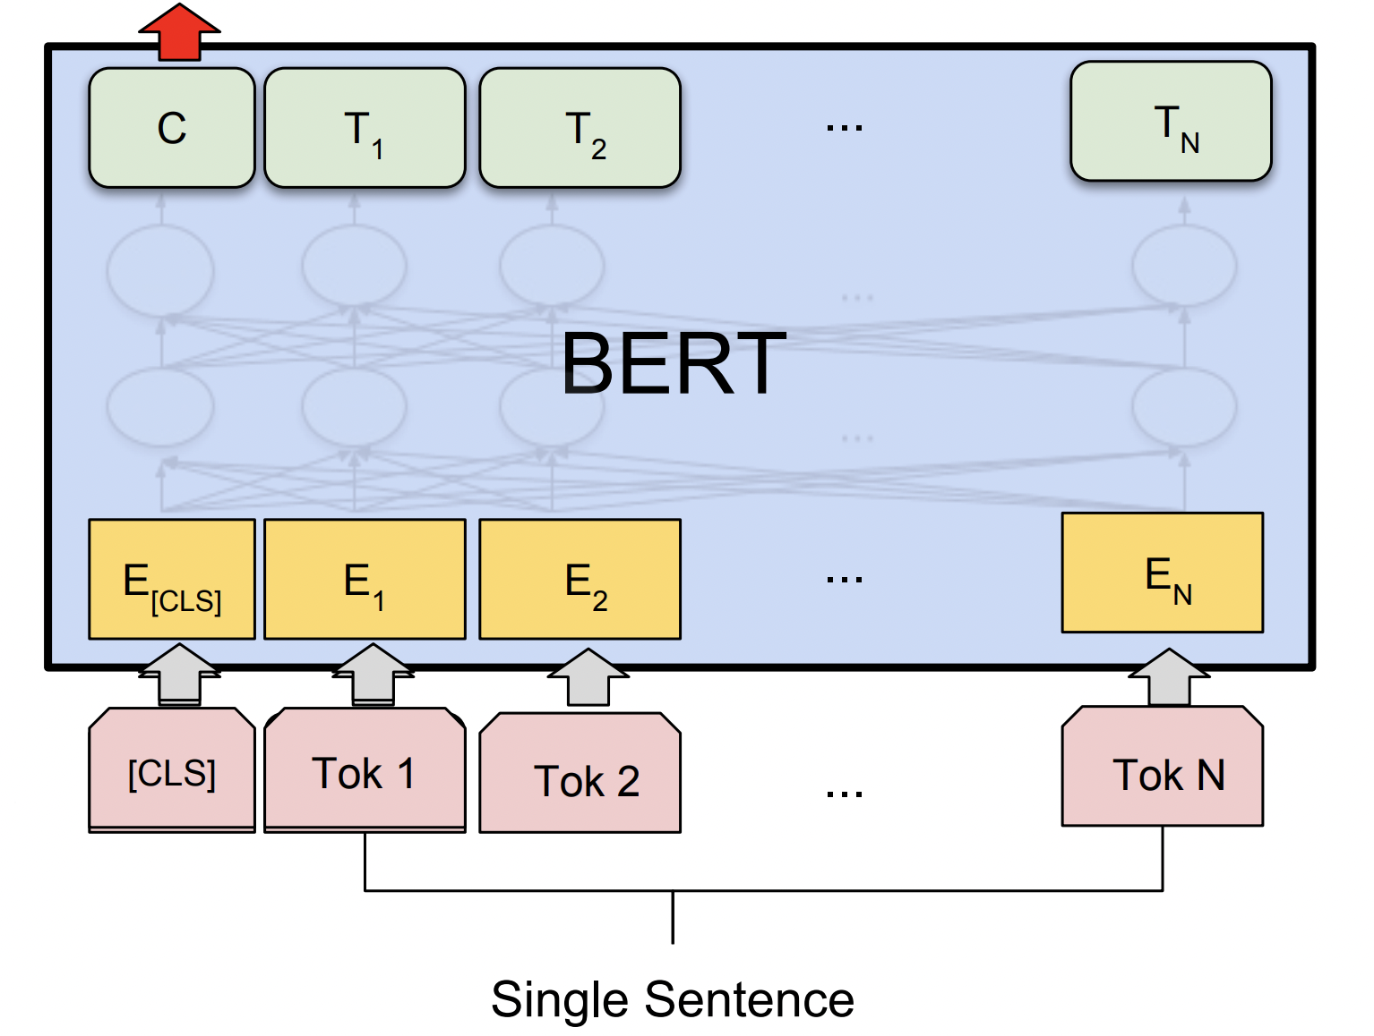
BERT Encoder
BERT: Bidirectional Encoder Representations from Transformers
It is a deep learning model that is designed to understand natural language text and is based on transformers.
It can be used as sentence encoder by taking the representation at the [CLS] token as the output, (so d = 768 for BERT base-uncased)

Slide 13
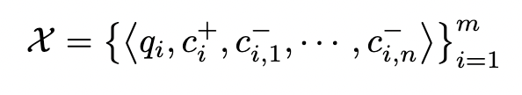
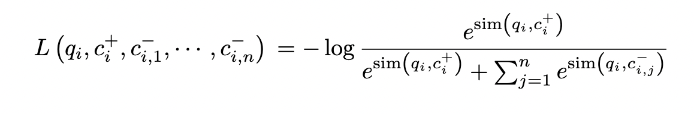
BiEncoder Training
Training data:
Loss function:
Negative context chosing:
Let Q and C be the (Bxd) matrix of question and contexts embeddings in a batch of size B. Then S = QP^{T} is a (B × B) matrix of similarity scores, where each row of which corresponds to a question, paired with B passages.

Slide 14
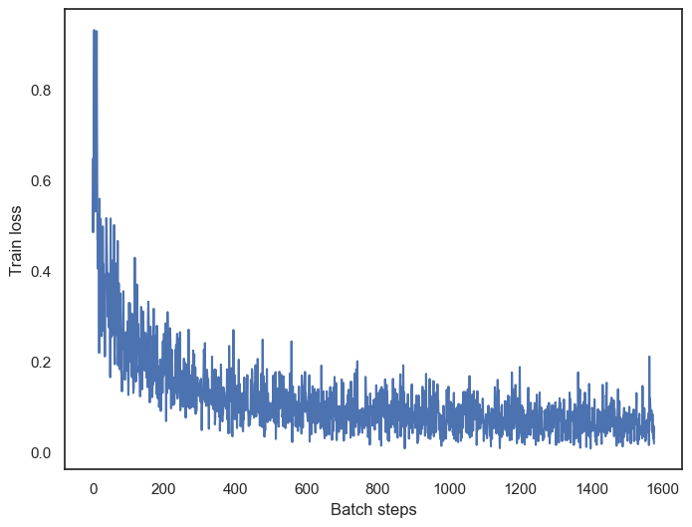
BiEncoder Training
Pe-trained BERT BiEncoder from DPR paper trained over 20 epochs, with batch size of 128 and learning rate of 1e-5 with warm-up and linear decay scheduling:

Slide 15
Results
Performance metric: Top-1 accuracy
Accuracy on SQuAD dev (validation):
Model Type | Top-1 Accuracy
TF-IDF | 59.25%
BM25 | 77.60%
BERT | 84.79%
(not relevant)

