Slide 1





BLOGER: Bi-Level Optimization for Generative Recommendation
Bridging Tokenization and Generation
Yimeng Bai, Chang Liu, Yang Zhang, Dingxian Wang, Frank Yang, Andrew Rabinovich, Wenge Rong, Fuli Feng
01/20
Notes:
Good morning, everyone. I am Yimeng Bai. Today I present BLOGER, Bi-Level Optimization for Generative Recommendation. As the subtitle says, our goal is bridging tokenization and generation: the two stages depend on each other, yet they are usually optimized separately.

Slide 2
Outline
Background
Methodology
Experiment
Conclusion
02/20
Notes:
The talk has four parts: Background on the alignment gap, our Methodology — the bi-level formulation and its solution — then Experiments and the Conclusion.

Slide 3
Background
Generative Recommendation (SID-based)
Two coupled stages in GR
Autoregressive generation: instead of matching each candidate item, the model autoregressively generates the next item's identifier
Item tokenization: map items into compact discrete representations
Example: RQ-VAE / RQ-Kmeans for generative recommendation
Critical role of item tokenization
Support the direct generation of items within the pre-defined token space
Improve scalability by replacing a large item vocabulary with small shared codebooks
Support generalization to new / long-tail items through content-derived identifiers
03/20
Notes:
SID-based generative recommendation has two coupled stages: the model autoregressively generates the next item's identifier instead of matching each candidate, and an item tokenizer maps items into compact discrete representations — typically RQ-VAE or RQ-Kmeans.
Tokenization is critical: it enables direct generation in the pre-defined token space, improves scalability through small shared codebooks, and generalizes to new and long-tail items via content-derived identifiers.

Slide 4
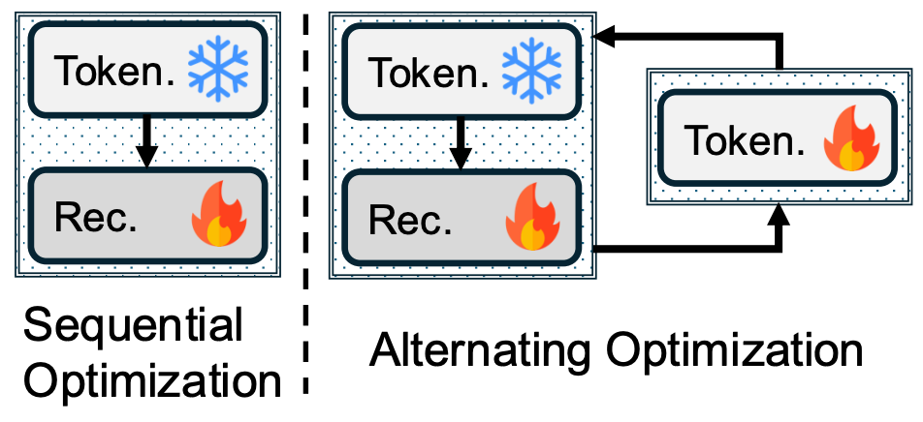
Background
Separate Training Creates an Alignment Gap
Existing works typically treat item tokenization and autoregressive generation as independent components
Sequential optimization: the tokenizer is first trained independently to produce static item IDs, which the recommender then uses for generation
Alternating optimization: the tokenizer and recommender are updated iteratively
Decoupled optimization trains the tokenizer without recommendation guidance, yielding misaligned identifiers that hurt recommendation performance.
04/20
Notes:
However, existing works treat tokenization and generation as independent components. In sequential optimization, the tokenizer is trained first and produces static item IDs for the recommender. In alternating optimization, the two modules are updated iteratively.
The takeaway at the bottom: decoupled optimization trains the tokenizer without recommendation guidance, yielding misaligned identifiers that hurt performance.

Slide 5
Background
Our Key Insight: Model the Mutual Dependence
Root cause: separate training breaks the interdependence
A better tokenizer → better item representations → more accurate next-item prediction
The recommender needs recommendation-aligned identifiers to model user preference
Our key insight
The tokenizer’s efficacy is directly reflected in the recommender’s performance
Reformulate it as a bi-level optimization problem
Inner level trains the recommender on tokenized inputs
Outer level optimizes the tokenizer using both tokenization loss and recommendation loss
05/20
Notes:
The root cause: separate training breaks this interdependence. A better tokenizer yields better item representations and predictions, while the recommender needs recommendation-aligned identifiers.
Our key insight: the tokenizer's efficacy is directly reflected in the recommender's performance. So we reformulate the problem as bi-level optimization — the inner level trains the recommender on tokenized inputs; the outer level optimizes the tokenizer with both tokenization and recommendation losses.

Slide 6
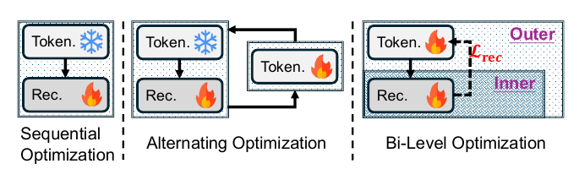
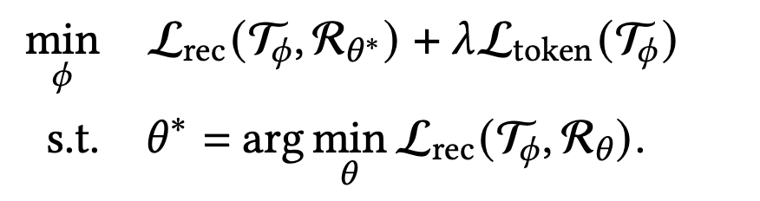
Methodology
Bi-Level Optimization Formulation
Prior strategies decouple tokenization and generation
Sequential: tokenizer frozen after pre-training, no recommendation guidance
Alternating: iterative updates via hand-crafted auxiliary alignment losses
BLOGER — unified bi-level objective
(outer)
(inner)
Recommendation loss directly supervises the tokenizer — no auxiliary objective needed
06/20
Notes:
Prior strategies decouple the two stages: sequential training freezes the tokenizer after pre-training; alternating training relies on hand-crafted auxiliary alignment losses.
BLOGER uses this unified bi-level objective. The inner problem trains the recommender under the current tokenizer; the outer problem updates the tokenizer with the optimized recommender's loss plus the tokenization loss weighted by lambda. The recommendation loss directly supervises the tokenizer — no auxiliary objective.

Slide 7
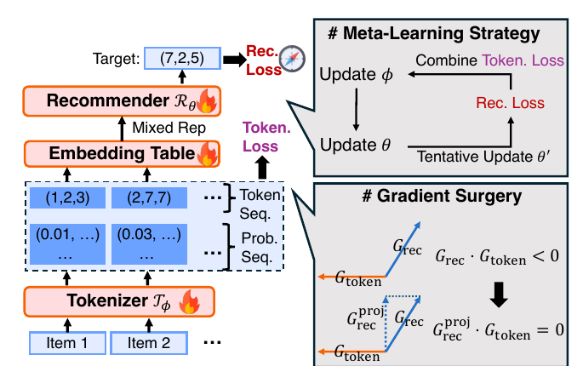
Methodology
BLOGER Framework Overview
Encoder-decoder recommender (T5) + RQ-VAE tokenizer, trained jointly
Mixed representation over codebook probabilities makes the recommendation loss differentiable w.r.t. the tokenizer
Meta-learning strategy enables efficient bi-level optimization
Gradient surgery extracts the beneficial, conflict-free component of the recommendation gradient
07/20
Notes:
This slide shows the full framework: a T5 encoder-decoder recommender and an RQ-VAE tokenizer, trained jointly.
BLOGER has three key components, matching three challenges. First, a mixed representation over codebook probabilities makes the recommendation loss differentiable with respect to the tokenizer. Second, a meta-learning strategy enables efficient bi-level optimization. Third, gradient surgery extracts the beneficial, conflict-free component of the recommendation gradient. I will explain each in turn.

Slide 8
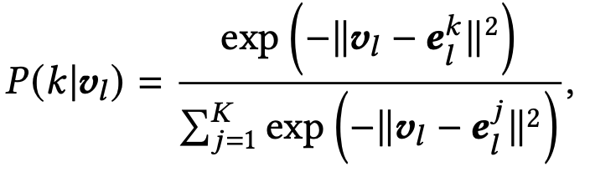
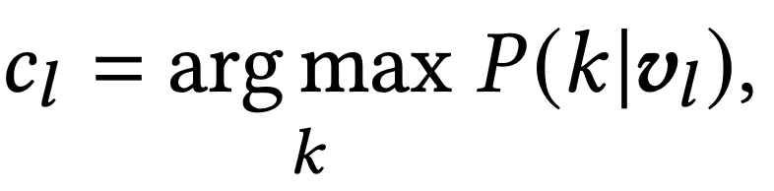
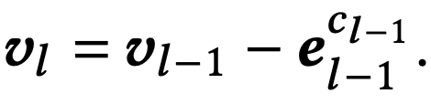
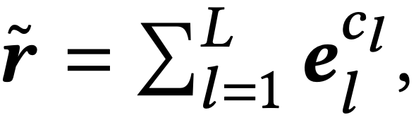
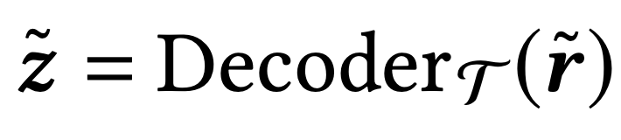
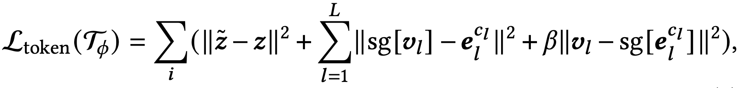
Methodology
Item Tokenizer: Residual Quantization
Represent each item as L discrete tokens via RQ over L codebooks
Soft assignment:
Hard token: ; residual:
Reconstruct semantic embedding from quantized code:
Tokenization loss = reconstruction + commitment with stop-gradient
08/20
Notes:
Our tokenizer represents each item as L discrete tokens via residual quantization over L codebooks. At each level, a soft assignment gives a probability distribution over codes; the hard token is the most likely code, and the residual passes to the next level. Summing the selected codes reconstructs the semantic embedding. The loss combines reconstruction and commitment with stop-gradient.

Slide 9
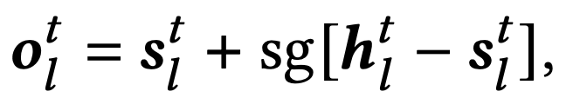
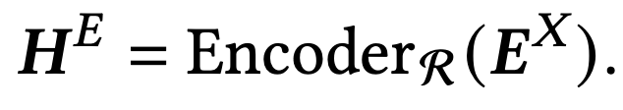
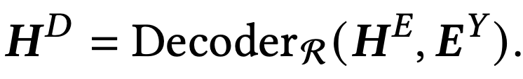
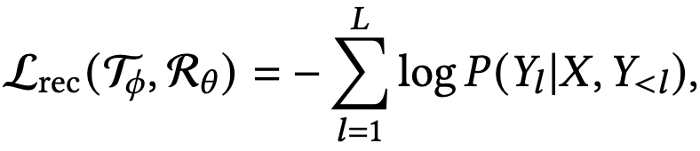
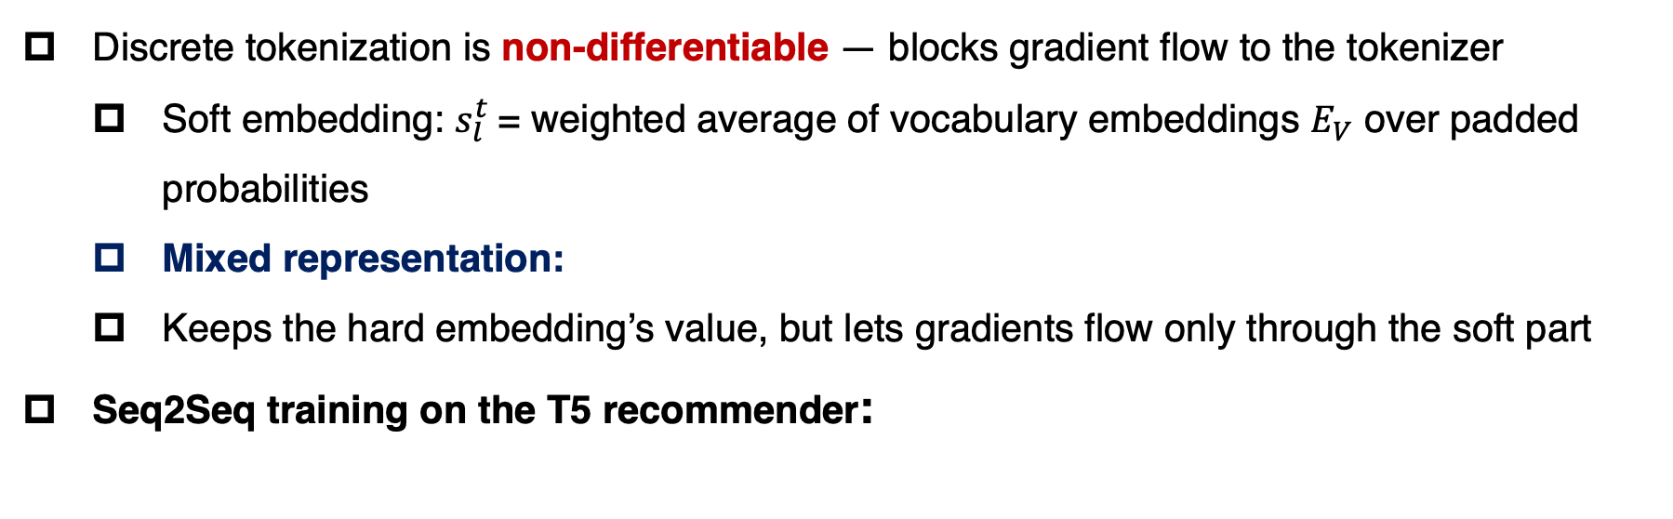
Methodology
Mixed Representation for Differentiability
Discrete tokenization is non-differentiable — blocks gradient flow to the tokenizer
Soft embedding: $s_{l}^{t}$= weighted average of vocabulary embeddings $E_{V}$ over padded probabilities
Mixed representation:
Keeps the hard embedding’s value, but lets gradients flow only through the soft part
Seq2Seq training on the T5 recommender:
(autoregressive next-item generation)
09/20
Notes:
The first challenge: discrete tokenization is non-differentiable, blocking gradient flow to the tokenizer.
We build a soft embedding — the weighted average of vocabulary embeddings under the soft-assignment probabilities — and combine it with the hard embedding through this mixed representation with stop-gradient: same value forward, but gradients flow only through the soft part backward.
So standard Seq2Seq training on the T5 recommender now has a differentiable path back to the tokenizer.

Slide 10


Methodology
Meta-Learning Strategy
Nested optimization is hard to solve directly → adopt a MAML-style meta-learning strategy
Inner update (recommender):
Meta-train — tentative recommender update (tokenizer fixed):
Meta-test — update tokenizer with the tentative recommender:
Back-propagation:
10/20
Notes:
The second challenge: the nested optimization is hard to solve directly, so we adopt a MAML-style meta-learning strategy with three steps.
First, the inner update: the recommender is updated as usual. Second, meta-train: with the tokenizer fixed, we make a tentative recommender update, obtaining theta-prime. Third, meta-test: we update the tokenizer using the recommendation loss at theta-prime together with the tokenization loss.
The back-propagation path at the bottom is the key: the outer gradient flows through the tentative update into the tokenizer, so it learns identifiers that actually help the recommender, without full inner-loop optimization.

Slide 11
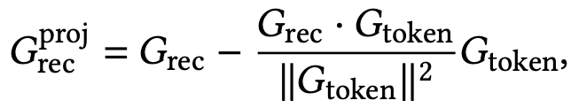
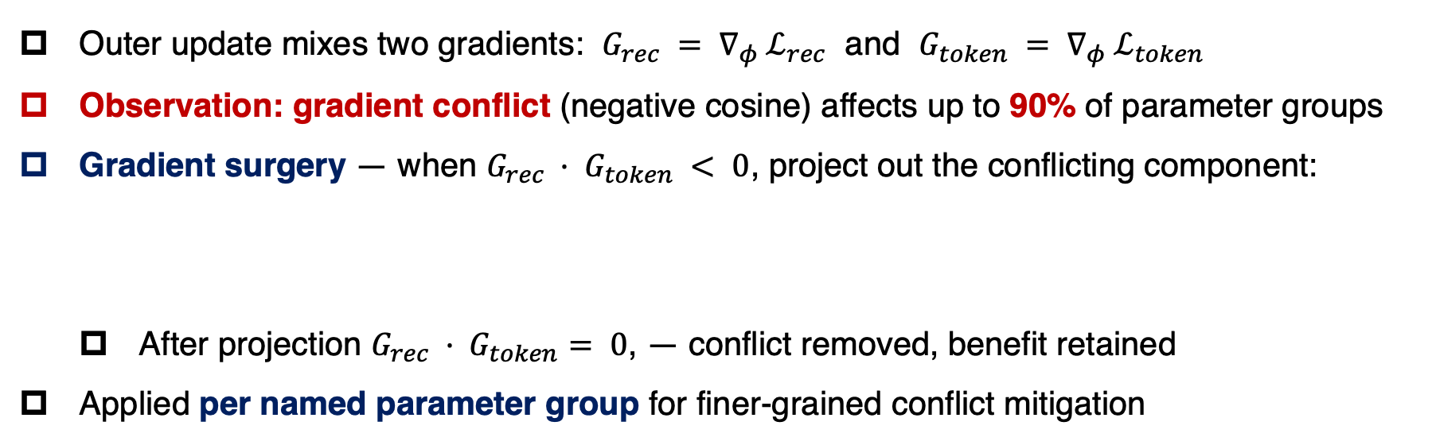
Methodology
Gradient Surgery
Outer update mixes two gradients: $G_{rec} = ∇_{φ} ℒ_{rec}$ and $G_{token} = ∇_{φ} ℒ_{token}$
Observation: gradient conflict (negative cosine) affects up to 90% of parameter groups
Gradient surgery — when $G_{rec} · G_{token} < 0$, project out the conflicting component:
After projection $G_{rec} · G_{token}= 0$, — conflict removed, benefit retained
Applied per named parameter group for finer-grained conflict mitigation
11/20
Notes:
The third challenge: the outer update mixes the recommendation gradient and the tokenization gradient, and we observe gradient conflict — negative cosine similarity — in up to 90 percent of parameter groups. Improving recommendation can damage the learned semantic structure.
So we apply gradient surgery: when the dot product is negative, we project out the conflicting component of the recommendation gradient. After projection the dot product is zero — conflict removed, benefit retained. This is done per named parameter group, for finer-grained mitigation.

Slide 12
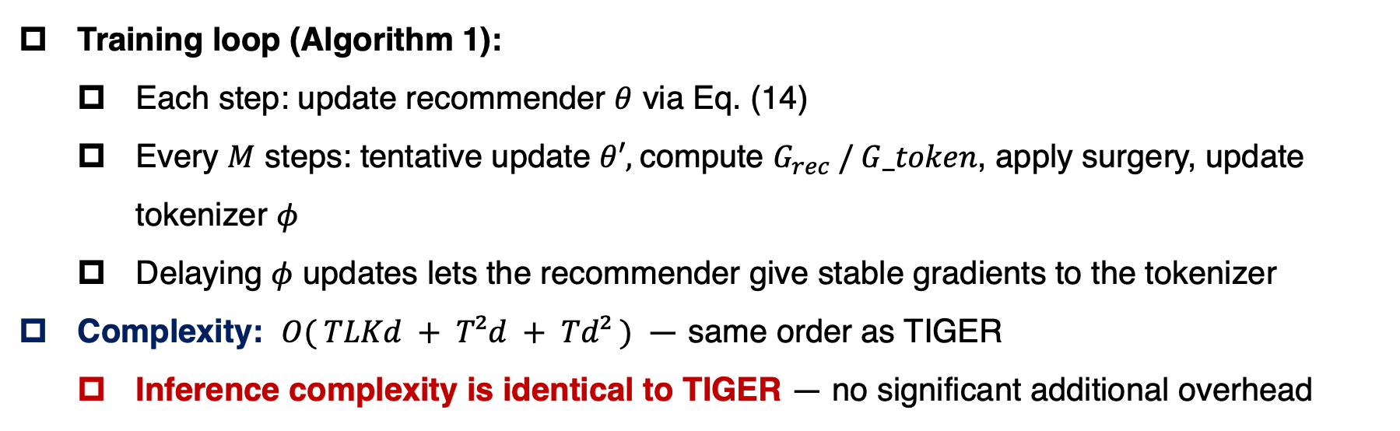
Methodology
Training Algorithm & Complexity
Training loop (Algorithm 1):
Each step: update recommender $θ$ via Eq. (14)
Every $M$ steps: tentative update $θ′,$compute $G_{rec} / G_token$, apply surgery, update tokenizer $φ$
Delaying $φ$ updates lets the recommender give stable gradients to the tokenizer
Complexity: $O( TLKd + T²d + Td² )$— same order as TIGER
Inference complexity is identical to TIGER — no significant additional overhead
12/20
Notes:
Putting it together, Algorithm 1 is simple: at each step, update the recommender; every M steps, make the tentative update, compute the two outer gradients, apply surgery, and update the tokenizer. Delaying tokenizer updates gives more stable gradients.
Training cost stays in the same order as TIGER, and inference complexity is identical — no significant overhead.

Slide 13
Experiment
Setup: Datasets & Metrics
Three Amazon Review subsets, 5-core filtering, leave-one-out split, max length 20
Metrics: Recall@K and NDCG@K (K = 5, 10), full ranking, constrained Trie decoding, beam search with 20
Recommender: T5, 4+4 layers, dim 128; RQ-VAE: 4 codebooks × 256 codes, dim 32
Dataset | #Users | #Items | #Interaction | Sparsity | AvgLen
Beauty | 22,363 | 12,101 | 198,502 | 99.93% | 8.87
Instruments | 24,772 | 9,922 | 206,153 | 99.92% | 8.32
Arts | 45,141 | 20,956 | 390,832 | 99.96% | 8.66
13/20
Notes:
We evaluate on three Amazon Review subsets — Beauty, Instruments, and Arts — with 5-core filtering and leave-one-out split. Metrics are Recall and NDCG, under full ranking with Trie-constrained decoding and beam search. The recommender is a compact T5 and the tokenizer a multi-level RQ-VAE — the full settings are on the slide. All three datasets are extremely sparse.

Slide 14
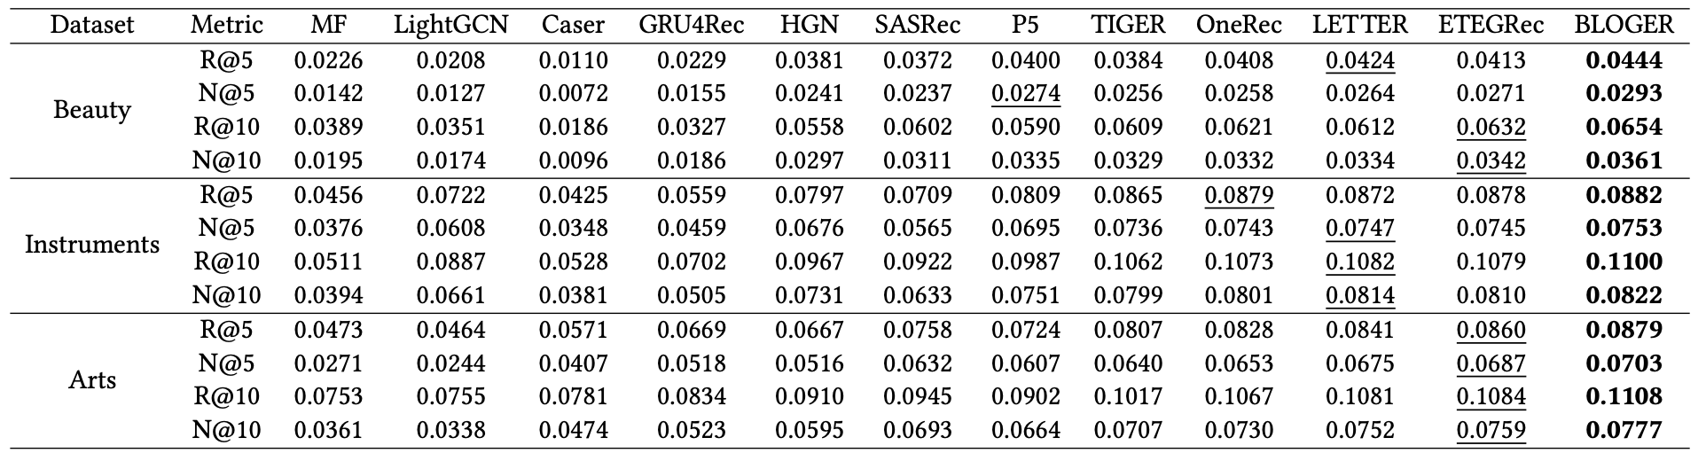
Experiment
Overall Performance (RQ1)
Compared against 11 baselines: MF, LightGCN, Caser, GRU4Rec, HGN, SASRec, P5, TIGER, OneRec, LETTER, ETEGRec
14/20
Notes:
This table compares BLOGER with eleven baselines, covering conventional models, sequential models, and recent generative recommenders such as TIGER, LETTER, and ETEGRec.
BLOGER is best in every dataset-metric combination. On Beauty, Recall improves clearly over the strongest baseline — the exact numbers are in the table — and the gains remain consistent on Instruments and Arts. So tokenization should not be a fixed upstream module — direct recommendation supervision helps.

Slide 15
Experiment
Ablation Study (RQ2)
Systematically disable each design element on Beauty
Method | R@5 | N@5 | R@10 | N@10
BLOGER | 0.0444 | 0.0293 | 0.0654 | 0.0361
w/ LETTER | 0.0489 | 0.0322 | 0.0732 | 0.0400
w/o GS | 0.0329 | 0.0209 | 0.0530 | 0.0274
Joint | 0.0418 | 0.0272 | 0.0637 | 0.0342
Joint w/ GS | 0.0412 | 0.0273 | 0.0631 | 0.0343
Fixed | 0.0384 | 0.0256 | 0.0609 | 0.0329
w/o GS: removing gradient surgery causes the sharpest drop — conflict-free gradients are essential
Bi-level beats both Joint and Fixed; pairing with LETTER further improves — backbone-agnostic
15/20
Notes:
We disable each design element on Beauty. The table lists BLOGER, BLOGER with LETTER, BLOGER without gradient surgery, Joint training, Joint with surgery, and the Fixed-tokenizer variant.
Two takeaways. First, removing gradient surgery causes the sharpest drop — even below Fixed — so conflict-free gradients are essential; and adding surgery to joint training barely helps, so the bi-level structure itself matters. Second, bi-level beats Joint and Fixed, and pairing with LETTER improves further — the framework is backbone-agnostic.

Slide 16
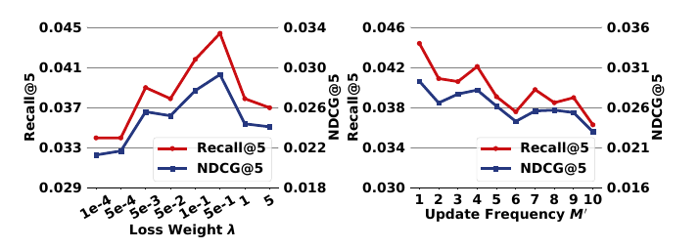
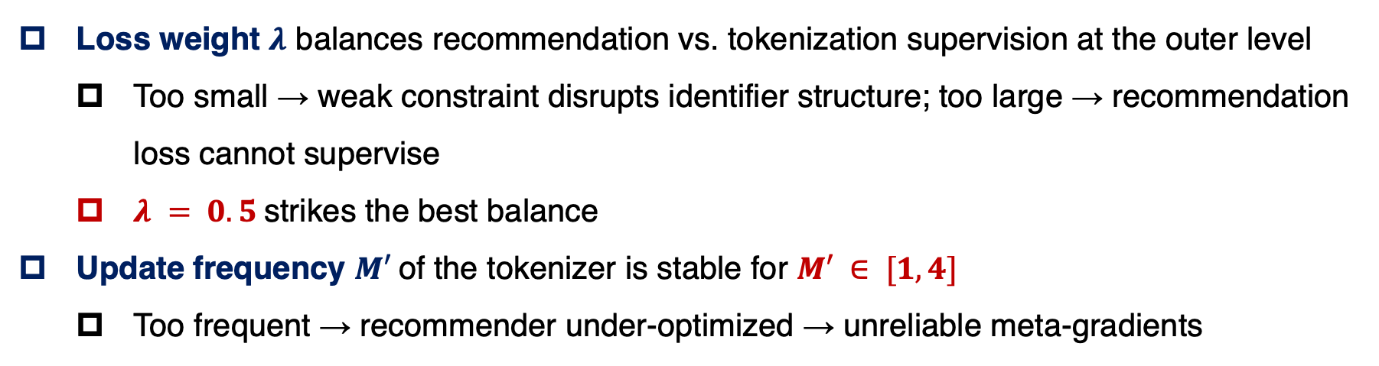
Experiment
Hyper-Parameter Analysis (RQ3)
Loss weight $λ$ balances recommendation vs. tokenization supervision at the outer level
Too small → weak constraint disrupts identifier structure; too large → recommendation loss cannot supervise
$λ = 0.5$strikes the best balance
Update frequency $M′$of the tokenizer is stable for $M′ ∈ [1, 4]$
Too frequent → recommender under-optimized → unreliable meta-gradients
16/20
Notes:
Two hyper-parameters. The loss weight lambda balances recommendation versus tokenization supervision: too small, the weak constraint disrupts the identifier structure; too large, the recommendation loss cannot supervise. Lambda 0.5 strikes the best balance.
The tokenizer update frequency is stable across moderate values of M; updating too frequently is harmful, because an under-optimized recommender gives unreliable meta-gradients.

Slide 17
Experiment
Time Efficiency (RQ4)
Average per-epoch training / testing time vs. TIGER on identical NVIDIA RTX 3090
Method | Train (s/epoch) | Test (s/epoch)
TIGER | 23.7 | 66.7
BLOGER | 26.6 | 66.9
Slight training increase, near-identical inference cost
Bi-level optimization adds minimal overhead — confirms the complexity analysis
17/20
Notes:
Compared with TIGER on the same GPU, training is only slightly slower per epoch, and testing time is essentially unchanged — the exact numbers are in the table. Bi-level optimization adds minimal overhead, confirming the complexity analysis.

Slide 18
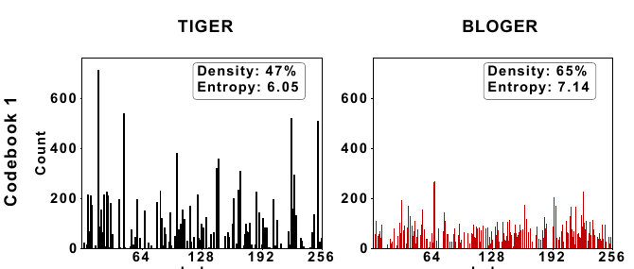
Experiment
Codebook Utilization Analysis (RQ5)
Analyze first-level codebook utilization on Beauty (TIGER vs. BLOGER)
Density 47% → 65%, Entropy 6.05 → 7.14
First level carries most information (residual op); higher levels differ little
Recommendation loss acts like a compass
It reveals hidden collaborative signals, correcting text-only bias
18/20
Notes:
To see why BLOGER works, we analyze first-level codebook utilization on Beauty. Compared with TIGER, both code density and entropy increase clearly — the numbers are on the slide — and the distribution becomes visibly more balanced. The first level carries the most information due to the residual operation, so this is exactly where it matters.
Our interpretation: the recommendation loss acts like a compass, revealing hidden collaborative signals and correcting the text-only bias.

Slide 19
Conclusion
Summary
Reformulated generative recommendation as a bi-level optimization problem
Explicitly captures the interdependence between tokenizer and recommender
BLOGER solves it efficiently via meta-learning + gradient surgery
Recommendation loss directly aligns tokenization with the downstream objective
No significant additional computational overhead
Gradient surgery is critical — up to 90% of parameter groups exhibit gradient conflict
Gains primarily stem from improved codebook utilization
19/20
Notes:
To conclude: BLOGER reformulates generative recommendation as bi-level optimization and solves it via meta-learning plus gradient surgery, letting the recommendation loss directly align tokenization with the downstream objective, at no significant overhead. Gradient surgery is critical, and gains stem mainly from better codebook utilization.

Slide 20
Thanks
20/20
Notes:
Thank you very much for your attention. I am happy to take questions.

