Slide 1
Ayrshire Planning Guidance on Wind Farm Development
• Areas to be given significant protection – See Map 1
• Areas of potential constraint – See Map 2
• Other Considerations – See Map 3
• Broad area of search – See Map 4

Slide 2
landscape, natural heritage and aviation interests.
Development will not generally be supported within 2km of a town and village or within either 700 metres or a distance of 10 time the turbines rotor blade diameter

Slide 3
For large scale development to supply power to national grid(exceeds 5MW):
Tens of turbines, each with tower of up to 45m and rotor of up to 35m,the overall height to about 80m
additionally, prefer upland and costal areas(wind speed and connection to the National Grid)
Wind farms prefer more complex and developed areas since there are already vertical elements, and it need enough space between each turbine.

Slide 4
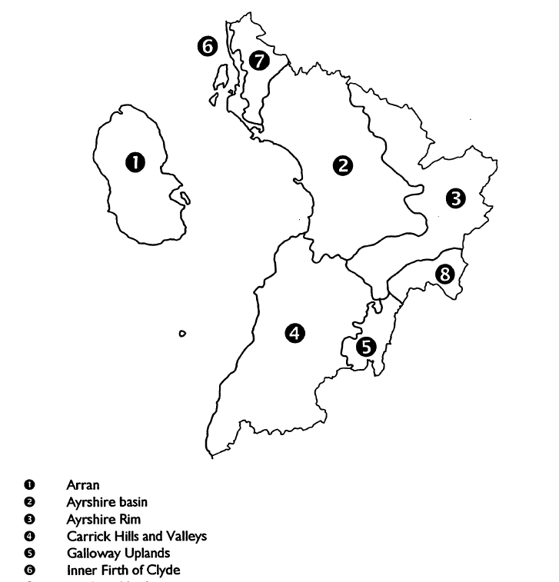

Slide 5
Key landscape issues
Pressure for urban development
Recreation pressure
Woodland managment

Slide 6
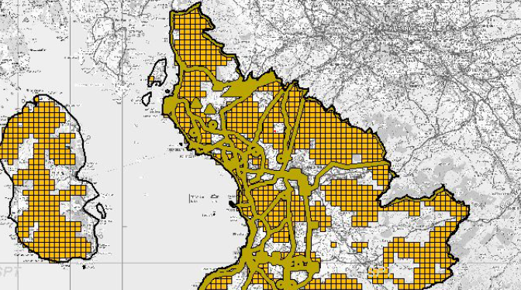
Wind speed greater than 6.5 mps

Slide 7
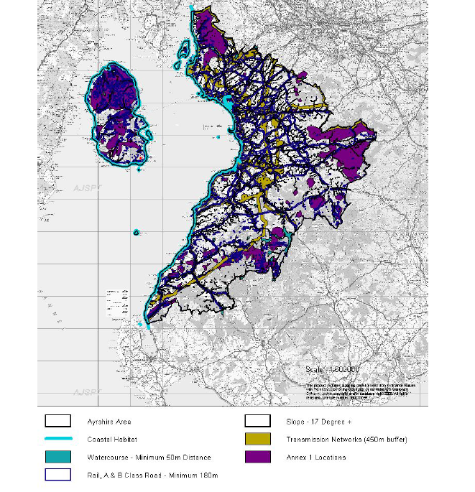
Watercourse and costal habitat

Slide 8
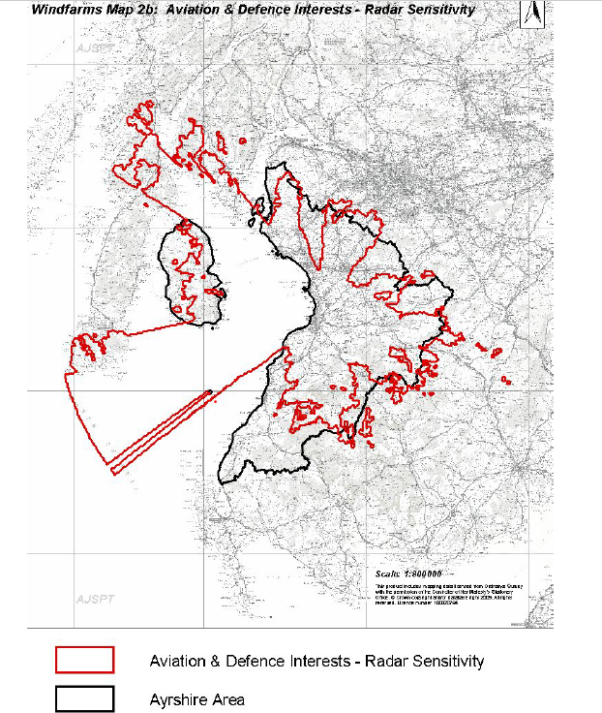
Aviation interests

Slide 9
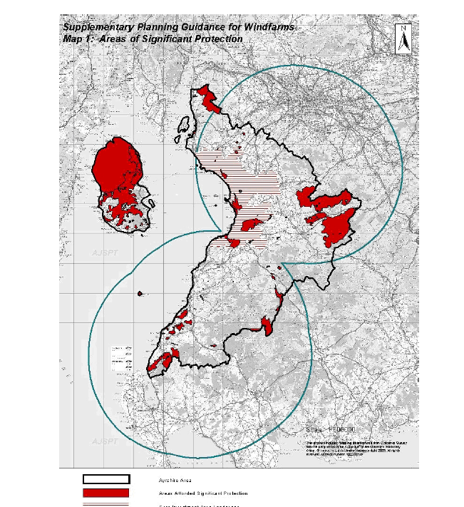
Significant protection

