Slide 1
Chapter 4 The Z Transform
§4-1 z-Transform of A Discrete-Time Signal
§4-2 Properties of the z-Transform
§4-3 Computation of the Inverse z-Transform
Problems

Slide 2
Chapter 4 The Z Transform
The chapter deals with the z-transform, which is the discrete-time counterpart of the Laplace transform. The z-transform operates on discrete-time signal x[n] in contrast to Laplace transform, which operates on a continuous-time or analog signal x(t).
The theory of the z-transform and its application to causal linear time-invariant discrete-time systems closely resembles the theory of the Laplace transform and its application to causal linear time-invariant continuous-time systems. In particular, results and techniques in this chapter closely parallel the results and techniques on Laplace transform. However, there are some differences between the transform theory in the continuous-time case and the transform theory in the discrete-time case, although for the most part, these differences are minor.

Slide 3
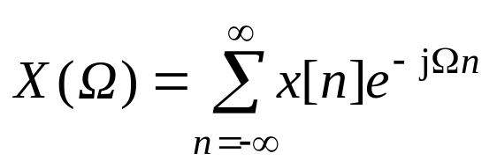
§4-1 z-Transform of A Discrete-Time Signal
Given the discrete-time signal x[n], the discrete-time Fourier transform (DTFT) was defined by
(4.1)
Recall that X(Ω) is in general a complex-valued function of the frequency variable Ω.
The z-transform of the signal x[n] is generated by adding the factor ρ^{–n} to the summation in (4.1), where ρ is a real number. The factor ρ^{–n} plays the same role as the exponential factor e^{–σt} that was added to the Fourier transform to generate the Laplace transform in the continuous-time case. Inserting ρ^{–n} in (4.1) gives

Slide 4
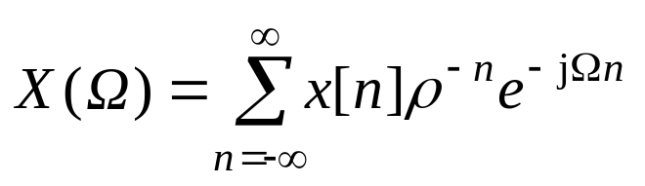
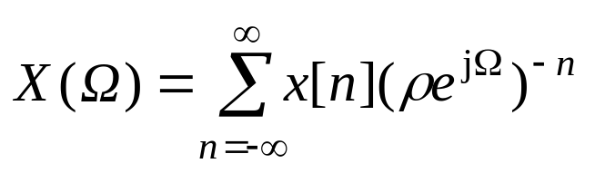
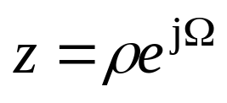
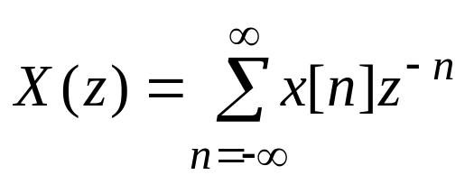
(4.2)
which can be rewritten as
(4.3)
The function X(Ω) given by (4.3) is now a function of the complex number
so X should be rewritten as a function of z, which gives
(4.4)

Slide 5
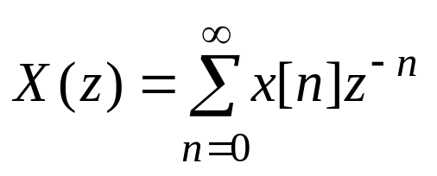
the function X(z) given by (4.4) is the two-sided z-transform of the discrete-time signal x[n]. The one-sided z-transform of x[n], also denoted by X(z), is defined by
(4.5)
As seen from (4.5) the one-sided z-transform is a power series in z^{–n} whose coefficients are the values of the signal x[n].
Note that if x[n]=0 for n= –1, –2, …, the one- and two-sided z-transforms are identical. The one-sided z-transform can be applied to signals x[n] that are nonzero for n= –1, –2, …, but any nonzero values of x[n] for n<0 cannot be recovered from the one-sided z-transform. Here, only the one-sided z-transform is pursued, which will be referred to as the z-transform.

Slide 6
Given the discrete-time signal x[n] with z-transform X(z) , the set of all complex numbers z such that the summation on the right-hand side of (4.5) converges (i.e., exists) is called the region of convergence of the z-transform X(z). The z-transform X(z) exists (is well defined) for any value of z belonging to the region of convergence .

Slide 7
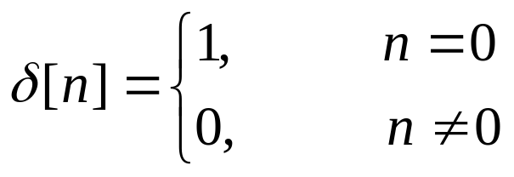
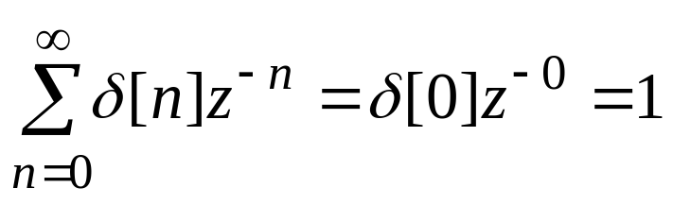
Example 4.1 Z-Transform of Unit Pulse
Let δ[n] denote the unit pulse concentrated at n=0 given by
Sinceδ[n] is zero for all n except n=0, the z-transform is
(4.6)
Thus the z-transform of the unit pulseδ[n] is equal to 1. In addition, it is obvious that the summation in (4.6) exists for any value of z, and thus the region of convergence of the z-transform of the unit pulse is the set of all complex numbers.

Slide 8
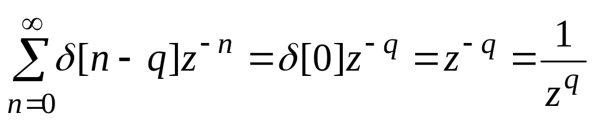
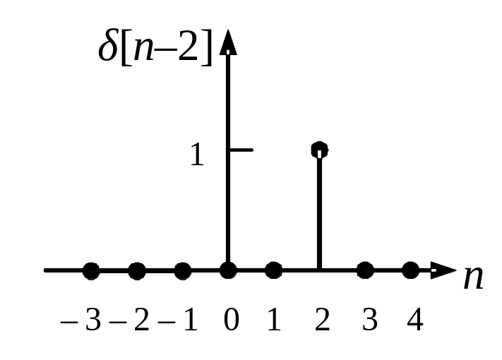
Example 4.2 Z-Transform of Shift Pulse
Given a positive integer q, consider the unit pulseδ[n–q] located at n=q. For example, when q=2, δ[n–2] is the pulse shown in Fig. 4-1. for any positive integer value of q, the z-transform of δ[n–q] is
The region of convergence is the set of all complex numbers z such that |z|>0.
Fig. 4-1 Unit pulse δ[n–2] located at n=2.

Slide 9
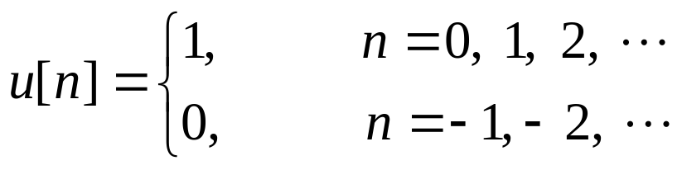
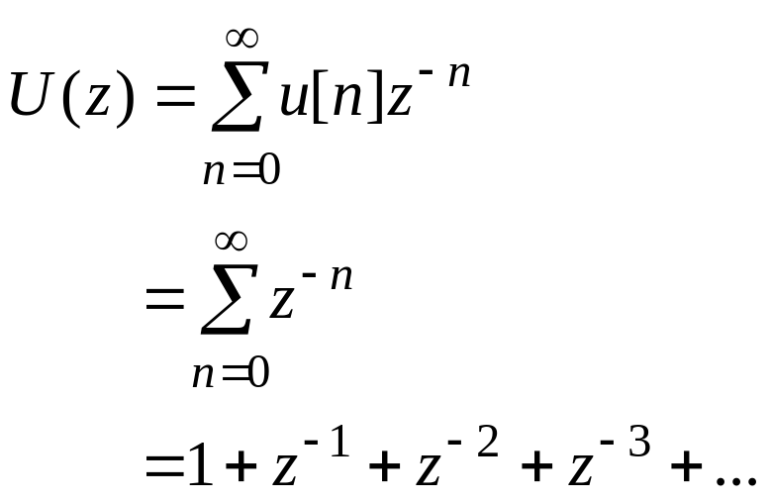
Example 4.3 Unit-Step Function
Consider the discrete-time unit-step function u[n] given by
The z-transform U(z) is
(4.7)

Slide 10
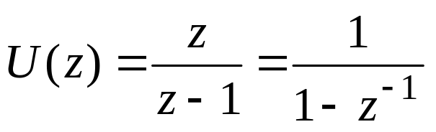
The transform U(z) can be expressed as a rational function of z: Multiplying both sides of (4.7) by z–1 gives
(z–1) U(z) =(z +1+ z^{–1}+ z^{–2} +…) – (1+ z^{–1}+ z^{–2} +…) (4.8)
=z
Dividing both sides of (4.8) by z–1 yields
(4.9)
Note that the form of the z-transform U(z) of the discrete-time unit-step function u[n] is different from the form of the Laplace transform 1/s of the continuous-time unit-step function u(t).

Slide 11
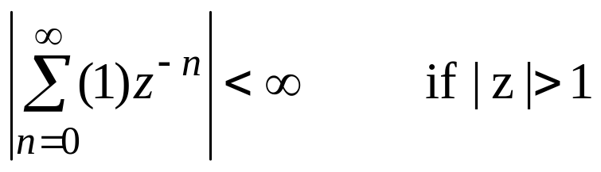
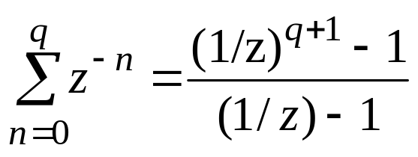
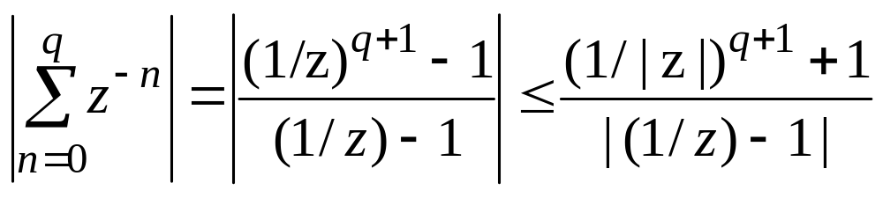
The region of convergence for the z-transform U(z) given by (4.9) includes the set of all complex numbers z such that |z|>1. This follows from the result that
(4.10)
To prove (4.10), first note that using the following equation, for any positive integer q,
(4.11)
|a−b|≤|a|+|b|
where it is assumed that z≠1. Then using (4.11)
(4.12)

Slide 12
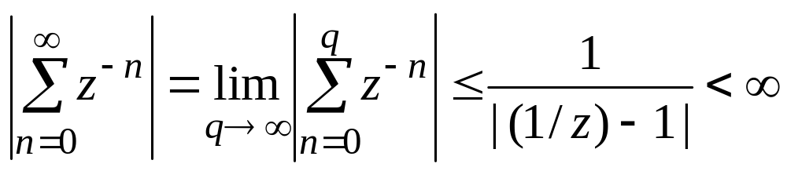
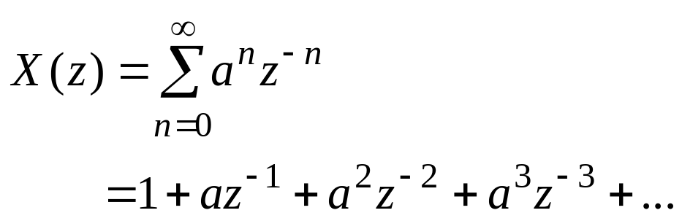
and using (4.12), if |z|>1,
Thus (4.10) is verified.
Example 4.4 Z-Transform of a^{n}u[n]
Given a real or complex number a, let x[n]=a^{n}u[n]. The z-transform X(z) of x[n] is given by
(4.13)

Slide 13
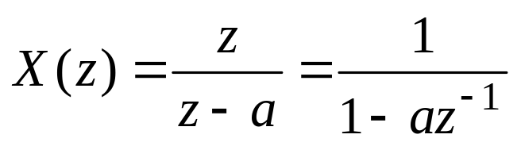
This transform can also be written as a rational function in z: Multiplying both sides of (4.11) by z–a gives
(z–a) X(z) =(z+ a + a²z^{–1}+a³z^{–2}+…) – (a+a²z^{–1}+a³z^{–2}+…)
=z
Hence
(4.14)
Note that if a=1, (4.14) is the same as (4.9). The region of convergence for the transform X(z)=z/(z–a) includes the set of all complex numbers z such that |z|>|a|. This follows by using an argument similar to that given in Example 4.3. The details are left to you.

Slide 14
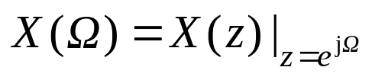
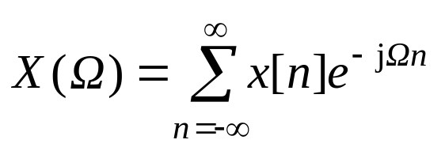

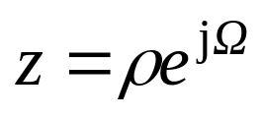
Relationship between the DTFT and the z-Transform
As shown above, the z-transform X(z) of a discrete-time signal x[n] can be viewed as a generalization of the discrete-time Fourier transform (DTFT) X(Ω). In fact, from (4.1) and (4.4) it appears that
(4.15)
However, (4.15) is not valid in general unless the region of convergence of X(z) includes all complex number z such that |z|=1. If this is the case, the DTFT X(Ω) of x[n] is given by (4.15).

Slide 15
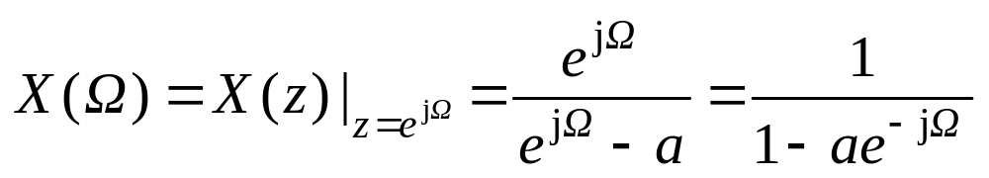
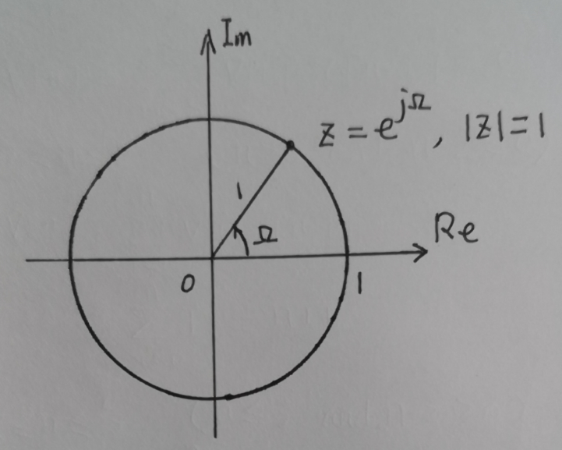
For example, suppose that x[n]=a^{n}u[n], where a is a real or complex number. In Example 4.4 it was shown that the z-transform of x[n] is X(z)=z/(z–a) and that the region of convergence of the z-transform includes the set of all complex number z such that |z|>|a|. Thus if |a|<1, the DTFT X(Ω) of x[n] exists (in the ordinary sense) and is given by
(4.16)

Slide 16
Given a signal x[n] with z-transform X(z), the transform pair notation
x[n] ↔X(z)
will sometimes be used to denote the fact that X(z) is the z-transform of x[n] , and conversely, that x[n] is the inverse z-transform of X(z). The transform pairs derived in the examples given above are shown in Table 4.1

Slide 17

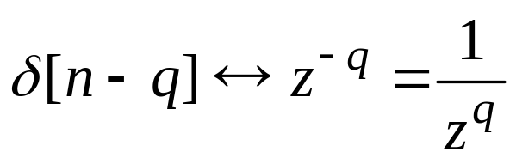
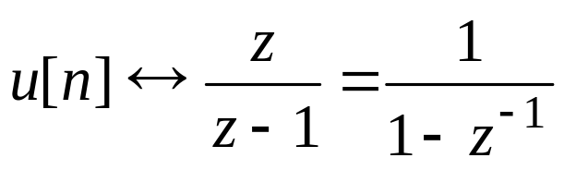
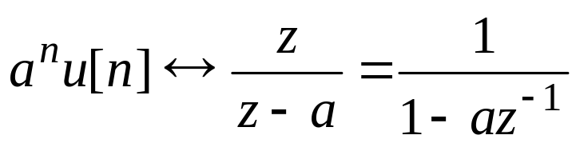
Table 4.1 Basic z-Transform Pairs
a is a real or complex number

Slide 18
§4-2 Properties of the z-Transform
The z-transform possesses a number of properties that are useful in deriving transform pairs and in the application of the transform to the study of linear causal time-invariant discrete-time systems. These properties are very similar to the properties of the Laplace transform.
Linearity
The z-transform is a linear operation, as is the Laplace transform, Hence if x[n]↔X(z) and v[n]↔V(z), then for any real or complex scalar a, b,
ax[n]+bv[n] ↔ aX(z) + bV(z)
(4.17)

Slide 19
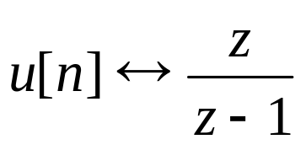
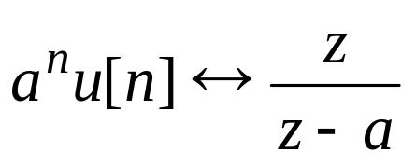
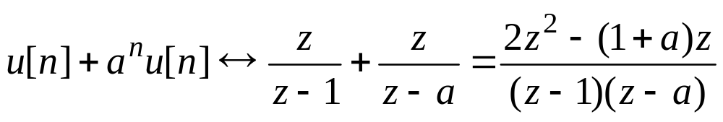
Example 4.5 Linearity
Let x[n]=u[n] and v[n]=a^{n}u[n], where a≠1. From Table 4.1,
and
Hence by linearity

Slide 20
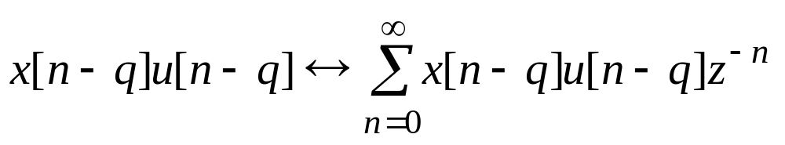
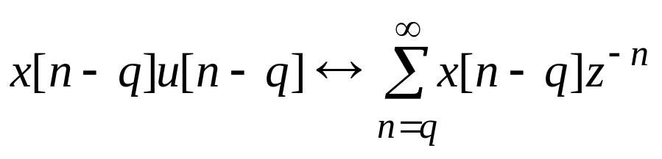
Right Shift of x[n]u[n]
Suppose that x[n]↔X(z). Given a positive integer q, consider the discrete-time signal x[n–q]u[n–q], which is the q-step right shift of x[n]u[n]. Then
x[n–q]u[n–q] ↔ z ^{–q} X(z) (4.18)
To prove this property, first note that by definition of the z-transform
Then since u[n–q] =1 for n≥q and u[n–q] =0 for n<q,
(4.19)

Slide 21
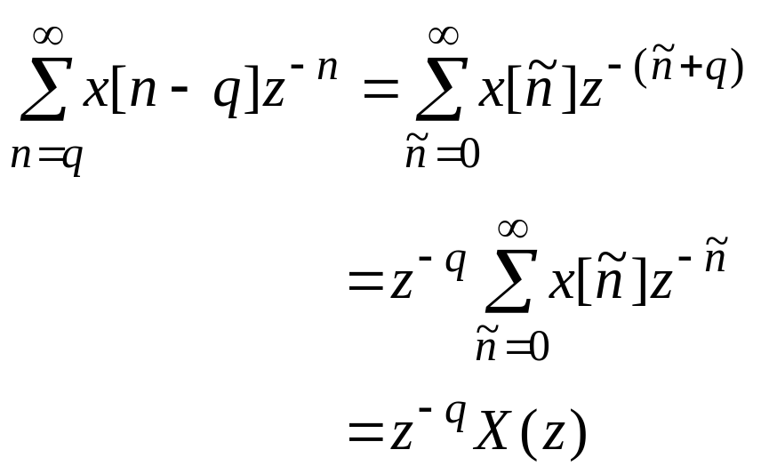
Consider a change of index in the summation in (4.19); With ñ=n–q so that n=ñ+q, then ñ=0 when n=q and ñ=∞ when n=∞. Hence
Therefore, combining this with (4.19) yields the transform pair (4.18).

Slide 22
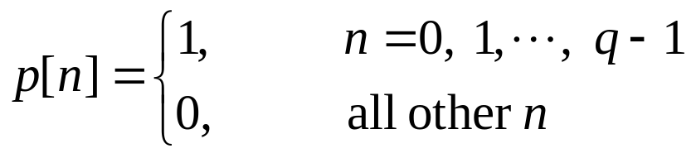
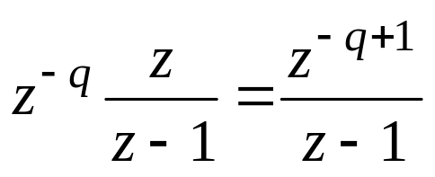
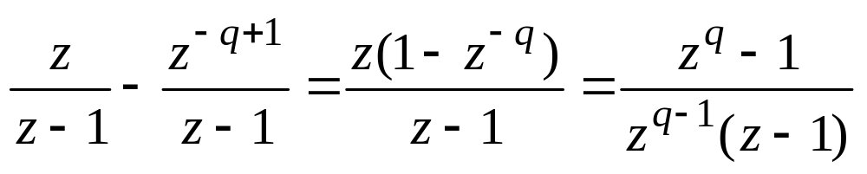
Example 4.6 z-Transform of a Pulse
Given a positive integer q, the objective is to determine the z-transform of the pulse p[n] defined by
Writing p[n] in terms of the unit-step function u[n] gives
p[n] = u[n] – u[n–q]
From Table 4.1, the z-transform of u[n] is z/(z–1) and thus by the right-shift property (4.18), the z-transform of u[n–q] is equal to
Thus, by linearity the z-transform of the pulse p[n] is

Slide 23
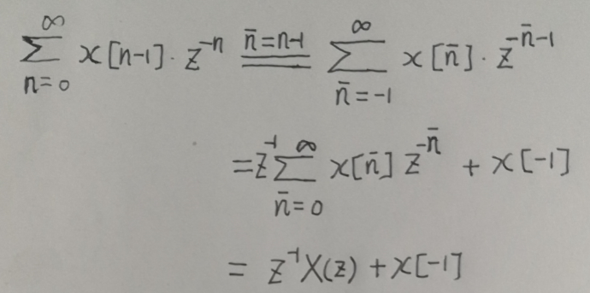
Right Shift of x[n]
Suppose that x[n]↔X(z). Then
x[n–1] ↔ z ^{–1} X(z)+ x[–1] (4.20)
x[n–2] ↔ z ^{–2} X(z) + x[–2]+ z ^{–1} x[–1] (4.21)
……
x[n–q] ↔ z ^{–q} X(z) + x[–q]+ z ^{–1} x[–q+1]+…+ z ^{–q+1} x[–1] (4.22)
Note that if x[n]=0 for n= –1, – 2, …, –q, the transform pair (4.22) reduces to
x[n–q] ↔ z ^{–q} X(z) (4.23)
which is identical to the transform pair (4.18).
To prove this property, see Page 562 in the textbook.

Slide 24
Left Shift in Time
Suppose that x[n]↔X(z). Then
x[n+1] ↔ z X(z) – x[0] z (4.25)
x[n+2] ↔ z ² X(z) – x[0] z ² – x[1] z (4.26)
……
x[n+q] ↔ z ^{q} X(z) – x[0] z ^{q} – x[1]z ^{q–1} – … –x[q–1] z (4.27)
To prove this property, see Page 563 in the textbook.

Slide 25
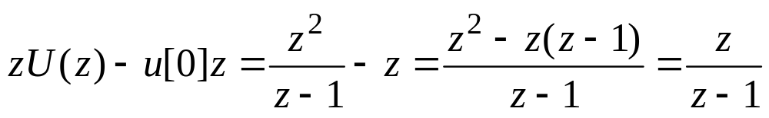
Example 4.7 Left Shift of Unit-Step Function
Consider the one-step left shift u[n+1] of the discrete-time unit-step function u[n]. By the left-shift property (4.25), the z-transform of u[n+1] is equal to
Hence the z-transform of u[n+1] is equal to the z-transform of u[n]. This result is not unexpected since u[n+1]= u[n] for n=0, 1, 2, …

Slide 26
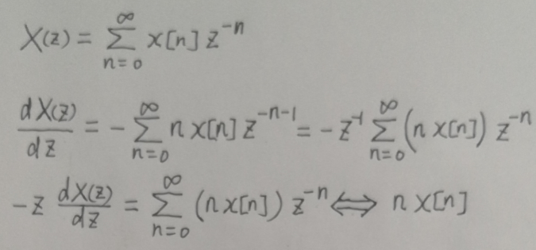
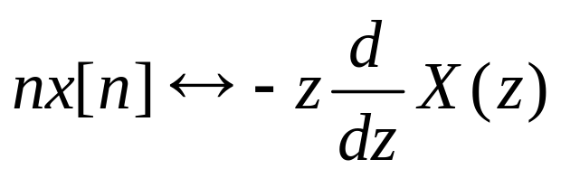
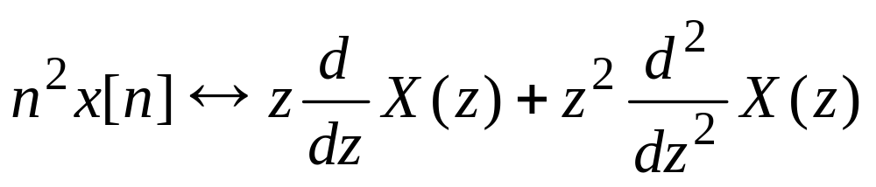
Multiplication by n and n²
Let x[n]↔X(z), then
(4.29)
and
(4.30)
To prove this property, see Page 564 in the textbook.

Slide 27
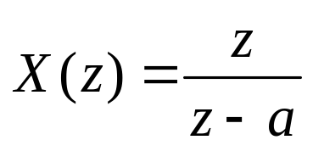
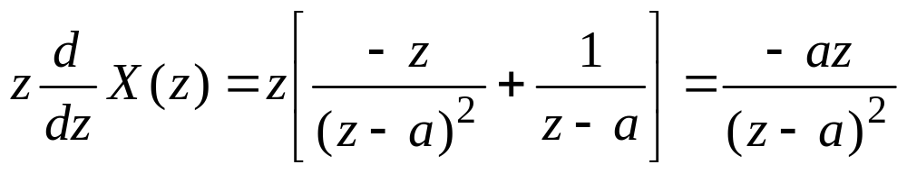
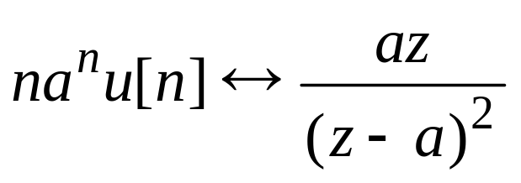
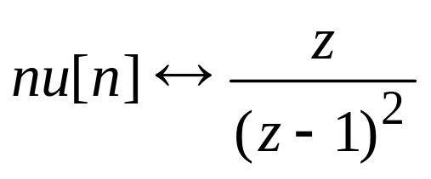
Example 4.8 z-Tansform of na^{n}u[n]
Let x[n]=a^{n}u[n], where a is any nonzero real or complex number. From Table 4.1,
Then
which gives the transform pair
(4.34)
Note that when a=1, (4.34) becomes
(4.35)

Slide 28
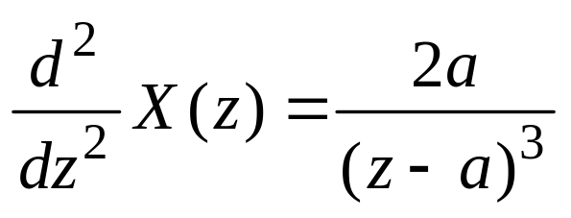
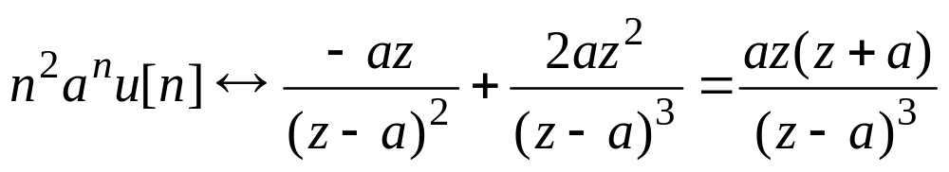
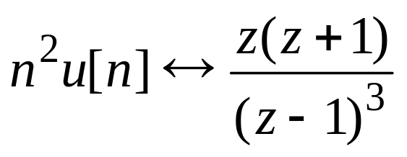
Example 4.9 z-Transform of n²a^{n}u[n]
To compute the z-transform of the signal n²a^{n}u[n], first set x[n]=a^{n}u[n], X(z)=z/(z–a), then
and thus, using the result in Example 4.8 and the transform pair (4.30) gives
(4.36)
Setting a=1 in (4.36) results in the transform pair
(4.37)

Slide 29
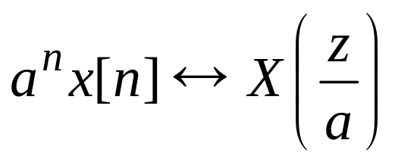
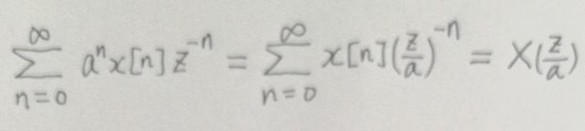
Multiplication by a^{n}
Let x[n]↔X(z), then for any nonzero real or complex number a,
(4.38)
To prove this property, see Page 565 in the textbook.

Slide 30


Example 4.10 z-Tansform of a^{n}p[n]
Let p[n] denote the pulse defined by p[n]=u[n]–u[n–q], where q is a positive integer. From Example 4.6, the z-transform of the pulse p[n] is
Then using (4.38) results in the transform pair

Slide 31



Multiplication by cos(Ωn) and sin(Ωn)
Let x[n]↔X(z), then for any positive real number Ω,
(4.39)
and
(4.40)
To prove this property, see Page 566 in the textbook.

Slide 32


Example 4.11 z-Tansform of Sinusoids
Let v[n]=cos(Ωn)x[n]. With x[n] set equal to the unit step u[n], X(z)=z/(z–1), and using (4.39) gives
(4.44)
Similarly, using (4.40) results in the transform pair
(4.45)

Slide 33


Example 4.12 a^{n} Times a Sinusoid
Let v[n]=a^{n}cos(Ωn)u[n]. The z-transform of v[n] can be computed by setting x[n]=a^{n}u[n] and using the multiplication by cos(Ωn) property. However, it is easier to set x[n] equal to cos(Ωn)u[n] and then apply the multiplication by a^{n} property. Using (4.38) and the transform pair (4.44) gives
(4.46)
Similarly, using (4.38) and (4.45) results in the transform pair
(4.47)

Slide 34



Summation
Given the discrete-time signal x[n] with x[n]=0 for n<0, let v[n] denote the sum of x[n], defined by
(4.48)
To derive an expression for the z-transform of v[n], first note that v[n] can be expressed in the form
Using the definition (4.48) of v[n] gives
(4.49)
Then taking the z-transform of both sides of (4.49) and using the right-shift property yields

Slide 35



and solving for V(z) gives
Hence we obtain the following result
(4.50)

Slide 36



Example 4.13 z-Transform of (n+1)u[n]
Let x[n]=u[n]. Then the sum is
and thus the sum of the step is a ramp. By (4.50), the transform of the sum is
This yields the transform pair
(4.51)

Slide 37


Convolution
Given two discrete-time signals x[n] and v[n] with both signals equal to zero for n<0, then
Thus we obtain the following result:
(4.54)
To prove this property, see Page 568 in the textbook.

Slide 38



Initial-value Theorem
If x[n]↔X(z), the initial values of x[n] can be computed directly from X(z) by using the relationships
(4.55)
…
(4.56)

Slide 39


To prove (4.55), first note that
and thus
Thus , taking the limit as z→∞ of both sides of
yields (4.55).

Slide 40

§4-3 Computation of the Inverse z-Transform
If X(z) is the z-transform of the discrete signal x[n], the signal can be computed from X(z) by taking the inverse z-transform of X(z) given by
(4.59)
The integral in (4.59) is evaluated by integrating along a counterclockwise closed circular contour that is contained in the region of convergence of X(z).
When the transform X(z) is a rational function of z ^{–1}, the inverse z-transform can be computed (thank goodness) without having to evaluate the integral in (4.59).

Slide 41
The computation of x[n] from a rational X(z) is considered in this section. When X(z) is a rational, x[n] can be computed by expanding X(z) into a power series in z ^{–1} or by expanding X(z) into partial fractions.

Slide 42

Expansion by Long Division
Let X(z) be given in the rational form X(z)=B(z)/A(z) with the polynomials B(z) and A(z) written in descending powers of z.
To compute the inverse z-transform x[n] for a finite range of values of n, X(z) can be expanded into a power series in z ^{–1} by dividing A(z) into B(z) using long division. The values of the signal x[n] are then “read off” from the coefficients of the power-series expansion. The process is illustrated by the following example.

Slide 43

Example 4.15 Inverse z-Transform via Long Division
Suppose that
Dividing A(z) into B(z) gives

Slide 44


Slide 45

Thus
(4.60)
By definition of the z-transform,
(4.61)
Equating (4.60) and (4.61) yields the following values for x[n]:
x[0]=0, x[1]=1, x[2]=0, x[3]= –3, x[4]= – 4, …

Slide 46


Inversion via Partial Fraction Expansion
Again suppose that X(z) is given in the rational form X(z)=B(z)/A(z). If the degree of B(z) is equal to that of A(z), dividing A(z) into B(z) yields the following form for X(z):
where x[0] is the initial value of the signal x[n] at time n=0 and R(z) is a polynomial in z whose degree is strictly less than that of A(z). The rational function R(z)/A(z) can then be expanded by partial fractions.
There is another approach that avoids having to divide A(z) into B(z); namely, first expand
There are two cases to consider

Slide 47



Distinct Poles
Suppose that the poles p₁, p₂, …, p_{N} of X(z) are distinct and are all nonzero. Then X(z)/z has the partial fraction expansion:
(4.62)
where c₀ is the real number given by
(4.63)
and the other residues in (4.62) are real or complex numbers given by
(4.64)

Slide 48




Multiplying both sides of (4.62) by z yields the following expansion for X(z):
(4.65)
Then taking the inverse z-transform of each term in (4.65) and using Table 4.3 gives
(4.66)
From (4.66), it is clear that the form of the time variation of the signal x[n] is determined by the poles p₁, p₂, …, p_{N} of the rational function X(z).

Slide 49





If all the poles of X(z) are real, the terms comprising the signal defined by (4.66) are all real. However if two or more of the poles are complex, the corresponding terms in (4.66) will be complex. Such terms can be combined to yield a real form. To see this, suppose that the pole p₁=a+jb is complex, so that b≠0. Then one of the other poles of X(z) must be equal to the complex conjugate of p₁. Suppose that p₂ = ; then in (4.66) it must be true that c₂ = . Hence the second and third terms of the right-hand side of (4.66) are equal to
(4.67)
This term can be expressed in the form.
(4.68)

Slide 50


Where
= magnitude of the pole p₁
= angle of p₁
The verification that (4.67) and (4.68) are equivalent is left to your homework.
Using (4.68) in (4.66) results in the following expression for x[n]:
(4.69)

Slide 51



Example 4.17 Complex Poles
Suppose that
Here
Using the Matlab command roots reveals that the roots of A(z) are
Then expanding X(z)/z gives

Slide 52


where
From (4.66), the inverse z-transform is

Slide 53


The second and third terms in x[n] can be written in real form by using the form (4.68).
Here the magnitude and angle of p₁ are given by
and the magnitude and angle of c₁ are given by

Slide 54

Then rewriting x[n] in the form (4.69) yields

Slide 55

Repeated Poles
Again let p₁, p₂, …, p_{N} denote the poles of X(z)=B(z)/A(z) and assume that all the p_{i} are nonzero. Suppose that the pole p₁ is repeated r times and that the other N–r poles are distinct. Then X(z)/z has the partial fraction expansion
(4.70)
where c₀=X(0) and the residues c_{r+1}, c_{r+2}, …, c_{N} are computed in the same way as in the distinct pole case [see (4.64)]. The constants c_{r}, c_{r–1}, …, c₁ are given by

Slide 56




……

Slide 57


Then multiplying both sides of (4.70) by z gives
The inverse z-transform of the term c₀ is c₀δ(n).
The inverse z-transform of the terms
can be computed for i=2 and 3 by using the transform pairs in Table 4.3 (see Page 572). This results in the transform pairs

Slide 58




(4.73)
(4.74)
and generally,
u[n]

Slide 59



Example 4.18 Repeated Pole Case
Suppose that
Then
Now the poles of X(z)/z are p₁=1, p₂=1, p₃= –1, and thus the expansion has the form

Slide 60




Slide 61


Hence
Using the transform pair (4.73) results in the following inverse transform:

Slide 62
Pole Locations and the Form of a Signal
Given a discrete-time signal x[n] with rational z-transform X(z)=B(z)/A(z), by the results above it is seen that there is a direct relationship between the poles of X(z) and the form of the time variation of the signal x[n].
In particular, if X(z) has a nonrepeated pole p, then x[n] contains a term of the form c(p)^{n} for some constant c, and if the pole p is repeated twice, x[n] contains the terms c₁(p)^{n} and c₂n (p)^{n−1} for some constants c₁ and c₂.
if X(z) has a nonrepeated pair a±jb of complex poles with magnitude σ and angles ±Ω, then x[n] contains a term of the form cσ^{n}cos(Ωn+θ) for some constant c and θ.

Slide 63
if the complex pair a±jb is repeated twice, x[n] contains the terms c₁σ^{n}cos(Ωn+θ₁) + c₂nσ^{n}cos(Ωn+θ₂) for some constants c₁, c₂, θ₁ , θ₂.
Note that these relationships between signal terms and poles are analogous to those in the Laplace transform theory of continuous-time signals. In fact, as was the case for continuous-time signals, the behavior of a discrete-time signal as n →∞ can be determined directly from the poles of X(z).
In particular, it follows from the results above that x[n] converges to 0 as n →∞ if and only if all the poles p₁, p₂, …, p_{N} of X(z) have magnitudes that are strictly less than 1; that is,
| p_{i} | < 1 for i=1, 2, …, N
(4.75)

Slide 64

In addition, it follows that x[n] converges (as n →∞) to a finite constant if and only if (4.75) is satisfied, except that one of the p_{i} may be equal to 1, if this is the case, x[n] converges to the value of the residue in the expansion of X(z)/z corresponding to the pole at 1, in other words,
(4.58)
Note that the result is just the final-value theorem in the discrete case.

Slide 65



Example 4.14 Final Value
Suppose that
In this case X(z) has 3 poles: p₁=1, p₂=0.5+j0.5, p₃=0.5–j0.5. It is clear that | p₂|<1, | p₃|<1.
By using (4.58), we can obtain the final value of x(n):

Slide 66


Problems
4.1 Consider the discrete-time signal x[n], where
Here b is an arbitrary real number and N is a positive integer.
(a) For what real values of b does x[n] possess a z-transform?
(b) For the values of b determined in part (a), find the z-transform of x[n], Express your answer as a ratio of polynomials.

Slide 67

4.2 A discrete-time signal x[n] has z-transform
Determine the z-transform V(z) of the following signals.
(a) v[n]= x[n–4]u[n –4]
(b) v[n]= x[n+2]u[n +2]
(c) v[n]= cos(2n)x[n]
(d) v[n]= e^{3n}x[n]
(e) v[n]= n²x₁[n], where x₁(n)=δ(n−1)
(f) v[n]= x[n]*x[n]
(g) v[n]= x[0]+x[1] +x[2]+ · · · +x[n]

Slide 68
4.3 Compute the z-transform of the following discrete-time signals. Express your answer as a ratio of polynomials in z whenever possible.
(a) x[n]= δ[n]+2δ[n –1]
(b) x[n]=1 for n=0, 1 and x[n]=2 for all n≥2
x[n]= e^{0.5n}u[n]+ u[n –1]
(d) x[n]= sin(πn/2)u[n –2]

Slide 69




4.4 Compute the inverse z-transform x[n] of the following transforms. Determine x[n] for all integers n≥0.
(1)
(2)
(3)
(4)

Slide 70


4.5 Compute the inverse z-transform x[n] of the following transforms. Determine x[n] for all integers n≥0.
(1)
(2)

Slide 71


