Slide 1
Chapter 1 Fundamental Concepts
§1-1 Introduction
§1-2 Discrete-Time Signals
§1-3 Discrete-time Systems
§1-4 Basic Properties of Discrete-time Systems
Problems

Slide 2
§1-1 Introduction
The concepts of signals and systems arise in virtually all areas of technology, ranging from appliances or devices found in homes to very sophisticated engineering innovations. In fact, it can be argued that much of the development of high technology is a result of advancements in the theory and techniques of signals and systems.
Last term, in the course of signals and systems, we have studied the continuous-time system analysis. In this term, we are going to study the discrete-time system analysis. Let us begin with the fundamental concepts of the discrete-time system analysis.

Slide 3
§1-2 Discrete-Time Signals
Definitions:
Discrete-time variable: The time variable t is said to be a discrete time variable if t takes on only the discrete values t=t_{n} for some range of integer values of n.
Discrete-time signals: A discrete-time signal is a signal that is a function of the discrete time variable t_{n}, denoted with x(t_{n}), where x(t) is a continuous-time signal.
The resulting discrete-time signal x(t_{n}) is called the sampled version of the original continuous-time signal x(t).

Slide 4
Let t_{n}=nT, where T is called the sampling interval. If T is a constant, the sampling process is called uniform sampling, otherwise, nonuniform sampling. Note that the nonuniform sampling is sometimes used in applications but is not considered in this course. So, we often use x[n] to denote x(t_{n}), i.e.,
x[n]= x(t_{n})= x(t)|_{t=nT}= x(nT)
Also note that the square brackets instead of parentheses are used to denote the discrete-time signal x[n].

Slide 5
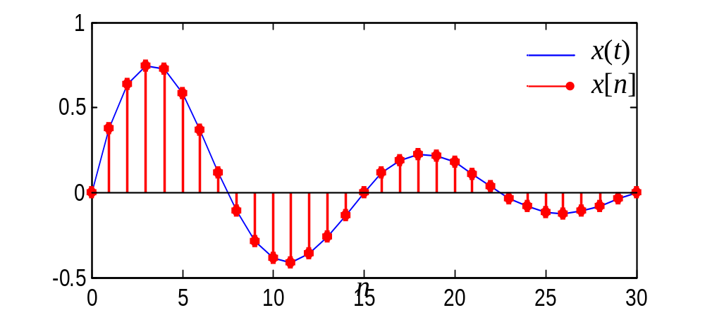
Fig. 1-1
For example,
where T=1/15, n=0, 1, 2, …, 30. The plots of x[n] and x(t) are given in Fig. 1-1

Slide 6
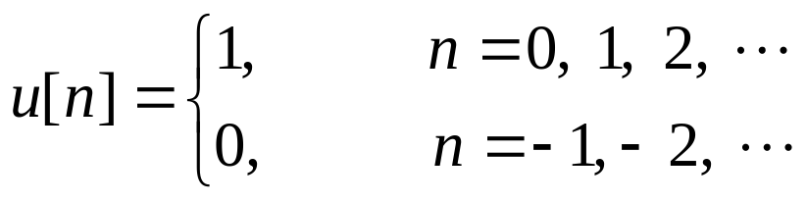
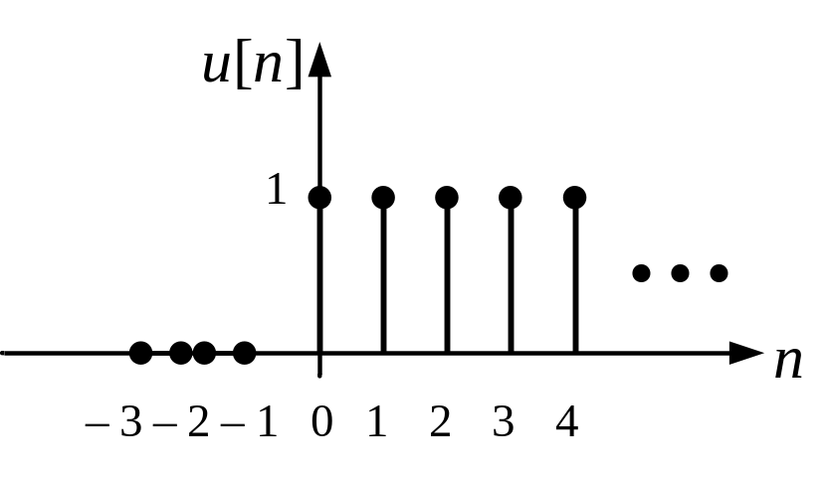
Typical and Simple Examples of Discrete-Time Signals
Discrete-time Unit-step Function u[n]
Definition:
The plot of u[n] is shown in Fig. 1-2
Fig. 1-2

Slide 7
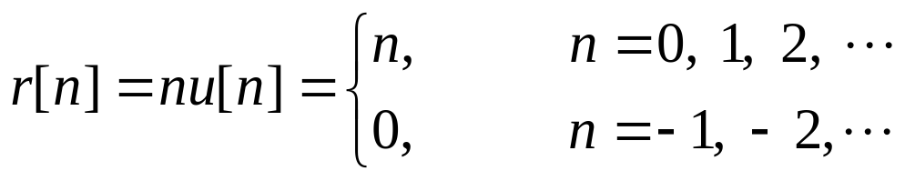
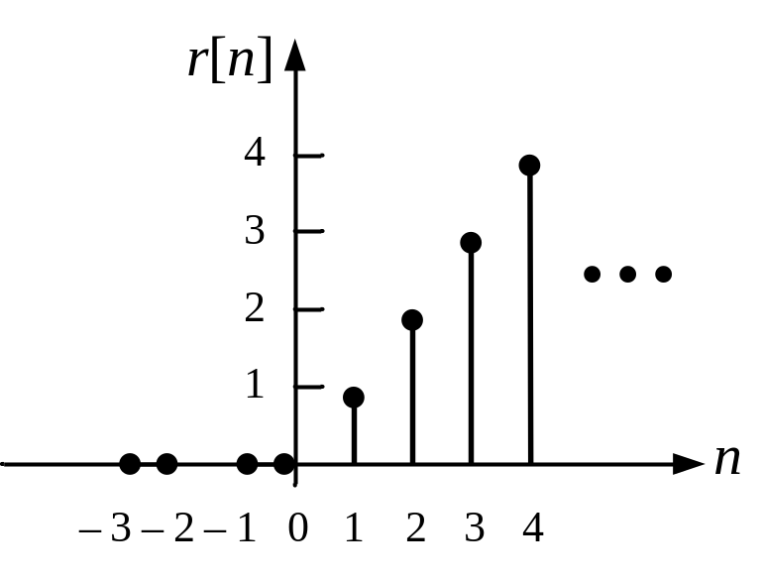
Discrete-time Unit-ramp Function r[n]
Definition:
The plot of r[n] is shown in Fig. 1-3
Fig. 1-3

Slide 8
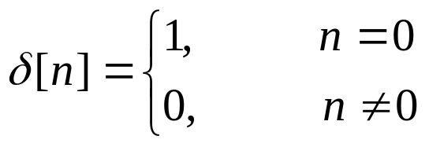
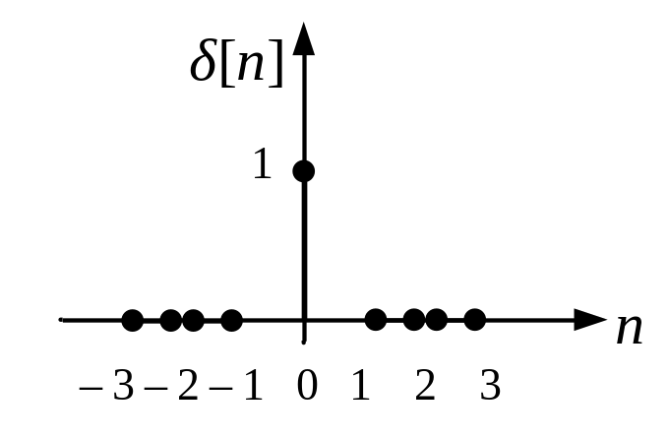
Unit Pulse
Definition:
The plot of δ[n] is shown in Fig. 1-4
Fig. 1-4

Slide 9
Periodic Discrete-time Signals
Definition: A discrete-time signal x[n] is periodic if there exists a positive integer r such that
x[n+r]= x[n] for all integers n
Hence x[n] is periodic if and only if there is a positive integer such that x[n] repeats itself every r time instants, where r is called the period.
The fundamental period is the smallest value of r for which the signal repeats.

Slide 10
For example, let us examine the periodicity of a discrete-time sinusoid given by
x[n]=Acos(Ωn+θ)
The signal is periodic if
Acos[Ω(n+r)+θ]= Acos(Ωn+θ)
Recall that the cosine function repeats every 2π radians, so that
Acos(Ωn+θ) = Acos(Ωn+2πq+θ)
for all integers q. Therefore, the signal Acos(Ωn+θ) is periodic if and only if there exists a positive integer r such that Ωr=2πq for some integer q, or equivalently, that the discrete-time frequency Ω is such that r=2πq/Ω for some positive integers q and r.

Slide 11
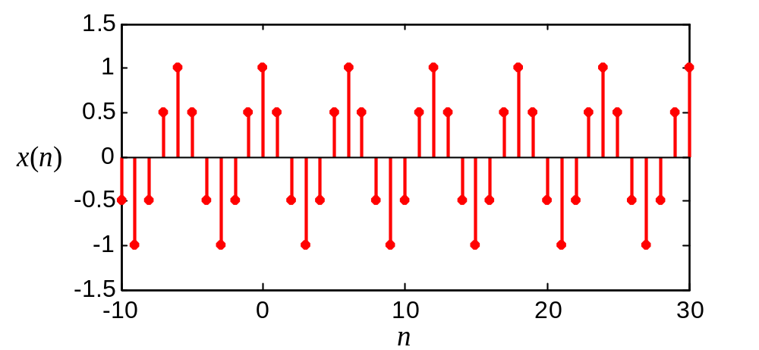
Fig. 1-5(a)
The discrete-time sinusoid x[n]=Acos(Ωn+θ) is plotted in Fig. 1-5.
For the case when Ω=π/3 and θ=0, which is plotted in Fig. 1-5(a), the corresponding period is found to be r=2πq/Ω=6q and the fundamental period is 6.

Slide 12
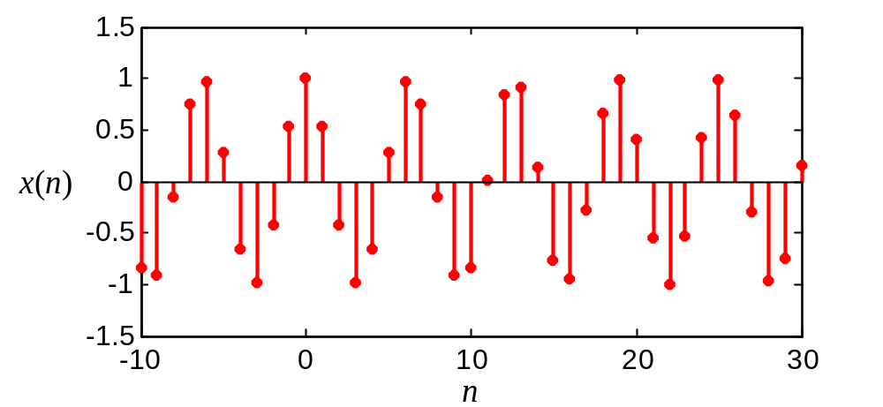
Fig. 1-5(b)
The case when Ω=1 and θ=0 is plotted in Fig. 1-5(b). Note that in this case the envelope of the signal is periodic but the signal itself is not periodic.
r=2πq/Ω=2πq

Slide 13
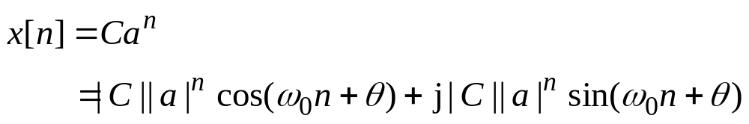
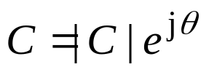
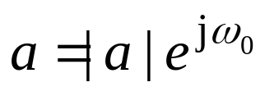

Discrete-time Complex Exponential Signals
Definition:
where , , j=

Slide 14
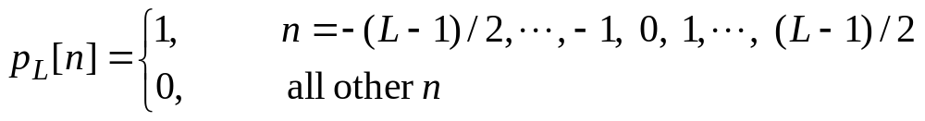
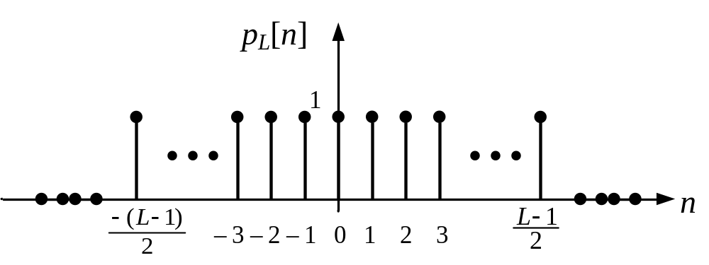
Discrete-time Rectangular Pulse
Definition:
where L is a positive odd integer. The plot of p_{L}[n] is displayed in Fig. 1-6
Fig. 1-6

Slide 15
Digital Signals
Definition: Let {a₁, a₂, … , a_{N}} be a set of N real numbers. A digital signal is a discrete-time signal whose values belong to the finite set {a₁, a₂, … , a_{N}}; that is, at each time instant t_{n}, x(t_{n})=x[n]=a_{i} for some i, where 1≤i≤N. So a digital signal can have a finite number of different values.
A sampled continuous-time signal is not necessarily a digital signal. For example, the sampled unit-ramp function r[n] shown in Fig. 1-3 is not a digital signal since it takes on an infinite range of values when n= …, –2, –1 0, 1, 2,….
A binary signal is a digital signal whose values are equal to 1 or 0; that is, x[n]=0 or 1 for n= …, –2, –1 0, 1, 2,…. The sampled unit-step function and the unit-pulse function are both examples of binary signals.

Slide 16
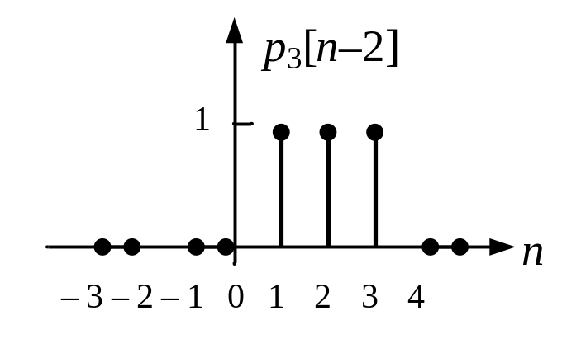
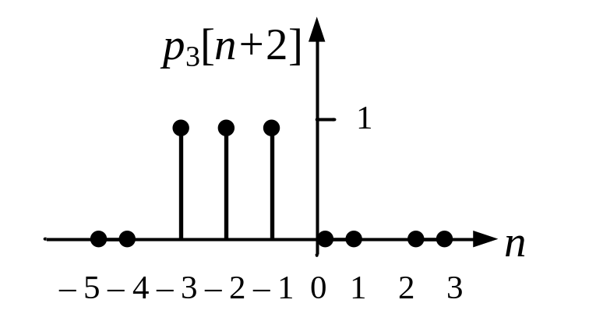
Time-shifted Signals
Given a discrete-time signal x[n] and a positive integer q, the discrete-time signal x[n–q] is the q-step right shifts of x[n] and x[n+q] is the q-step left shifts of x[n].
For example, p₃[n–2] is the two-step right shifts of the discrete-time rectangular pulse p₃[n]; p₃[n+2] is the two-step left shifts of p₃[n]. The shifted signals are plotted in Fig. 1-7.
(a)
(b)
Fig. 1-7 Two-step shifts of p₃[n]: (a) right shift; (b) left shift.

Slide 17
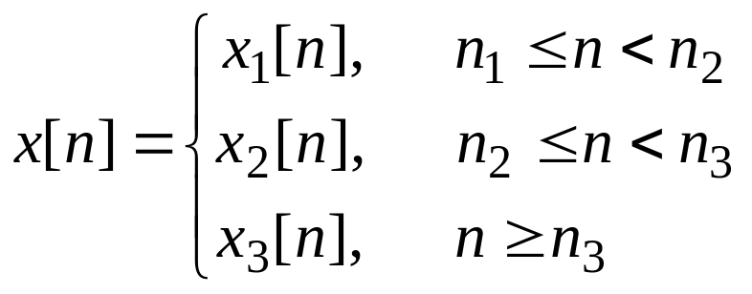
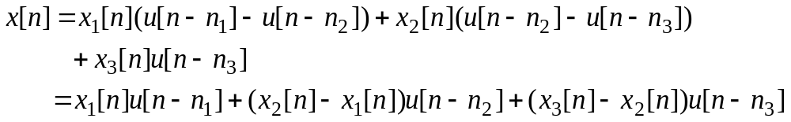
Discrete-time Signals defined Interval by Interval
As in the case of continuous-time signals, discrete-time signals are sometimes defined interval by interval. For instance, x[n] may be specified by
where x₁[n], x₂[n] and x₃[n] are discrete-time signals and n₁, n₂ and n₃ are integers with n₁<n₂<n₃. With u[n] equal to the discrete-time unit-step function, x[n] can be written in the form

Slide 18
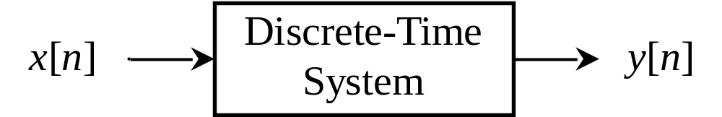
§1-3 Discrete-time Systems
Definition of Discrete-time Systems:
A discrete-time system is a system that transforms discrete-time inputs into discrete-time outputs, as shown in Fig. 1-8.
Fig. 1-8 Discrete-Time System
Definition of Discrete-time System Analysis:
Given a discrete-time input and a discrete-time system, how to solve the discrete-time output of the system is called discrete-time system analysis.

Slide 19
Example of a Discrete-time System
As a simple example of a discrete-time system, consider a simple model for the balance in a bank account from month to month. Specifically, let y[n] denote the balance at the end of the n-th month, and suppose that y[n] evolves from month to month according to the equation
y[n] = 1.01y[n–1] + x[n],
or equivalently,
y[n] –1.01y[n–1] = x[n],
where x[n] represents the net deposit (i.e., deposits minus withdrawals) during the n-th month and the term 1.01y[n–1] models the fact that we accrue 1% interest each month.

Slide 20
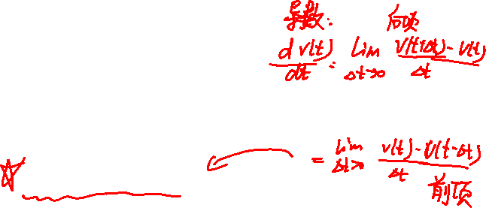
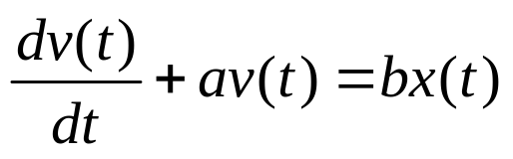
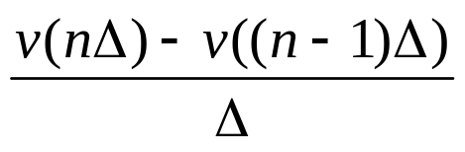
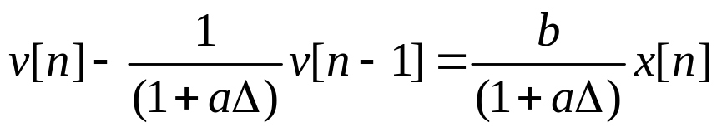
As a second example, consider a simple digital simulation of the differential equation
in which we resolve time into discrete intervals of length Δ and approximate dv(t)/dt at t=nΔ by the first backward difference, i.e.,
in this case, if we let v[n]= v(nΔ) and x[n]= x(nΔ), we obtain the following discrete-time model relating the sampled signals x[n] and v[n]:
Δ

Slide 21
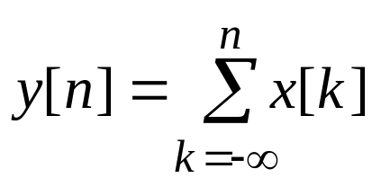
§1-4 Basic Properties of Discrete-time Systems
Systems with and without Memory
Definition: A system is said to be memoryless if its output for each value of the independent variable at a given time is dependent only on the input at that same time, otherwise the system is one with memory.
For example, the system specified by the relationship y[n]=(2x[n]–x[n]²)² is memoryless, as the value of y[n] at any particular time depends only on the value of x[n] at that time.
An example of a discrete-time system with memory is an accumulator or summer:
and a second example is a delay: y[n]=x[n–1].

Slide 22

Causality
Definition: A system is causal if the output at any time depends only on values of the input at the present time and in the past.
For example, the systems and y[n]=x[n–1] are causal, but the systems defined by y[n]= x[n]–x[n+1] and y[n]= x[–n] are not.

Slide 23

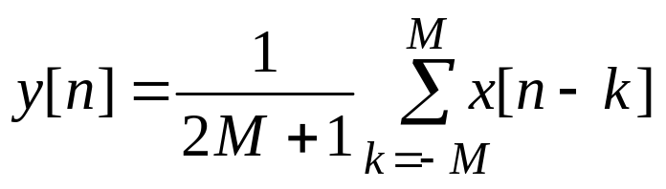

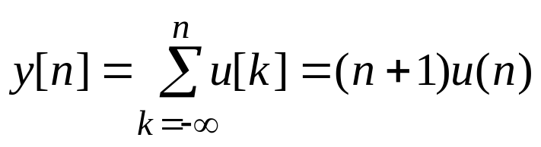
Stability
Definition: A stable system is one in which bounded inputs lead to bounded outputs.
For example, the averaging system defined by
is stable, but the accumulator system defined by
is not, because y[n] grows without bound.

Slide 24
Time Invariance
Definition: A system is time invariant if a time shift in the input signal results in an identical time shift in the output signal.
For example, the system defined by y[n]=nx[n] is obviously not time invariant.
As a second example, the system defined by y[n]= x[2n] represents a time scaling. That is, y[n] is a time-compressed (by a factor of 2) version of x[n]. Intuitively, any time shift in the input will also be compressed by a factor of 2, and it is for this reason that the system is not time invariant.

Slide 25
Linearity
Definition: A linear system is a system that if an input consists of the weighted sum of several signals, then the output is the weighted sum of the responses of the system to each of those signals.
More precisely, let y₁[n] be the response of a discrete-time system to an input x₁[n], and let y₂[n] be output corresponding to the input x₂[n]. Then the system is linear if:
• The response to x₁[n]+ x₂[n] is y₁[n]+ y₂[n]
• The response to ax₁[n] is ay₁[n], where a is any complex constant.
The first of these two properties is known as the additivity property; the second is known as the scaling or homogeneity property

Slide 26
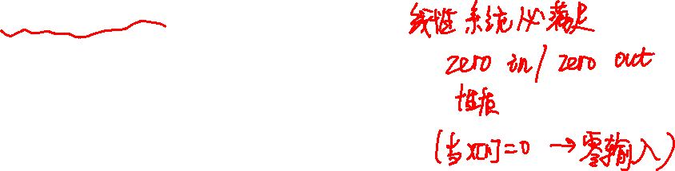
Consider the system y[n]= 2x[n]+3. This system is not linear because it violates the additivity property. For two inputs x₁[n] and x₂[n],
x₁[n] → y₁[n]= 2x₁[n]+3
x₂[n] → y₂[n]= 2x₂[n]+3
However, the response to the x₃[n]= x₁[n]+ x₂[n] is
y₃[n]= 2(x₁[n]+ x₂[n])+3≠ y₁[n]+ y₂[n]
Note that y[n]=3 if x[n]=0, we see that the system violates the “zero-in/zero-out” property.

Slide 27
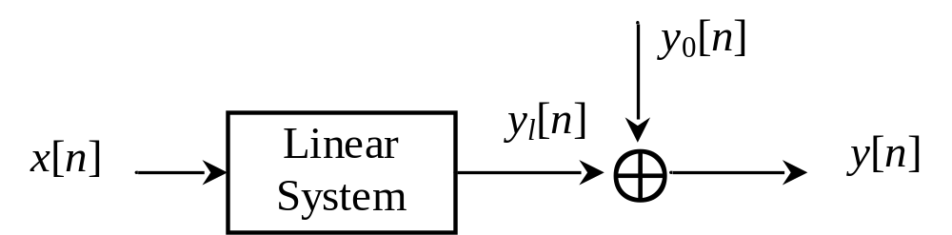
It may seem surprising that the system in the above example is nonlinear, since the system equation y[n]= 2x[n]+3 is linear. On the other hand, as shown in Fig. 1-9, the output of the system can be represented as the sum of the output of a linear system and another signal equal to the zero-input response of the system. For the system y[n]= 2x[n]+3, the linear system is y_{l}[n]= 2x[n] and the zero-input response is y₀[n]=3.
Fig. 1-9

Slide 28
Problems
1.1 Sketch the discrete-time signal x[n] (0≤n≤10) obtained by sampling the continuous-time signal x(t)=e^{–2t} with sampling interval T=0.1.
1.2 Sketch the following discrete-time signals
(a) x[n]= u[n]–2u[n–1]+ u[n–4]
(b) x[n]=(n+2)u[n+2]–2u[n] –nu[n–4]
(c) x[n]= δ[n+1]–δ[n]+u[n+1] – u[n–2]
1.3 Let x[n] be a signal with x[n]=0 for n < – 2 and n > 4. for each signal given below, determine the values of n for which it is guaranteed to be zero.
(a) x[n–3] (b) x[n+4] (c) x[–n] (d) x[–n+2] (e) x[–n–2]
Answer: (a)n<1 and N>7; (b)n<-6 and n>0; (c)n<-4 and n>2; (d)n<-2 and n>4; (e)n<-6 and n>0

Slide 29
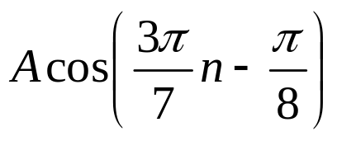
1.4 Determine if the following discrete-time signals are periodic. If so, find the fundamental period.
(a) x[n]= (b) x[n]=e^{j7πn} (c) x[n]= e^{j(n/8–π)}
1.5 Consider a discrete-time system with input x[n] and output y[n]. The input-output relationship for this system is
y[n]= x[n] x[n – 2]
(a) Is the system memoryless?
(b) Determine the output of the system when the input is
Aδ[n], where A is any real or complex number.
Answer: N=14
Answer: N=2
Answer: not periodic
Answer: No
Answer: 0

Slide 30
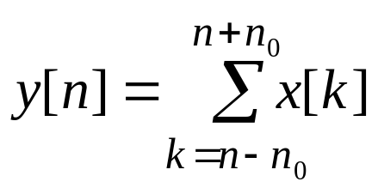
1.6 Consider a discrete-time system with input x[n] and output y[n] related by
where n₀ is a finite positive integer.
(a) Is the system linear?
(b) Is the system time-invariant?
1.7 For each of the following input-output relationships, determine whether the corresponding system is linear, time invariant or both.
(a) y[n]= x[n–2]²
(b) y[n]= x[n+1]+x[n–1]
Answer: Yes
Answer: Yes
Answer: Not linear; Time invariant
Answer: Linear; Time invariant

Slide 31
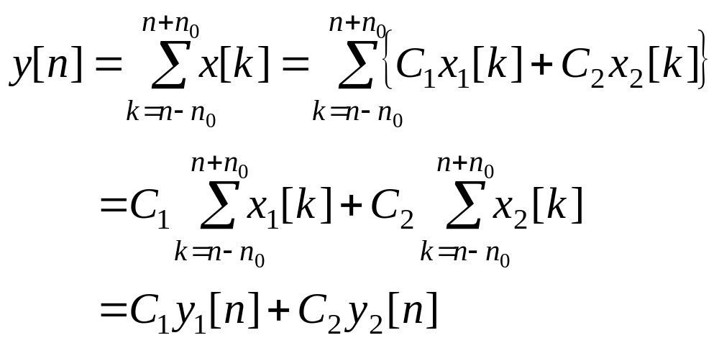
1.6 (a)
Consider two inputs x₁[n] and x₂[n], y₁[n] and y₂[n] are the outputs of the system with the two inputs, respectively. Suppose that C₁ and C₂ are any complex constants and let the input x[n] =C₁x₁[n]+C₂ x₂[n], the corresponding output of the system is:
By the definition of a linear system, this system is linear.

Slide 32
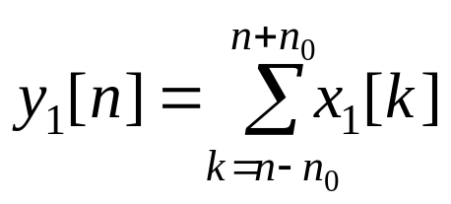
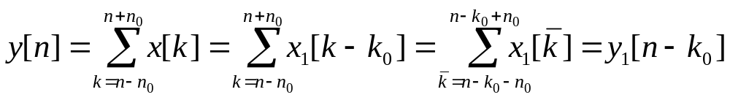
1.6 (b)
Suppose that k₀ is a time shift, y₁[n] is the output of the system with the input x₁[n], i.e.,
Let the input x[n]=x₁[n−k₀], the corresponding output of the system is:
By the definition of a time-invariant system, this system is time-invariant.

Slide 33
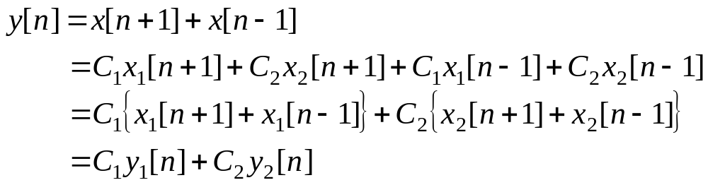
1.7 (b)
(1) Consider two inputs x₁[n] and x₂[n], y₁[n] and y₂[n] are the outputs of the system with the two inputs, respectively. Suppose that C₁ and C₂ are any complex constants and let the input x[n] =C₁x₁[n]+C₂ x₂[n], the corresponding output of the system is:
By the definition of a linear system, this system is linear.

Slide 34

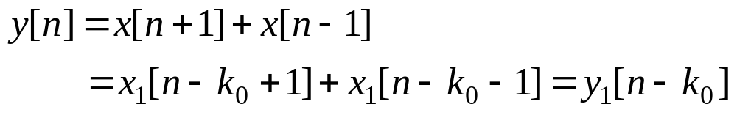
1.7 (b)
(2) Suppose that k₀ is a time shift, y₁[n] is the output of the system with the input x₁[n], i.e.,
Let the input x[n]=x₁[n−k₀], the corresponding output of the system is:
By the definition of a time-invariant system, this system is time-invariant.

Slide 35
Determine if the discrete-time signal x[n]= e ^{j(2πn/3–3/7)} is periodic. If so, find the fundamental period.

