Slide 1
Chapter 3 Convolution Representation
§3-1 Convolution Representation of Linear Time-invariant Discrete-Time Systems
§3-2 Convolution of Discrete-Time Signals
Problems

Slide 2
Chapter 3 Convolution Representation
§3-1 Convolution Representation of Linear Time-invariant Discrete-Time Systems
Consider a single-input single-output discrete-time system with input x[n] and output y[n]. Throughout this section it is assumed that y[n] is the output response resulting from x[n] with no initial energy in the system prior to the application of x[n]. It is also assumed that the system under consideration is causal, linear, and time-invariant.

Slide 3
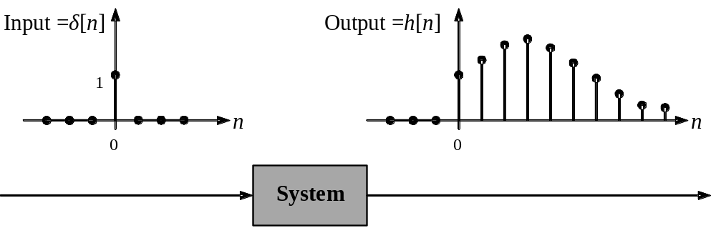
Unit-Pulse Response
Let h[n] denote the output response of the system when the input x[n] is equal to the unit pulse δ[n] with no initial energy in the system at time n=0. (Recall that δ[0]=1 and δ[n]=0 for all n≠0.) The response h[n] is called the unit-pulse response of the system. Note that since δ[n]=0 for n=1, 2, …, by causality the unit-pulse response must be zero for all integers n<0 (since in a causal system there can be no response before an input is applied). An example of the form of the unit-pulse response is illustrated in Fig. 3-1.
Fig. 3-1

Slide 4
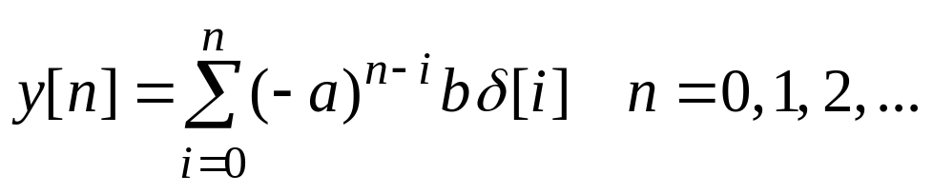
Example 3.1
Consider the finite-dimensional discrete-time system given by the input/output difference equation
y[n] +ay[n−1] = bx[n] (3.1)
where a and b are constants. The unit-pulse response for this system can be computed by solving Eq.(3.1) with initial condition y[−1]=0 and with input x[n]=δ[n]. From the discussion in Section 2.1, the solution to Eq.(3.1) can be expressed in the form
(3.2)
But sinceδ[n]=0 for all n≠0 and δ[0]=1, Eq. (3.2) reduces to
y[n] =(–a)^{n} b , n =0, 1, 2, … (3.3)

Slide 5
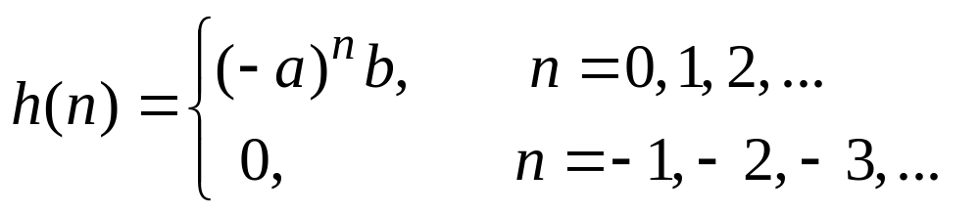
Hence the unit-pulse response h[n] for this system is given by
Returning to the general case, consider a causal linear time-invariant discrete-time system with input x[n], ouput y[n], and unit-pulse response h[n]. Since the system is time invariant, for any positive integer i the output response resulting from the i-step right shift of the unit pulseδ[n] must be equal to the i-step right shift of h[n]; that is, the response toδ[n–i] must be equal to h[n–i]. An example of the form of h[n–i] is illustrated in Fig. 3.2.

Slide 6
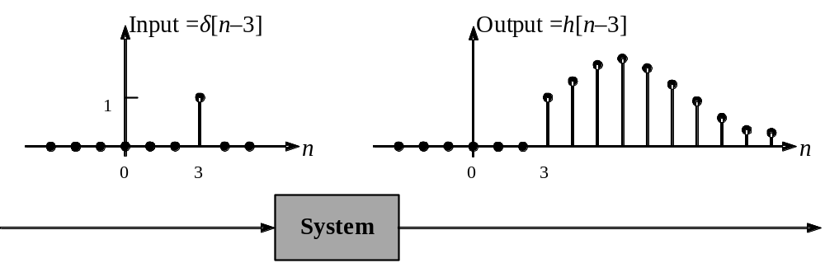
Fig. 3.2 The shifted unit-pulse response h[n–3].

Slide 7
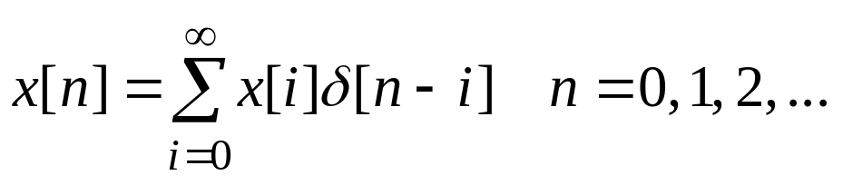
Now let x[n] be an arbitrary input with x[n]=0 for n=−1, −2, …. To compute the resulting output response (assuming zero initial energy), first note that since δ[n–i] =0 when i≠n and δ[n–i] =1 when i=n, x[n] can be expressed in the form
x[n]= x[0]δ[n]+ x[1]δ[n–1]+ x[2]δ[n–2]+…
or
(3.3)
Then to compute the output response resulting from the input x[n], the idea is first to compute the output response, denoted by y_{i}[n], due to the i-th term x[i]δ[n–i] comprising x[n]. Since the system is linear and thus is homogeneous, and the response to δ[n–i] is h[n–i], the response y_{i}[n] to x[i]δ[n–i] is given by
y_{i}[n]=x[i]h[n–i] (3.4)

Slide 8
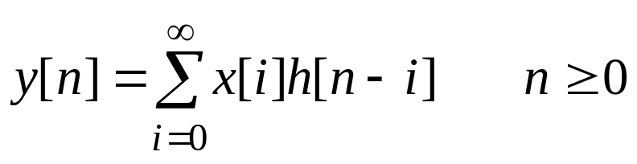
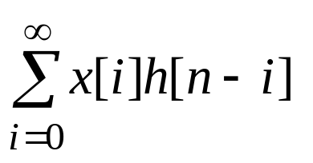
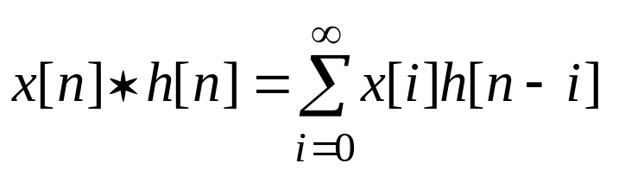
By the additivity property, the response to the sum given by (3.3) must be equal to the sum of the y_{i}[n] defined by (3.4). Thus the response to x[n] is
(3.5)
The operation defined by the expression
is called the convolution of x[n] and h[n], and is denoted by the symbol “*”; that is,

Slide 9
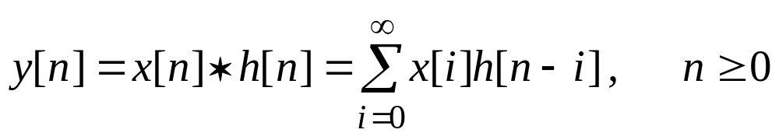
Rewriting (3.5) in terms of the convolution symbol gives
(3.6)
By (3.6), the output response y[n] resulting from input x[n] with no initial energy at time n=0 is equal to the convolution of the unit-pulse response h[n] with the input x[n]. Eq. (3.6) or (3.5) is called the convolution representation of the system. This is a time domain model since the components of (3.6) are functions of the discrete-time index n.

Slide 10
An interesting consequence of the convolution representation (3.6) is the result that the system is determined completely by the unit-pulse response h[n]. In particular, if h[n] is known, the output response resulting from any input x[n] can be computed by evaluating (3.6). The evaluation of the convolution operation and the basic properties of this operation are studied in the next section.

Slide 11
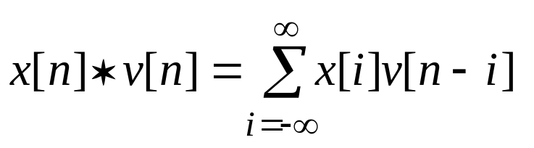
§3-2 Convolution of Discrete-Time Signals
In Section 3.1 the convolution of an input x[n] and the unit-pulse response h[n] was defined, with both x[n] and h[n] equal to zero for all n<0. In this section the convolution operation is defined for arbitrary discrete-time signals x[n] and v[n] that are not necessarily zero for n<0.
Given two discrete-time signals x[n] and v[n], the convolution of x[n] and v[n] is defined by
(3.7)
The summation on the right-hand side of (3.7) is called the convolution sum. If x[n] and v[n] are zero for all integers n<0,

Slide 12
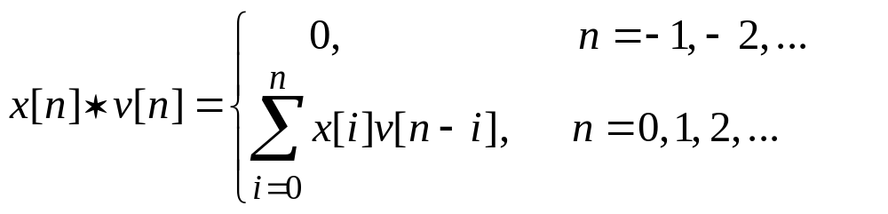
then x[i] =0 for all integers i<0, and v[n–i]=0 for all integers n–i <0 (or n<i). Thus the summation on i in (3.7) may be taken from i=0 to i=n, and the convolution operation is given by
(3.8)
The computation of the convolution (3.7) or (3.8) can be carried out by first changing the discrete-time index n to i in the signals x[n] and v[n]. The resulting signals x[i] and v[i] are then functions of the discrete-time index i. The next step is to determine v[n–i] and then form the product x[i]v[n–i]. The signal v[n–i] is a folded and shifted version of the signal v[i].

Slide 13
More precisely, v[–i] is v[i] folded about the vertical axis, and v[n–i] is v[–i] shifted by n steps. If n>0, v[n–i] is an n-step right shift of v[–i]. Once the product x[i]v[n–i] is formed, the value of the convolution x[n]∗v[n] at the point n is computed by summing the values of x[i]v[n–i] as i ranges over the set of integers.

Slide 14
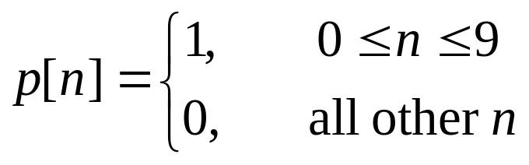
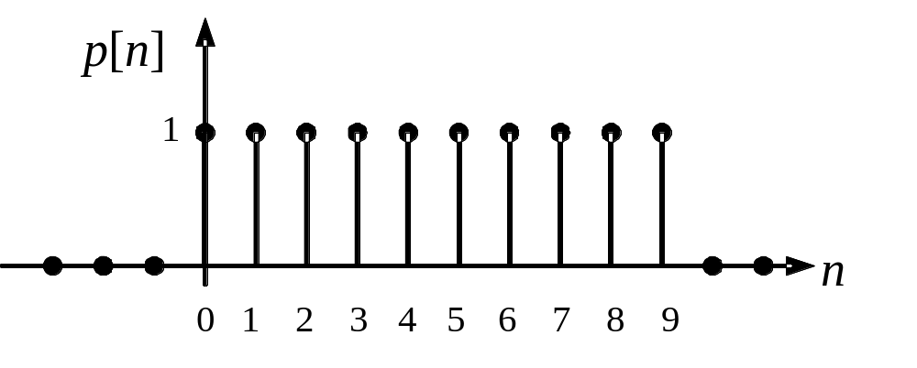
Example 3.2 Convolution of Rectangular Pulses
Suppose that x[n] and v[n] are equal to the rectangular pulse p[n] defined by
Fig. 3.3 The pulse p[n]

Slide 15
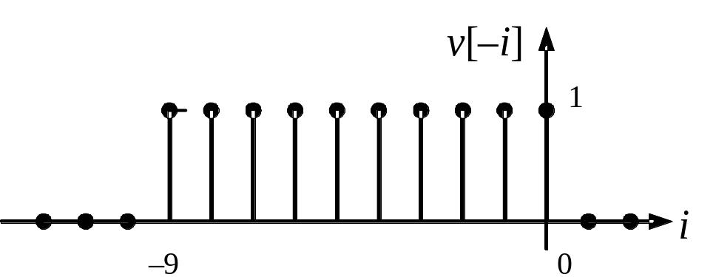
The pulse p[n] is plotted in Fig. 3.3. Since both x[n] and v[n] are zero for n<0, the convolution x[n]∗v[n] is given by (3.8). To evaluate (3.8), the graphical representations of x[i] and v[n–i] as functions of i are first considered: The plot of v[–i] as a function of i is given in Fig. 3.4. Note that v[–i] is equal to the pulse p[i] folded about the vertical axis. Now for any positive value of n, v[n–i] is equal to v[–i] shifted to the right by n steps. The plot of v[n–i] as a function of i for n≤9 is given in Fig. 3.5b and the plot of x[i] is given in Fig. 3.5a.
v[n–i] =v[–(i–n)]
Fig. 3.4 The folded pulse

Slide 16
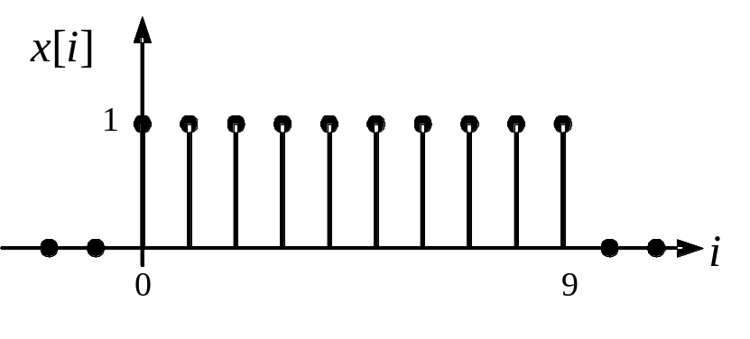
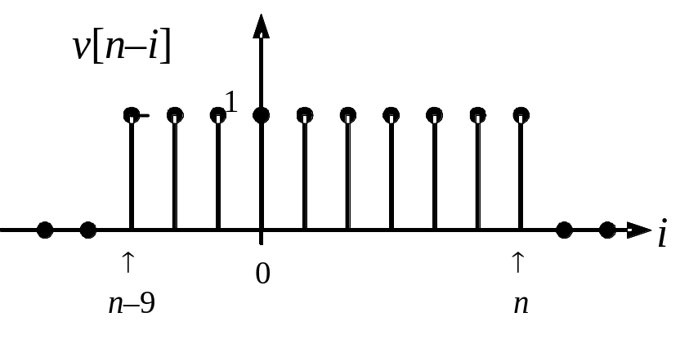
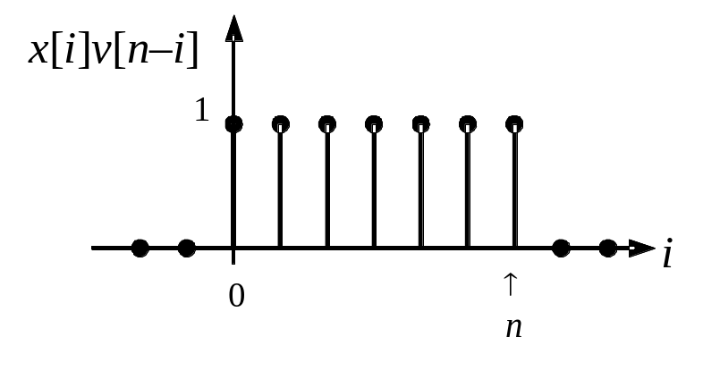
×
(a)
(b)
(c)
Fig. 3.5 Plots of (a) x[i]; (b) v[n–i]; (c) x[i]v[n–i] for 0≤n≤9

Slide 17
The product x[i]v[n–i] is then formed by multiplying point-by-point the plots x[i] and v[n–i]. For an arbitrary value of 0≤n≤9, the product x[i]v[n–i] is illustrated in Fig. 3.5c. The product is a rectangular pulse of amplitude one running from i=0 to i=n, and thus the sum of the values of x[i]v[n–i] is equal to (n+1)(1)= n+1. Hence
x[n]∗v[n]= n+1 for 0≤n≤9
For an arbitrary value of n between 10 and 18, the computation of the product is illustrated in Fig. 3.6. In this case the product is a rectangular pulse of amplitude one running from i=n–9 to i=9. Hence the sum of the values of x[i]v[n–i] is equal to [9–(n–9)+1] (1)=19–n, and therefore
x[n]∗v[n]= 19–n for 10≤n≤18
n–9>0
n–9≤9

Slide 18
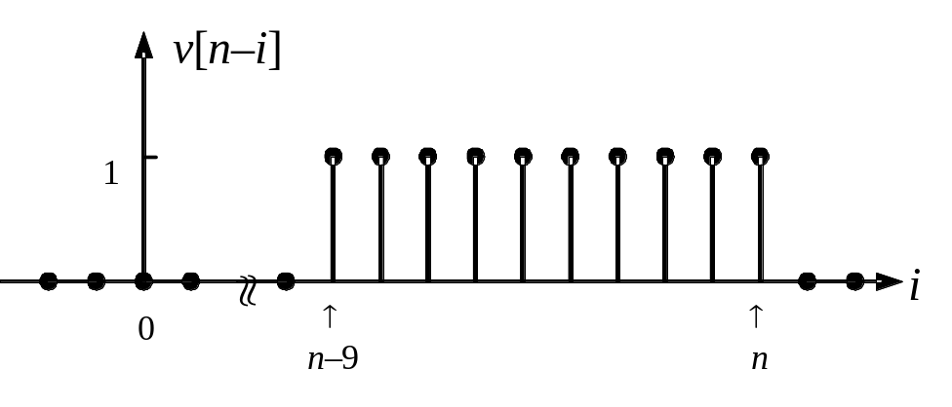
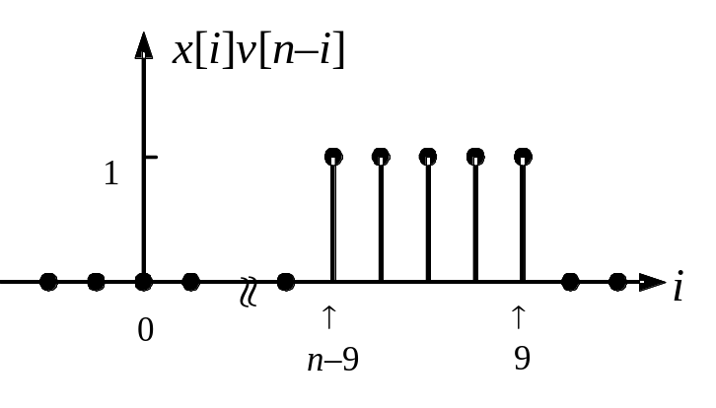
×
Fig. 3.6 Plots of (a) x[i]; (b) v[n–i]; (c) x[i]v[n–i] for 10≤n≤18

Slide 19
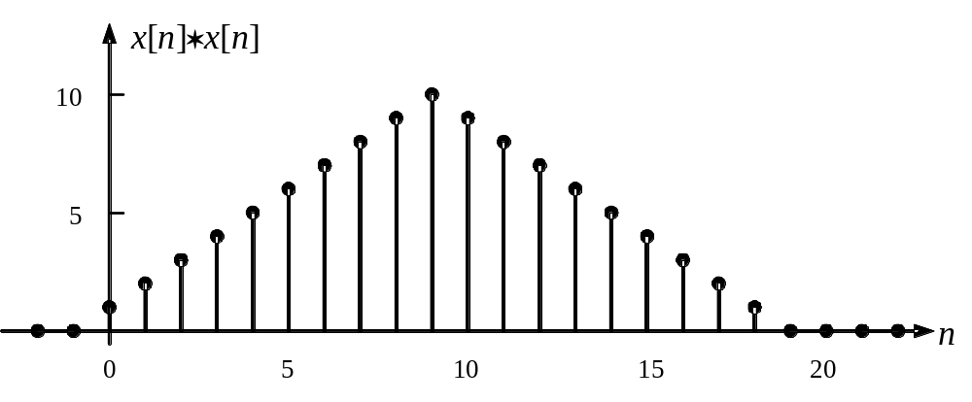
Finally, for n>18 or n<0, x[i] and v[n–i] do not overlap, so the product is zero, and hence
x[n]∗v[n]= 0 for n>18 or n<0
A plot of the convolution x[n]∗v[n] is given in Fig. 3.7. This result shows that the convolution of a rectangular pulse with itself is equal to a triangular pulse of twice the time duration of the rectangular pulse.
Fig. 3.7 Polt of x[n]∗v[n]

Slide 20
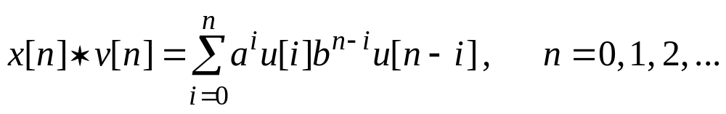
If the signals x[n] and v[n] are given by simple analytical expressions, the following convolution x[n]∗v[n] may be computed analytically. This is illustrated by the following example.
Example 3.3 Use of Analytical Form
Suppose that x[n]=a^{n}u[n] and v[n]=b^{n}u[n], where u[n] is the discrete-time unit-step function and a and b are fixed nonzero real numbers. Inserting x[i]=a^{i}u[i] and v[n–i]=b^{n–i}u[n–i] into (3.8) gives
(3.9)

Slide 21
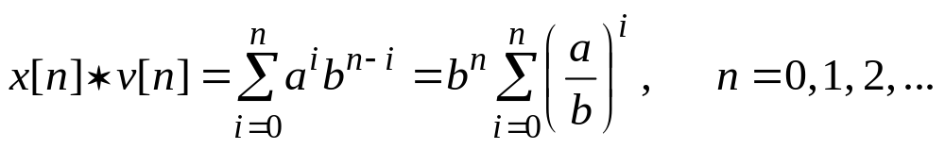
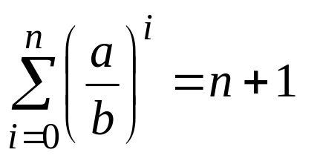
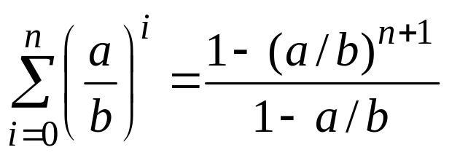
i ≥0
n–i ≥0
Now u[i]=1 and u[n–i]=1 for all integer values of i ranging from i=0 to i=n, and thus (3.9) reduces to
(3.10)
If a=b
and
x[n]∗v[n]=b^{n}(n+1)=a^{n}(n+1), n=0, 1, 2, …
If a ≠ b
(3.11)

Slide 22
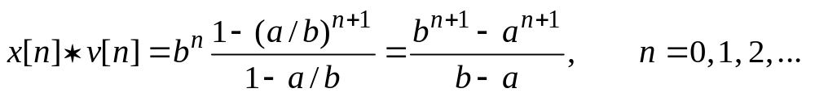
The relationship (3.11) can be verified by multiplying both sides of (3.11) by 1–(a/b). Inserting (3.11) into (3.10) yields (assuming that a ≠ b)

Slide 23
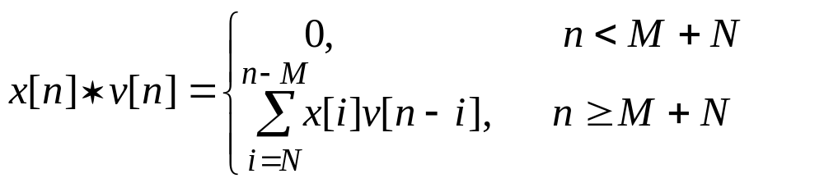
It is easy to generalize (3.8) to the case when x[n] and v[n] are not necessarily zero for all integers n<0. In particular, suppose that x[n] =0 for all n<N and v[n] =0 for all n<M, where M and N are positive or negative integers. In this case the convolution operation (3.7) can be written in the form
(3.12)
Note that the convolution sum in (3.12) is still finite, and thus the convolution x[n]∗v[n] exists.

Slide 24
The convolution sum in (3.12) can be evaluated using an array which is defined as follows:
Let the first row of the array consist of the values x[N], x[N+1], …, and let the second row consist of values v[M], v[M+1], …. The third row of the array consists of the products of the first element in the second row and successive elements of the first row. The elements of the fourth row are the products of the second element of the second row and successive elements of the first row. The products in the fourth, fifth, … rows are shifted one column to the right of the products in the previous row. This pattern is repeated as shown in the array below. Then the values of y[n]=x[n]∗v[n] are computed by summing the products in each column of the array starting with the third row.

Slide 25
The values y[n] of the convolution are displayed in last row of the array as shown below:
x[N] x[N+1] x[N+2] x[N+3] …
v[M] v[M+1] v[M+2] v[M+3] …
x[N]v[M] x[N+1]v[M] x[N+2]v[M] x[N+3]v[M] …
x[N]v[M+1] x[N+1]v[M+1] x[N+2]v[M+1] …
x[N]v[M+2] x[N+1]v[M+2] …
…
…
y[M+N] y[M+N+1] y[M+N+2] y[M+N+3] …
The process is illustrated by the following example.

Slide 26
Example 3.4 Array Method
Suppose that x[n]=0 for n<–1, x[–1]=1, x[0]=2, x[1]=3, x[2]=4, x[3]=5, …, and v[n]=0 for n<–2, v[–2]=–1, v[–1]=5, v[0]=3, v[1]=–2, v[2]=1, …. In this case, N= –1, M= –2 and the array is as follows:
1 2 3 4 5 …
–1 5 3 –2 1 …
–1 –2 –3 –4 –5 …
5 10 15 20 …
3 6 9 …
–2 –4 …
1 …
–1 3 10 15 21 …
The values y[n] of the convolution x[n]∗v[n] are given by the last row; that is, y[–3]= –1, y[–2]=3, y[–1]=10, y[0]=15, y[1]=21, …, and y[n]=0 for n<–3.

Slide 27
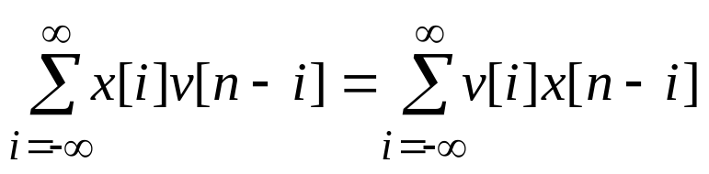
Properties of the Convolution Operation
The convolution operation x[n]∗v[n] satisfies a number of useful properties that are given below.
Associativity. For any convolvable signals x[n], v[n], and w[n],
x[n]∗(v[n]∗w[n])= (x[n]∗v[n])∗w[n]
so convolution satisfies the associativity property. The proof of the associativity follows easily from the definition of convolution and is left to you.
Commutativity. The convolution operation x[n]∗v[n] is commutative; that is,
x[n]∗v[n]= v[n]∗x[n] (3.13)
or
(3.14)
The proof of (3.14) is available in our textbook.

Slide 28
Distributivity with addition. The convolution operation is distributive with addition; that is, for any signals x[n], v[n] and w[n],
x[n]∗(v[n]+w[n])= x[n]∗v[n]+ x[n]∗w[n] (3.17)
The relationship (3.17) follows directly from the definition of convolution. The details are omitted here.
Shift property. Given two signals x[n] and v[n] and a positive or negative integer q, consider the shifted signals x[n–q] and v[n –q]. Recall that x[n–q] and v[n –q] are q-step right shifts (respectively, q-step left shifts) of x[n] and v[n] when q>0 (respectively, when q<0). Now let x_{q}[n]=x[n–q], v_{q}[n]=v[n–q], and let w[n]= x[n]∗v[n]. Then
w[n–q]=x_{q}[n]∗v[n]=x[n]∗v_{q}[n] (3.18)

Slide 29
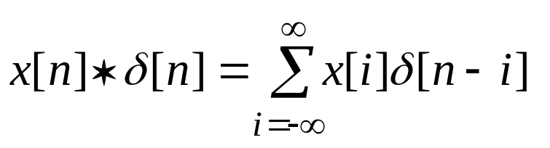
By (3.18), the q-step shift of the convolution w[n]= x[n]∗v[n] is equal to the q-step shift of x[n] convolved with v[n], which in turn is equal to x[n] convolved with the q-step shift of v[n].
Convolution with the unit pulse. For any signal x[n],
x[n]∗δ[n]= x[n] (3.20)
where δ[n] is the unit pulse. By (3.20), the convolution of any discrete-time signal x[n] with the unit pulse δ[n] reproduces x[n]. As a result of this property, the unit pulse δ[n] is said to be the identity element of the convolution operation. To prove (3.20), first note that by (3.7)
(3.21)
Since δ[n–i]=0 when n≠i, and δ[n–i]=1 when n=i, the summation in (3.21) reduces to x[n]. Hence (3.20) is verified.

Slide 30
Convolution with the shifted unit pulse. Given a positive or negative integer q, let δ_{q}[n] denote the shifted unit pulse δ[n–q]; that is δ_{q}[n]=δ[n–q]. Then for any signal x[n],
x[n]∗δ_{q}[n]=x[n–q] (3.22)
The relationship (3.22) reveals that the convolution of x[n] with the shifted unit pulse δ_{q}[n] is equivalent to shifting x[n] by q steps. This characterization of the shift operation turns out to be very useful. The proof of (3.22) follows from (3.20) and the shift property (3.18).

Slide 31
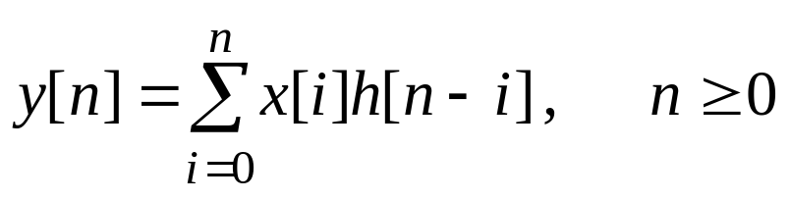
Computation of System Output
Given a causal linear time-invariant discrete-time system with unit-pulse response h[n], let y[n] denote the output response resulting from the input x[n] with x[n]=0 for n<0 and with no initial energy in the system at time n=0. as shown in section 3.1, y[n] is equal to the convolution of x[n] and h[n]; that is,
(3.23)
Since h[n]=0 for n<0 (by causality), h[n–i]=0 for i>n and thus (3.23) reduces to
(3.24)

Slide 32
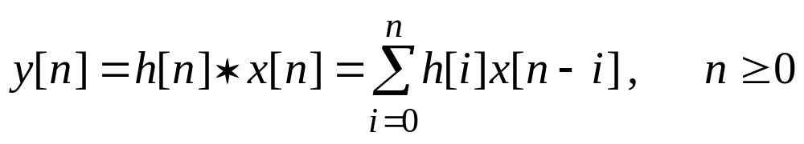
Also note that by commutativity of convolution, (3.24) can be rewritten in the form
(3.25)
Since the output y[n] is equal to the discrete-time convolution x[n]∗h[n] given by (3.24), the response y[n] for any finite range of values of n can be computed using the MATLAB M-file conv. The procedure is illustrated by the following example.

Slide 33
Example 3.5 Convolution of Sinusoids
Suppose that the unit-pulse response h[n] is equal to sin(0.5n) for n≥0, and the input x[n] is equal to sin(0.2n) for n≥0. Plots of x[n] and h[n] are given in Fig. 3.8. Now to compute the response y[n] for n=0, 1, …, 40, use the commands:
n=0:40;
x=sin(0.2*n);
h=sin(0.5*n);
y=conv(x,h);
stem(n,x(1:length(n)));figure;
stem(n,h(1:length(n)));figure;
stem(n,y(1:length(n)))
A MATLAB-generated plot of the response value is given in Fig. 3.9

Slide 34
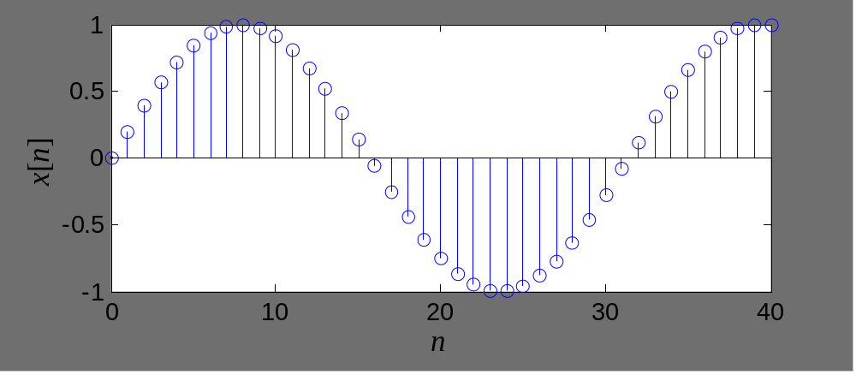
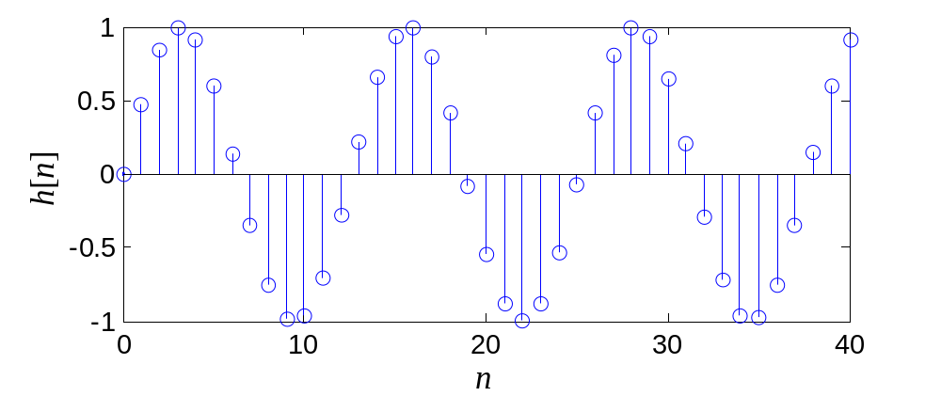
(a)
(b)
Fig. 3.8 Plots of (a) h[n] and (b) x[n] in Example 3.5

Slide 35
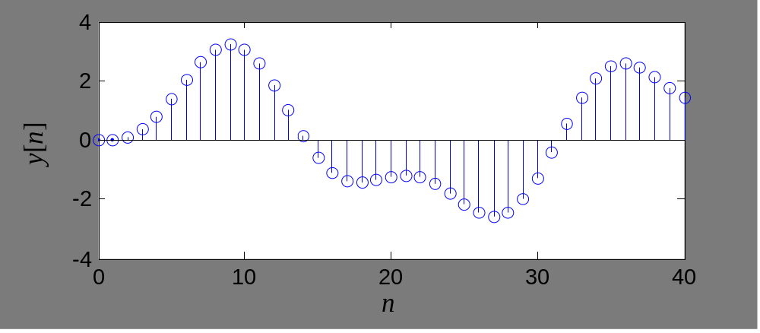
Fig. 3.9 Plot of output response in Example 3.5

Slide 36
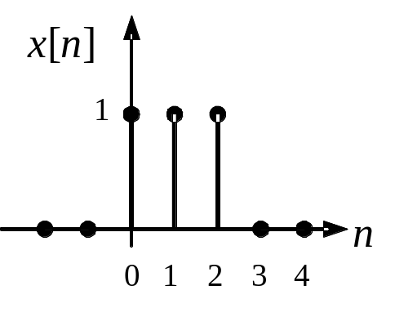
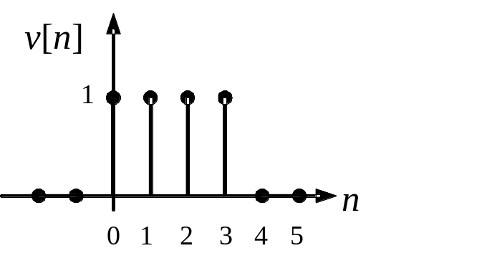
Problems
3.1 For the discrete-time signal x[n] and v[n] shown below, compute the convolution x[n]∗v[n] for all n≥0. Sketch the result.
3.2 Given the discrete-time signal x[n] and v[n]:
x[n]=1 for –1≤n≤2 and x[n]=0 for all other integers n;
v[–1]=1, v[0]=2, v[1]=3, v[2]=2, v[3]=1 and v[n]=0 for all other integers n.
Compute x[n]∗v[n] for n≥–2.

Slide 37
3.3 Given v[n]=(0.8)^{n}u[n] and x[n]=(0.5)^{n}u[n], compute x[n]∗v[n] and x[n]∗v[n–2].

Slide 38
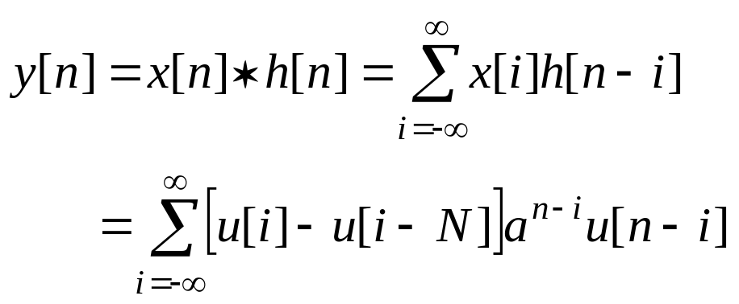
Example 3.6
Given the unit pulse response of a system
h[n]=a^{n}u[n]
where 0 < a < 1, u[n] is the discrete-time unit-step function. If the input signal is given by
x[n] = u[n] − u[n− N]
Compute the zero-state response y[n].
Solution:
Using the equation (3.7), the zero-state response y[n] can be computed by

Slide 39
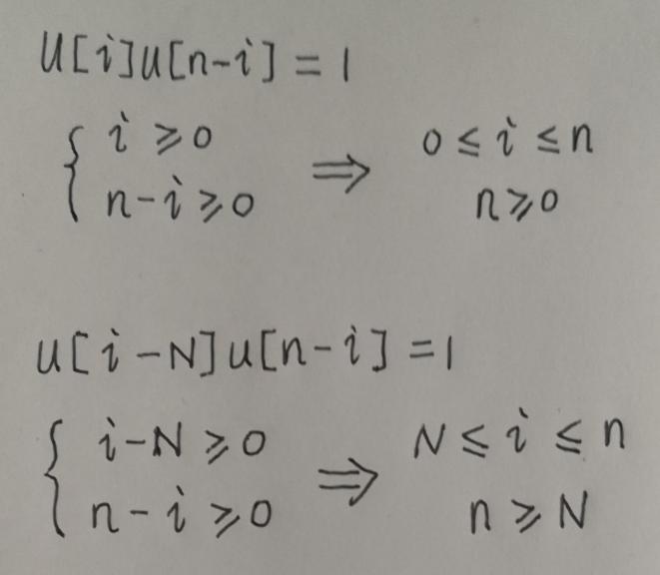
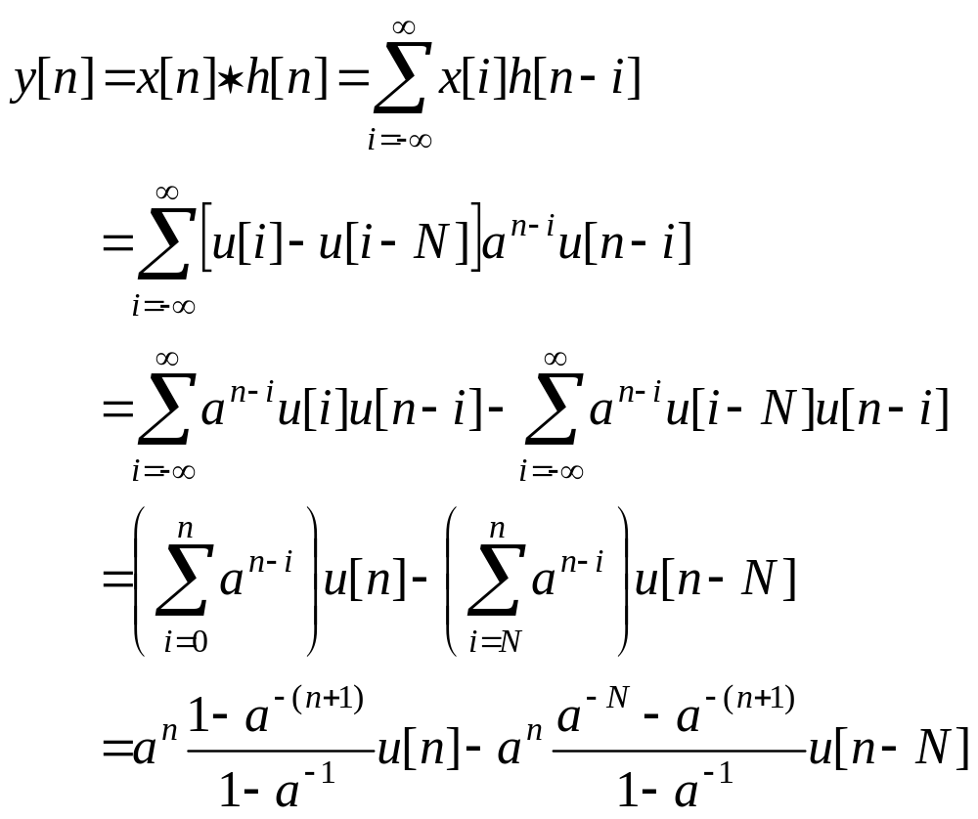

Slide 40
Example 3.7
Given x[n] = 2δ[n] + δ[n−1] + 4δ[n−2]+δ[n− 3], and v[n]= 3δ[n] + δ[n−1] + 5δ[n−2]. Compute y[n]= x[n]∗v[n].
Solution:
Use an array to compute y[n]=x[n]∗v[n]. In this case, N= 0, M= 0 and the array is as follows:
2 1 4 1
3 1 5
6 3 12 3
2 1 4 1
10 5 20 5
6 5 23 12 21 5
y[0] y[1] y[2] y[3] y[4] y[5]

