Slide 1
Chapter 2 Discrete-Time System Analysis in the Time Domain
§2-1 Linear Input/Output Difference Equations with Constant Coefficients
§2-2 Discretization in Time of Differential Equations
Problems

Slide 2
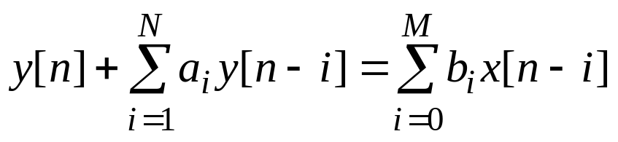
§2-1 Linear Input/Output Difference Equations with Constant Coefficients
Now consider single-input single-output discrete-time system defined by the input/output difference equation
(2.1)
where n is the integer-valued discrete-time index, x[n] is the input, and y[n] is the output. Here it is assumed that the coefficients a₁, a₂, …, a_{N} and b₀, b₁, b₂, …, b_{M} are constants.

Slide 3
Since Eq. (2.1) is a linear difference equation with constant coefficients, the system defined by the equation is linear, time invariant, and finite dimensional. The integer N in (2.1) is the order or dimension of the system. Also, any discrete-time system in the form of Eq. (2.1) is causal since the output y[n] at time n depends only on previous values of the output and the current and previous values of the input x[n].
Solution by Recursion
Unlike linear input/output differential equations, linear input/output difference equations can be solved by a direct numerical procedure. More precisely, the output y[n] for some finite range of integer values of n can be computed recursively as follows. First, rewrite (2.1) in the form

Slide 4
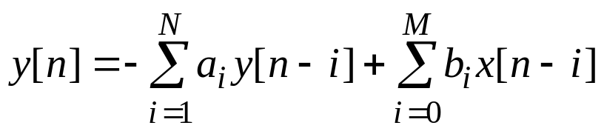
(2.2)
Then setting n=0 in (2.2) gives
y[0] = −a₁y[−1] −a₂y[−2] − · · · −a_{N}y[−N]
+ b₀x[0] −b₁x[−1] − · · · −b_{M}x[−M]
Thus the output y[0] at time 0 is a linear combination of y[−1], y[−2], · · ·, y[−N] and x[0], x[−1], · · ·, x[−M].
Setting n=1 in (2.2) gives
y[1] = −a₁y[0] −a₂y[−1] − · · · −a_{N}y[−N+1]
+ b₀x[1] −b₁x[0] − · · · −b_{M}x[−M+1]
So y[1] is a linear combination of y[0], y[−1], · · ·, y[−N+1] and x[1], x[0], · · ·, x[−M+1].

Slide 5
If this process is continued, it is clear that the next value of the output is a linear combination of the N past values of the output and M+1 values of the input. At each step of the computation, it is necessary to store only N past values of the output (plus, of course, the input values). This process is called an Nth-order recursion. Here the term recursion refers to the property that the next value of the output is computed from N previous values of the output (plus the input values). The discrete-time system defined by (2.1) [or (2.2)] is sometimes called a recursive discrete-time system or a recursive discrete-time filter since its output can be computed recursively. Here it is assumed that at least one of the coefficients a_{i} in (2.1) is nonzero. If all the a_{i} are zero, the input/output difference equation (2.1) reduces to

Slide 6
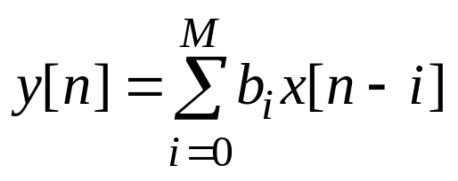
In this case, the output at any fixed time point depends only on values of the input x[n], and thus the output is not computed recursively. Such systems are said to be nonrecursive.
Finally, from (2.1) or (2.2) it is clear that the computation of the output response y[n] for n≥0 requires that the N initial conditions y[−1], y[−2], · · ·, y[−N] must be satisfied. In addition, if the input x[n] is not zero for n<0, the evaluation of (2.1) or (2.2) also requires the M initial input values x[−1], x[−2], · · ·, x[−M].

Slide 7
Example 2.1
Consider the discrete-time system given by the second-order input/output difference equation
y[n] −1.5y[n−1] +y[n−2] =2x[n−2] (2.3)
Write (2.3) in the form (2.2) results in the input/output equation
y[n] =1.5y[n−1] −y[n−2] +2x[n−2] (2.4)
Now suppose that the input x[n] is the discrete-time unit-step function u[n] and that the initial output values are y[−2]=2 and y[−1]=1. Thus setting n=0 in (2.4) gives
y[0] =1.5y[−1] −y[−2] +2x[−2]
=(1.5)(1) − 2 +(2)(0)= − 0.5

Slide 8
Setting n=1 in (2.4) gives
y[1] =1.5y[0] −y[−1] +2x[−1] =(1.5)(−0.5) − 1 +(2)(0)= − 1.75
Continuing the process yields
y[2] =1.5y[1] −y[0] +2x[0] =(1.5)(−1.75) − 0.5 +(2)(1)= − 0.125
y[3] =1.5y[2] −y[1] +2x[1] =(1.5)(−0.125) − 1.75 +(2)(1)= 3.5625
and so on.
In solving (2.1) and (2.2) recursively, the process of computing the output y[n] can begin at any time point desired. In the development above, the first value of the output that was computed was y[0]. If the first desired value is the output y[q] at time q, the recursive process should be started by setting n=q in (2.2). In this case, the initial values of the output that are required are y[q −1], y[q −2], · · ·, y[q −N]

Slide 9
Complete Solution
By solving (2.1) or (2.2) recursively, it is possible to generate an expression for the complete solution y[n] resulting from initial conditions and the application of the input x[n]. The process is illustrated by considering the first-order linear difference equation
y[n] = – ay[n –1] +bx[n], n =1, 2, … (2.5)
with the initial condition y[0]. First, setting n =1, n =2 and n =3 in (2.5) gives
y[1] = – ay[0] +bx[1], (2.6)
y[2] = – ay[1] +bx[2], (2.7)
y[3] = – ay[2] +bx[3], (2.8)
Inserting the expression (2.6) for y[1] into (2.7) gives
y[2] = – a(– ay[0] +bx[1]) +bx[2],
= a²y[0] –abx[1] +bx[2], (2.9)

Slide 10
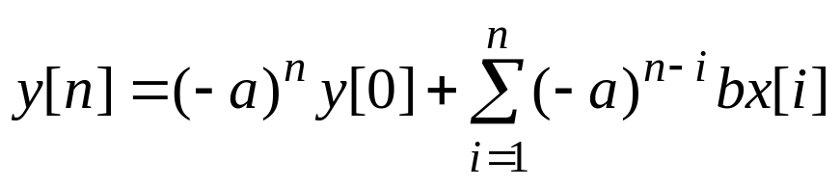
Inserting the expression (2.9) for y[2] into (2.8) yields
y[3] = – a(a²y[0] –abx[1] +bx[2]) +bx[3],
= –a³y[0] +a²bx[1]– abx[2]+bx[3], (2.10)
From the pattern in (2.6), (2.9) and (2.10), it can be seen that for n≥1,
This equation gives the complete output response y[n] for n≥1 resulting from initial condition y[0] and the input x[n] applied for n≥1.

Slide 11
§2-2 Discretization in Time of Differential Equations
As an application of the difference equation, in this section it is shown that a linear constant-coefficient input/output differential equation can be discretized in time, resulting in a difference equation that can be then solved by recursion. This discretization in time actually yields a discrete-time representation of the continuous-time system defined by the given input/output differential equation. The development begins with the first-order case.

Slide 12
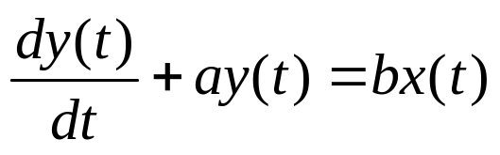
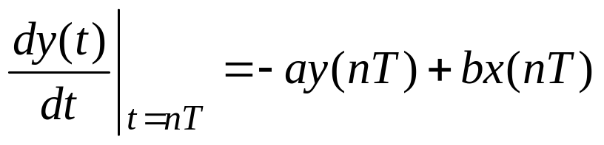
First-Order Case
Consider the linear time-invariant continuous-time system with the first-order input/output differential equation
(2.11)
where a and b are constants. Eq. (2.11) can be discretized in time by setting t=nT, where T is a fixed positive number and n takes on integer values only. This results in the equation
(2.12)

Slide 13
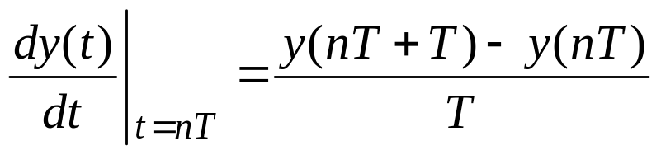
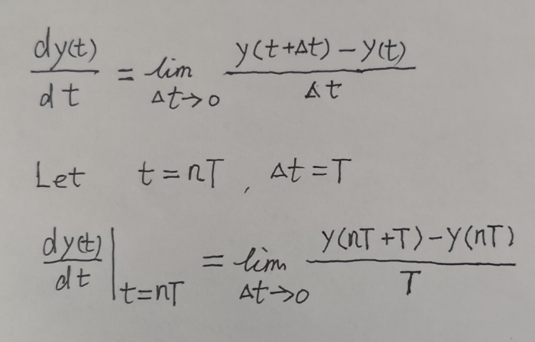
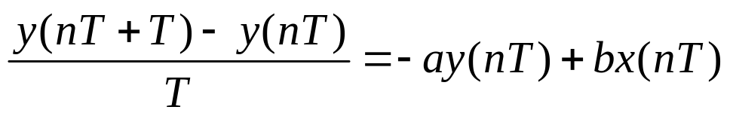
Now the derivative in (2.12) can be approximated by
(2.13)
If T is suitable small and y(t) is continuous, the approximation (2.13) to the derivative dy(t)/dt will be accurate. This approximation is called the Euler approximation of the derivative.
Inserting the approximation (2.13) into (2.12) gives
(2.14)
To be consistent with the notation that is being used for discrete-time signals, the input signal x(nT) and the output signal y(nT) will be denoted by x[n] and y[n], respectively; that is, x[n]= x(t)| _{t=nT} and y[n]= y(t)| _{t=nT}

Slide 14
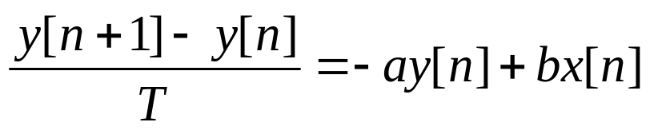
In terms of this notation, (2.14) becomes
(2.15)
Finally, multiplying both sides of (2.15) by T and replacing n by n –1 results in a discrete-time approximation to (2.11) given by the first-order input/output difference equation
y[n] –y[n –1] = –aTy[n –1]+ bTx[n –1],
or
y[n] = (1 –aT)y[n –1]+ bTx[n –1], (2.16)
The difference equation is called the Euler approximation of the given input/output differential equation (2.11) since it is based on the Euler approximation of the derivative.

Slide 15
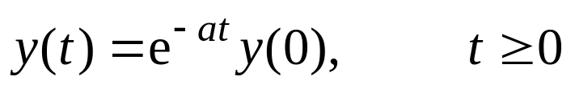
The discrete values y[n]= y(nT) of the solution y(t) to (2.11) can be computed by solving the difference equation (2.16). The solution of (2.16) with initial condition y[0] and with x[n]=0 for all n given by
y[n]=(1 – aT)^{n} y[0], n =0, 1, 2, … (2.17)
The exact solution y(t) to (2.11) with initial condition y(0) and zero input is given by
(2.18)
To analyze the approximation error between (2.17) and the exact solution (2.18) of y(t), set t=nT in (2.18) gives the following exact expression for y[n]
y[n]=e^{–anT} y[0]= (e^{–aT})^{n} y[0], n =0, 1, 2, … (2.19)
Further, inserting the expansion

Slide 16
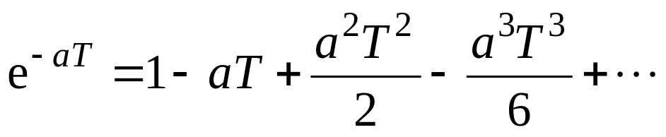
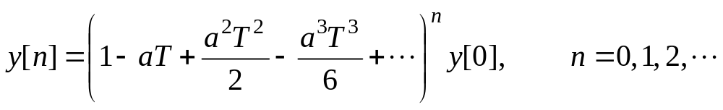
for the exponential into (2.19) results in the following exact expression for the values of y(t) at the times t=nT:
(2.20)
Comparing (2.17) and (2.20) shows that (2.17) is an accurate approximation if 1 – aT is a good approximation to the exponential e^{–aT}. This will be the case if the magnitude of aT is much less than 1, in which case the magnitude of aT will be much smaller than the quantity 1 – aT.

Slide 17
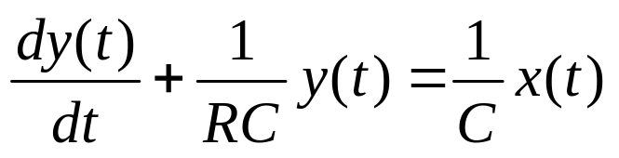
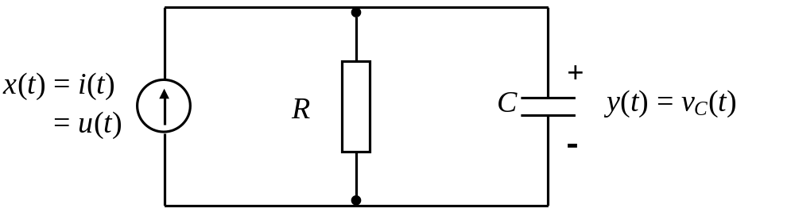
Example 2.2 RC Circuit
Consider the RC circuit given in Fig. 2-1. The circuit has the input/output differential equation
(2.21)
where x(t) is the current applied to the circuit and y(t) is the voltage across the capacitor.
Fig. 2-1

Slide 18
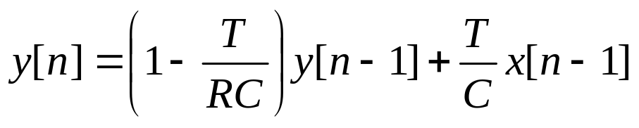
Writing (2.21) in the form (2.11) reveals that in this case, a=1/(RC) and b=1/C . Hence, the discrete-time representation (2.16) for the RC circuit is given by
(2.22)
The difference equation (2.22) can be solved recursively to yield approximate values y[n] of the voltage on the capacitor resulting from initial voltage y[0]=0, input current x[n]= x(nT)= u(nT) and R=C=1. The recursion can be carried out using the MATLAB program in the course text.

Slide 19
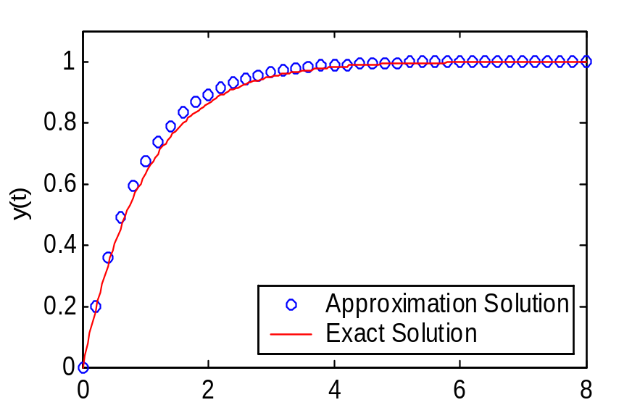
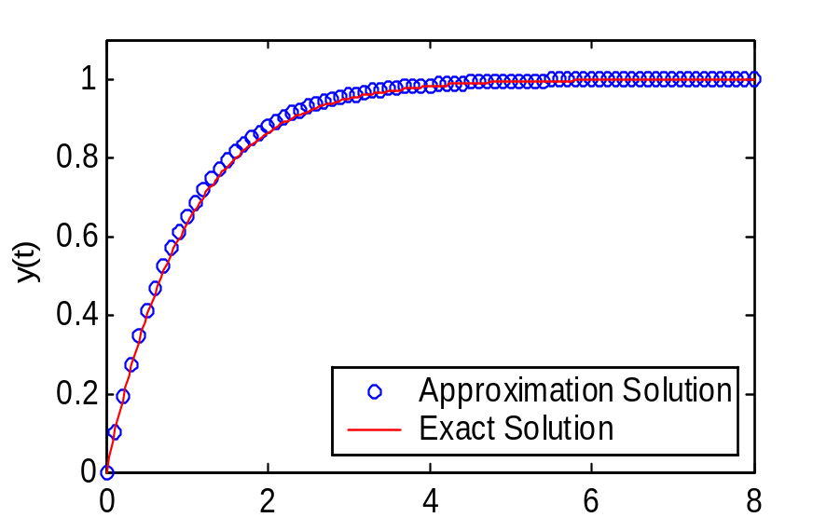
Fig. 2-2(a)
Fig. 2-2(b)
To compare with the exact solution of (2.21), the plots of the resulting output (the unit-step response) for the approximation are displayed in Fig. 2-2(a) for T=0.2 and Fig. 2-2(b) for T=0.1 along with the exact unit-step response y(t)=(1–e^{–t})u(t).
Obviously, the approximation error in Fig. 2-2(b) is smaller than that in Fig. 2-2(a) as the sampling interval T becomes smaller.

Slide 20

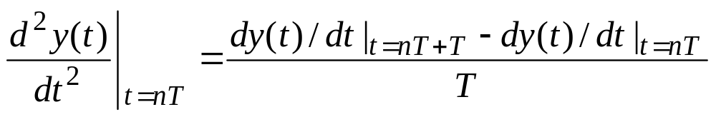
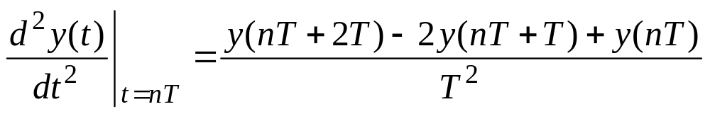
Second-Order Case
The discretization technique for first-order differential equations described above can be generalized to second- and high-order differential equations. In this second-order case the following approximations can be used:
(2.23)
(2.24)
Combining (2.23) and (2.24) yields the following approximation to the second derivative:
(2.25)

Slide 21
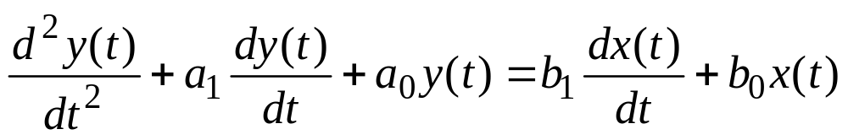
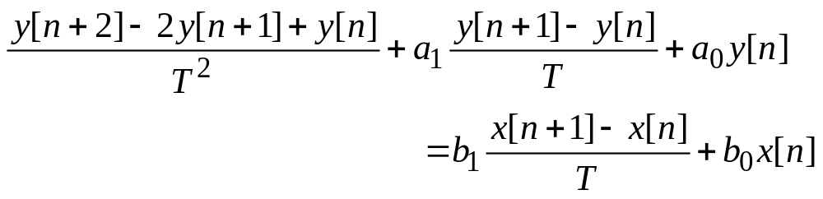
The approximation (2.25) is the Euler approximation of the second derivative.
Now consider a linear time-invariant continuous-time system with the second-order input/output differential equation
(2.26)
Setting t=nT in (2.26) and using the approximations (2.23) and (2.25) results in the following time discretization of (2.26):
(2.27)

Slide 22
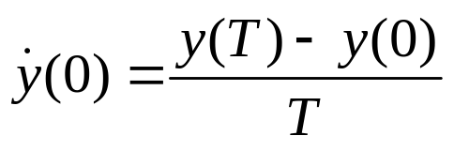

Replacing n by n – 2 in (2.27) and multiplying both sides of (2.27) by T² yields the difference equation
y[n] +(a₁T – 2) y[n – 1]+ (1– a₁T + a₀T²) y[n – 2]
= b₁T x[n – 1]+( b₀T² –b₁T) x[n – 2] (2.28)
Eq. (2.28) is the discrete-time approximation to the second-order input/output differential equation (2.26).
The discrete values y(nT) of the solution y(t) to (2.26) can be computed by solving the difference equation (2.28). To solve (2.28), the recursion will be started at n=2 so that the initial values y[0]= y(0) and y[1]= y(T) are required. The initial value y(T) can be generated by using the approximation
(2.29)
where denotes the derivative of y(t).

Slide 23

Solving (2.29) for y(T) gives
y[1]= y(T) = y(0) + (2.30)
with the initial values y[0] and y[1], the second-order difference equation (2.28) can be solved using the MATLAB program in the course text.

Slide 24
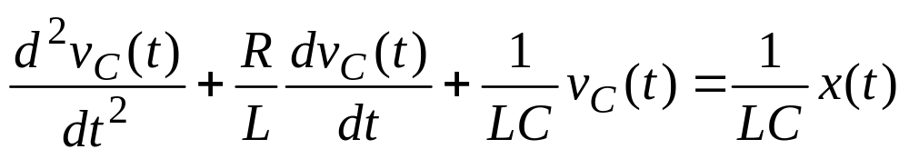
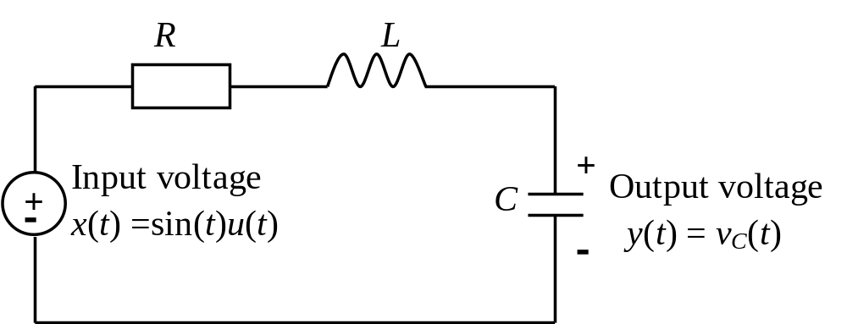
Example 2-3 Series RLC Circuit
Consider the series RLC circuit shown in Fig. 2-3. As indicated, the input x(t) is the voltage applied to the circuit and the output y(t) is the voltage v_{C}(t) across the capacitor. We have known that the differential equation for the circuit is given by
(2.31)
Fig. 2-3 Series RLC circuit

Slide 25
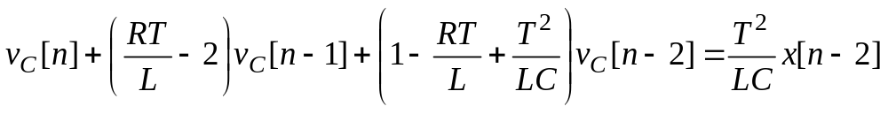

Eq. (2.31) is a second-order differential equation that can be written in the form (2.26) with
a₁=R/L, a₀=1/(LC), b₁=0, b₀=1/(LC) (2.32)
Inserting (2.32) into the discretized equation (2.28) yields
(2.33)
Eq. (2.33) is the difference equation approximation of the RLC circuit. The voltage v_{C}(t) across the capacitor will be computed using the discretization (2.33) in the case when R=2, L=C=2, v_{C}(0)=1, , and x(t)=sin(t)u(t).

Slide 26
To solve the difference equation (2.33) for n ≥ 2, the initial conditions are x[0]=sin(0)=0, x[1]= sin(T), v_{C}[0]=1, and from (2.30), we get
Now the second-order difference equation (2.33) can be solved using the MATLAB program.
To compare with the exact solution v_{C}(t)=0.5[(3+t)e^{–t}–cos(t)]u(t) to the differential equation (2.31), the plots of the resulting output for the approximation are displayed in Fig. 2-4(a) for T=0.2 and Fig. 2-4(b) for T=0.1 along with the exact solution.

Slide 27
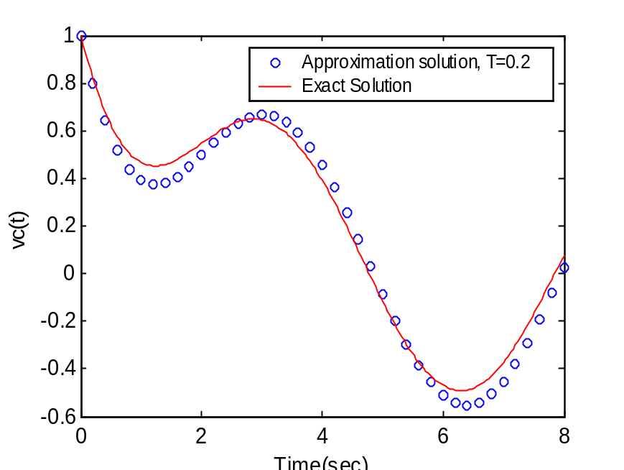
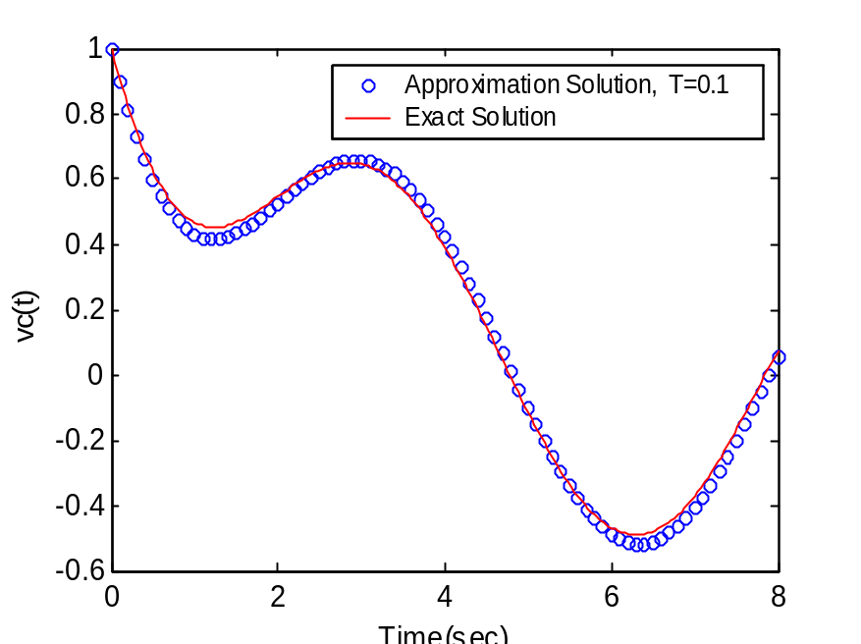
Fig. 2-4(a)
Fig. 2-4(b)
From the plots it is seen that there is a significant error in the approximation in Fig. 2-4(a) for T=0.2. To obtain a better approximation, the discretization interval T can be decreased to be 0.1, the result is shown in Fig. 2-4(b). In fact, as T→0, the approximation should approach the true response values.

Slide 28
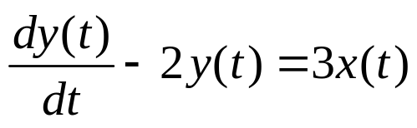
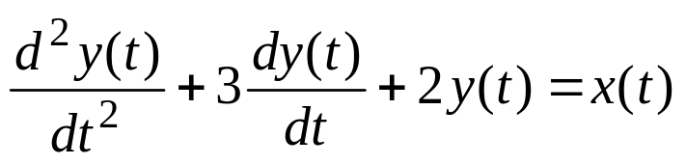
Problems
2.1 For the difference equation y[n]+ 1.5y[n –1]= x[n], use the method of recursion to compute y[n] for n=0, 1, 2, 3, when x[n]=0 for all n and y[–1]=2, and then find a complete solution for y[n].
2.2 Consider the following differential equations:
(a)
(b)
Using Euler’s approximation of derivatives with T arbitrary and input x(t) arbitrary, derive a difference equation model.

