Slide 1


Database Project (GROUP 1)
GROUP Member
Tenzin Choklang
Orlando
Tenzin Ngawang

Slide 2
Database Presentation
First Part: Analyze the data
Understand the data in the table
Second Part: Problem faced/ Errors
Inconsistence data ( Name dash, Married, etc…)
Empty Attributes (PlayerName, PlayerID)
Third Part: Our Accomplishment
Database Diagram
Relation between some table

Slide 3
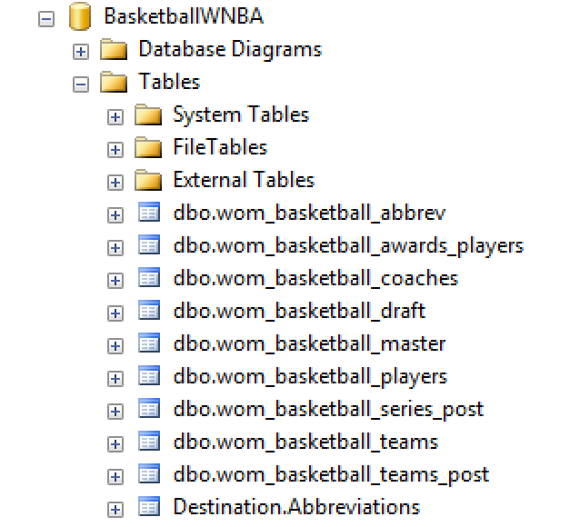
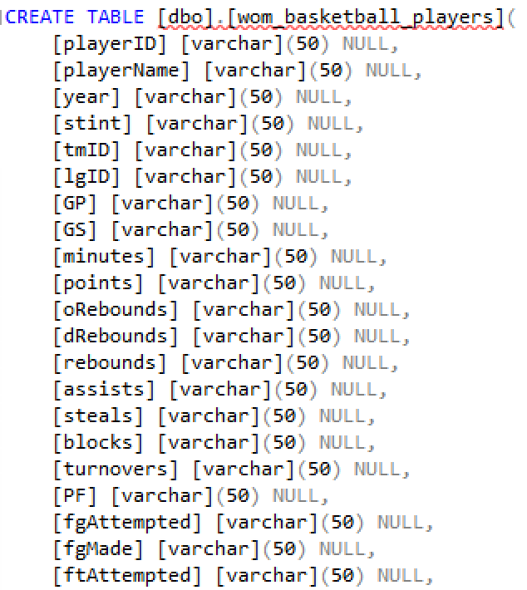
Original Database

Slide 4
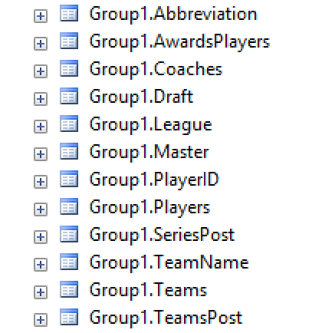
Modified Table Name
Schema change

Slide 5
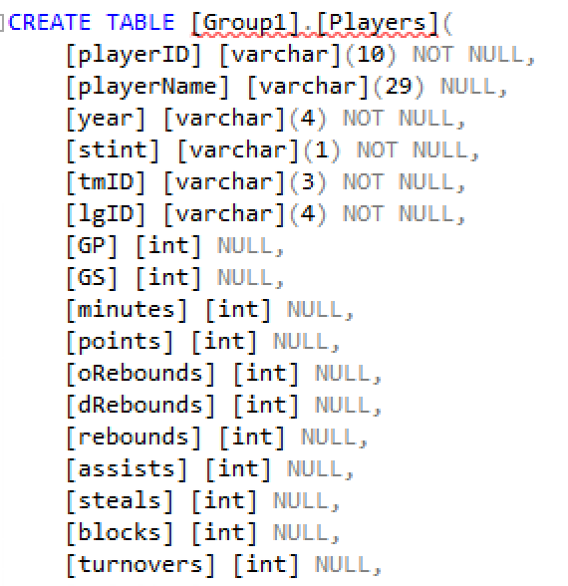
Modified Data Type of Attributes

Slide 6
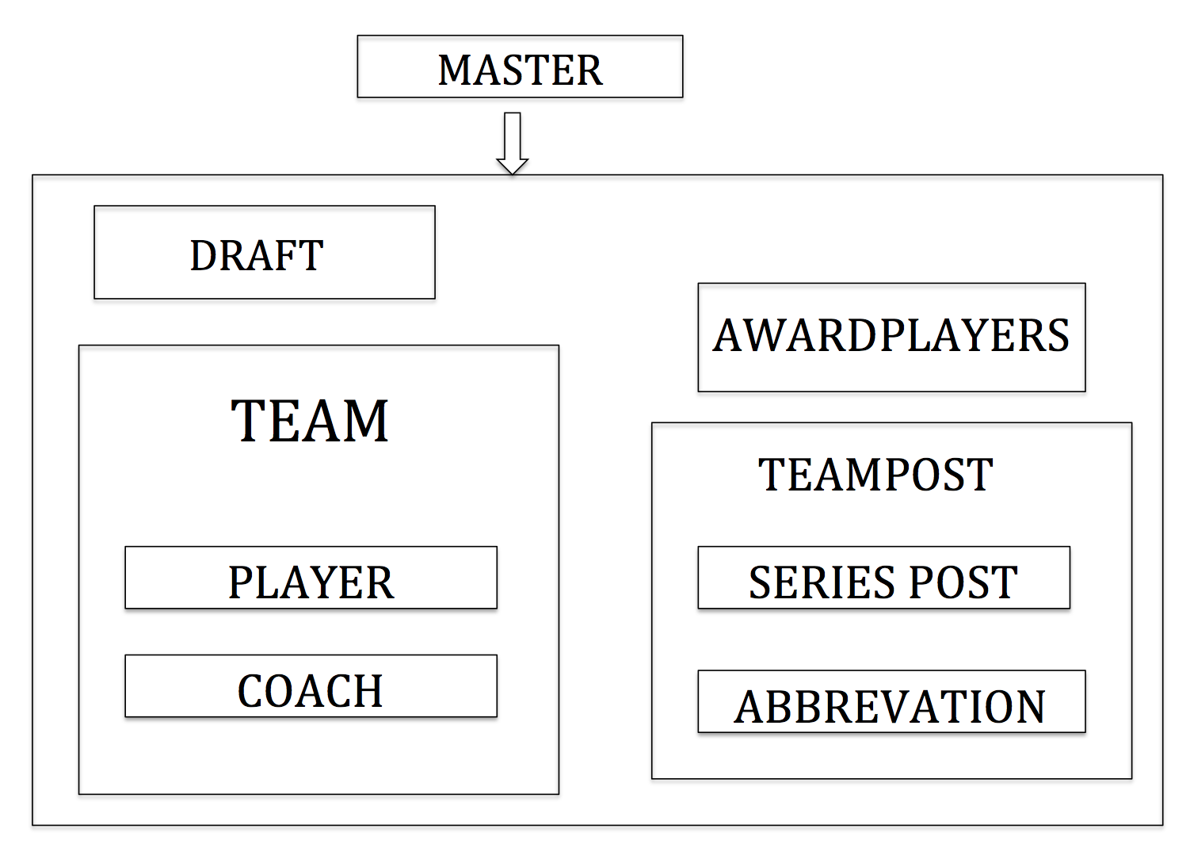

Slide 7
Analyze Data
MASTER 893
Draft 935
Players 818
Coach 84
Does Not Add Up
818 + 84 = 902
902 – 893 = 9
Player who become Coach

Slide 8
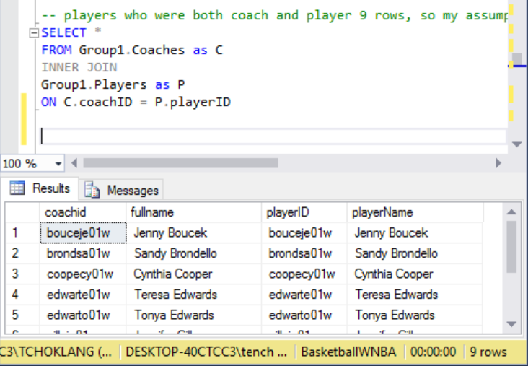
Analyze Data
Our assumption is Correct!

Slide 9
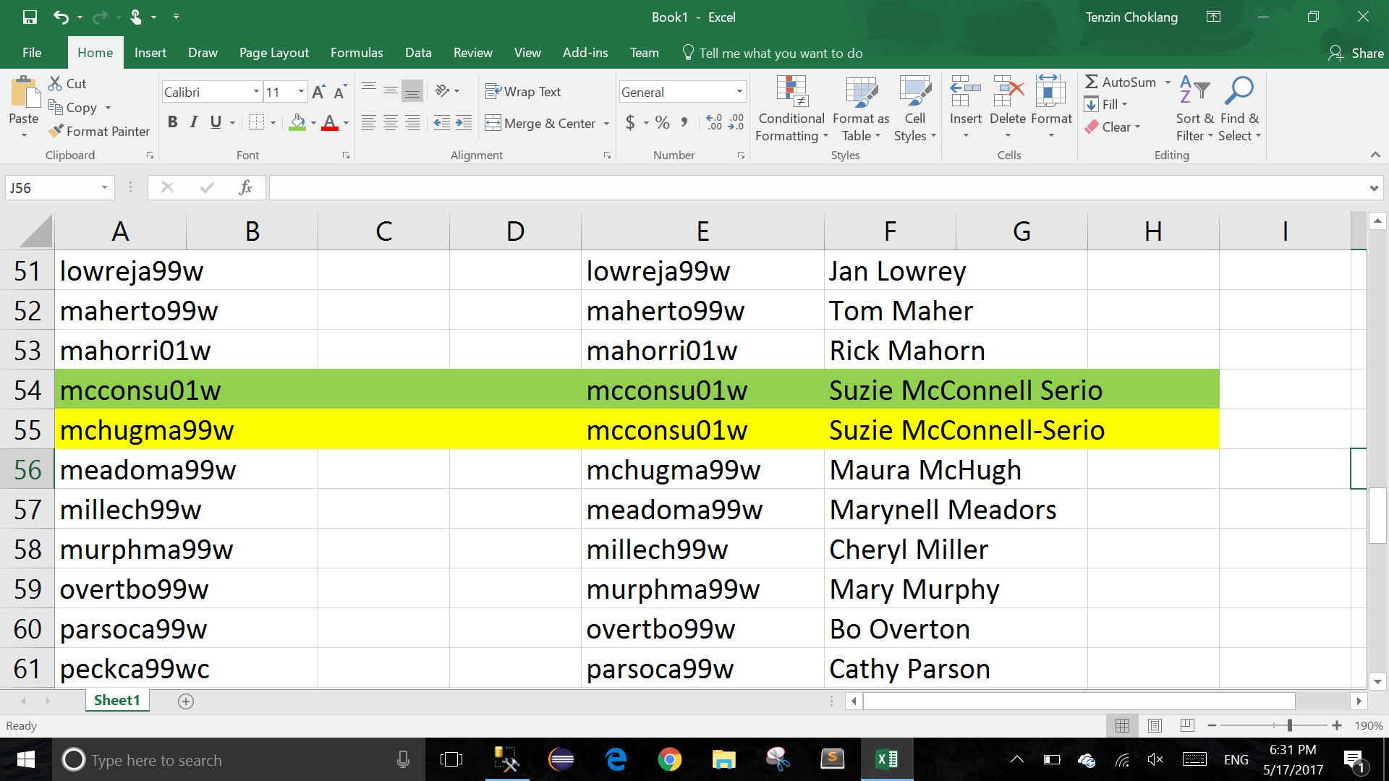
Problems ( Inconsistence Data)

Slide 10
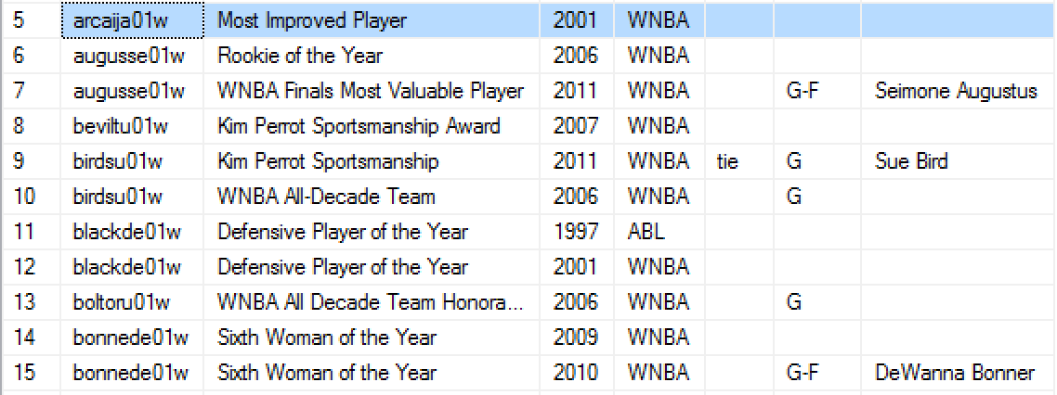
Problems ( Inconsistence Data)
AwardPlayer Table
PlayerName

Slide 11
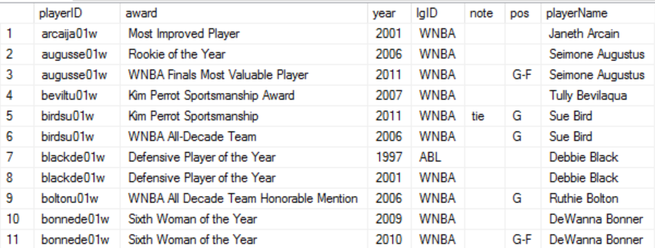
Problems ( Inconsistence Data)
AwardPlayer Table (Populated)

Slide 12
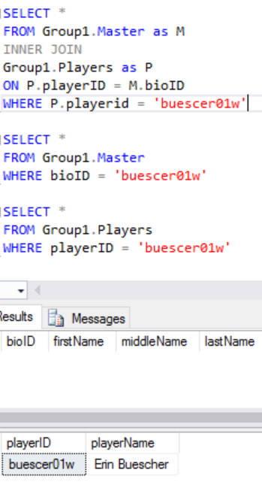
Problems ( Inconsistence Data)
Master Table & Player Table
Master Table
Player Table

Slide 13
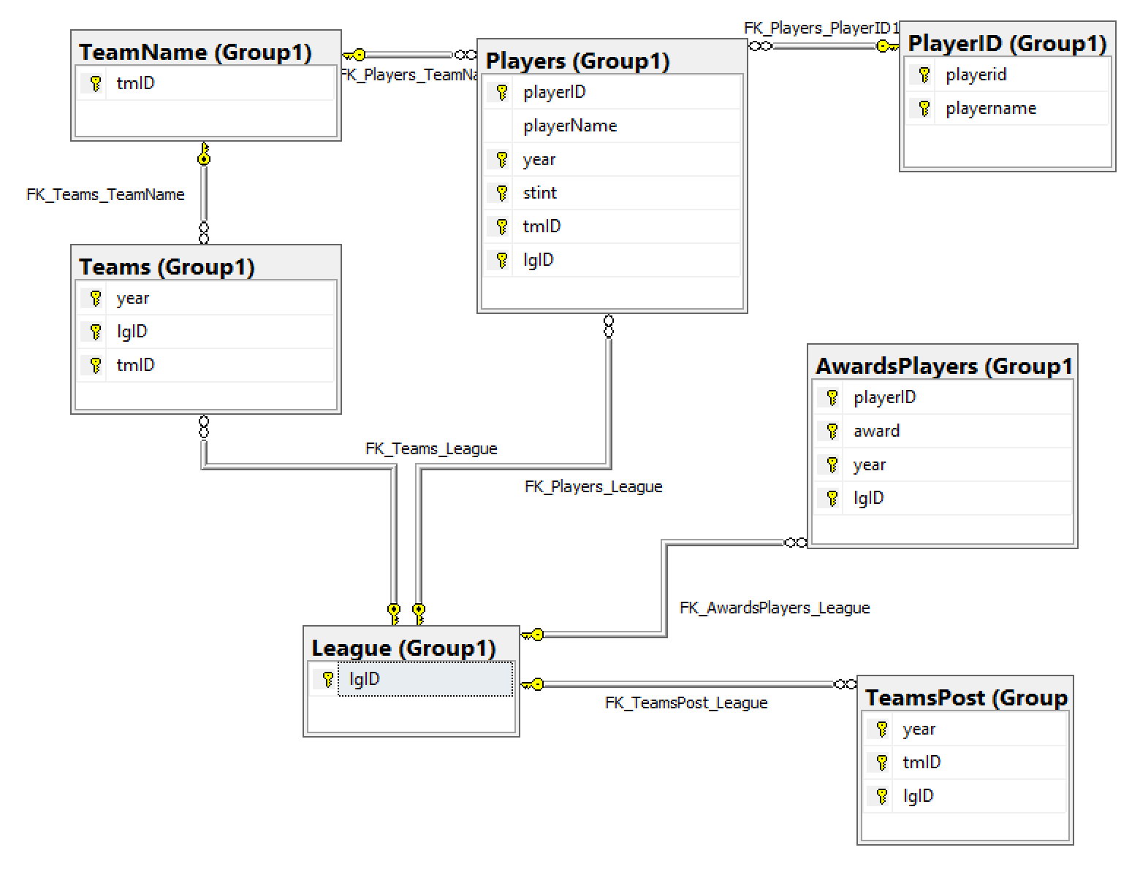
Accomplishment (Diagram)
Separate Team ID
Separate PlayerID
Separate LgID
Problem:
PlayerID to AwardPlayer
Master to PlayerID

Slide 14
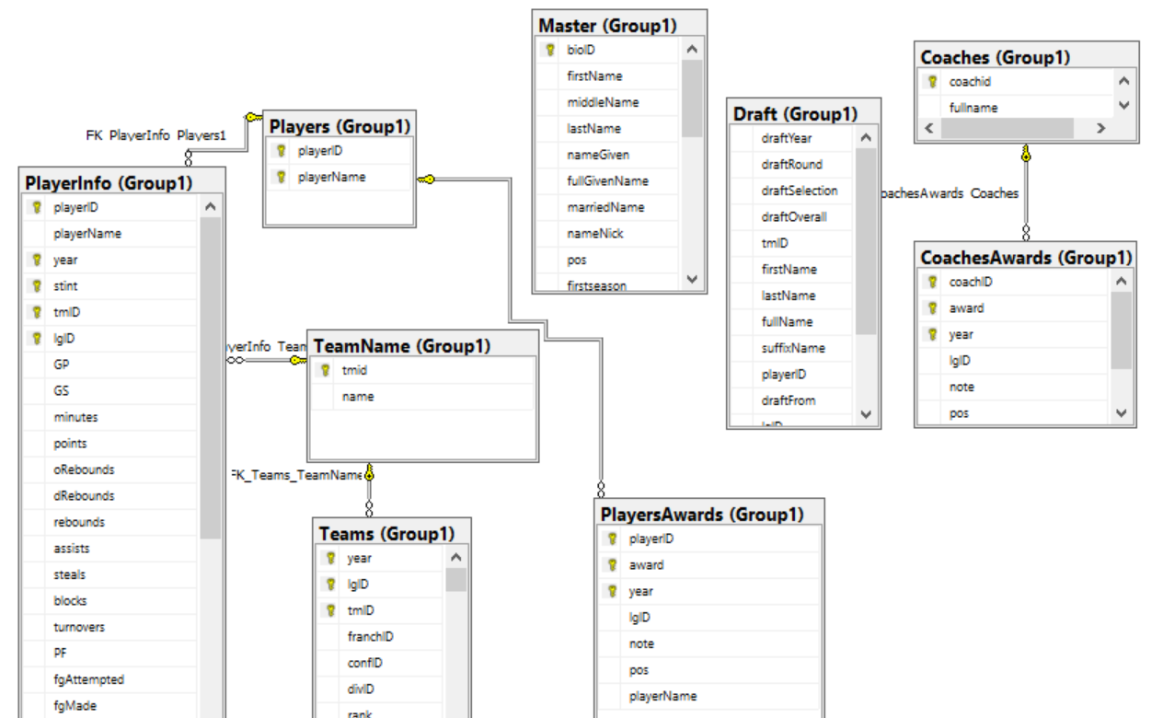
Accomplishment (Diagram)
Separate Team ID
Separate PlayerID
Separate Awards
Problem:
Master to Player
Player to Draft

Slide 15


