Slide 1
Academic Presentation
2025 Nobel Physics Prize
Quantum Properties on Human Scale
Presentation
2025-11-10

Slide 2
01
Introduction
Macroscopic Quantum Effects

Slide 3
The Nobel Laureates 2025
John Clarke: Born 1942 in Cambridge, UK. Professor at UC Berkeley.
Michel H. Devoret: Born 1953 in Paris, France. Professor at Yale and UC Santa Barbara.
John M. Martinis: Born 1958. Professor at UC Santa Barbara and CTO at Qolab.

Slide 4
02
Background
Quantum Mechanics Basics

Slide 5
Key Quantum Concepts
Quantum
Q
1
Energy in discrete packets
T
Tunneling
2
Particles pass through barriers
S
Superconductivity
3
Zero resistance current flow
E
Wave Function
4
Probability description system

Slide 6
Microscopic vs Macroscopic
Microscopic: Single particles, quantum effects dominate
Macroscopic: Large systems, classical physics usually applies
Breakthrough: Showing quantum effects in macroscopic systems

Slide 7
03
The Experiment
Groundbreaking Research

Slide 8
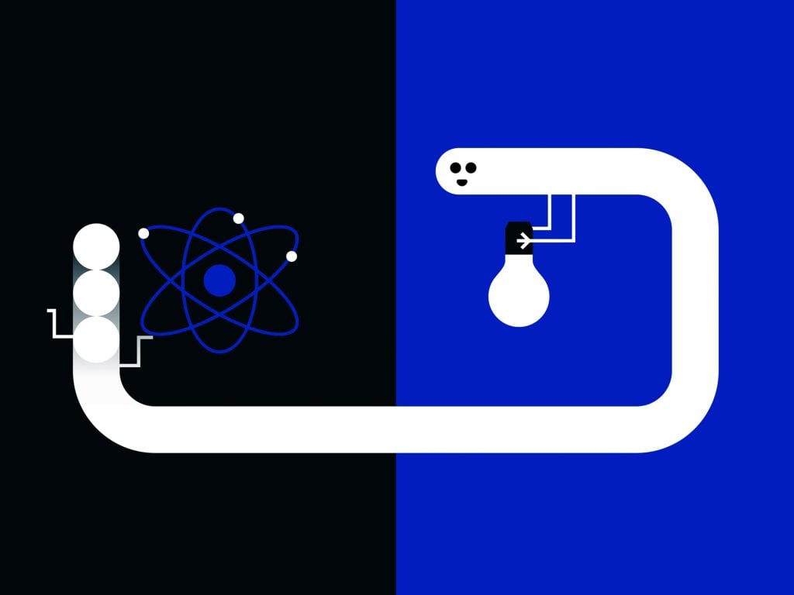
Experimental Setup
Superconductors
Zero resistance materials
Josephson Junction
Thin insulating barrier
Cooper Pairs
Electron pairs synchronized
Quantum System
Macroscopic wave function

Slide 9
Key Discoveries
Macroscopic Quantum Tunneling: System escapes zero-voltage state
Energy Quantization: System absorbs/emits specific energy amounts
Statistical Measurements: Multiple trials to observe quantum chance

Slide 10
04
Significance
Impact and Applications

Slide 11
Scientific Impact
O1
O2
O3
Foundation
Understanding
Schrödinger's Cat
Bridges microscopic and macroscopic worlds
Tests quantum mechanics at large scales
Real quantum effects in macroscopic systems

Slide 12
Practical Applications
Quantum Bits
Simulation
Superconducting qubits for computing
Artificial atoms for quantum systems
Technology
Research
New quantum devices and sensors
Platform for quantum experiments

Slide 13
Historical Context
1972 Nobel Prize: Bardeen, Cooper, Schrieffer - Superconductivity theory
1973 Nobel Prize: Josephson - Josephson junction predictions
2003 Nobel Prize: Leggett - Macroscopic quantum phenomena theory
2025 builds on this foundation with experimental verification

Slide 14
05
Conclusion
Future Directions

Slide 15
Summary and Outlook
Demonstrated quantum effects in macroscopic electrical circuits
Verified tunneling and energy quantization at large scales
Opened new possibilities for quantum technology development
Foundation for future quantum computers and simulations

Slide 16
Academic Presentation
Thank You
Quantum Future Ahead
Presentation
2025-11-10

