Slide 1
Customer Day 8 Roadshow
Team 24

Slide 2
Agenda
Meeting items | Time
Introduction | 5 Mins
Problem Statement | 5 Mins
Purpose of developing application | 5 Mins
Requirement Gathering | 5 Mins
Our Solution | 5 Mins
Achievements | 5 Mins
Q&A | 10 Mins

Slide 3
Introduction

Slide 4
Introduction
Our project aims to empower and support low-income earners to become skilled technicians in the air conditioning servicing industry

Slide 5
Problem Statement
Low-income earners encounter barriers accessing stable employment and skill development in the air conditioning servicing industry, exacerbating economic disparities and perpetuating poverty cycles.
Despite demand, individuals from economically disadvantaged backgrounds lack necessary resources and opportunities, hindering their entry and success in the field, necessitating initiatives for economic empowerment and social inclusion.

Slide 6
Purpose of our application
We provide a platform for individuals to access job servicing opportunities within their locale, develop their skills, and improve their economic prospects

Slide 7
Requirement Gathering

Slide 8
Requirement Gathering
Coordinators
Register Technicians
Ad-Hoc rescheduling of appointments
Maintain relationships of customers & technicians
Technicians
Look for more job opportunities
Retrieve & accept Appointments
Receive notifications before appointment
Customers
Add Air Conditioners to their profile
Schedule Appointments
Edit Appointments
Cancel Appointments
​

Slide 9
Our solution

Slide 10



All in 1 integrated aircon scheduling algorithm

Slide 11






Technology Stack
Frontend
Web Portal
Backend

Slide 12

Customers
Oh no , I have something on the day of my appointment, I would need to cancel or reschedule another date
I would like to service my air conditioner

Slide 13
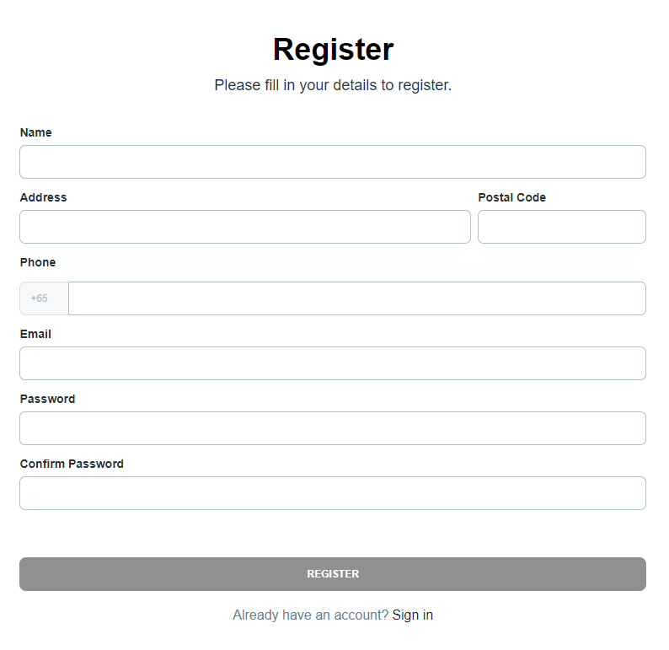
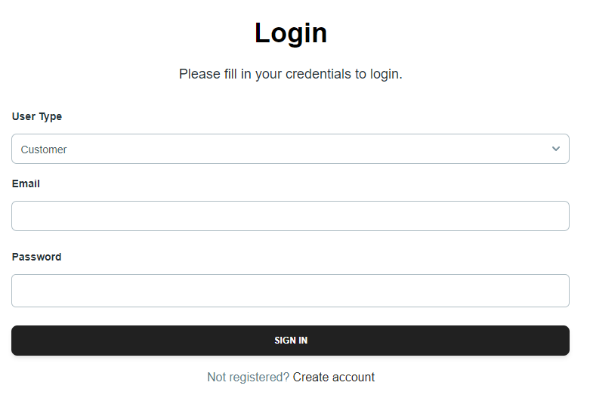
Customers
Register page
Login Page
Register an account
Login

Slide 14
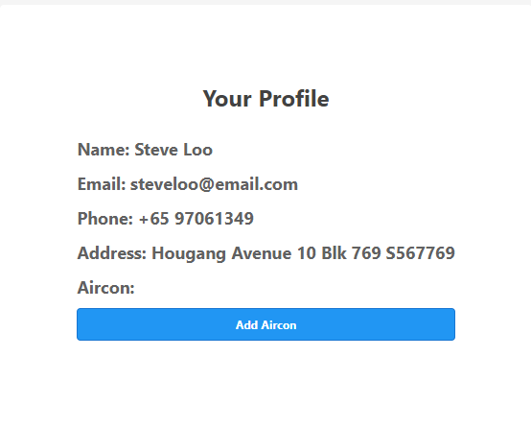
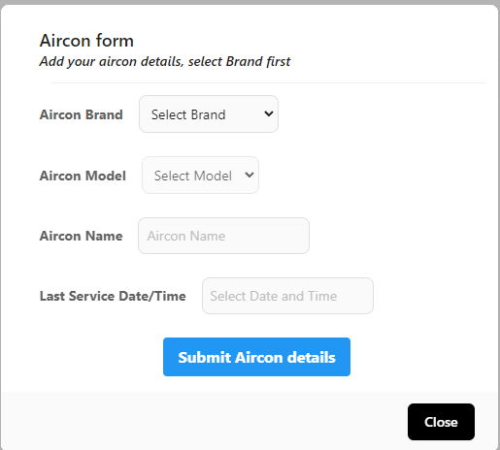
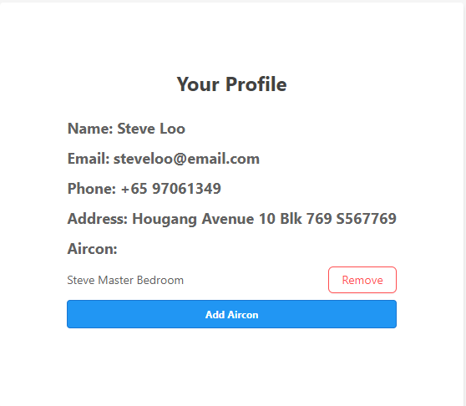
Customers
Profile page
Add aircon form
Add aircon
Add aircon info successfully

Slide 15
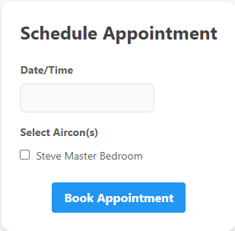
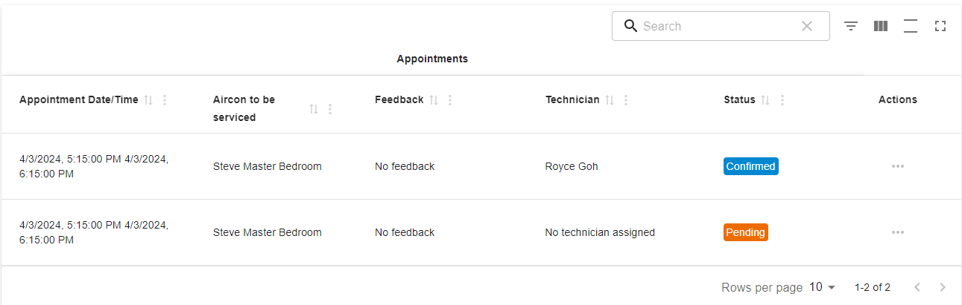

Customers
Book appointment page
Home page / Dashboard
Technician Scheduling algorithm

Slide 16
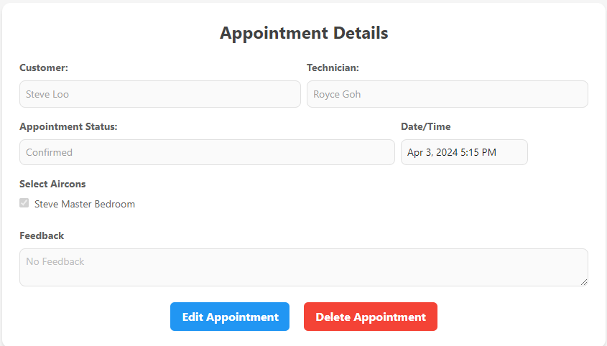
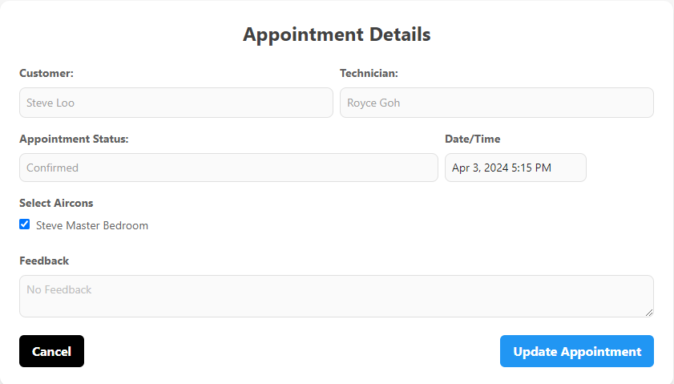
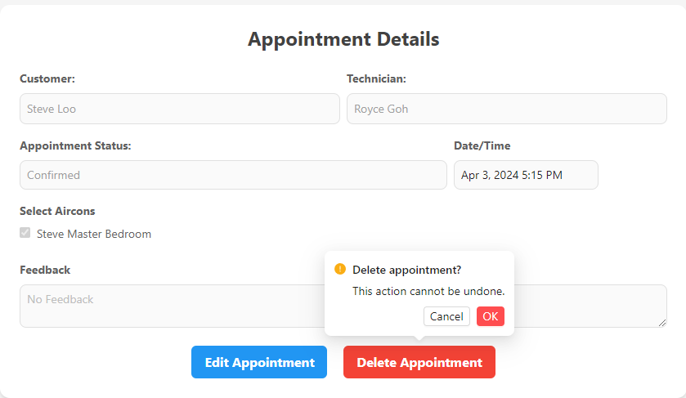
Customers
Appointment Details page

Slide 17
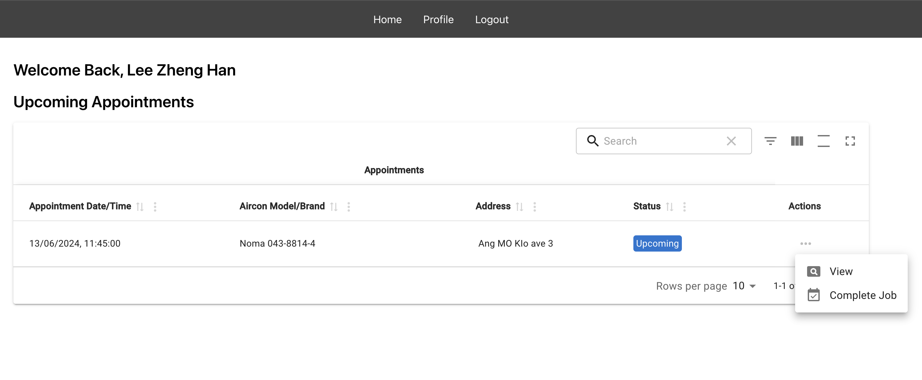
Technician

Slide 18
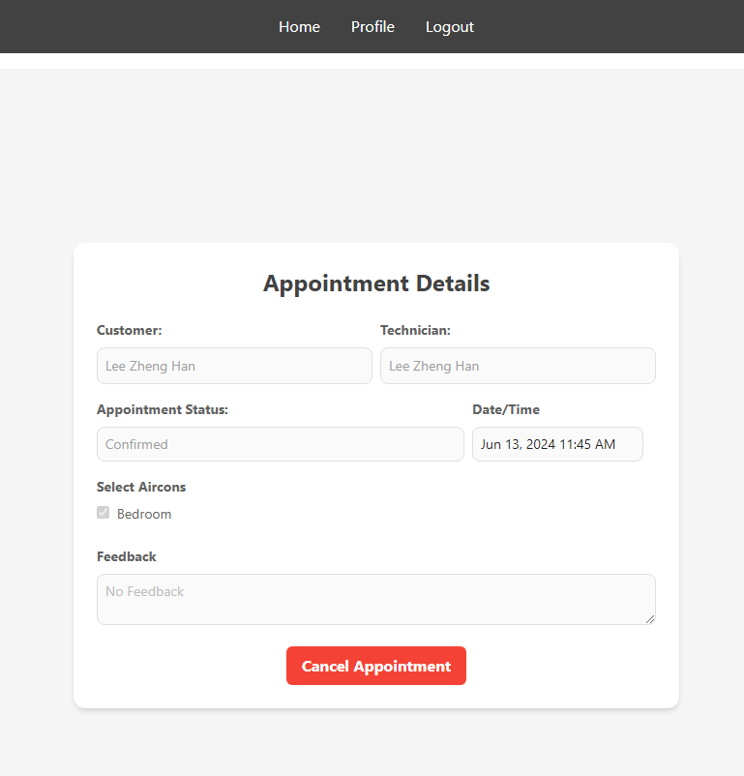
Technician

Slide 19
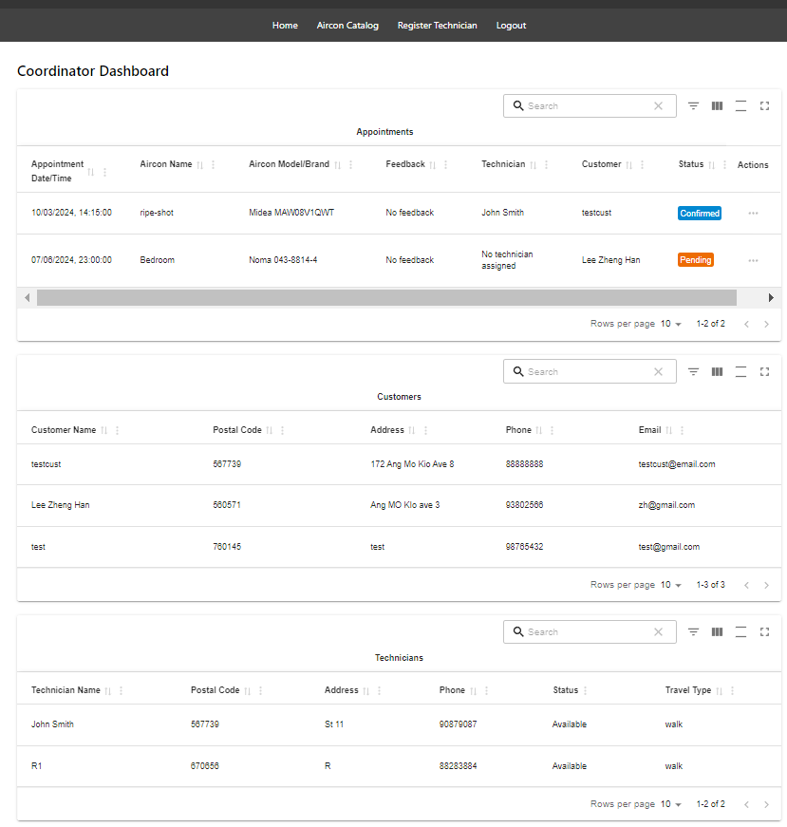
Coordinator Homepage
Manage appointment details
Search customer details
Search technician details

Slide 20
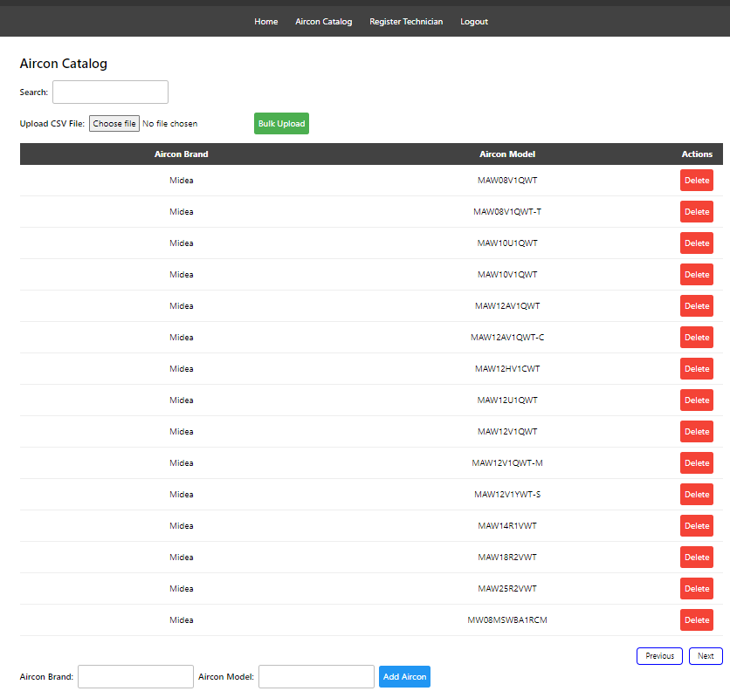
Aircon Catalog page
Manage aircon brands & models
Single addition & bulk additions of data
Searching of aircon brand / model

Slide 21
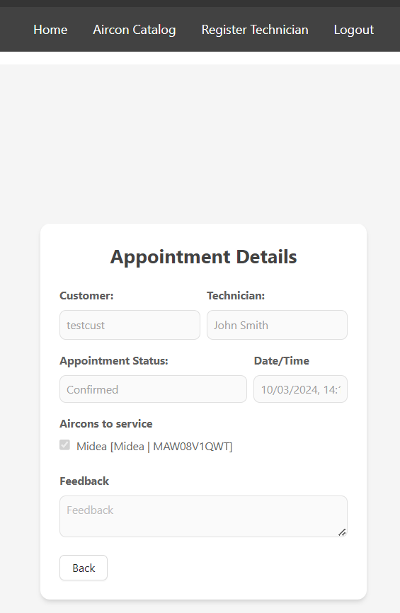
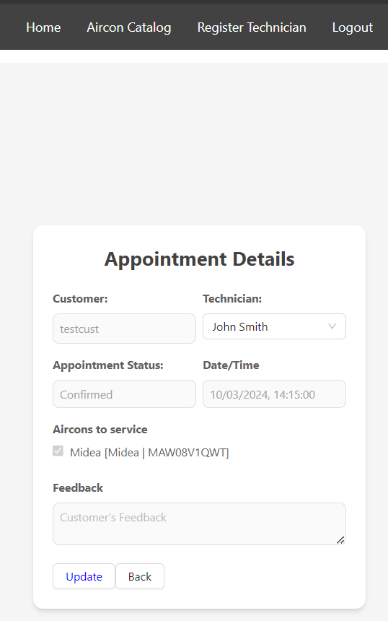
Coordinator appointment details page
View details of selected appointment
Coordinator appointment update page
Update details of selected appointment

Slide 22
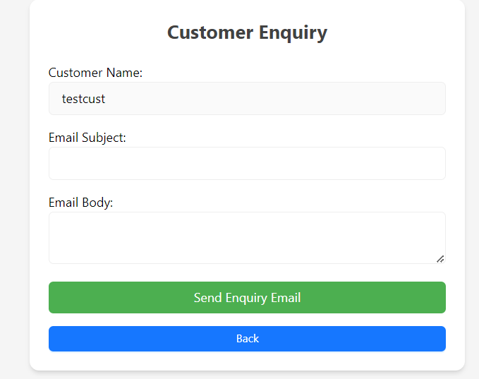
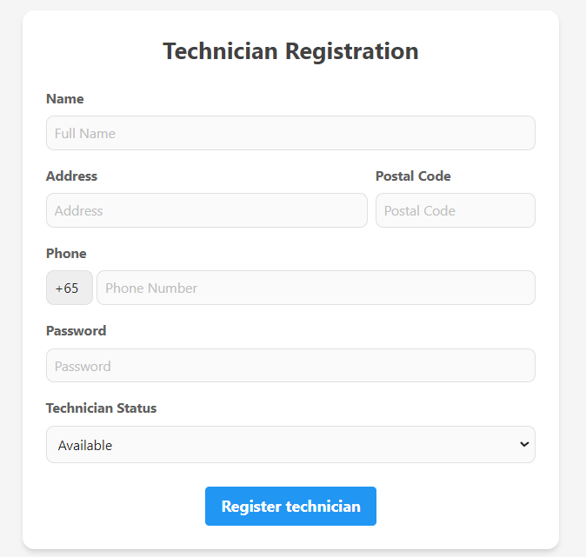
Customer enquiry page
Send ad-hoc email to customer
Technician registration page
Register new technicians

Slide 23
Demo

Slide 24
Achievements

Slide 25
Achievements
Successfully carried out requirement gatherings in accordance to the problem statement & identified key user stories & requirements
Successfully converted the user stories & requirements to functionalities in our product
Overcame setbacks regarding initial product ideation
Successfully developed & delivered the Minimum Viable Product (MVP) of this integrated aircon appointment scheduling web application that meets all basic requirements as agreed
Successfully completed all necessary documentations needed for handover

Slide 26
Q&A

Slide 27
Thank You!

