Slide 1
Inconsistency within machine Learning
Created by Heather Kearnan
Intro to Data Science Fall 2020 Term

Slide 2
Background of the Compas data
The Compas(Correctional Offender Management Profiling for Alternative Sanctions) data set is used to predict a person's chance of reoffending.
After a few years of using the Algorithm people noticed that dark coloured people were rated as a higher risk then those who are light coloured.
With the Data it is very one sided as people that are black are rated higher than those that are white.

Slide 3
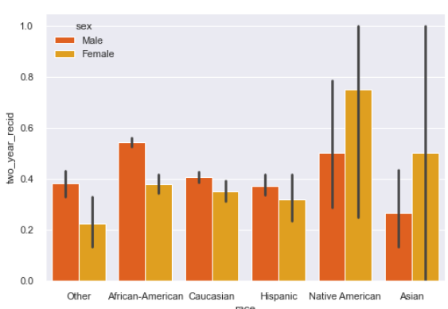
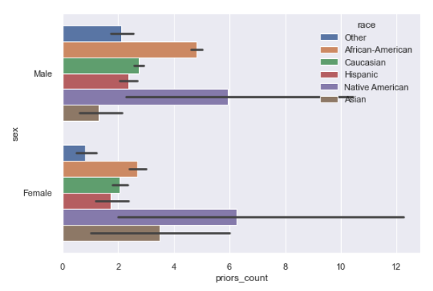
What's in the data?
The data contains a mix of most races with equal females to males.
Looking at the data based on the priors of each gender/race North Americans have the highest prior count.

Slide 4
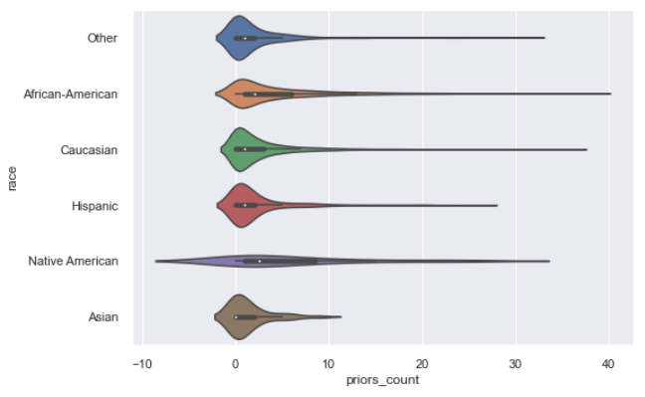
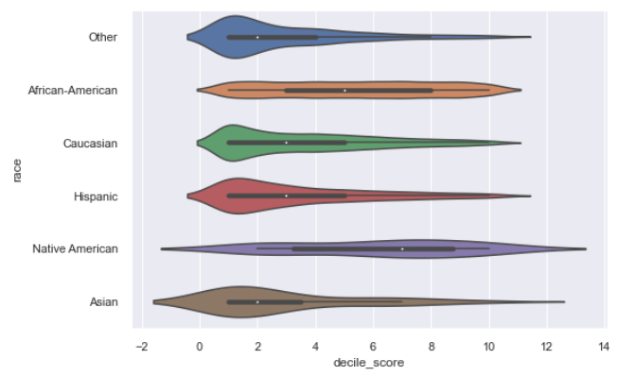
Continued EDA
If we look at the Decile score and priors for each race. Shows most of the data shows that the users have a low score for prior.

Slide 5


Working Through The Algorithm

Slide 6
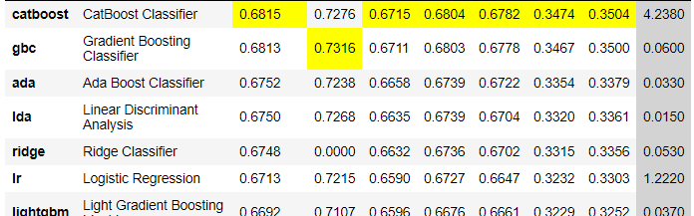
What the Models showed
After Running a series of different Models. The Model that came out with the best result was a Cat boost Classifier.

Slide 7
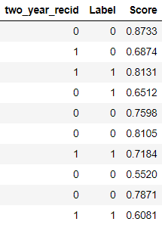
What the Model showed
After Fine tuning our base model we ran it against the data to see how accurate it was. The Label column is what our model came to a decision on along with the Score it was given. Compared against the two_year_recid Column there is a bit of difference for a few columns that do not match.

Slide 8
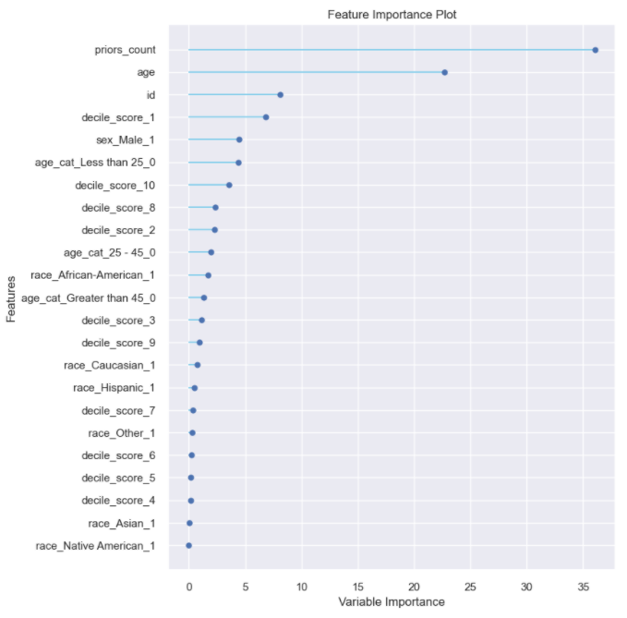
Generating Numbers
Our Model considers the priors, age, decile Score, and a few other minor ones.
While the model does consider the race it has a very low impact on the model to reduce the biasness possible with the machine learning

Slide 9


Results
With going through Data and Articles its very clear that there is some Biasness present. Although with the article by ProPublica, There is evidence of the article being bias with the examples provided. Each example shows two people but only goes to explain one person's side or if they are similar in any way.
The results also do not consider if the user is seeking help to turn there life around. Which can change the outcome substantially.

