Slide 1
Communication Theory
CIE 337
Marwan Ahmed 202101214
Amr Ashraf 202101355
Amr Ahmed 202100302

Slide 2
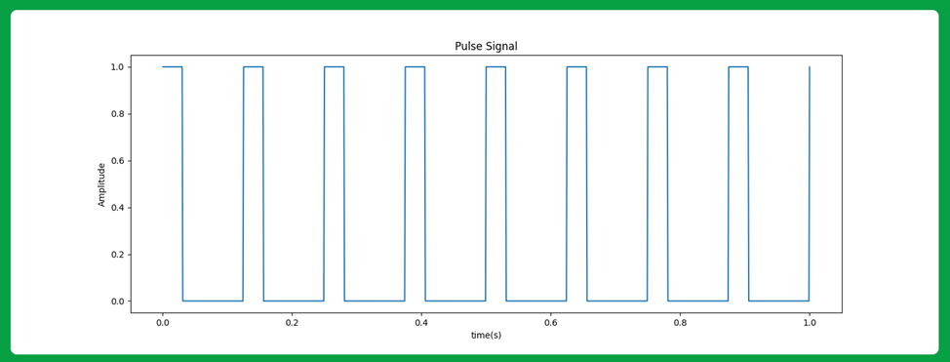
PART A: PAM MODULATION
To modulate the message signal, we first need to make the Train of pulses with the specified Ts (pulse period) and T (pulse on time)

Slide 3
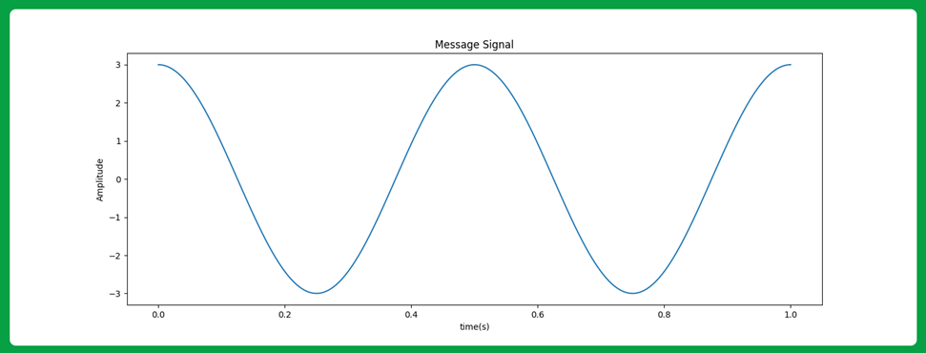
Then: we get our message signal

Slide 4
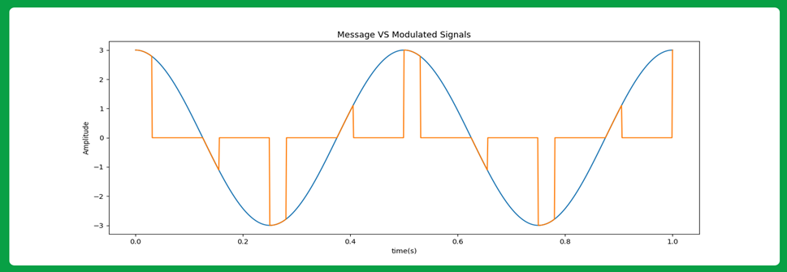
Then: we multiply the pulse signal with the message signal to obtain the modulated signal

Slide 5
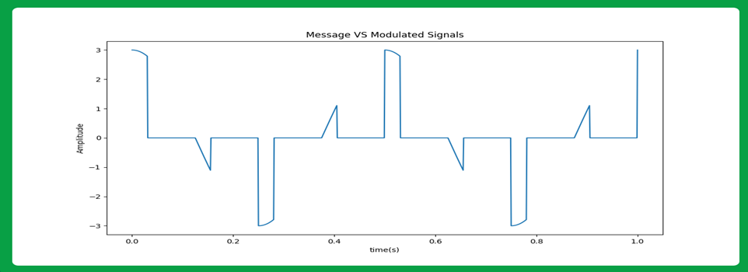

Slide 6
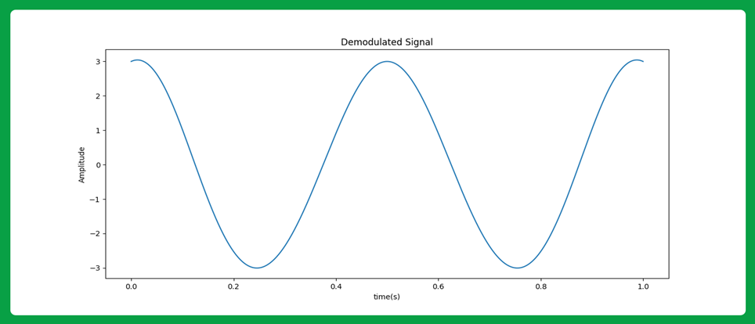
Demodulation
To demodulate the received signal, we pass it to a (lop pass filter) with cutoff frequency more than message bandwidth (B) and less than (Fs – B) and then apply a suitable gain

Slide 7
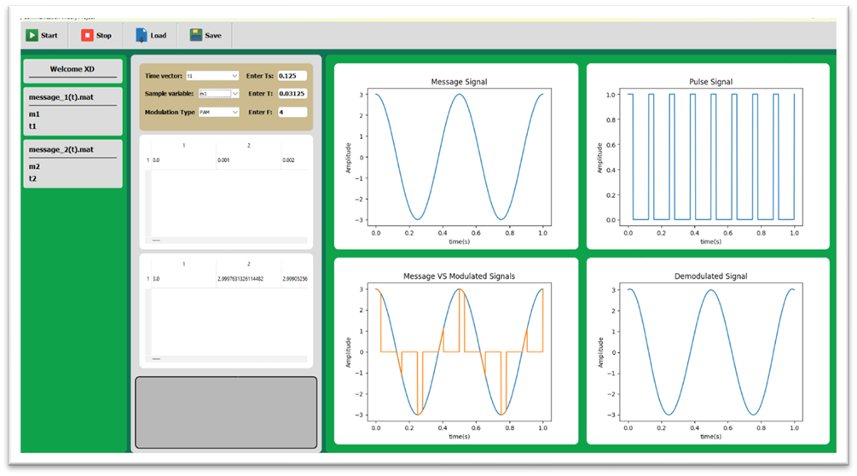
Test cases:
Message 1: with (Ts = 1/8) and (T = 0.25 * Ts) and (t = 0: 0.001: 1)

Slide 8
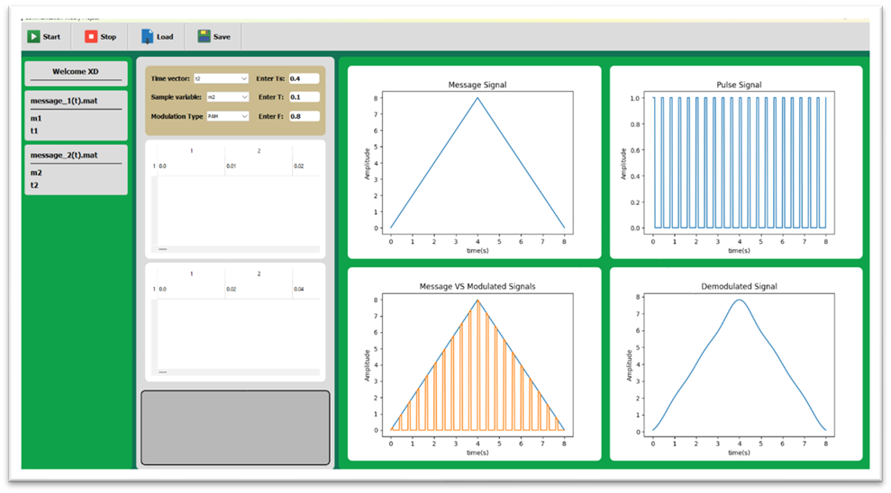
Test cases:
Message 2: with (Ts = 0.4) and (T = 0.1) and (t = 0: 0.01: 8)

Slide 9
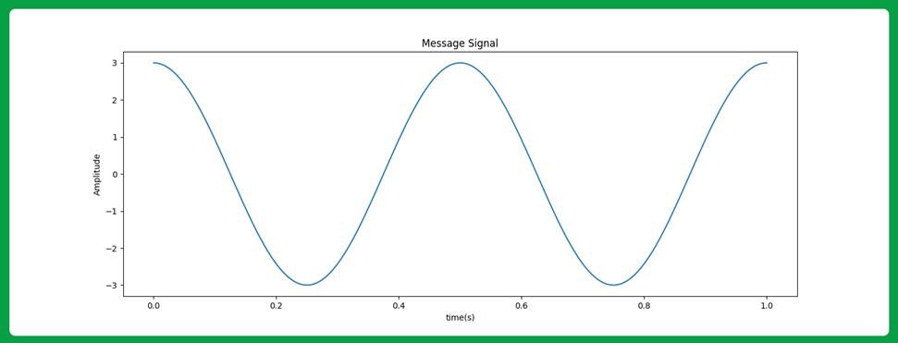
PART B: FLAT-TOP PAM MODULATION:
To modulate the message signal, we get our message signal

Slide 10
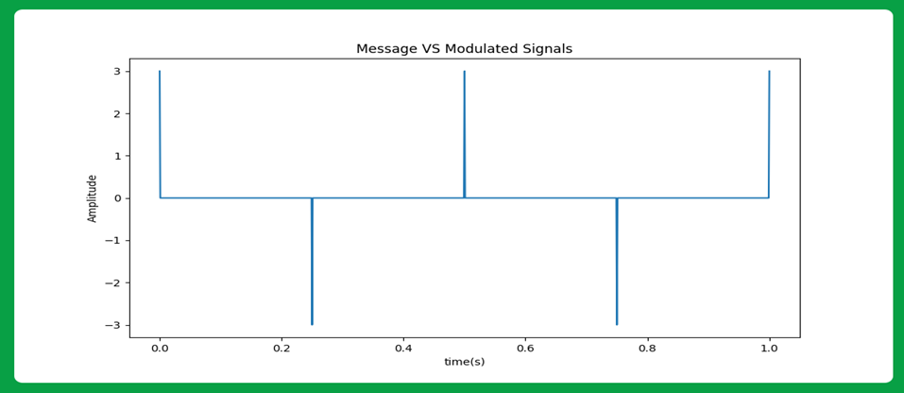
Then: we sample it

Slide 11
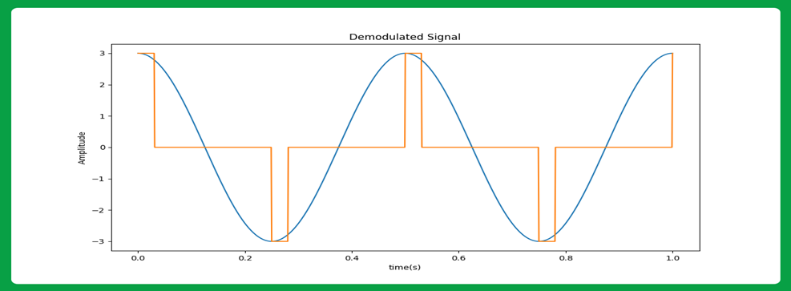
Then: we enter the sampled signal to a pulse generator which output is rectangle at each pulse

Slide 12
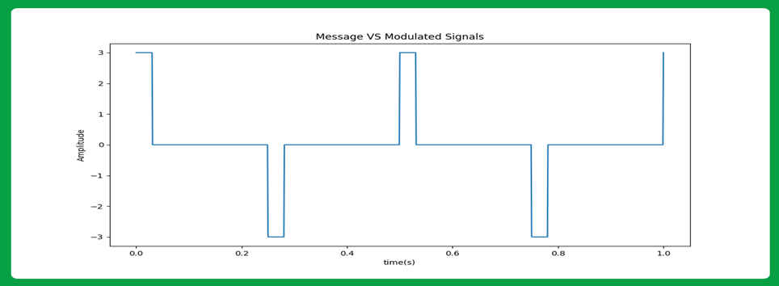

Slide 13
Demodulation
To demodulate the received signal, we pass it to a (lop pass filter) with cutoff frequency more than message bandwidth (B) and less than (Fs – B) and then apply a suitable gain

Slide 14

Test cases:
Message 1: with (Ts = 1/8) and (T = 0.25 * Ts) and (t = 0: 0.001: 1)

Slide 15

Test cases:
Message 2: with (Ts = 0.4) and (T = 0.4) and (t = 0: 0.01: 8)

Slide 16
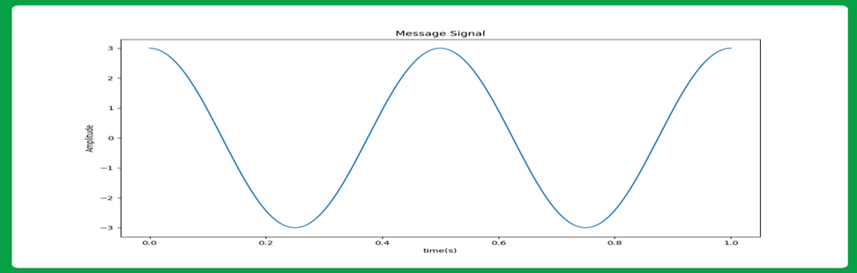
PART C: PWM MODULATION
We first get our message signal

Slide 17
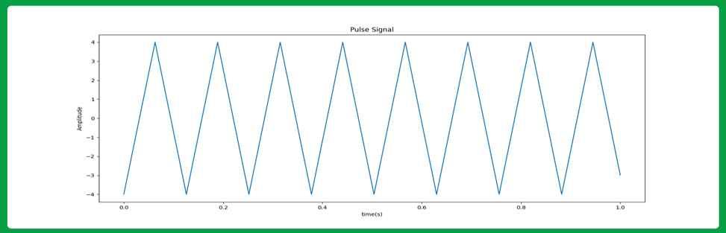
Then: we make a train of triangle pulses

Slide 18
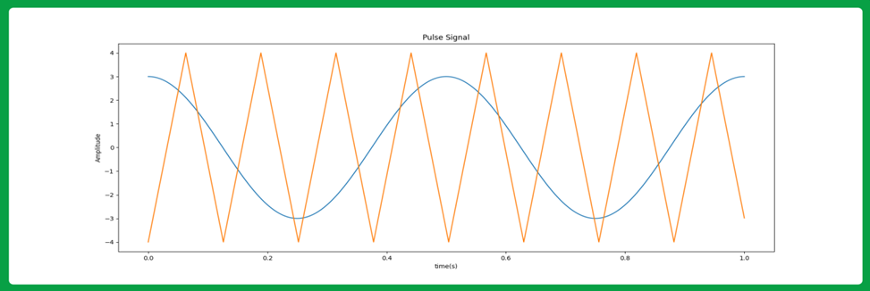
Then: we enter the two signals to a comparator which gives True only when the message signal amplitude is higher the pulse signal amplitude

Slide 19
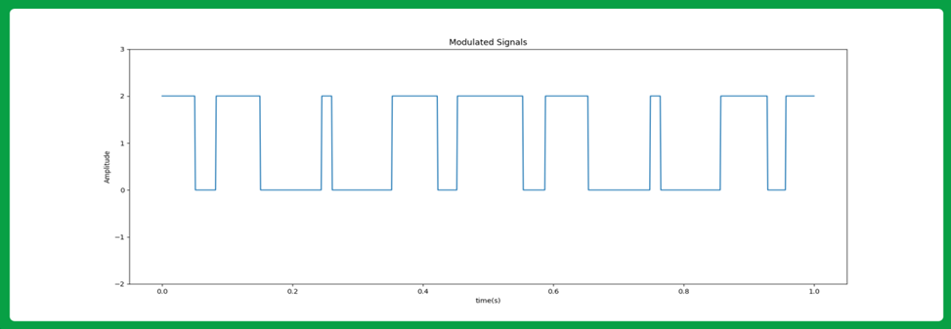
Which gives the modulated signal as the output

Slide 20
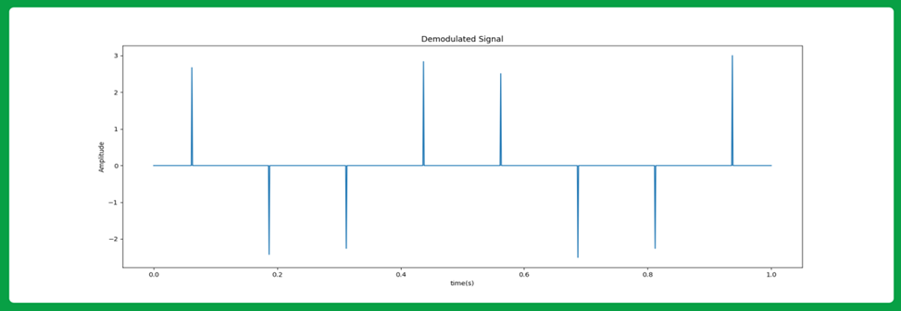
Demodulation:
To demodulate the received signal, we need to convert it to a PAM signal then we pass it to a (lop pass filter) with cutoff frequency more than message bandwidth (B) and less than (Fs – B) and then apply a suitable gain, we can do this by enter the signal to a integrate and sample device which give us the PAM version of our signal:

Slide 21
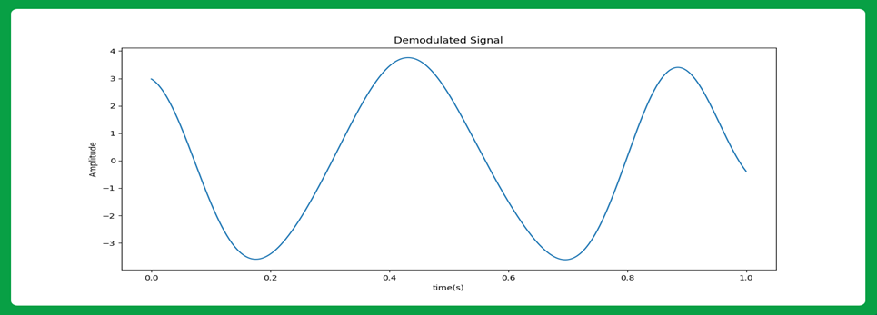
Then: we enter it to a low pass filter to generate the original signal

Slide 22

Test cases:
Message 1: with (Ts = 1/8) and (A = 2) and (t = 0: 0.001: 1)

Slide 23
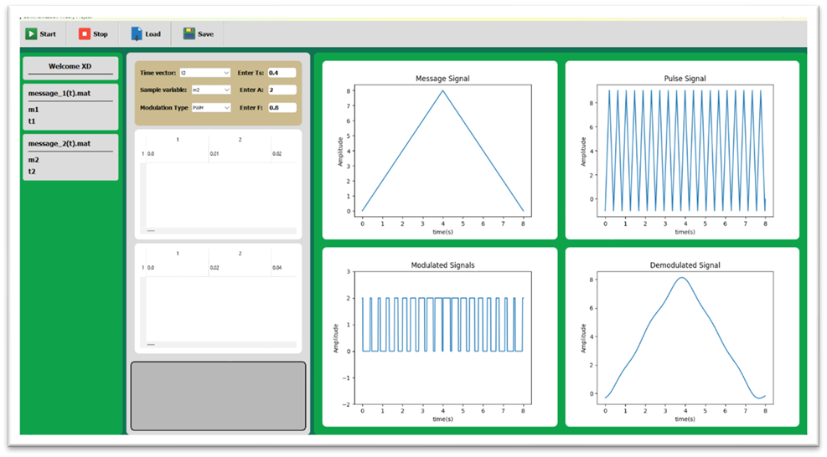
Test cases:
Message 2: with (Ts = 0.4) and (A = 2) and (t = 0: 0.01: 8)

Slide 24
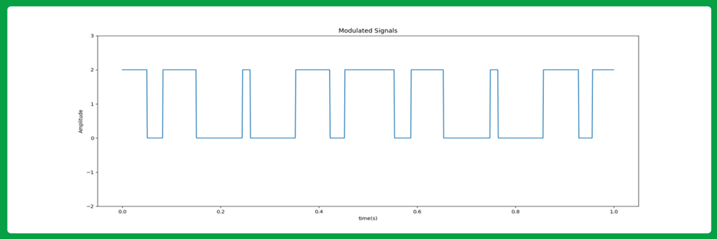
PART D: PPM MODULATION
We do the same steps as PWM but after that we enter the signal to a pulse generator which only generate fixed width pulses at the end of the widths of the PWM

Slide 25
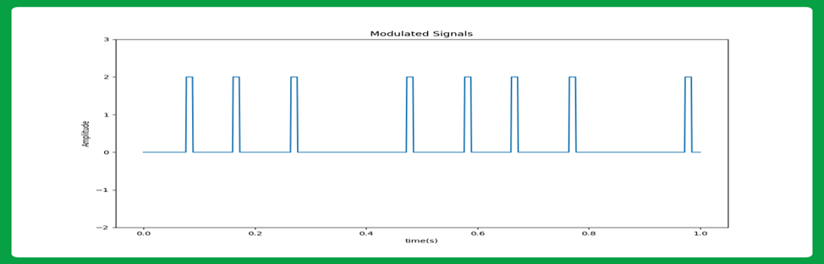

Slide 26
Demodulation:
We convert the signal back to the PWM signal using SR flip-flop (we enter Pulse generator signal to the R input, and enter a reference pulse signal to the S input), due to the set and reset signals applied to the flip-flop, we get a PWM signal at its output. The PWM signal can be demodulated using the PWM demodulator as explained above in the report.

Slide 27

Test cases:
Message 1: with (Ts = 1/8) and (T = 0.1*Ts) and (A = 2) and (t = 0: 0.001: 1)

Slide 28
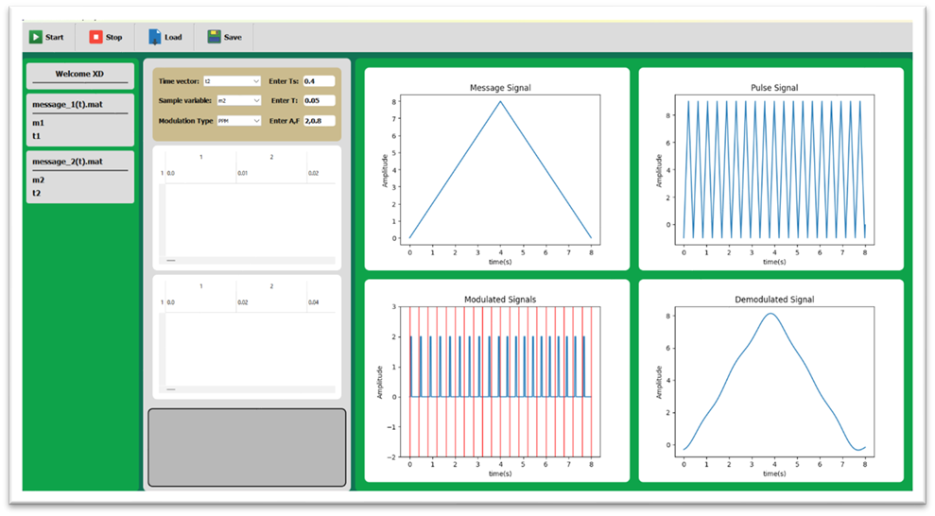
Test cases:
Message 2: with (Ts = 0.4) and (T = 0.05) and (A = 2) and (t = 0: 0.01: 8)

Slide 29
Thank you

