Slide 1
Software Requirements Specification for Warehouse Management System
<
Version 1.0 approved
Prepared by <Tendongfor Nick>
<CHITECHMA UNIVERSITY>
<13th November 2022>

Slide 2
Table of Contents
Introduction
1.1 Purpose
1.2 Project Scope
2.Warehouse Management System Features
3. System Features
3.1 Functional Requirements
3.2 Non-Functional Requirements
4.External Interface Requirements
4.1 User Interfaces
4.2 Hardware Interfaces
4.3 Software Interfaces
4.4 Communications Interfaces
5. Advantages/Disadvantages of a WMS
5.1 Advantages of a WMS
5.2 Disadvantages of a WMS
6. Analysis Model

Slide 3
1.0 INTRODUCTION 1.1 Purpose
The warehouse management system is one which comes to solve problems in the society. This software is required to perform the following tasks:

Slide 4
1.2 PROJECT SCOPE
This software is designed to ease how goods are stored, sold, check stock and how inventory is done.When goods arrive the shipping port, all identical goods are put an identical barcode understandable only by the company. When these goods arrive the company, the barcode reader is used to identify all identical goods.These goods will automatically be entered into the system, upon arrival with the help of the barcode, which scans through all goods when they arrive.When the goods have been kept in the magazine, a minimum and maximum price is setup for all goods which can only be modified by the IT manager. Upon selling, the barcode is still used to search for the goods name. When this is done, the price of the good also appears and the quantity (no of cartons) is recorded manually or the barcode is passed through the carton multiple times until the desired number is attained. If the seller accidentally changes the price of the good until it is no longer within the range of the acceptable price, the good will not be able to be sold.Any good sold in this system is stored alongside its date, hour and customer name. This site is accessible exclusively only to authorized personnel. Incase 2 goods are mistaken for each other, retrieval is easy just with 1 click you can get all past sales which helps you predict future market sales.With this system, goods can be easily classified either as slow, medium or fast selling goods and investors will know where to invest for better profit.This system also helps reduce labour cost as an approximate of tasks are automated.

Slide 5
2.0 Warehouse Management System Features
Inventory management
Cartonization
Warehouse automation
Order and billing Management
Facilitate the sales of goods
Reduce the labour load on workers….

Slide 6
3.0 SYSTEM FEATURES 3.1 FUNCTIONAL REQUIREMENTS
INVENTORY MANAGEMENT
Inventory management is one of the most significant warehouse management system features. Some major components of this system are inventory visibility, forecasting, purchasing history, tracking, analysis and accounting. This WMS improvise customer experience and cash flow, optimizes fulfillment and prevents shrinkage.
CARTONIZATION
This feature evaluates items based on the number and size of cartons. The WMS has algorithms which analyze the best way to pack cartons and minimize labour costs. These alogorithms select items according to weight, height, width and length to pcak them most efficiently.

Slide 7
WAREHOUSE AUTOMATION
One key factor in industry growth is warehouse automation. It offers a wide range of benefits including enhanced productivity, minimized labour risk, reduced human errors, increased efficiency and better accuracy.
SHIPPING
These enables the WMS to end bills of lading ahead of the shipment, generate packaging lists and invoices for the shipment and send advance shipment notifications to recipients….

Slide 8
3.2 Non-Functional Requirements
Speed: This management system should be able to process with a speed of atleast 2.3GHz with a negligible latency time.
Portability: This system is expected to operate perfectly without any bugs on any appliance linked with it.
Storage: for this system to be installed, the device must have atleast 8GB availaible free space at hand.
Reliability: This system should be able to meet the standards expected, yielding correct output within a desired time.

Slide 9
5.0 ADVANTAGES/DISADVANTAGES 5.1 ADVANTAGES OF A WMS
Gathering information about all the sold goods
The system keeps all up-to-date information regarding the sales of goods which makes managing easier. This as a result saves time and make work more organized.
Complete Information on stock levels
Access to up-to-date information also makes it possible to control stock levels. With the help of the WMS, new items are automatically ordered when the stock level is below normal.
Inventory Visibility
Using a WMS will also provide visibility of accurate, real-time inventory levels. These enables a company to more securely estimate supply and avoid backorders which leads to more satisfied customers.

Slide 10
Effective Labour
Considering workers skill levels, their proximity in the warehouse, their equipment and available warehouse tasks, a WMS can better assign the right task to the right to the right person at the right time. Using labour forecasting, the system can assign jobs on a day-to-day basis and efficiently design schedules.
Optimized Supply Chain
A WMS optimizes a warehouse’s internal operation which can then extend to the broader supply chain. Within a warehouse, a WMS streamlines the entire warehouse process from inbound receipts to outbound deliveries improving operational efficiencies and reducing costs.

Slide 11
5.2 DISADVANTAGES OF A WMS
Many processes are integrated into a system an error in one place entails errors in others: In this way, a human error can cause the whle system to be inaccurate. To prevent such situations, there are certain operations that the system will not allow anyone perform (e.g issuing more goods than what is available)
More complex to resolve problems caused by incorrect processing.
It entails a great deal of money to build and maintain the system…
It takes time to build a software as intended

Slide 12
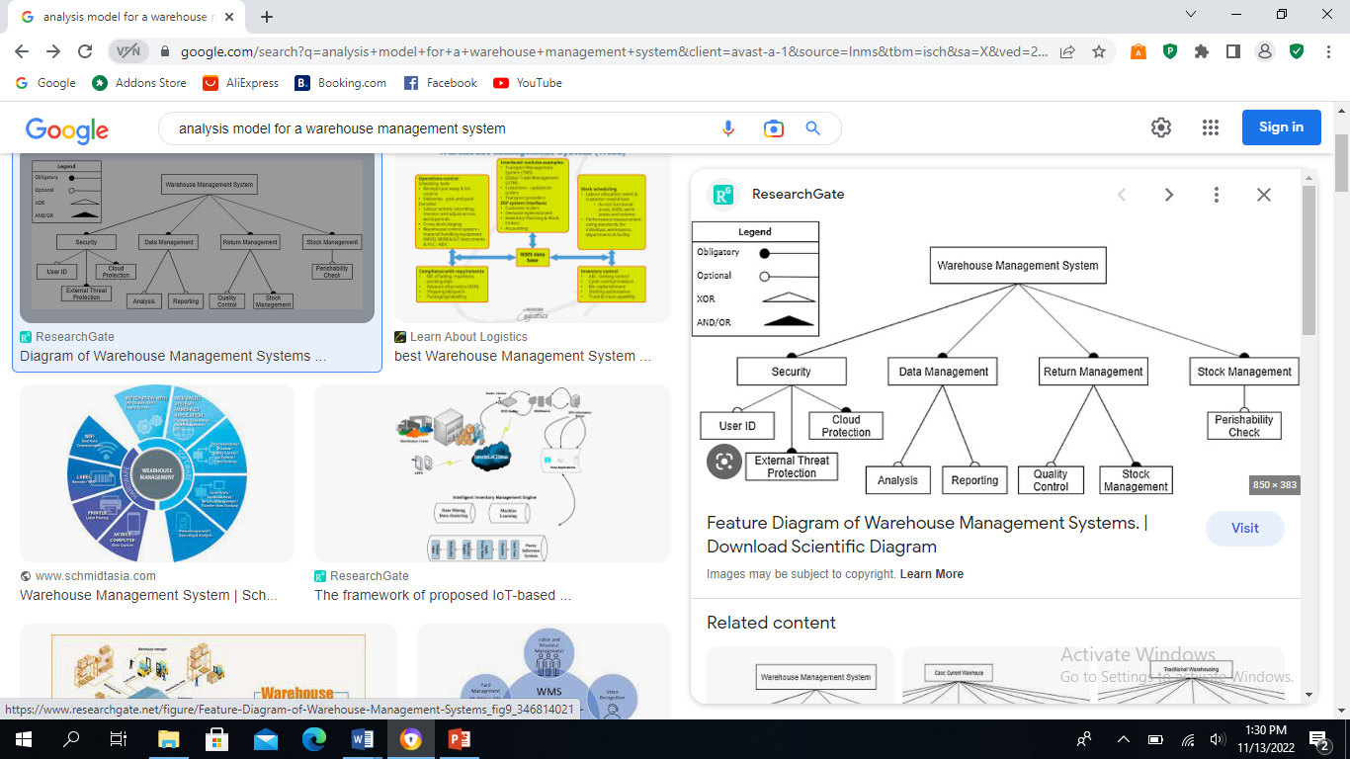
Analysis Model

Slide 13
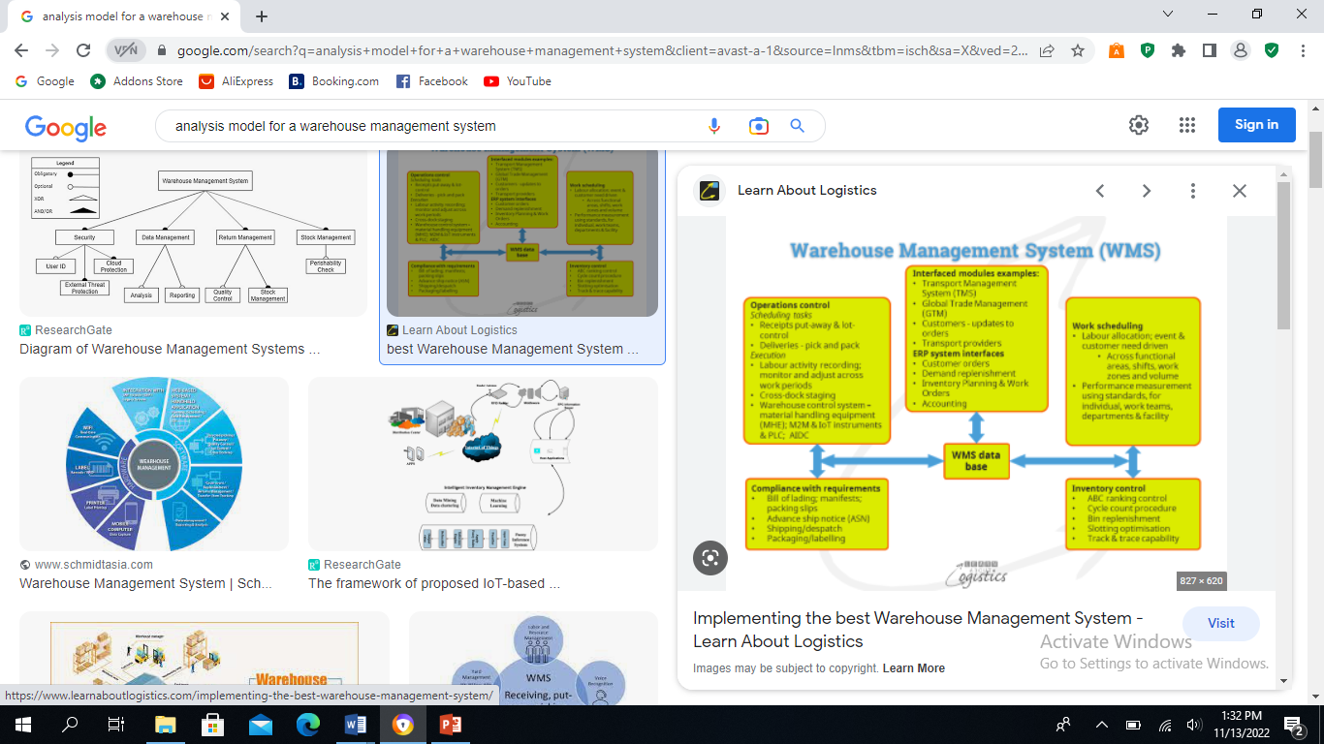
Some ware house Management system being analysed

Slide 14
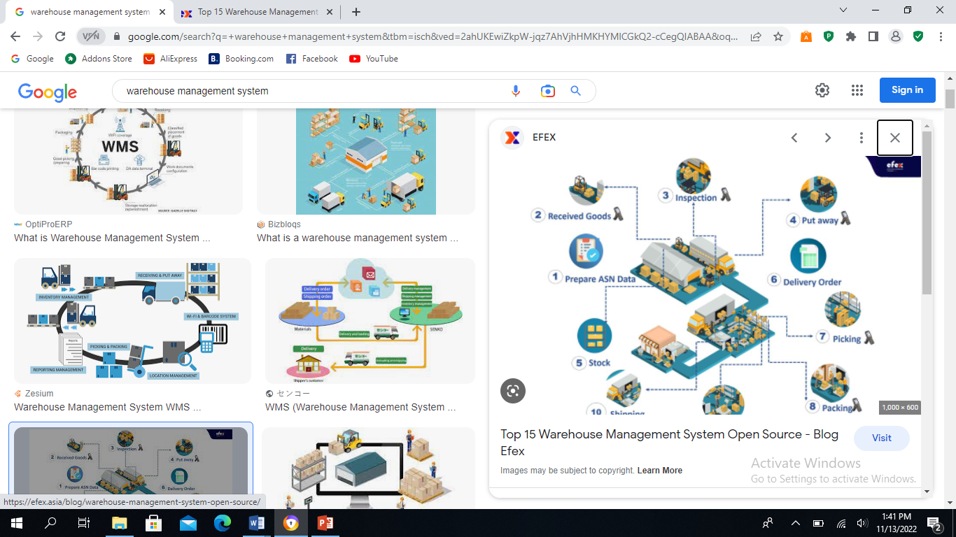
Procedural- Steps

Slide 15
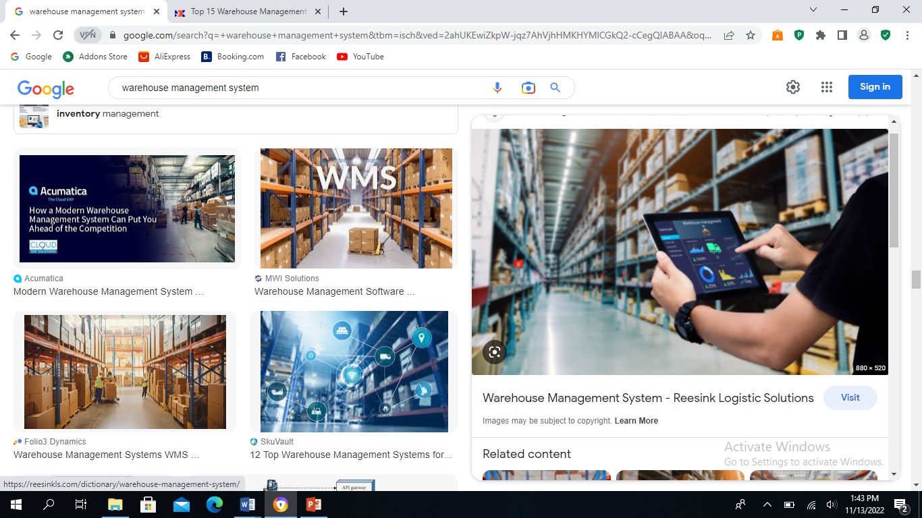
Sample of Final Product

