Slide 1

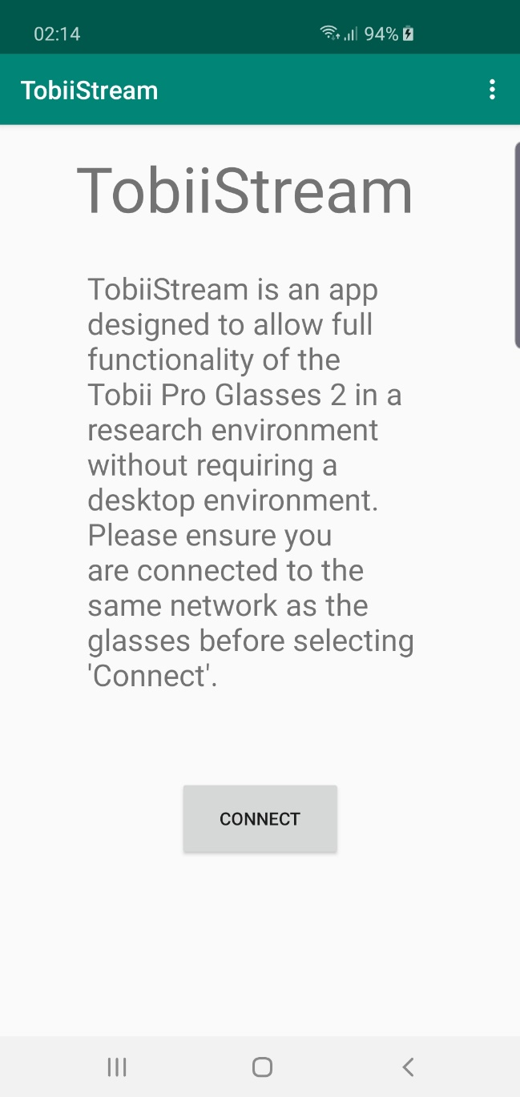
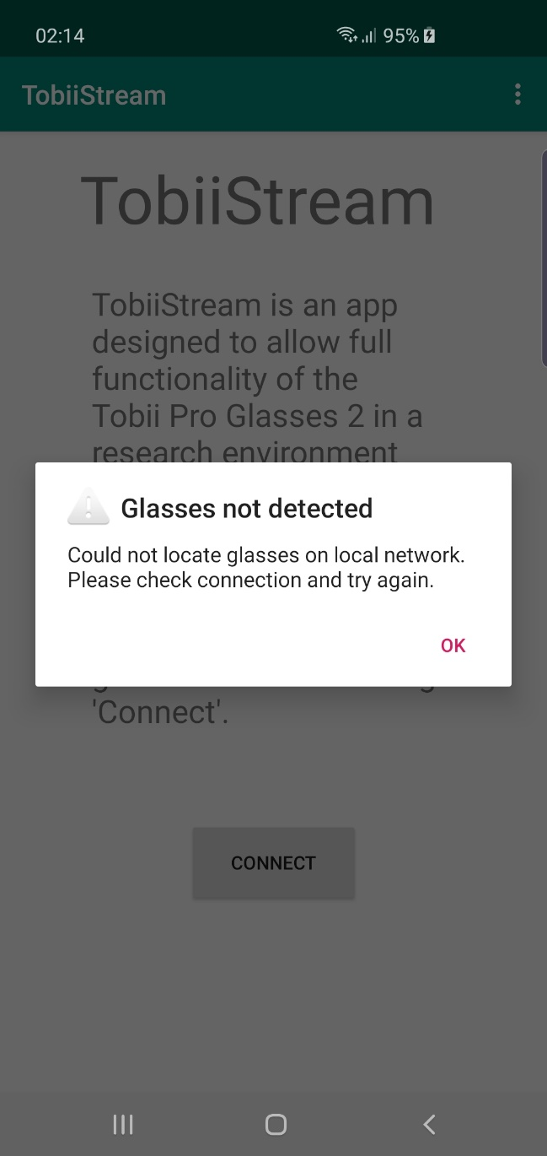
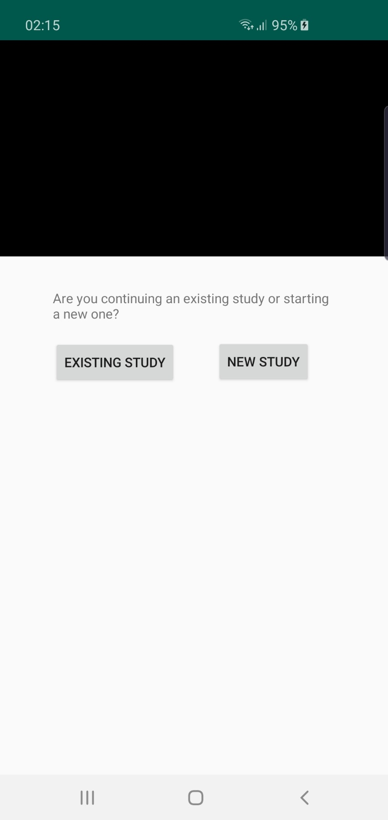
A System to Link Tobii Pro Glasses to a Standard Desktop Environment
Craig Chicken
Supervised by Dr. Michael Crabb
Infra-red eye tracking devices have experienced a rise in popularity in recent years.
Originally designed primarily as alternative computer input for AAC users, it’s now relatively common to see them being used in more mundane scenarios, even in gaming.
However, these tend to take the form of desk-mounted IR emitters, which place restrictions on the user’s movement, making usage awkward for some AAC users.
Head-mounted optical trackers like the Tobii Pro Glasses 2 bypass this issue entirely as the trackers are always oriented to the user’s eyes.
Despite this benefit, they have yet to be developed as an input device the way desk-mounted trackers have been.
With the use of a mobile app to allow for ad-hoc testing, this project’s aim is to examine the feasibility of linking the Tobii Pro Glasses 2 to a standard desktop environment.
Do not allow any text, image or shadow to go below this level
Do not allow any text, image or shadow to go below this level

