Slide 1

Finding Model Parameters from Noisy Data
Tene L. Carter
Department of Mathematics
Department of Computer Science
University of Arizona
Supported by

Slide 2
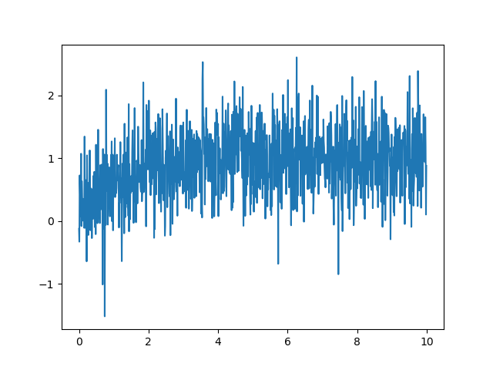
Noisy data and hidden signals
When you ask someone for data….
Time

Slide 3

Noisy data and hidden signals
Goals
take noisy data from some experiment
convert it into a more readable model
use model to predict future happenings
Time

Slide 4
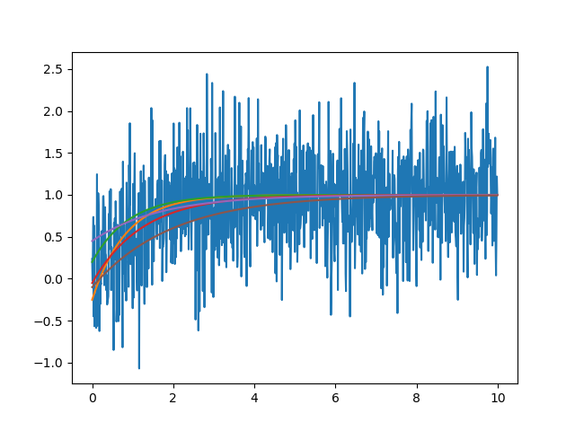
How to find unknown parameters
Time
Time
Make a model
Recursion in time:
To run the model, you need x₀ and a (parameters)
Problem: we don’t know what x₀ or a should be

Slide 5

Data mismatch
Data mismatch
Take parameters x₀ and a
Use the model to produce a time series
Compute the difference between model output m and data y
Time

Slide 6
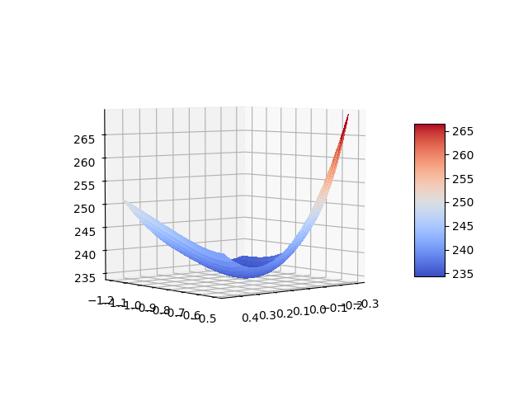
How to find optimal parameters?
Grid search
Pick a large number of possible parameters x₀ and a
Compute data mismatch for all possible x₀ and a combinations
Find x₀ and a that lead to smallest mismatch (optimal parameters)
Optimal parameters

Slide 7
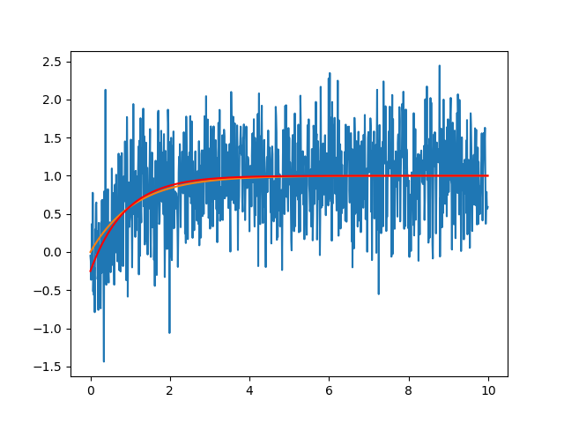
Results: simulation with optimal parameters
Time

Slide 8
Summary
What I did
Create a model
data mismatch
minimizing data mismatch makes for good predictions
Optimal parameters
Time

Slide 9
Code
def model(a,yo,dt,T):
t = np.arange(0,T,dt)
N = t.size;
y = np.zeros(N);
y[0] = yo;
for kk in range(1 , N):
y[kk] = (1+a*dt)*y[kk-1]-dt*a;
return y,t
def F(yn,a,dt,T,yo):
yTest = model(a,yo,dt,T)[0].tolist();
out = np.linalg.norm(np.subtract(yn,yTest))**2;
return out;

Slide 10
Code
a = -.9;
T = 10;
dt = 0.01;
yo = 0;
[y,t] = model(a,yo,dt,T);
y= y.tolist();
t= t.tolist();
yn = [];
for k in range(0,len(y)):
yn.append(y[k] + 0.5*np.random.normal());
plt.plot(t,yn);
plt.plot(t,y);
aTest = np.arange(-1.2,-.5,.01).tolist();
yoTest =np.arange(-.3,.5, .05)
Fs = np.zeros((len(yoTest),len(aTest)));
for kk in range( 0,len(aTest)):
for jj in range(0 , len(yoTest)):
Fs[jj,kk] = F(yn,aTest[kk],dt,T,yoTest[jj]);

Slide 11
Fin.
Thank you.

