Slide 1
Hands-on Practice
Scenario:
Multiple services that would like to access data with RESTful API
You’ll try to implement this RESTful server
website
fullstack
Service A
Main Service
Service B
RESTful: get/post/put/delete …

Slide 2
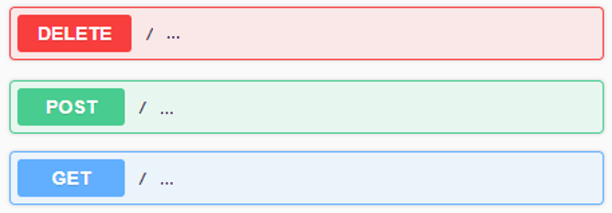
Hands-on Requirement
Create a RESTful server with following RESTful APIs:
A POST API to create a user with “name” and “age” fields.
A DELETE API to delete a specific user by “name”.
A GET API to get a list of users who have been added.
A POST API to add multiple users from CSV file.
The CSV file should be uploaded in API request.
Refer to the attached CSV file: backend_users.csv
A GET API to calculate average age of each group of users.
Please use pandas package to calculate it.
Group by the first character of the usernames.
Example
Note
Please live demonstrate your API specifications by using Swagger.
You can use any libraries.
An explanation of your code structure is necessary.

Slide 3
Bonus requirement
Use unittest to test your create user API
TC1: User name is empty when request to create user API
TC2: User age is 999 when request to create user API
Use docker to execute demo

Slide 4
Demo
Try RESTful APIs with swagger
or try RESTful APIs with postman

Slide 5
把簡報題目丟給GPT，修改為適合問Copilot的格式(條列)
Copilot生成程式碼，根據CSV格式和題目需求進行程式碼修改
測試功能、撰寫單元測試(名稱為空、年齡不合理)
修改名稱為選填，但如果留空會跳出提示，不會進到user列表
年齡不合理直接報錯(Age out of range) 合理範圍為0至125的整數
將整個流程寫入docker(安裝docker desktop到本機)
安裝roo code套件，模型選擇Google Gemini

Slide 6
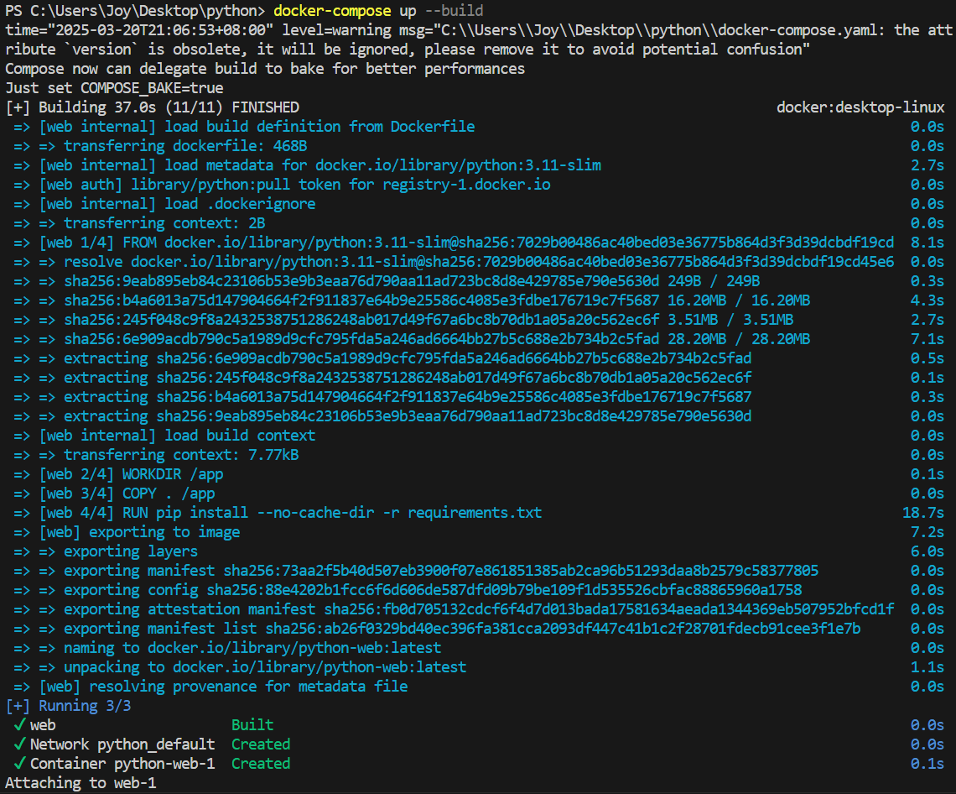
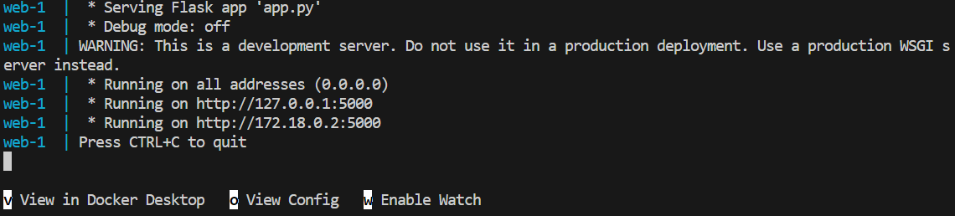

Slide 7
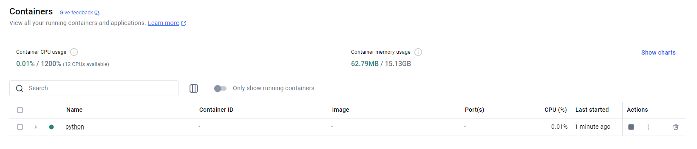
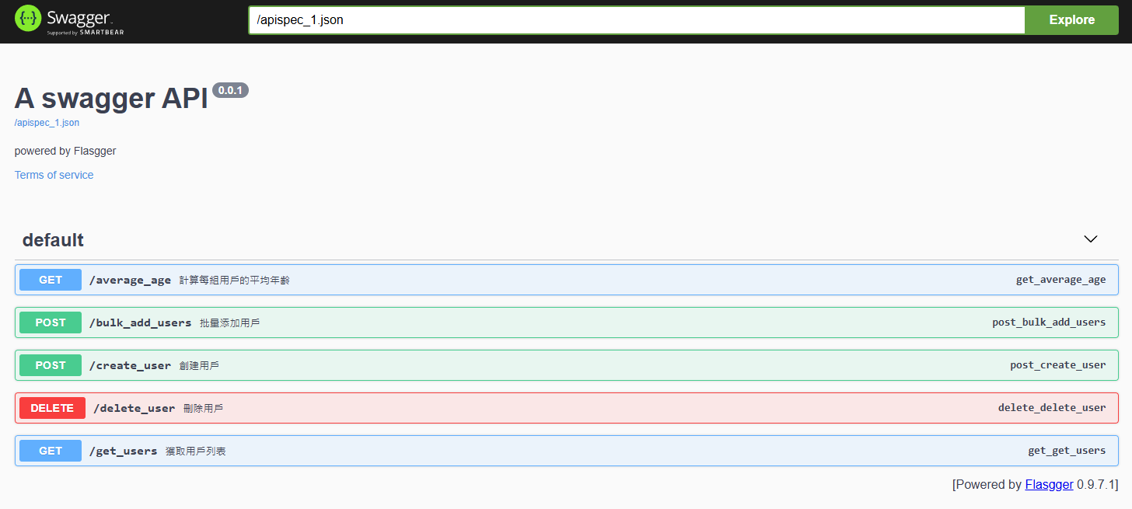

Slide 8
新增錯誤處理(try/except)
逐步分段查看
註解詳細
互動性強，可以清楚看到修改了哪邊
每次詢問的結果差異蠻大的(第一次直接修改整份程式碼，第二次又把他拆解)
註解詳細、適合初學者、教育性質高

Slide 9
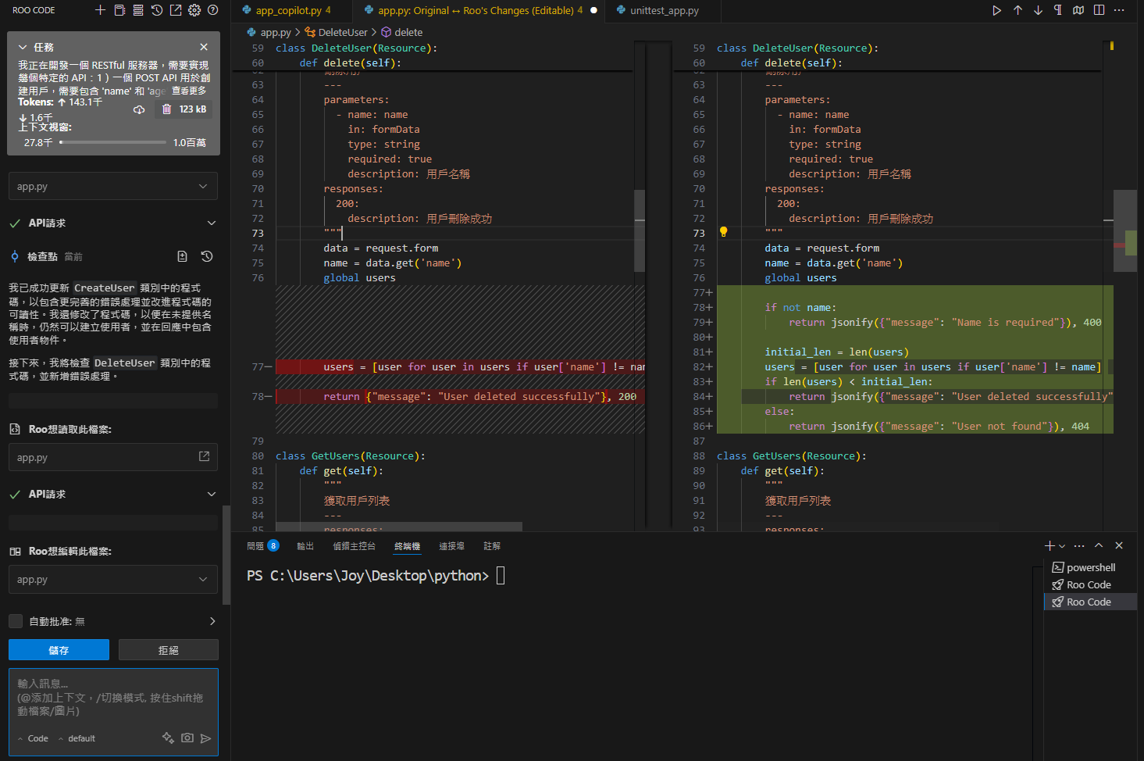

Slide 10
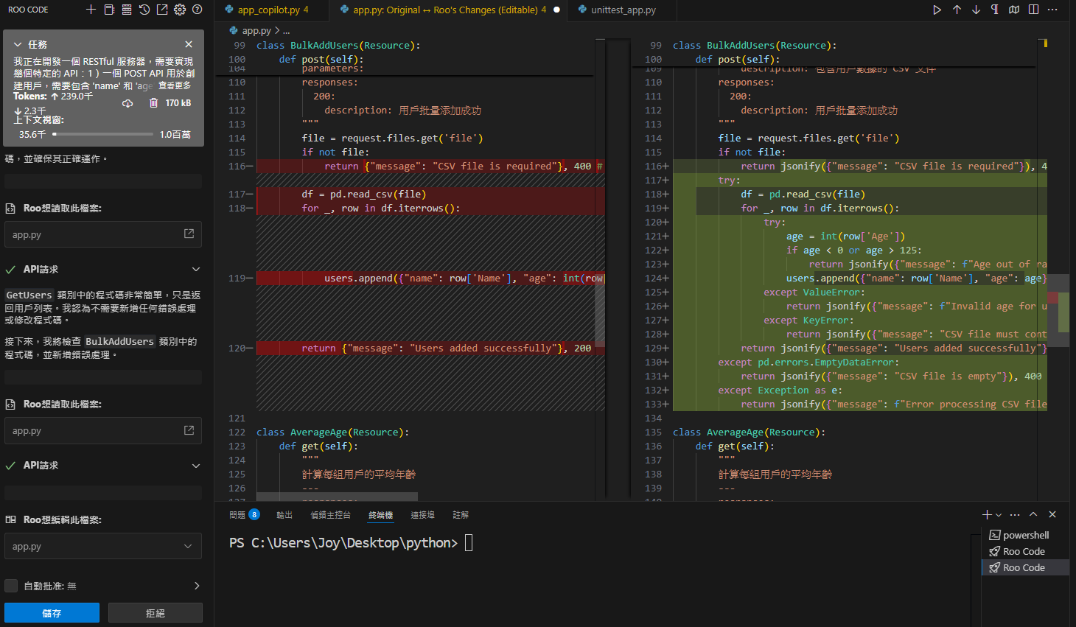

Slide 11
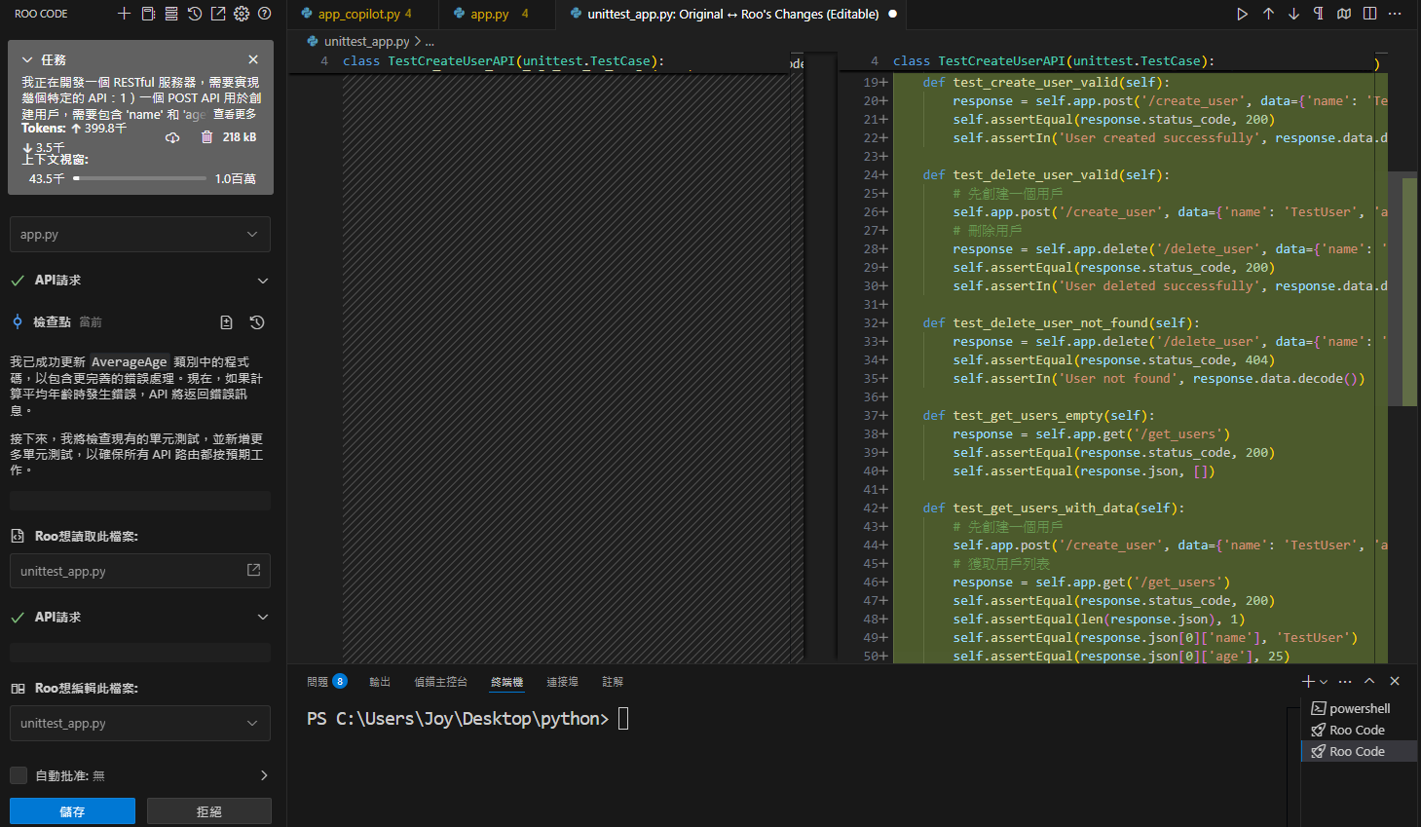

Slide 12
