Slide 1


Master Thesis Defense
Master Thesis Defense
Interpreting Text Classification with Human-Understandable Counterfactual Instances
Name: Li, Teng
Matrikelnummer: 10010265
First Examiner: Prof.Dr. Avishek Anand
Second Examiner: Prof. Dr. rer. nat. Marius Lindauer
Advisor: Zhang, Zijian

Slide 2
Content
Motivation
Background Knowledge
Counterfactual Instances generating
Experiments Setup and Evaluation
Conclusion and Future Works

Slide 3
Content
Motivation
Background Knowledge
Counterfactual Instances generating
Experiments Setup and Evaluation
Conclusion and Future Works

Slide 4
Motivation
ML models are widely used
They are Black box models
Interpreting models with counterfactual instances
Counterfactual interpretation is not human-understandable

Slide 5
Content
Motivation
Background Knowledge
Token-level HotFlip
Experiments Setup and Evaluation
Conclusion and Future Works

Slide 6
Background Knowledge
Word Representation
Counterfactual Interpretation
Kim’s CNN
HotFlip
Part-of-speech Tagging

Slide 7
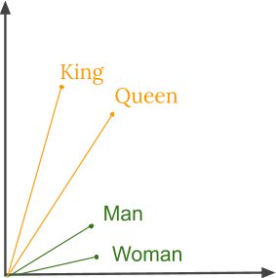
Background Knowledge
Word Representation
Represent human words with computer understandable data structures.
One-Hot Representation
Distributed Representation

Slide 8
Background Knowledge
Counterfactual Interpretation
Counterfactual: what has not happened or is not the case.
Counterfactual Interpretation: Interpreting models using the contrast between the original data instance and its counterfactuals.

Slide 9

Background Knowledge
Counterfactual Interpretation
e.g. Alice seeks a loan, but she is denied by a machine learning classifier:
Counterfactual Instance:
Income | Age | Education | ... | Get Loan?
2000 | 28 | Bachler | ... | No
Income | Age | Education | ... | Get Loan?
3000 | 28 | Bachler | ... | Yes

Slide 10
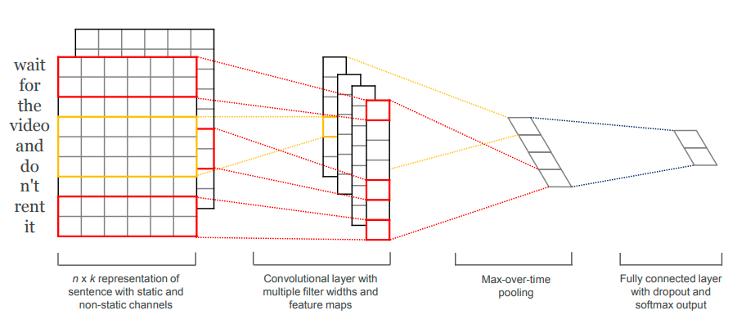
Background Knowledge
Kim’s CNN

Slide 11
Background Knowledge
HotFlip(character-level)
HotFlip: White-Box Adversarial Examples for Text Classification
Main idea: We need to find a character and its position that increases the loss maximal.

Slide 12

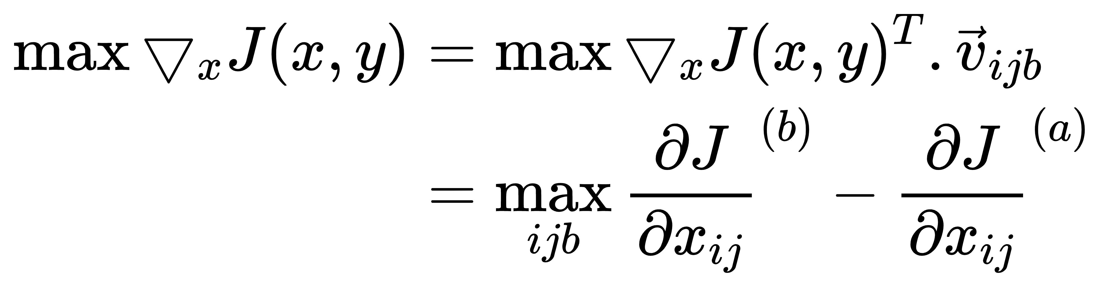
Background Knowledge
HotFlip(character-level)
A Text X: ,
Flip j-th character of the i-th word (a→b):
We want to find the vector with the biggest increase in loss:

Slide 13
Background Knowledge
POS-Tagging
Categorizing words with a particular part of speech, depending on the definition of the word and its context.
• Nouns (NN): Nouns refer to entities in the real world.
• Verbs (VB): Verbs are used to describe actions, states, activities.
• Adjectives (JJ): Adjectives usually used to describe properties of nouns.

Slide 14
Content
Motivation
Background Knowledge
Counterfactual Instances generating
Experiments Setup and Evaluation
Conclusion and Future Works

Slide 15
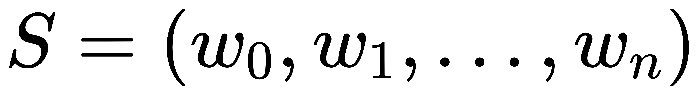
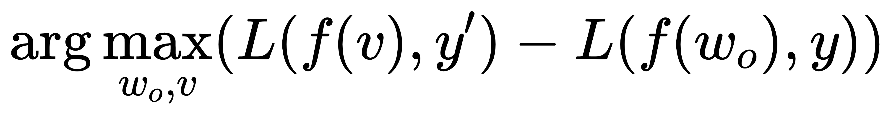

Counterfactual Instances generating
HotFlip(Token-level)
Given a Sentence , Vocabulary V, we need to find a word w_{o} in Sentence S and a word v in Vocabulary V, and replace w_{o} by v so that:
And this value can be approximated using the gradient:

Slide 16
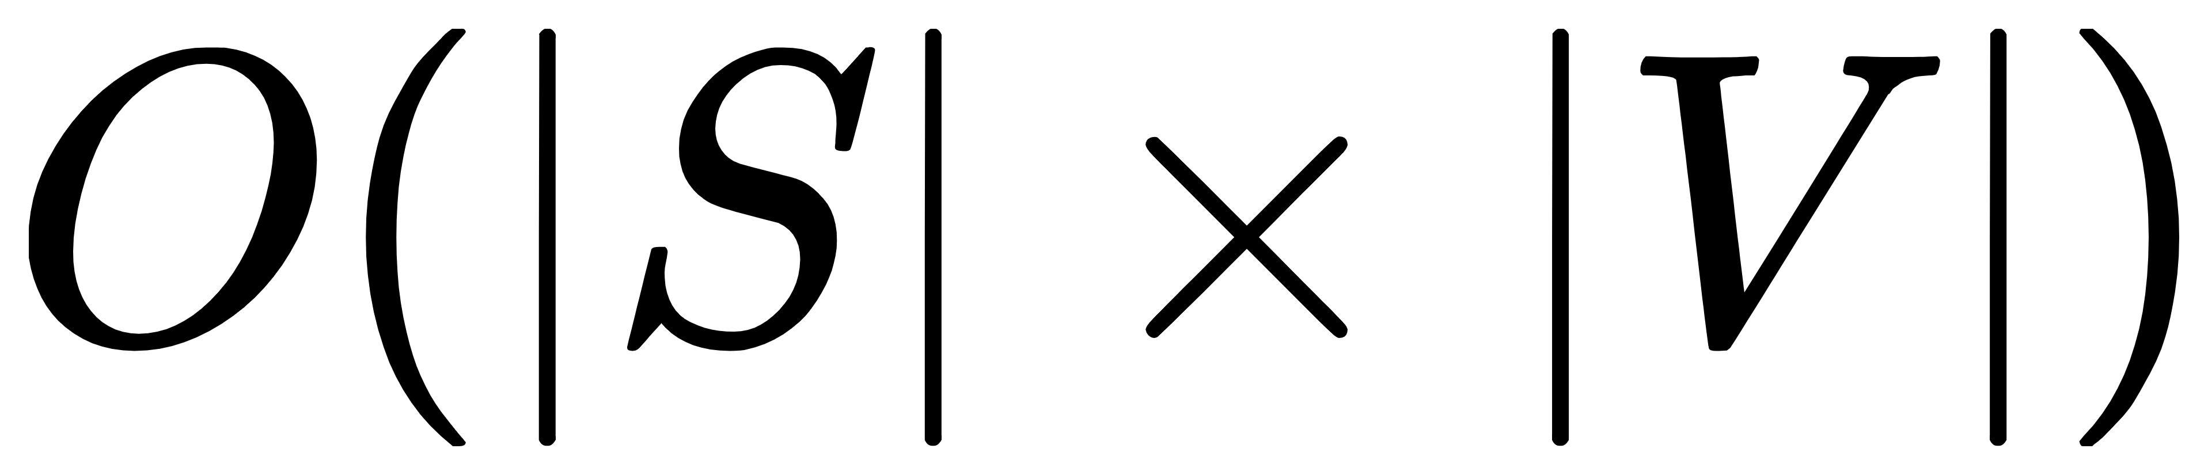
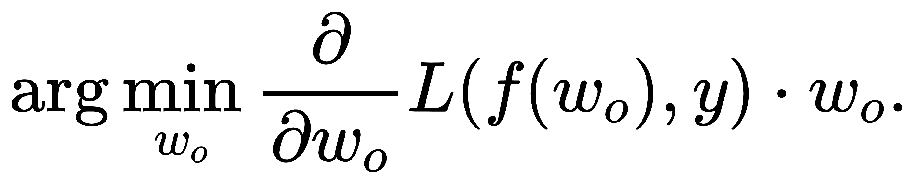
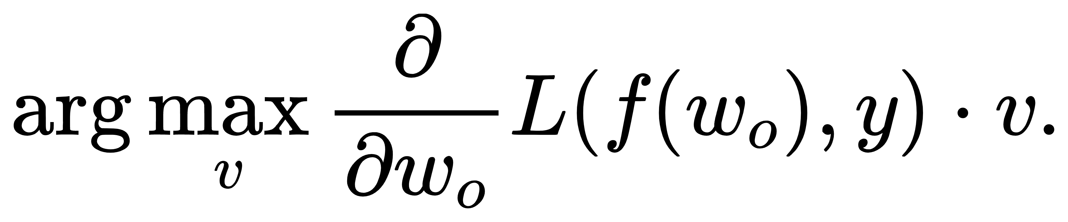
Counterfactual Instances generating
HotFlip(Token-level)
We can search w_{o} and v using beam search in 2 steps:
Firstly, we need to find the top k w_{o} that has minimal value:
Secondly, for each word w_{o} in our beam, we search the best word v:

Slide 17
Counterfactual Instances generating
HotFlip(Token-level)
Human-Understandable Counterfactual Instances:
2 Constraint:
POS-Tag Constraint (w_{o} and v have same POS-Tag)
Cos-similarity Constraint (cos-simmilarity(w_{o} ,v) > threshold) (threshold=0.3)

Slide 18
Content
Motivation
Background Knowledge
Counterfactual Instances generating
Experiments Setup and Evaluation
Conclusion and Future Works

Slide 19
Experiments Setup & Evaluation
Models:
Kim’s CNN (Acc: 87.5%)
Bidirectional LSTM (Acc: 97.5%)
Dataset:
Movies(ERASER)
Word Embedding:
Word2Vec (fine-tuned)

Slide 20
Experiments Setup & Evaluation
Vanilla HotFlip (no Constraint)
• Document 1 sentence: but the other two – prom night and terror train – were the uninspired(learn) knockoffs that came directly after the success of halloween.
• Document 2 sentence: this film reminds us that original approach can’t prevent filmmakers from wasting(writer) too many opportunities.

Slide 21
Experiments Setup & Evaluation
HotFlip (with POS-Tag Constraint)
• Document 1 sentence: but the other two – prom night and terror train – were the uninspired(learn) knockoffs that came directly after the success of halloween.
• Document 2 sentence: this film reminds us that original approach can’t prevent filmmakers from wasting(learning) too many opportunities.

Slide 22
Experiments Setup & Evaluation
HotFlip (with Cos-similarity Constraint)
• Document 1 sentence: but the other two – prom night and terror train – were the uninspired(mostly) knockoffs that came directly after the success of halloween.
• Document 2 sentence: this film reminds us that original approach can’t prevent filmmakers from wasting(giving) too many opportunities.

Slide 23
Experiments Setup & Evaluation
HotFlip (with both Constraint)
• Document 1 sentence: but the other two – prom night and terror train – were the uninspired knockoffs(drugs) that came directly after the success of halloween.
• Document 2 sentence: this film reminds us that original approach can’t prevent filmmakers from wasting(giving) too many opportunities.

Slide 24
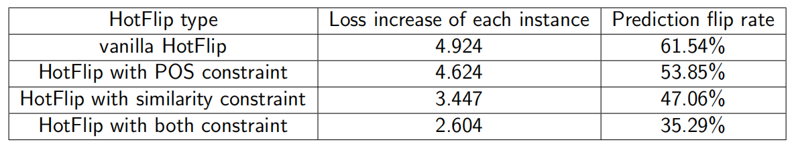
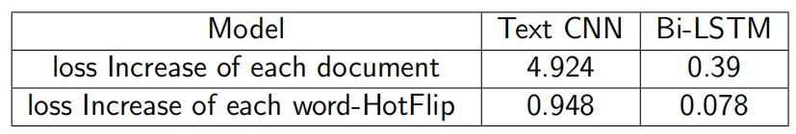
Experiments Setup & Evaluation
Summary
HotFlip result on the Text CNN model
HotFlip result on Text CNN and Bi-LSTM

Slide 25
Content
Motivation
Background Knowledge
Counterfactual Instances generating
Experiments Setup and Evaluation
Conclusion and Future Works

Slide 26
Conclusion & Future Works
Pros & Cons:
Pros:
1. Don’t need to change the structure of the model or retrain the model. Easy and humen-understandble.
2. We can get counterfactual instances, which can be used to imporve our models
Cons:
1. Not stable when used on gradient vanishing models.
2. Some counterfactual instances are still weird.

Slide 27
Conclusion & Future Works
Future Works:
Implement in more different classifers.
Improve the accuracy of POS-tagging method.
Improve counterfactual instances with more constraint.

Slide 28
Thank you for your attention
Questions and comments are highly appreciated
Li, Teng
Hannover
17. 03. 2018

