Slide 1
FIDVR in Co-simulation Update
Teng WANG

Slide 2
Dynamic Transmission-Distribution Co-simulation
Updates:
Set up the dynamic response for the IEEE118-IEEE8500(10) T&D co-simulation
Setup the FIDVR event in the IEEE14-IEEE13 T&D co-simulation framework

Slide 3
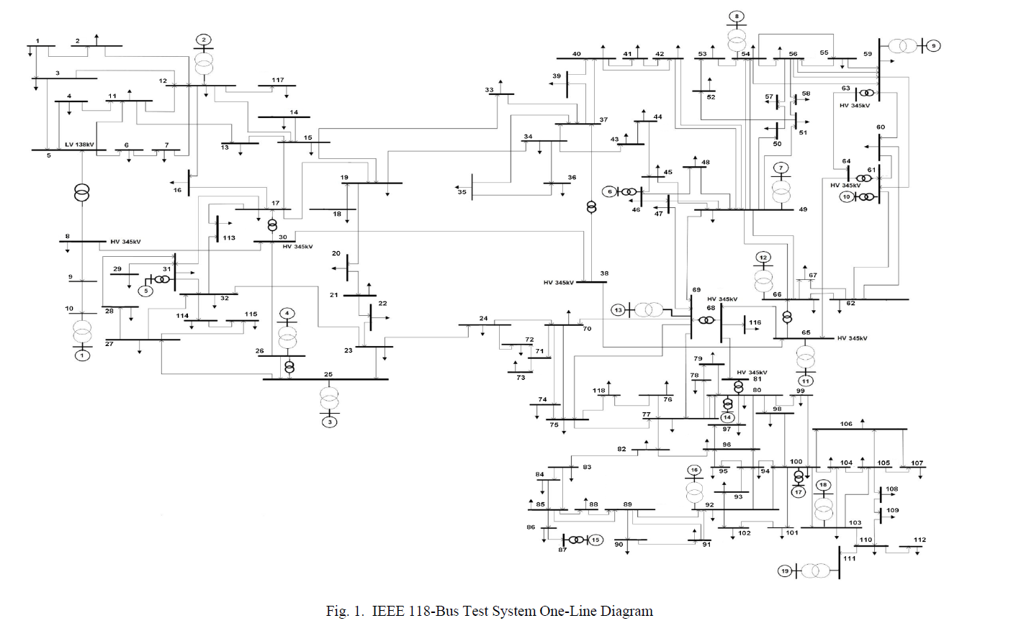
IEEE-118 System Topology
Now the system includes the `.dyr` file contains 19 generator and corresponding dynamic data.

Slide 4
Dynamic event testing 1
Fault location: Line Bus 2-12
Fault type: Temporary line trip
Fault duration: Happens at 1s and clears at 1.2s.

Slide 5
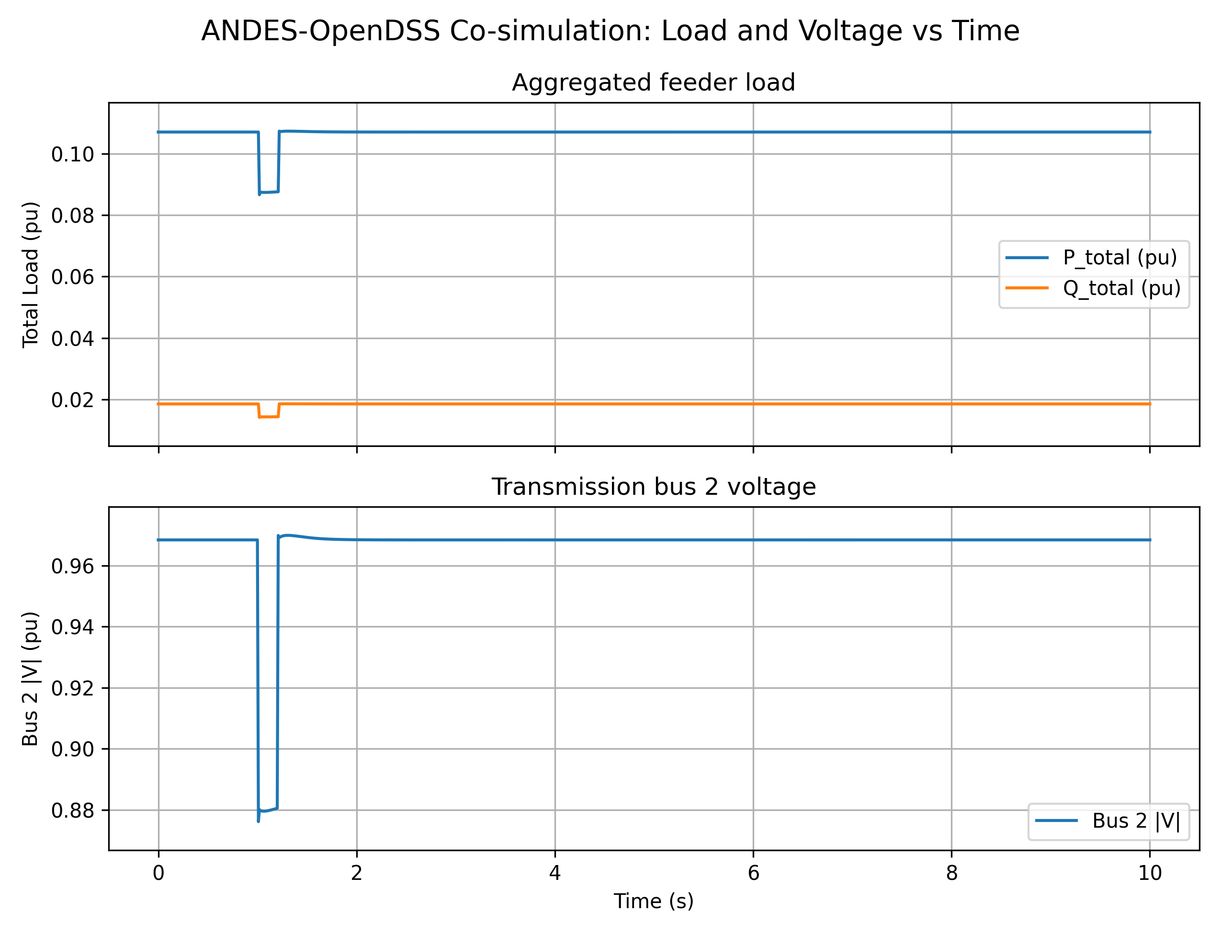
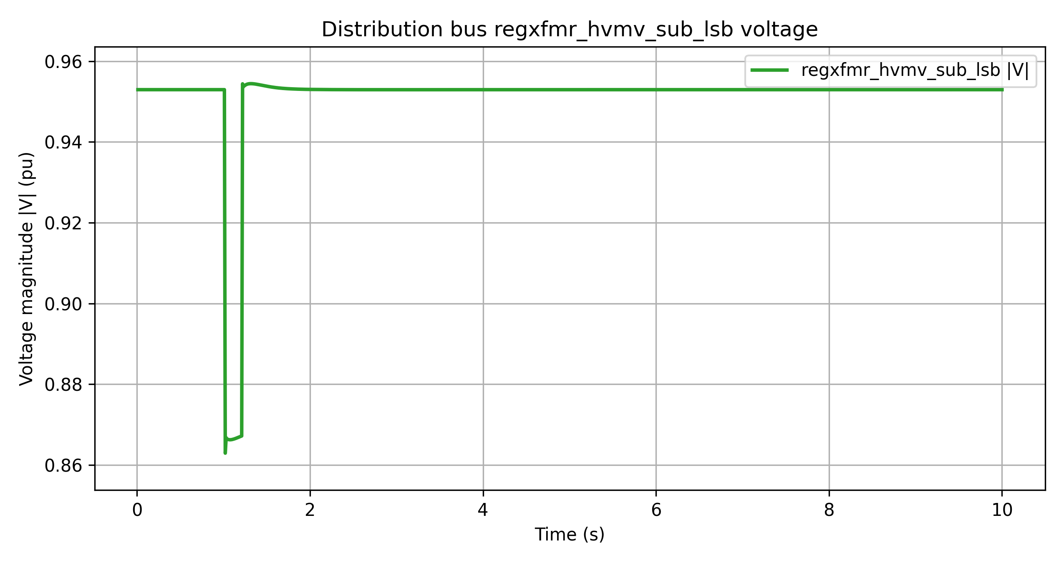
Dynamic event result 1
Transmission side -- ANDES
Distribution substation voltage deviation -- OpenDSS
Time span: 10s
T&D co-simulation time step: 0.033 TDS time step: 0.033s
Reference Time Scale: PSSE 60 Hz systems: 0.004167 seconds (1/2 cycle).
ANDES defaulted time scale: 0.033s(2 cycle)

Slide 6
Dynamic event testing 1
Fault location: Line Bus 2-12
Fault type: Temporary line trip
Fault duration: Happens at 1s and clears at 1.2s.

Slide 7
Dynamic event result 1
Transmission side -- ANDES
Distribution substation voltage deviation -- OpenDSS
Time span: 10s
T&D co-simulation time step: 0.033 TDS time step: 0.033s
Reference Time Scale: PSSE 60 Hz systems: 0.004167 seconds (1/2 cycle).
ANDES defaulted time scale: 0.033s(2 cycle)

Slide 8
Dynamic event testing 2
Fault location: Bus 2
Fault type: Three phase to ground fault
Fault duration: Happens at 1s and clears at 1.08s.

Slide 9
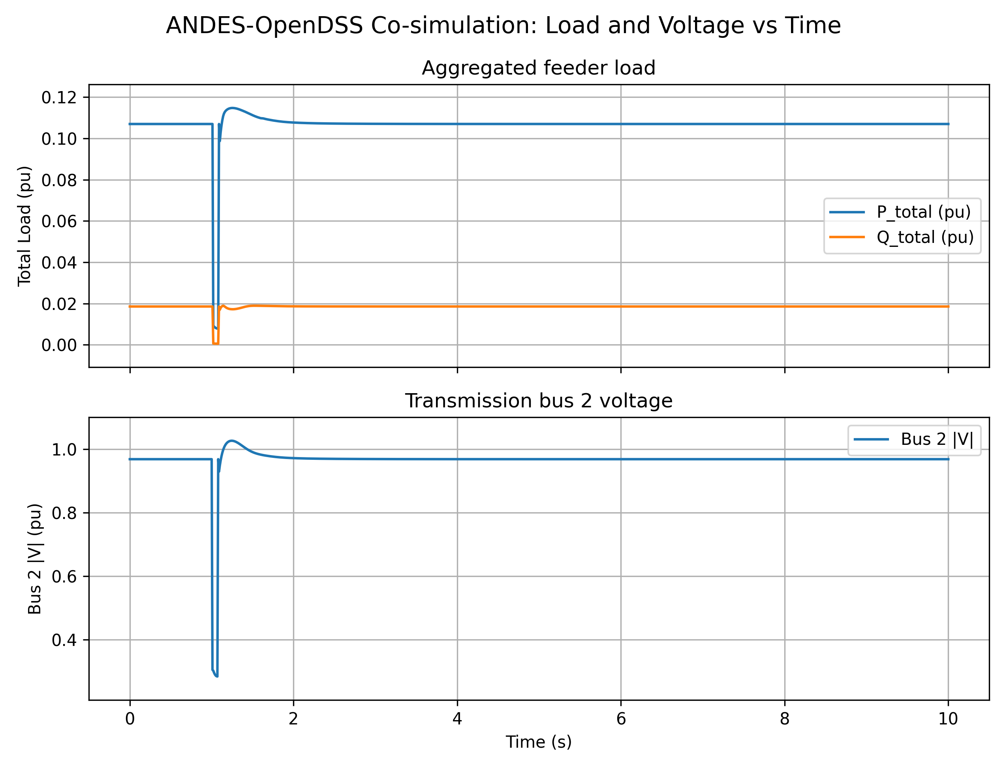
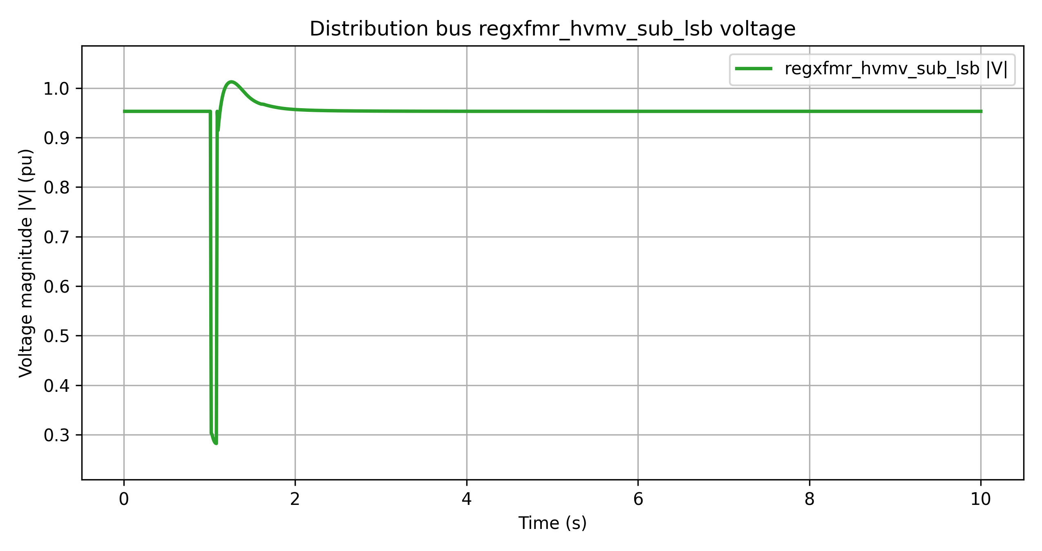
Dynamic event result 2
Transmission side -- ANDES
Distribution side substation voltage deviation -- OpenDSS
Time span: 10s
T&D co-simulation time step: 0.033 TDS time step: 0.033s
Reference Time Scale: PSSE 60 Hz systems: 0.004167 seconds (1/2 cycle).
ANDES defaulted time scale: 0.033s(2 cycle)

Slide 10
Dynamic event testing 2
Fault impedance: rf = 0, xf = 0.05;
Fault location: Bus 2
Fault type: Three phase to ground fault
Fault duration: Happens at 1s and clears at 1.08s.

Slide 11
Dynamic event result 2
Transmission side -- ANDES
Distribution side substation voltage deviation -- OpenDSS
Time span: 10s
T&D co-simulation time step: 0.033 TDS time step: 0.033s
Reference Time Scale: PSSE 60 Hz systems: 0.004167 seconds (1/2 cycle).
ANDES defaulted time scale: 0.033s(2 cycle)

Slide 12
Dynamic event testing 3
Fault impedance: rf = 0, xf = 0.05;
Fault location: Bus 80
Fault type: Three phase to ground fault
Fault duration: Happens at 1s and clears at 1.08s.

Slide 13
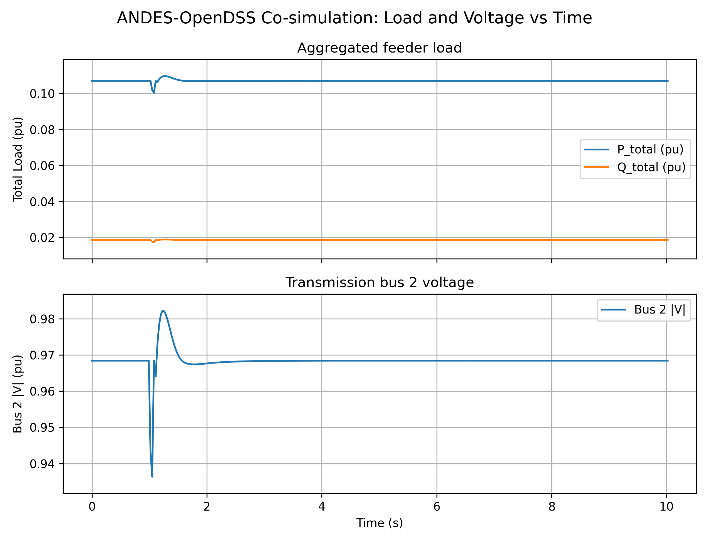
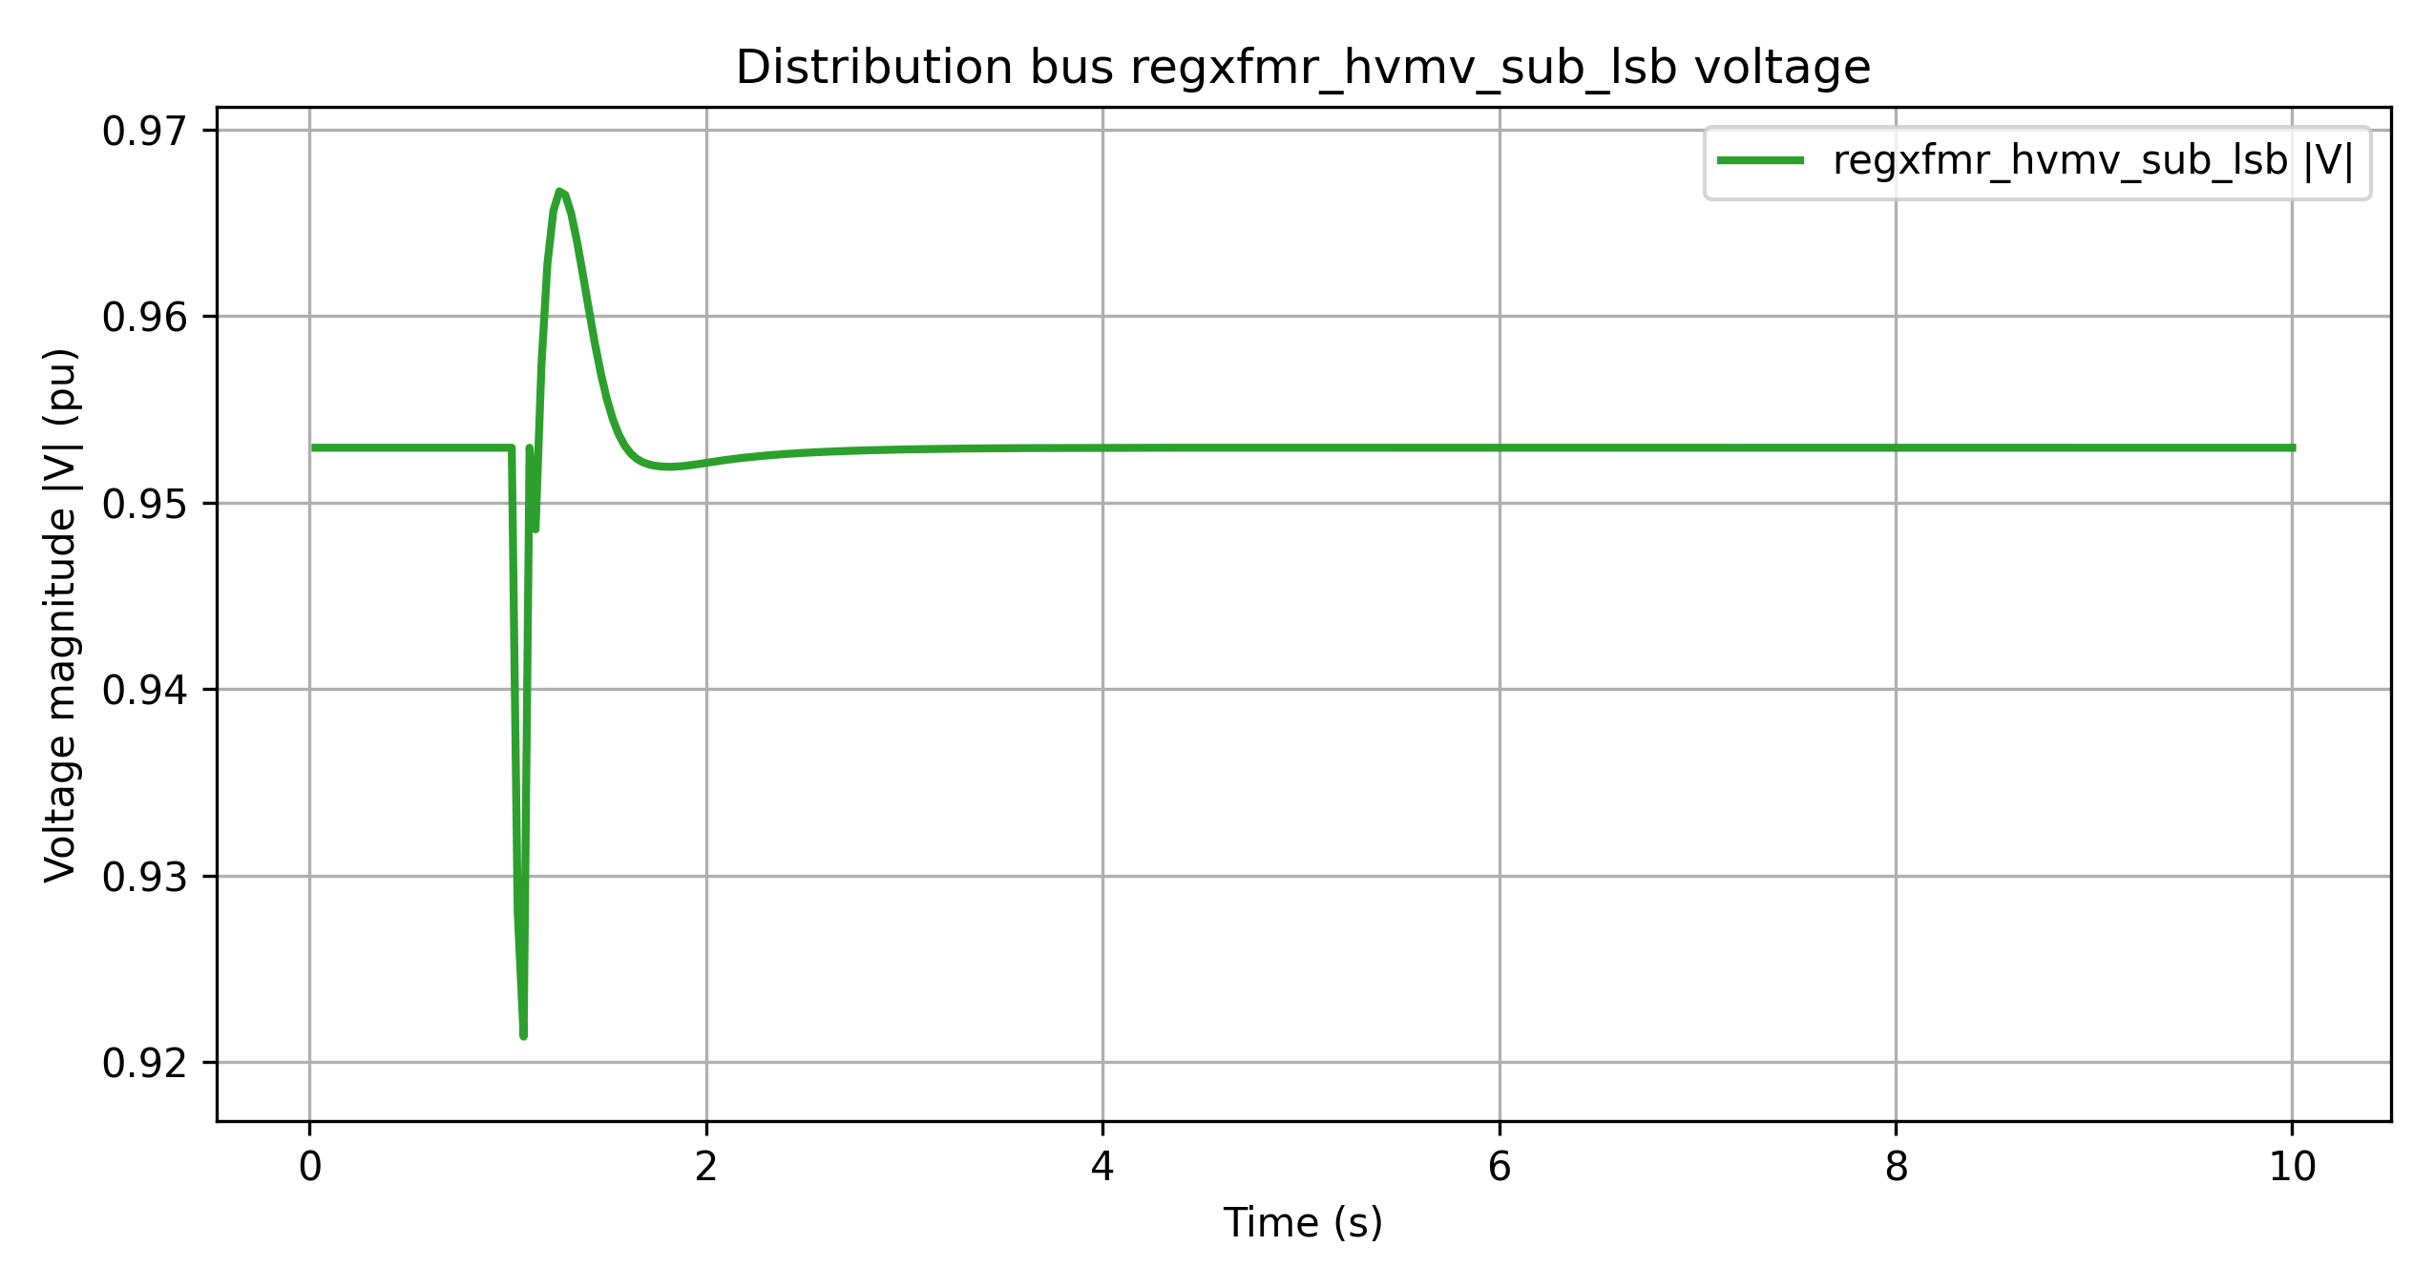
Dynamic event result 3
Transmission side -- ANDES
Distribution side substation voltage deviation -- OpenDSS
Time span: 10s
T&D co-simulation time step: 0.033 TDS time step: 0.033s
Reference Time Scale: PSSE 60 Hz systems: 0.004167 seconds (1/2 cycle).
ANDES defaulted time scale: 0.033s(2 cycle)

Slide 14
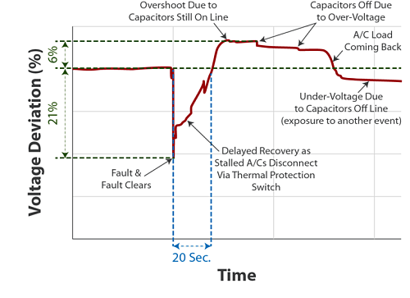
FIDVR in Co-simulation Framework
Typical FIDVR curve,
Fault clears.
Motors stall, drawing high Q.
Some motor trip or disconnect, load drops.
Voltage overshoot because load is reduced.
Capacitor banks switch off due to overvoltage.
Motors come back online.
Load is higher than before, capacitors switch on.
Voltage dips again.

Slide 15
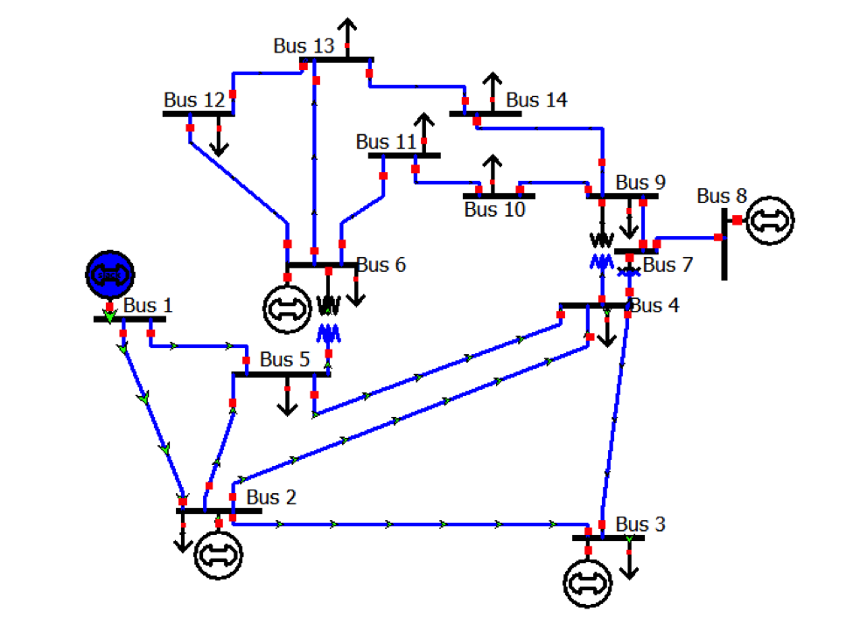
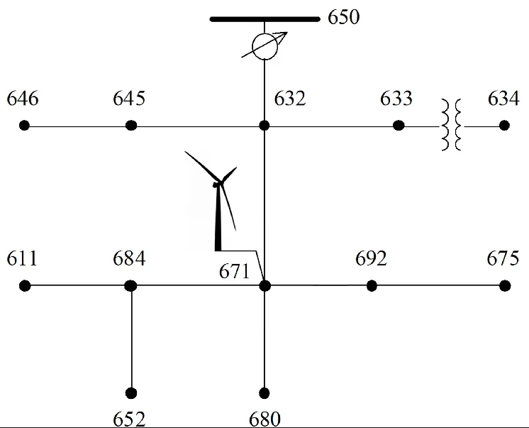
FIDVR in Co-simulation Framework
Transitioning the IEEE118-8500 system to IEEE14-13 system
IEEE14 Bus Transmission System
IEEE14 Nodes Distribution System

Slide 16
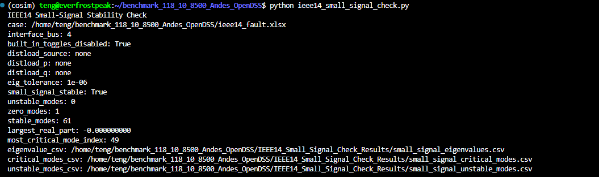
FIDVR in Co-simulation Framework
Small Signal Stability Check of IEEE118 System

Slide 17
FIDVR in Co-simulation Framework
Dynamic simulation test before implementing FIDVR
Test the dynamic simulation with the Line_3 trip (Bus 2 to Bus 3)at 1s and reclose at 1.2s
Inter-connected at Bus 2. Measure the substation voltage.

Slide 18
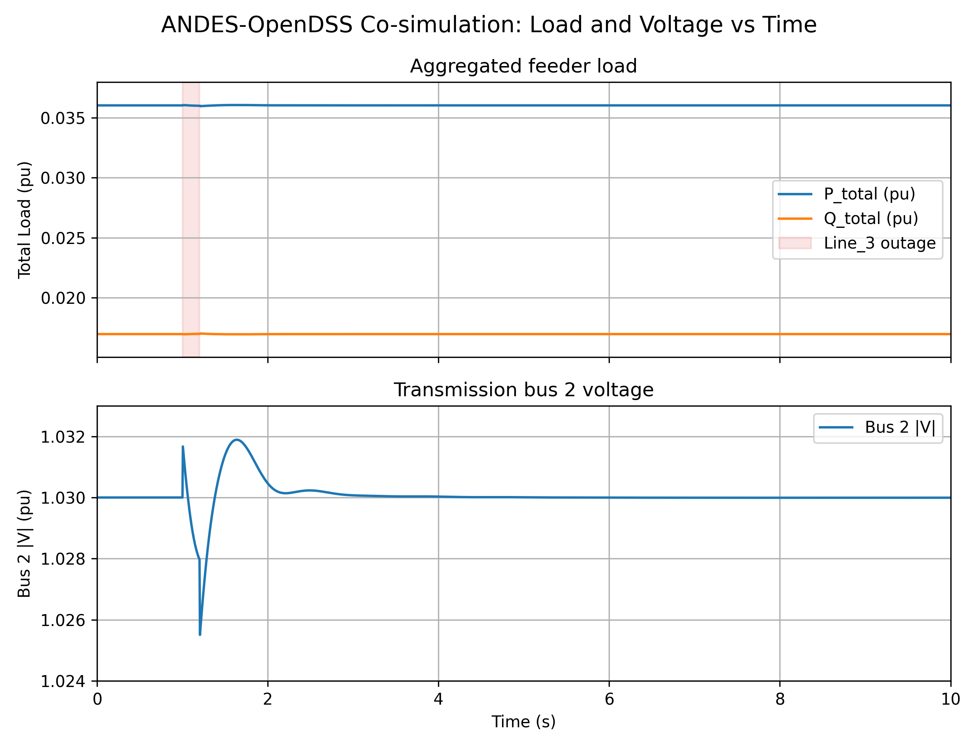
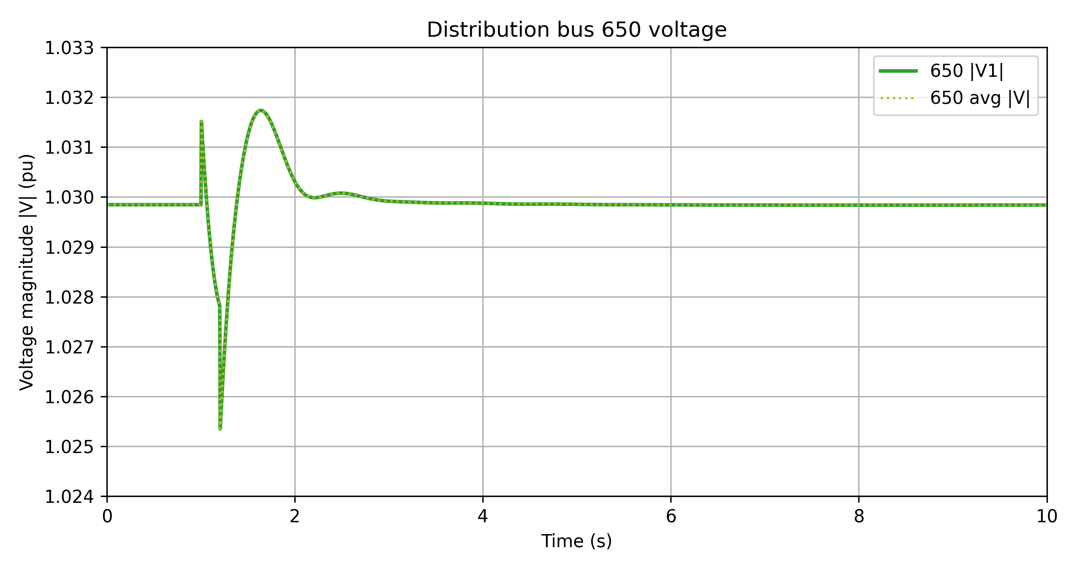
Dynamic Transmission-Distribution Co-simulation
Transmission side
Distribution side
It cross validates the result between transmission system and distribution system with the difference of ${10}^{−4}$.

Slide 19
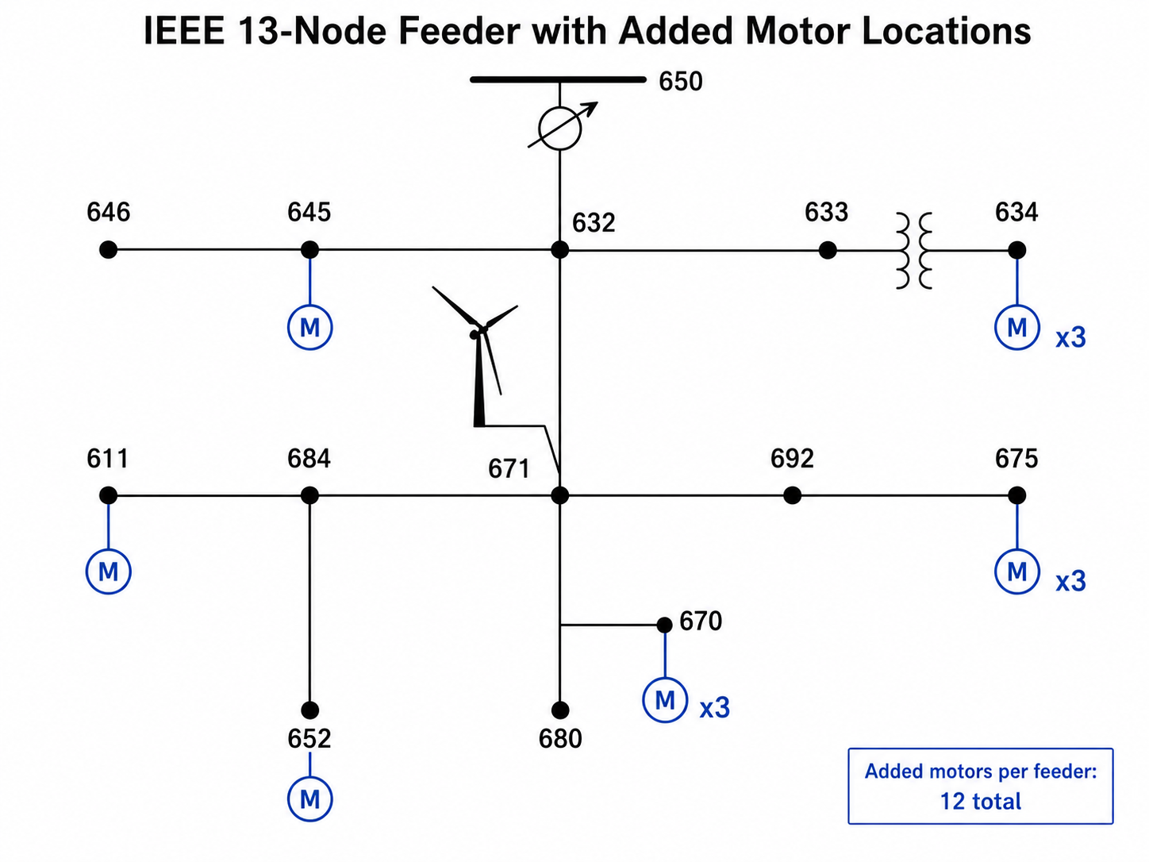
FIDVR in Co-simulation Framework
FIDVR Setup: Motors model (WECC Motor D)
Using aggregated Motor D replaces the selected one single phase OpenDSS Load.
The model is created using the published report. https://www.wecc.org/sites/default/files/documents/meeting/2024/WECC%20Air%20Conditioner%20Motor%20Model%20Test%20Report--%20Final.pdf

Slide 20
FIDVR in Co-simulation Framework
FIDVR Setup: Motors model (WECC Motor D) places
Total Motor D size: 1911.0 kW and 1970.1 kVA.
Motor D elements | Source load | Bus | kW
Load.weccmd_634a | 634a | 634.1 | 160
Load.weccmd_634b | 634b | 634.2 | 120
Load.weccmd_634c | 634c | 634.3 | 120
Load.weccmd_645 | 645 | 645.2 | 170
Load.weccmd_675a | 675a | 675.1 | 485
Load.weccmd_675b | 675b | 675.2 | 68
Load.weccmd_675c | 675c | 675.3 | 290
Load.weccmd_611 | 611 | 611.3 | 170
Load.weccmd_652 | 652 | 652.1 | 128
Load.weccmd_670a | 670a | 670.1 | 17
Load.weccmd_670b | 670b | 670.2 | 66
Load.weccmd_670c | 670c | 670.3 | 117

Slide 21
FIDVR in Co-simulation Framework
FIDVR Setup
Measure the distribution side voltage at node 675.
Setup a three phase to ground fault at Bus 14 at 1s and reclose at 1.08s. Measure the substation 675 voltage.
Inter-connected at Bus 14. rf = 0, xf = 0.3.

Slide 22
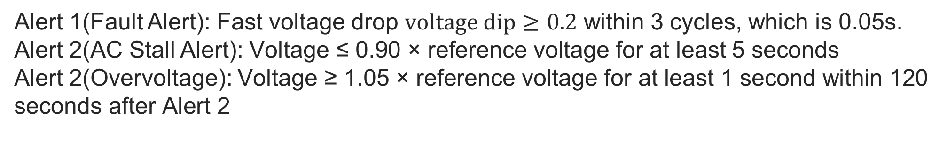
FIDVR in Co-simulation Framework
FIDVR Setup: Alerts
Alert 1(Fault Alert): Fast voltage drop $voltage dip≥0.2$ within 3 cycles, which is 0.05s.
Alert 2(AC Stall Alert): $\text{Voltage}\text{ ≤ 0.90 × }\text{reference} \text{voltage}$ for at least 5 seconds
Alert 2(Overvoltage): $\text{Voltage}\text{ ≥ 1.05 × }\text{reference} \text{voltage}$ $\text{for} \text{at} \text{least}\text{ 1 }\text{second} \text{within}\text{ 120 }\text{seconds} \text{after} \text{Alert}\text{ 2}$

Slide 23
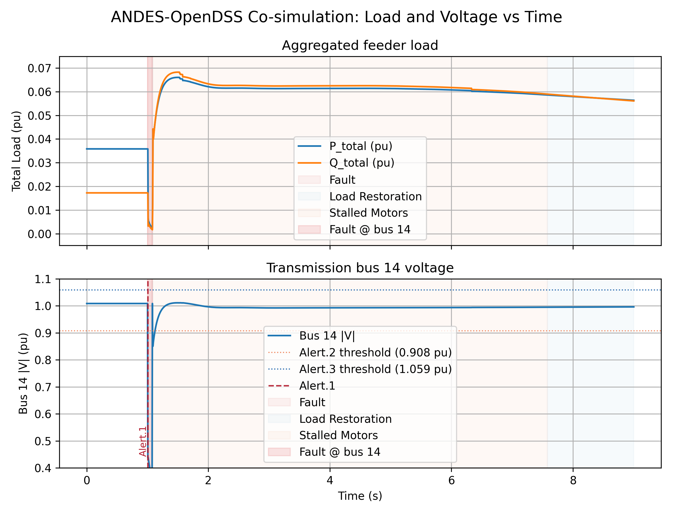
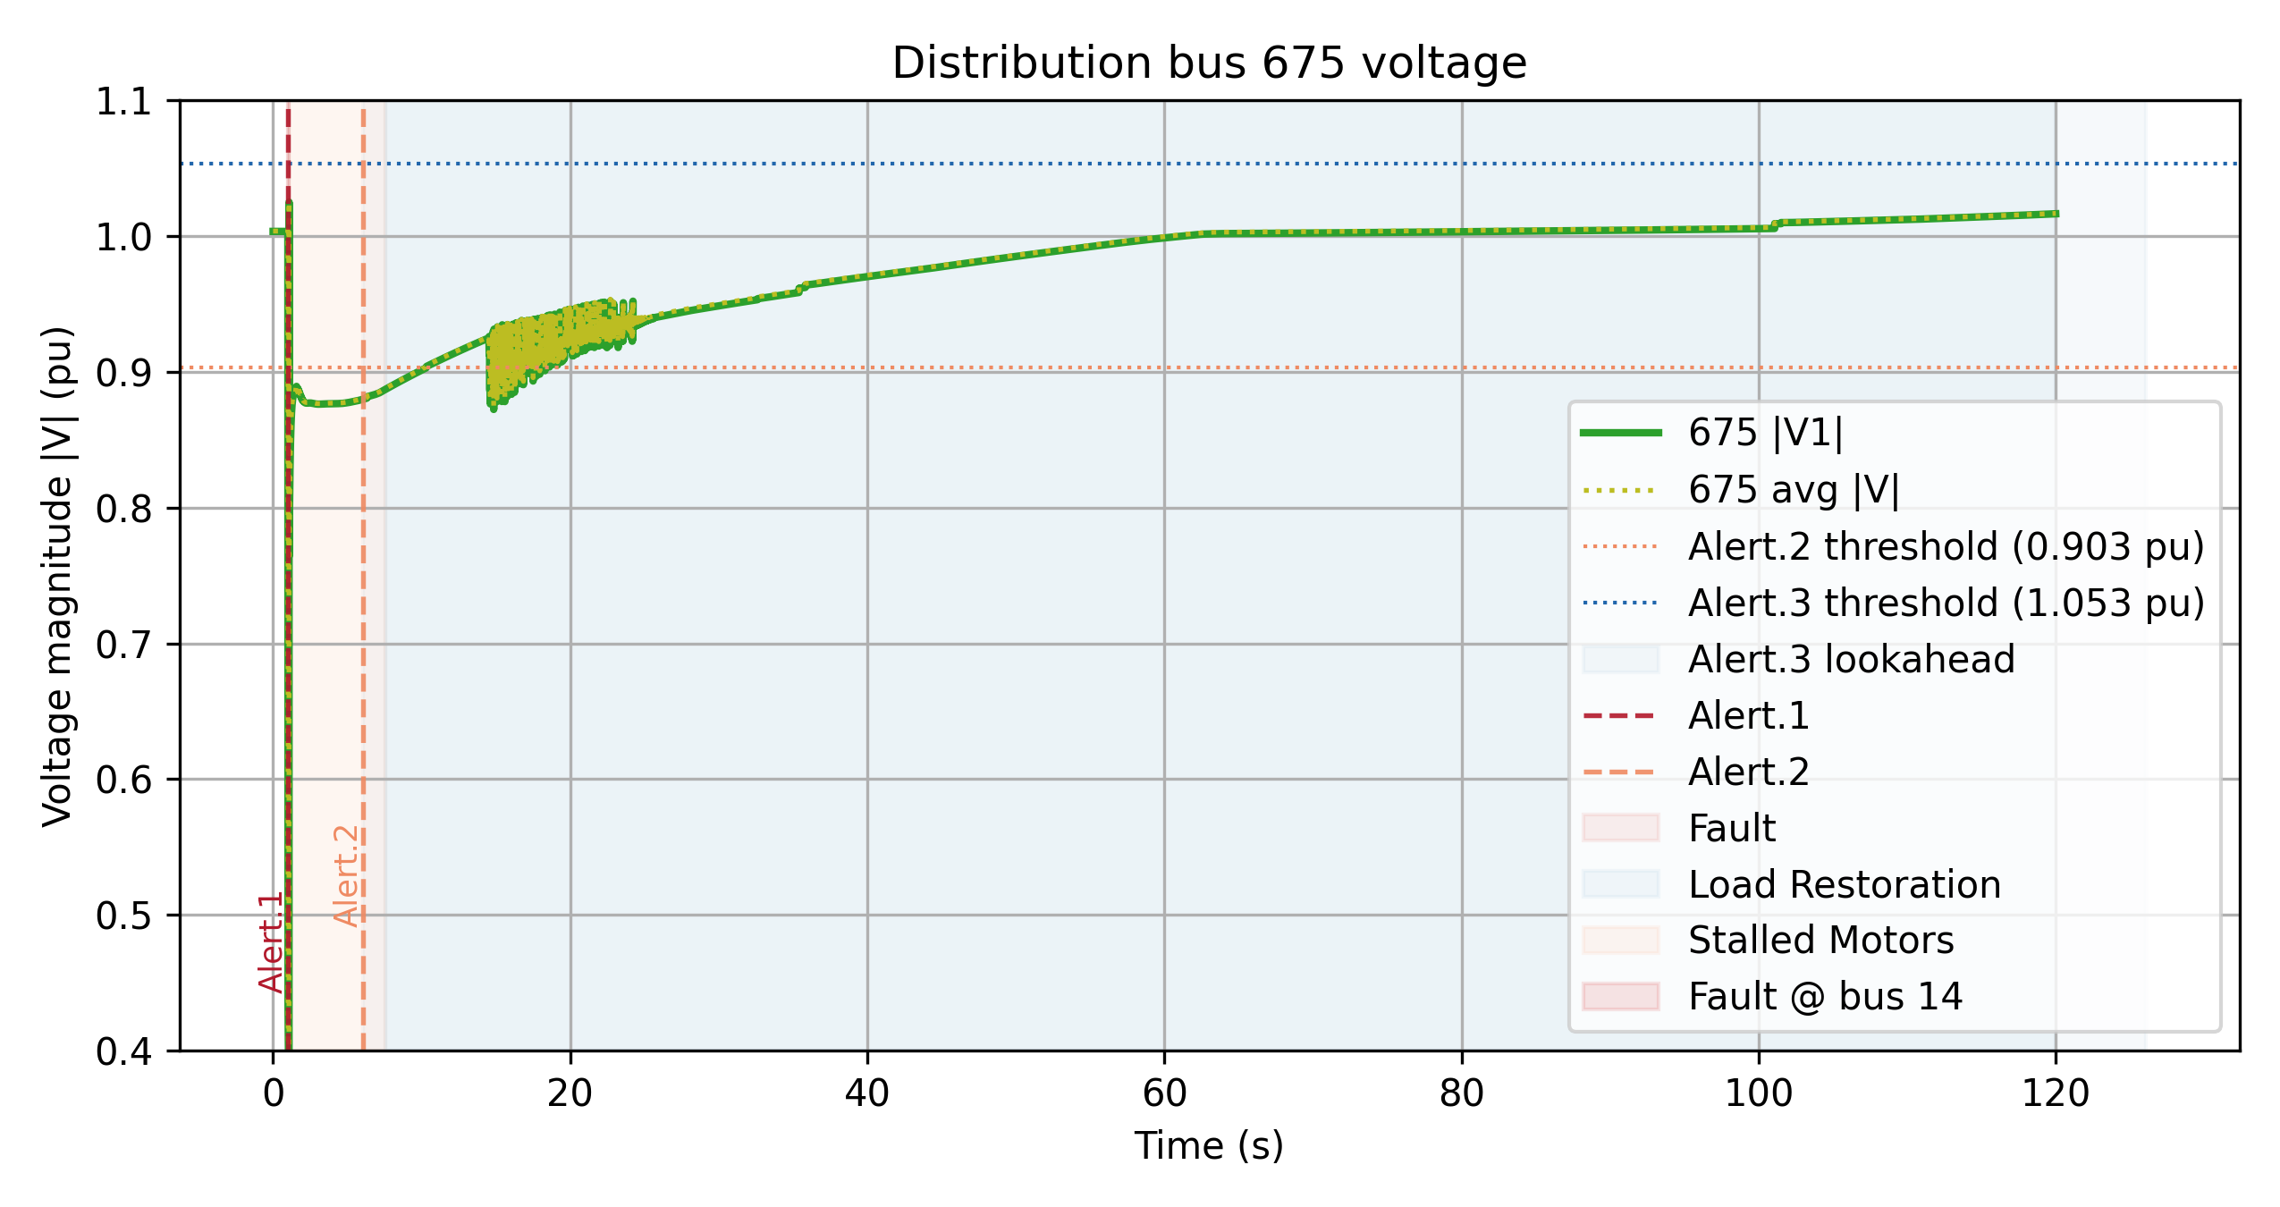
Dynamic Transmission-Distribution Co-simulation
Transmission side
Distribution side
While the transmission voltage recovers immediately, the feeder side triggers FIDVR.
Alert 1 and 2 are triggered. Around $t≈7.58s$, all motors are tripped.

Slide 24
Appendix
Teng WANG

Slide 25
FIDVR in Co-simulation Framework
FIDVR Setup: Surrogate Motors
Residential compressor load is represented as distributed single phase motors attached to actual feeder loads. The stall thresholds are 0.82.

Slide 26
FIDVR in Co-simulation Framework
FIDVR Setup: Alerts
Alert 1(Fault Alert): Fast voltage drop $voltage dip≥0.2$ within 3 cycles, which is 0.05s.
Alert 2(AC Stall Alert): $\text{Voltage}\text{ ≤ 0.90 × }\text{reference} \text{voltage}$ for at least 5 seconds
Alert 2(Overvoltage): $\text{Voltage}\text{ ≥ 1.05 × }\text{reference} \text{voltage}$ $\text{for} \text{at} \text{least}\text{ 1 }\text{second} \text{within}\text{ 120 }\text{seconds} \text{after} \text{Alert}\text{ 2}$

Slide 27
FIDVR in Co-simulation Framework
FIDVR Setup
Measure the distribution side voltage at node 675.
Setup a three-phase to ground fault at Bus 14 at 1s and reclose at 1.06s
Inter-connected at Bus 2. rf = 0, xf = 0.6.

Slide 28
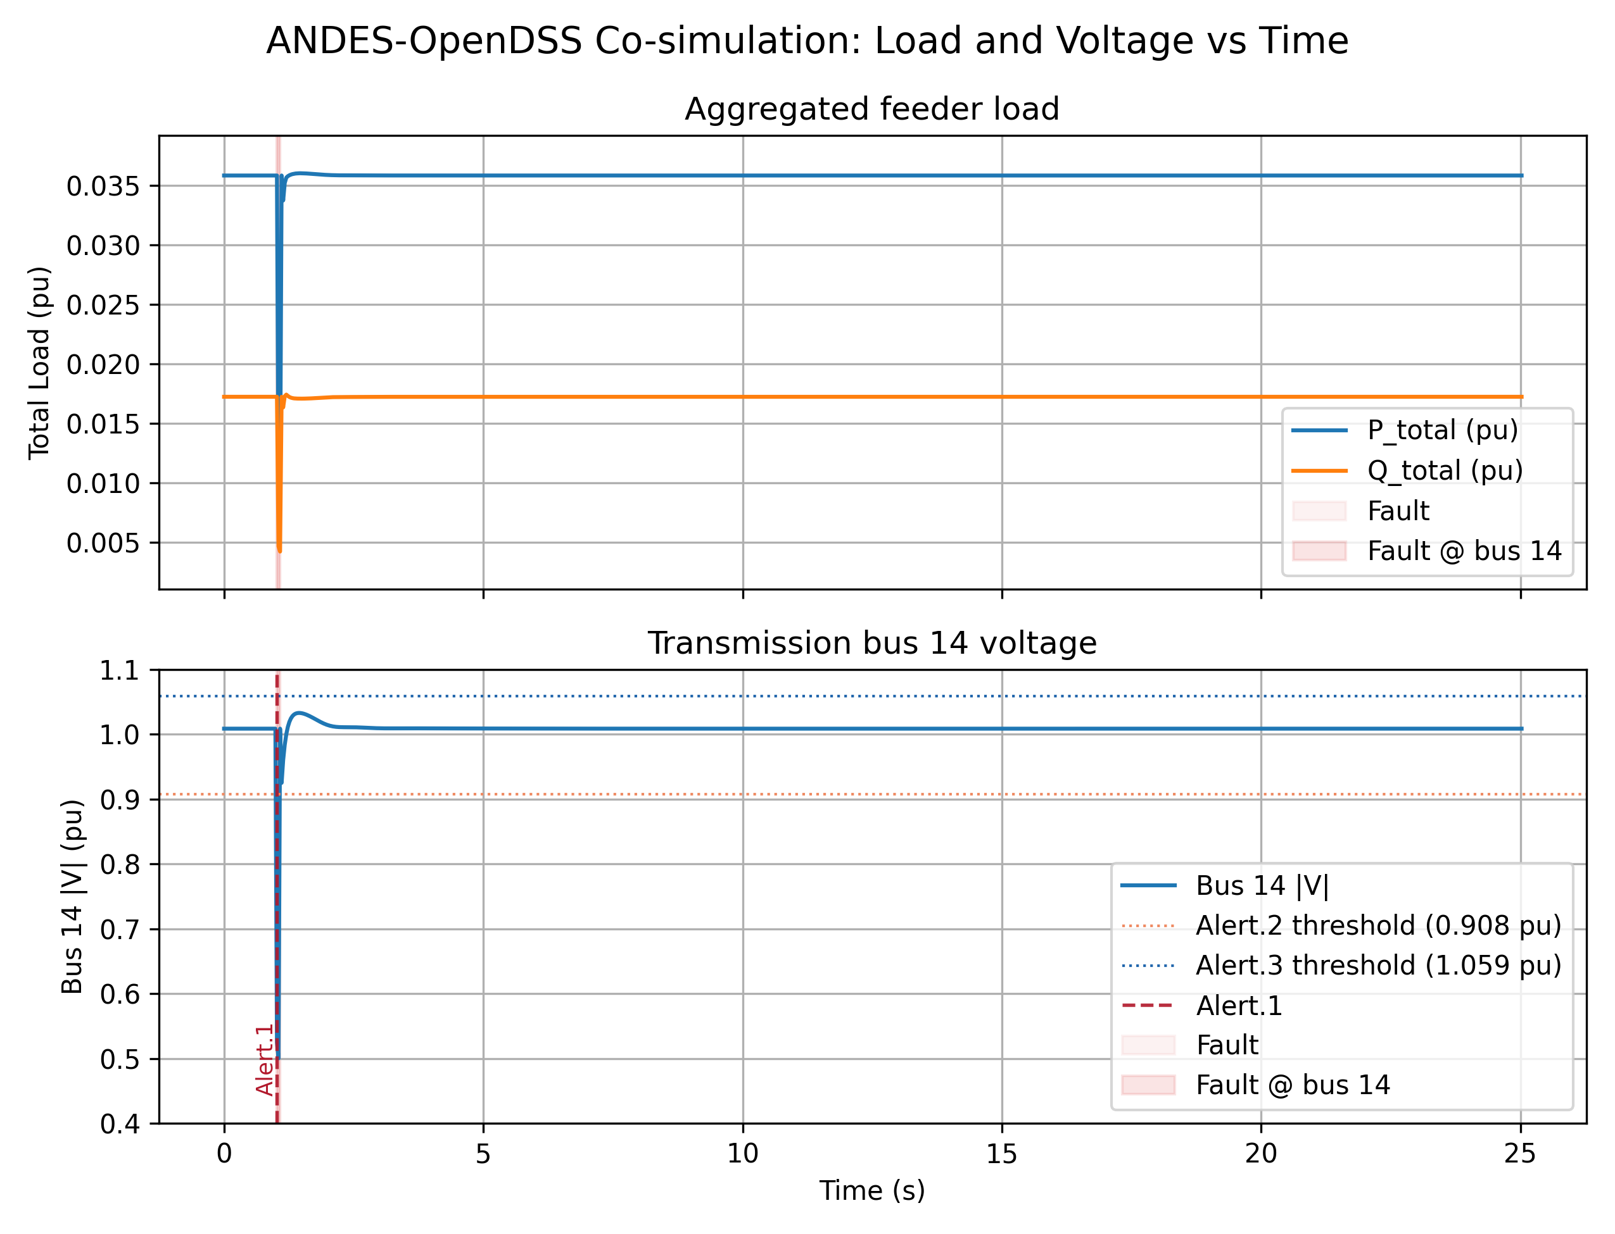
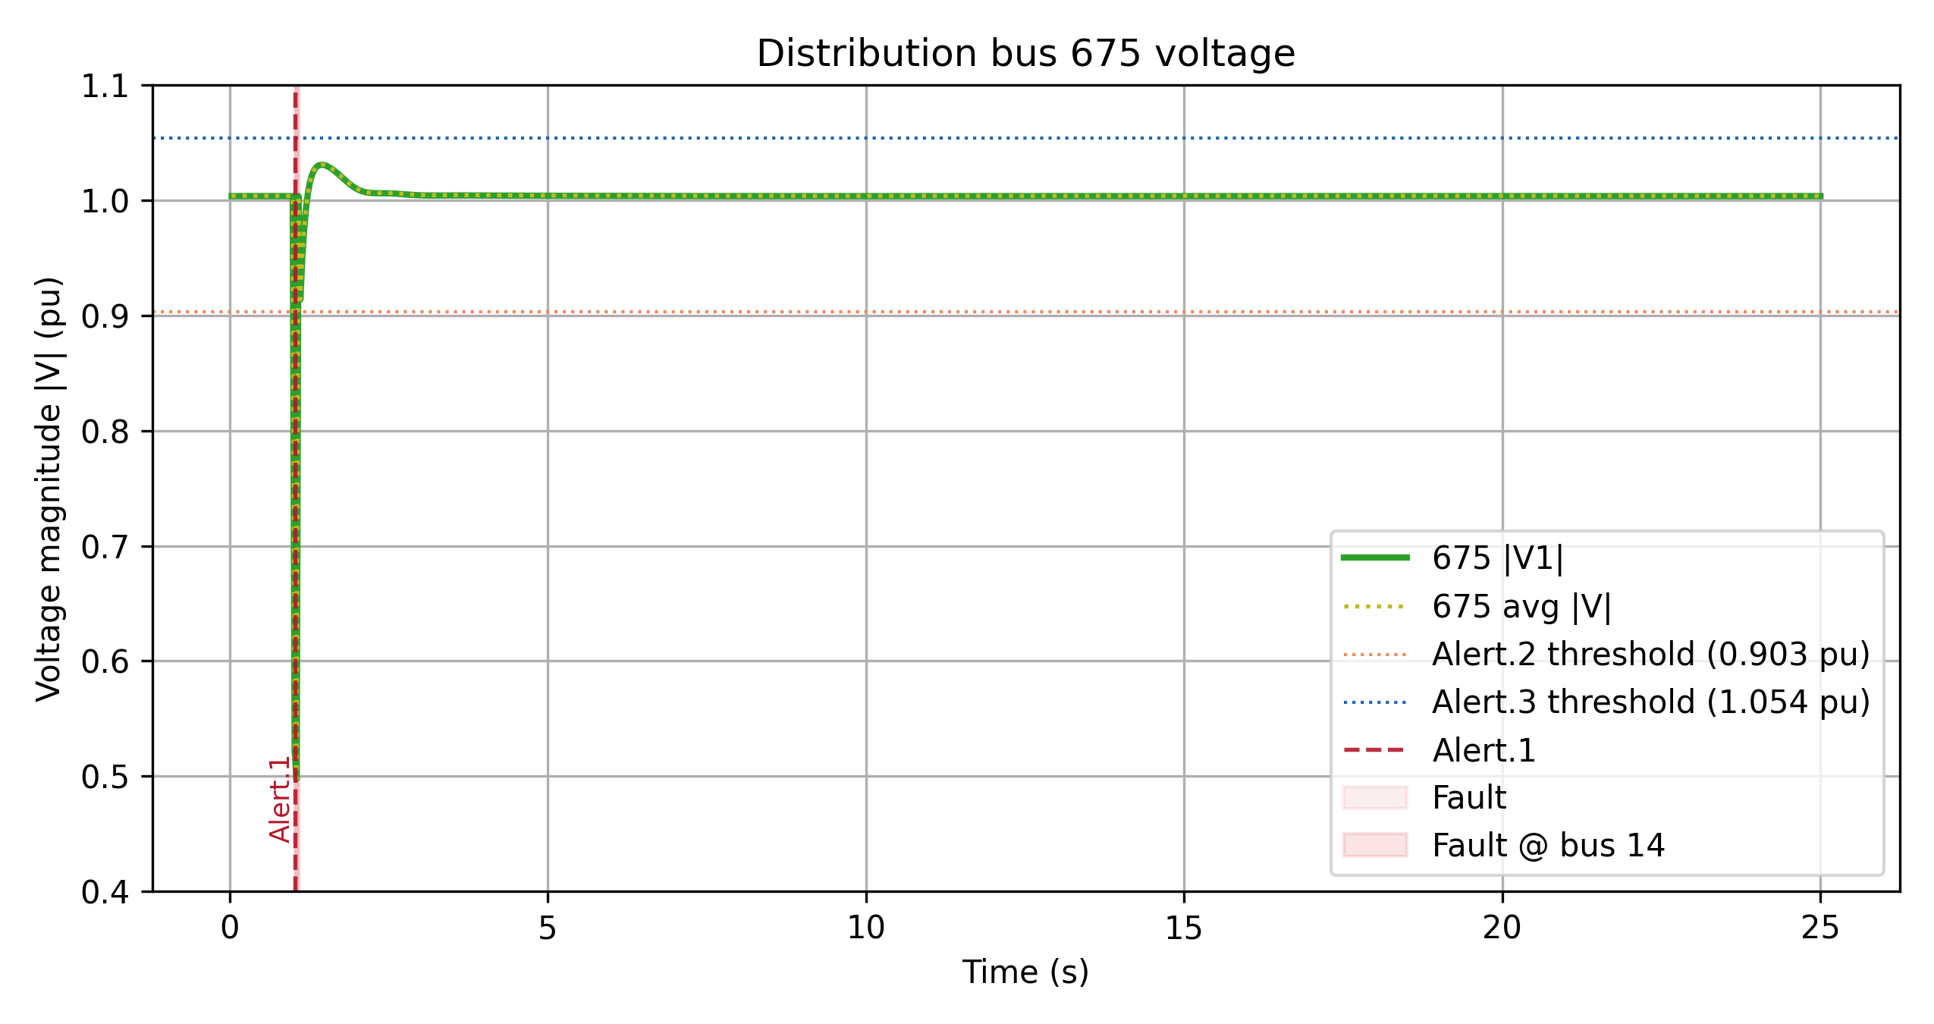
Dynamic Transmission-Distribution Co-simulation
Transmission side
Distribution side
Alert 1 is triggered, whereas alert 2 and 3 are not, thus, there is no motor stalled.

Slide 29
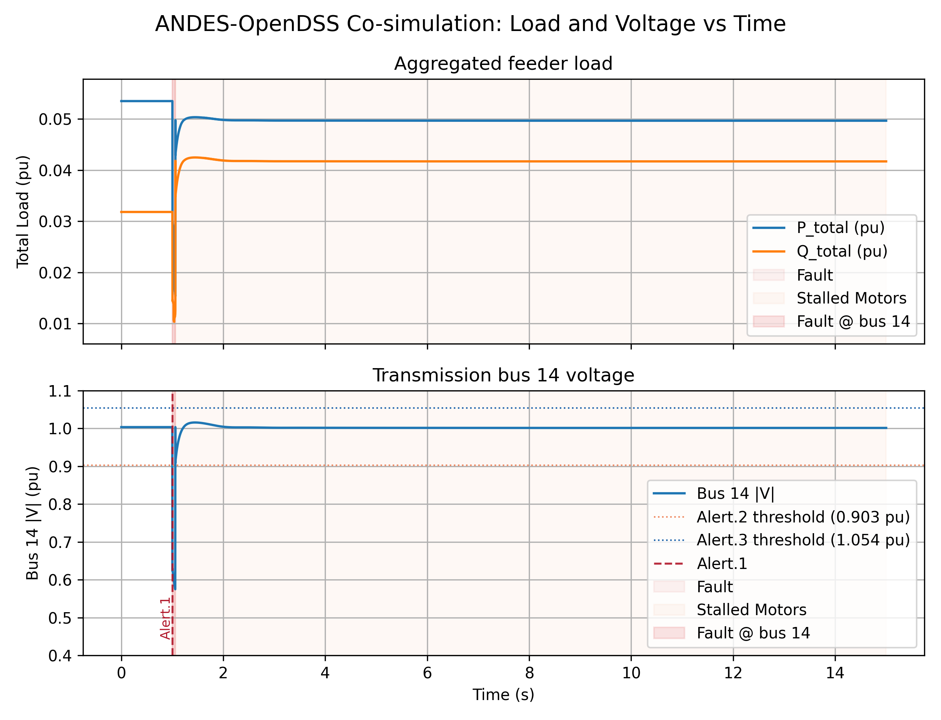
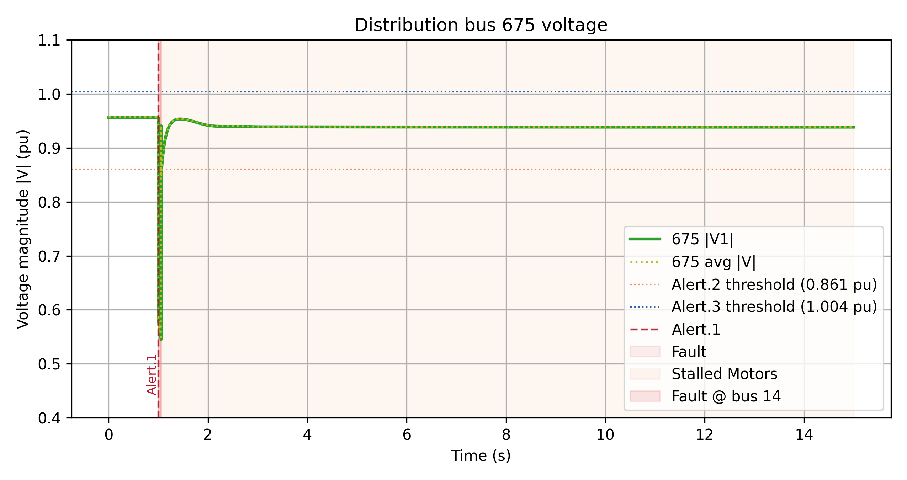
Dynamic Transmission-Distribution Co-simulation
Transmission side
Distribution side
Alert 1 is triggered, whereas alert 2 and 3 are not, thus, there is no motor stalled.

Slide 30
FIDVR in Co-simulation Framework
FIDVR Setup
Increase the severity of the fault.
Setup a three-phase to ground fault at Bus 14 at 1s and reclose at 1.1s
Inter-connected at Bus 2. rf = 0, xf = 0.35.

Slide 31
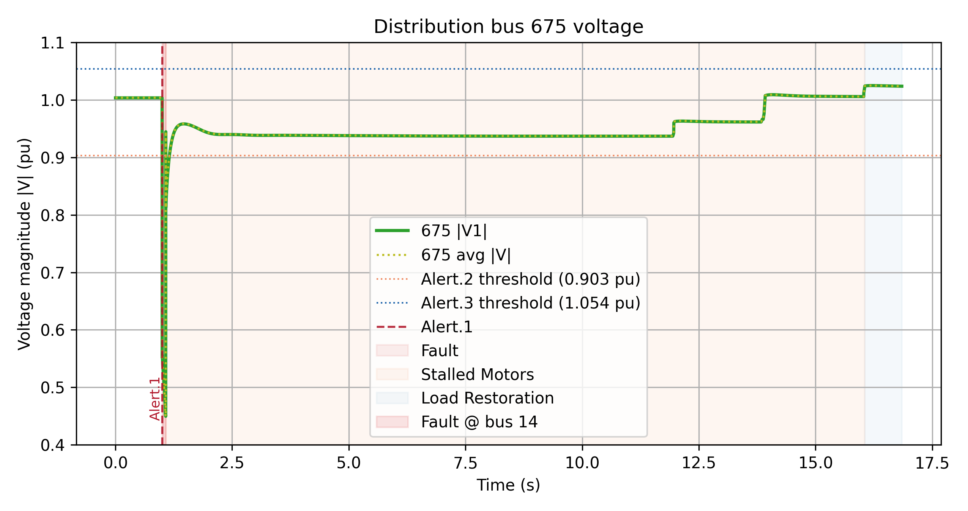
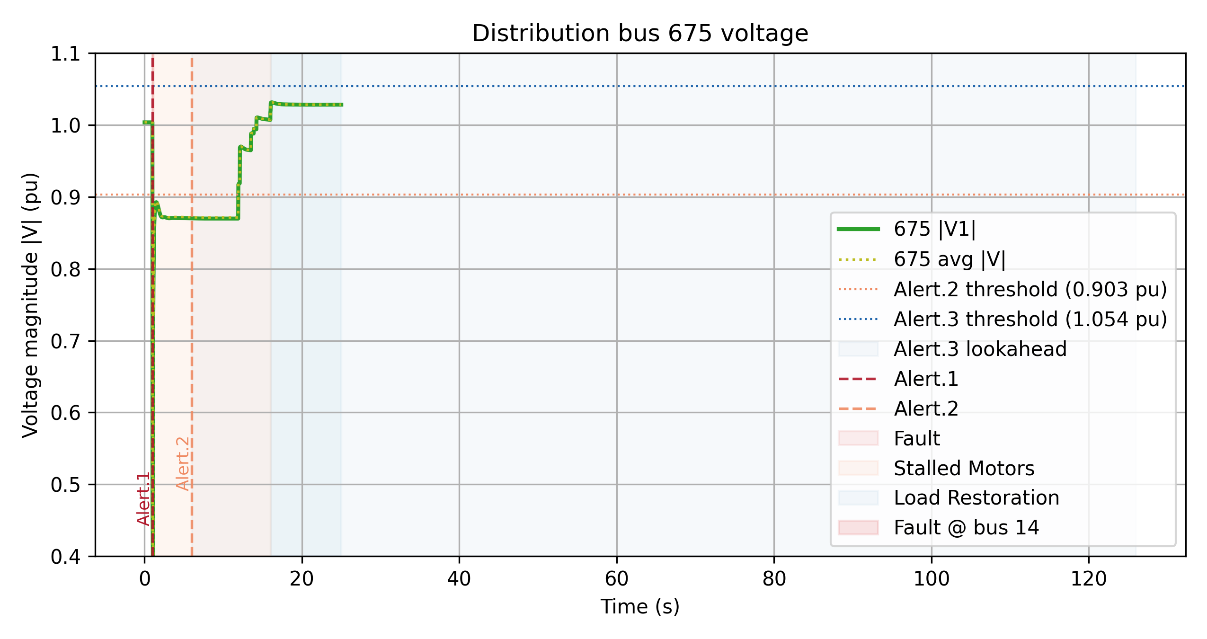
Dynamic Transmission-Distribution Co-simulation
Distribution side – zoom in
Distribution side – zoom out
Alert 1 and alert 2 is triggered, whereas alert 3 is not, thus, while there are motors stalled and tripped, there is no action from the capacitor side.

Slide 32
FIDVR in Co-simulation Framework
Increase the severity of the fault, and tune the parameters of the surrogate model.
FIDVR Setup
Setup a three-phase to ground fault at Bus 14 at 1s and reclose at 1.1s
Inter-connected at Bus 2. rf = 0, xf = 0.35.

Slide 33
FIDVR in Co-simulation Framework
Parameters tuning
FIDVR_ENABLE_CAP_CONTROL=0 \
FIDVR_ENABLE_REG_CONTROL=0 \
FINE_DT=0.002 COARSE_DT=0.05 COARSE_START=1.6 \
TX_TDS_STEP=0.03 FIDVR_ENABLE_CAP_CONTROL=1 \
FIDVR_ENABLE_REG_CONTROL=1 \
FIDVR_CAPACITOR_INITIAL_FRACTION=1.0 \
FIDVR_CAPACITOR_ON_VOLTAGE_PU=1.025 \
FIDVR_CAPACITOR_ON_DELAY_S=0.3 \
FIDVR_CAPACITOR_OFF_VOLTAGE_PU=0.9 \
FIDVR_CAPACITOR_OFF_DELAY_S=120.0 \
FIDVR_REGULATOR_MONITOR_BUS=675 \
FIDVR_REGULATOR_LOW_VOLTAGE_PU=0.93 \
FIDVR_REGULATOR_HIGH_VOLTAGE_PU=1.025 \
FIDVR_REGULATOR_DELAY_S=0.5 \
FIDVR_REGULATOR_TAP_DELAY_S=0.25 \
FIDVR_NONRESTARTABLE_FRACTION=0.0 \
FIDVR_CONTACTOR_FRACTION=0.10 \
FIDVR_MOTOR_RECONNECT_RAMP_S=1.5 \
FIDVR_MOTOR_GROUP_RESTORE_OFFSETS=0,0.5,1.0
TX_INTERFACE_BUS=14 TX_FAULT_BUS=14 \
TX_FAULT_TIME=1.0 \
TX_FAULT_DURATION=0.1\
TX_FAULT_RF=0.0 \
TX_FAULT_XF=0.35 \
TARGET_TIME=120.0 \
FEEDER_COUNT=1 \
TX_CASE_XLSX=ieee14_fault.xlsx \
DIST_MASTER_DSS=13Bus/IEEE13Nodeckt.dss \
DIST_VOLTAGE_BUS=675 \
DIST_LOAD_SCALE=1.0 \
FIDVR_MOTOR_SHARE=0.9 \
FIDVR_MOTOR_STALL_VOLTAGE_PU=0.82 \
FIDVR_MOTOR_STALL_CLEAR_VOLTAGE_PU=0.92\
FIDVR_STALL_KVAR_PER_KW=5 \
FIDVR_MOTOR_STALL_KVAR_SCALE=15.0 \
FIDVR_MOTOR_THERMAL_TRIP_TIME_S=8.0 \
FIDVR_MOTOR_RECONNECT_DELAY_S=25.0 \

Slide 34
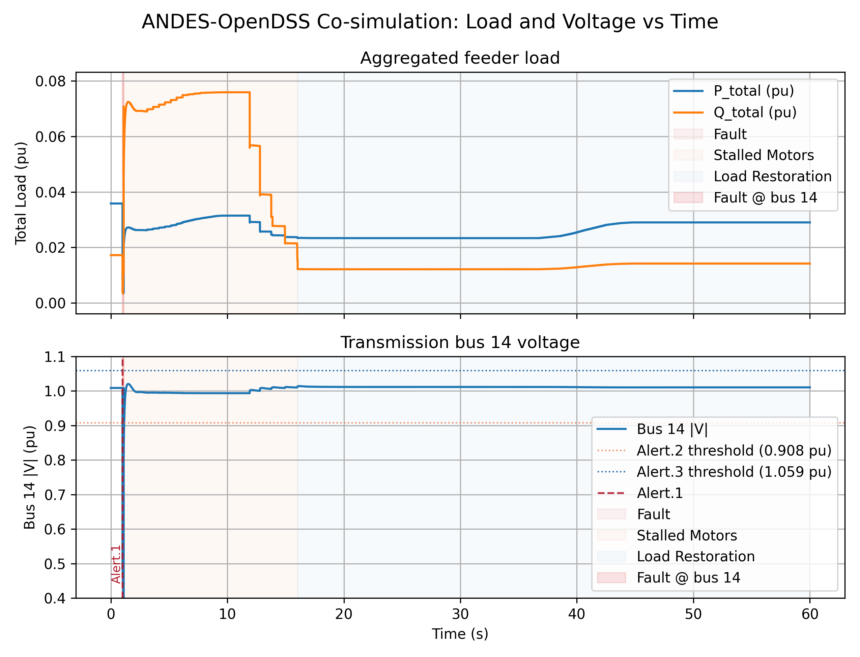
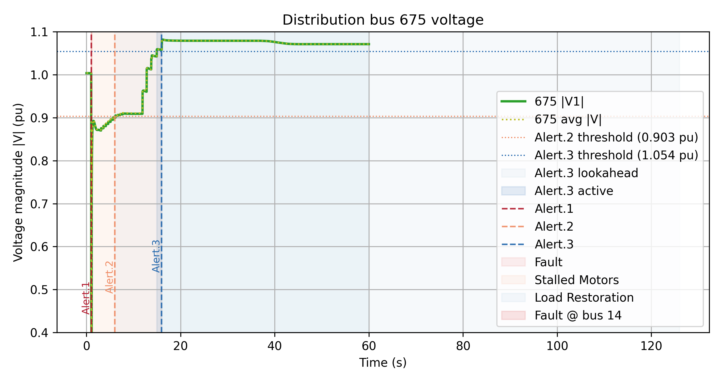
Dynamic Transmission-Distribution Co-simulation
Transmission side
Distribution side
Fault and motor stalling: By around 1.068, all 12 motors have stalled.
Delayed low voltage recovery: Voltage is around 0.88 to 0.91 for a several seconds, and regulator type moving from 1.05 to 1.10.
Motor tripping causes voltage rise: As stalled motors trip. motor reactive power scale reduces from 15.005 to 1.930, and voltage rises from 0.95 to 1.068

Slide 35

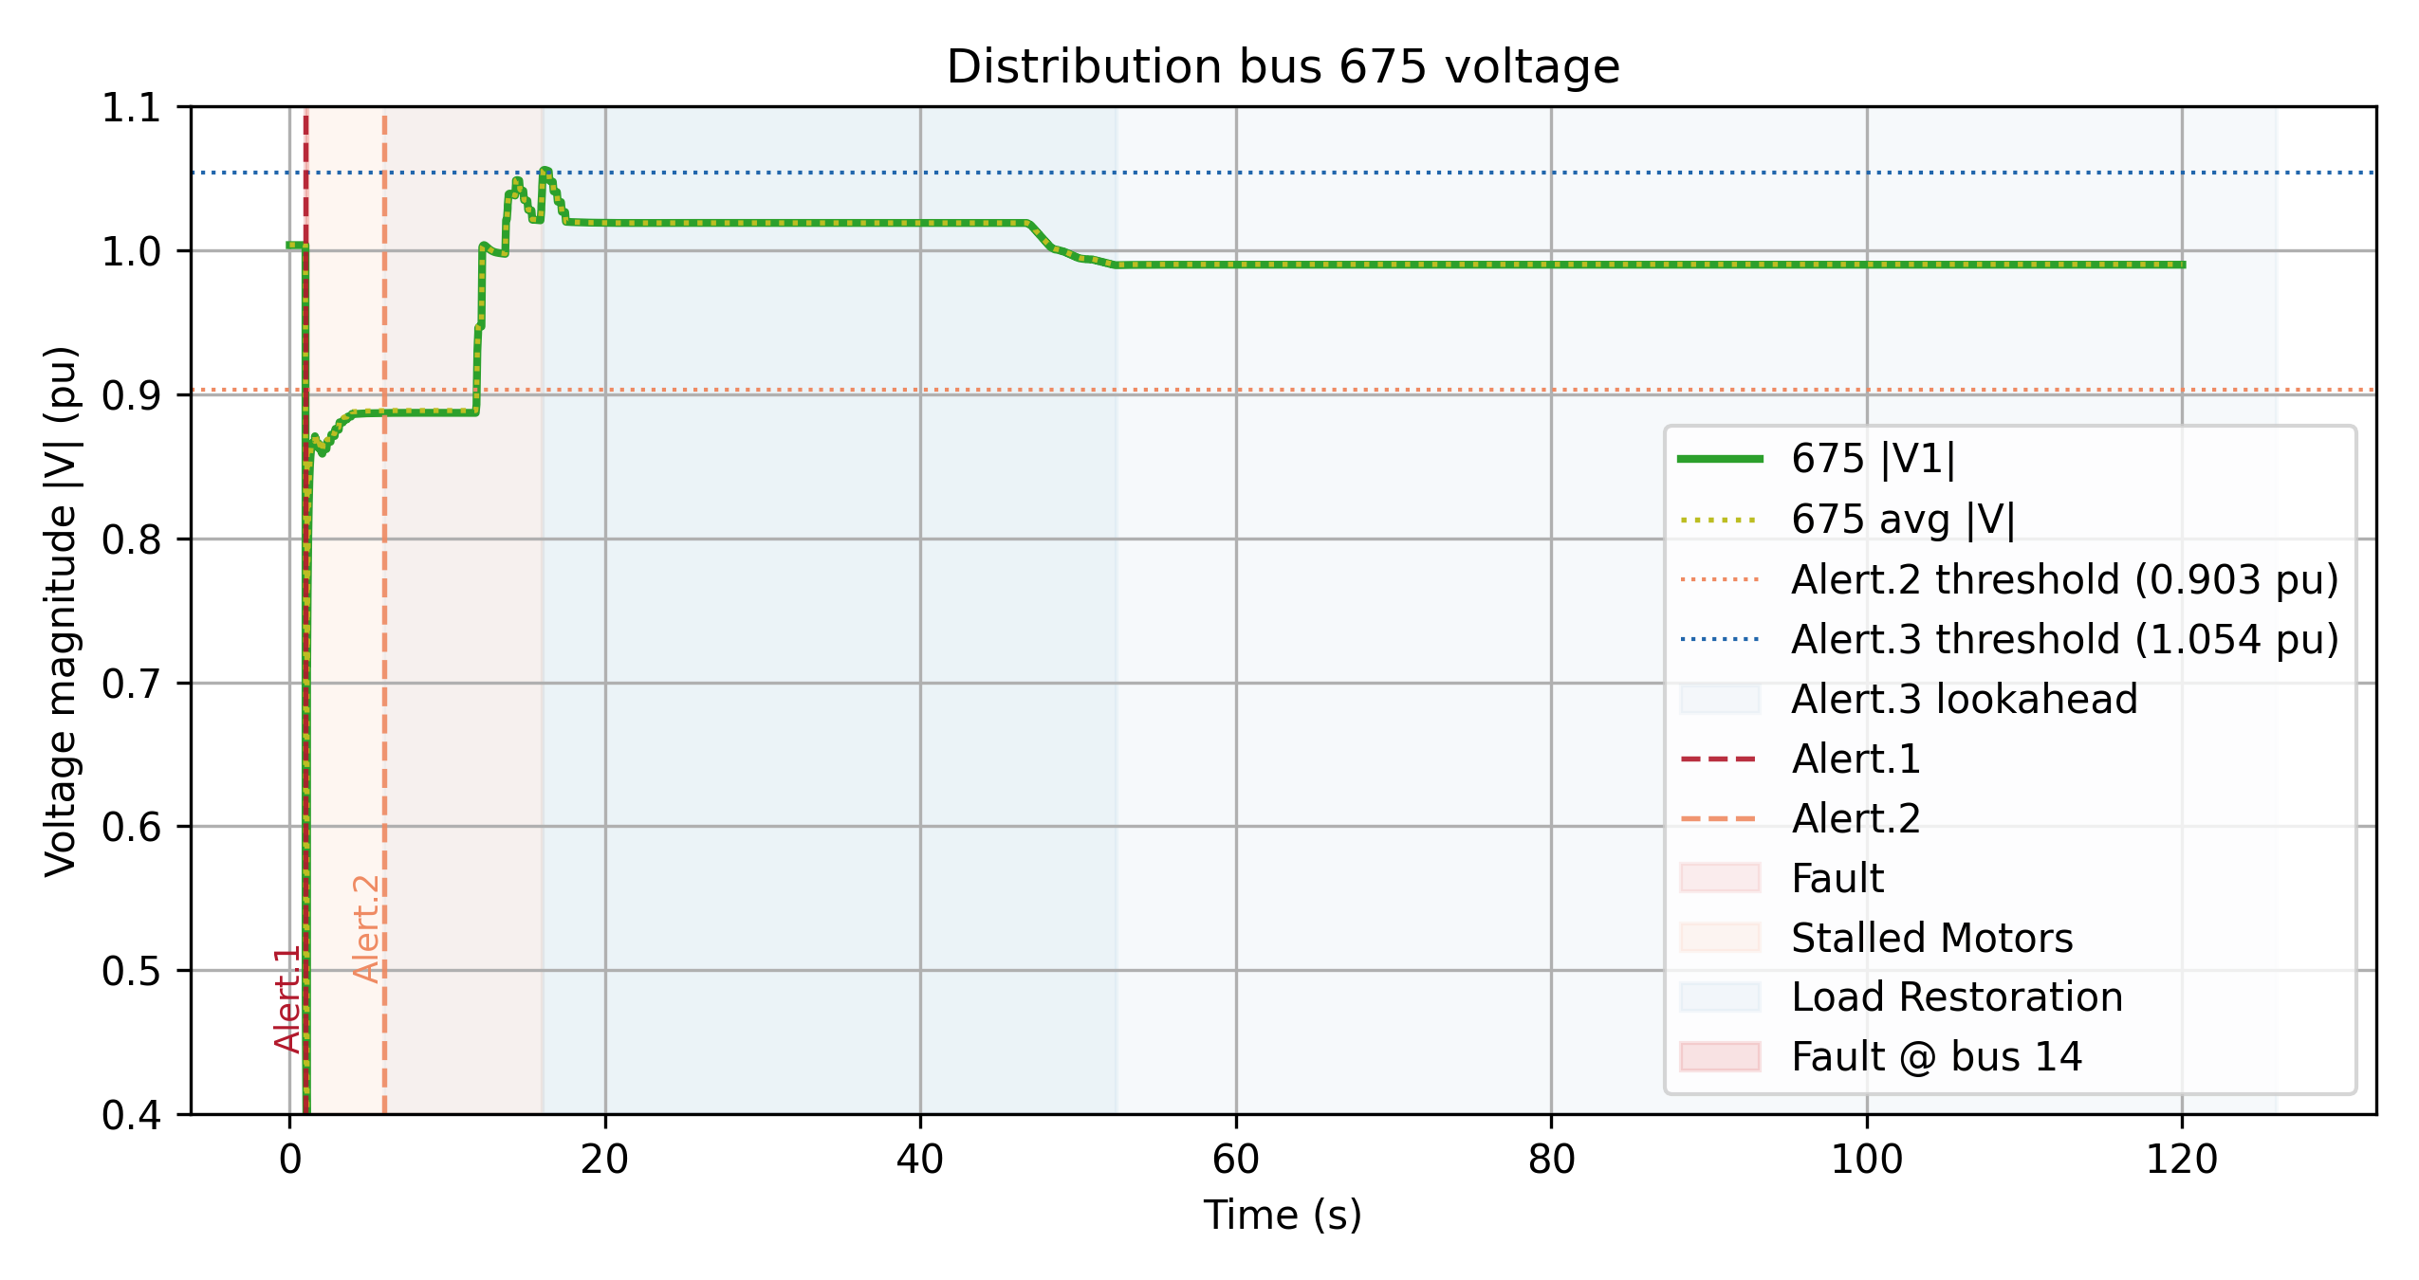
Dynamic Transmission-Distribution Co-simulation
Transmission side
Distribution side
Fault and motor stalling: By around 1.06, all 12 motors have stalled.
Delayed low voltage recovery: Voltage is around 0.88 to 0.91 for a several seconds, and regulator type moving from 1.05 to 1.10.
Motor tripping causes voltage rise: As stalled motors trip. motor reactive power scale reduces from 15.00 to 1.93, and voltage rises from 0.95 to 1.07

Slide 36
Dynamic Transmission-Distribution Co-simulation
Fault and motor stalling: By around 1.06, all 12 motors have stalled.
Delayed low voltage recovery: Voltage is around 0.88 for a several seconds, and regulator type moving from 1.05 to 1.10.
Motor tripping causes voltage rise: Motors trips from around 11s to 16s, causing a voltage overshoot to about 1.05.
Types wind down and bus voltage settles near 1.02.
Motors reconnected and pull back the voltage to 0.99 after 50s.
Distribution side

Slide 37
Dynamic Transmission-Distribution Co-simulation
Time window | Stages | Actions | Observision
0 - 1.0 s | Pre-fault | Substation 675 | Voltage
1.0 - 1.1 s | Fault occurs | Alert.1 at 1.004 s | Voltage
1.1 - 12 s | Delayed recovery | Substation 675 | Voltage
12 - 16 s | Trip cascade | first thermal tripped about 11.8 s, the rest tripped by 16 s | Thermal trip logic removing stalled motors in groups
16 - 16.5 s | Overvoltage overshoot | Peak voltage ≈ 1.06 pu near 16 s | Sudden load removal with capacitors still on and tap regulators elevated
17 - 18 s | Tap unwind | taps step from about 1.07 down to 1.03 | Tap regulator
47 - 52 s | Load restoration | restore fraction ramps from 0 to 1.0 | Voltage

