Slide 1
Dynamic FIDVR Response in Transmission-Distribution Co-Simulation
Teng WANG

Slide 2
Overall
Introduction
Literature review
Methodology
Case studies
Conclusion

Slide 3



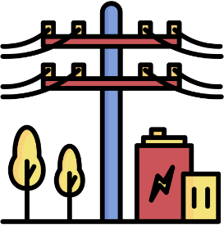








Introduction: motivation
Traditional power system simulation
Modern power system simulation
Transmission system
Balanced
Positive sequence
Represent as equivalent load
Increasing interaction
Distribution system
Unbalanced
Near unity X/R ratios

Slide 4
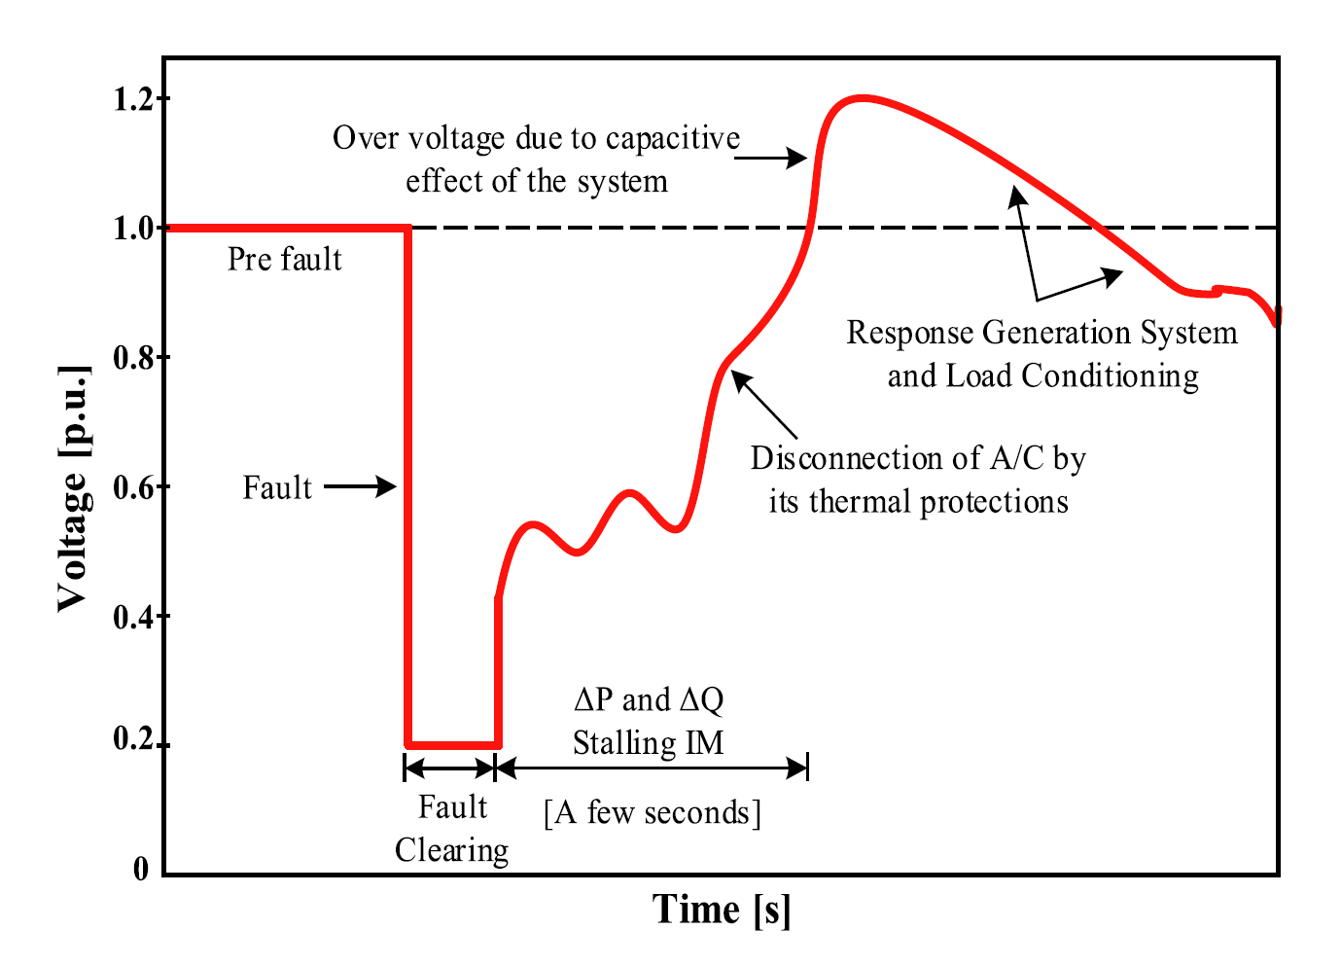
Introduction: backgroud
Fault clears
Explanatory FIDVR response
Motor stall
Draw high Q
Thermal Protection
Motor trips
V overshoot
Capacitor off
Motor back
V dips
Capacitor on
…

Slide 5
Literature Review
 |  | Approach | Main contribution | Network representation | Remaining limitation
Motivation model | [1] | Field motivated FIDVR models | Estimates variables, including tilt angle, azimuth angles, and albedo, which are related to irradiance. | 115 kV and 66 kV sub-transmission systems. | Limited feeder level and phase domain resolution.
Composite model | [2] | WECC composite load mode | Estimate model parameters using the MD model’s equations. | Southern California Edison Valley substation. | Does not resolve feeder topology, phase imbalance, or the spatial distribution of stalled single-phase motors
 | [3] | WECC CMPLDW with variable-frequency drive(VFD) air conditioners | Estimate irradiance by employing an optimization-based approach derived from the equations of the SD model | Utility planning network. | Focuses on the effect of VFD A/C penetration rather than feeder level motor stalling diversity.
EMT model | [4] | EMTP point-on-wave model | Estimate model parameters using the SD model’s equations. However, the uncertainty of the irradiance sensor was not considered. | Can estimate model parameters that correspond to the V-I curve and V-P curve in the manufacturer's datasheet. | High model detail limits scalability for large system dynamic studies.
 | [5] | Hybrid EMT transient stabil-ity model | Coupled PSCAD/EMTDC and InterPSS through a three-phase boundary equivalent to study unbalanced faults and A/C motor stalling in a large WECC system. | Sub-transmission and distribution systems supplied from selected WECC buses. | Uses equivalent feeders and a fundamental frequency interface, which limits detailed feeder topology and harmonic representation.
 | [6] | Coupled PSLF-OpenDSS study with WECC CMPLDWG and PVD1 | Showed that feeder level inverter ride-through behavior can significantly change the bulk system response during a disturbance. | WECC transmission case with distribution feeders and IEEE 1547 ride-through logic. | Focuses on DER/PV ride-through rather than compressor-motor stalling and FIDVR motor dynamics.
Composite model | Proposed work | WECC ld1pac model | Develops an open source, feeder level, FIDVR oriented extension of T&D dynamic co-simulation using ANDES-OpenDSS-HELICS. | IEEE 14-bus transmission system coupled to an IEEE 13-node feeder.

Slide 6
Literature Review: Co-simulation Framework
 | Category | Transmission tools | Distribution tools | System network
[7-10] | Static T&D co-simulation | MATLAB, FESTIV/Matpower | OpenDSS, MATLAB, GridLAB-D | IEEE 9/14/39-bus transmission systems with small or utility feeders
[11-15] | Dynamic T&D co-simulation | PSCAD/EMTDC, InterPSS, PSAT, PSLF, three-phase dynamic models | OpenDSS, GridLAB-D, EMT/OpenDSS, three-phase models | IEEE 9/39-bus or WECC systems coupled with feeders from 8 buses to thousands of nodes
[16-17] | Distribution dynamic | No explicit transmission model | GridLAB-D, EMT/OpenDSS | IEEE 123-node/IEEE 8500-node feeders
[18] | Selected Framework | ANDES | OpenDSS | ACTIVSg2000 transmission system coupled with large scale distribution networks with over one million nodes
W. Wang, X. Fang, H. Cui, F. Li, Y. Liu and T. J. Overbye, "Transmission-and-Distribution Dynamic Co-Simulation Framework for Distributed Energy Resource Frequency Response," in IEEE Transactions on Smart Grid, vol. 13, no. 1, pp. 482-495, Jan. 2022, doi: 10.1109/TSG.2021.3118292.

Slide 7
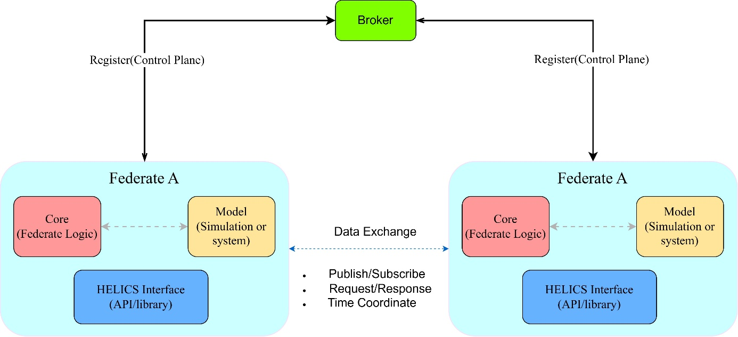
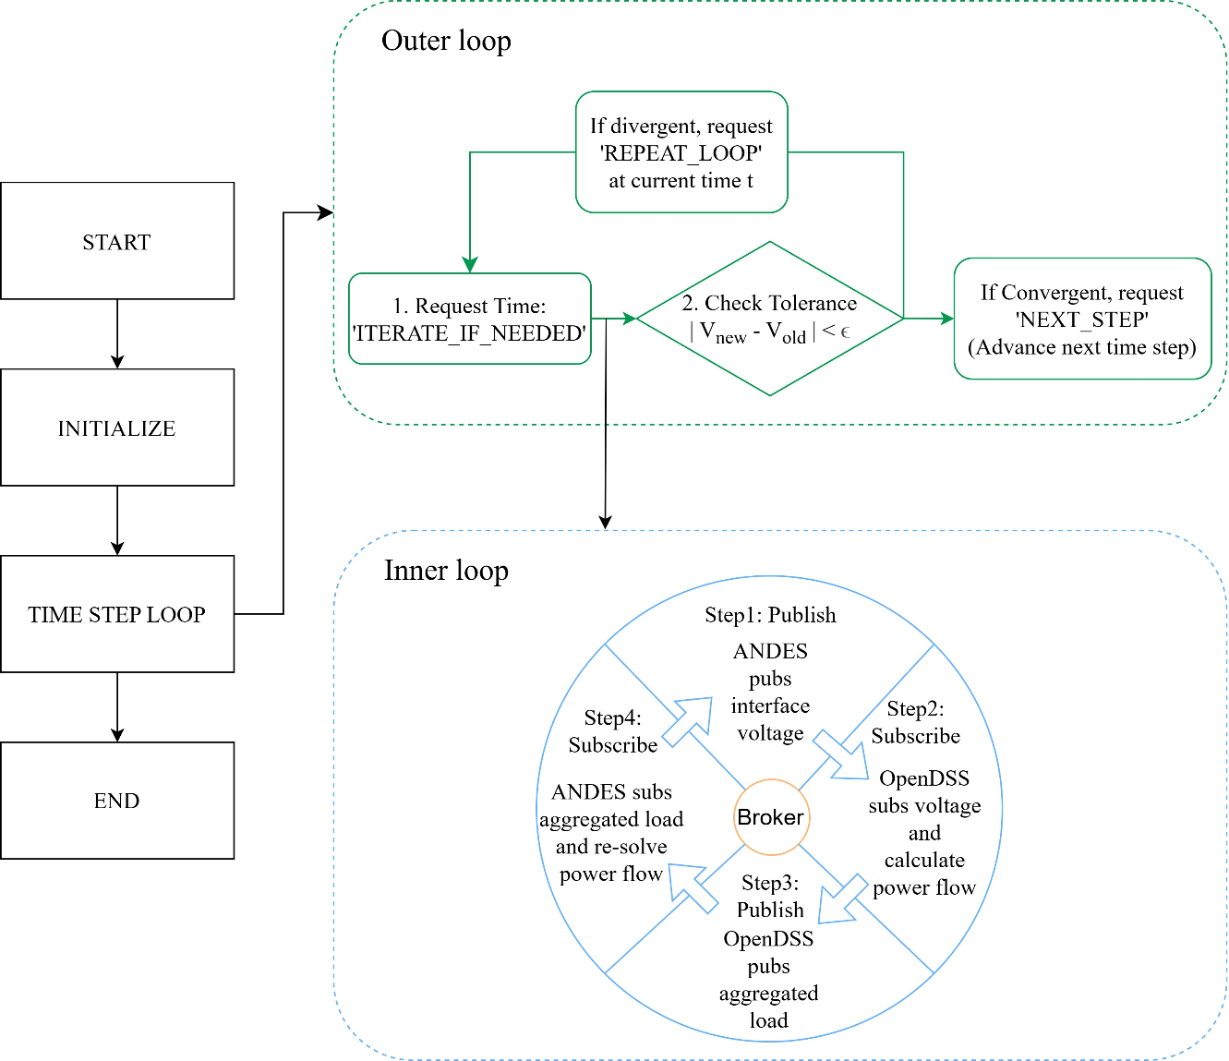
Methodology: HELICS
Hierarchical Engine for Large-scale Infrastructure Co-Simulation (HELICS) was developed to coordinate large-scale co-simulation studies involving power, communication, market, and end-use simulators.
The outer loop advances the global simulation time, whereas the inner loop exchanges boundary variables among federates at a fixed time instant

Slide 8

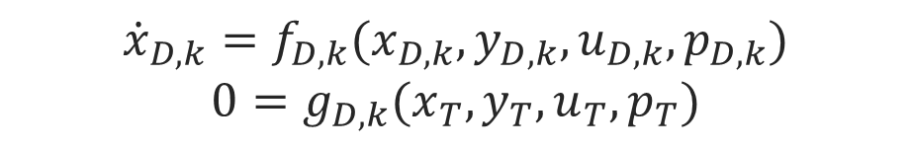

Methodology: Co-simulation
$${\dot{x}}_{T}=f_{T}(x_{T},y_{T},u_{T},p_{T})$$
$$0=g_{T}(x_{T},y_{T},u_{T},p_{T})$$
$${\dot{x}}_{D,k}=f_{D,k}(x_{D,k},y_{D,k},u_{D,k},p_{D,k})$$
$$0=g_{D,k}(x_{T},y_{T},u_{T},p_{T})$$
Where $x_{T}$ denotes the transmission dynamic states, $y_{T}$ is the algebraic variables, $u_{T}$ is the boundary input received from the distribution feeder, and $p_{T}$ is the model parameters. Same definition can be applied to the distribution system.
$$u_{D,k}=V_{abc,k}$$
$$u_{T}=\sum_{k=1}^{N_{f}}{S_{abc,k}}$$
Where $V_{abc,k}$ is the three-phase interface voltage supplied to feeder k, $S_{abc,k}$ is the three-phase complex power drawn by feeder k, and $N_{T}$ is the number of coupled feeders.

Slide 9
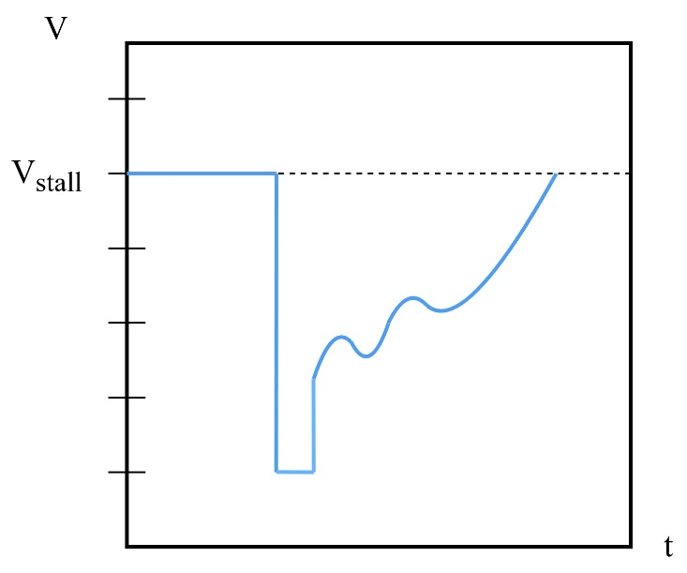

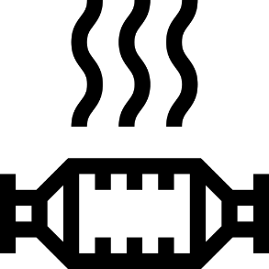
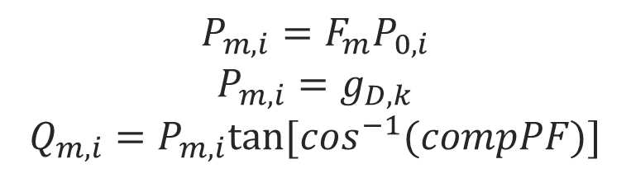
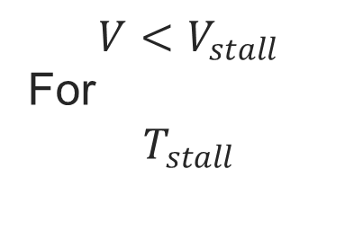
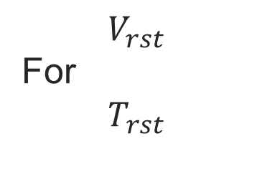


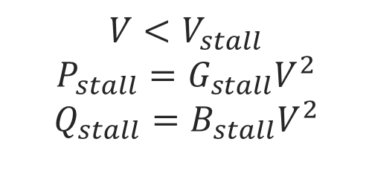
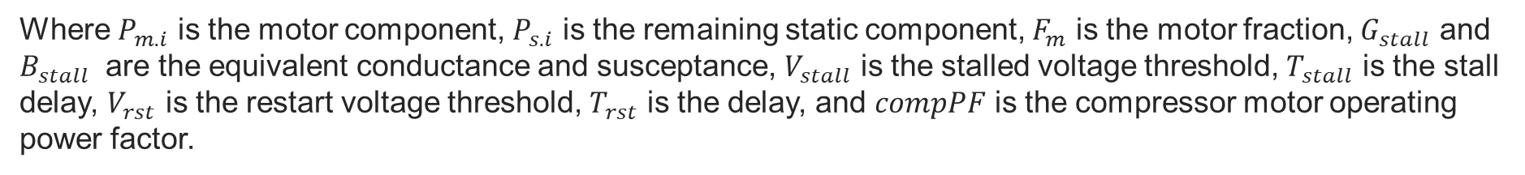
Methodology: Motor
Load split
Stall trigger
Motor stall
Thermal trip
Static
Motor D
$$1−F_{m}$$
$$F_{m}$$
$$V<V_{stall}$$
For
$$T_{stall}$$
$$V<V_{stall}$$
$$P_{stall}=G_{stall}V^{2}$$
$$Q_{stall}=B_{stall}V^{2}$$
$$V_{rst}$$
For
$$T_{rst}$$
$$P_{m,i}=F_{m}P_{0,i}$$
$$P_{m,i}=g_{D,k}$$
$$Q_{m,i}=P_{m,i}tan⁡[\cos^{−1}(compPF)]$$
Where $P_{m.i}$ is the motor component, $P_{s.i}$ is the remaining static component, $F_{m}$ is the motor fraction, $G_{stall}$ and $B_{stall}$ are the equivalent conductance and susceptance, $V_{stall}$ is the stalled voltage threshold, $T_{stall}$ is the stall delay, $V_{rst}$ is the restart voltage threshold, $T_{rst}$ is the delay, and $compPF$ is the compressor motor operating power factor.

Slide 10
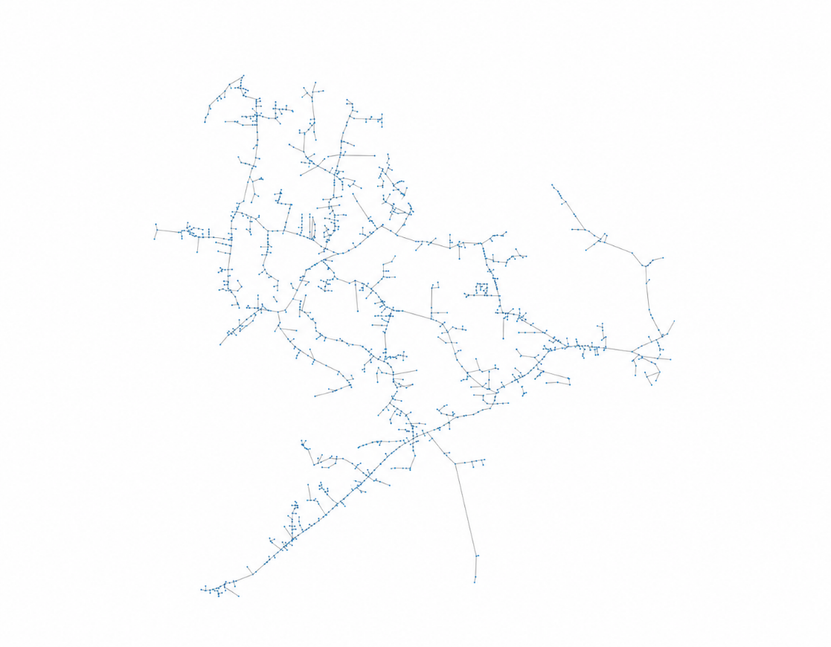
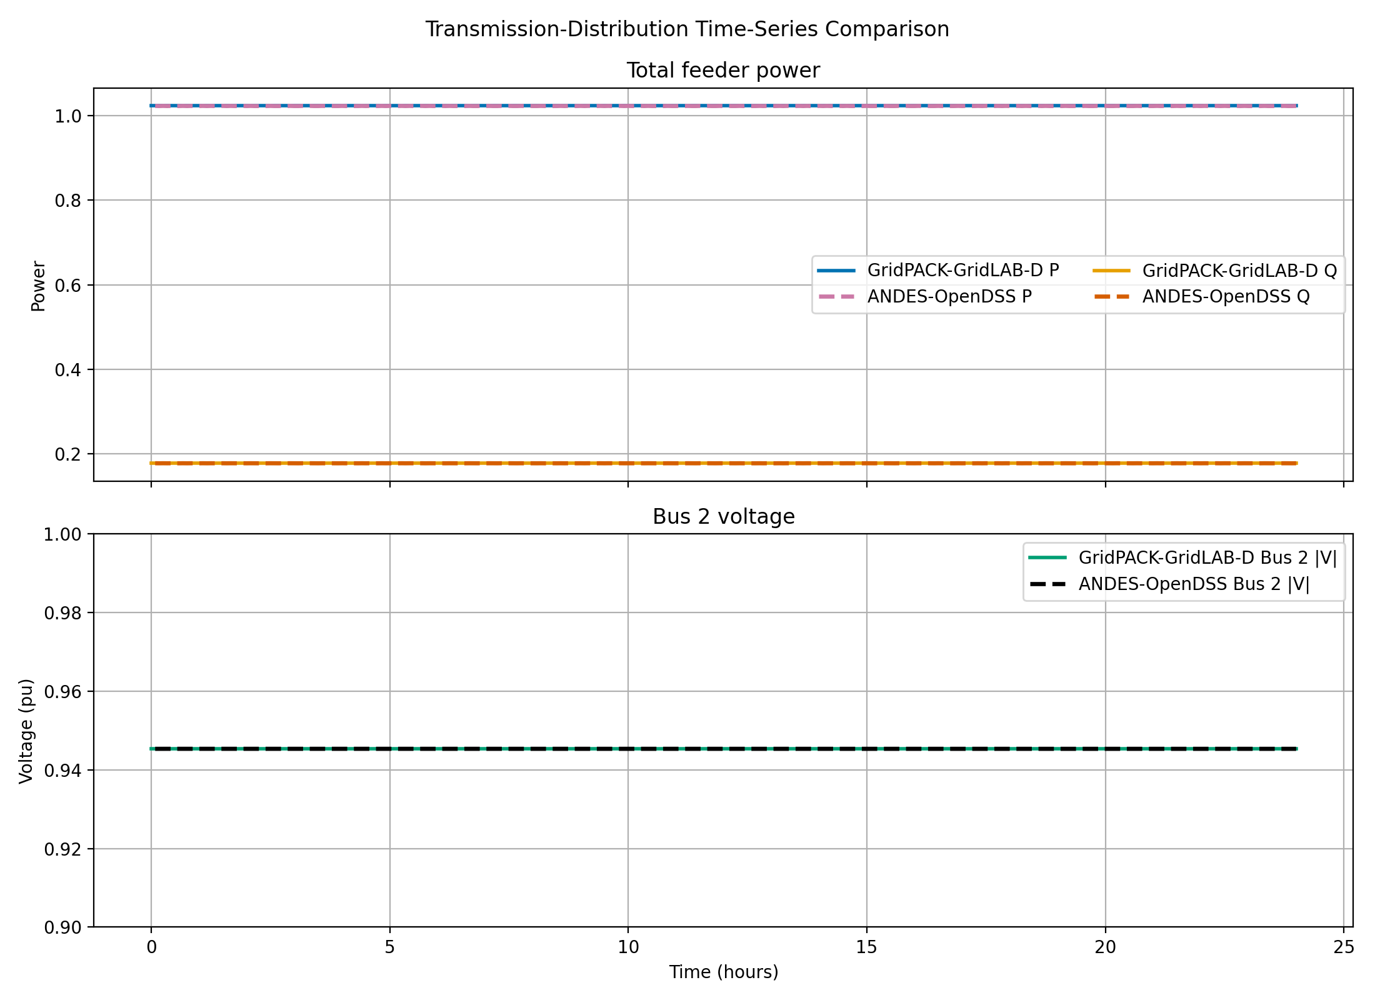
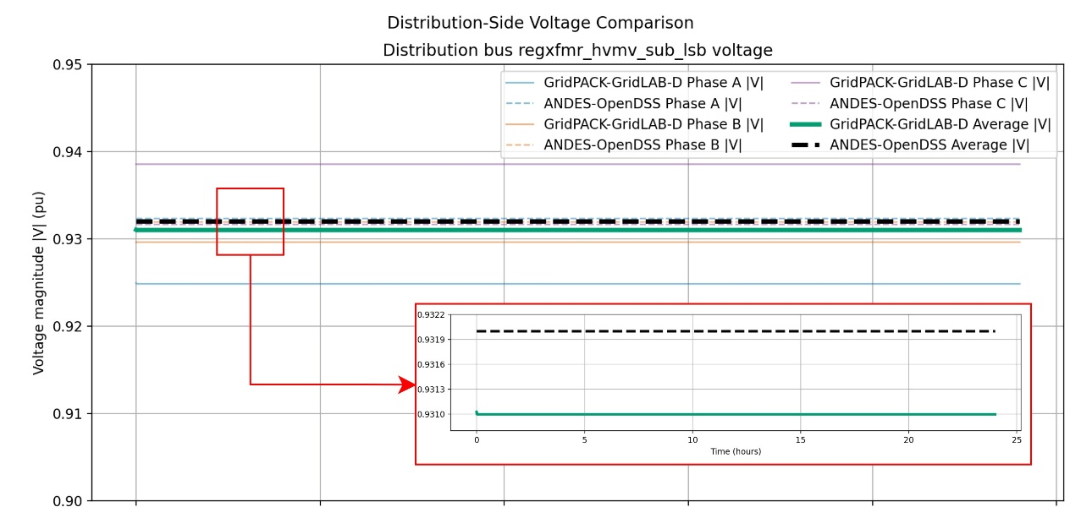
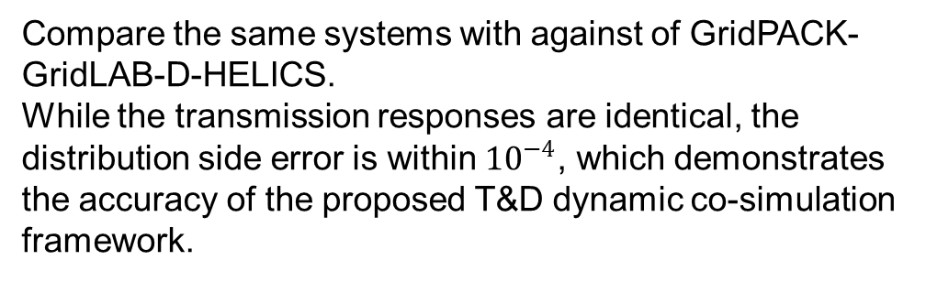
Case Studies: validation
IEEE 118-bus system*
IEEE 8500-nodes system
Compare the same systems with against of GridPACK-GridLAB-D-HELICS.
While the transmission responses are identical, the distribution side error is within ${10}^{−4}$, which demonstrates the accuracy of the proposed T&D dynamic co-simulation framework.
* IIT Power Group, 2003.

Slide 11
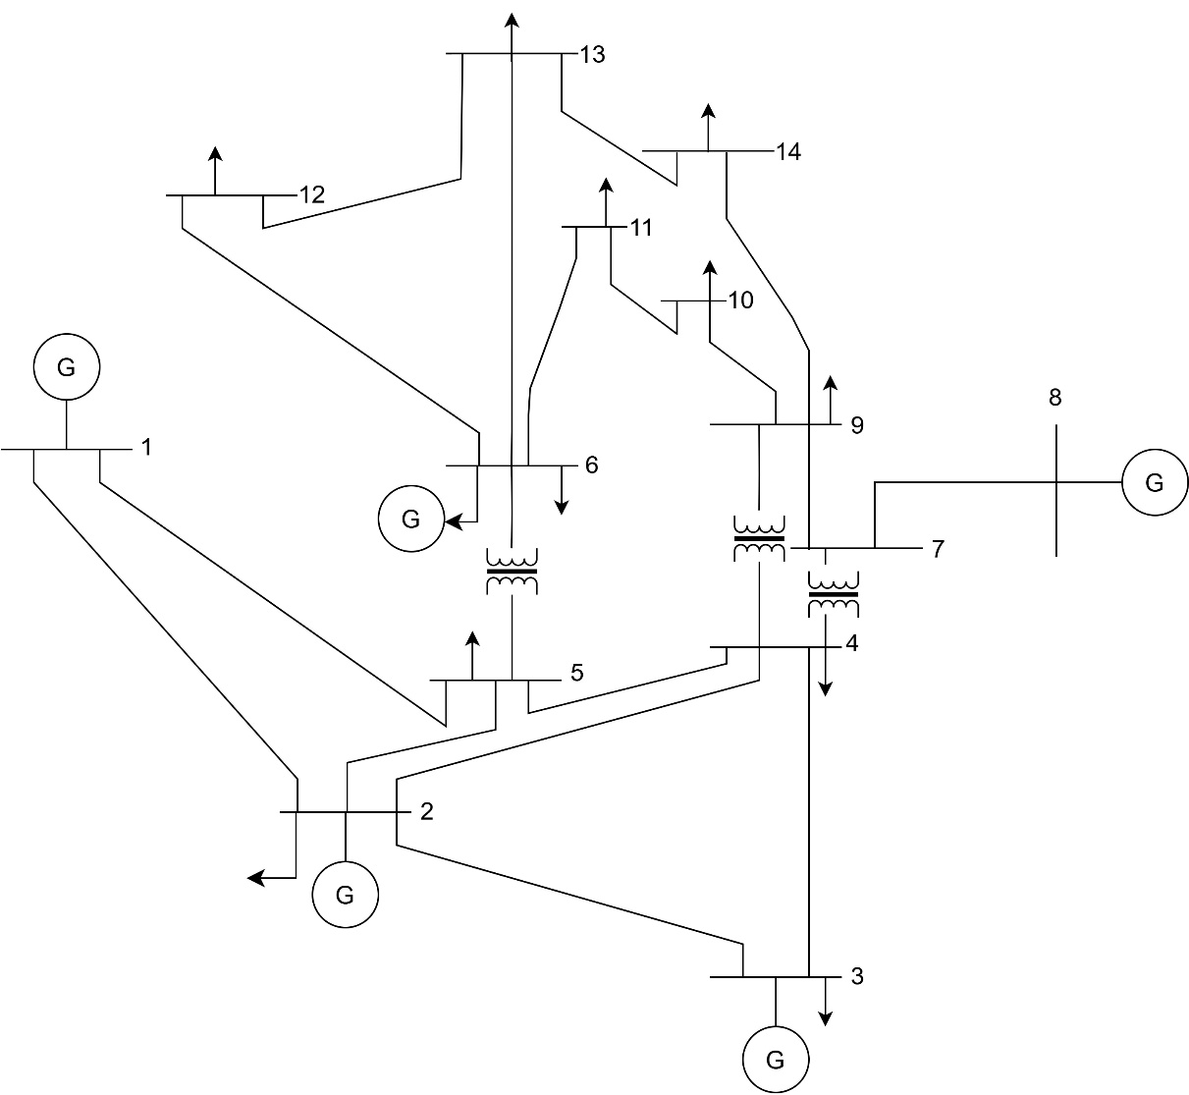
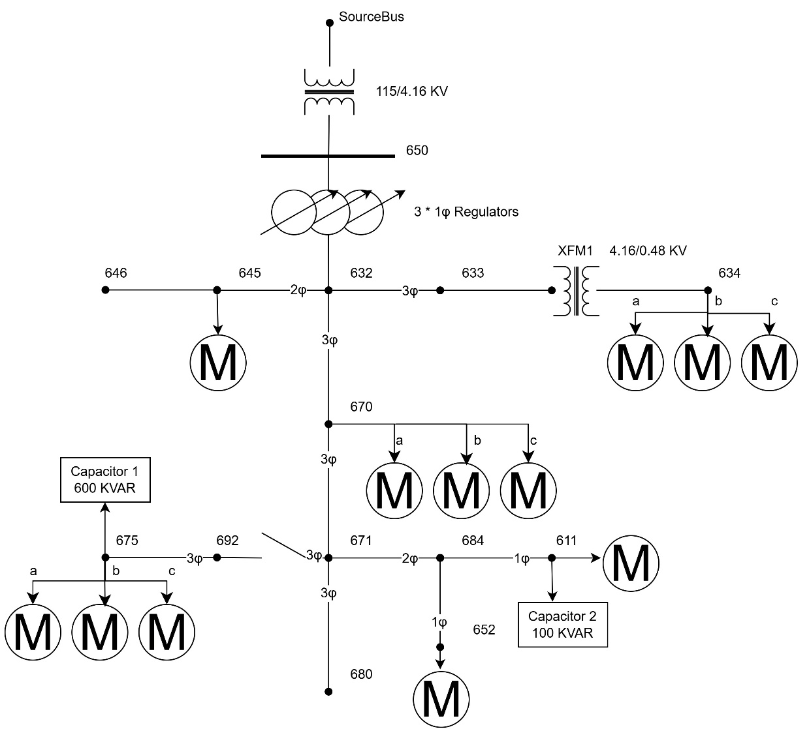
Case Study: Test System
IEEE 14-bus system with dynamic data
IEEE 13-nodes system with added motors

Slide 12
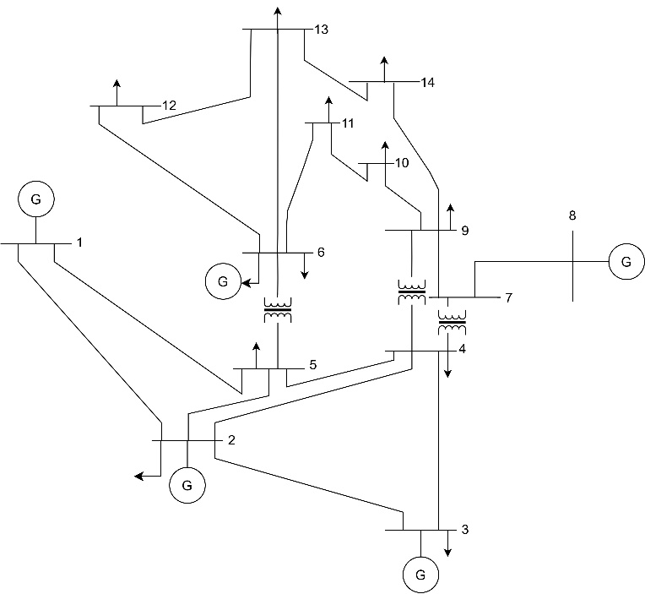
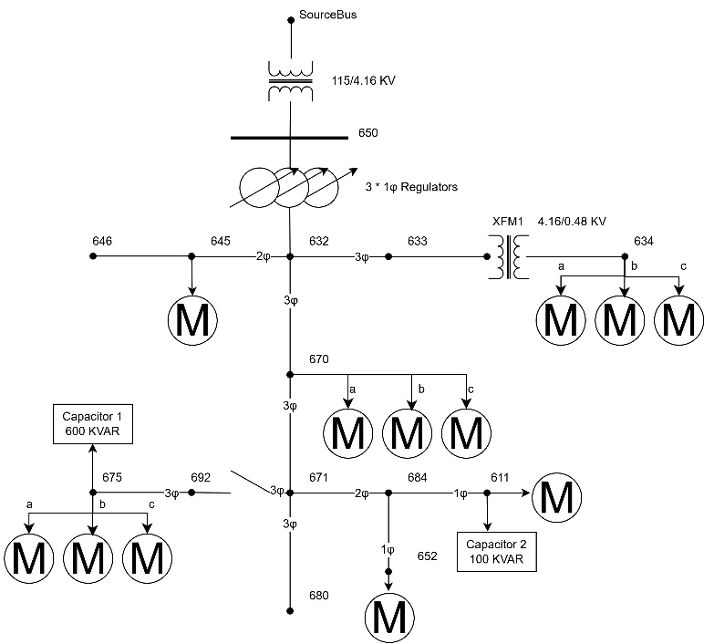
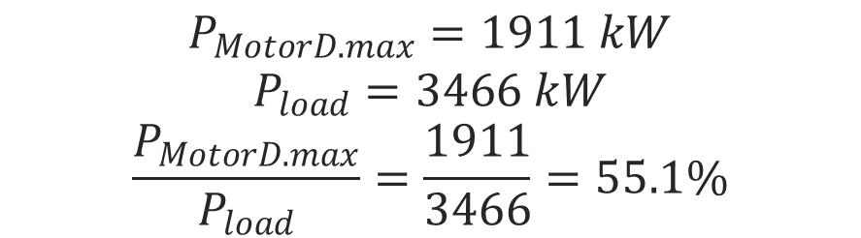
Case Study: Test System
Table1: Basic information of the IEEE 13-node feeder
Item | Value
Total active load | 3466 kW
Total reactive load | 2102 kvar
Motor locations | 634, 645, 675, 611, 652, 670
Maximum Motor D active load | 1911 kW
Motor D active load share | 55.1%
Capacitor at Bus 675 | 600 kvar, three-phase
Capacitor at Bus 611 | 100 kvar, single-phase
For each selected phase load, the original load is divided into a static component and a motor component. The maximum motor share is
$$P_{MotorD.max}=1911 kW$$
$$P_{load}=3466 kW$$
$$\frac{P_{MotorD.max}}{P_{load}}=\frac{1911}{3466}=55.1\%$$

Slide 13
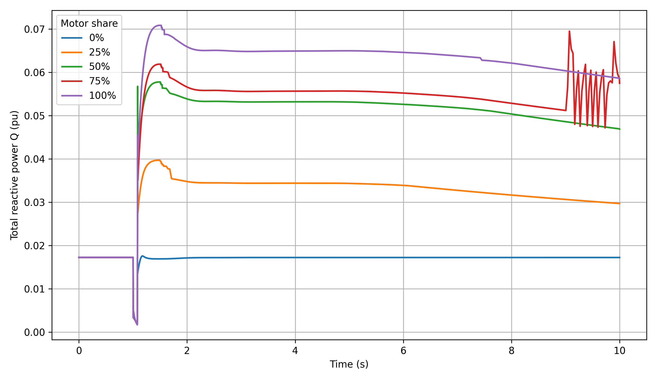
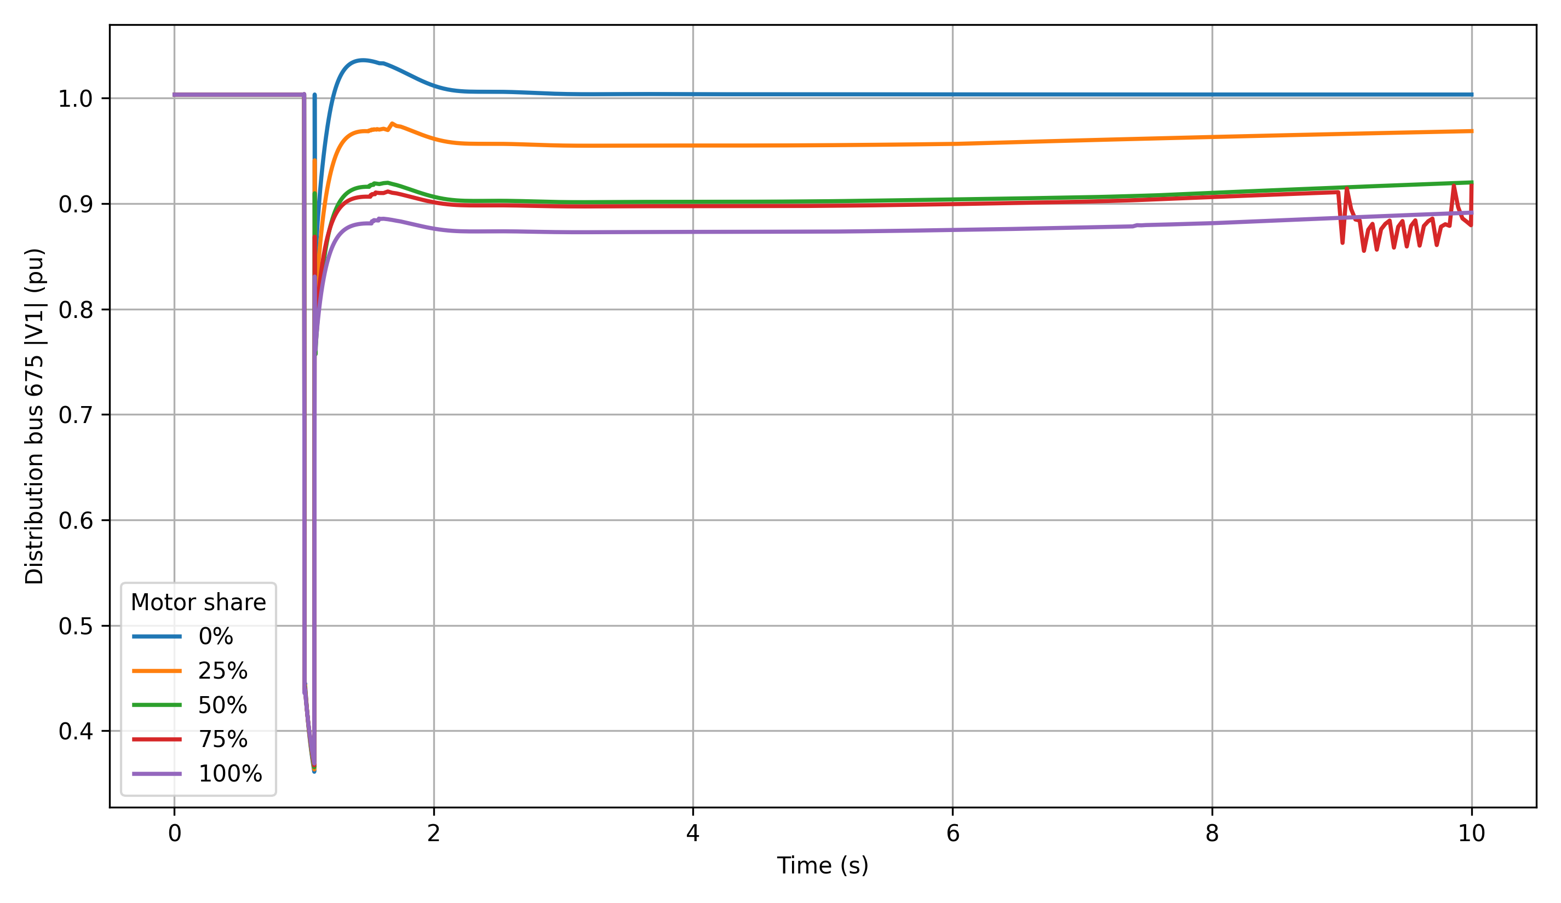
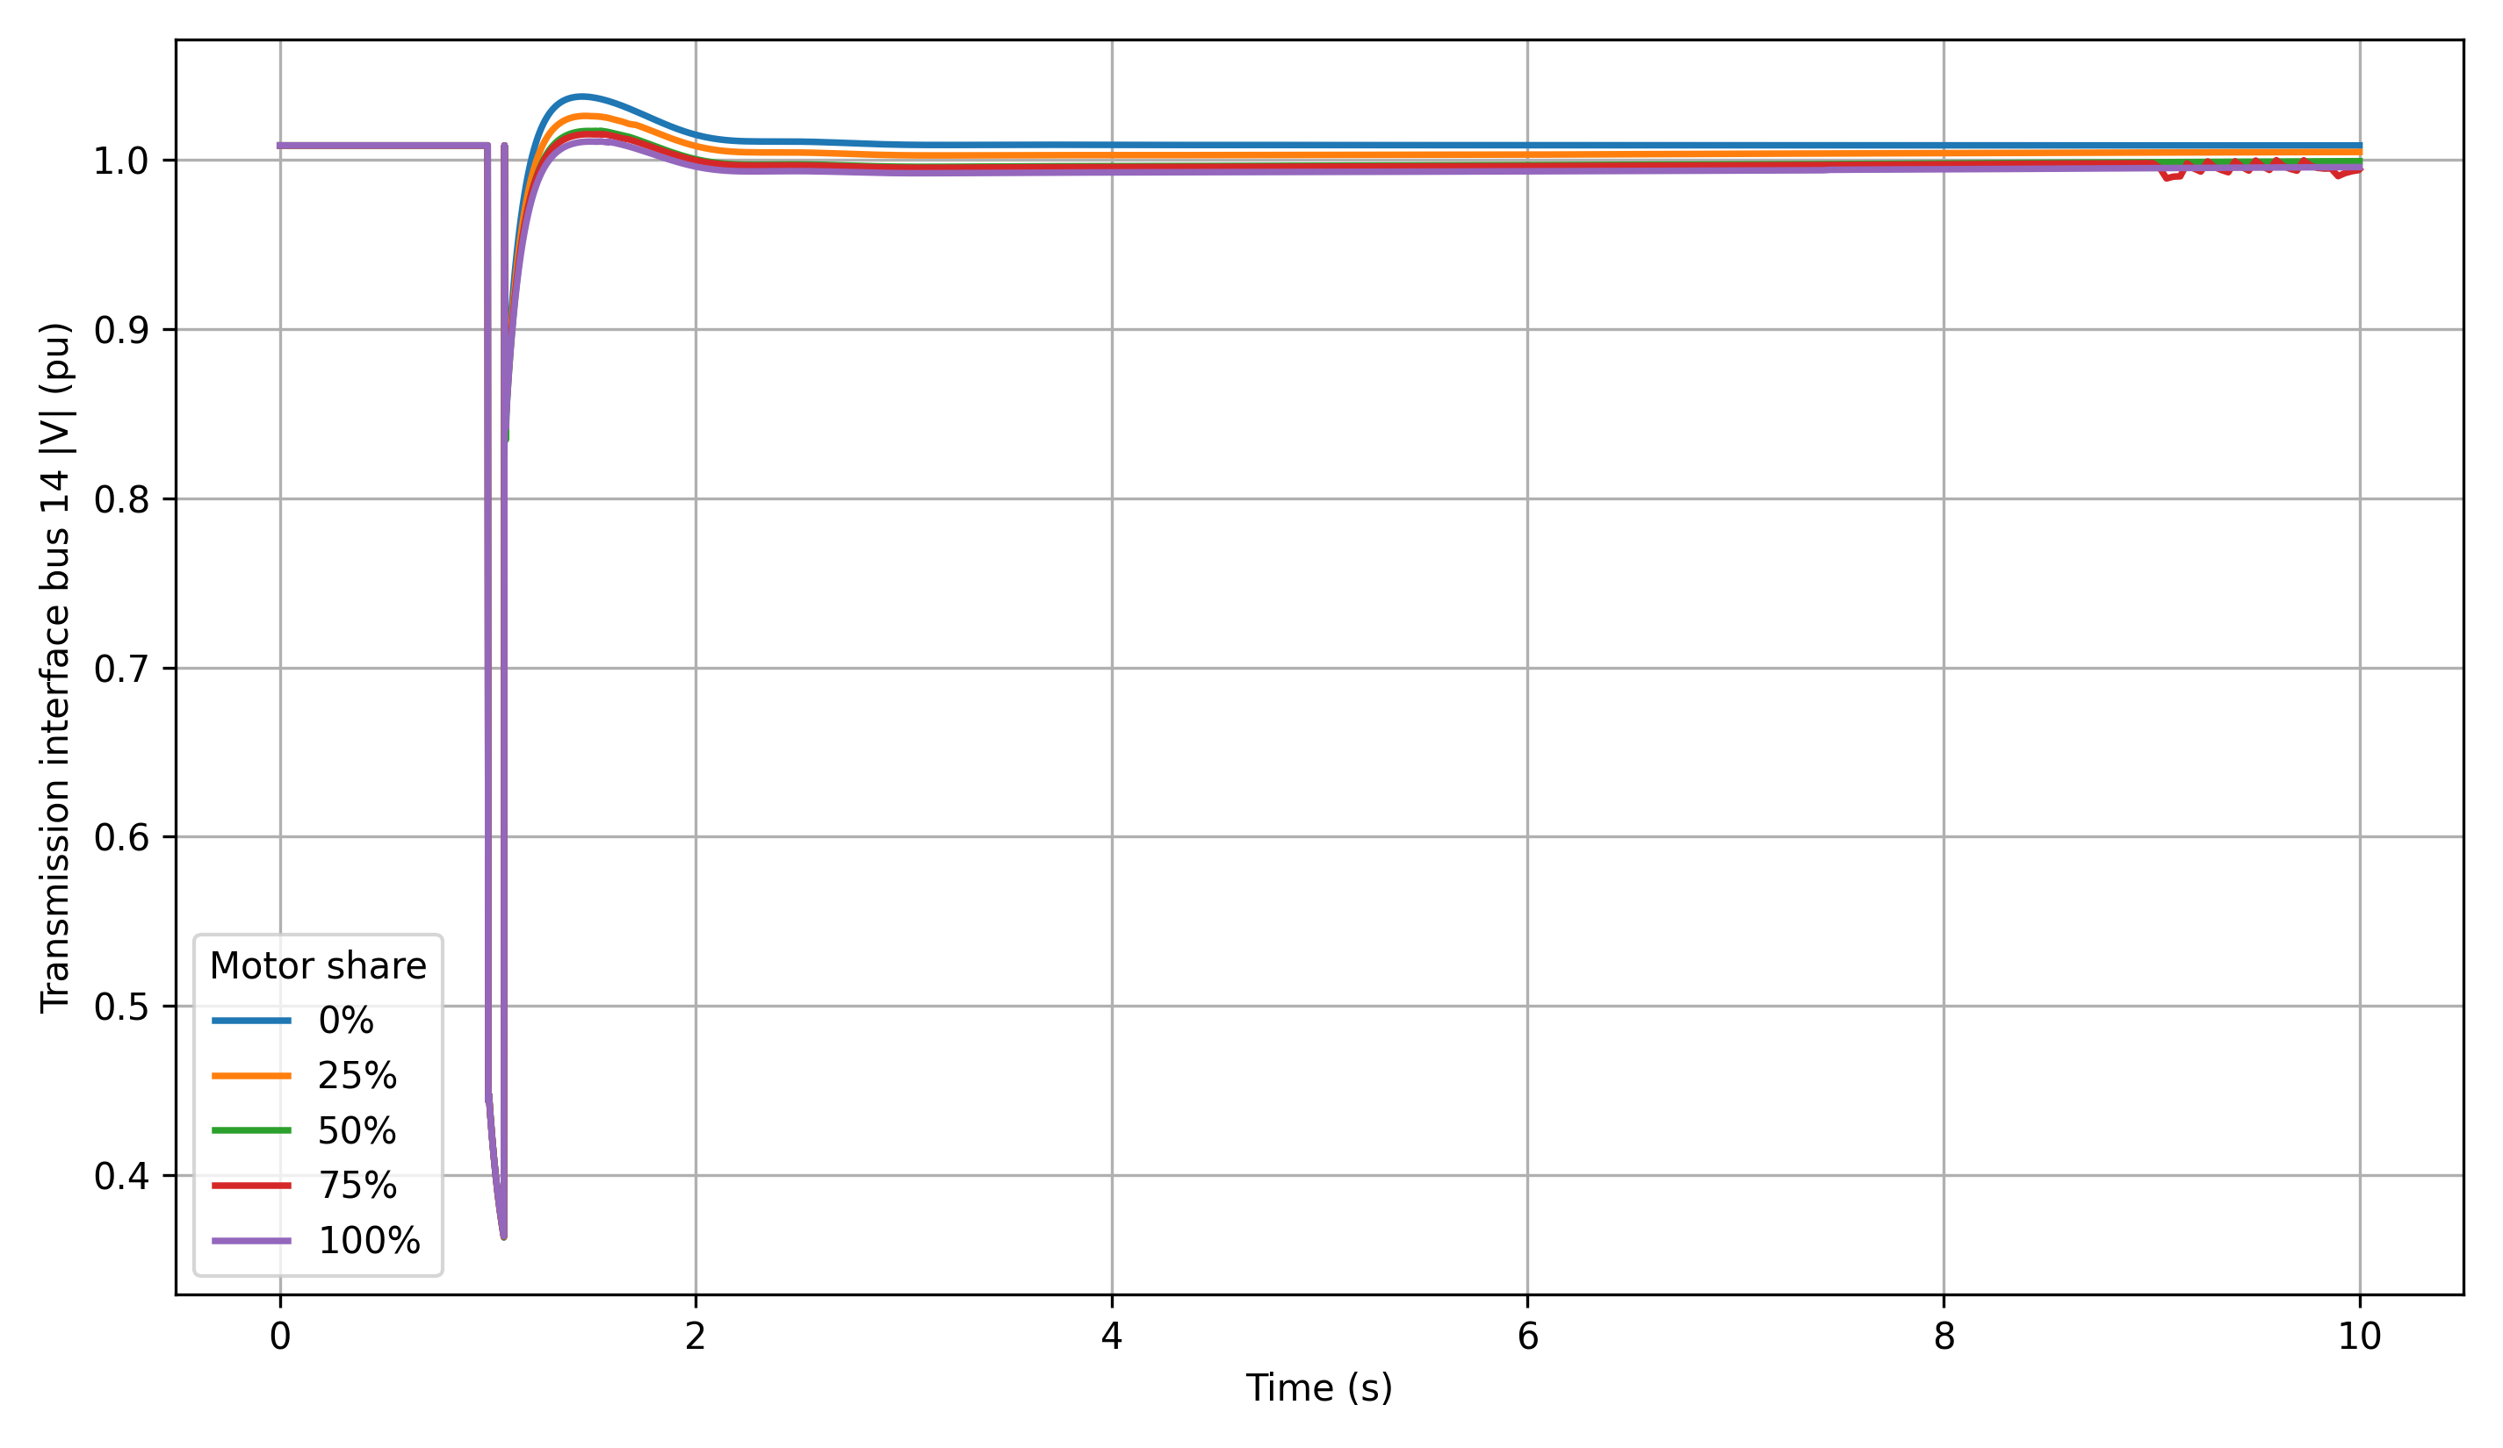
Case Studies
The fault on voltage dip is almost the same, but higher motor share causes worse post-fault recovery.

Slide 14
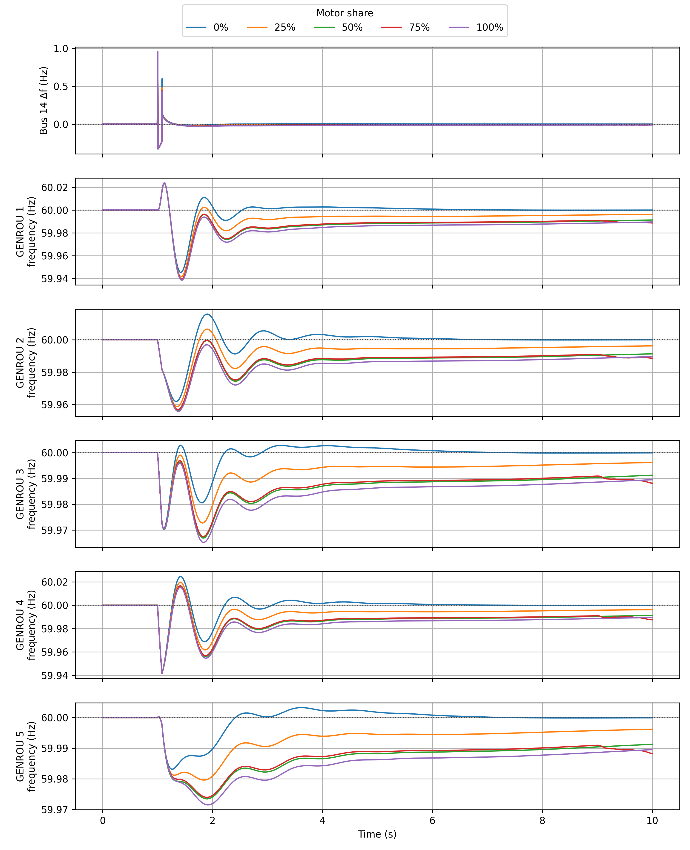
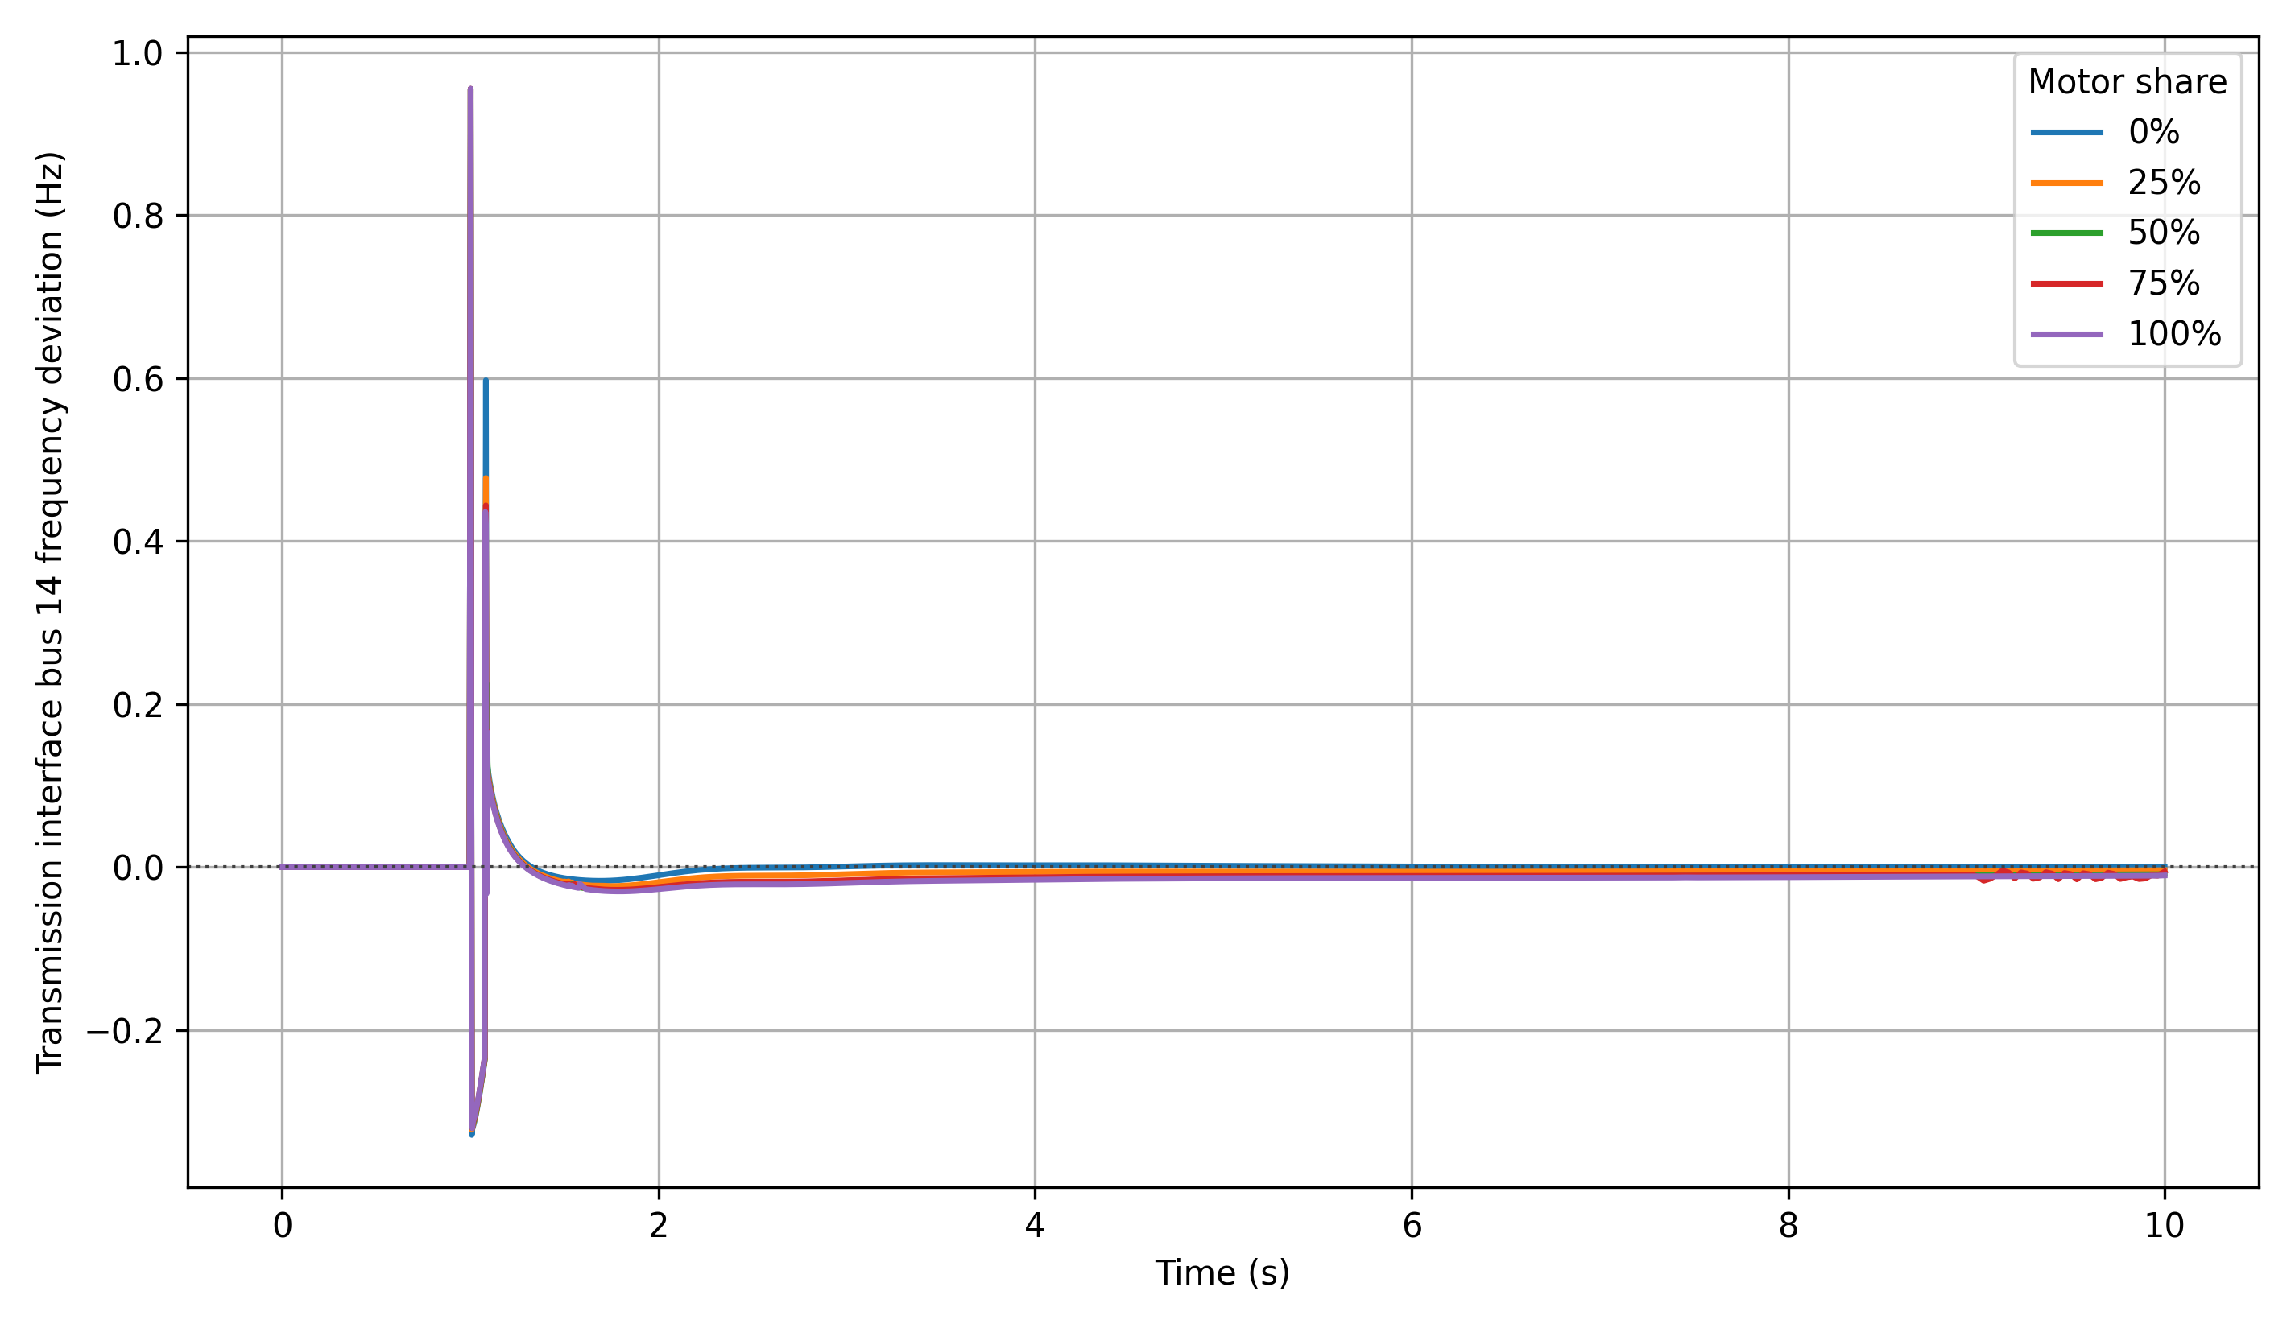
Case Studies
Table2: Fault information
Item | Value
Fault Type | Three-phase to ground
Fault bus | 14
Fault start time | 1s
Fault clear time | 1.08s
Fault resistance | 0.0
Fault reactance | 0.3

Slide 15
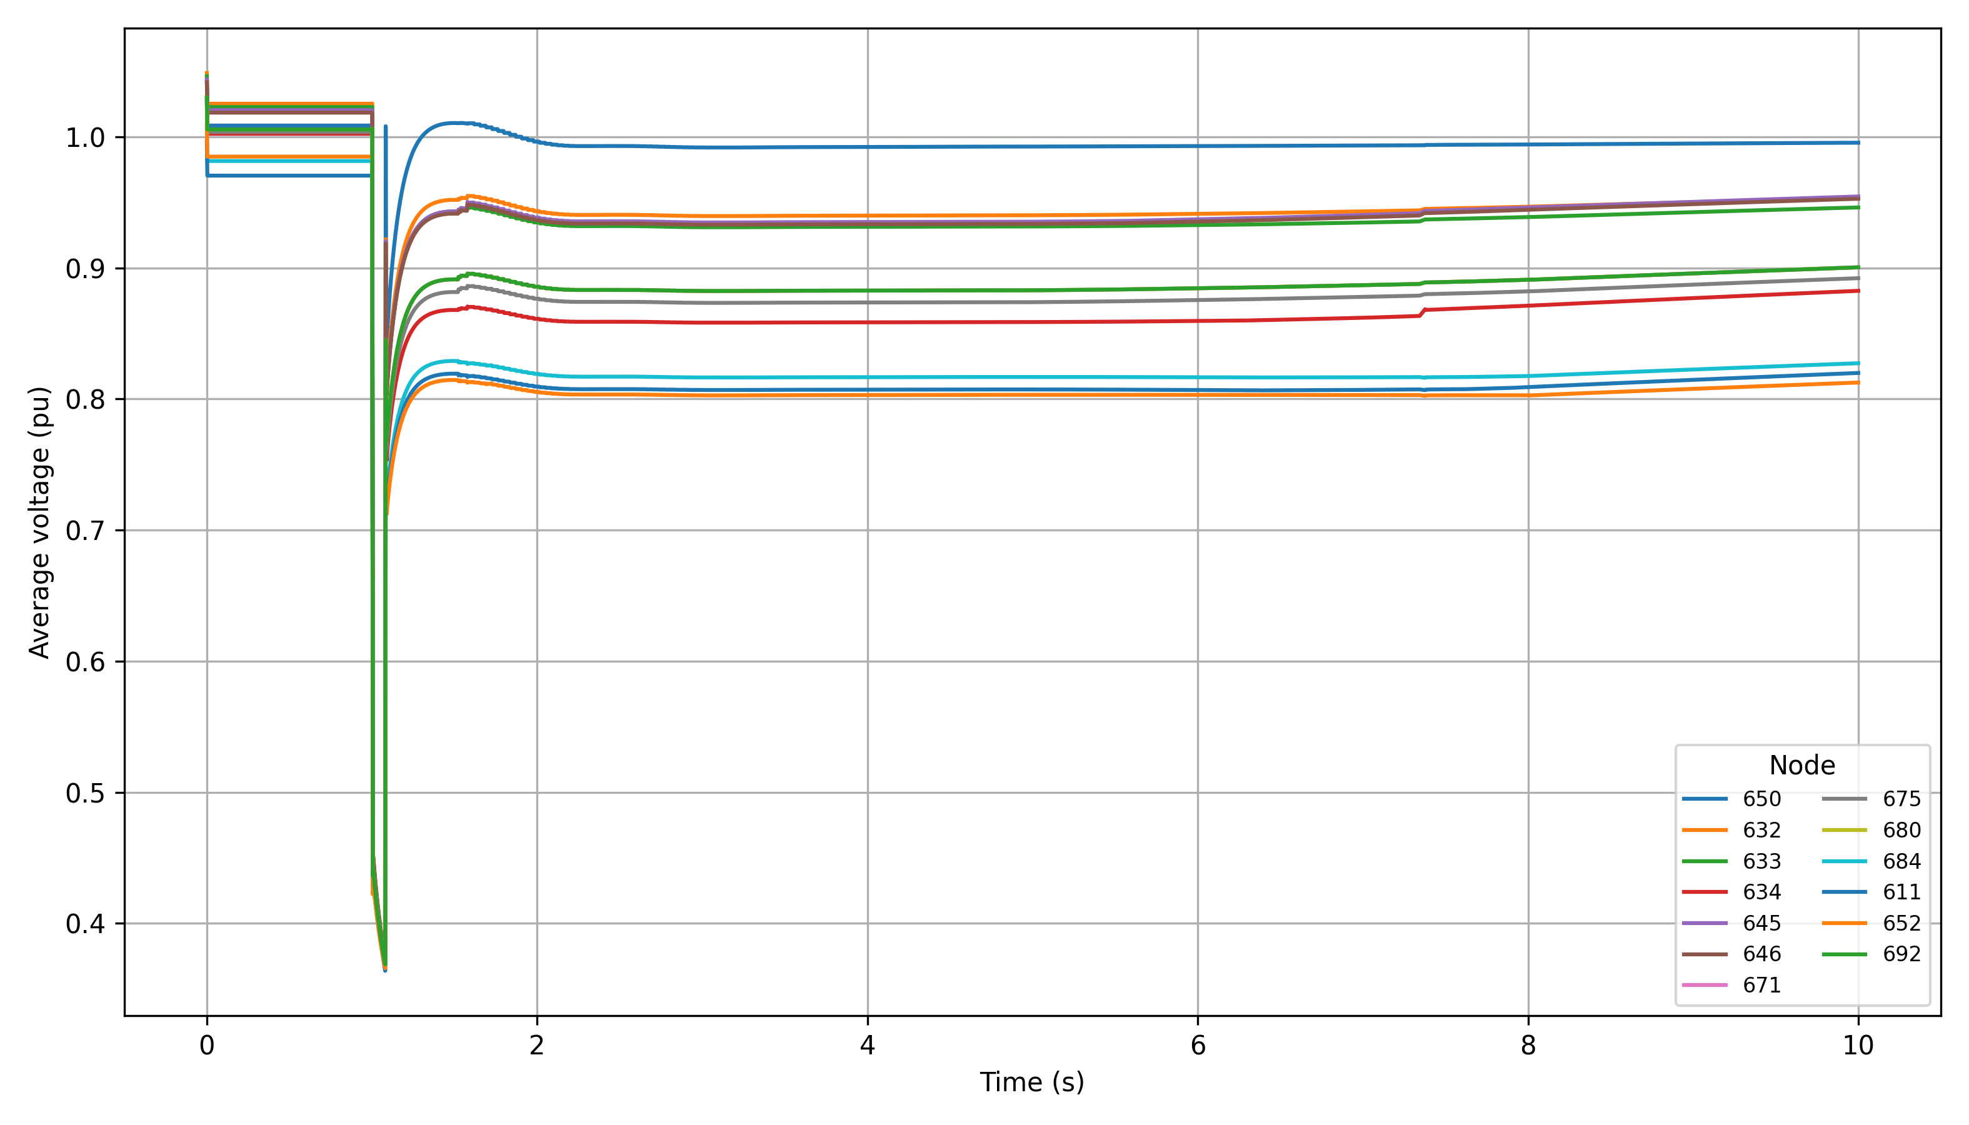
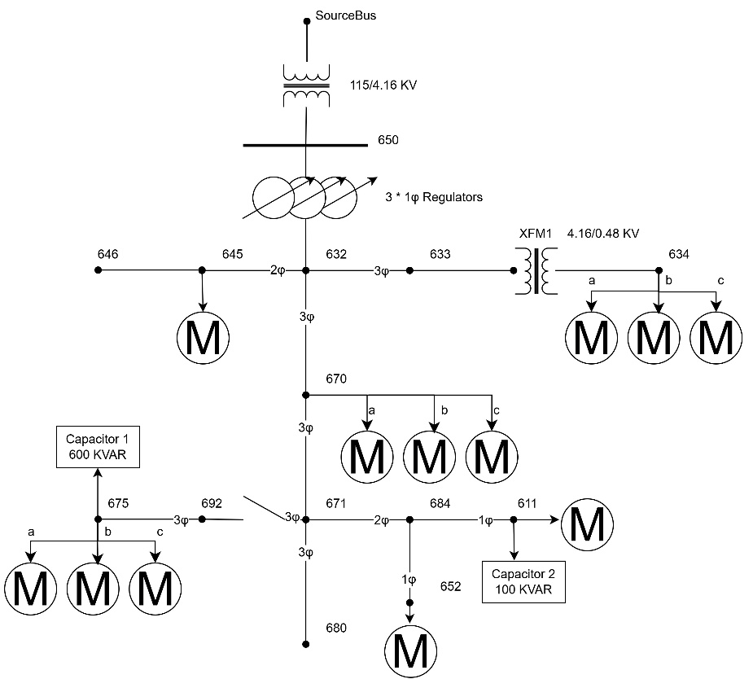
Case Studies
650
652
Applying the same fault, observe that the feeder does not recover uniformly, downstream nodes stay much lower than the source node.

Slide 16
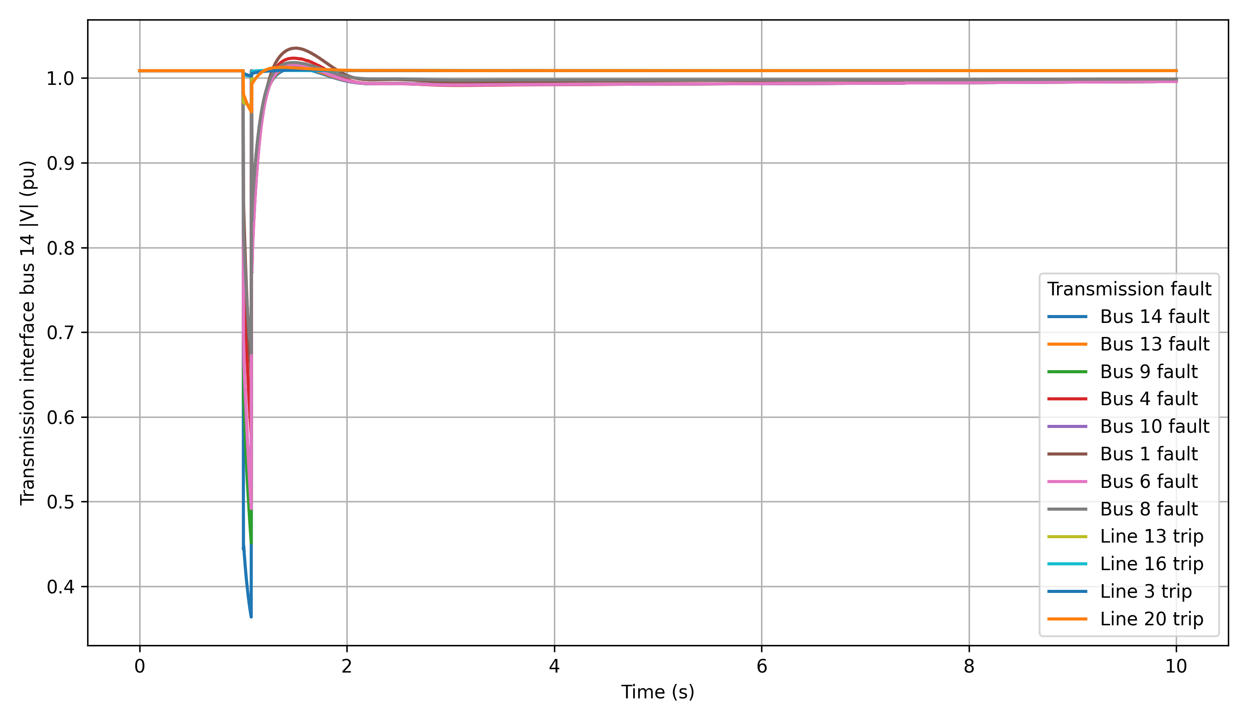
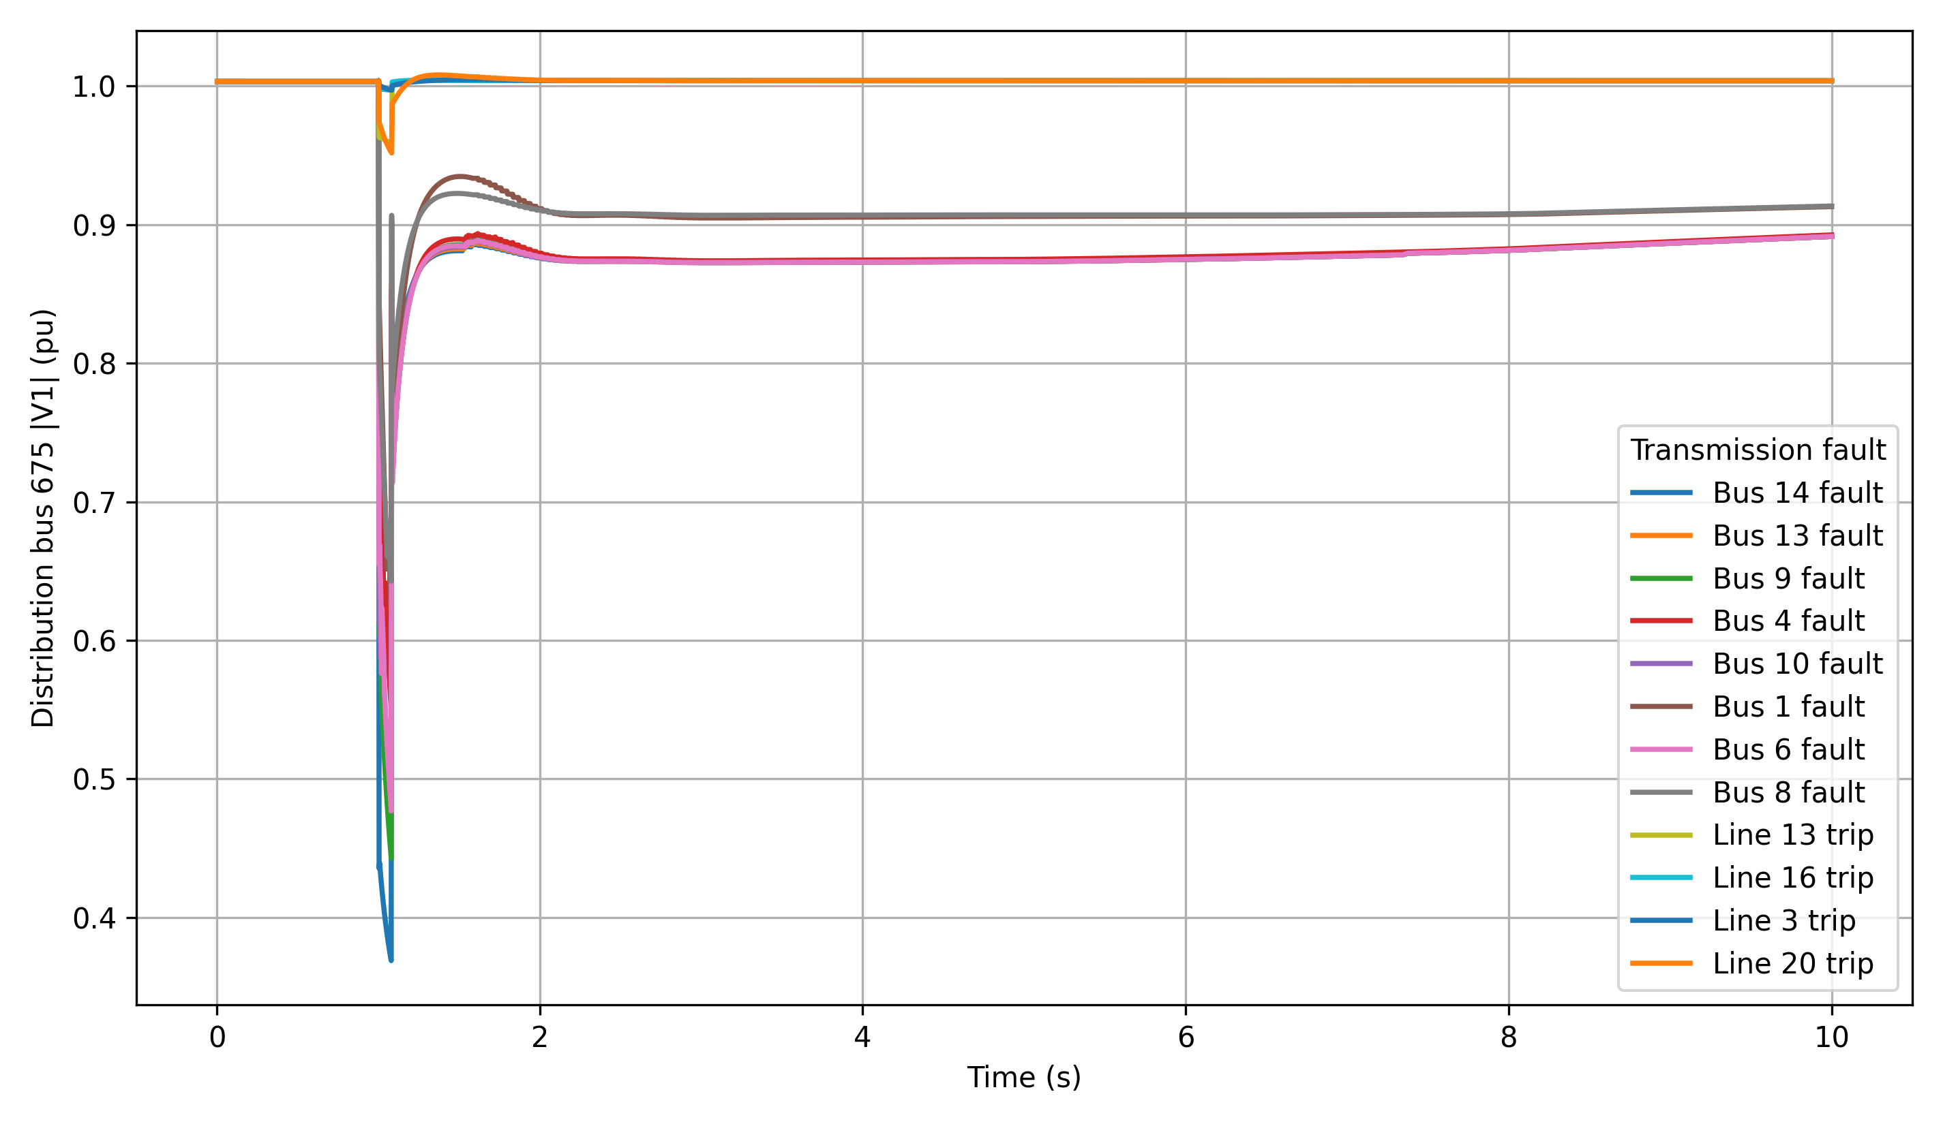
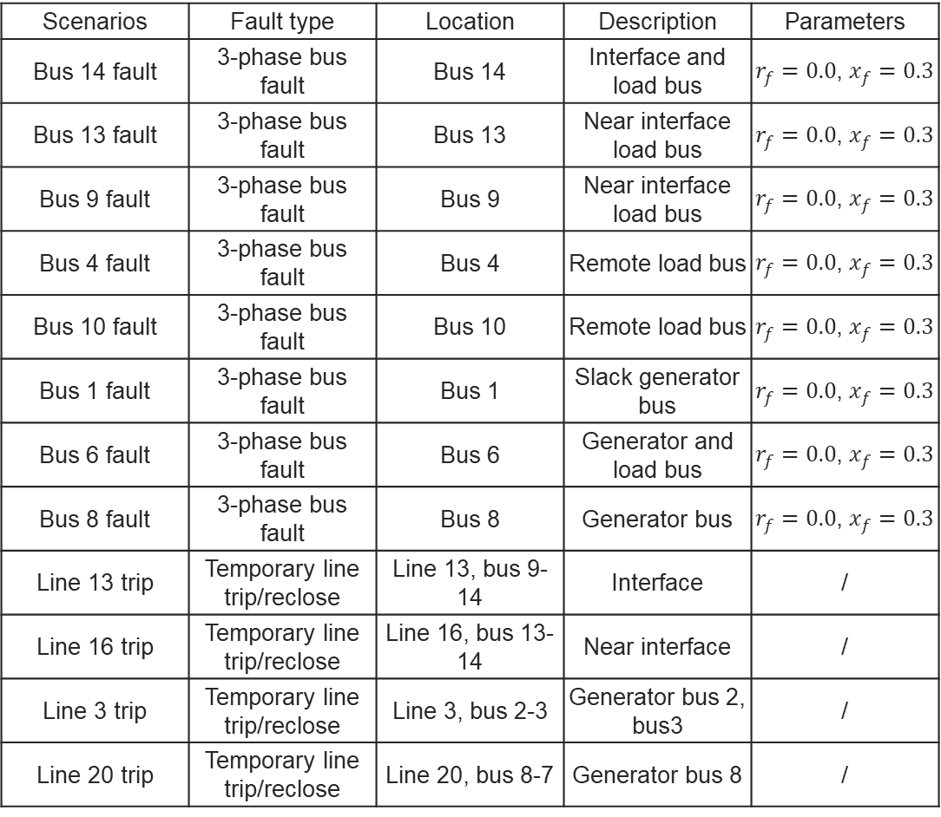
Case Studies
Scenarios | Fault type | Location | Description | Parameters
Bus 14 fault | 3-phase bus fault | Bus 14 | Interface and load bus | $r_{f}=0.0$, $x_{f}=0.3$
Bus 13 fault | 3-phase bus fault | Bus 13 | Near interface load bus | $r_{f}=0.0$, $x_{f}=0.3$
Bus 9 fault | 3-phase bus fault | Bus 9 | Near interface load bus | $r_{f}=0.0$, $x_{f}=0.3$
Bus 4 fault | 3-phase bus fault | Bus 4 | Remote load bus | $r_{f}=0.0$, $x_{f}=0.3$
Bus 10 fault | 3-phase bus fault | Bus 10 | Remote load bus | $r_{f}=0.0$, $x_{f}=0.3$
Bus 1 fault | 3-phase bus fault | Bus 1 | Slack generator bus | $r_{f}=0.0$, $x_{f}=0.3$
Bus 6 fault | 3-phase bus fault | Bus 6 | Generator and load bus | $r_{f}=0.0$, $x_{f}=0.3$
Bus 8 fault | 3-phase bus fault | Bus 8 | Generator bus | $r_{f}=0.0$, $x_{f}=0.3$
Line 13 trip | Temporary line trip/reclose | Line 13, bus 9-14 | Interface | /
Line 16 trip | Temporary line trip/reclose | Line 16, bus 13-14 | Near interface | /
Line 3 trip | Temporary line trip/reclose | Line 3, bus 2-3 | Generator bus 2, bus3 | /
Line 20 trip | Temporary line trip/reclose | Line 20, bus 8-7 | Generator bus 8 | /

Slide 17
Conclusion
An ANDES-OpenDSS-HELICS dynamic co-simulation framework was developed to study FIDVR with both transmission dynamics and feeder level voltage resolution.
The framework couples the positive sequence IEEE 14-bus transmission system with the quasi-static IEEE 13-node feeder and a WECC Motor D load representation.
Case studies show that motor share mainly controls the post-fault recovery behavior, while fault location controls the severity of the initial voltage depression at the interface bus.
Feeder level results reveal non uniform node voltage recovery, which would be hidden by a single equivalent distribution load.
The most severe FIDVR response occurs when a high motor share feeder is exposed to a strong near interface transmission fault.
Future work:
Future work should explore the mitigation strategies for FIDVR.
Extend the study to multiple feeders and larger transmission systems.

Slide 18
Reference
[1]B. Williams, W. Schmus, and D. Dawson, “Transmission voltage recov-ery delayed by stalled air conditioner compressors,” IEEE Transactionson Power Systems, vol. 7, no. 3, pp. 1173–1181, 1992.
[2]S. Adhikari, J. Schoene, N. Gurung, and A. Mogilevsky, “Fault induceddelayed voltage recovery (fidvr): Modeling and guidelines,” in 2019IEEE Power & Energy Society General Meeting (PESGM), 2019, pp.1–5.
[3]Cisco Sullberg, M. Wu, V. Vittal, B. Gong, and P. Augustin, “Exam-ination of composite load and variable frequency drive air conditioningmodeling on fidvr,” IEEE Open Access Journal of Power and Energy,vol. 8, pp. 147–156, 2021.
[4]“Examination of composite load and variable frequency drive airconditioning modeling on fidvr,” IEEE Open Access Journal of Powerand Energy, vol. 8, pp. 147–156, 2021.
[5]Q. Huang and V. Vittal, “Application of electromagnetic transient-transient stability hybrid simulation to fidvr study,” IEEE Transactionson Power Systems, vol. 31, no. 4, pp. 2634–2646, 2016.
[6]R. W. Kenyon, B. Mather, and B.-M. Hodge, “Coupled transmissionand distribution simulations to assess distributed generation responseto power system faults,” Electric Power Systems Research, vol. 189,p. 106746, 2020. [Online]. Available: https://www.sciencedirect.com/science/article/pii/S0378779620305496
[7]G. Krishnamoorthy and A. Dubey, “Transmission–distribution cosimula-tion: Analytical methods for iterative coupling,” IEEE Systems Journal,vol. 14, no. 2, pp. 2633–2642, 2020.
[8]R. Sadnan, G. Krishnamoorthy, and A. Dubey, “Transmission anddistribution (t&d) quasi-static co-simulation: Analysis and comparisonof t&d coupling strength,” IEEE Access, vol. PP, pp. 1–1, 06 2020.
[9]Z. Li, Q. Guo, and J. Wang, “Coordinated transmission and distributionac optimal power flow,” IEEE Transactions on Smart Grid, vol. PP, pp.1–1, 06 2016.
[10]B. Palmintier, E. Hale, T. M. Hansen, W. Jones, D. Biagioni,H. Sorensen, H. Wu, and B.-M. Hodge, “Igms: An integrated iso-to-appliance scale grid modeling system,” IEEE Transactions on SmartGrid, vol. 8, no. 3, pp. 1525–1534, 2017.
[11]Q. Huang and V. Vittal, “Advanced emt and phasor-domain hybridsimulation with simulation mode switching capability for transmissionand distribution systems,” IEEE Transactions on Power Systems, vol. 33,no. 6, pp. 6298–6308, 2018.
[12]“Integrated transmission and distribution system power flow anddynamic simulation using mixed three-sequence/three-phase modeling,”IEEE Transactions on Power Systems, vol. 32, no. 5, pp. 3704–3714,2017.
[13]H. Jain, A. Parchure, R. P. Broadwater, M. Dilek, and J. Woyak,“Three-phase dynamic simulation of power systems using combinedtransmission and distribution system models,” IEEE Transactions onPower Systems, vol. 31, no. 6, pp. 4517–4524, 2016.
[14]M. A. Elizondo, F. K. Tuffner, and K. P. Schneider, “Three-phaseunbalanced transient dynamics and powerflow for modeling distributionsystems with synchronous machines,” IEEE Transactions on PowerSystems, vol. 31, no. 1, pp. 105–115, 2016.
[15]A. Hariri and M. O. Faruque, “A hybrid simulation tool for the studyof pv integration impacts on distribution networks,” IEEE Transactionson Sustainable Energy, vol. 8, no. 2, pp. 648–657, 2017.
[16]R. Venkatraman, S. K. Khaitan, and V. Ajjarapu, “Dynamic co-simulation methods for combined transmission-distribution system withintegration time step impact on convergence,” IEEE Transactions onPower Systems, vol. 34, no. 2, pp. 1171–1181, 2019.
[17]R. Huang, R. Fan, J. Daily, A. Fisher, and J. Fuller, “An open-sourceframework for power system transmission and distribution dynamics co-simulation,” IET Generation, Transmission & Distribution, vol. 11, 062017.
[18]W. Wang, X. Fang, H. Cui, F. Li, Y. Liu, and T. J. Overbye,“Transmission-and-distribution dynamic co-simulation framework fordistributed energy resource frequency response,” IEEE Transactions onSmart Grid, vol. 13, no. 1, pp. 482–495, 2022.

Slide 19
Appendix
Teng WANG

Slide 20
FIDVR in Co-simulation Framework
FIDVR Setup: Motors model (WECC Motor D) places
Total Motor D size: 1911.0 kW.
Motor D elements | Source load | Bus | kW
Load.weccmd_634a | 634a | 634.1 | 160
Load.weccmd_634b | 634b | 634.2 | 120
Load.weccmd_634c | 634c | 634.3 | 120
Load.weccmd_645 | 645 | 645.2 | 170
Load.weccmd_675a | 675a | 675.1 | 485
Load.weccmd_675b | 675b | 675.2 | 68
Load.weccmd_675c | 675c | 675.3 | 290
Load.weccmd_611 | 611 | 611.3 | 170
Load.weccmd_652 | 652 | 652.1 | 128
Load.weccmd_670a | 670a | 670.1 | 17
Load.weccmd_670b | 670b | 670.2 | 66
Load.weccmd_670c | 670c | 670.3 | 117

Slide 21
FIDVR in Co-simulation Framework
Parameters tuning
FIDVR_ENABLE_CAP_CONTROL=0 \
FIDVR_ENABLE_REG_CONTROL=0 \
FINE_DT=0.002 COARSE_DT=0.05 COARSE_START=1.6 \
TX_TDS_STEP=0.03 FIDVR_ENABLE_CAP_CONTROL=1 \
FIDVR_ENABLE_REG_CONTROL=1 \
FIDVR_CAPACITOR_INITIAL_FRACTION=1.0 \
FIDVR_CAPACITOR_ON_VOLTAGE_PU=1.025 \
FIDVR_CAPACITOR_ON_DELAY_S=0.3 \
FIDVR_CAPACITOR_OFF_VOLTAGE_PU=0.9 \
FIDVR_CAPACITOR_OFF_DELAY_S=120.0 \
FIDVR_REGULATOR_MONITOR_BUS=675 \
FIDVR_REGULATOR_LOW_VOLTAGE_PU=0.93 \
FIDVR_REGULATOR_HIGH_VOLTAGE_PU=1.025 \
FIDVR_REGULATOR_DELAY_S=0.5 \
FIDVR_REGULATOR_TAP_DELAY_S=0.25 \
FIDVR_NONRESTARTABLE_FRACTION=0.0 \
FIDVR_CONTACTOR_FRACTION=0.10 \
FIDVR_MOTOR_RECONNECT_RAMP_S=1.5 \
FIDVR_MOTOR_GROUP_RESTORE_OFFSETS=0,0.5,1.0
TX_INTERFACE_BUS=14 TX_FAULT_BUS=14 \
TX_FAULT_TIME=1.0 \
TX_FAULT_DURATION=0.1\
TX_FAULT_RF=0.0 \
TX_FAULT_XF=0.35 \
TARGET_TIME=120.0 \
FEEDER_COUNT=1 \
TX_CASE_XLSX=ieee14_fault.xlsx \
DIST_MASTER_DSS=13Bus/IEEE13Nodeckt.dss \
DIST_VOLTAGE_BUS=675 \
DIST_LOAD_SCALE=1.0 \
FIDVR_MOTOR_SHARE=0.9 \
FIDVR_MOTOR_STALL_VOLTAGE_PU=0.82 \
FIDVR_MOTOR_STALL_CLEAR_VOLTAGE_PU=0.92\
FIDVR_STALL_KVAR_PER_KW=5 \
FIDVR_MOTOR_STALL_KVAR_SCALE=15.0 \
FIDVR_MOTOR_THERMAL_TRIP_TIME_S=8.0 \
FIDVR_MOTOR_RECONNECT_DELAY_S=25.0 \

