Slide 1
Dynamic FIDVR Response in Transmission-Distribution Co-Simulation
Teng WANG
May 15, 2026

Slide 2
Outline
Introduction: Motivation for T&D co-simulation and FIDVR background
Literature review: Existing FIDVR models and co-simulation frameworks
Methodology: HELICS-based co-simulation and WECC Motor D implementation
Case studies: Validation and FIDVR response under varying fault scenarios
Conclusion: Key findings and future work

Slide 3



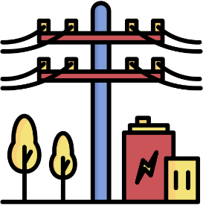








Introduction: motivation
Traditional power system simulation
Modern power system simulation
Transmission system
Balanced
Positive sequence
Represent as equivalent load
Increasing interaction
Distribution system
Unbalanced
Near unity X/R ratios

Slide 4
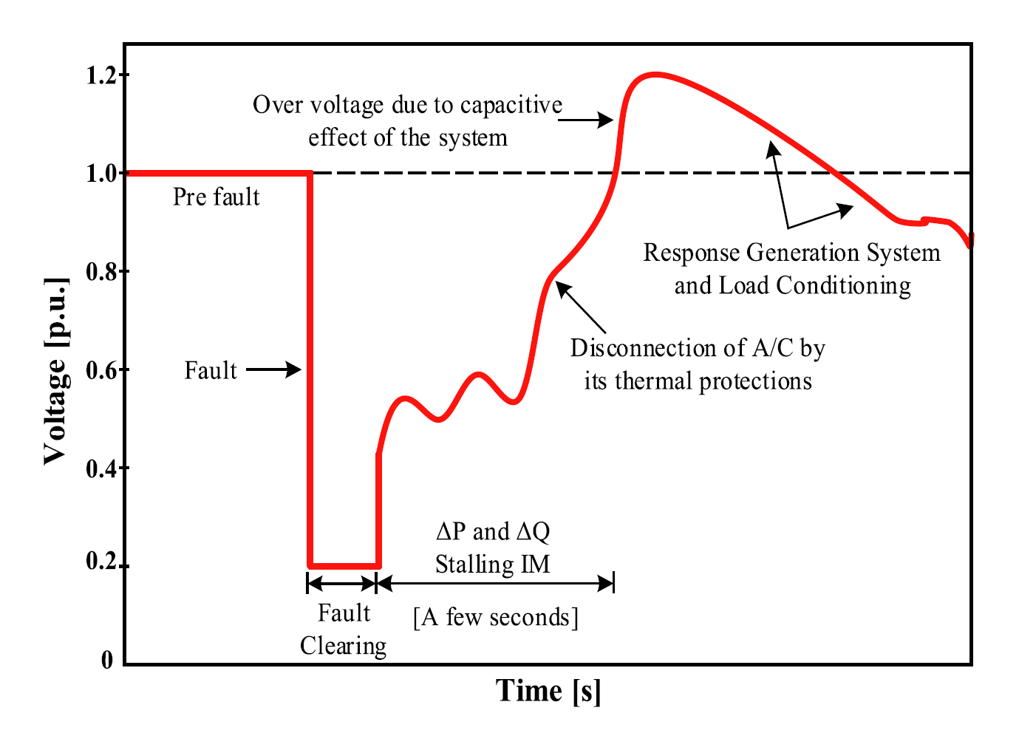
Introduction: background
Transmission fault
Fault clears
Explanatory FIDVR response
Motor stall
Draw high Q
Thermal Protection
Motor trips
V overshoot
Motor back/Capacitor off
V dips
Capacitor on
…

Slide 5
Literature Review
 | Approach | Main contribution | Network representation | Remaining limitation
[1] | Field observation based FIDVR studies | Connect delayed voltage recovery to stalled A/C compressor motors | 115 kV and 66 kV sub-transmission systems. | Limited feeder level and phase domain resolution.
[2][3] | WECC composite load models | Calibrated aggregate FIDVR load models, and identified sensitive Motor D parameters. | Southern California Edison Valley substation. | Does not resolve feeder topology or phase imbalance
[4][5] | Detailed motor / EMT model | Capture motor stalling physics, and unbalanced fault effects in detail. | Can estimate model parameters that correspond to the V-I curve and V-P curve in the manufacturer's datasheet. | High model detail limits scalability.
[6] | DER / feeder coupled studies | Showed that feeder level dynamics can affect bulk system response. | WECC transmission case with distribution feeders and IEEE 1547 ride-through logic. | Focuses more on DER/PV ride-through than compressor motor FIDVR.

Slide 6
Literature Review
Existing approach | Strength | Limitation | Gap addressed by this work
Transmission level aggregate load model | Efficient for large system dynamic simulation | Cannot show voltage diversity inside the feeder | Add feeder level voltage resolution
Distribution dynamic study | Captures feeder behavior | Missing transmission side disturbance interaction | Couple feeder response with transmission dynamics
Detailed EMT motor model | Captures motor stalling physics accurately | Too detailed for scalable T&D system studies | Use simplified Motor D model suitable for dynamic co-simulation
Existing T&D co-simulation studies | Show the value of transmission distribution coupling | Often focus on DER/PV or general dynamics rather than FIDVR motor behavior | Build a FIDVR oriented ANDES-OpenDSS-HELICS study

Slide 7
Literature Review: Co-simulation Framework
 | Category | Representative tools | System network | Note
[7-10] | Static T&D co-simulation | MATLAB, FESTIV/Matpower + OpenDSS, MATLAB, GridLAB-D | IEEE 9/14/39-bus transmission systems with small or utility feeders | Useful for steady-state coupling, but limited dynamic detail
[11-15] | Dynamic T&D co-simulation | PSCAD/EMTDC, InterPSS, PSAT, PSLF, three-phase dynamic models + OpenDSS, GridLAB-D, EMT/OpenDSS, three-phase models | IEEE 9/39-bus or WECC systems coupled with feeders from 8 buses to thousands of nodes | Capture dynamics, but many studies use small systems or equivalent feeders
[16-17] | Distribution dynamic | GridLAB-D, EMT/OpenDSS | IEEE 123-node/IEEE 8500-node feeders | Detailed feeder dynamic but no transmission interaction
[18] | Framework adopted in this work | ANDES + OpenDSS + HELICS | ACTIVSg2000 transmission system coupled with large scale distribution networks with over one million nodes | Open-source, scalable, and suitable for feeder level dynamic co-simulation
W. Wang, X. Fang, H. Cui, F. Li, Y. Liu and T. J. Overbye, "Transmission-and-Distribution Dynamic Co-Simulation Framework for Distributed Energy Resource Frequency Response," in IEEE Transactions on Smart Grid, vol. 13, no. 1, pp. 482-495, Jan. 2022, doi: 10.1109/TSG.2021.3118292.

Slide 8
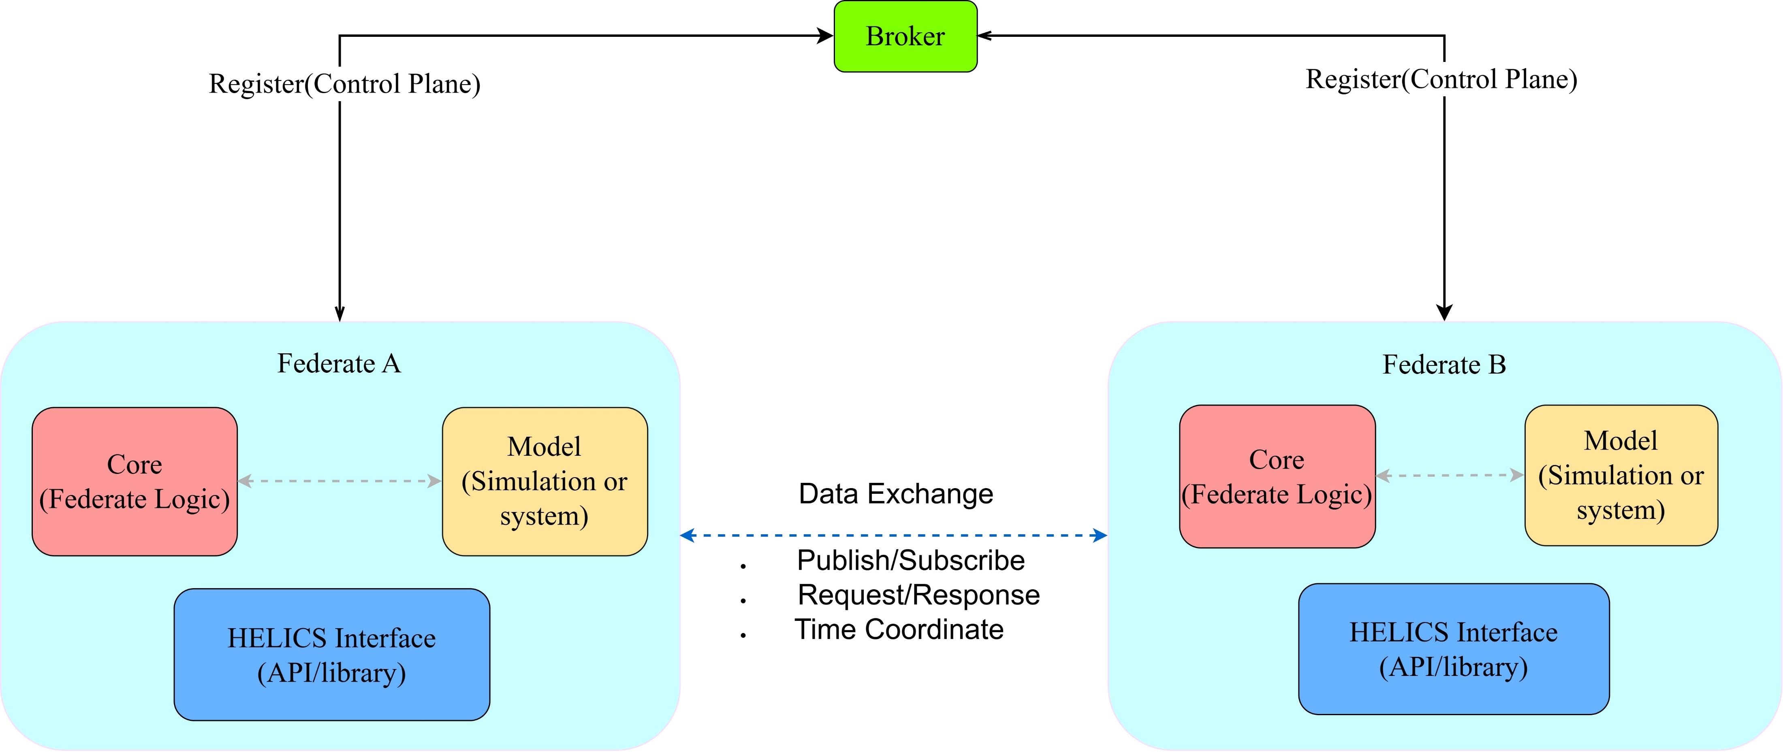
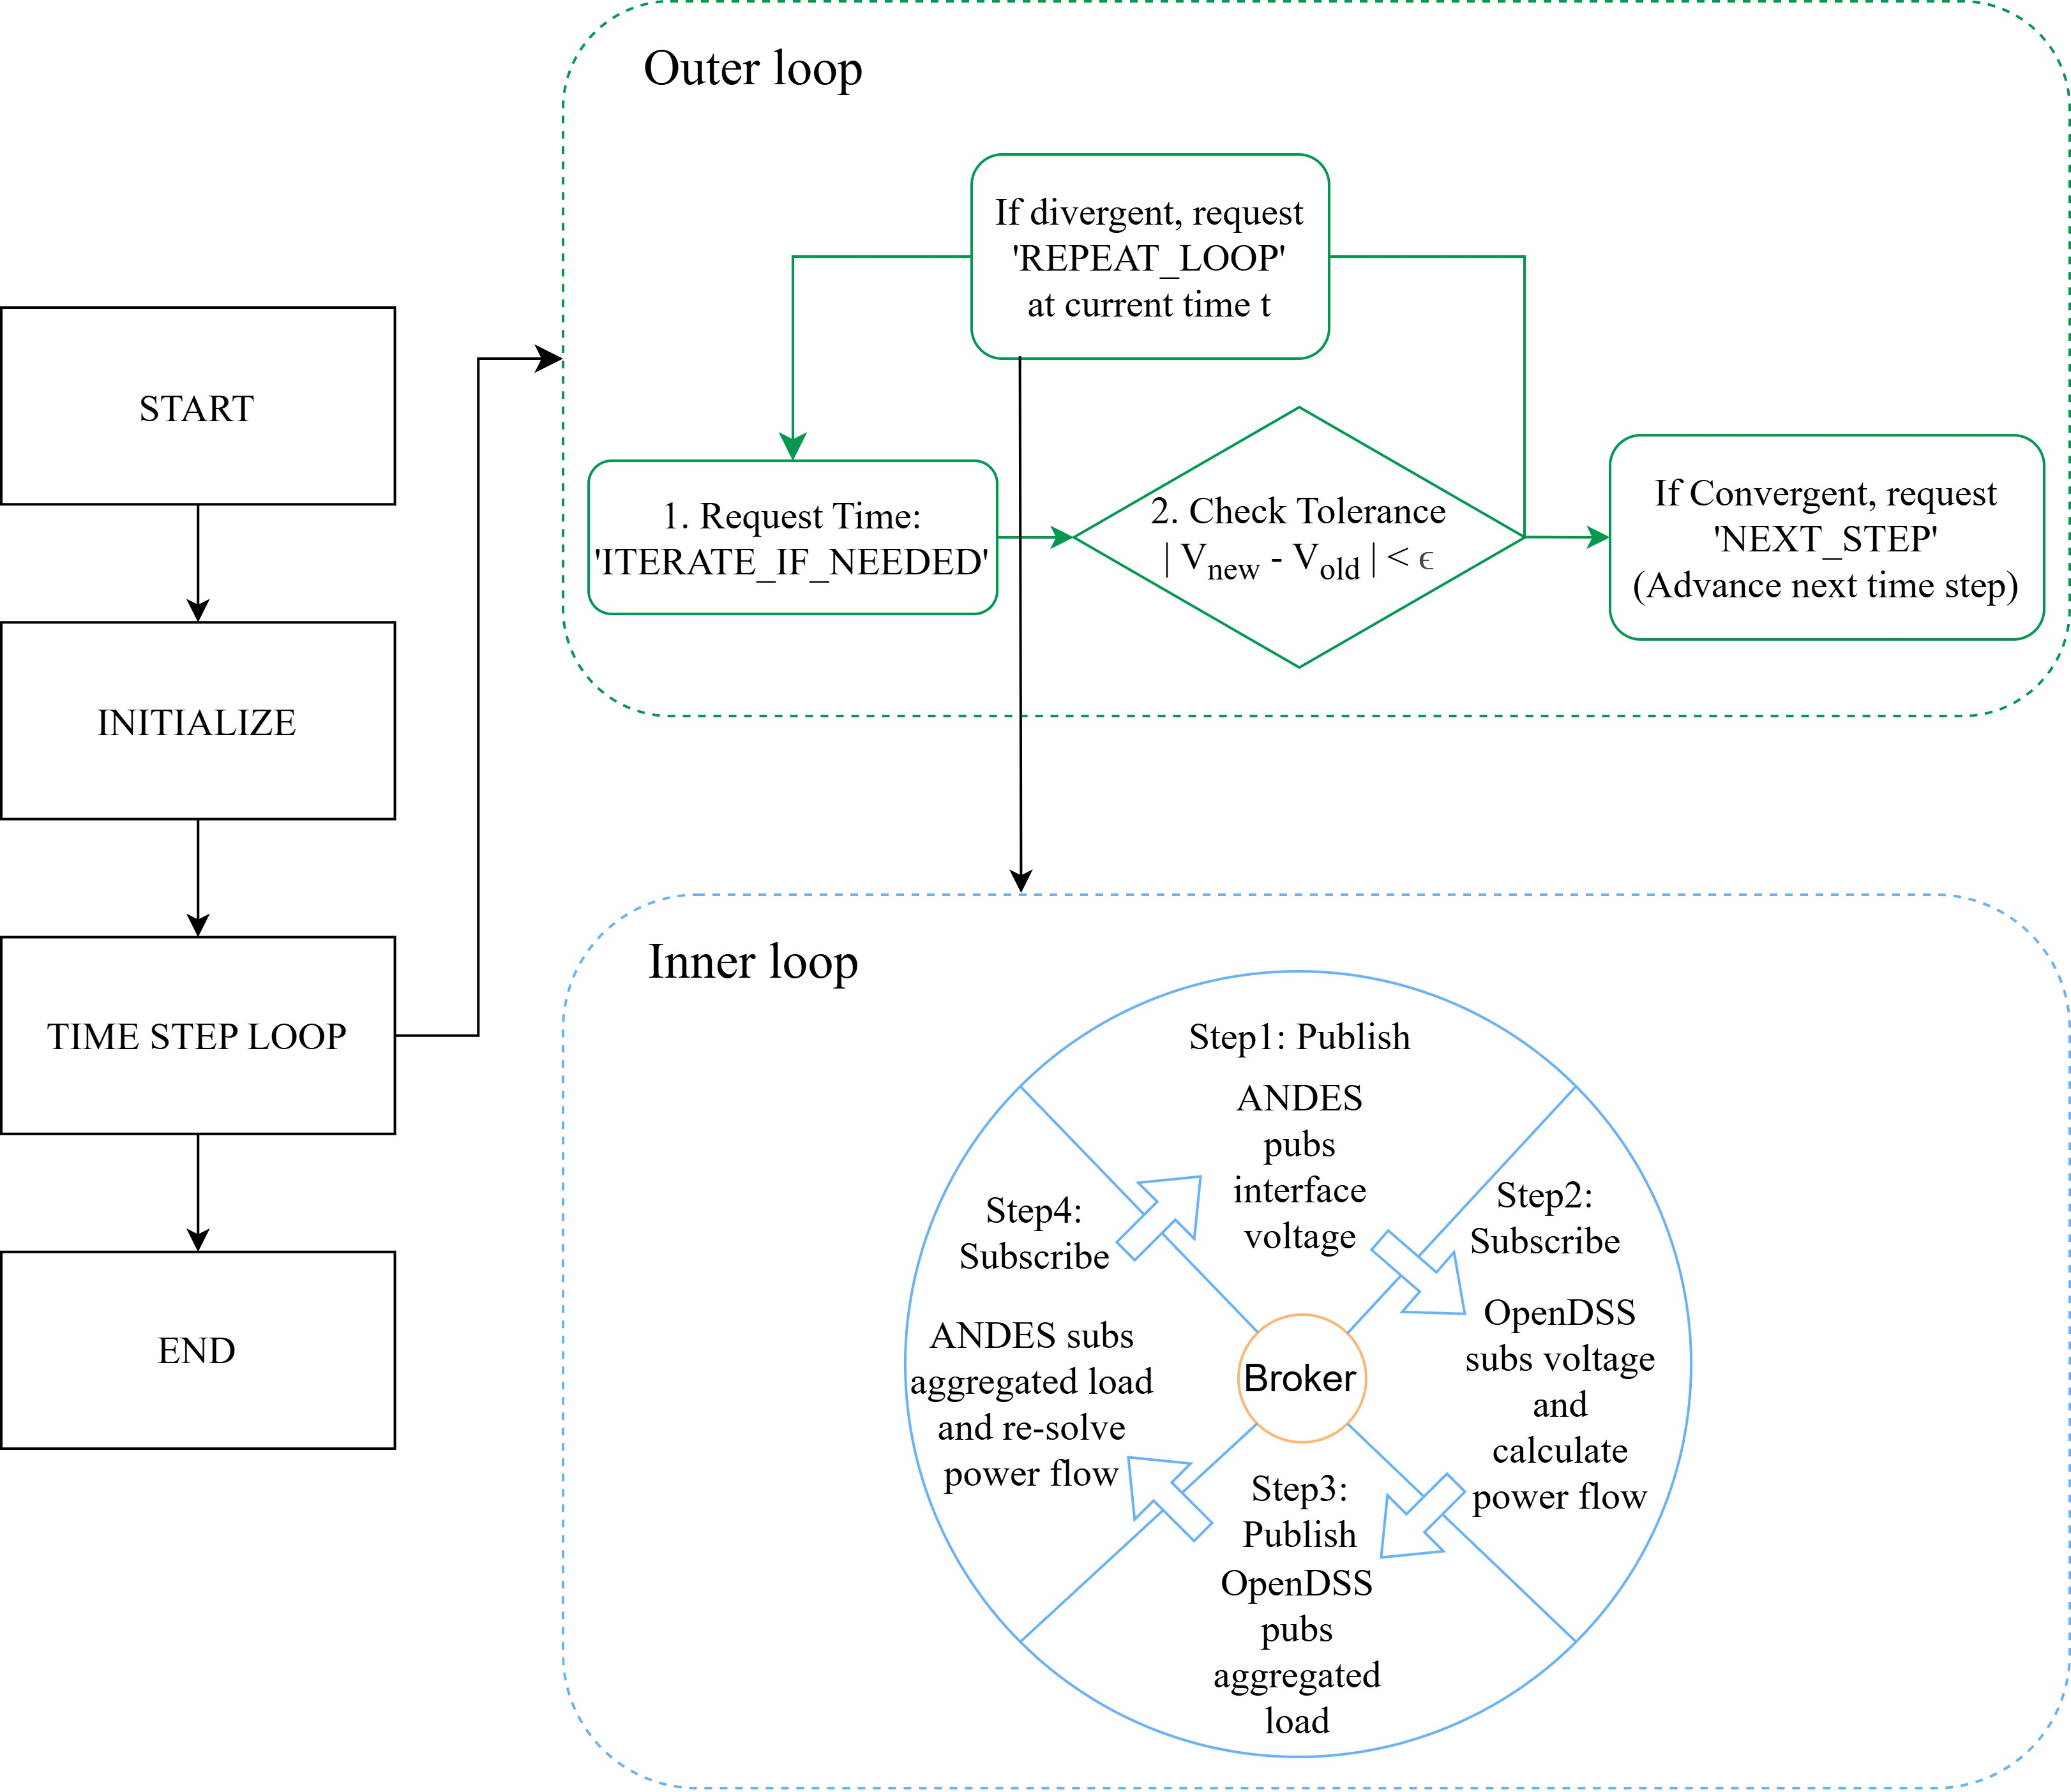
Methodology: HELICS
HELICS coordinates iterative exchange of boundary voltage and power between transmission and distribution simulators.
The outer loop advances the global simulation time, whereas the inner loop exchanges boundary variables among federates at a fixed time instant

Slide 9








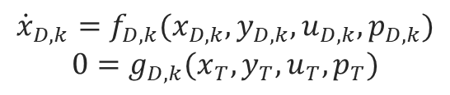

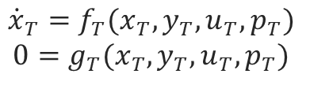


Methodology: Co-simulation
Transmission federate
HELICS broker
Distribution federate
$$V_{abc,k}$$
$$V_{abc,k}$$
Positive sequence dynamic simulation
Solves differential-algebraic equations
Publishes interface bus voltage
Time synchronization
Data exchange
Iterative coupling
Three phase feeder simulation
Quasi-static feeder solution
Publishes feeder complex power
$$S_{abc,k}$$
$$S_{abc,k}$$
Transmission
Distribution
Interface
$$u_{D,k}=V_{abc,k}$$
$$u_{T}=\sum_{k=1}^{N_{f}}{S_{abc,k}}$$
$k$: $k^{th}$ feeder
$${\dot{x}}_{T}=f_{T}(x_{T},y_{T},u_{T},p_{T})$$
$$0=g_{T}(x_{T},y_{T},u_{T},p_{T})$$
$${\dot{x}}_{D,k}=f_{D,k}(x_{D,k},y_{D,k},u_{D,k},p_{D,k})$$
$$0=g_{D,k}(x_{T},y_{T},u_{T},p_{T})$$
$V_{abc,k}$: three-phase interface voltage
$S_{abc,k}:$ three-phase complex power
$N_{T}$: number of coupled feeders.

Slide 10

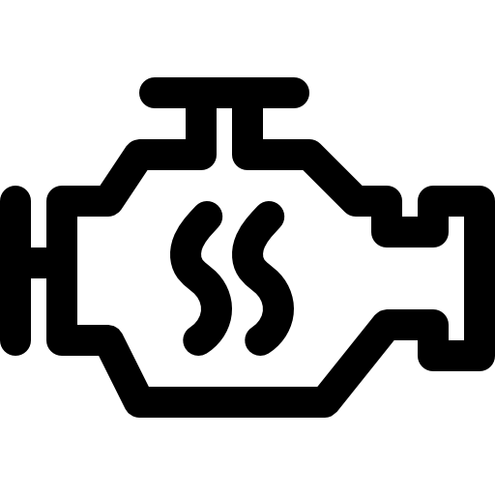



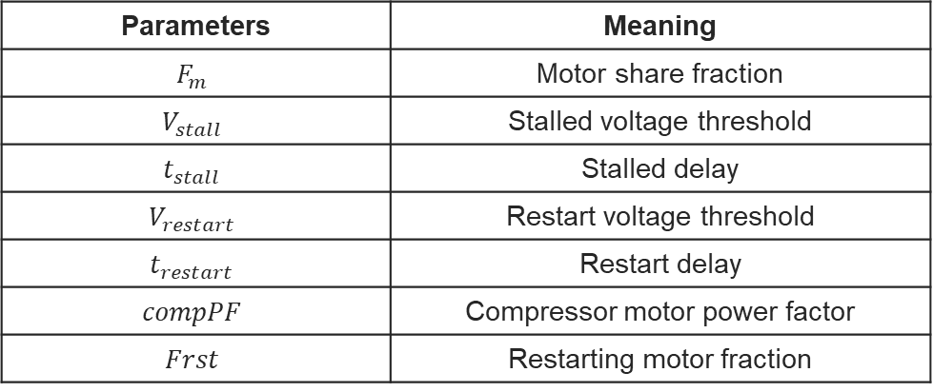
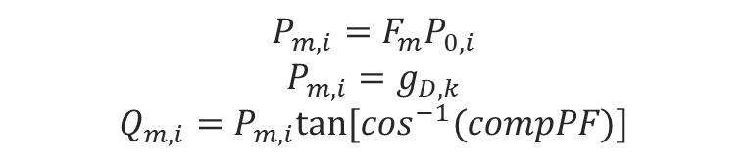
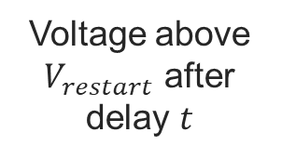


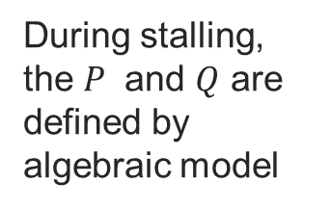
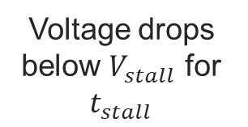

Methodology: Motor
Table1: Motor key parameters
Load split
$$P_{m,i}=F_{m}P_{0,i}$$
$$P_{m,i}=g_{D,k}$$
$$Q_{m,i}=P_{m,i}tan⁡[\cos^{−1}(compPF)]$$
Parameters | Meaning
$$F_{m}$$ | Motor share fraction
$$V_{stall}$$ | Stalled voltage threshold
$$t_{stall}$$ | Stalled delay
$$V_{restart}$$ | Restart voltage threshold
$$t_{restart}$$ | Restart delay
$$compPF$$ | Compressor motor power factor
$$Frst$$ | Restarting motor fraction
Static
Motor D
For each selected phase load, the original load is divided into a static and a motor component.
$$1−F_{m}$$
$$F_{m}$$
1
2
3
4
5
Normal
Operation
Stall
trigger
Stalled
motor
Thermal
protection
Reconnect
(Partially)
During stalling, the $P$ and $Q$ are defined by algebraic model
$$P=G_{stall}∗V^{2}$$
$$Q=B_{stall}∗V^{2}$$
Motor operates
normally
Voltage drops below $V_{stall}$ for $t_{stall}$
Motor stalls and draws high reactive power
Heating accumulates and motors trip
Voltage above $V_{restart}$ after delay $t$

Slide 11
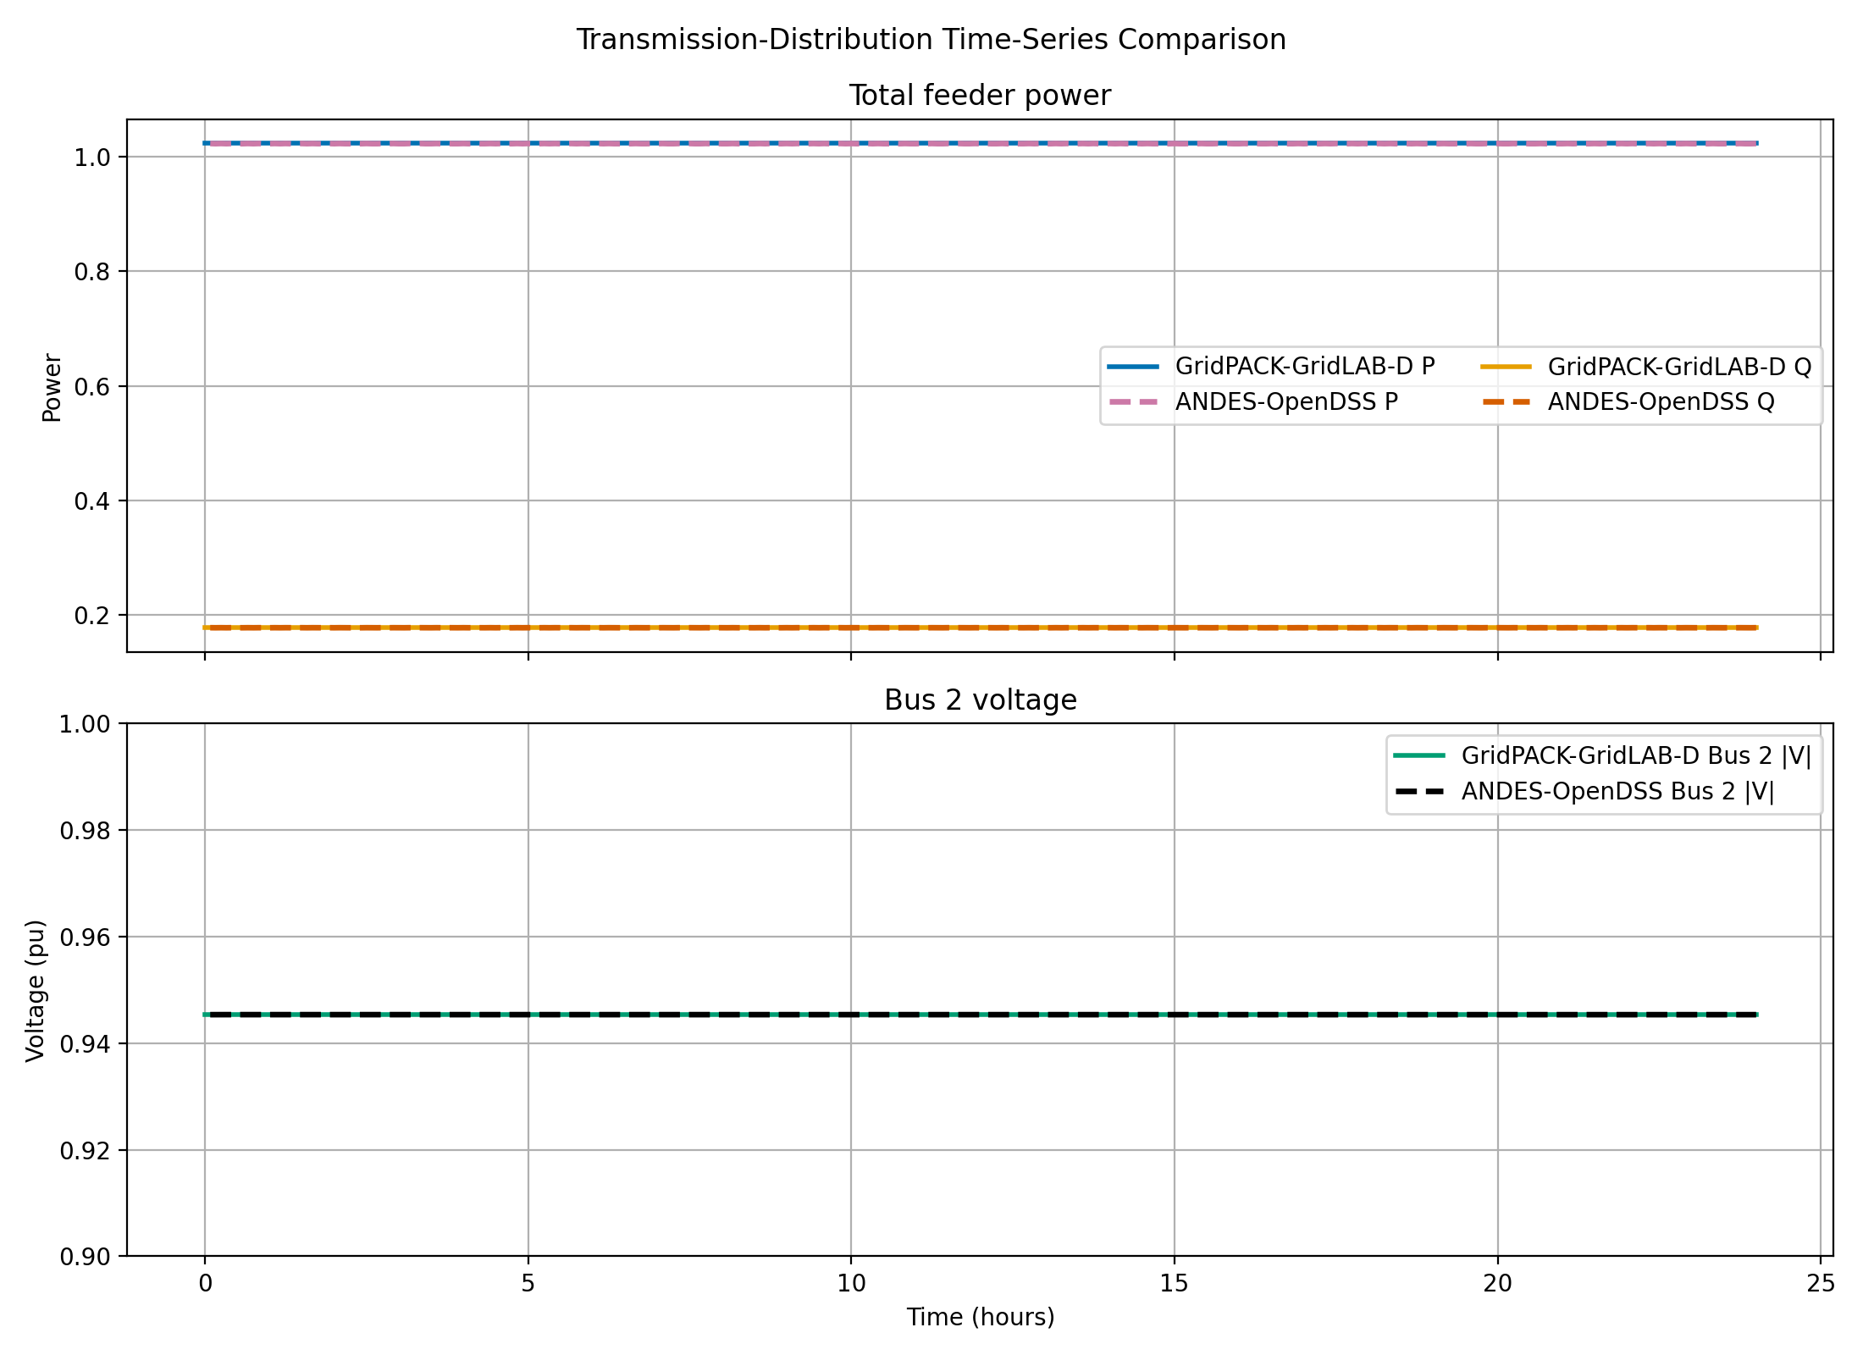
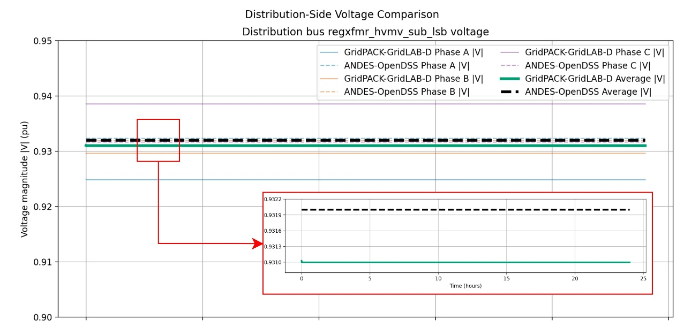
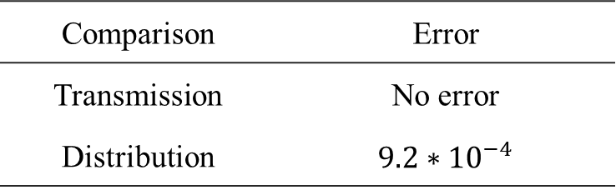
Case Studies: validation
Transmission voltage comparison
Test system
Transmission: IEEE 118-bus system
Distribution: IEEE 8500-node feeder
Validate: Against GridPACK-GridLAB-D
Same feeder power
Distribution voltage comparison
Comparison | Error
Transmission | No error
Distribution | $9.2∗{10}^{−4}$

Slide 12
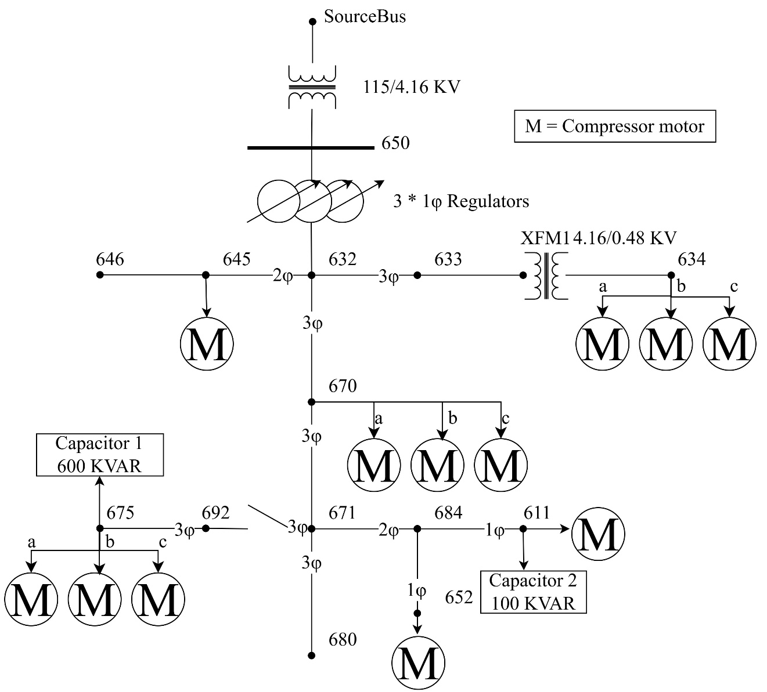
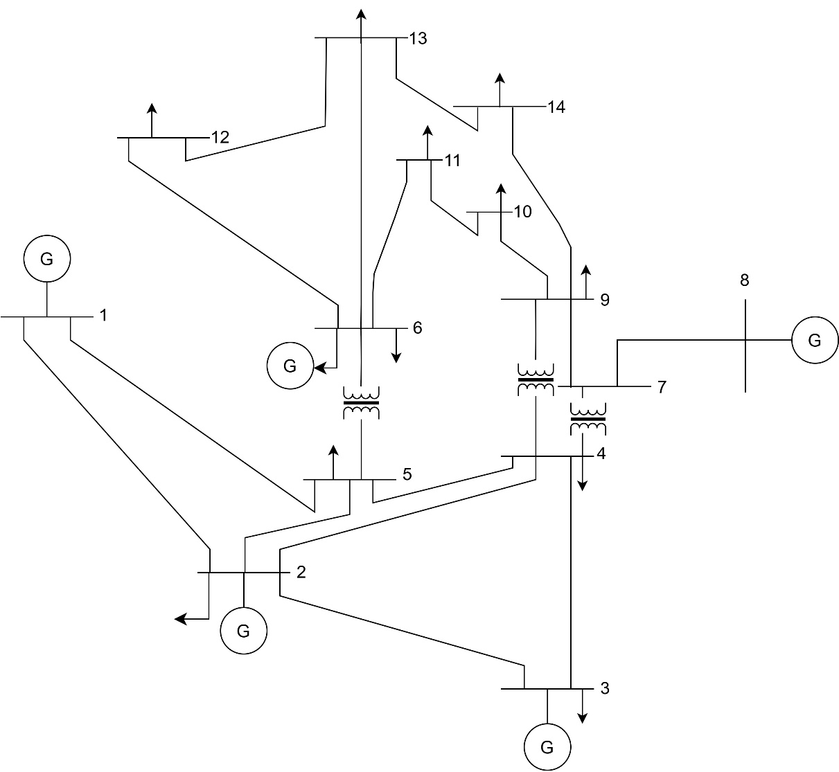
Case Study: Test System
Interface bus 14
Transmission side: IEEE 14-bus system with dynamic data
Distribution side: IEEE 13-nodes system with added motors

Slide 13
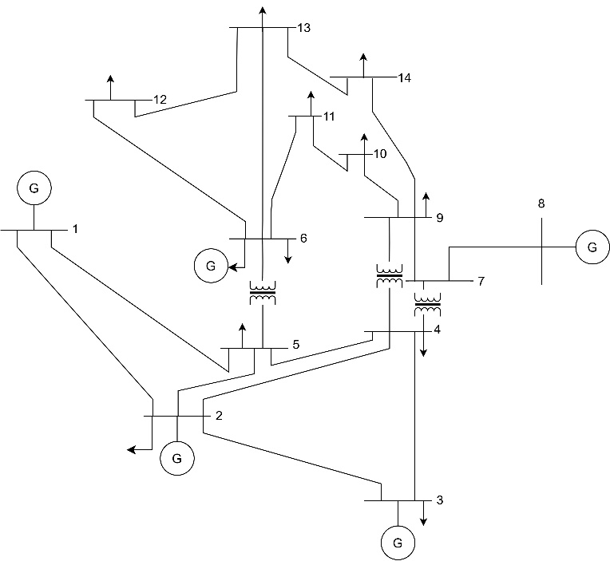
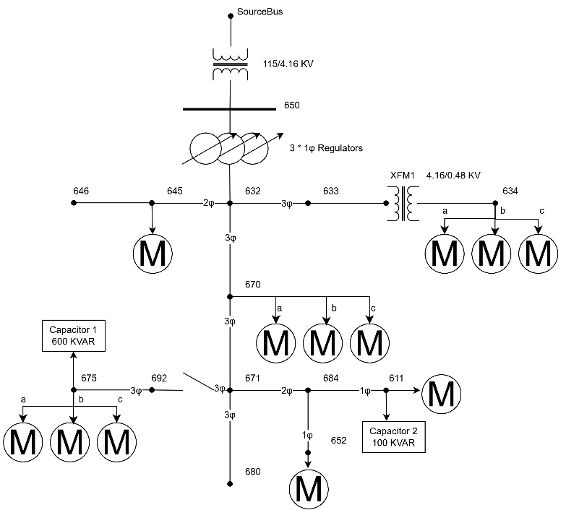
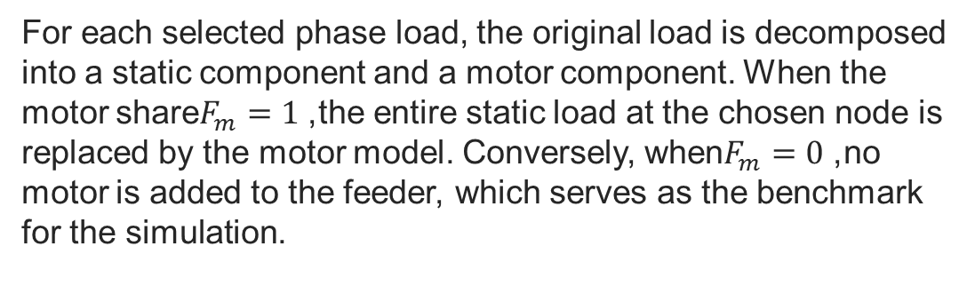
Case Study: Test System
Table1: Basic information of the IEEE 13-node feeder
Item | Value
Total active load | 3466 kW
Total reactive load | 2102 kvar
Motor replace locations | 634, 645, 675, 611, 652, 670
Maximum Motor D active load | 1911 kW
Maximum motor D active load share | 55.1%
Capacitor at Bus 675 | 600 kvar, three-phase
Capacitor at Bus 611 | 100 kvar, single-phase
For each selected phase load, the original load is decomposed into a static component and a motor component. When the motor share$F_{m}=1$, the entire static load at the chosen node is replaced by the motor model. Conversely, when$F_{m}=0$, no motor is added to the feeder, which serves as the benchmark for the simulation.

Slide 14
Case Studies: Fault setup
Set up the transmission side fault.
Table2: Fault information
Item | Value
Fault Type | Three-phase to ground
Fault bus | 14
Fault start time | 1s
Fault clear time | 1.08s
Fault resistance | 0.0
Fault reactance | 0.3
Severe disturbances near the interface bus.

Slide 15
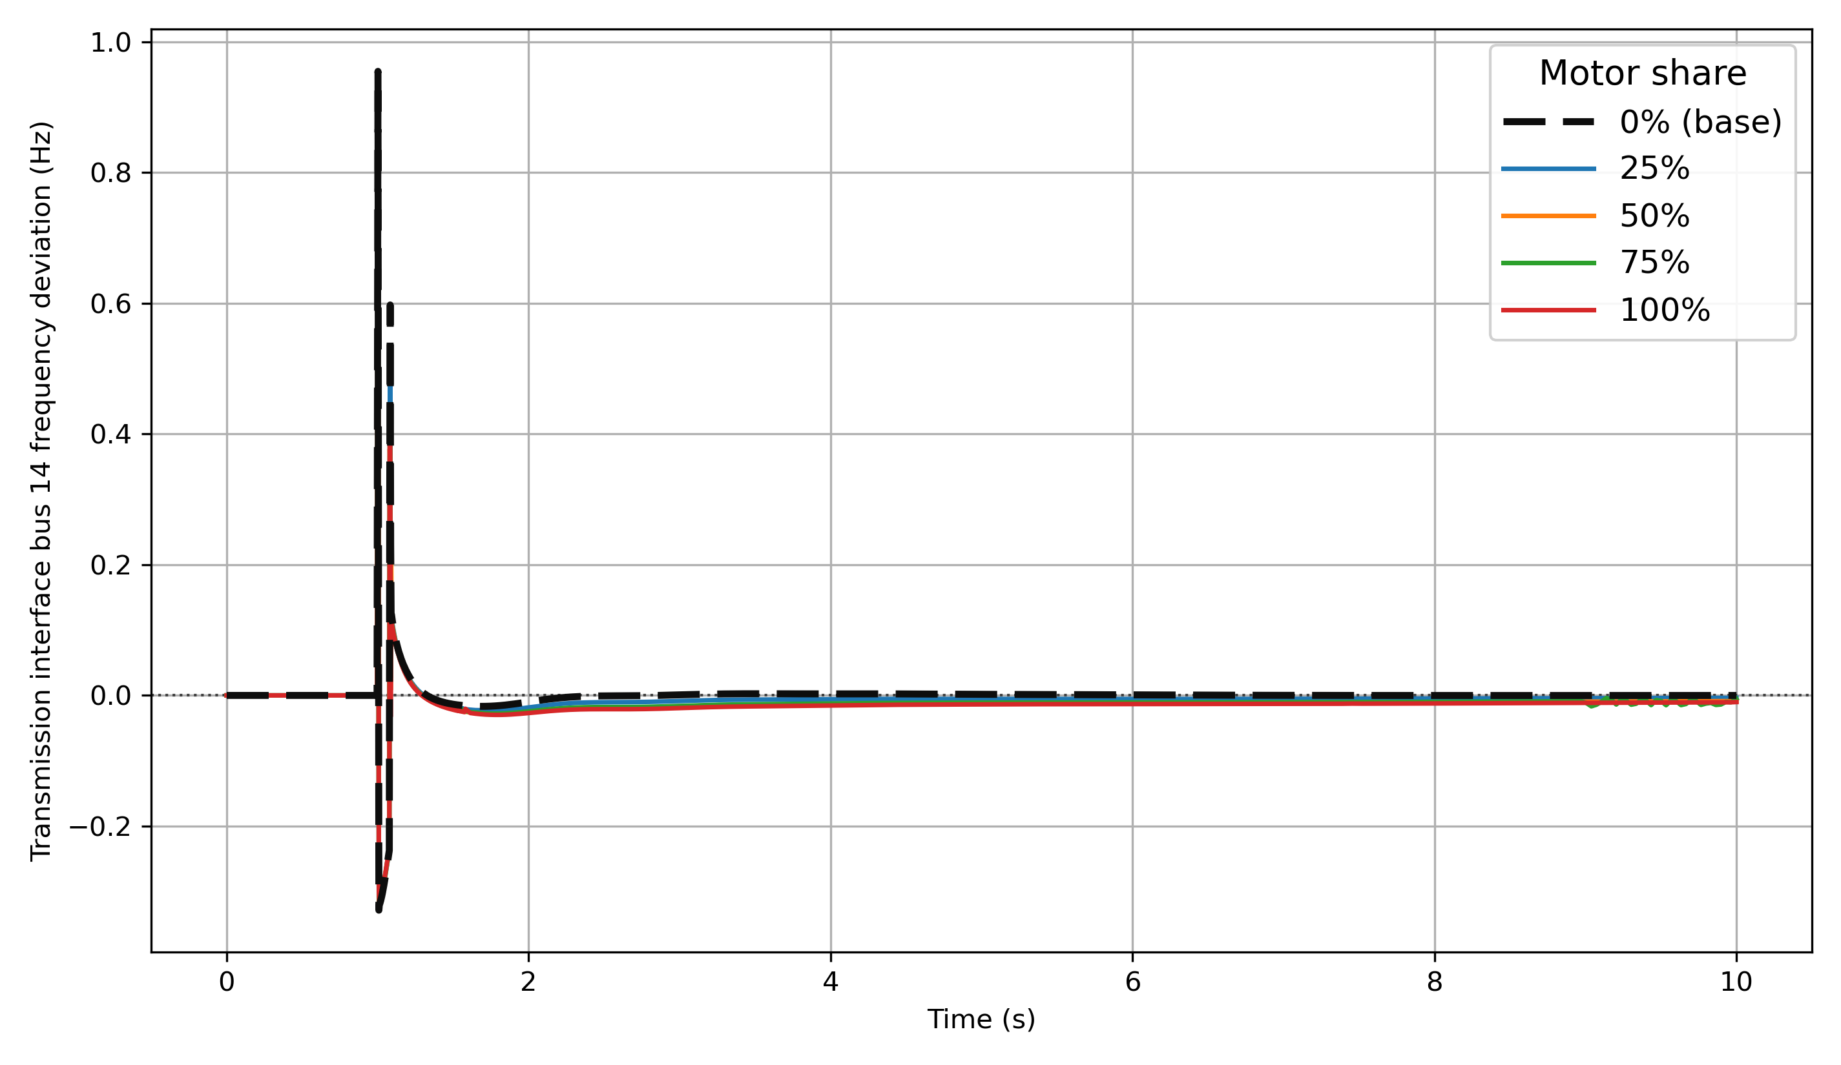
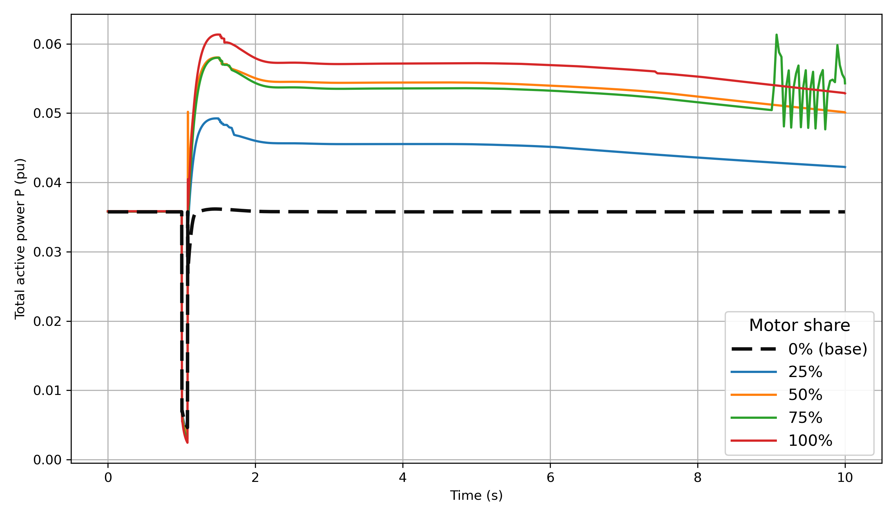
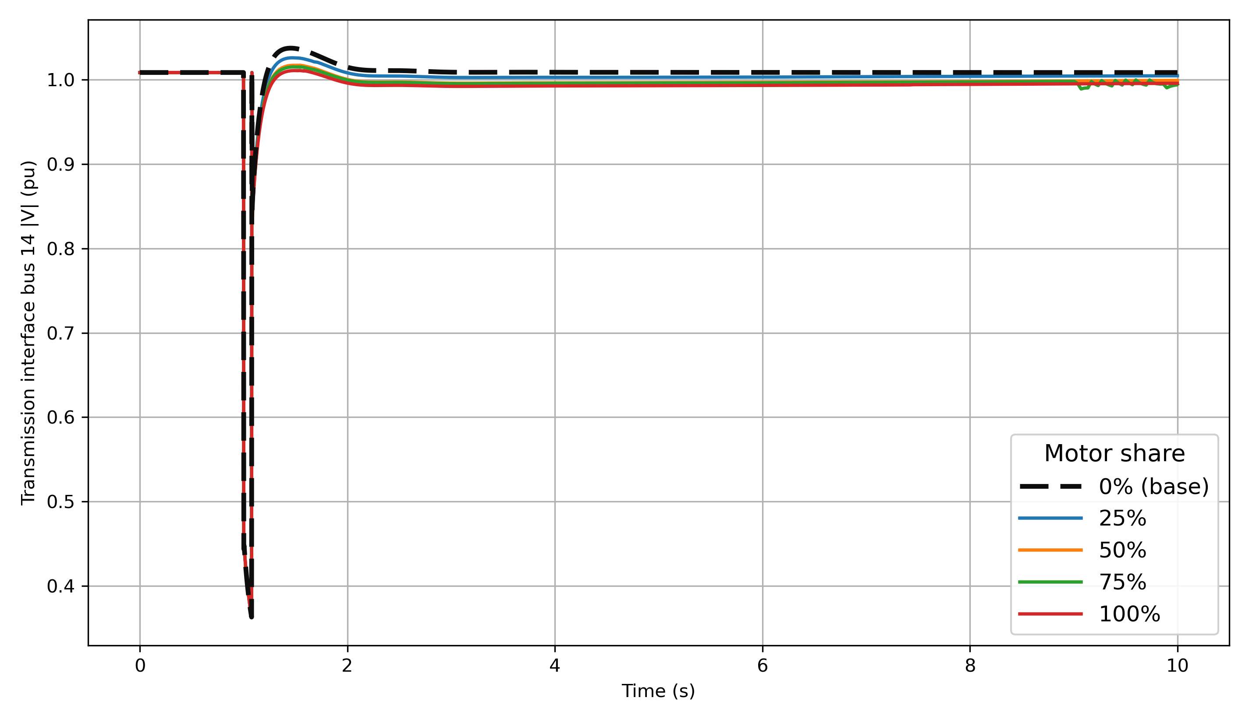
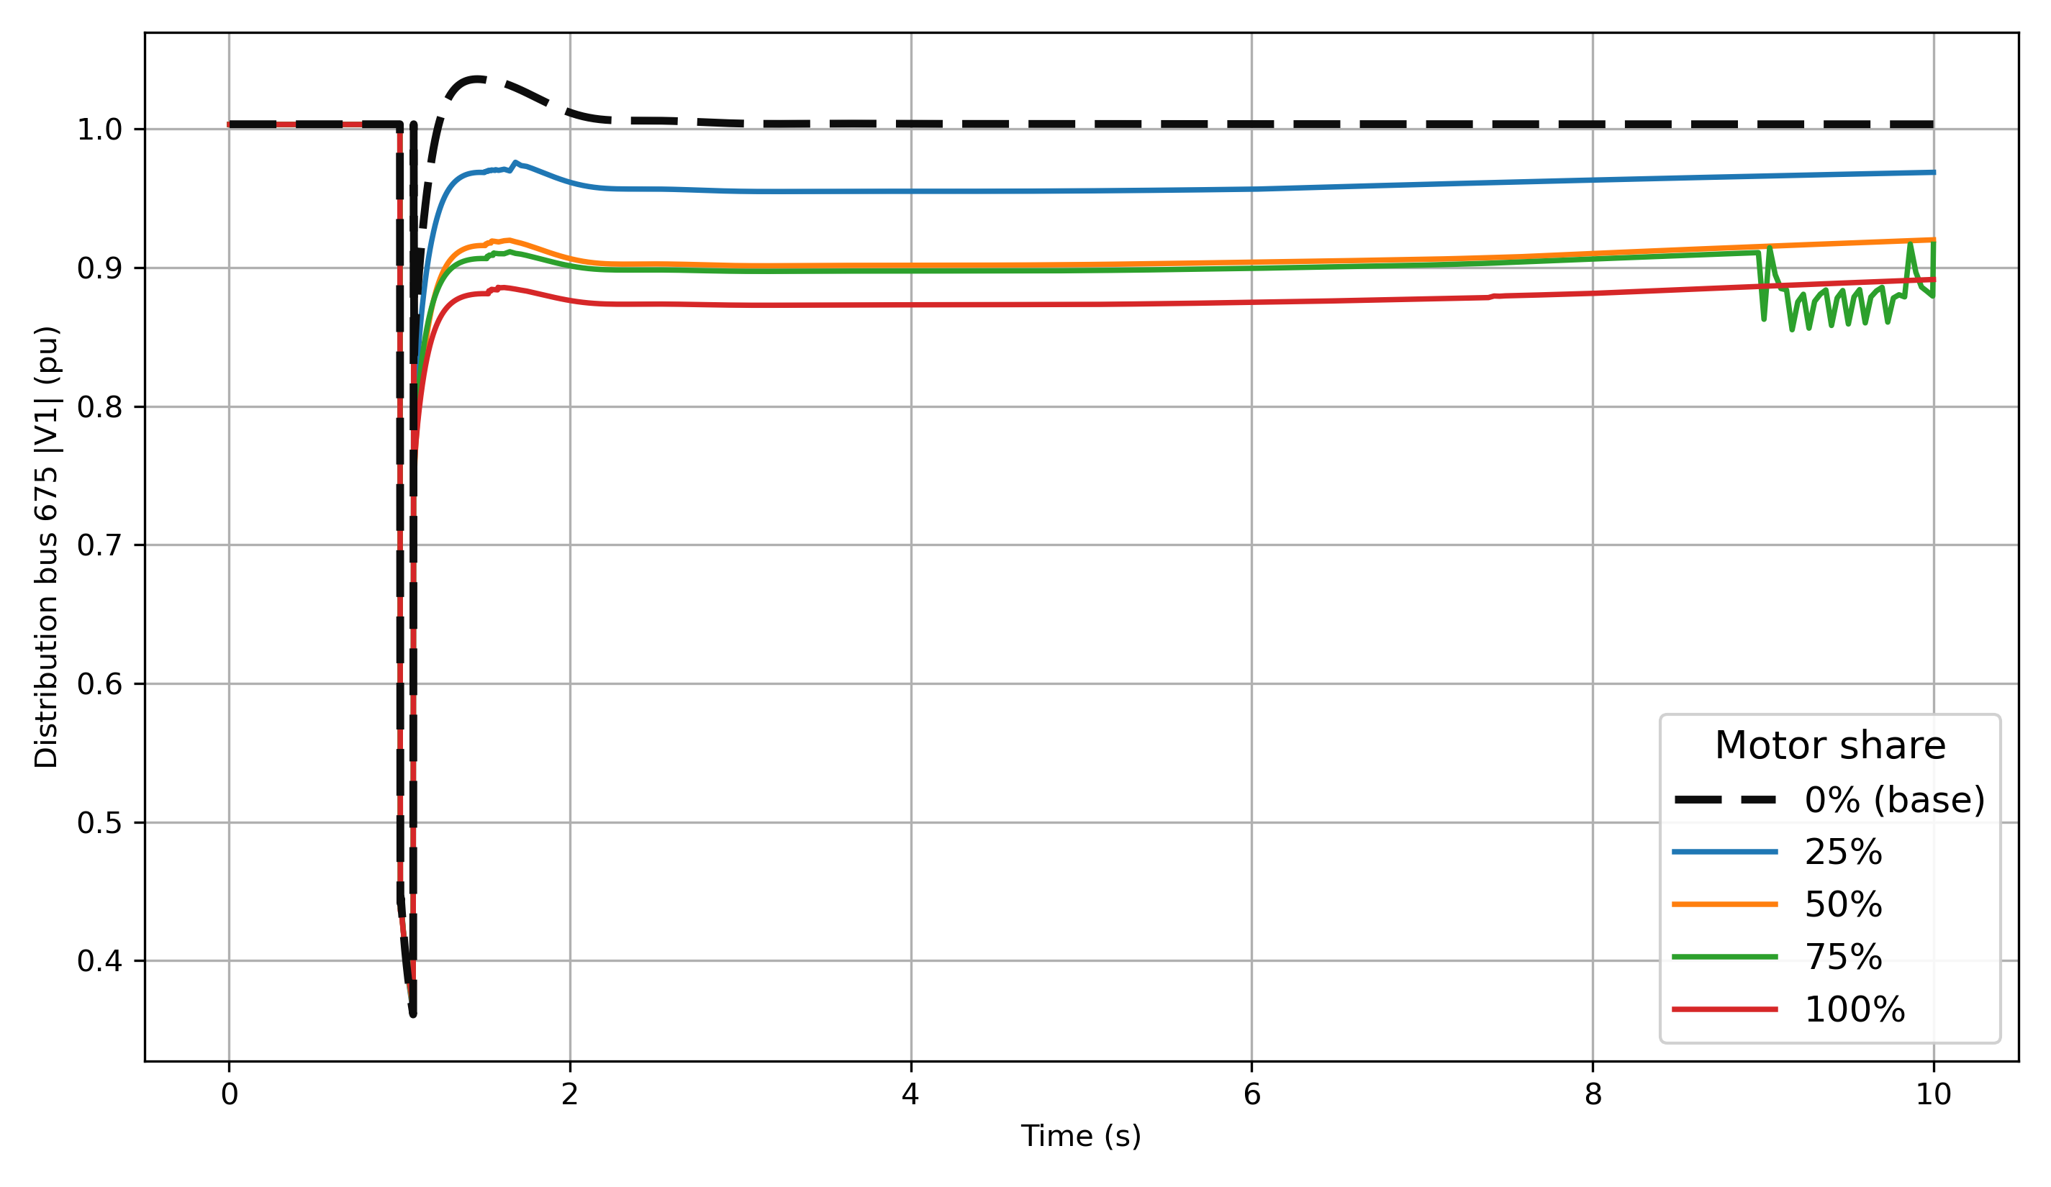
Case Studies: various motor share effect voltage recovery--benchmark
Transmission
Distribution
Applying the same fault and various motor fraction. Observe the 675 node voltage at feeder.
The result shows Motor share is the key sensitivity parameter for FIDVR. With 0% motor share, the feeder behaves as the static load benchmark and voltage recovers quickly. As Motor D share increases, post-fault reactive demand increases, the voltage recovery becomes slower, and high motor share cases show delayed recovery
Frequency response
Q response
Voltage response
Voltage response

Slide 16
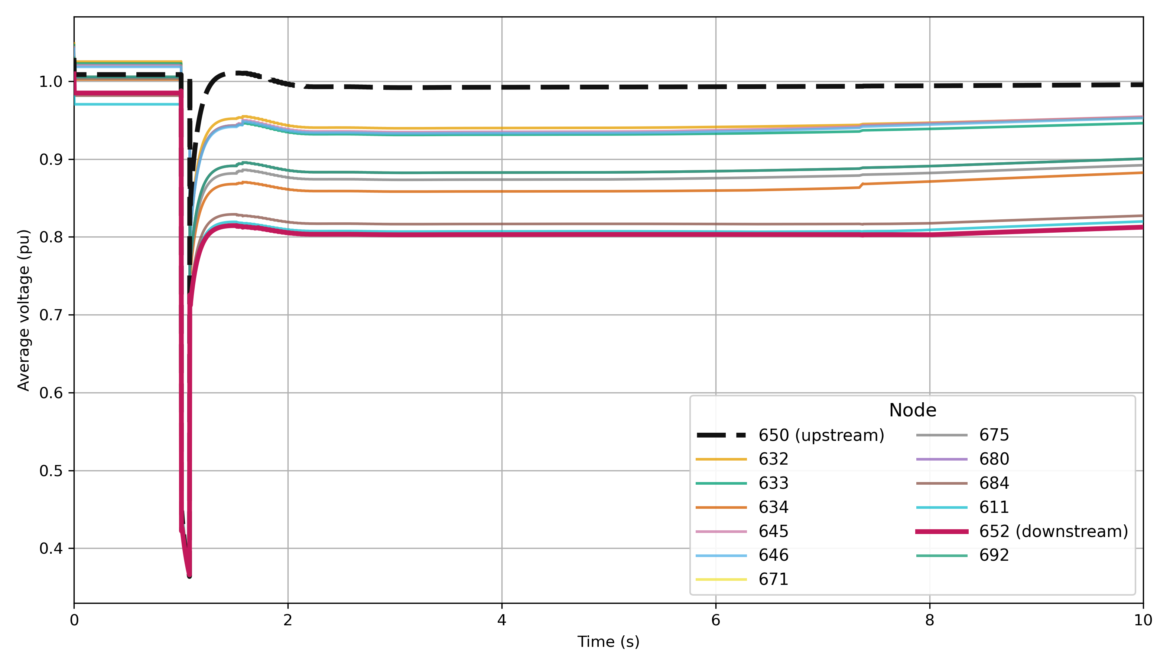

Case Studies: feeder level voltage recovery
Voltage recovery at different feeder location
Applying the same fault at bus 14 and $F_{m}=1$ .
The feeder head recovers faster than downstream nodes. Node 650 remains close to the source voltage, while downstream nodes such as 652 and 675 experience deeper and longer voltage depression. This feeder level voltage diversity would be hidden if the distribution system were represented only as an equivalent load.

Slide 17
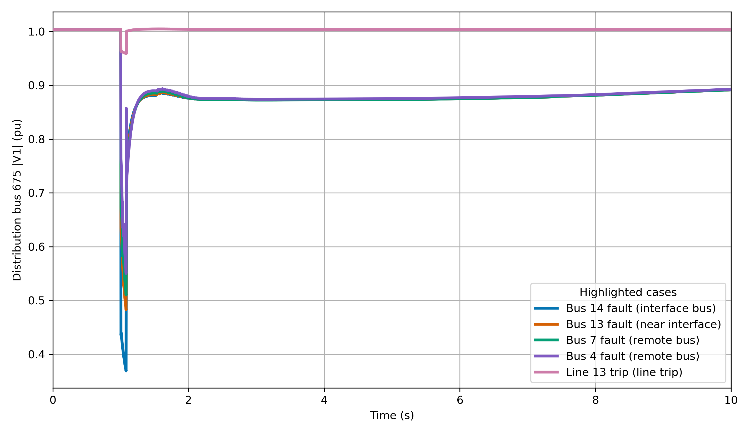
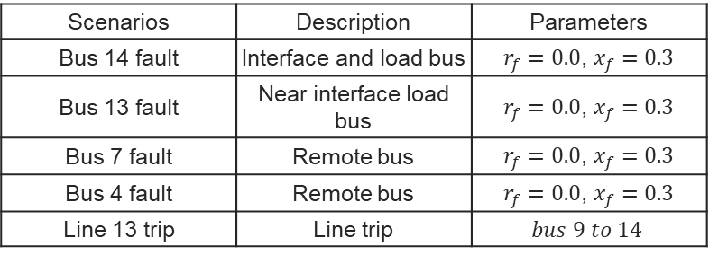
Case Studies: fault variation
Voltage of node 675 at feeder with various transmission faults
Scenarios | Description | Parameters
Bus 14 fault | Interface and load bus | $r_{f}=0.0$, $x_{f}=0.3$
Bus 13 fault | Near interface load bus | $r_{f}=0.0$, $x_{f}=0.3$
Bus 7 fault | Remote bus | $r_{f}=0.0$, $x_{f}=0.3$
Bus 4 fault | Remote bus | $r_{f}=0.0$, $x_{f}=0.3$
Line 13 trip | Line trip | $$bus 9 to 14$$
FIDVR risk is not limited to faults directly at the interface bus. Bus 14 produces the strongest voltage depression, but nearby and remote transmission faults such as Bus 13, Bus 7, and Bus 4 can still depress the feeder voltage and produce delayed recovery.

Slide 18
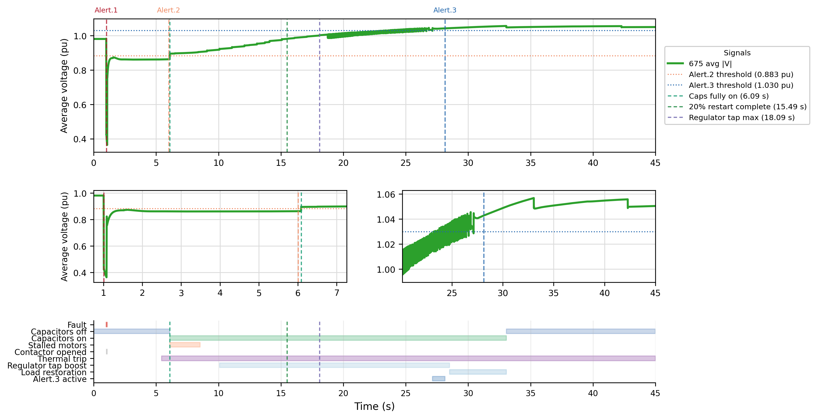
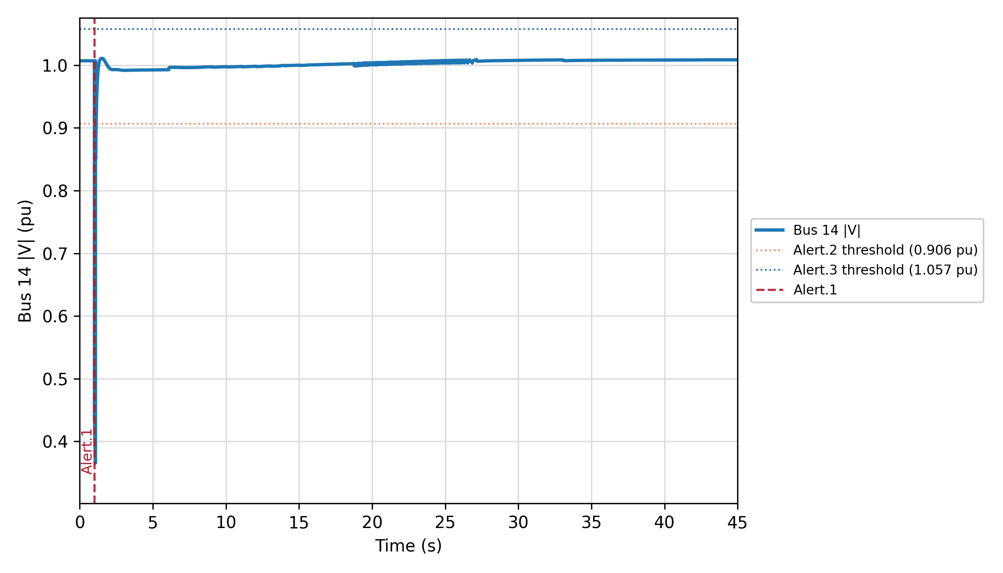
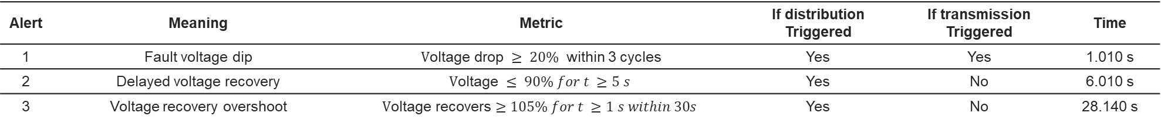
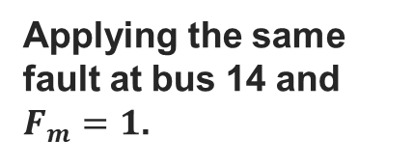
Case Studies: FIDVR analysis
675 node voltage alert -- feeder
FIDVR is mainly a feeder-level dynamic response.
Applying the same fault at bus 14 and $F_{m}=1$.
14 bus voltage alert -- transmission
Alert | Meaning | Metric | If distribution Triggered | If transmission Triggered | Time
1 | Fault voltage dip | $\text{V}\text{oltage} \text{drop} ≥ 20\%$ within 3 cycles | Yes | Yes | 1.010 s
2 | Delayed voltage recovery | $$\text{V}\text{oltage} ≤ 90\% for t ≥5 s$$ | Yes | No | 6.010 s
3 | Voltage recovery overshoot | $$\text{V}\text{oltage} \text{recovers}≥105\% for t ≥1 s within 30s$$ | Yes | No | 28.140 s

Slide 19
Conclusion
Key findings
An ANDES-OpenDSS-HELICS dynamic co-simulation framework was developed to study FIDVR with both transmission dynamics and feeder level voltage resolution.
Motor share strongly affects post-fault voltage recovery. A higher Motor D fraction increases reactive power demand and leads to more delayed voltage recovery.
Feeder level voltage recover non-uniformly. Downstream nodes can experience deeper and longer voltage depression than the feeder head, showing why feeder level modeling is necessary.
Transmission faults away from the interface can still propagate through the interface voltage and trigger distribution side FIDVR.
Future work
Extend the study to multiple feeders and larger transmission systems.
Investigate FIDVR mitigation strategies.

Slide 20
Selected reference
[1]B. Williams, W. Schmus, and D. Dawson, “Transmission voltage recovery delayed by stalled air conditioner compressors,” IEEE Transactions on Power Systems, vol. 7, no. 3, pp. 1173–1181, 1992.
[6]R. W. Kenyon, B. Mather, and B.-M. Hodge, “Coupled transmission and distribution simulations to assess distributed generation response to power system faults,” Electric Power Systems Research, vol. 189,p. 106746, 2020. [Online]. Available: https://www.sciencedirect.com/science/article/pii/S0378779620305496
[18]W. Wang, X. Fang, H. Cui, F. Li, Y. Liu, and T. J. Overbye, “Transmission-and-distribution dynamic co-simulation framework fordistributed energy resource frequency response,” IEEE Transactions on Smart Grid, vol. 13, no. 1, pp. 482–495, 2022.

Slide 21
Appendix
Teng WANG

Slide 22
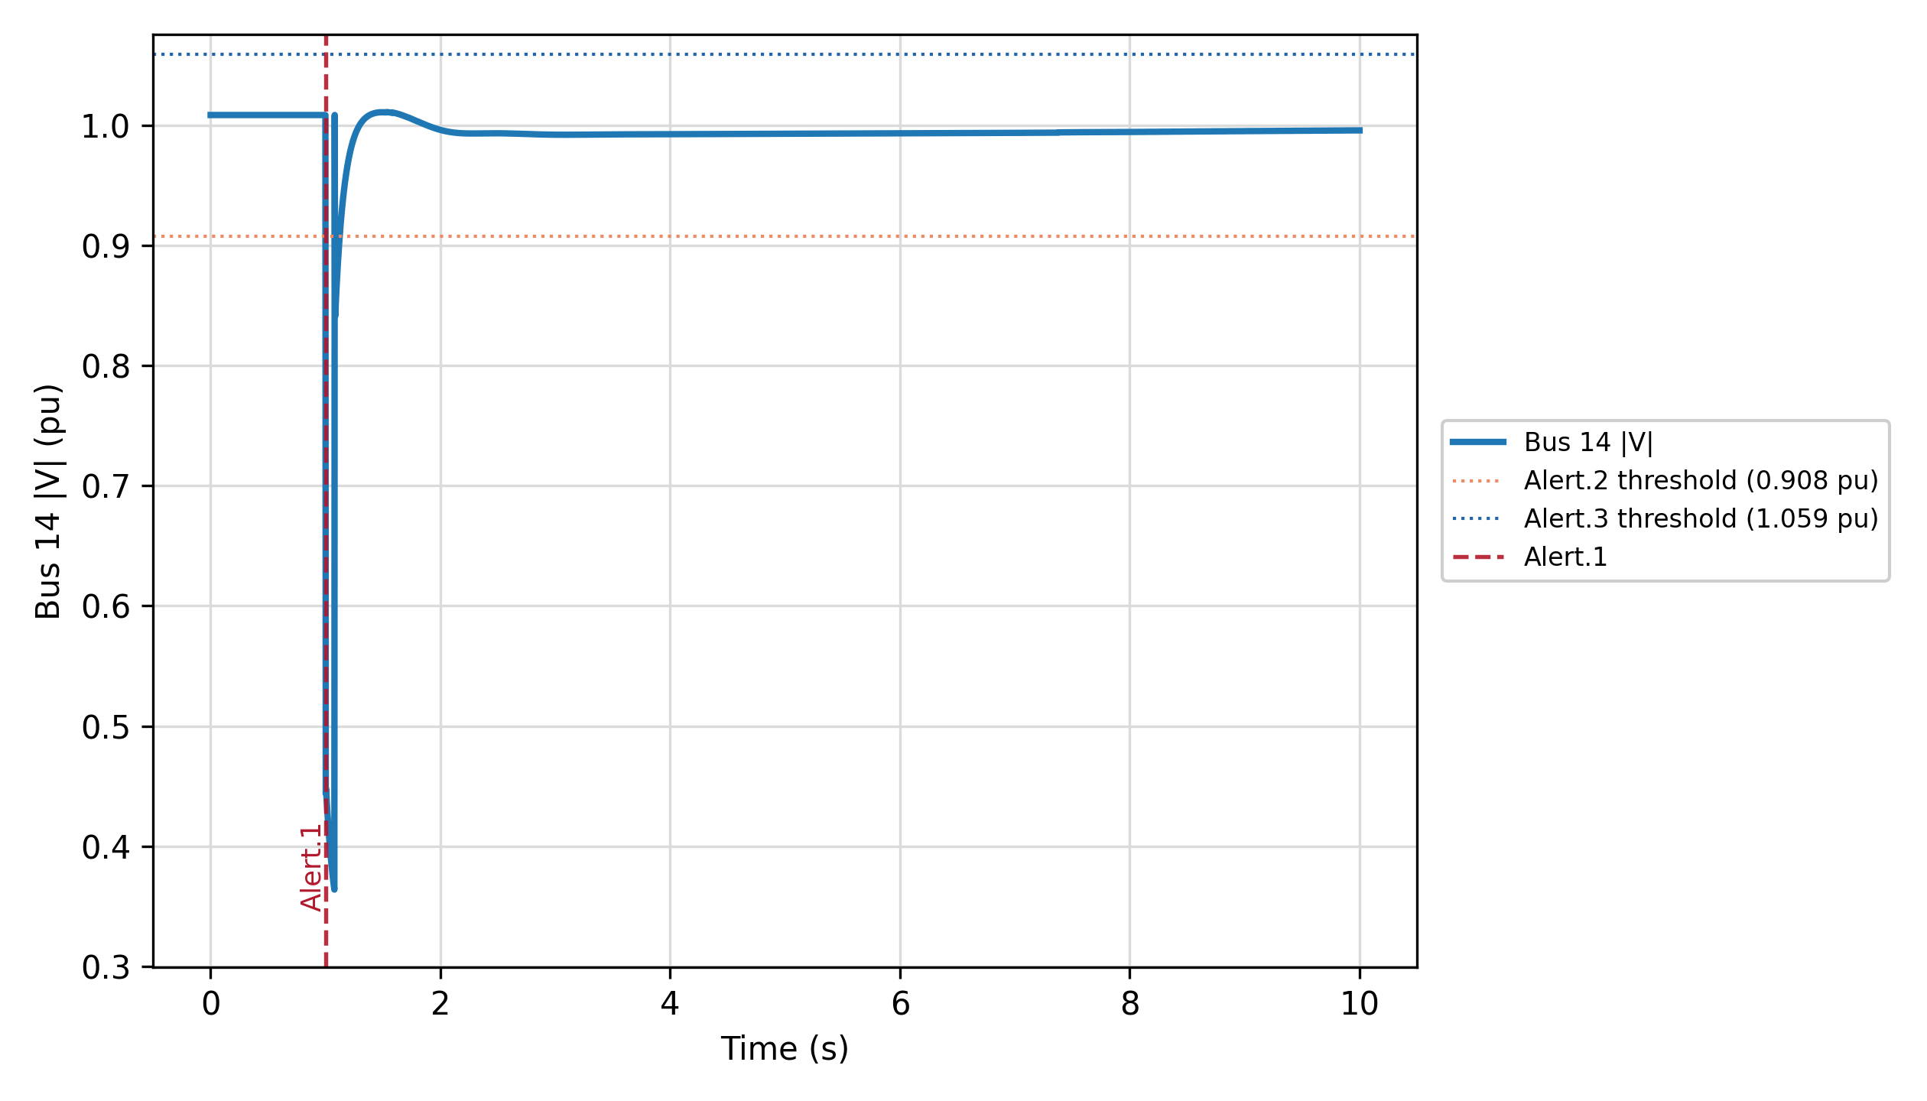
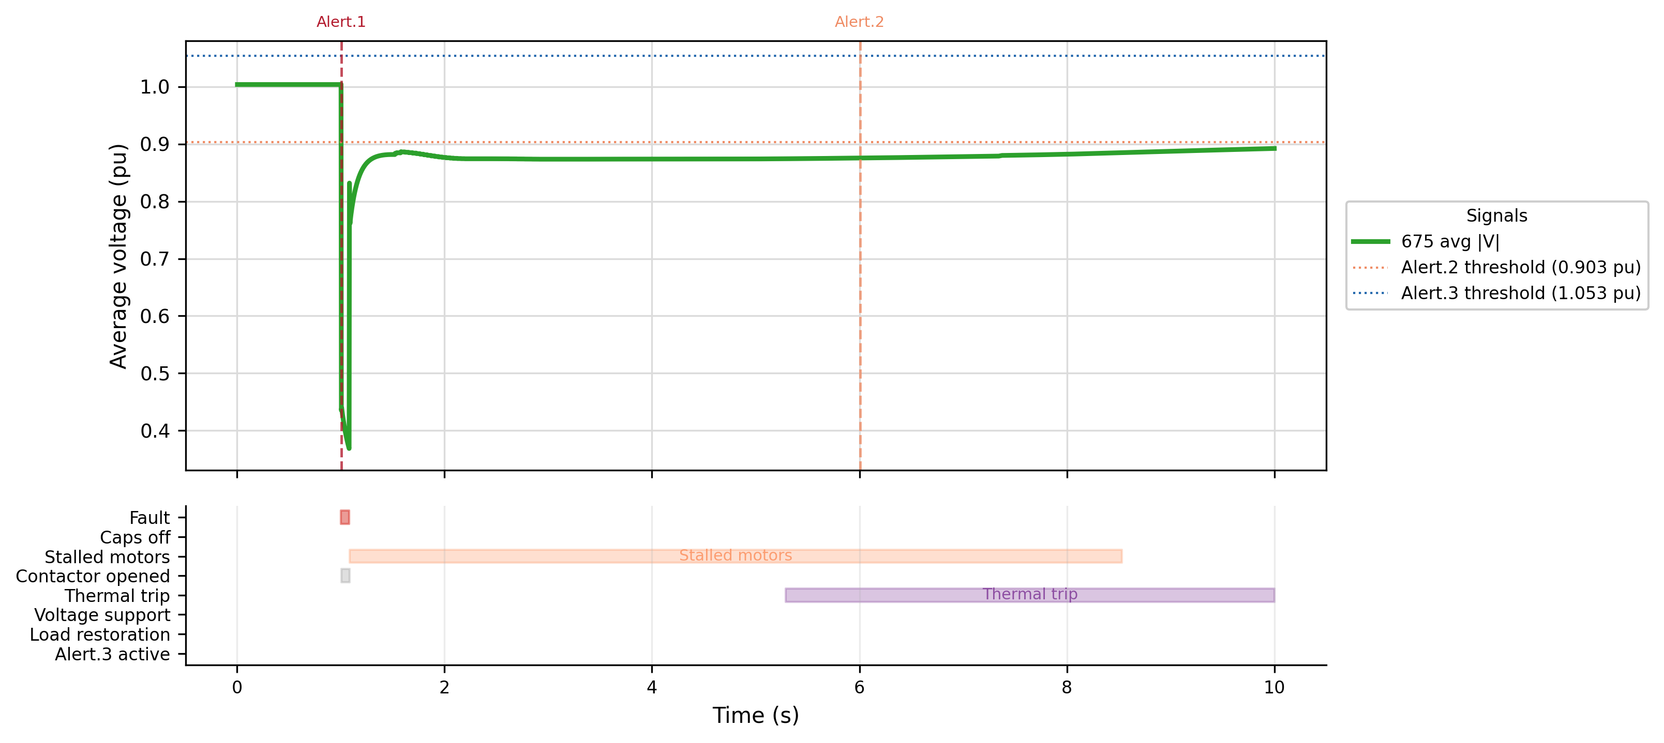
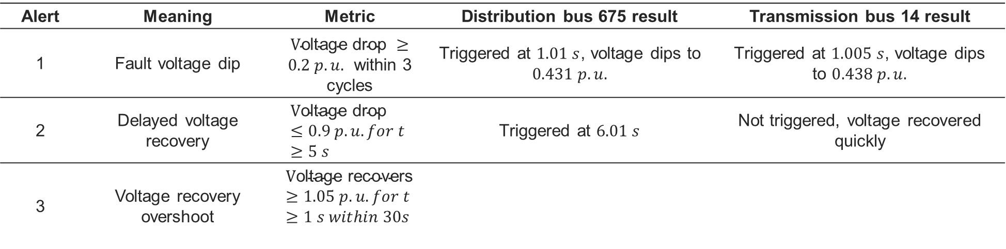
Case Studies: FIDVR analysis
Transmission bus voltage alert
Distribution alert
Alert | Meaning | Metric | Distribution bus 675 result | Transmission bus 14 result
1 | Fault voltage dip | $\text{V}\text{oltage} \text{drop} ≥0.2 p.u.$ within 3 cycles | Triggered at $1.01 s$, voltage dips to $0.431 p.u.$ | Triggered at $1.005 s$, voltage dips to $0.438 p.u.$
2 | Delayed voltage recovery | $$\text{V}\text{oltage} \text{drop} ≤0.9 p.u. for t ≥5 s$$ | Triggered at $6.01 s$ | Not triggered, voltage recovered quickly
3 | Voltage recovery overshoot | $$\text{V}\text{oltage} \text{recovers}≥1.05 p.u. for t ≥1 s within 30s$$

Slide 23
Appendix: literature review
 | Approach | Main contribution | Network representation | Remaining limitation
[1] | Field motivated FIDVR models | Combined field observations and laboratory tests to explain delayed voltage recovery and to motivate dynamic load representation. | 115 kV and 66 kV sub-transmission systems. | Limited feeder level and phase domain resolution.
[2] | WECC composite load mode | Implemented and calibrated aggregate composite load models, compared simulated recovery with PMU data, and identified sensitive Motor D and protection parameters. | Southern California Edison Valley substation. | Does not resolve feeder topology, phase imbalance, or the spatial distribution of stalled single-phase motors
[3] | WECC CMPLDW with variable-frequency drive(VFD) air conditioners | Showed that higher VFD penetration can reduce voltage sag and recovery time. | Utility planning network. | Focuses on the effect of VFD A/C penetration rather than feeder level motor stalling diversity.
[4] | EMTP point-on-wave model | Demonstrated that motor stalling depends on voltage magnitude, duration, loading condition, and point-on-wave initiation angle. | Can estimate model parameters that correspond to the V-I curve and V-P curve in the manufacturer's datasheet. | High model detail limits scalability for large system dynamic studies.
[5] | Hybrid EMT transient stabil-ity model | Coupled PSCAD/EMTDC and InterPSS through a three-phase boundary equivalent to study unbalanced faults and A/C motor stalling in a large WECC system. | Sub-transmission and distribution systems supplied from selected WECC buses. | Uses equivalent feeders and a fundamental frequency interface, which limits detailed feeder topology and harmonic representation.
[6] | Coupled PSLF-OpenDSS study with WECC CMPLDWG and PVD1 | Showed that feeder level inverter ride-through behavior can significantly change the bulk system response during a disturbance. | WECC transmission case with distribution feeders and IEEE 1547 ride-through logic. | Focuses on DER/PV ride-through rather than compressor-motor stalling and FIDVR motor dynamics.
Proposed work | WECC ld1pac model | Develops an open source, feeder level, FIDVR oriented extension of T&D dynamic co-simulation using ANDES-OpenDSS-HELICS. | IEEE 14-bus transmission system coupled to an IEEE 13-node feeder.

Slide 24
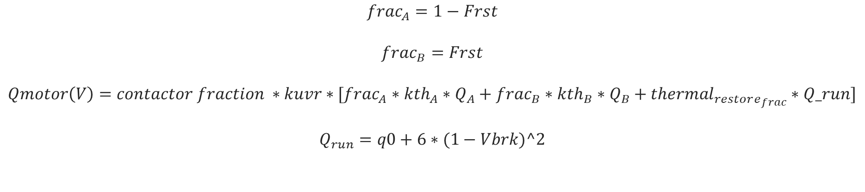
Case Study: Test System
For each selected phase load, the original load is divided into a static component and a motor component. The maximum motor share is
$$frac_{A}=1−Frst$$
$$frac_{B}=Frst$$
$$Qmotor\left(V\right)=contactor fraction ∗kuvr∗[frac_{A}∗kth_{A}∗Q_{A}+frac_{B}∗kth_{B}∗Q_{B}+thermal_{restore_{frac}}∗Q_run]$$
$$Q_{run}=q0+6∗(1−Vbrk)^2$$

Slide 25
Appendix: reference
[1]B. Williams, W. Schmus, and D. Dawson, “Transmission voltage recovery delayed by stalled air conditioner compressors,” IEEE Transactions on Power Systems, vol. 7, no. 3, pp. 1173–1181, 1992.
[2]S. Adhikari, J. Schoene, N. Gurung, and A. Mogilevsky, “Fault induced delayed voltage recovery (fidvr): Modeling and guidelines,” in 2019IEEE Power & Energy Society General Meeting (PESGM), 2019, pp.1–5.
[3]Cisco Sullberg, M. Wu, V. Vittal, B. Gong, and P. Augustin, “Examination of composite load and variable frequency drive air conditioning modeling on fidvr,” IEEE Open Access Journal of Power and Energy, vol. 8, pp. 147–156, 2021.
[4]“Examination of composite load and variable frequency drive airconditioning modeling on fidvr,” IEEE Open Access Journal of Powerand Energy, vol. 8, pp. 147–156, 2021.
[5]Q. Huang and V. Vittal, “Application of electromagnetic transient-transient stability hybrid simulation to fidvr study,” IEEE Transactions on Power Systems, vol. 31, no. 4, pp. 2634–2646, 2016.
[6]R. W. Kenyon, B. Mather, and B.-M. Hodge, “Coupled transmission and distribution simulations to assess distributed generation response to power system faults,” Electric Power Systems Research, vol. 189,p. 106746, 2020. [Online]. Available: https://www.sciencedirect.com/science/article/pii/S0378779620305496
[7]G. Krishnamoorthy and A. Dubey, “Transmission–distribution co-simulation: Analytical methods for iterative coupling,” IEEE Systems Journal, vol. 14, no. 2, pp. 2633–2642, 2020.
[8]R. Sadnan, G. Krishnamoorthy, and A. Dubey, “Transmission and distribution (t&d) quasi-static co-simulation: Analysis and comparison of t&d coupling strength,” IEEE Access, vol. PP, pp. 1–1, 06 2020.
[9]Z. Li, Q. Guo, and J. Wang, “Coordinated transmission and distribution ac optimal power flow,” IEEE Transactions on Smart Grid, vol. PP, pp.1–1, 06 2016.
[10]B. Palmintier, E. Hale, T. M. Hansen, W. Jones, D. Biagioni,H. Sorensen, H. Wu, and B.-M. Hodge, “Igms: An integrated iso-to-appliance scale grid modeling system,” IEEE Transactions on SmartGrid, vol. 8, no. 3, pp. 1525–1534, 2017.
[11]Q. Huang and V. Vittal, “Advanced emt and phasor-domain hybrid simulation with simulation mode switching capability for transmission and distribution systems,” IEEE Transactions on Power Systems, vol. 33,no. 6, pp. 6298–6308, 2018.
[12]“Integrated transmission and distribution system power flow and dynamic simulation using mixed three-sequence/three-phase modeling,” IEEE Transactions on Power Systems, vol. 32, no. 5, pp. 3704–3714,2017.
[13]H. Jain, A. Parchure, R. P. Broadwater, M. Dilek, and J. Woyak, “Three-phase dynamic simulation of power systems using combined transmission and distribution system models,” IEEE Transactions on Power Systems, vol. 31, no. 6, pp. 4517–4524, 2016.
[14]M. A. Elizondo, F. K. Tuffner, and K. P. Schneider, “Three-phase unbalanced transient dynamics and power flow for modeling distribution systems with synchronous machines,” IEEE Transactions on Power Systems, vol. 31, no. 1, pp. 105–115, 2016.
[15]A. Hariri and M. O. Faruque, “A hybrid simulation tool for the study of pv integration impacts on distribution networks,” IEEE Transactions on Sustainable Energy, vol. 8, no. 2, pp. 648–657, 2017.
[16]R. Venkatraman, S. K. Khaitan, and V. Ajjarapu, “Dynamic co-simulation methods for combined transmission-distribution system with integration time step impact on convergence,” IEEE Transactions on Power Systems, vol. 34, no. 2, pp. 1171–1181, 2019.
[17]R. Huang, R. Fan, J. Daily, A. Fisher, and J. Fuller, “An open-source framework for power system transmission and distribution dynamics co-simulation,” IET Generation, Transmission & Distribution, vol. 11, 062017.
[18]W. Wang, X. Fang, H. Cui, F. Li, Y. Liu, and T. J. Overbye, “Transmission-and-distribution dynamic co-simulation framework fordistributed energy resource frequency response,” IEEE Transactions on Smart Grid, vol. 13, no. 1, pp. 482–495, 2022.

Slide 26
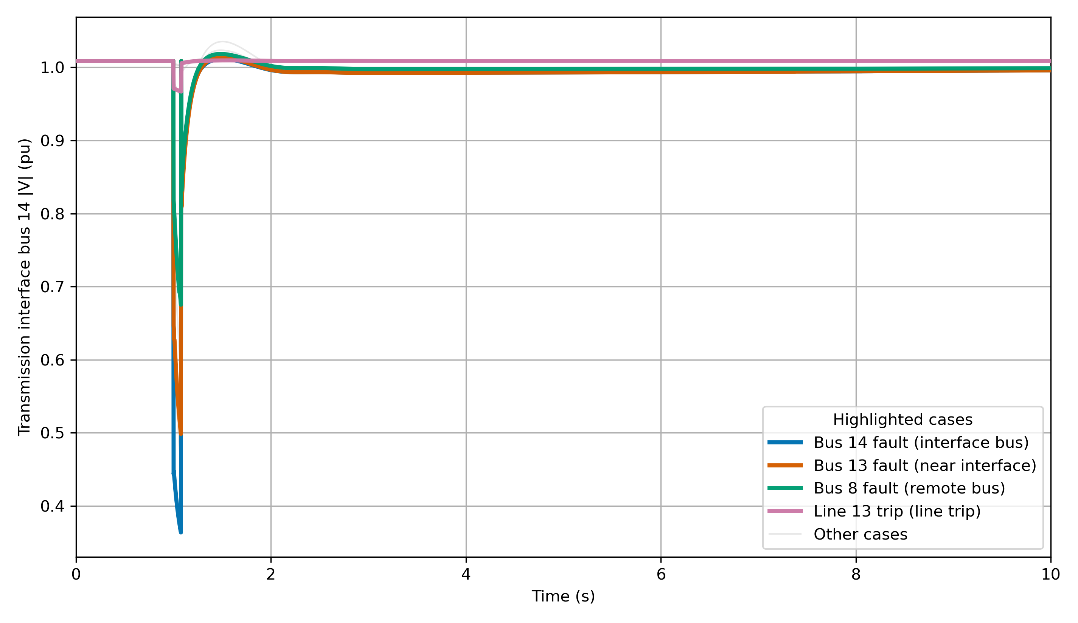
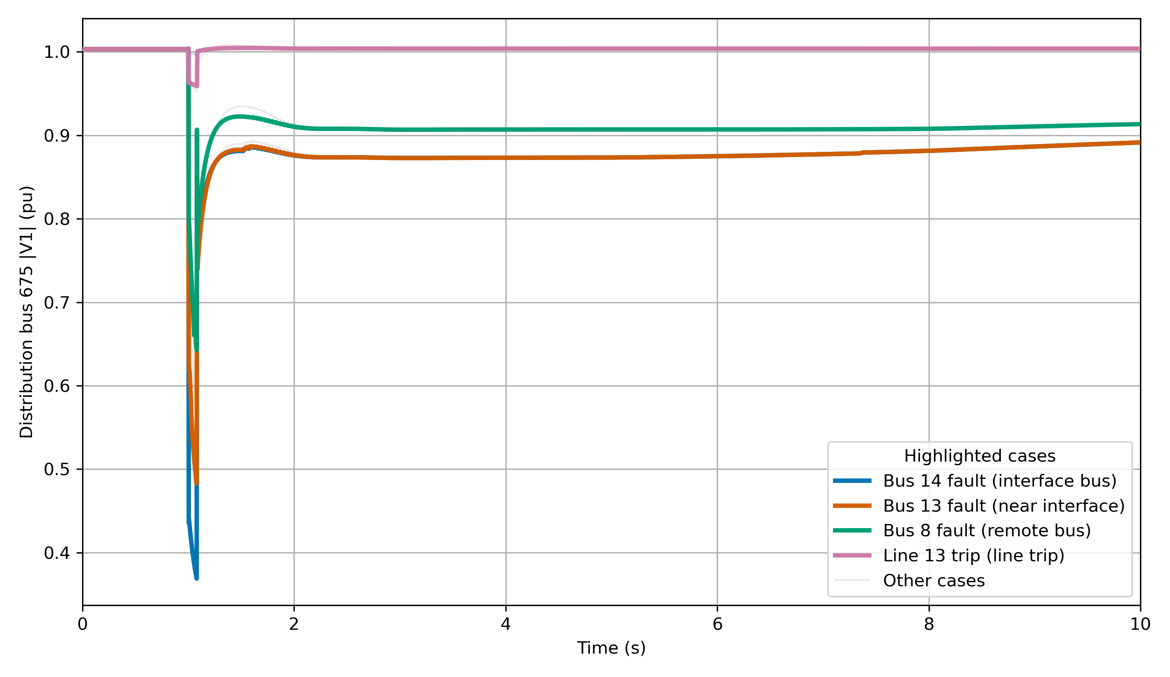
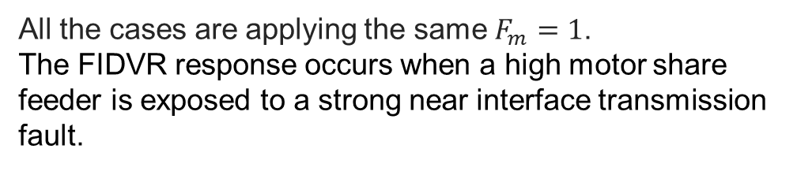
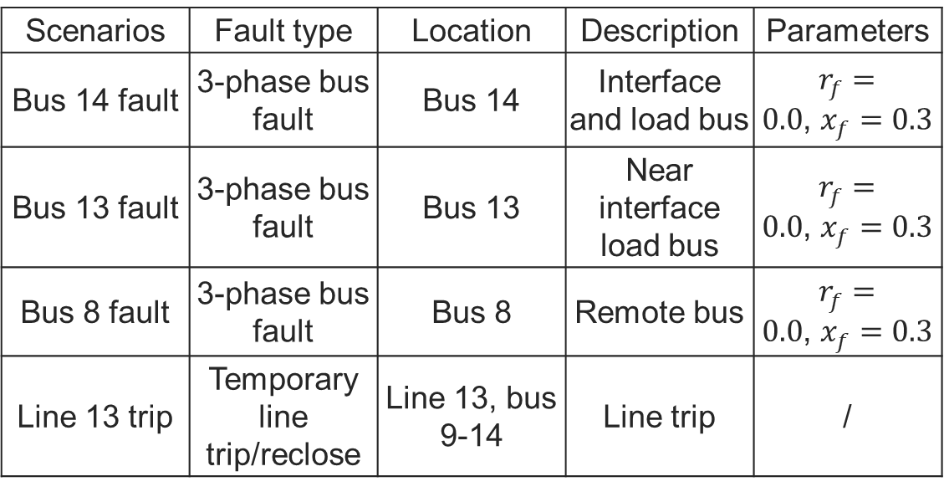
Appendix: case Studies : fault variation
Transmission voltage comparison
Table3: Fault information
Scenarios | Fault type | Location | Description | Parameters
Bus 14 fault | 3-phase bus fault | Bus 14 | Interface and load bus | $r_{f}=0.0$, $x_{f}=0.3$
Bus 13 fault | 3-phase bus fault | Bus 13 | Near interface load bus | $r_{f}=0.0$, $x_{f}=0.3$
Bus 8 fault | 3-phase bus fault | Bus 8 | Remote bus | $r_{f}=0.0$, $x_{f}=0.3$
Line 13 trip | Temporary line trip/reclose | Line 13, bus 9-14 | Line trip | /
Distribution voltage comparison
All the cases are applying the same $F_{m}=1$.
The FIDVR response occurs when a high motor share feeder is exposed to a strong near interface transmission fault.

Slide 27
Appendix: motor location
FIDVR Setup: WECC Motor D places
Total Motor D size: 1911.0 kW.
Motor D elements | Source load | Bus | kW
Load.weccmd_634a | 634a | 634.1 | 160
Load.weccmd_634b | 634b | 634.2 | 120
Load.weccmd_634c | 634c | 634.3 | 120
Load.weccmd_645 | 645 | 645.2 | 170
Load.weccmd_675a | 675a | 675.1 | 485
Load.weccmd_675b | 675b | 675.2 | 68
Load.weccmd_675c | 675c | 675.3 | 290
Load.weccmd_611 | 611 | 611.3 | 170
Load.weccmd_652 | 652 | 652.1 | 128
Load.weccmd_670a | 670a | 670.1 | 17
Load.weccmd_670b | 670b | 670.2 | 66
Load.weccmd_670c | 670c | 670.3 | 117

Slide 28
Appendix: motor data
Parameters tuning
FIDVR_ENABLE_CAP_CONTROL=0 \
FIDVR_ENABLE_REG_CONTROL=0 \
FINE_DT=0.002 COARSE_DT=0.05 COARSE_START=1.6 \
TX_TDS_STEP=0.03 FIDVR_ENABLE_CAP_CONTROL=1 \
FIDVR_ENABLE_REG_CONTROL=1 \
FIDVR_CAPACITOR_INITIAL_FRACTION=1.0 \
FIDVR_CAPACITOR_ON_VOLTAGE_PU=1.025 \
FIDVR_CAPACITOR_ON_DELAY_S=0.3 \
FIDVR_CAPACITOR_OFF_VOLTAGE_PU=0.9 \
FIDVR_CAPACITOR_OFF_DELAY_S=120.0 \
FIDVR_REGULATOR_MONITOR_BUS=675 \
FIDVR_REGULATOR_LOW_VOLTAGE_PU=0.93 \
FIDVR_REGULATOR_HIGH_VOLTAGE_PU=1.025 \
FIDVR_REGULATOR_DELAY_S=0.5 \
FIDVR_REGULATOR_TAP_DELAY_S=0.25 \
FIDVR_NONRESTARTABLE_FRACTION=0.0 \
FIDVR_CONTACTOR_FRACTION=0.10 \
FIDVR_MOTOR_RECONNECT_RAMP_S=1.5 \
FIDVR_MOTOR_GROUP_RESTORE_OFFSETS=0,0.5,1.0
TX_INTERFACE_BUS=14 TX_FAULT_BUS=14 \
TX_FAULT_TIME=1.0 \
TX_FAULT_DURATION=0.1\
TX_FAULT_RF=0.0 \
TX_FAULT_XF=0.35 \
TARGET_TIME=120.0 \
FEEDER_COUNT=1 \
TX_CASE_XLSX=ieee14_fault.xlsx \
DIST_MASTER_DSS=13Bus/IEEE13Nodeckt.dss \
DIST_VOLTAGE_BUS=675 \
DIST_LOAD_SCALE=1.0 \
FIDVR_MOTOR_SHARE=0.9 \
FIDVR_MOTOR_STALL_VOLTAGE_PU=0.82 \
FIDVR_MOTOR_STALL_CLEAR_VOLTAGE_PU=0.92\
FIDVR_STALL_KVAR_PER_KW=5 \
FIDVR_MOTOR_STALL_KVAR_SCALE=15.0 \
FIDVR_MOTOR_THERMAL_TRIP_TIME_S=8.0 \
FIDVR_MOTOR_RECONNECT_DELAY_S=25.0 \

Slide 29
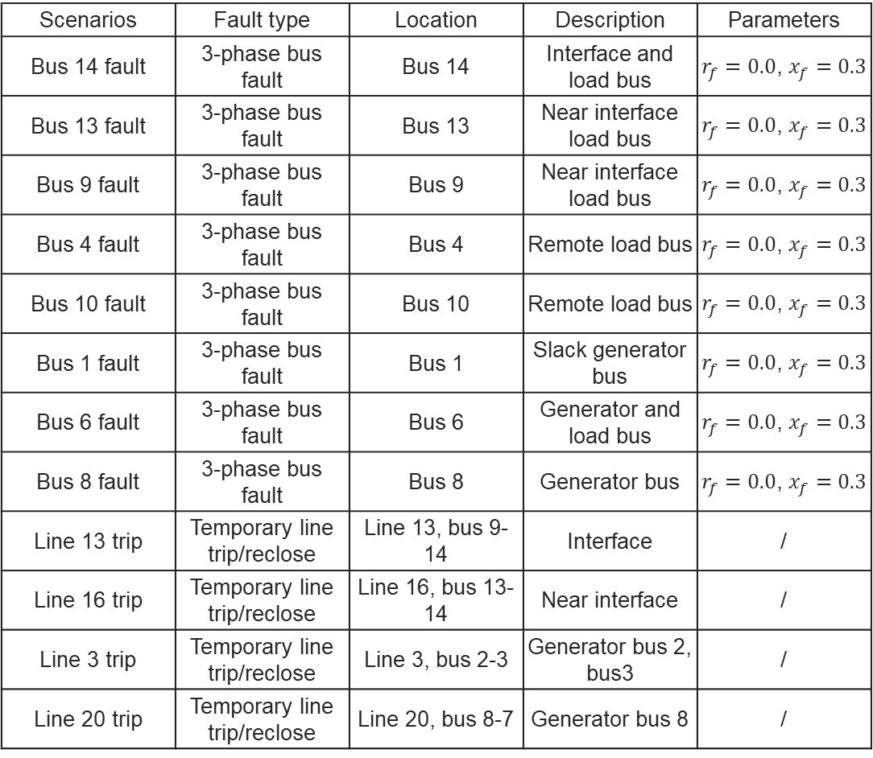
Appendix: fault data
FIDVR test: different faults parameters
Scenarios | Fault type | Location | Description | Parameters
Bus 14 fault | 3-phase bus fault | Bus 14 | Interface and load bus | $r_{f}=0.0$, $x_{f}=0.3$
Bus 13 fault | 3-phase bus fault | Bus 13 | Near interface load bus | $r_{f}=0.0$, $x_{f}=0.3$
Bus 9 fault | 3-phase bus fault | Bus 9 | Near interface load bus | $r_{f}=0.0$, $x_{f}=0.3$
Bus 4 fault | 3-phase bus fault | Bus 4 | Remote load bus | $r_{f}=0.0$, $x_{f}=0.3$
Bus 10 fault | 3-phase bus fault | Bus 10 | Remote load bus | $r_{f}=0.0$, $x_{f}=0.3$
Bus 1 fault | 3-phase bus fault | Bus 1 | Slack generator bus | $r_{f}=0.0$, $x_{f}=0.3$
Bus 6 fault | 3-phase bus fault | Bus 6 | Generator and load bus | $r_{f}=0.0$, $x_{f}=0.3$
Bus 8 fault | 3-phase bus fault | Bus 8 | Generator bus | $r_{f}=0.0$, $x_{f}=0.3$
Line 13 trip | Temporary line trip/reclose | Line 13, bus 9-14 | Interface | /
Line 16 trip | Temporary line trip/reclose | Line 16, bus 13-14 | Near interface | /
Line 3 trip | Temporary line trip/reclose | Line 3, bus 2-3 | Generator bus 2, bus3 | /
Line 20 trip | Temporary line trip/reclose | Line 20, bus 8-7 | Generator bus 8 | /

Slide 30
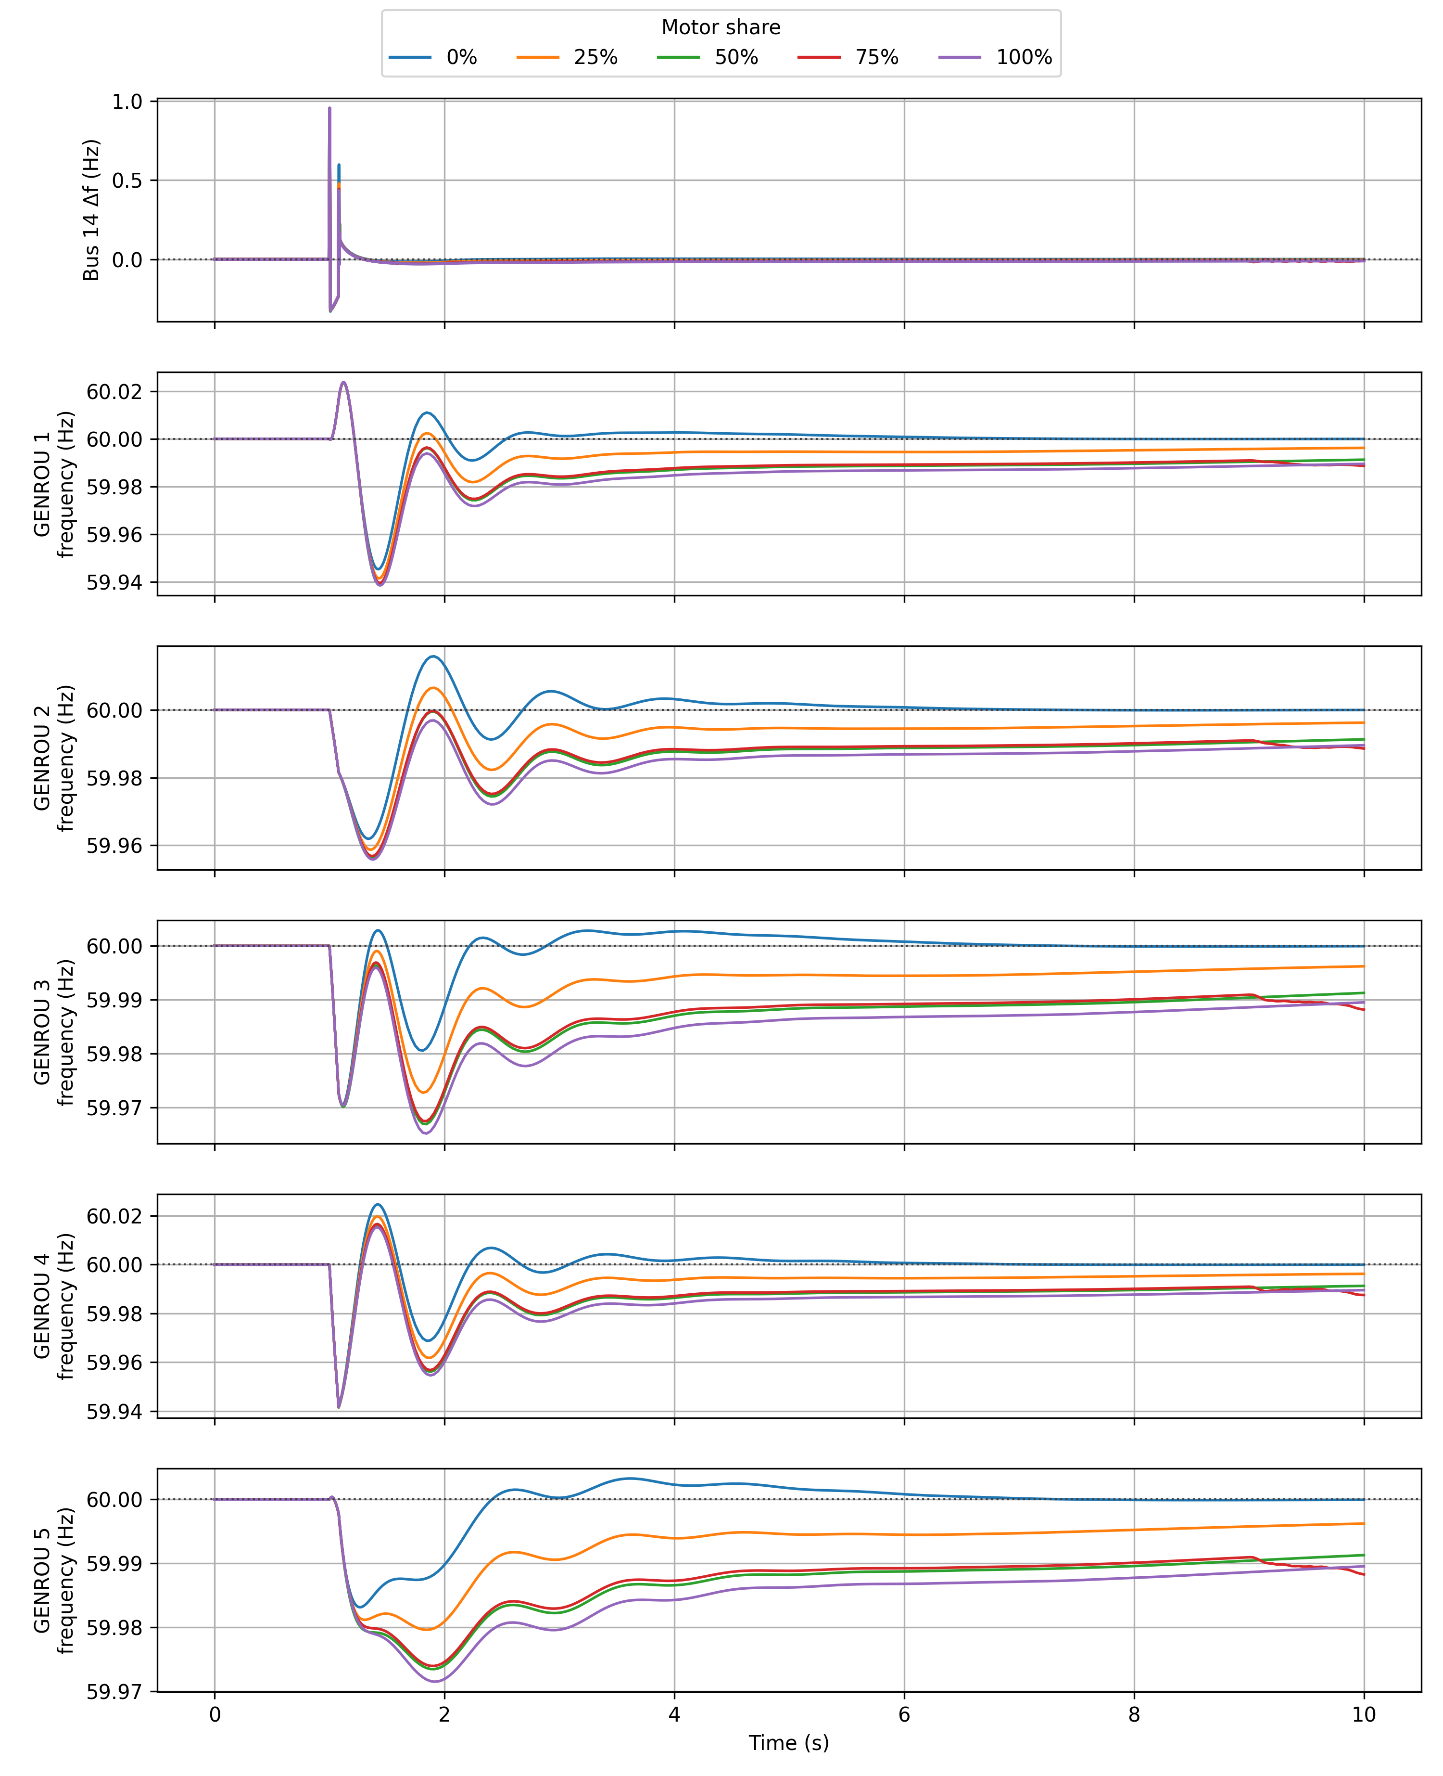
Appendix: plots
FIDVR test: transmission side generator response

