Slide 1
Database Design
The ER Diagram, Relation Schemas, and Dependencies

Slide 2
Main Needs of Supermarkets
Including product management, product supply, product sales, and employee management.
01
Product Management System
02
Product Supply System
The Product Management System is responsible for product assortment, pricing and inventory control.
The Product Supply System manages the information of suppliers. They store supplier purchasing conditions, prices and delivery times.
03
Product Sales System
04
Employee Management System
The Product Sales System mainly records customer data, transaction data and some discount information.
The Employee Management System mainly stores employee information and is used to interact with other records.

Slide 3
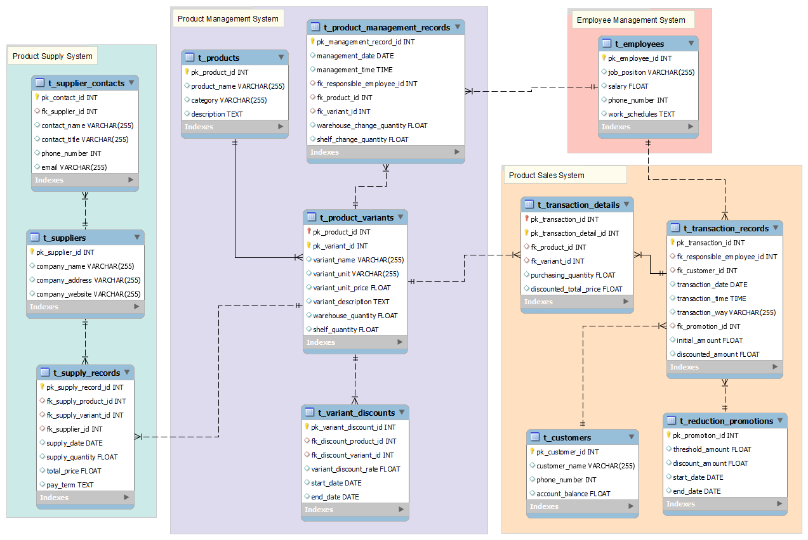
Entity-Relationship Diagram

Slide 4
Product Management System
t_products (
pk_product_id,
product_name,
category,
description)
t_product_variants (
pk_product_id,
pk_variant_id,
variant_name,
variant_unit,
variant_unit_price,
variant_description,
warehouse_quantity,
shelf_quantity)
t_product_management_records (
pk_management_record_id,
management_date,
management_time,
fk_responsible_employee_id,
fk_product_id,
fk_variant_id,
warehouse_change_quantity,
shelf_change_quantity)
t_variant_discounts (
pk_variant_discount_id,
fk_discount_product_id,
fk_discount_variant_id,
variant_discount_rate,
start_date,end_date)
→ t_employees
→ t_product_variants
→ t_products
→ t_product_variants

Slide 5
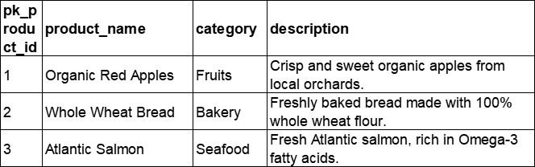
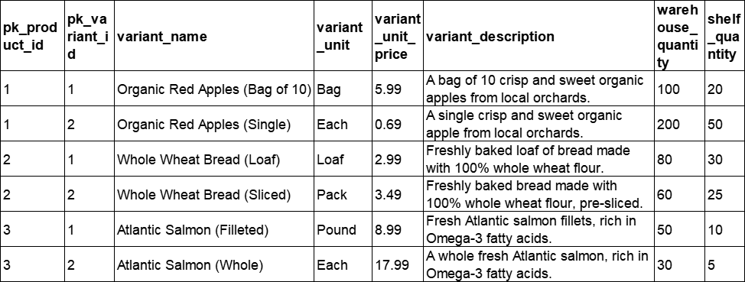
Product Management System
t_products (
pk_product_id,
product_name,
category,
description)
t_product_variants (
pk_product_id,
pk_variant_id,
variant_name,
variant_unit,
variant_unit_price,
variant_description,
warehouse_quantity,
shelf_quantity)
→ t_products

Slide 6
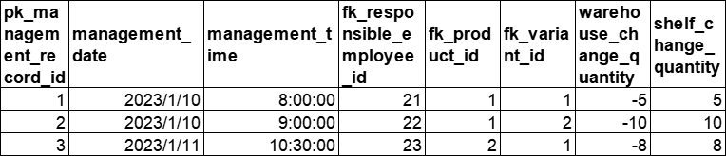
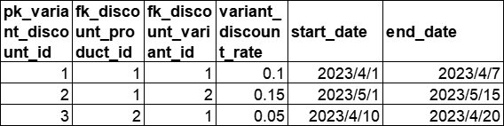
Product Management System
t_product_management_records (
pk_management_record_id,
management_date,
management_time,
fk_responsible_employee_id,
fk_product_id,
fk_variant_id,
warehouse_change_quantity,
shelf_change_quantity)
t_variant_discounts (
pk_variant_discount_id,
fk_discount_product_id,
fk_discount_variant_id,
variant_discount_rate,
start_date,end_date)
→ t_employees
→ t_product_variants
→ t_product_variants

Slide 7
Product Supply System
t_suppliers (
pk_supplier_id,
company_name,
company_address,
company_website)
t_supplier_contacts (
pk_contact_id,
fk_supplier_id,
contact_name,
contact_title,
phone_number,
email)
t_supply_records (
pk_supply_record_id,
fk_supply_product_id,
fk_supply_variant_id,
fk_supplier_id,
supply_date,
supply_quantity,
total_price,
pay_term)
→ t_product_variants
→ t_supplier
→ t_supplier

Slide 8
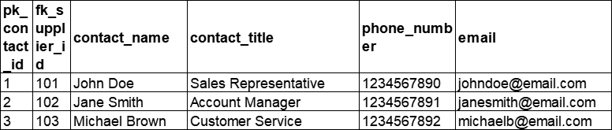
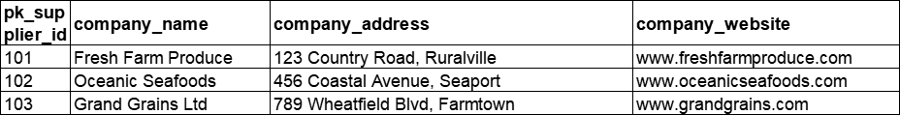
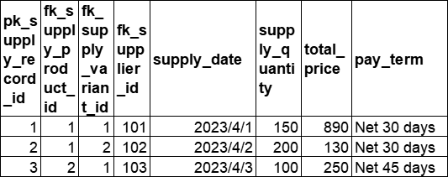
Product Supply System
t_suppliers (
pk_supplier_id,
company_name,
company_address,
company_website)
t_supplier_contacts (
pk_contact_id,
fk_supplier_id,
contact_name,
contact_title,
phone_number,
email)
→ t_supplier
t_supply_records (
pk_supply_record_id,
fk_supply_product_id,
fk_supply_variant_id,
fk_supplier_id,
supply_date,
supply_quantity,
total_price,
pay_term)
→ t_product_variants
→ t_supplier

Slide 9
Product Sales System
t_transaction_records (
pk_transaction_id,
fk_responsible_employee_id,
fk_customer_id,
transaction_date,
transaction_time,
transaction_way,
fk_promotion_id,
initial_amount,
discounted_amount)
t_customers (
pk_customer_id,
customer_name,
phone_number,
account_balance)
t_transaction_details (
pk_transaction_id,
pk_transaction_detail_id,
fk_product_id,
fk_variant_id,
purchasing_quantity,
discounted_total_price)
t_reduction_promotions (
pk_promotion_id,
threshold_amount,
discount_amount,
start_date,
end_date)
→ t_transaction_records
→ t_employees
→ t_customers
→ t_product_variants
→ t_reduction_promotions

Slide 10
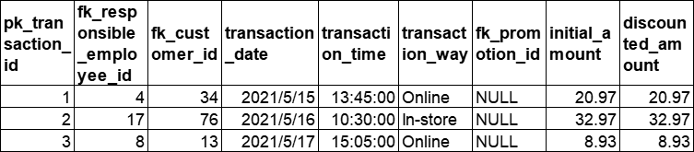
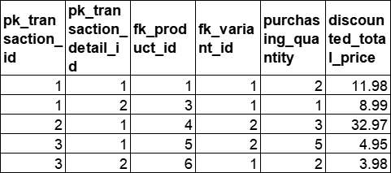
Product Sales System
t_transaction_records (
pk_transaction_id,
fk_responsible_employee_id,
fk_customer_id,
transaction_date,
transaction_time,
transaction_way,
fk_promotion_id,
initial_amount,
discounted_amount)
→ t_employees
→ t_customers
→ t_reduction_promotions
t_transaction_details (
pk_transaction_id,
pk_transaction_detail_id,
fk_product_id,
fk_variant_id,
purchasing_quantity,
discounted_total_price)
→ t_transaction_records
→ t_product_variants

Slide 11
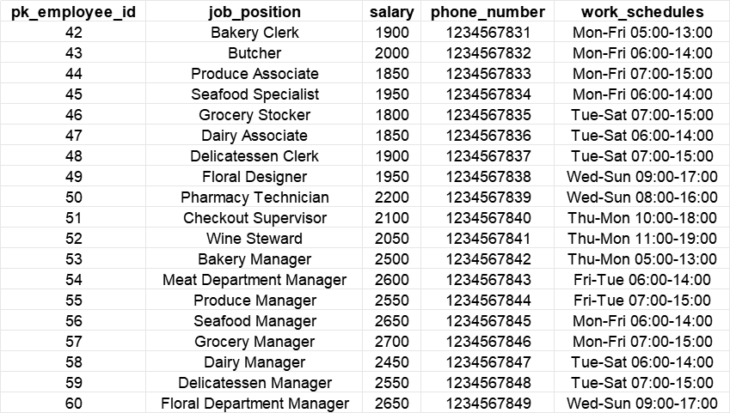
Employee Management System
t_employees (
pk_employee_id,
job_position,
salary,
phone_number,
work_schedules)

Slide 12
Analysis of the Database Design
About the functional and/or multivalued dependencies
All the tables have only one primary key (single attribute or in composition form) and no other candidate keys. The functional dependencies in the form X → Y, where:
X must be the primary key of R, Y can only be nonprime attributes
Therefore, any table neither has a transitive dependency, nor partial dependency.
In conclusion, all the tables are at least in Third Normal Form (3NF).
For example, the table t_transaction_details (primary key in composition form) is shown below. All the other tables are similar to the form of this table, hence omitted here.
pk_transaction_id | pk_transaction_details_id | fk_product_id | fk_variant_id | purchasing_quantity | discounted_total_price

Slide 13
Just Break
Insert the title of
your subtitle Here

