Slide 1
Deep Reinforce Learning based
Sales Automation
Tengfei Ma

Slide 2
Cotents
1
Motivation & Aim
2
Literature Review
3
My Model & Data Collection
4
Demo based on GPT-4

Slide 3
Motivation & Aim

Slide 4
Motivation
01
Powerful LLM
02
Challenge: Sales Efficiency
The capabilities of Large Language Models (LLMs) have significantly improved, enabling efficient communi- cation with humans.
Nearly all products require sales per-sonnel for transactions, but they
cannot chat with numerous users
simultaneously or conduct extensive user information surveys.
03
Cost Efficiency
04
Data Collection
Once trained, models can be reused with very low marginal costs. As the scale of the audience increases, the cost-effectiveness improves.
Customers have limited patience for salesperson, making it challenging
to gather extensive data from sales practices. Therefore, we utilize
reinforcement learning to
solve this problem.

Slide 5
Aim
Our goal is to fine-tune an existing trained large
model, such as GPT-4, using Deep Reinforcement
Learning, or to apply prompt engineering to
develop a "salesperson agent" that can
communicate with customers and ultimately close
deals.
Notice that the reason for adopting fine-tuning or
prompt engineering is that training a large model from
scratch involves significant time and economic costs.

Slide 6
Literature Review

Slide 7
Review
Marketing Automation & Business Intelligence
How marketing automation and Business Intelligence (BI) leverage software to streamline and enhance
marketing processes and business operations. Marketing automation utilizes tools for customer segmentation, data integration, and campaign management, which significantly improves efficiency and enables new functionalities. Meanwhile, BI systems provide real-time sales data and extensive reporting capabilities, helping
businesses gain a deeper understanding of their operations, customers, supply chains, and financial
performance, ultimately driving better strategic decisions and increased ROI.
Reference:
https://www.researchgate.net/profile/Mohammad-Khan-48/publication/348668779_Development_of_An_e-commerce_Sales_Chatbot/links/60617de8458515e8347bb660/Development-of-An-e-commerce-Sales-Chatbot.pdf
E-commerce Sales Chatbot
The field of e-commerce sales chatbots is focused on enhancing customer interaction and sales through advanced artificial intelligence technologies. Central to this is the use of machine learning to develop natural language understanding capabilities, allowing chatbots to process and respond to user queries more effectively. These systems are typically built on modular frameworks that facilitate scalability and adaptability, incorporating elements such as language training platforms, text classification, and entity extraction.
Reference:
https://webbut.unitbv.ro/index.php/Series_V/article/download/3962/3130
They all look at issues from the perspective of the business and do not provide customized services for customers.

Slide 8
My Model & Data Collection

Slide 9
Core Idea
We have two models in total -- ‘customer network’ & ‘salespeople network’.
1. The first model is the 'customer network'.
- This model involves appending a bitNet model to the output end of GPT for fine-tuning.
- We then collect messages from the customer's social media platforms for imitation learning to mimic the way the customer speaks.
- The loss function can be cross entropy, from which we calculate the gradients for bitNet and update its parameters.
2. The second model is the 'salespeople network' (DRL)
- Also uses GPT+bitNet, and consider bitNet as policy function
- After completing a set of dialogues, we use policy gradient to update bitNet’s parameters.
-We chose bitNet because it offers high cost-effectiveness; our ultimate goal is to increase corporate profits. If the training costs exceed the expenses of manual labor, it would be unjustifiable.

Slide 10
Customer Network
The purpose of customer network is to mimic a customer.
GPT
bitNet
a token
a predicted token
For example, a customer post a message “I like playing basketball.” on X.
We input a token “I”, and the predicted token is denoted by “y_p”
The loss function is cross entropy, and we adapt gradient descent to update
only parameters of bitNet :
The parameters of GPT is frozen.

Slide 11
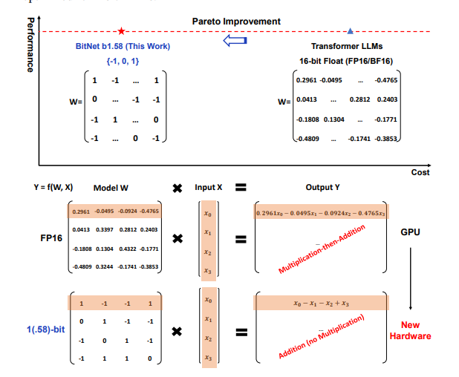
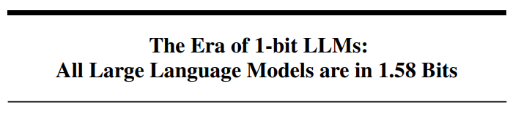
bitNet
https://arxiv.org/pdf/2402.17764.pdf

Slide 12
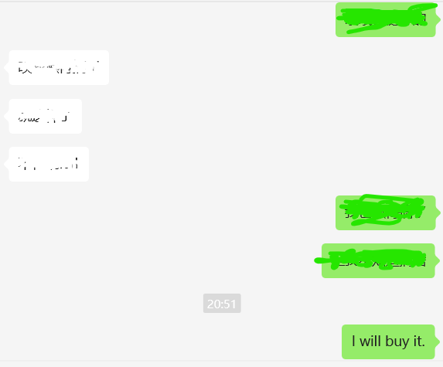

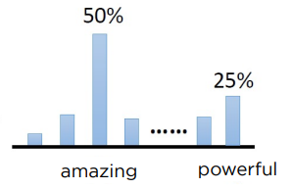
Salespeople Network
Deep Reinforcement Learning:
State: All the conversations that have happened
Action: Output a next predicted token
policy function π(action∣states; parameters): bitNet
Return (U_t): 1, if deal; -1, if not deal.
After a set of conversations, we use policy gradient to update
parameters of bitNet:
“I will buy it.” means deal.
so after a set of conversations, u = 1
State
GPT
bitNet
a token
Reference:
Mastering the game of Go with DNN and tree search

Slide 13
Date Collection
‘customer network’:
- we need the information of customers as data. We could collect the data from
public social media platform such as X, instagram, Tiktok, Wechat moments
and so on.
- Characters of the data:
- Natural Language
--need to embedding using CBOW, skip-gram and so on.
- Position matters.
-- positional embedding
- Privacy
‘salespeople network’:
- need a ‘customer network’

Slide 14
Demo based on GPT-4

Slide 15
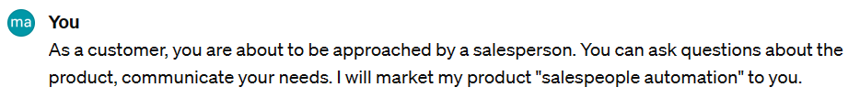
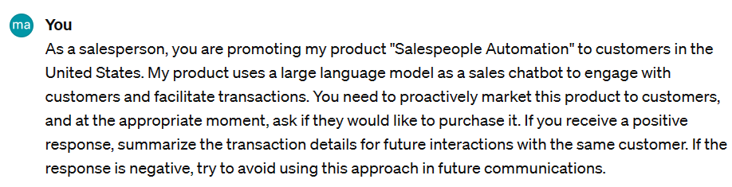
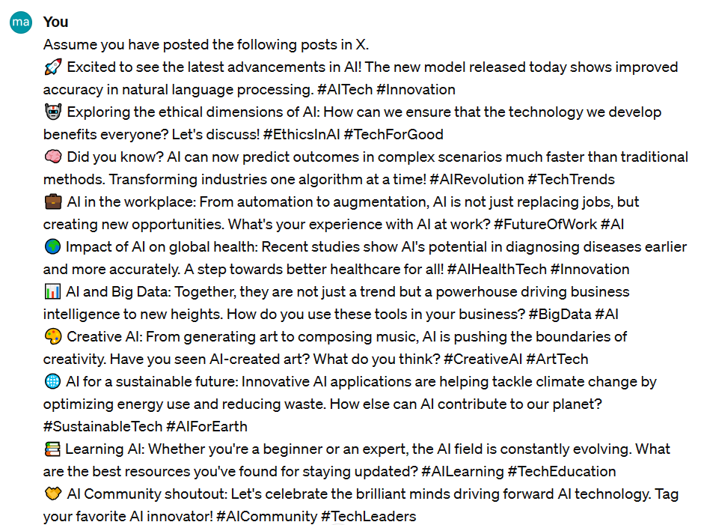
Demo
I am not a native English speaker and know little about American culture, but I want
to sell this ‘Sales Automation’ product to the U.S.
I fail to gain API of chatGPT, so I show the feasibility by Prompt Engineering.
Prompts:
Customer Network:
Salespeople Network:

Slide 16
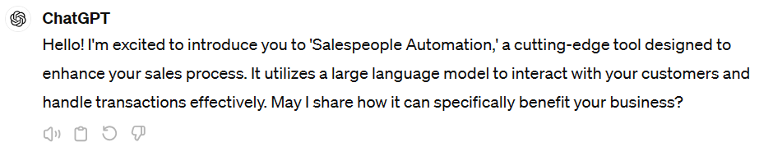
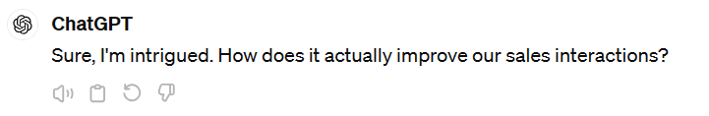
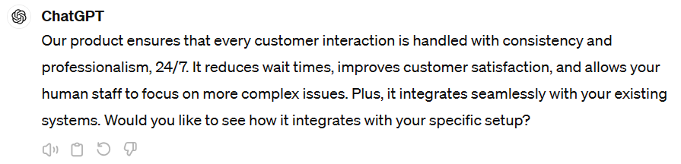
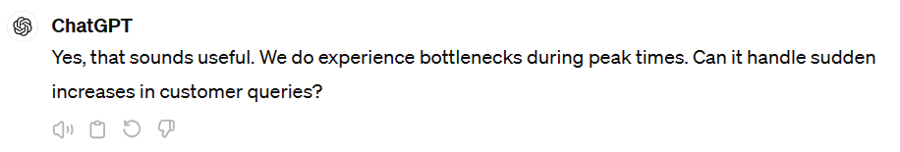
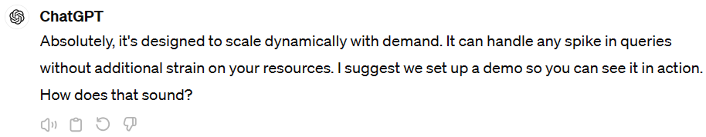
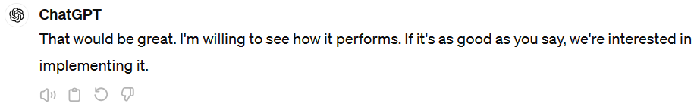
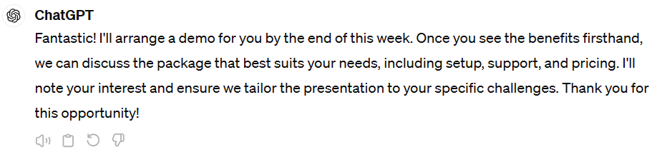
Demo
Salespeople Network:
Customer Network:

Slide 17
Thank you

