Slide 1

Restorable Image Operators with Quasi-Invertible Networks
Hao Ouyang*, Tengfei Wang*, Qifeng Chen
AAAI 2022

Slide 2
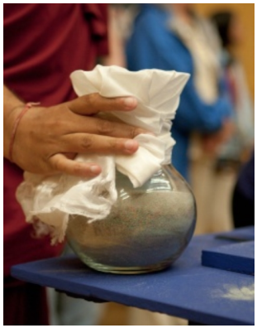
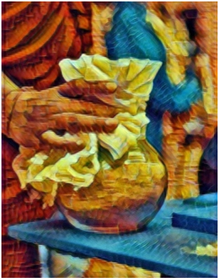
Image filters are broadly applied for sharing attractive photos on social media.
Image operators
Original image
Processed image

Slide 3
How to deal with the original image after we have the processed one?
- Desired to have access to original ones for alternative editing.
- reluctant to keep original ones for saving storage.
Image operators
Original image
Processed image

Slide 4
Can image operators be restorable?
Image operators
inverse operators
Original image
Processed image
So that we can restore the original image anytime!

Slide 5
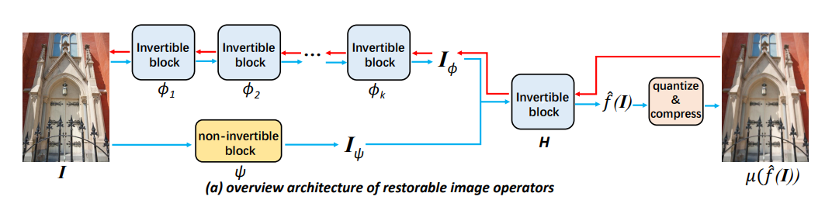
Design a model to perform both high-quality approximation and restoration.

Slide 6
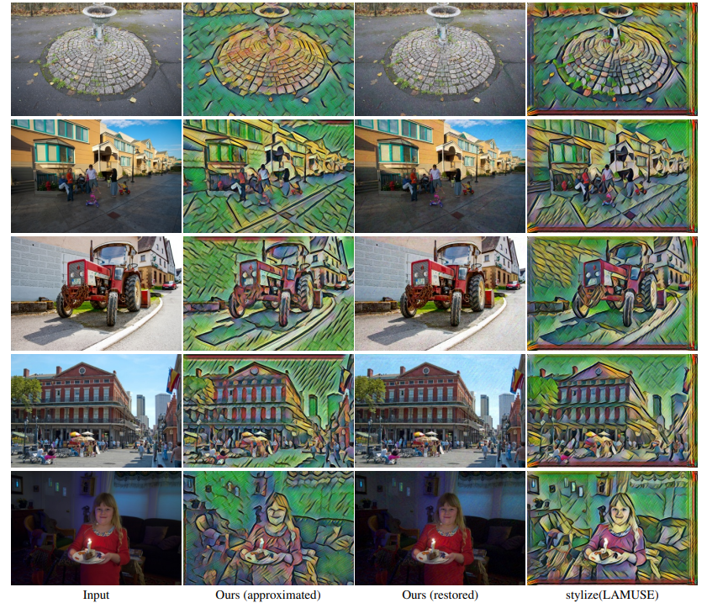
Style Transfer
Original Ours Ours (restored) ground-truth filter

Slide 7
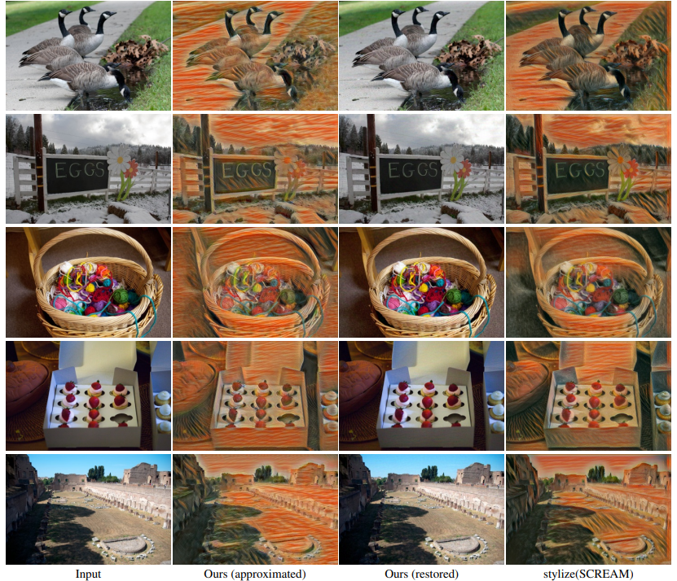
Style Transfer
Original Ours Ours (restored) ground-truth filter

Slide 8
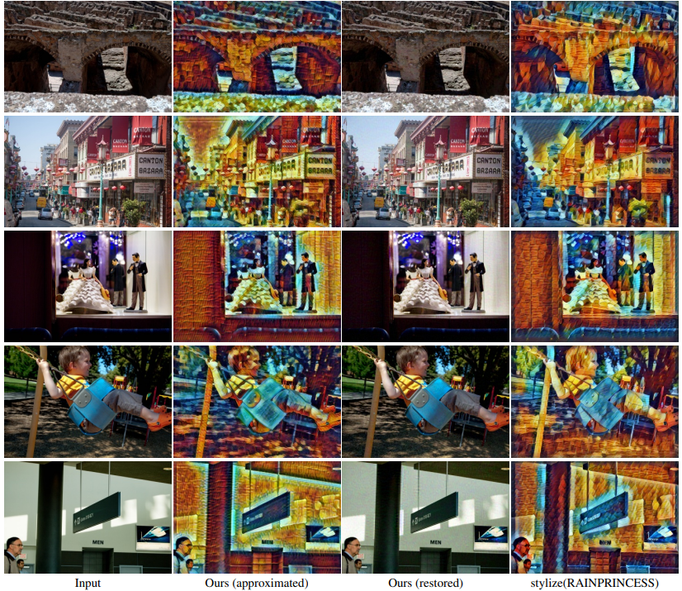
Style Transfer
Original Ours Ours (restored) ground-truth filter

Slide 9
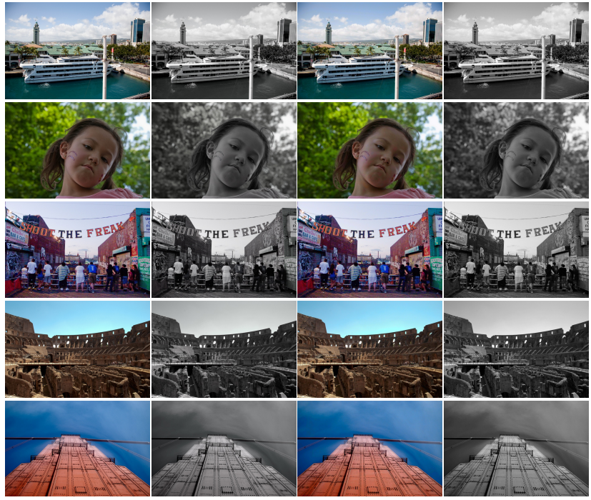
Black-White Style
Original Ours Ours (restored) ground-truth filter

Slide 10
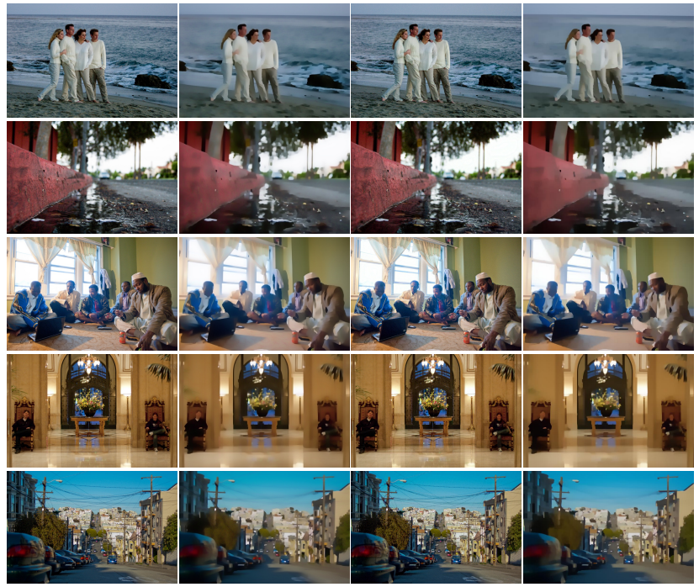
Blur
Original Ours Ours (restored) ground-truth filter

Slide 11
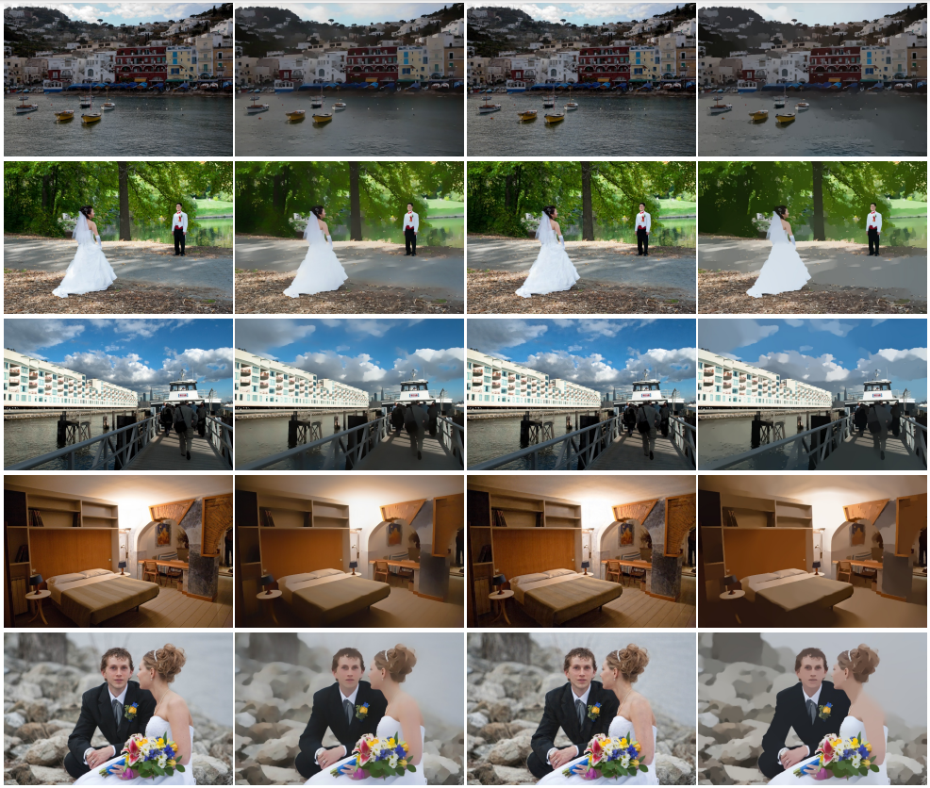
Smooth
Original Ours Ours (restored) ground-truth filter

Slide 12
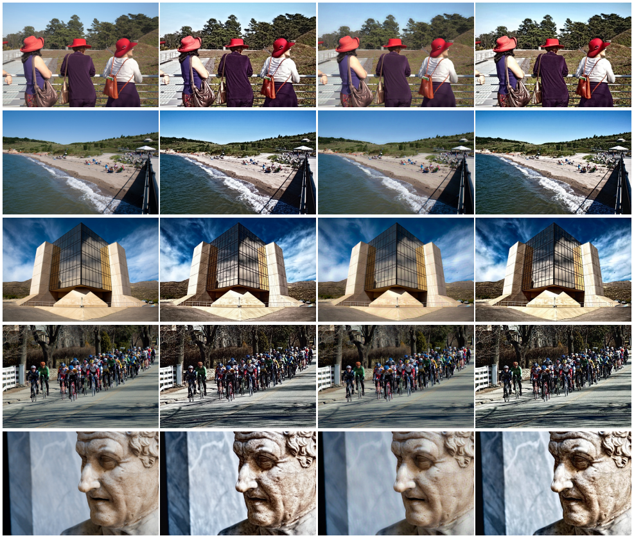
Enhancement
Original Ours Ours (restored) ground-truth filter

Slide 13
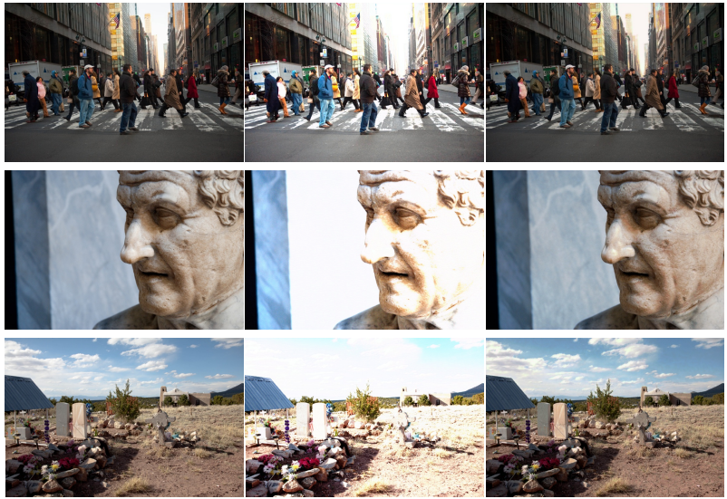
Exposure Adjust
Original Ours Ours (restored)

Slide 14
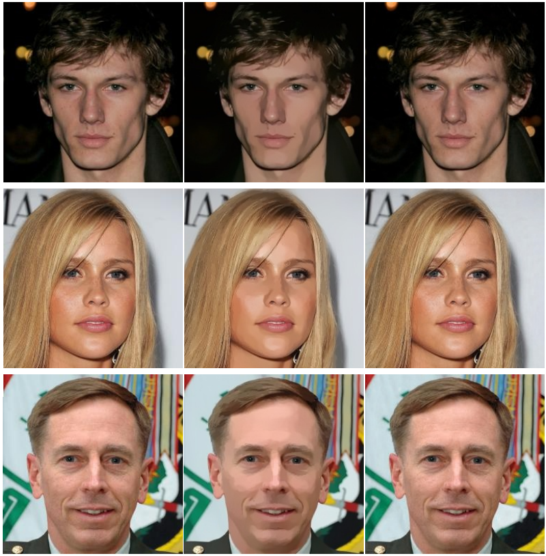
Face Retouching
Original Ours Ours (restored)

Slide 15
Thanks!

