Slide 1
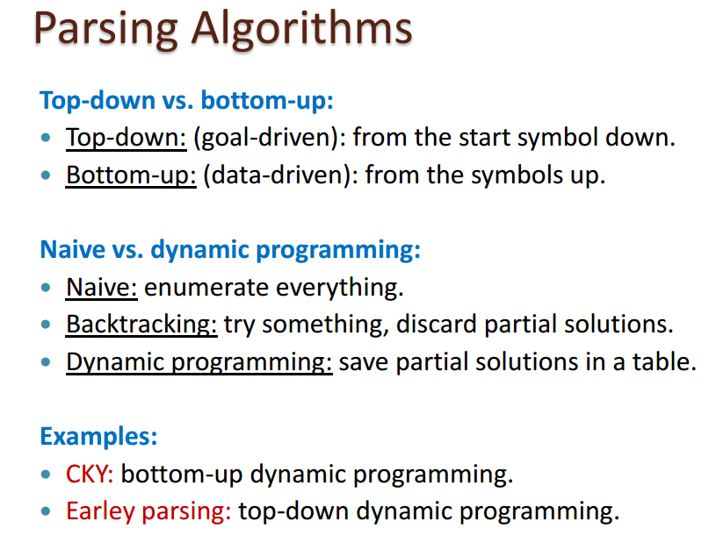
Parsing Algorithms

Slide 2
The CYK Algorithm
The membership problem:
Problem:
Given a context-free grammar G and a string w
G = (V, T ,P , S) where
V finite set of variables
T (the alphabet) finite set of terminal symbols
P finite set of rules
S start symbol (distinguished element of V)
V and T are assumed to be disjoint
Question: Is w in L(G)?

Slide 3
The CYK Algorithm Basics
The grammar must be in a Chomsky Normal Form.
Uses a “dynamic programming” or “table-filling algorithm”

Slide 4
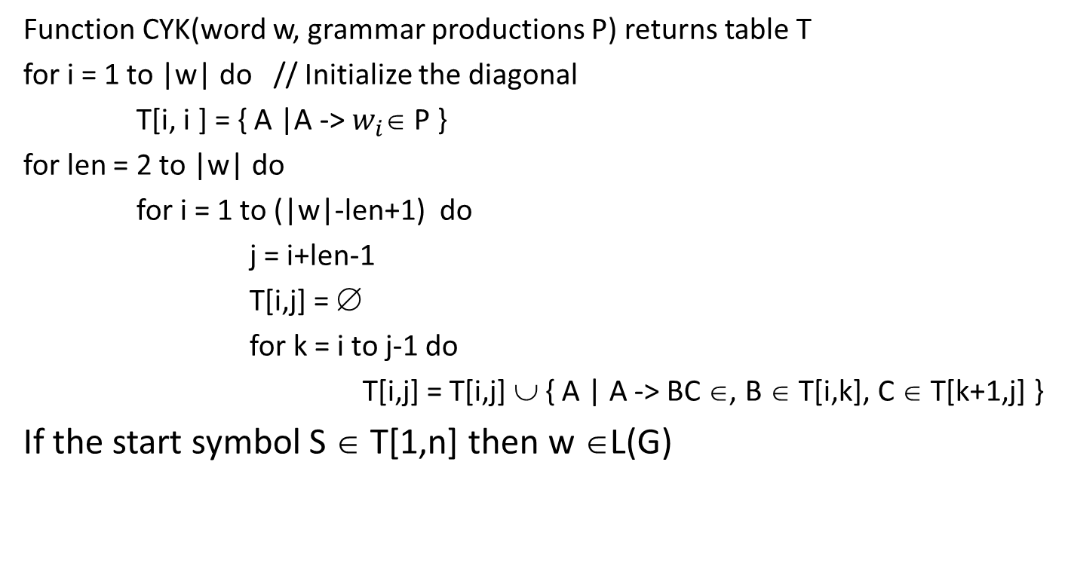
CYK Algorithm
Function CYK(word w, grammar productions P) returns table T
for i = 1 to |w| do // Initialize the diagonal
T[i, i ] = { A |A -> $w_{i}$∈ P }
for len = 2 to |w| do
for i = 1 to (|w|-len+1) do
j = i+len-1
T[i,j] = ∅
for k = i to j-1 do
T[i,j] = T[i,j] ∪ { A | A -> BC ∈, B ∈ T[i,k], C ∈ T[k+1,j] }
If the start symbol S ∈ T[1,n] then w ∈L(G)

Slide 5
Let G = (V,T,S,P) with T ={a, b}
V = { S, A, B, T, X} and P defined below
S -> AB | XB
T -> AB | XB
X -> AT
A -> a
B -> b
And let w = aaabbb. Is w∈L(G)?

Slide 6
S -> AB | XB
T -> AB | XB
X -> AT
A -> a
B -> b
w = aaabbb
w on the diagonal
i \ j | 1 | 2 | 3 | 4 | 5 | 6
1 | a
2 |  | a
3 |  |  | a
4 |  |  |  | b
5 |  |  |  |  | b
6 |  |  |  |  |  | b

Slide 7
S -> AB | XB
T -> AB | XB
X -> AT
A -> a
B -> b
w = aaabbb
Strings length 1
i \ j | 1 | 2 | 3 | 4 | 5 | 6
1 | A
2 |  | A
3 |  |  | A
4 |  |  |  | B
5 |  |  |  |  | B
6 |  |  |  |  |  | B

Slide 8
S -> AB | XB
T -> AB | XB
X -> AT
A -> a
B -> b
w = aaabbb
Strings length 2
i \ j | 1 | 2 | 3 | 4 | 5 | 6
1 | A | ∅
2 |  | A | ∅
3 |  |  | A | S, T
4 |  |  |  | B | ∅
5 |  |  |  |  | B | ∅
6 |  |  |  |  |  | B

Slide 9
S -> AB | XB
T -> AB | XB
X -> AT
A -> a
B -> b
w = aaabbb
Strings length 3
i \ j | 1 | 2 | 3 | 4 | 5 | 6
1 | A | ∅ | ∅
2 |  | A | ∅
3 |  |  | A | S, T
4 |  |  |  | B | ∅
5 |  |  |  |  | B | ∅
6 |  |  |  |  |  | B

Slide 10
S -> AB | XB
T -> AB | XB
X -> AT
A -> a
B -> b
W = aaabbb
Strings length 3
i \ j | 1 | 2 | 3 | 4 | 5 | 6
1 | A | ∅ | ∅
2 |  | A | ∅ | X
3 |  |  | A | S, T
4 |  |  |  | B | ∅
5 |  |  |  |  | B | ∅
6 |  |  |  |  |  | B

Slide 11
S -> AB | XB
T -> AB | XB
X -> AT
A -> a
B -> b
w = aaabbb
Strings length 3
i \ j | 1 | 2 | 3 | 4 | 5 | 6
1 | A | ∅ | ∅
2 |  | A | ∅ | X
3 |  |  | A | S, T | ∅
4 |  |  |  | B | ∅
5 |  |  |  |  | B | ∅
6 |  |  |  |  |  | B

Slide 12
S -> AB | XB
T -> AB | XB
X -> AT
A -> a
B -> b
w = aaabbb
Strings length 3
i \ j | 1 | 2 | 3 | 4 | 5 | 6
1 | A | ∅ | ∅
2 |  | A | ∅ | X
3 |  |  | A | S, T | ∅
4 |  |  |  | B | ∅ | ∅
5 |  |  |  |  | B | ∅
6 |  |  |  |  |  | B

Slide 13
S -> AB | XB
T -> AB | XB
X -> AT
A -> a
B -> b
w = aaabbb
Strings length 4
i \ j | 1 | 2 | 3 | 4 | 5 | 6
1 | A | ∅ | ∅ | ∅
2 |  | A | ∅ | X
3 |  |  | A | S, T | ∅
4 |  |  |  | B | ∅ | ∅
5 |  |  |  |  | B | ∅
6 |  |  |  |  |  | B

Slide 14
S -> AB | XB
T -> AB | XB
X -> AT
A -> a
B -> b
w = aaabbb
Strings length 4
i \ j | 1 | 2 | 3 | 4 | 5 | 6
1 | A | ∅ | ∅ | ∅
2 |  | A | ∅ | X | S, T
3 |  |  | A | S, T | ∅
4 |  |  |  | B | ∅ | ∅
5 |  |  |  |  | B | ∅
6 |  |  |  |  |  | B

Slide 15
S -> AB | XB
T -> AB | XB
X -> AT
A -> a
B -> b
w = aaabbb
Strings length 4
i \ j | 1 | 2 | 3 | 4 | 5 | 6
1 | A | ∅ | ∅ | ∅
2 |  | A | ∅ | X | S, T
3 |  |  | A | S, T | ∅ | ∅
4 |  |  |  | B | ∅ | ∅
5 |  |  |  |  | B | ∅
6 |  |  |  |  |  | B

Slide 16
S -> AB | XB
T -> AB | XB
X -> AT
A -> a
B -> b
w = aaabbb
Strings length 5
i \ j | 1 | 2 | 3 | 4 | 5 | 6
1 | A | ∅ | ∅ | ∅ | X
2 |  | A | ∅ | X | S, T
3 |  |  | A | S, T | ∅ | ∅
4 |  |  |  | B | ∅ | ∅
5 |  |  |  |  | B | ∅
6 |  |  |  |  |  | B

Slide 17
S -> AB | XB
T -> AB | XB
X -> AT
A -> a
B -> b
w = aaabbb
Strings length 5
i \ j | 1 | 2 | 3 | 4 | 5 | 6
1 | A | ∅ | ∅ | ∅ | X
2 |  | A | ∅ | X | S, T | ∅
3 |  |  | A | S, T | ∅ | ∅
4 |  |  |  | B | ∅ | ∅
5 |  |  |  |  | B | ∅
6 |  |  |  |  |  | B

Slide 18
S -> AB | XB
T -> AB | XB
X -> AT
A -> a
B -> b
w = aaabbb
Strings length 5
i \ j | 1 | 2 | 3 | 4 | 5 | 6
1 | A | ∅ | ∅ | ∅ | X | S, T
2 |  | A | ∅ | X | S, T | ∅
3 |  |  | A | S, T | ∅ | ∅
4 |  |  |  | B | ∅ | ∅
5 |  |  |  |  | B | ∅
6 |  |  |  |  |  | B

Slide 19
S -> AB | XB
T -> AB | XB
X -> AT
A -> a
B -> b
w = aaabbb
Strings length 5
i \ j | 1 | 2 | 3 | 4 | 5 | 6
1 | A | ∅ | ∅ | ∅ | X | S, T
2 |  | A | ∅ | X | S, T | ∅
3 |  |  | A | S, T | ∅ | ∅
4 |  |  |  | B | ∅ | ∅
5 |  |  |  |  | B | ∅
6 |  |  |  |  |  | B

Slide 21
Therefore:
aaabbb ∈L(G)
Time Complexity:
O(|w|³)
Observation:
The CYK algorithm can be
easily converted to a parser
(bottom up parser)

Slide 22
Example 2
Consider the CNF grammar G = (V,T,S,P) where
V = {S, A, B, C, D }, T = { a, b, c }, S = S and P is given below.
S →AB | AC
A → AC | AB | a
B → BB | BC | b
C → AC | CC | c | b
Use the CYK to determine if the strings w₁ = acbb and w₂ = bbca are in the language L(G). If the string is in L(G) construct the parse tree.

Slide 23
S →AB | AC
A → AC | AB | a
B → BB | BC | b
C → AC | CC | c | b
w₁ = acbb
w on the diagonal
i \ j | 1 | 2 | 3 | 4
1 | a
2 |  | c
3 |  |  | b
4 |  |  |  | b

Slide 24
S →AB | AC
A → AC | AB | a
B → BB | BC | b
C → AC | CC | c | b
w₁ = acbb
w on the diagonal
i \ j | 1 | 2 | 3 | 4
1 | A | S,A,C
2 |  | C | C
3 |  |  | B,C | B, C
4 |  |  |  | B,C

Slide 25
S →AB | AC
A → AC | AB | a
B → BB | BC | b
C → AC | CC | c | b
w₁ = acbb
w on the diagonal
i \ j | 1 | 2 | 3 | 4
1 | A | S,A,C | S,A,C
2 |  | C | C | C
3 |  |  | B,C | B, C
4 |  |  |  | B,C

Slide 26
S →AB | AC
A → AC | AB | a
B → BB | BC | b
C → AC | CC | c | b
w₁ = acbb
Yes
i \ j | 1 | 2 | 3 | 4
1 | A | S,A,C | S,A,C | S, A, C
2 |  | C | C | C
3 |  |  | B,C | B, C
4 |  |  |  | B,C

Slide 27
S →AB | AC
A → AC | AB | a
B → BB | BC | b
C → AC | CC | c | b
w₂ = bbca
w on the diagonal
i \ j | 1 | 2 | 3 | 4
1 | b
2 |  | b
3 |  |  | c
4 |  |  |  | a

Slide 28
S →AB | AC
A → AC | AB | a
B → BB | BC | b
C → AC | CC | c | b
w₂ = bbca
w on the diagonal
i \ j | 1 | 2 | 3 | 4
1 | B, C
2 |  | B, C
3 |  |  | C
4 |  |  |  | A

Slide 29
S →AB | AC
A → AC | AB | a
B → BB | BC | b
C → AC | CC | c | b
w₂ = bbca
w on the diagonal
i \ j | 1 | 2 | 3 | 4
1 | B, C | B, C
2 |  | B, C | B, C
3 |  |  | C | ∅
4 |  |  |  | A

Slide 30
S →AB | AC
A → AC | AB | a
B → BB | BC | b
C → AC | CC | c | b
w₂ = bbca
w on the diagonal
i \ j | 1 | 2 | 3 | 4
1 | B, C | B, C | B, C
2 |  | B, C | B, C | ∅
3 |  |  | C | ∅
4 |  |  |  | A

Slide 31
S →AB | AC
A → AC | AB | a
B → BB | BC | b
C → AC | CC | c | b
w₂ = bbca
No not in the language
i \ j | 1 | 2 | 3 | 4
1 | B, C | B, C | B, C | ∅
2 |  | B, C | B, C | ∅
3 |  |  | C | ∅
4 |  |  |  | A

Slide 32
Theorem
The CYK Algorithm correctly computes X _{i j} for all i and j; thus w is in L(G) if and only if S is in X_{1n}.
The running time of the algorithm is O(|w|³|P|), where |P| is the number of productions in the grammar, we can assume this is a constant.
O(w²) cells in the table, O(w) to fill in each cell.

Slide 33
Question
Show the CYK Algorithm with the following example:
CNF grammar G
S → AB | BC
A → BA | a
B → CC | b
C → AB | a
w is ababa
Question Is ababa in L(G)?
Basics of CYK Algorithm
The Structure of the rules in a Chomsky Normal Form grammar
Uses a “dynamic programming” or “table-filling algorithm”
Complexity O(|w|³)

Slide 34
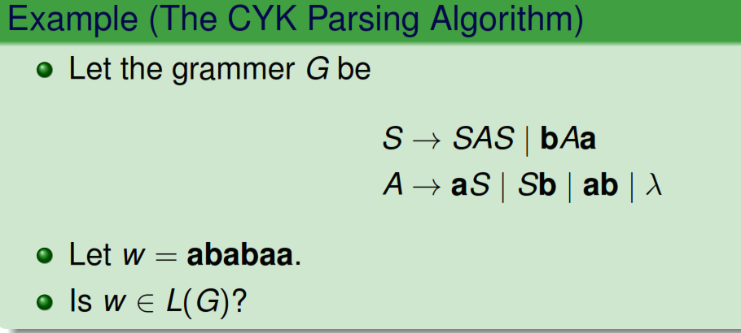

Slide 35
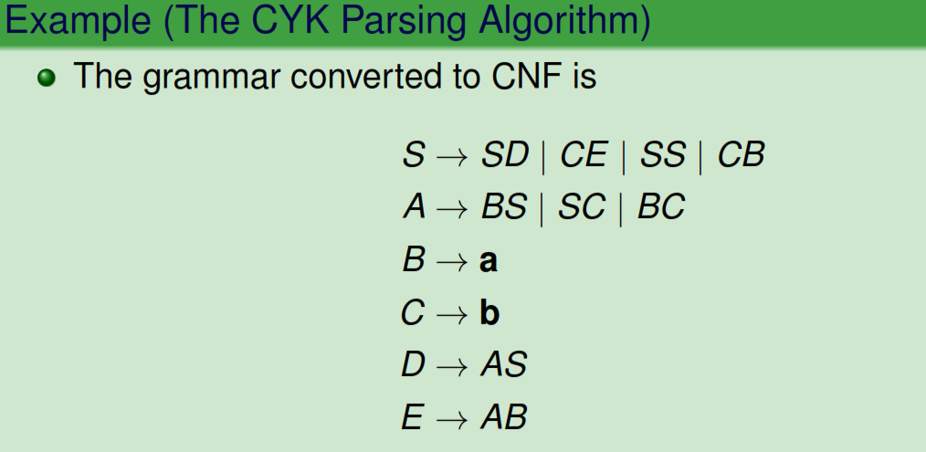

Slide 36
