Slide 1
Basic Instruction Simulation
Wei Hong and Tengyu Sun

Slide 2
Basic Instructions
Data Transfer
Arithmetic & Logical
Control

Slide 3
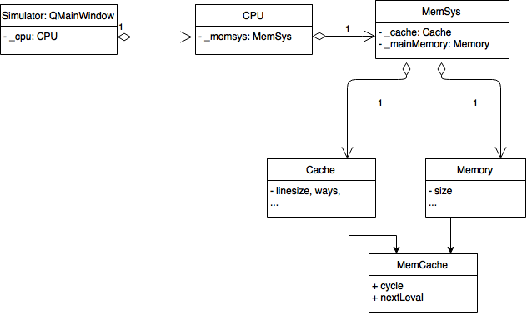
Architecture

Slide 4
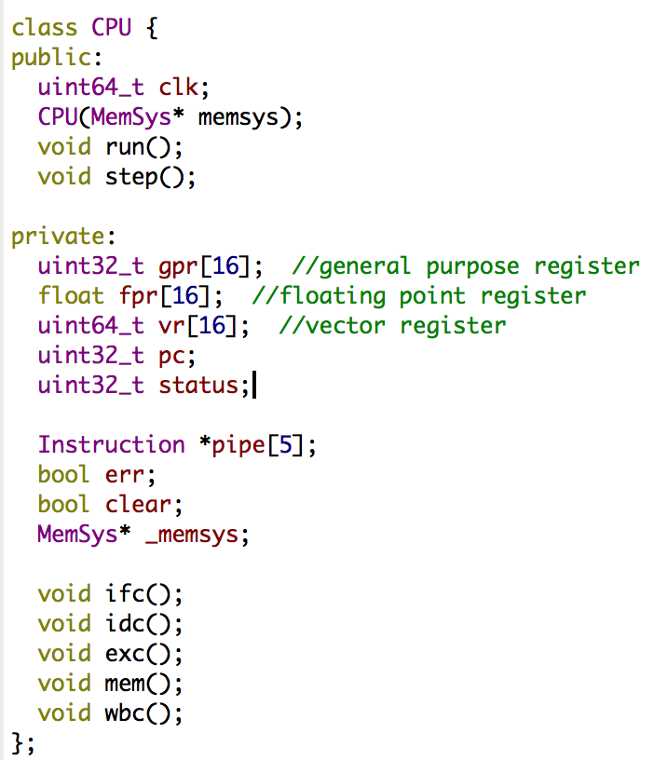
CPU
5 stage (IF/ID/EX/MEM/WB)
registers

Slide 5
Demo
preload mem[100] = 1, mem[101]=2
lb $0,$1,100 #$1 = 1
lb $0,$2,101 #$2 = 2
add $1,$2,$3 #$3 = $1 + $2 = 3
bgez $3,1 #$3>0, branch to sb…
lb $0,$3,100
sb $0,$3,102 #mem[102] = 3
break

Slide 6
Demo
preload mem[100] = 1, mem[101]=2
lb $0,$1,100 #$1 = 1
lb $0,$2,101 #$2 = 2
sub $1,$2,$3 #$3 = $1 + $2 = -1
bgez $3,1 #$3<0 do not branch
lb $0,$3,100 #$3 = 1
sb $0,$3,102 #mem[102] = 1
break

