Slide 1
Benchmark Demo
Wei Hong and Tengyu Sun

Slide 2
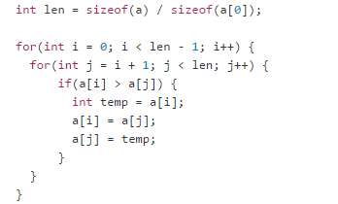
Exchange Sort

Slide 3
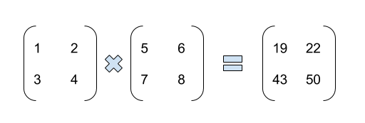
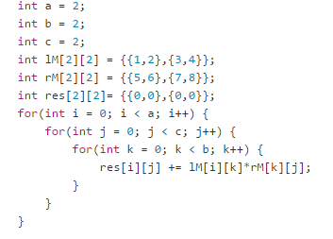
Matrix Multiplication

Slide 4
Matrix multiplication with SIMD
res[i][j] = sum(row[i]*col[j])
$v1 = [1, 2, 1, 2, 3, 4, 3, 4]
$v2 = [5, 7, 6, 8, 5, 7, 6, 8]
$v3 = $v1 * $v2 = [5, 14, 6, 16, 15, 28, 18, 32]
res[i][j] = $v3[(i*2+j)*2] + $v3[(i*2+j)*2+1]

