Slide 1

ISDT CA1
Members:
Tenia Xu Yuan (p1935334)
Sebastian Pang (P1935631)

Slide 2
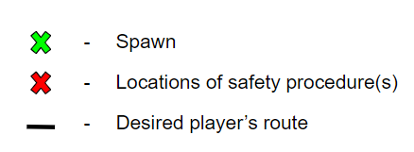
Legend(s)

Slide 3
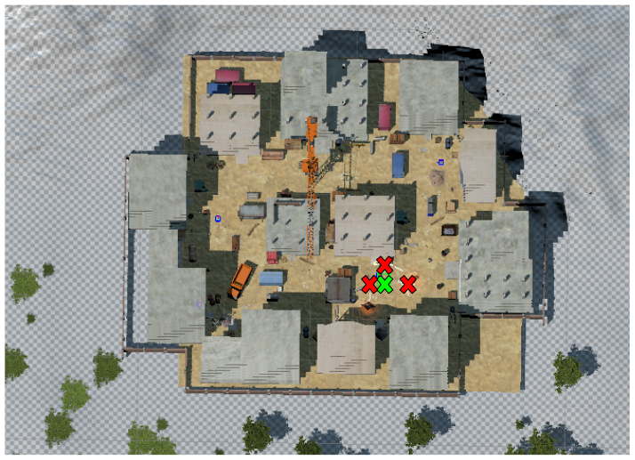
Summary Map

Slide 4

End of Slides

