Slide 1

ISDT CA2
Members:
Tenia Xu Yuan (p1935334)
Sebastian Pang (P1935631)

Slide 2
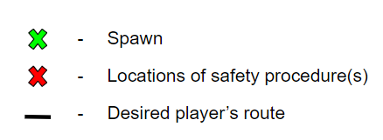
Legend(s)

Slide 3
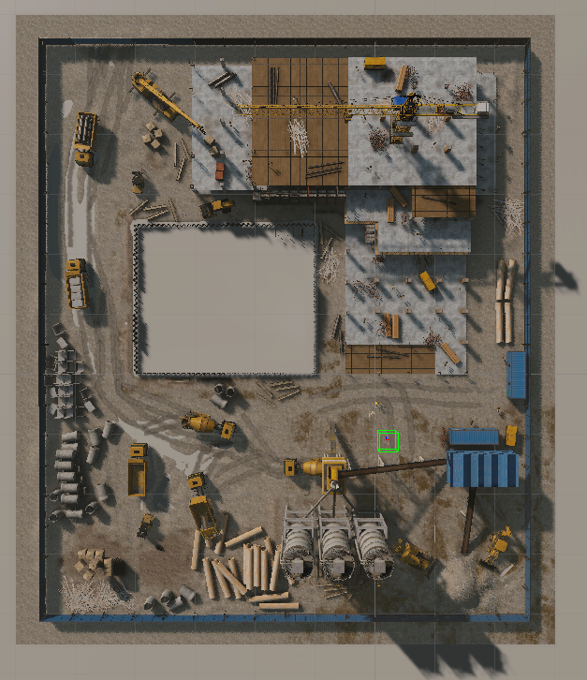
Summary Map – Top-Down View

Slide 4
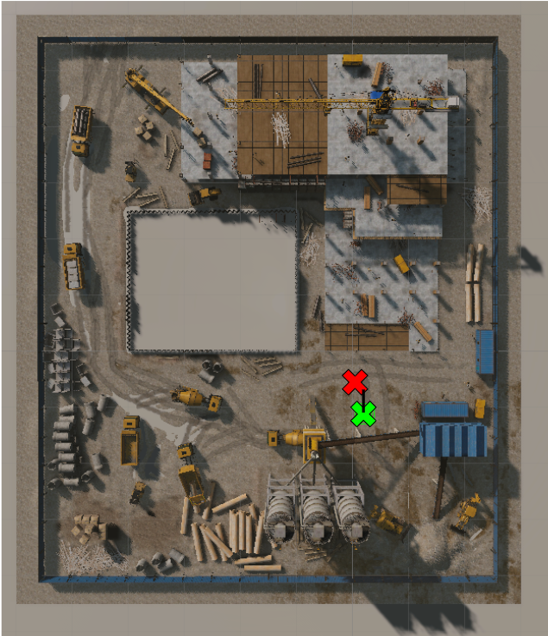
Summary Map – Safety Gear (Top-Down)

Slide 5
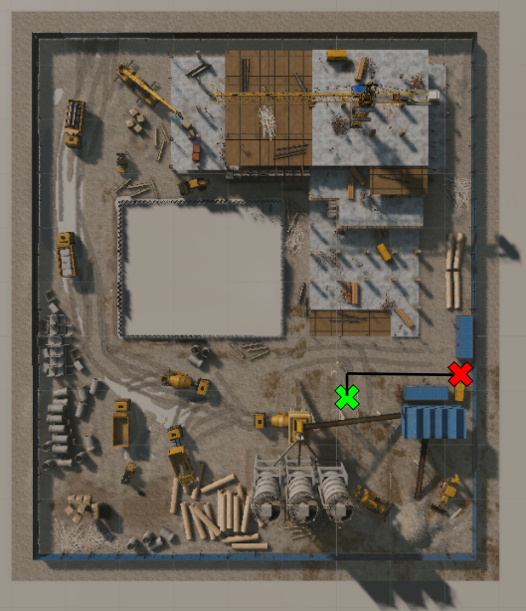
Summary Map – Fire Safety

Slide 6
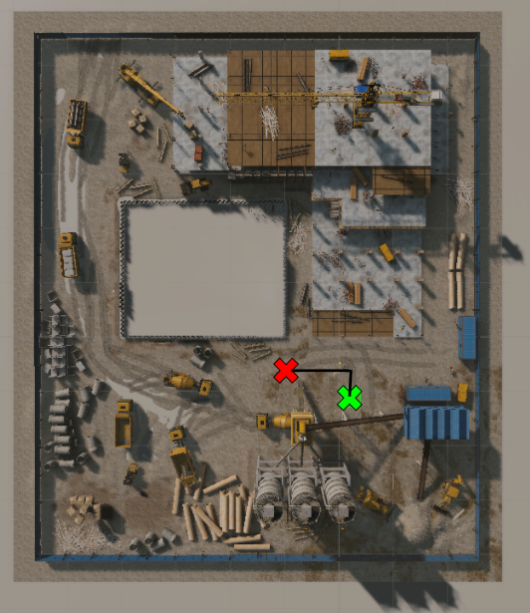
Summary Map – Gas Leak

Slide 7

End of Slides

