Slide 1
Domain Name System (DNS)

Slide 2
Outline
Ecosystem and overview
  You’ll notice multiple occurrences of “$”
DNSSEC (some of Olaf’s “Block_03” slides)
  https://www.dns-school.org/ is somewhat old but still accurate in large part
  A number of images are copied from there (thanks NLnet!)
DNSSEC deployment
DNS privacy

Slide 3
What’s the DNS?
The single world-wide distributed naming system/database that essentially replaced the host file because that got too big
  There’s also the DNS protocol, which is how clients and servers interact
Main purpose is to map names to IP addresses so that applications and humans can deal with names rather than addresses
  tcd.ie is easier to type/remember than something within 134.226/16 or 2001:770:10::/48
  IPv4 addresses use A resource record (RR) type
  IPv6 addresses use AAAA resource record (RR) type
The DNS is also used for many other purposes
  Mail address right-hand-side to mail server name(s) via MX RR
  DNS block lists of spam sources (and other block lists)
  “Passive DNS” monitoring for various security purposes
  Telling lies (RPZ) to help people avoid “bad” domains
  State- or enterprise-level censorship
  ...

Slide 4
DNS names
We know that tcd.ie is a DNS name, right?
  tcd.ie is a domain
www.tcd.ie and down.dsg.cs.tcd.ie are also DNS names
  Those are Fully Qualified Domain Names (FQDNs)
tcd.ie is the parent of cs.tcd.ie, cs.tcd.ie is a child of tcd.ie
TCD internally (modulo cloudiness) manage the names below tcd.ie within their “zone,” often spoken about as if managed via a “zone file”
Reality: most zone data is probably in databases, but tiny domains can keep all their data in one file and there’s a standard format for zone files that’s supported by most DNS tools

Slide 5
Zone file fragment
$ORIGIN .
$TTL 3600 ; 1 hour
responsible.ie IN SOA ns2.my-own.net. hostmaster.responsible.ie. (
2020101984 ; serial
86400 ; refresh (1 day)
7200 ; retry (2 hours)
3600000 ; expire (5 weeks 6 days 16 hours)
3600 ; minimum (1 hour)
)
NS ns2.my-own.net.
NS ephemera.nmugroup.se.
A 213.108.108.218
TXT "This host is used as the souce of zmap scans ..."
AAAA 2a00:c6c0:0:119:7::10
CAA 128 issue "letsencrypt.org"
The real zone file for this domain has keys and signatures for DNSSEC

Slide 6
DNS Ecosystem
The root: “.”
Top Level Domains (TLDs)
  Country-code TLDs (ccTLDs): .ie, .uk, .is,...
    Each more or less do what they want
    IEDR manage .ie zone, CZ.nic manage .cz, ...
  Generic TLDs (gTLDs): .com, .org, .net,...
    Run under ICANN’s oversight (https://icann.org)
    There are ~1591 of those now (because $$$)
    https://data.iana.org/TLD/tlds-alpha-by-domain.txt
Second level domains (2LDs), or effective Top Level Domains (eTLD)
  Comply with parental controls (to some extent)
  Examples: example.com, tcd.ie, amazon.com
  Odd example: tcd.co.uk is a 2LD (and “parked,” and nothing to do with tcd.ie)
  .com zone has ~160M names, .ie has ~330k, .org has ~10M
Third level and below: controlled by 2LD/eTLD
  E.g. down.dsg.cs.tcd.ie

Slide 7
Public Suffix List (PSL)
Some TLDs don’t have all 2LDs directly below the TLD, e.g. .co.uk, .com.au etc.
Causes a problem for browsers, when deciding whether to re-tx cookies in HTTP
Ickky “solution” is the Public Suffix List (PSL)
  https://publicsuffix.org/ maintained by Mozilla and others
  A text file with 16303 lines at 20260325 (10156 “entries”)
    Was 15756 lines at 20250326 (9747 “entries”)
    Was 15495 lines at 20240219; 14305 lines at 20230307; 13,679 lines at 20210419; 13,085 lines at 20200218
PSL has other uses, e.g. anti-spam
PSL ideally would be maintained via information in the DNS, but is not, and attempts to do that (IETF DBOUND wg) have all failed so far
  Another attempt is in the offing now
Indicative of how DNS can be messy but works despite all

Slide 8
Registry/Registrar/Registrant
Top Level Domains (TLDs) are operated by registries,
  IEDR for .ie (they rebranded themselves recently as weare.ie)
  “Identity Digital” operate a whole bunch of ccTLDs and gTLDs (used to be donuts, and acquired Affilias)
  https://www.identity.digital/tld-portfolio
  Public Interest Registry (PIR) operate .org (and feed $$$ to Internet Society, which feeds $$ to IETF and RFC editor https://pir.org/who-we-are/ (notwithstanding 2019/2020 controversy about possible sale of PIR)
Registrars are accredited by registries and deal with registration of names (and transfer and de-registration)
Registrant is the entity that wants/has a name registered
  Per-registry rules may apply, e.g. “connection to Ireland” for .ie
Registries handle name conflicts, e.g. when trademark issues arise via some dispute resolution process (can involve $$$)
Registration costs to registrants from registrars vary from “free” to ~$1000, but mostly ~$10 per year
  Some money flows up from registrar to registry (ccTLD or gTLD) and to ICANN (for gTLDs)
ICANN auction new gTLDs now and then
  Costs ~$1M+ to play that game, ICANN have ~$150M resting in an account as a result

Slide 9
Registry/Registrar
Registrar <-> registry protocols vary a lot
  IEDR have (or had) a web console and an “API” that accredited registrars can use
  Extended Provisionin Protocol (EPP)
  Registration Data Access Protocol (RDAP)
whois
  “Legacy” protocol where registry publishes some registrant data
    May contain personally identifying information (PII)
  You can install “whois” on you machine or use via the web
  Lots of fun with ICANN and whois and GDPR

Slide 10
DNS Operators/Servers
A (logical) zone file for a domain is served by an Authoritative DNS server
Typically 2 or 3 authoritative servers are serving each zone for redundancy
The DNS protocol has “zone transfer” commands (e.g. AXFR) that help syncing multiple servers
Recursive DNS servers query Authoritatives to resolve names, e.g. starting at “.” ask “where is .ie”; get answer; at “.ie” ask “where is tcd.ie”; at “tcd.ie” ask “what is the IP for www.tcd.ie
Clients (your laptop/phone) ask (their stub resolver to ask a) Recursive servers to resolve names e.g. “where is tcd.ie” and if it doesn’t already know the answer (or if earlier answers have timed out) the Recursive will do as much of the dance above as needs (re-)doing
The protocol spoken between clients, Recursives and Authoritatives is the DNS protocol
On linuxes, the “dig” tool allows you to explore the DNS (“nslookup” on windoze)

Slide 11
Example
$ dig +dnssec ietf.org
; <<>> DiG 9.18.4-2ubuntu2.1-Ubuntu <<>> +dnssec ietf.org
;; global options: +cmd
;; Got answer:
;; ->>HEADER<<- opcode: QUERY, status: NOERROR, id: 27100
;; flags: qr rd ra ad; QUERY: 1, ANSWER: 2, AUTHORITY: 0, ADDITIONAL: 1
;; OPT PSEUDOSECTION:
; EDNS: version: 0, flags: do; udp: 1232
;; QUESTION SECTION:
;ietf.org. IN A
;; ANSWER SECTION:
ietf.org. 1800 IN A 50.223.129.194
ietf.org. 1800 IN RRSIG A 5 2 1800 20240229210120 20230301200316 40452 ietf.org. JZN6Rk7d+wv34m728PfIW0Yq87FANjlTKmrMvBjTBKmuxW6uMM9/3bC0 HqCOb0UR2kg+YKfs9v9zppbaZmTJR80Zd4NGXYfnrU0QcraDSeV9AGLb fQJMq3oDwtE7TG5d8nEFOpPN3ggv32k1Bu1r66qihEl7On8+SmofiZI0 Nb3087leOLUTwS002sMyD1NS94gZGUSb1JcX7CUYfDjK3nm81k5GR7k3 6cynaGJHGE2IGJ5ZWpP4Ro2OJ9g6rcYi5c+/ZqPGHB1lcdmolb417S6F UtIu8JGpzalWT63yAHWreA3yE86Q4lCaNDfR4Gta1q5qnHme8h9aLNEN LWs66w==
;; Query time: 1135 msec
;; SERVER: ::1#53(::1) (UDP)
;; WHEN: Wed Mar 15 16:06:15 GMT 2023
;; MSG SIZE rcvd: 349

Slide 12
The root zone
The root zone “.” is special – it’s content is (carefully) managed by IANA and handed over to the root server operators…
  https://www.iana.org/domains/root/servers
The root server operators serve the root zone – about 1000 instances worldwide in about 130 countries, with subsets of those managed by 12 organisations via 13 named root servers (there was one merger in the last couple of decades)
Most root zone instances are accessed using anycast IP routing
  Other public authoritative and even recursive servers (e.g. QuadN’s such as 8.8.8.8 or 1.1.1.1 or 9.9.9.9) also use anycast for better performance
The root zone is pretty stable – and the Internet really needs that to be the case
Every Recursive needs at least one root server IP to start

Slide 13
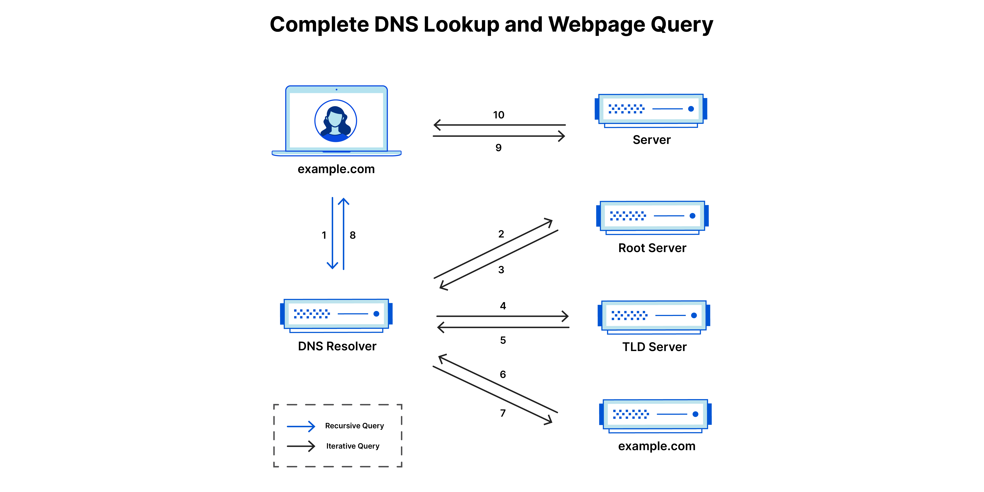
Example DNS Resolution
Image from: https://www.cloudflare.com/learning/dns/what-is-dns/

Slide 14
DNS Poisoning
DNS queries sent by default via UDP to port 53
Query contains:
  QNAME, type, class, 16-bit id, source port
Answer contains
  QNAME, type, class, id, RRset, additional data
Anyone can answer

Slide 15
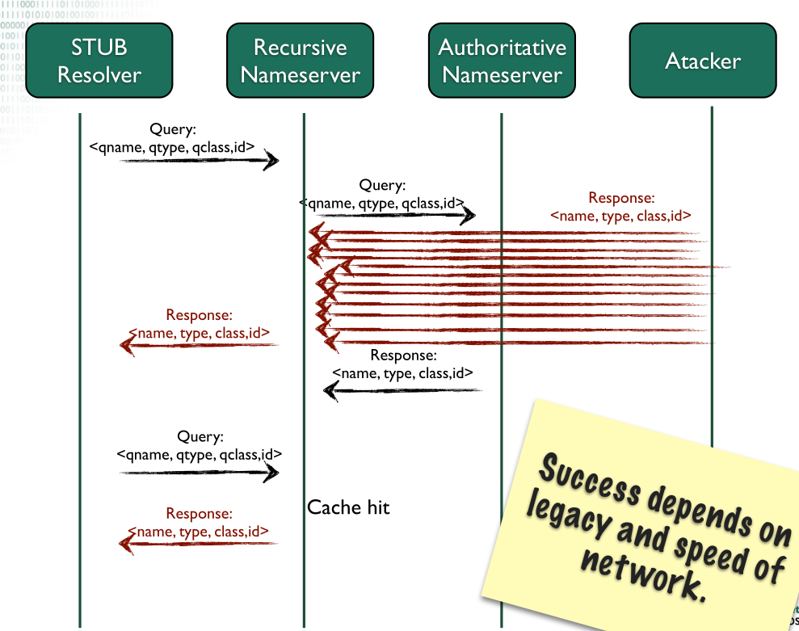
DNS Poisoning

Slide 16
Olaf’s DNSSEC Slides

Slide 17
DNSSEC Deployment
Dependency on parent (for DS record) makes DNSSEC hard to deploy
  Should registrar or registrant contact parent?
  If registrar, how does zone get signed, or, how does DS/KSK get to registrar? (usually via a crappy web form)
  If registrant, how does registry know it’s dealing with the right party (registrant has a/c at registrar, not registry)
Early DNSSEC deployments broke things (and still can)
  DNSSEC adds a new thing to manage (RRSIG expiry) that you can muck up
  But many zones these days are likely fairly dynamic (VMs) so maybe this is lessening as a downside
There are reported issues with stubs and recursives that don’t handle DNSSEC well, or who even strip DNSSEC RRs (typical middlebox issue!)
  Browsers are quite intolerant of >1% additional failures
There was also lots of delay getting the root zone signed (only happened in 2010)
Some zone maintainers (say they) cannot sign their zones due to lack of control over names
Some zone maintainers claim that DNSSEC isn’t worthwhile for them

Slide 18
DNSSEC Deployment
CDS/CDNSKEY (RFC 8078) provides a way for zone maintainer to publish a “new” DS (CDS) or new KSK (CDKSKEY) in their zone
  Parent scans children (who are known to do this) and can pick up new DS value that can be used to populate parent zone file (if various conditions met)
  Hasn’t seen much deployment yet, but should help with ongoing maintainance, allowing much easier changes to KSKs
I know of one pentester who likes to see DNSSEC as it tells him that his customers have asserted control over their DNS
DNSSEC does offer real protection though, e.g. the DNSpoinage attack would likely have been detected and some aspects of those attacks may have been prevented
  https://krebsonsecurity.com/2019/02/a-deep-dive-on-the-recent-widespread-dns-hijacking-attacks/
  I do recommend a read of the above article!
Some big Registrars are starting to include DNSSEC in a bundle
  https://www.godaddy.com/en-ie/hosting/premium-dns
Some TLDs are incentivise registrars (via discounts of maybe 10%) to deploy DNSSEC for new domains
  Leads to more deployment, not clear if more security

Slide 19
DNSSEC Deployment
Result: few 2LDs signed, similar percentage of names covered
Some stats: https://www.statdns.com/
  .com: about 4.5% signed (was 4.1% a year ago, 3.8%, 3.2%, 2% the years before)
  .se: 60.5% signed (was 59.9%, 57% the years before but closer to 70% once)
More stats: https://stats.dnssec-tools.org/
  https://stats.dnssec-tools.org/images/totalds.svg shows ~25M DS’s (next slide)
  the recent dip then recovery seemingly due to a registrar acquisition
  .ie: 0.45% signed (1511/332777) which was more than I thought, but still tiny
Some major web properties/CDNs are not signed, others are
  Not sure why – they say something to do with internal systems
“Economic incentives on DNSSEC deployment: time to move from quantity to quality”
  https://ieeexplore.ieee.org/abstract/document/8406223/
  https://research.tue.nl/en/publications/economic-incentives-on-dnssec-deployment-time-to-move-from-quanti

Slide 20
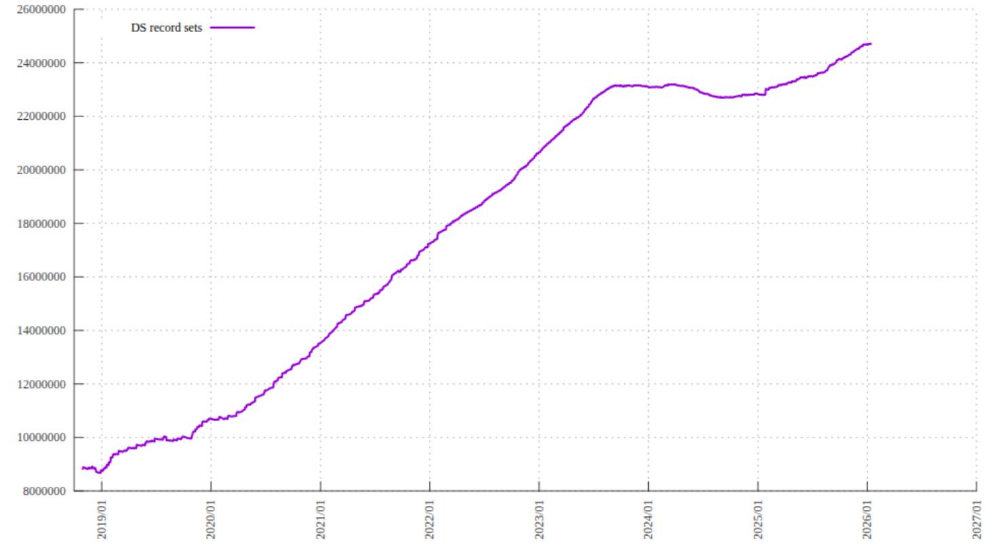
https://stats.dnssec-tools.org/images/totalds.svg

Slide 21
KeyTrap (discovered: Nov ‘23)
Implementation flaw present for >10 years; arguably also a protocol flaw
Basic idea: publish “attack” zone with colliding key IDs and many (bad) signatures and keys; resolver will spend CPU trying to find a good sig
To execute: submit query to target resolver, authoritative forces query to TCP, encodes hundreds of sigs/keys in one 64K DNS answer message
Result: up to hours of DoS with CPU @ 100%
Most DNS servers have by now issued new releases with mitigations
Blog/paper:
  https://labs.ripe.net/author/haya-shulman/keytrap-algorithmic-complexity-attacks-exploit-fundamental-design-flaw-in-dnssec/
  https://dl.acm.org/doi/pdf/10.1145/3658644.3670389
Credit: Elias Heftrig, Haya Schulmann, Niklas Vogel, Michael Waidner

Slide 22
DNS Privacy
All data published in DNS is public, so historically there was little/no interest in confidentiality when DNSSEC was defined
But the fact of access to DNS data can be sensitive, e.g. if you access https://www.aa.org/ that may say something about your life
RFC9076 documents DNS privacy considerations
  Names, timing, IP addresses (e.g. if local recursive), client-subnet
Mitigations:
  Use Tor browser
  QNAME minimisation (RFC9156)
  Define ways to provide confidentiality for DNS traffic (DoT/DoH/ADoX)
  Don’t (always) send EDNS(0) client subnet

Slide 23
DNS over TLS (DoT)
IETF “DPRIVE” working group has defined how to run DNS over TLS (DoT, RFC7858)
DoT is usable today between stub and recursive
Generally, you replace your system stub resolver (e.g. systemd, dnsmasq) with something that can do DoT (e.g. stubby+unbound – I do that)
  https://dnsprivacy.org/dns_privacy_daemon_-_stubby/
There are public recursives now who offer that kind of “DNS privacy service”, e.g. 9.9.9.9, 1.1.1.1, ...

Slide 24
DoT with padding
DNS message lengths may leak information about names
RFC 7830 describes an EDNS(0) padding option
Responders MUST pad if requesters do (and MAY in any case)
RFC 8467 describes ways in which one might use padding and recommends:
  Pad queries to block lengths of N x 128 octets
  Pad responses to block lengths of N x 468 octets
  Don’t do random stuff (signal leaks), maximal-length is wasteful (esp if we go > MTU)

Slide 25
Recursive <->Authoritative
Today, DoT is usable for stub <-> recusive
Would like to also secure recursive <-> authoritative
Can’t amortise TLS state so much so needs lots of performance testing, esp., if done near root
Not clear if/how to authenticate authoritative (various proposal being considered)
Might get deployed in medium term, but not clear
Despite uncertainty, we sometimes talk about Authoritative DNS over TLS, (ADoT) ‘cause that’s what we’ll most likely end up doing
Opportunistic ADoT can be deployed - RFC9539

Slide 26
DNS over HTTPS (DoH)
Browsers and some JS code however can’t easily tell if DoT is being used as there’s no portable OS API to use for that today (some OSes may add such a thing, not sure)
So DNS over HTTPS (DoH, RFC 8484) describes how to encapsulate DNS traffic in HTTPS
Supported today in FF with their “Trusted Recursive Resolver” (TRR) concept, with a set of “built-in” TRR instances (Cloudflare, NextDNS,...)
Google, Microsoft and Apple have also all included in browsers. They differ in various ways.
DoH lead to the usual major fuss – the move from a system/OS stub, to an in-browser stub causes many changes and people fear/dislike such changes

Slide 27
Anti-DoH!
Around 2019, various operator-like folks described their problems with DoH (or more correctly with the mozilla/CF deployment they feared might happen)
  https://tools.ietf.org/html/draft-bertola-bcp-doh-clients
  https://datatracker.ietf.org/doc/html/draft-doh-reid-operator
  https://tools.ietf.org/html/draft-livingood-doh-implementation-risks-issues
Some of the above folks even started an industry association, with an apparent goal of encouraging deployment of DNS privacy, but possibly in a flavour that better suits ISPs who traditionally operated the DNS recursives
  That was at: https://www.encrypted-dns.org/ but they seem to have abandoned ship ‘cause there’s no A/AAAA for it any more:-)
None of the above are objective analyses, but work will likely happen to do that analysis, because there are some real issues (if DoH gets widely deployed in applications):
  Split horizon
  Loss of enterprise control for BYOD and/or parental control @ home
  Passive DNS
IETF chartered a working group to look at some of the less controversial aspects of all this:
  https://datatracker.ietf.org/wg/add/about/

Slide 28
My DNS client setups
Laptop OS: unbound+stubby
  Unbound caches, stubby does DoT; config prefers my DNS recursive
  QNAME minimisation/padding turned on
  Stubby config has to include DoT servers on port 443 because of port 853 blocking
  Occasional glitches require “sudo service stubby restart” now and then
DoT testing: dig, kdig tools
Within FF: DoH to NextDNS TRR (other browsers: I forget:-)
De-googled android uses DoT to 1.1.1.1 (Cloudflare)
On-phone browser (brave) uses DoH to 8.8.8.8 (Google)
At home: my home router (Turris) does DoT to Cloudflare using knot-resolver (as stub)
  Clients at home use Turris as their DNS recursive via Do53
  Recursive distribution via DHCP/RA as normal
Anyone could do all that (but you’d wonder why they’d bother;-) client stuff ought be much more out-of-the-box and likely will become so
I used to operate my own DNS recursive resolver and use it in the above – I moved that VM though and haven’t gotten around to setting that up again yet

Slide 29
My (ex-)DNS recursive setup
Ran on a small VPS rented from a local hoster (circa 20200225)
DoH: Apache handles port 443 DoH queries, handed those to dnsdist which en/decpasulated DNS in/from HTTP, and used a local unbound as the real caching, validating recursive
DoT: knot resolver (as recursive) directly handles port 853 traffic
dnsdist could/can also do that, just not this setup
QNAME minimisation turned on in upstream queries
Padding turned on for stubs
Server side problem: above meant me, those in my home, and a few buddies “hiding” in a very tiny crowd – would be better with a bigger (local) crowd but without involving mega-company services like Google or Cloudflare
A setup like this was never going to be as fast/reliable as a mega-company one
Net effect: moved DNS surveillance/poisoning risk from any of ISP, TCD or visited-networks mostly to my chosen hoster or someone attacking their network – but hoster was a chap who lives in Sligo and is hence much closer to me accountability-wise, compared to Cloudflare or Google

Slide 30
SVCB/HTTPS RR
Browsers like things being fast but DNS and TLS add RTTs
HTTPS RR (RFC 9460) provides a way to put more things needed for TLS into a single RR and maybe save RTTs
$ dig +short https rte.ie
1 . alpn="h3,h2" ipv4hint=104.16.239.220,104.17.160.147 ipv6hint=2606:4700::6810:efdc,2606:4700::6811:a093
Can also “solve” the “CNAME at apex” issue for CDNs
SVCB is a generalisation of HTTPS
HTTPS and SVCB RR definition extensible allowing new tag/value pairs to be defined so even more connection and TLS related info can be found via DNS before connecting to (TLS) server

Slide 31
(I)DELEG RR
A current topic under IETF discussion: could we benefit if we had an SVCB-like RR higher up the tree?
Possibly make it easier to handle NSes, DS RRs, ADoT and other things needed at a “zone-cut”
Maybe also make DNS operators into first-class citizens (like registrant/registrar/registry) as more people now outsource DNS ops
IETF working group currently evaluating two proposals (DELEG and IDELEG)
  https://datatracker.ietf.org/wg/deleg/about/

Slide 32
DNS Conclusions
DNS is sort-of criticial infrastructure that (sometimes amazingly) works well
DNSSEC deployment is still woeful
DNS privacy is starting to be addressed, and represents a real change, but one that will happen in the presence of significant tussles

