Slide 1
A real hybrid public key encryption scheme
(HPKE – RFC9180)
CS7NS5/CSU44032
stephen.farrell@cs.tcd.ie
https://down.dsg.cs.tcd.ie/cs7053
https://github.com/sftcd/cs7053

Slide 2
Setting
Encryptor/initiator/client somehow has a copy of a public key for a decryptor/recipient/server and wants to use that to encrypt a possible large message to that decryptor/recipient/server
  Encrypt “to” a public key
Key agreement uses ephemeral-static ECDH
Use well studied key derivation functions
Bulk encryption should use an AEAD cipher
We’d like options to authenticate, but also using ECDH
We’d like to be able to bind in pre-shared symmetric keys (as a hedge against quantum attacks)
The term “hybrid” here is being used differently from it’s use when we talked about PQ stuff
RFC9180 defines all the above in ways that can be used in practice
  Used in TLS/ECH and MLS protocols and others

Slide 3
Modes
Base – encrypt to public key
Auth – base + ECDH-based authentication
PSK – base + binding in pre-shared-keys
PSK-AUTH – do it all
Only base mode is really in use so far

Slide 4
Code Points
We specify which ECDH variant we’ll be using using a KEM_ID, e.g. p256, x25519, ...
We specify how we’ll derive symmetric keys using a KDF_ID, e.g. hkdf-sha256, ...
We specify which AEAD ciper using an AEAD_ID e.g. aes-128-gcm, ...
  There’s a “special” AEAD code point for the exporter case where HPKE is just used to generate a good symmetric key that’ll be used by the application outside of HPKE
Both sides need to agree on the above
All repesented as 16-bit numbers
  Each such code point also defines the various field lengths involved e.g. size of encapsulated DH public values, length of secrets
And we also need the public key and probably some other protocol stuff, e.g. for Encrypted ClientHello (ECH) we define an ECHConfig as...

Slide 5
Encrypted ClientHello (ECH) config
opaque HpkePublicKey<1..2^16-1>;
uint16 HpkeKemId; // Defined in RFC9180
uint16 HpkeKdfId; // Defined in RFC9180
uint16 HpkeAeadId; // Defined in RFC9180
struct {
HpkeKdfId kdf_id;
HpkeAeadId aead_id;
} HpkeSymmetricCipherSuite;
struct {
uint8 config_id;
HpkeKemId kem_id;
HpkePublicKey public_key;
HpkeSymmetricCipherSuite cipher_suites<4..2^16-4>;
} HpkeKeyConfig;
struct {
HpkeKeyConfig key_config;
uint8 maximum_name_length;
opaque public_name<1..255>;
Extension extensions<0..2^16-1>;
} ECHConfigContents;
struct {
uint16 version;
uint16 length;
select (ECHConfig.version) {
case 0xfe0d: ECHConfigContents contents;
}
} ECHConfig;
From https://datatracker.ietf.org/doc/draft-ietf-tls-esni/ (will be RFC 9849)
A list of ECHConfig structures ends up published in the DNS in an HTTPS resource record for the receiver

Slide 6
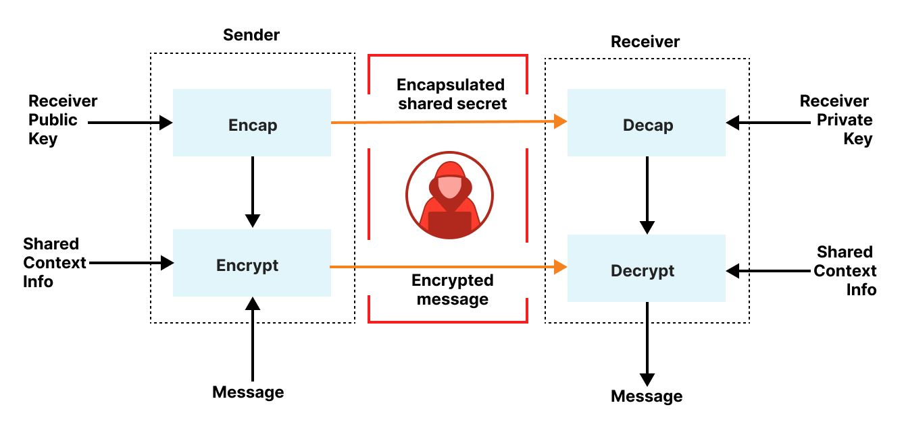
HPKE Overview
https://blog.cloudflare.com/hybrid-public-key-encryption/

Slide 7
HPKE comes with some analysis
One of the reasons to do this was that previous protocols had done similar things in an ad-hoc manner
HPKE comes with some formal analysis
  https://www.benjaminlipp.de/p/hpke-cryptographic-standard/
  https://eprint.iacr.org/2020/1499.pdf
The hope is that protocols using HPKE will benefit from that analysis so we’ll make fewer mistakes in future

Slide 8
OpenSSL API example (1)
/* receiver: ghenerate key pair. */
OSSL_HPKE_keygen(hpke_suite, pub, &publen, &priv,
NULL, 0, NULL, NULL);
/* sender: encap and encrypt data using the receivers public key */
sctx = OSSL_HPKE_CTX_new(hpke_mode, hpke_suite,
OSSL_HPKE_ROLE_SENDER, NULL, NULL);
OSSL_HPKE_encap(sctx, enc, &enclen, pub, publen, info, infolen);
OSSL_HPKE_seal(sctx, ct, &ctlen, aad, aadlen, pt, ptlen);
https://www.openssl.org/docs/manmaster/man3/OSSL_HPKE_open.html

Slide 9
OpenSSL API example (2)
/* receiver: decap and decrypt data using private key */
rctx = OSSL_HPKE_CTX_new(hpke_mode, hpke_suite, OSSL_HPKE_ROLE_RECEIVER, NULL, NULL);
OSSL_HPKE_decap(rctx, enc, enclen, priv, info, infolen);
OSSL_HPKE_open(rctx, clear, &clearlen,
aad, aadlen, ct, ctlen);

Slide 10
A few HPKE notes
There’s an IETF WG considering how to handle PQ algs in HPKE
Internal data structures process various cryptographic values in “wire” format affects interop
  That’s fine, but means those wire formats need to be part of the definition (esp. short/long encoding of NIST curve public values)
Single-shot operation is defined, but not clear if many protocols can benefit from that
  E.g. HelloRetryRequest in TLSv1.3 means we can’t use single-shot APIs for ECH
Nonce/sequence handling for multiple calls to seal()/open() is well-defined but re-sync after packet loss on receiver requires using an odd API (OSSL_HPKE_CTX_set_seq() in OpenSSL) – I nearly messed up and allowed that for sender’s too!

Slide 11
HPKE PR for OpenSSL
I had some funding (from OTF) to write code for HPKE, so submitted a PR to OpenSSL in Nov 2021:
https://github.com/openssl/openssl/pull/17172
RFC9180 issued in Feb 2022, PR finally merged in Nov 2022
  Comment from upsteam maintainer: “Wow! What an effort. After nearly one year of work, close to 4.5k net lines-of-code added and >1,300 comments on the PR (not including the other related contribution from @slontis in #19068) - we finally got there”
  OpenSSL test code HPKE is 1694 LOC
Included in OpenSSL 3.2 release in Oct 2023
  https://www.openssl.org/blog/blog/2023/10/18/ossl-hpke/
I learned quite a lot from that, esp., that it’s hard if your 1st contribution is complex
I hope to not be the next source of a hearbleed type event (gulp:-), but funder for coding also paid for a security audit, which went well
  https://7asecurity.com/blog/2023/12/defo-2-openssl-hpke-pr-security-audit/

Slide 12
Conclusion
HPKE seems like a good example of better glue between cryptographic algorithms and protocols/applications
Thesis: Schemes like this with proofs are better than those invented by a few very smart people
Contributing code for things like this to upstream projects is doable but takes a lot of time, effort and determination
  And don’t get irritated along the way (or at least, don’t show it:-)

