Slide 1
Censorship Overview
(shortened)
Stephen Farrell
stephen.farrell@cs.tcd.ie
April 2026

Slide 2
A bit of Irish history
Ireland has a long history of censorship: the wikipedia page for that seems relatively accurate
    https://en.wikipedia.org/wiki/Censorship_in_the_Republic_of_Ireland
Monty Python’s Life of Brian was banned in 1979
    https://www.irishtimes.com/culture/film/an-awful-dump-the-ireland-that-banned-monty-python-s-life-of-brian-1.3807270
  ‘The film censor at the time, (Frank) Hall, himself a skilled satirist, quipped that the film was “offensive to Christians and to Jews as well, because it made them appear a terrible load of gobshites”’
  It was “unbanned” in 1987

Slide 3
Current Irish Internet Censorship
Russia Today/rt.com – not blocked in TCD, but since ~2022, is blocked via IP address from my current home ISP (Eir) and likely others
  Also not blocked from my hosting provider (greenhost, based in .nl)
After a court case in 2013, thepiratebay.org was blocked from 6 ISPs in Ireland (not currently block from Eir)
  https://www.bbc.com/news/technology-22888851
The .ie ccTLD registry (IEDR/weare.ie) maintain a blocklist of names they will not allow be registered, e.g. porn.ie (you’ll get an error from whois)
  There are likely other names/sites blocked, but the list is not public
  Should (some/more/all) of those lists be public?
  For almost all people: There will be some names you’d prefer to never see and sites you’d rather not highlight

Slide 4
Coimisiún na Meán
Media Service Code and Media Service Rules Audiovisual On-demand Media Service Providers
  https://www.cnam.ie/app/uploads/2025/01/Media-Service-Code-Rules-Audiovisual-On-demand-Media-Service-Providers-November-2024.pdf
  The above is a crappy URL – the ‘2025/01’ part changes monthly even though the document doesn’t!
That includes
  13.3 Media service providers of on-demand services shall not provide audiovisual commercial communications that are harmful to the general public, namely: -
    ...
    iv. audiovisual commercial communications which encourage behaviour grossly prejudicial to the protection of the environment.
Question: does that seem ambiguous?

Slide 5
Coimisiún na Meán
Online Safety Code
  https://www.cnam.ie/app/uploads/2025/01/Coimisiun-na-Mean_Online-Safety-Code.pdf
  Same complaint about a bad URL
Mostly reasonable, but includes:
  12.10: A video-sharing platform service provider whose terms and conditions do not preclude the uploading or sharing of adult only video content as defined in this Code shall implement effective age assurance measures as defined in this Code to ensure that adult-only video content cannot normally be seen by children. An age assurance measure based solely on self-declaration of age by users of the service shall not be an effective measure for the purposes of this section.

Slide 6
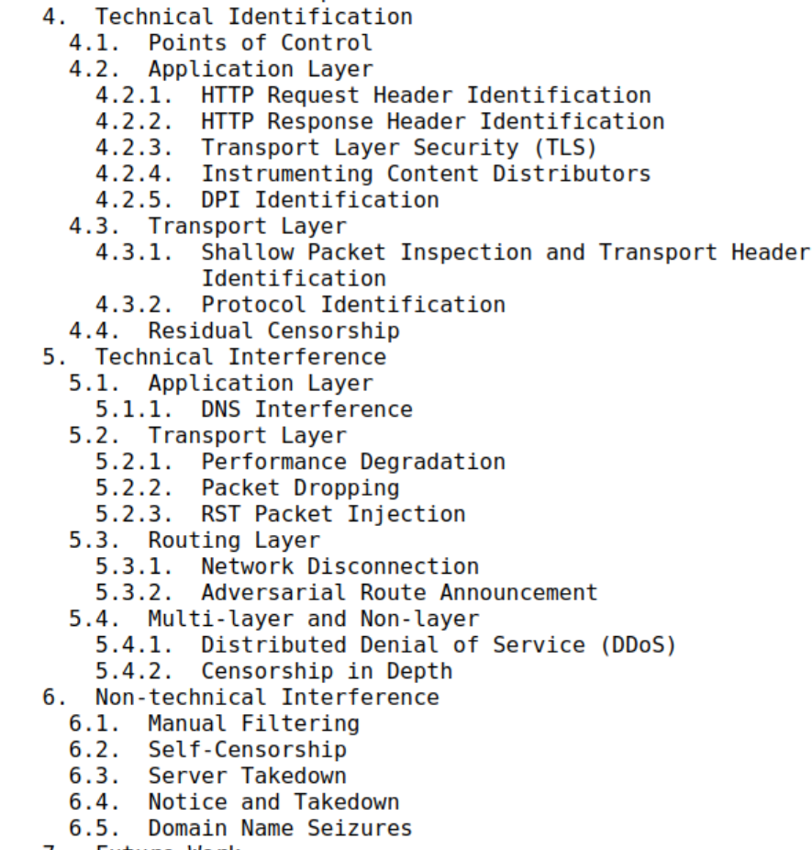
RFC9505: A Survey of Worldwide Censorship Techniques
Published in 2023 based on text accumulated since 2014, so inevitably outdated
Nonetheless, a good reference

Slide 7
Physical Layer
Regulatory: prohibit use of frequencies or operating a business
  https://www.semafor.com/article/07/18/2024/elon-musks-starlink-battles-africa-regulators
Radio jamming, e.g. against voice of America in China
  https://www.sigidwiki.com/wiki/Chinese_Firedrake_Jammer
Many (other) jammers are illegal!

Slide 8
IP layer
Lots of IP address based blocking, typically configured via address-ranges, e.g. “134.226/16” (for IPv4) or “2001:770:10::/48” (IPv6) would block all of TCD
  Overblocking is therefore common
Just throw away packets destined for an IP on the block-list
  Can be done in a normal router easily enough or using special kit
  Simple and scalable for the censor, if the to-be-censored site/content has stable IP addresses
Or, rate-limit packets to that destination so the destination isn’t “blocked” but becomes too slow to be usable
Or, use Deep Packet Inspection (DPI) to only drop/limit some packets for that destination

Slide 9
IP layer/Routing
A way to censor an entire network is to publish bad routing information about that network, using BGP
  BGP announcements include AS number and specifiy the set of related IP addresses
  If you’re a BGP speaker then you can lie
  If other BGP speakers (are coerced to) believe you, or don’t notice, then they’ll mis-route packets for destinations you’ve chosen
Pakistan attempting to block youtube locally, but in fact causing a brief global outage is the classic example
  https://www.cnet.com/culture/how-pakistan-knocked-youtube-offline-and-how-to-make-sure-it-never-happens-again/
Perhaps not the censor’s favourite technique as it’s pretty public and people do carefully monitor BGP announcements for accidental misconfigurations as those happen all the time, so the censor’s attempts will likely be spotted
  Doesn’t stop nation states trying though, though perhaps more to inspect mis-routed traffic rather then to censor

Slide 10
Transport Layer Reset
Censors might not just drop packets – they may instead send RST (reset) packets to try convince both sides of a transport connection to drop the connection - pretending to both sides that an error has occurred
This can be “easier” for the censor as they can just copy some possibly-matching packets off the “fast-path” and, when desired, send the few(ish) RST packets needed from off-path devices
  The “fast-path” of routers is expensive kit so better for the censor to interfere with that as little as possible

Slide 11
TLS for multiple web sites
Web Server
TLS session
TLS
Client
(browser)
TLS
server
Web
Site
Web
Site
Web
Sites
ClientHello->
(incl. SNI)
<-ServerHello
...

Slide 12
Transport Layer/SNI
The Transport Layer Security (TLS) protocol is used to encrypt at the tranport layer for the web, email transport security and many other protocols
The first packet in a TLS session is a ClientHello packet, inside of which is the server-name-indication (SNI) that tells the server with which service (e.g. web site) the client wishes to establish an encrypted transport connection
  SNI is needed as many services can be run on the same port, e.g. a single web server install can be used for many different web sites, and the server has to disambiguate in order to pick the right keys for the TLS session
Censors commonly examine the SNI in ClientHello messages and block if that matches a block-list
  More on this later (spoiler: Encrypted ClientHello or ECH:-)
South Korea has used this method to block things, including pornography
  https://www.technadu.com/south-korea-extend-site-blocking-snooping-sni/58125/

Slide 13
(Transport) Protocol Fingerprinting
A censor can examing the set of protocol options used to “fingerprint” specific clients or implementations and then block those
  This is easier than you might think, developers make seemingly inconsequential choices all the time and those can end up reflected in protocol options, e.g. the order of fields in a packet or the set of cryptographic algorithms supported
  Similar to the panopticon: https://coveryourtracks.eff.org/
This is a bit like DPI but typically applied against ClientHello-like messages that initiate an encrypted transport connection
This has been used against Tor:
  https://blog.torproject.org/browser-fingerprinting-introduction-and-challenges-ahead/

Slide 14
The “Great Cannon”
The GFW also actively probes, partly to inform itself on what to block, but also sometimes as an attack
In 2015 citizenlab documented DDoS attacks against greatfire.org and github originating from hosts co-located with the GFW and coined the “great cannon” phrase
  Not clear how often this is used
  https://citizenlab.ca/2015/04/chinas-great-cannon/

Slide 15
DNS Censorship
Many protocols start with a DNS request
If you want to censor clients in your location, then having DNS servers tell lies is a good option for you as a censor
  Rather than the real IP address, the censor might return the IP address for a web server only hosting a “forbidden” web page
One technique that could be used for this is DNS RPZ (response policy zone) - https://dnsrpz.info/
  That involves DNS servers getting a “feed” of names and the related lies to tell, so can scale well
DNS RPZ can be (and is) also used for good – if you get a feed for “domains less than 1 day old” then you may want to not help your email users to click on links to those domains from emails
  Huge probability super-fresh domains are being used for phishing

Slide 16
Application Layer
Human and/or machine-learning systems that (auto)delete posts
  Some level of that is seemingly required in all large-scale systems with user-generated content (UGC)
This extends to memes and images, e.g. of Winnie-the-pooh
    https://www.theguardian.com/world/2018/aug/07/china-bans-winnie-the-pooh-film-to-stop-comparisons-to-president-xi
Meta/facebook censoring Palestinian content
  This is the 1st place we mention a private sector entity being in control of censorship (as opposed to for-profit co-operation with nation states which is common)
    https://www.hrw.org/report/2023/12/21/metas-broken-promises/systemic-censorship-palestine-content-instagram-and

Slide 17
Application Layer
Child Sexual Abuse Material (CSAM) is a horrible, and criminal, problem for which better solutions are pressingly needed
CSAM is also regularly used to argue for the kind of controls that censors would really like to have
Client-side scanning proposals:
  Apple (abandoned) https://educatedguesswork.org/posts/apple-csam-intro/
  EU Chatcontrol (keeps coming back) https://www.patrick-breyer.de/en/posts/chat-control/
Issue: with even a 0.001% false positive rate, these schemes would utterly overwhelm law enforcement with bogus alerts
  There are more issues;-)

Slide 18
Application Layer
Many censorship schemes depend on surveillance as an enabler
Commercial surveillance (advertising) builds profiles of people/interests based on knowing who is involved in a particular e.g. web interaction
If you know who is attempting access then you could control what they have access to and on the basis of advertising profiles, e.g. religious affiliation

Slide 19
Application Layer
In places where censorship is “strict,” posting critical comments can get you in trouble:
  Nov 2024: Co Tyrone man detained in Dubai over online review
    https://www.rte.ie/news/ireland/2024/1113/1480697-craig-ballentine/
  Oct 2020: US man avoids jail in Thailand over bad resort review left on Tripadvisor and Google
    https://www.abc.net.au/news/2020-10-09/us-man-wesley-barnes-avoid-jail-thailand-over-bad-resort-review/12748666
Be careful what you say when (and before/after!) you travel to places with very different expectations/rules
The “before/after” aspect here is why this relates to censorship

Slide 20
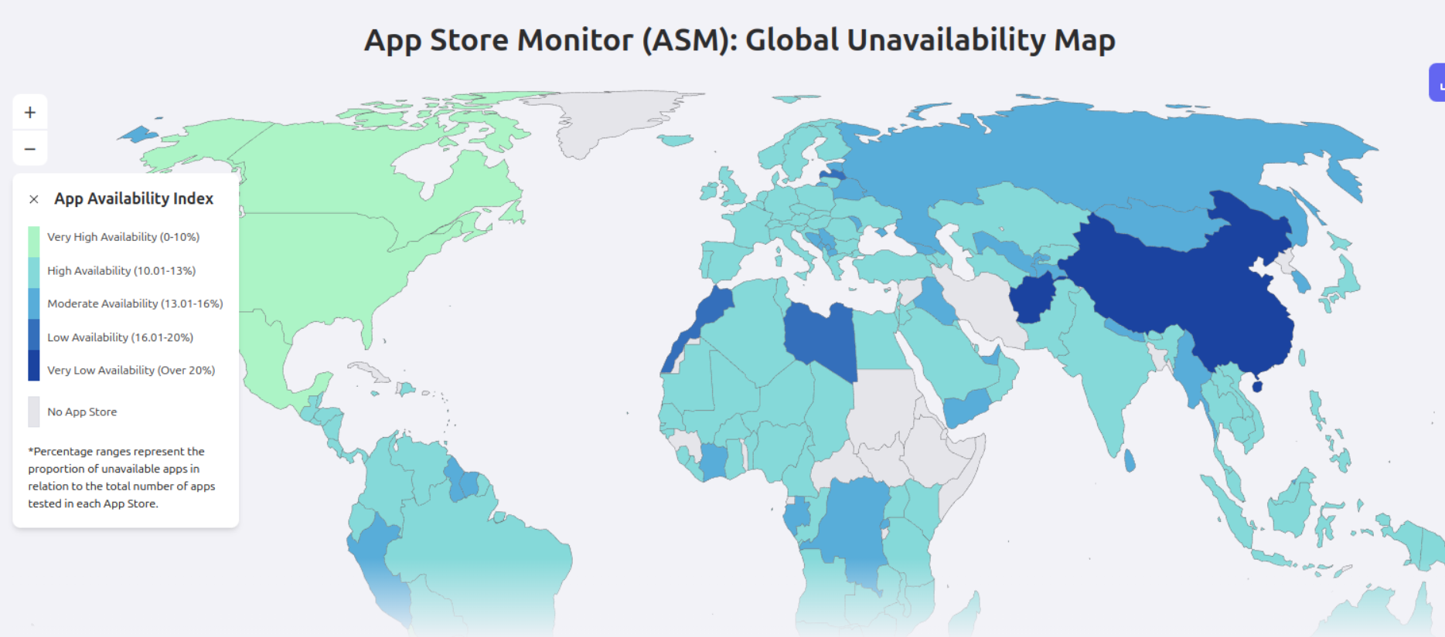
App Stores
Censors and app store curators may block or remove applications considered undesirable
Curators can be coerced or may co-operate (even if gruddingly)
Same issues could
arise with any s/w
distribution scheme
https://applecensorship.com/

Slide 21
Internet Kill Switches
Rather than censor at various layers some governments (also) like to have an Internet kill switch, at national or regional level
Usually requires forcing ASes to each implement this (with a turn-it-on-again switch!), which is somewhat non-trivial
India/Kashmir
  https://internetshutdowns.in/
Gabon on election day:
  https://netblocks.org/reports/internet-cut-in-gabon-on-election-day-Q8oxM3An

Slide 22
Coverage
Each nation seems to have a different way of distributing censorship instructions, with varying consequences
  This also changes over time
China: highly efficient (in terms of coverage) and scaleable (seemingly both bottom-up and top-down)
  “The total number of people employed to monitor opinion and censor content on the internet – a role euphemistically known as “internet public opinion analyst” – was estimated at 2 million in 2013. “ https://www.theguardian.com/news/2018/jun/29/the-great-firewall-of-china-xi-jinpings-internet-shutdown
Russia: instructions from centre sent to AS/ISPs who choose HOWTO implement, leading to spotty coverage
  Some indications this may change via hardware distributed from the centre and to be installed in each ISP
India: coverage has been both regional and per-AS/ISP, perhaps being part of the motiviation for liking kill switches

Slide 23
Censorship Business
For ever: Internet equipment vendors will sell specialised kit to censors
2025 Turkmenistan – the censors sell uncensored access
  Censors here seemingly didn’t care about collatoral damage; turns out overblocking is fine if you also sell an unblocked VPN service
  https://blog.torproject.org/Corruption-Control-Turkmenistan-internet-censorship-business/
2025 China exporting the GFW
  “Geedge Networks” exporting/replicating GFW capability in Kazakhstan, Ethiopia, Pakistan, Myanmar
  https://interseclab.org/wp-content/uploads/2025/09/The-Internet-Coup_September2025.pdf

Slide 24
Caution!
In some places, having circumvention technology on your device, or attempting to use such technologies, can itself get you in trouble
  https://www.businessinsider.com/chinese-police-search-banned-foreign-apps-phones-2022-11
Presumably part of this is to encourage more self-censorship
SO – be careful and consider what you’re doing before adopting the the things discussed in this part
OTOH, it’d be bad if we all self-censor just in case

Slide 25
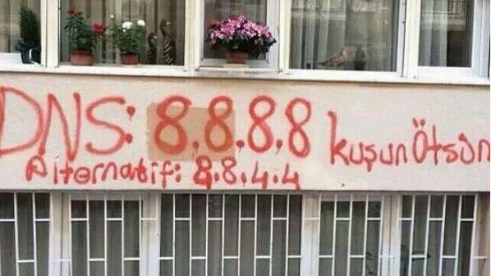
DNS
2014 incident: https://www.bortzmeyer.org/dns-routing-hijack-turkey.html

Slide 26
Choose your DNS preferences
DoT – for your (home?) upstream
DoH – for your browser(s)
There’s no point in round-robin’ing your queries, as each server will basically learn everything eventually, so choose well!
The above would basically take your ISP out of the loop for DNS but replace that with your chosen public recursive servers

Slide 27
Public Recursive Filtering
Many public recursives offer service at a few different IPs, some with various kinds of filtering, e.g for malware sites, net-nanny stuff etc. You can choose which to configure.
Is that censorship? Depends who controls which services are allowed/forced to do what.
  https://www.quad9.net/service/service-addresses-and-features/

Slide 28
Virtual Private Networks (VPN)
A VPN will “move” the source location of your traffic to a VPN egress node
That can get you “outside” a censorship regime
Or, make it a bit harder for a censor to track the actual origin of traffic (you!)
VPNs vary hugely in levels of trustworthiness
Often used for access to geo-blocked content
If you really depend on the VPN for hiding your origin, then you need to be much more sure that no traffic (e.g. DNS, NTP) is leaking so as to be visible to a censor

Slide 29
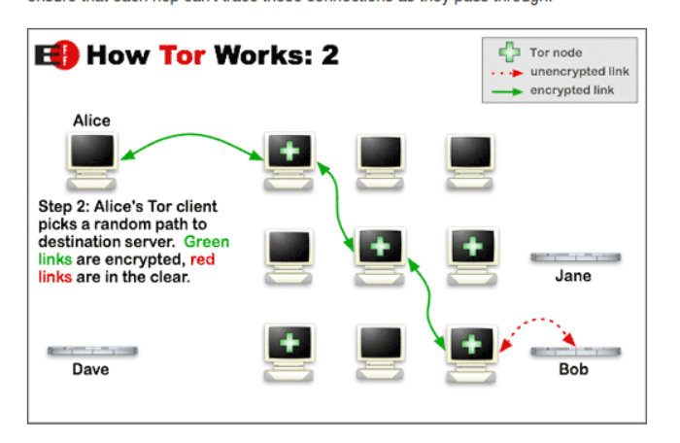
Tor
https://2019.www.torproject.org/about/overview.html.en

Slide 30
Tor Browser
Easiest way to use Tor is via the Tor browser
  A special build of firefox using Tor for it’s HTTP traffic
Brave browser supports “new private window with Tor”
  A bit more deniable!
You won’t be able to connect to the Tor network from everywhere – “bridges” exist to try help here by obfuscating the connection from you to the ingress node and using a (hopefully not well known) bridge for ingress
  This is to help people get connection to “outside” the censor
Remember: if you are the only one using Tor in your local network, then that fact is detectable
  Corollary: if we use Tor when we don’t really need to, we’re maybe helping others a teeny bit

Slide 31
Sneakernet
Passing around censored content and/or tools on a physical storage medium (e.g. USB stick) has often been a good fallback
The Cuban El Paquette was(?) perhaps the best known example
  https://laredcubana.blogspot.com/search/label/paquete
This was a weekly distribution of content, including web sites, TV shows etc
Source unclear
May have fallen victim to pandemic:
https://web.archive.org/web/20200123173814/http://paquetedecuba.com/

Slide 32
Conclusion
Remember that “ancient” Irish censorship?
Brave new world:
  https://www.theguardian.com/us-news/2024/nov/13/florida-book-bans-removals-education-department-list
  That said, the article does not describe what kinds of school, nor ages, so it’s maybe too easy to consider this ridiculuous
Bottom line: we can go back, maybe as quickly as we advanced, and it’s your future, so be informed, consider what you’d like to see, and work towards that! (as much as that’s relevant to you)

