Slide 1
Post-Quantum Cryptography
CS7NS5/CSU44032
https://down.dsg.cs.tcd.ie/cs7053/
stephen.farrell@cs.tcd.ie

Slide 2
Top Level Message
Don’t panic
Cryptographers are studying new public key algorithms that aim to provide good security even in the face of a cryptographically relevant quantum computer (CRQC)
Engineers are considering how to integrate those algorithms into protocols and applications
Hybrid cryptographic solutions (using both “classic” algorithms and post-quantum algorithms) will be deployed at scale in the next few years
  Some are already deployed

Slide 3
Resources
A good “for engineers” slide deck from DJB (Jan 2024):
  https://cr.yp.to/talks/2024.01.11/slides-djb-20240111-pqcrypto-4x3.pdf
IETF working group considering PQ effects on protocols
  https://datatracker.ietf.org/wg/pquip/documents/
Ericsson: "Quantum-Resistant Cryptography", John Mattsson et al (40pp)
    https://arxiv.org/abs/2112.00399
2021 ICANN-sponsored backgrounder by Hilarie Orman (a very good security/crypto person and a really excellent writer!)
    https://eprint.iacr.org/2021/1637.pdf
Some PQ algs described from a mathematical perspective
  https://www.mdpi.com/2227-7390/10/15/2579
A Nov 2025 survey of the PQ in protocols zoo: (by me:-)
  https://pqcsa.eu/deliverables/pq-protocols.pdf

Slide 4
Overview
The quantum computing problem for cryptography
Cryptographically relevant quantum computer (CRQC)
Effects on “classic” cryptography
When does this matter?
NIST PQ Competition Algorithms
Hash-based (Stateful) signatures
Hybrid application/protocol approaches
Quantum Key Distribution

Slide 5
Quantum Computing
Classical computers (today’s) based on binary bits; Quantum computers based on (coherent) qubits that allow running algorithms that explore many different values at once
Many, many well-resourced people are working to develop quantum computers that could improve on current classic computers
  There will be other uses for quantum computers, they’re not only for breaking crypto
CRQCs do not exist, and might never… Or they might… someday, we don’t know
At present, quantum computers seem unlikely to be general purpose computers, seems more like each hardware device will be built to solve a particular problem
Current experiments only support tiny numbers of physical qubits (up to ~1000)
Error-correction/de-coherence problem means many physical qubits needed for each logical qubit – there are many practical problems that need to be overcome to get a CRQC

Slide 6
The quantum problem
No real impact on hash functions
Grover’s algorithm is a more efficient brute-force attack/search meaning attacks on 128-bit keys take 2^64 operations (not speedy ops nor easy to parallelise so far)
  Easy solution, if even needed: use 256 bit symmetric keys (AES-256/ChaCha20)
Shor’s algorithm describes how to quickly factor integers and hence break RSA
  Variants solve discrete log problem, breaking (EC)DH
  Hard solution: new post-quantum (PQ) algorithms
Beware though: attacks only get worse – new quantum attacks may well be discovered in future (even before a cryptographically relevant quantum computer exists)

Slide 7
When is this a problem?
Signals intelligence agencies seem to like to store all ciphertext, as far as practical, so we should assume all ciphertexts/cryptographic sessions are stored somewhere
If a cryptographically relevant quantum computer were to exist in 20xx then data that is protected today using classic public key algorithms, and that will still be sensitive in 20xx, is at risk now
  Data that will not be sensitive in 20xx is unaffected
  Don’t forget long-lived meta-data: phone numbers, email addresses, usernames
So: analyse what data you’re dealing with that will be sensitive in 10, 20, 30 years time and keep an eye on developments
There are usable or nearly-usable hybrid approaches for protecting data against the “record-now-decrypt-later” attack now (more later)

Slide 8
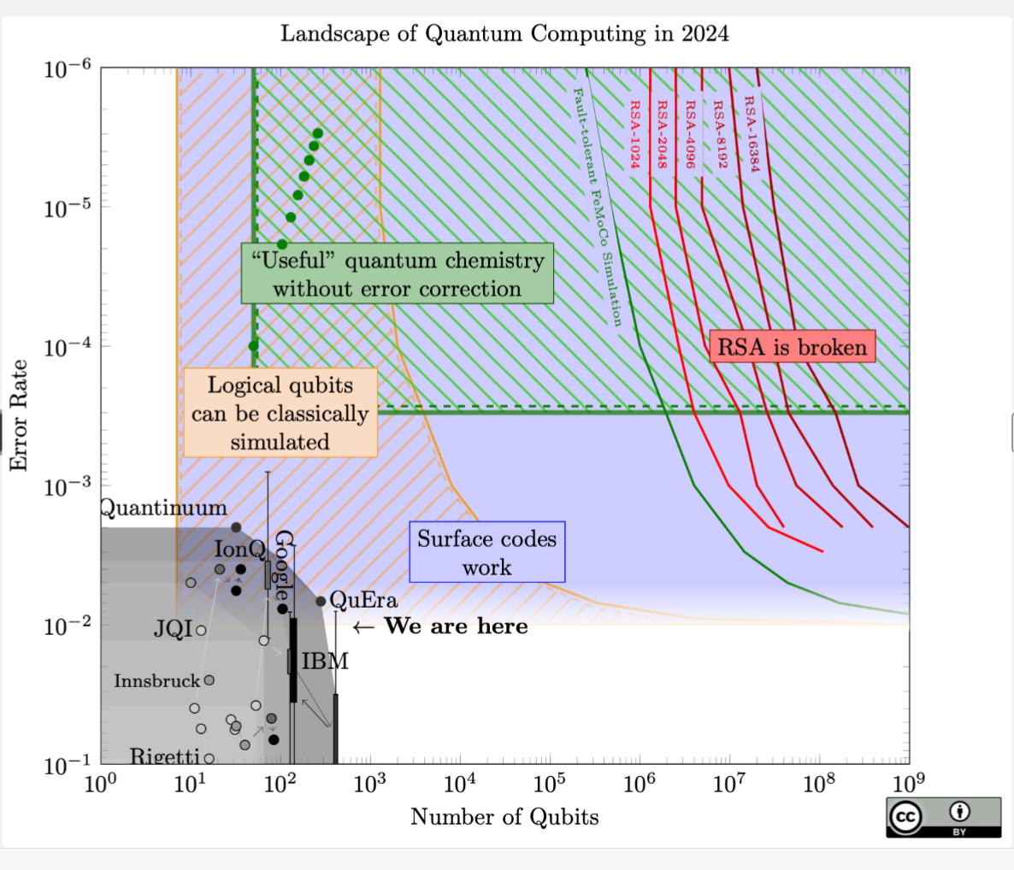
Quantum Landscape 2024
https://sam-jaques.appspot.com/quantum_landscape

Slide 9
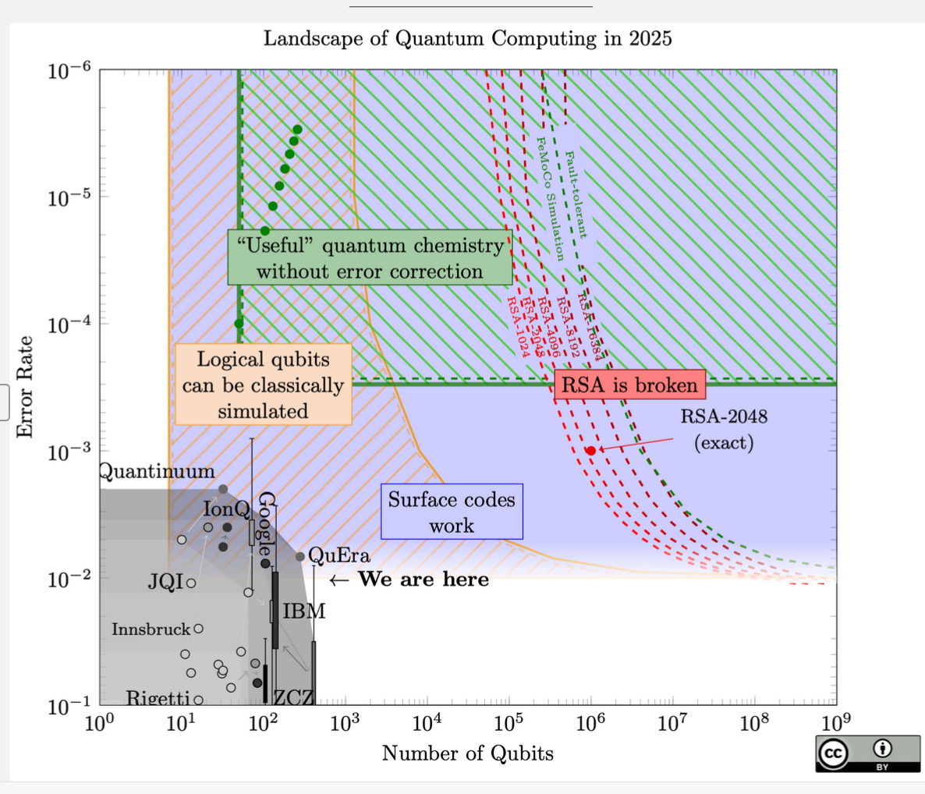
Quantum Landscape 2025

Slide 10
NIST Competition
Started in 2017, first “winners” in 2022, appears to have attracted best talent for entries https://csrc.nist.gov/projects/post-quantum-cryptography
Looking for Key Encapsulation Mechanisms (KEMs) and Signature algs
  KEMs more pressing – alternative to RSA key transport or (EC)DH key establishment
  Signatures less urgent and we have stateful sigs already
After 3 elimination rounds, some winners announced in July 2022
KEM: Kyber (aka ML-KEM) https://doi.org/10.6028/NIST.FIPS.203
Signature:
  Dilithium (aka ML-DSA) https://doi.org/10.6028/NIST.FIPS.204
  and
  SPHINCS+ (aka SLH-DSA) https://doi.org/10.6028/NIST.FIPS.205
  and
  FALCON https://falcon-sign.info/falcon.pdf will become FIPS 206 (as FN-DSA) sometime
NIST’s standardisation process for ML-KEM, ML-DSA and SLH-DSA is complete

Slide 11
NIST Competition: winner all right?
As well as announcing winners NIST also announced a “round 4” of evaluation for more KEMs and issued a new call for submissions for signatures
BUT...
  Kyber IPR situation wasn’t quite clean so NIST agreed/paid-for licenses
  https://csrc.nist.gov/csrc/media/Projects/post-quantum-cryptography/documents/selected-algos-2022/nist-pqc-license-summary-and-excerpts.pdf
    Not sure if that’ll be enough, time will tell
  NTRUprime was not selected but proponents and some deployments (esp SSH) continue working on that
  Selected signature schemes may create an API issue for large to-be-signed values
  One of the round 4 KEM algorithms (SIKE) was busted in August 2022
  https://www.schneier.com/blog/archives/2022/08/sike-broken.html
  One of the round 3 signature finalists (Rainbow) had been busted in Feb 2022
  https://eprint.iacr.org/2022/214

Slide 12

BUSTED
From: https://arxiv.org/pdf/2112.00399.pdf

Slide 13

BUSTED
From: https://arxiv.org/pdf/2112.00399.pdf

Slide 14
PQC not a “drop-in” replacement
As you can see from the size/performance numbers, PQC algs don’t satisfy the same size/CPU requirements met by classic public key algs
Size/CPU impact varies from alg to alg and application to application:
  BIG public keys or sigs – bad for DNSSEC, X.509 sizes
  Bigger KEM outputs – not great but maybe ok if e.g. TLS ClientHello still fits in one packet
  CPU performance generally ok, not true for all submitted algs though
We still need more time to be more confident in these algorithms

Slide 15
Kyber aka ML-KEM (1)
Based on module learning with errors (MLWE) problem
  Can be stated a different ways, e.g. the shortest vector problem (SVP):
  What x,y,z makes x(a,b,c)+y(d,e,f)+z(i,j,k) closest to (but !=) (0,0,0) ?
  If you could solve that 3-D problem in 256 dimensions, you could break Kyber
  As usual, there may be easier ways to break Kyber, we don’t know
Variants: Kyber512, Kyber768, Kyber1024
Kyber768 (used in current browser TLS)
  similar security level to AES128 (if a CRQC exists)
  public key: 1184 octets, encap: 1088 octets

Slide 16
Kyber (2)
Arithmetic deals with vectors and matrices of polynomials over a ring:
  Rq is Zq [X]/(X^{n} +1) for n = 256, q = 3329
Secret vector s is an element of Rq² and error vector e another element of Rq²
Secret and (all) error vectors are “small” (think of ‘em as vectors of polynomials with small coefficients)
We use a matrix A from Rq^{2x2}
Public key is A and t = As + e

Slide 17
Kyber (3)
Encrypt message m (< 256 bits) as a polynomial with one message bit per coefficient
Random “small” vector r in Rq² and error vectors e1, e2 also in Rq²
u = Ar + e1
v = tr + e2 + [q/2]m
Ciphertext is u,v
In real alg, there’s a compression thing going on and a number of the values are represented differently

Slide 18
Kyber (4)
To decrypt calculate v – su
= (As + e)r + e2 + [q/2]m – s(Ar + e1)
= Asr + er + e2 + [q/2]m – Asr – se1
= [q/2]m + er + e2 – se1
Other than [q/2]m all terms are “small” and since each m coefficient is 0 or 1 result has coefficients that are either close to 0 in which case the relevant message bit was zero, or close to [q/2] in which case the relevant message bit was 1
These slides describe the Kyber public key encryption alg, the KEM is a little different

Slide 19
Kyber (5)
Algebra needed for Kyber: https://words.filippo.io/dispatches/kyber-math/
“Simplified” explainations: https://crypto.stackexchange.com/questions/103754/kyber-and-dilithium-explained-to-primary-school-students
Another simplification: https://medium.com/@krisinfosec/post-quantum-cryptography-38bcbad95284

Slide 20
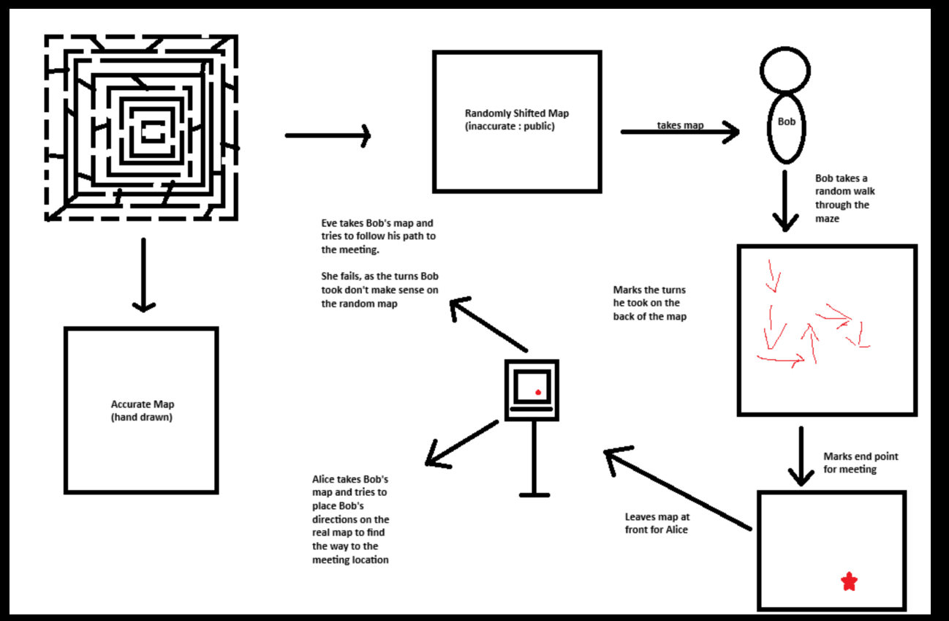
A new Kyber analogy
Credit:
James Doyle, 2025/2026 student!

Slide 21
Stateful Hash-Based Signatures
These are stateful signature schemes which means that the private state (i.e. the value of the private key) changes with every signature operation
Yes, they are quantum resistant, so worth having, esp. for things like software-signing where we won’t need many signatures and sizes aren’t a big deal
BUT they need a different cryptographic API as private keys have a fixed, limited number of uses allowed, (maybe 2^10 or 2^20) and if you go over that limit, you lose all security (signatures could be forged)
Also, if you EVER re-use a private key value you’re hosed, so you need to be very very careful e.g. about reboots, forking, and state maintenance
Two algorithms standardised: XMSS (RFC 8391 and LMS (RFC 8554)
You can’t just replace Ed25519 with XMSS or LMS without changes to applications/systems

Slide 22
SPHINCS+ Stateless HBS
SPHINCS+ (aka SLH-DSA) is internally similar to stateful hash based signatures like XMSS
Statelessness achieved by selecting from many private signing values using an r-subset resilient selection function
  Basically, select the set of private values to use based on the hash of the to-be-signed thing (and some randomness), thereby not re-using private values too often
As the private key doesn’t change it’s ok to sign 2^64 messages without significant loss of security (sign more and security degrades)
A nice description:
https://er4hn.info/blog/2023.12.16-sphincs_plus-step-by-step/

Slide 23
Embed PQ KEMs with classic ECDH (hybrid approach)
TLS, SSH, IPsec and other “classic” key exchanges have been extended to allow mixing in of PQ key exchanges in addition to the classic DH exchange
Bottom line: it’s OK to do this now, and if your data is long-term sensitive definitely start now, if you’re not sure, then do it anyway
Draft specification for TLS: https://datatracker.ietf.org/doc/draft-ietf-tls-hybrid-design/
Browsers do this already, using X25519MLKEM768

Slide 24
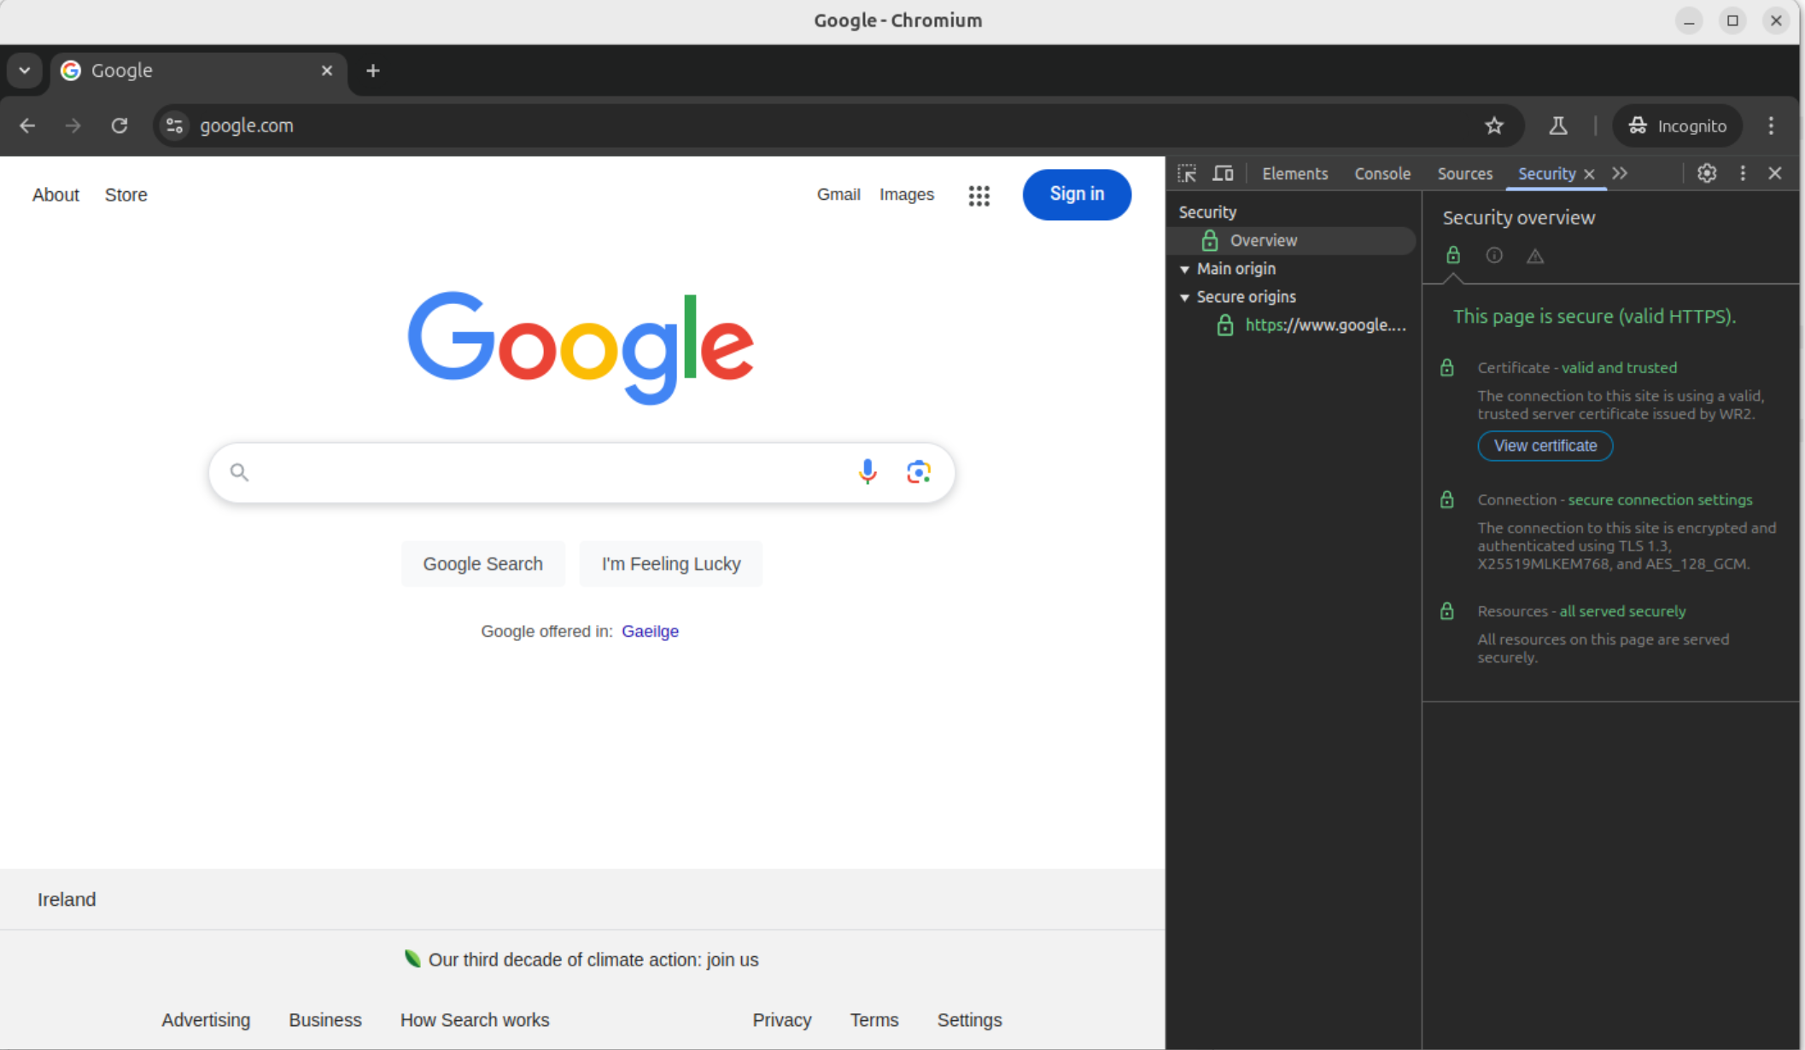

Slide 25
Quantum Key Distribution
QKD: Directly exchange photons between endpoints e.g. (over a single-hop fibre or RF link); accumulate key bits based on received photon state (e.g. polarisation)
  Claims made this is “unbreakable… because <physics>”
  (At least) Saturation attacks exist against real implementations
    https://www.nature.com/articles/s41598-021-87574-4
Requires (classic) authentication of eventual key bits selected
    https://www.ietf.org/proceedings/99/slides/slides-99-saag-post-quantum-cryptography-01.pdf
      Slides 12-18
By definition, QKD requires no intermediaries hence has scaling problems
Still could be useful for specific links used for specific purposes
But: be aware of marketing hype

Slide 26
Top Level Message
Don’t panic
Cryptographers are studying new public key algorithms that aim to provide good security even in the face of a cryptographically relevant quantum computer (CRQC)
Engineers are considering how to integrate those algorithms into protocols and applications
Hybrid cryptographic solutions (using both “classic” algorithms and post-quantum algorithms) will be deployed at scale in the next few years
  Some are already deployed

Slide 27
My Message
Do pay attention to harvest-now-decrypt-later
Do not yet pay attention to signatures
  https://datatracker.ietf.org/doc/draft-farrell-tls-pqg/
The above is far from an accepted opinion
But is nowhere near as scathing as Peter Gutmann’s “Why Quantum Cryptanalysis is Bollocks”
  https://www.cs.auckland.ac.nz/~pgut001/pubs/bollocks.pdf

