Slide 1
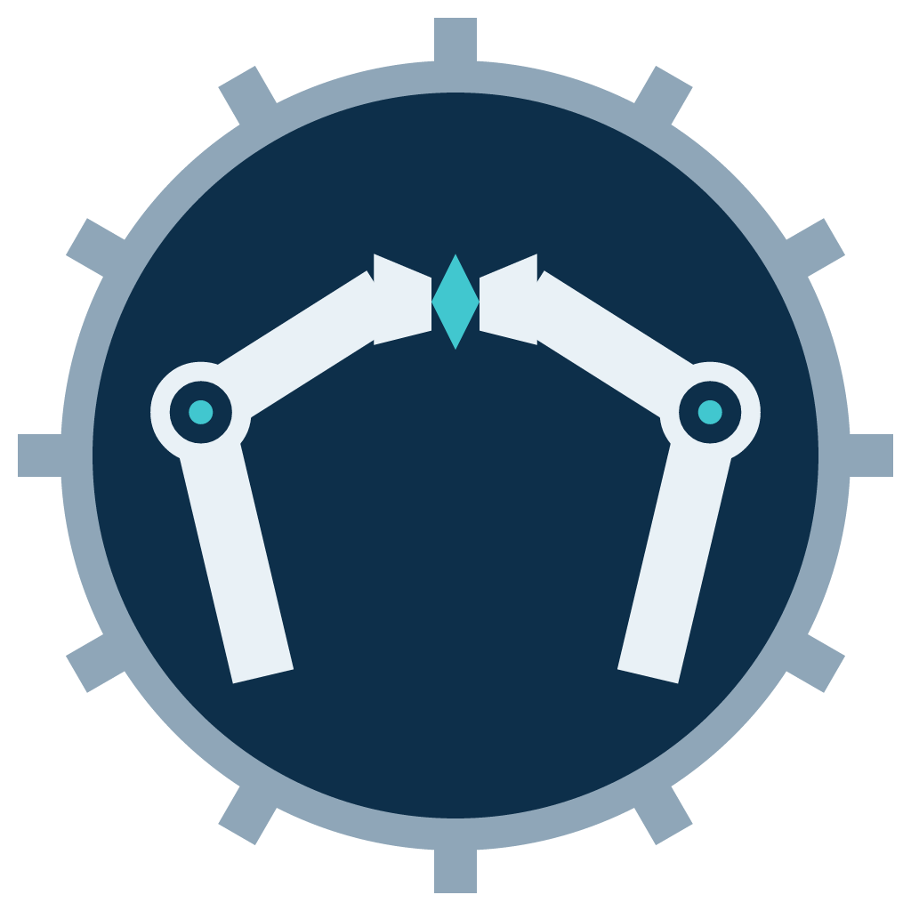
TouchPair
Feeling Every Layer
Duke Kunshan University · DKU Innovation Challenge
Notes:
SEGMENT 1 — cold open. The camera is on the hands; this card is only a fallback / safety.

Slide 2
WHO WE ARE
We're TouchPair.
A dual-arm robot that takes exactly one sheet
from a tight stack — every time — and places it flat.
Still done by hand today in
electronics assembly · garment making · printing · labs
Notes:
SEGMENT 2 — three-shot with the robot.
We're TouchPair. We're building a dual-arm robot that works by touch: it takes exactly one sheet from a tight stack — every time — and places it flat.
It sounds like a small thing. But separating thin sheets is still done by hand — in electronics assembly, in garment making, in printing, in labs.

Slide 3
THE PROBLEM
Three things make it hard
01
Cameras can't tell
One sheet and two sheets look the same from above.
02
Friction drags the next sheet
Pull with one arm, and two sheets come up.
03
The signal is in the change
Not in contact itself — in the moment contact changes.
Notes:
SEGMENT 3 — Tianyuan.
Three things make it hard.
First, cameras can't tell. One sheet and two sheets look the same from above.
Second, pull with one arm, and friction drags the next sheet up with it. We call that a double pick.
And third — the one that matters most — the useful information isn't in contact. It's in the moment contact changes.
That single idea shapes everything we build.

Slide 4
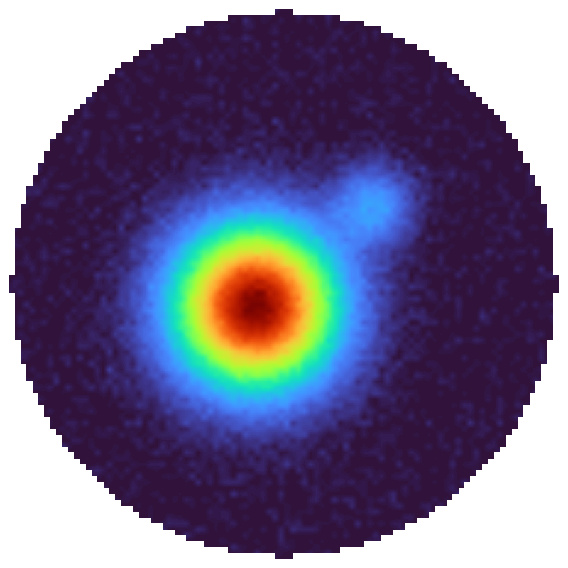
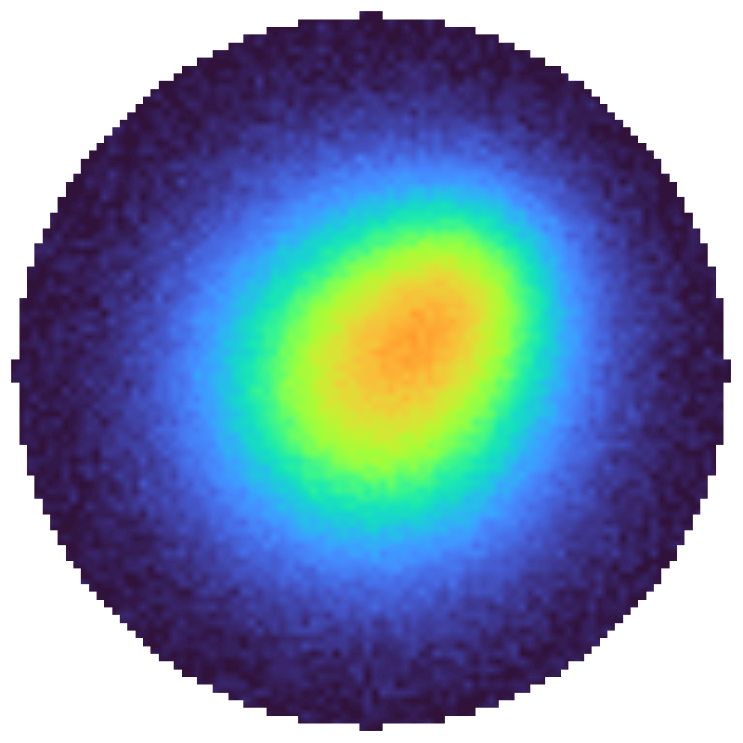
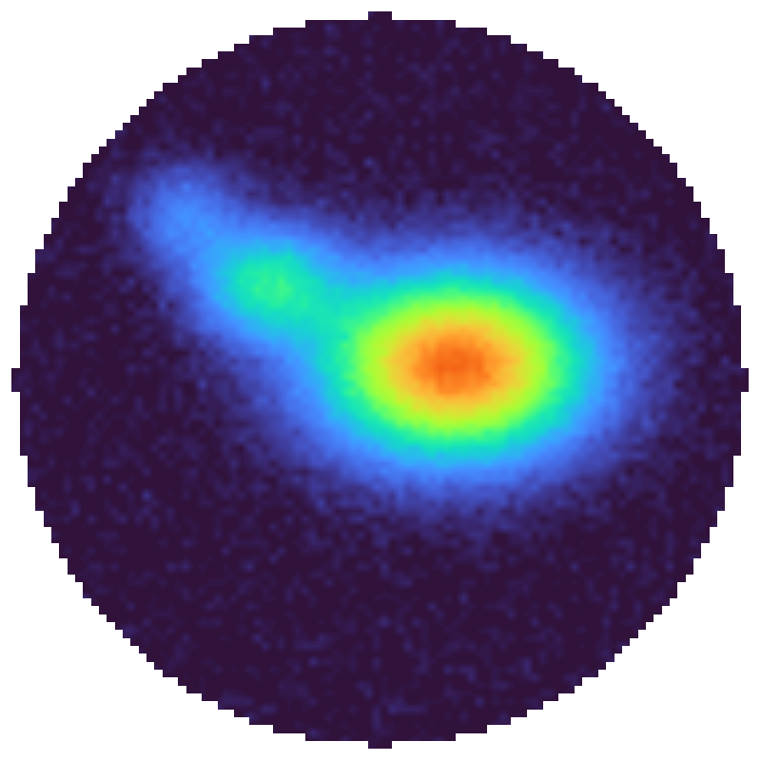
TOUCH
What touch reads
One layer
Two layers
Slip starting
same gripper · same sheet · different reading
0 / 1 / several layers
slip
stack dragged
schematic
Notes:
SEGMENT 4 — Peiyuan.
I'm Peiyuan. I work on touch — and touch answers the third one.
Each fingertip carries a tactile array. It reads how pressure is spread across the pad.
One layer and two layers read differently. And when a sheet starts to slip, the pattern visibly shifts.
But a single frame barely shows it. So our model reads a short window of change. A graph network encodes the spatial pattern in each frame. A temporal network encodes how it evolves. And a head predicts what happens next.
It outputs three things: zero, one or several layers; slip; and whether the stack is being dragged.
Those three readings drive every correction that follows.
NOTE: heatmaps are schematic, not logged sensor data.

Slide 5
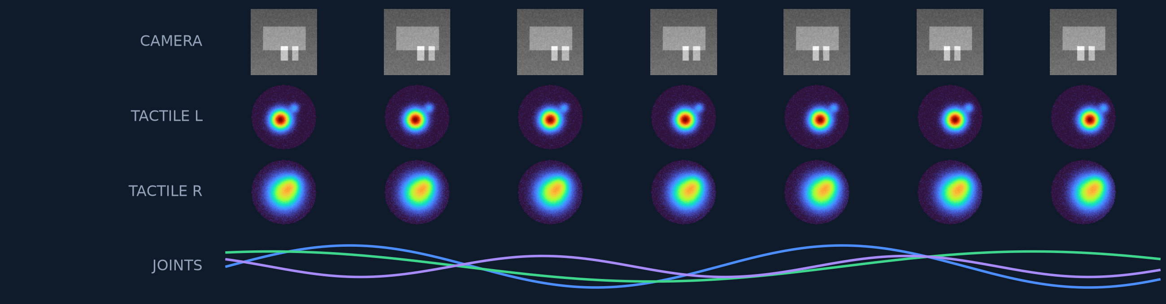
DEMONSTRATIONS
Teaching the robot
V
C
R
V
C
V
normal · correction · recovery
300 demonstrations per material, failures included
Notes:
SEGMENT 5 — Hongyang.
I'm Hongyang. I own the data.
We teach the robot by teleoperation. A person moves both arms, and we record video, touch and joint states on one clock.
About three hundred demonstrations per material. Some of them are deliberate failures — because to learn to correct, the robot has to see what failure feels like.
Every episode is labelled in three modes: normal, correction, recovery. And the rule is strict. Two people label the same batch. If they agree on less than eighty percent, we rewrite the rule.

Slide 6
SYSTEM OVERVIEW
INPUTS
PERCEPTION
EXPERTS
ROUTER · EXECUTION
Head + wrist
cameras
Vision encoder
ViT / CNN → f_V
Vision policy π_V
ACT / Diffusion → a_V
Stateful policy router
context
f_V · z_t · ĉ t+1
a_V · a_C · a_R
robot state · current mode
Tactile × 4
two per gripper
Tactile dynamics model
Correction expert π_C
tactile residual → a_C
ST-GCN
spatial encoder
Robot state
joints · gripper
TCN
temporal encoder
Recovery expert π_R
back off, re-grasp → a_R
V vision
C correction
R recovery
Safety supervisor
joint limits · force limits
Task
take one sheet
Contact prediction head
Constrained IK
ĉ t+1 predicted contact
Joint commands
CROSS-ARM TACTILE SHARING
anchor gripper tactile
picker gripper tactile
each hand's touch
informs the other
Notes:
SEGMENT 6 — Tianyuan, standing next to the screen.
Here's the whole system, on one diagram. ... the bottom band is the part only two arms can do.

Slide 7
EVALUATION
How we know it works
WHAT IT ANSWERS
A
Vision only
How far can vision go alone?
B
Fixed tactile threshold
Does a simple rule stop double picks?
C
Picker-only touch
Does learned touch beat a fixed rule?
D
Shared touch
What do two arms add?
≥ 50 real trials per material · success rate · double-pick rate · time per sheet
Notes:
SEGMENT 7 — Tianyuan.
So how do we know touch actually helps? Four versions, same materials ... At least fifty real trials each ... And because we can switch the correction off.

Slide 8
WHY US
Already in our lab.
The arm. The grippers. The tactile fingertips.
We put them together into one robot that can feel.
— and add the hardest piece: touch shared between the two hands.
Twelve months. Three people. One measurable result.
Notes:
SEGMENT 8 — three-shot with the robot.
We're not drawing a system on paper. The arm, the grippers, the tactile fingertips — they're already in our lab. We're putting them together into one robot that can feel. And then we add the hardest piece: touch shared between the two hands.
Twelve months. Three people. One measurable result.

Slide 9
TouchPair
Feeling Every Layer
Duke Kunshan University
Notes:
SEGMENT 9 — end card. Hold at least 2 seconds.

