Slide 1
CPE 301 | Heart Rate Monitor with MAX 30105
Tenniel Takenaka-Fuller takenkaf@unlv.nevada.edu

Slide 2
AIM & ACCOMPLISHMENT
AIM:
Display the heartbeat signal using the MAX30105 sensor and I2C interfacing.
Utilize the Arduino Sparkfun library & Wire.h to interface the MAX30105 sensor
Use a BLE module to transmit the data from AVR to host using BLE communication and display the live data on the host
Apply a smoothing/filtering algorithm to raw data in post-processing
ACCOMPLISHMENTS
Collect and display heartbeat data using the Arduino Sparkfun library to the Data Visualizer
Collected the RR data (BPM)
Created code to smooth graph data

Slide 3
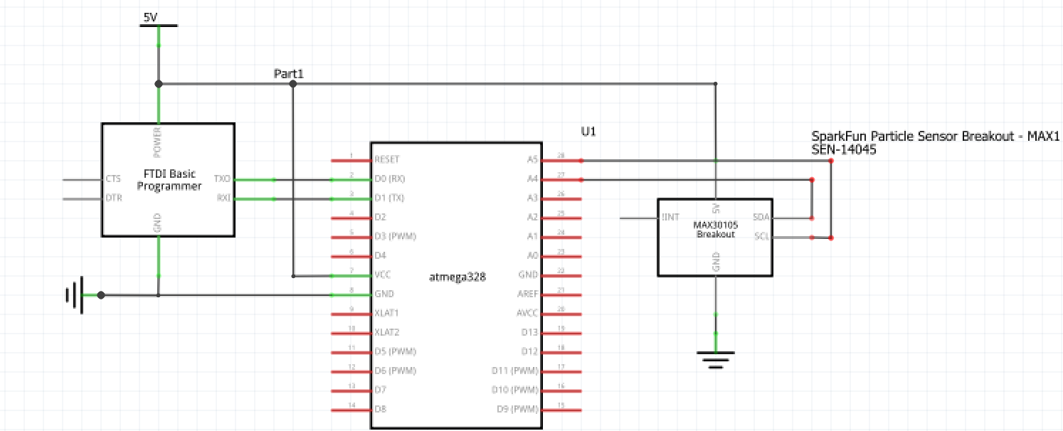
SCHEMATIC

Slide 4
DESIGN STAGES
Components
AVR ATMEGA328
Xplained Mini
Has an internal FTDI chip for 5 volt power
MAX 30105 Particle Sensor
Interfaces
Atmega328p – MAX 30105 using I2C – Address (0x57)

Slide 5
CODE DEVELOPMENT
Initialization
Code was developed with Sparkfun Arduino libraries
MAX30105.cpp and MAX30105.h were used to initialize sensor
MAX30100.cpp and MAX30100.h were used to initialize filtering functions
HeartRate.cpp and HeartRate.h were used to initialize the checkForBeat functions and lowFIRFilter function
Example 5 Heart Rate code used. This code took average of readings and utilized Serial.println to send the heart rate data to the plotter

Slide 6
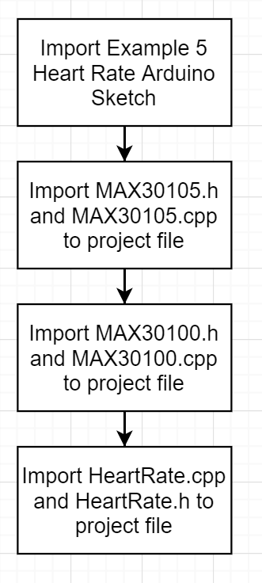
Code Development
Flow chart for code initialization:

Slide 7
CODE DEVELOPMENT
Data Collection
MAX 30105 data was collected using an I2C interface. Data is to be displayed as a graph & in terminal of Atmel Data Visualizer using Serial.println()
checkForBeat() function used to check if MAX30105 is reading a heart rate
If so, use the information to calculate the RR (or BPM)
Calculate the BMP average
Filter the IR data found in the dcRemoval() and meanDiff() function
Send this data to the graph to be printed when pulse is read

Slide 8
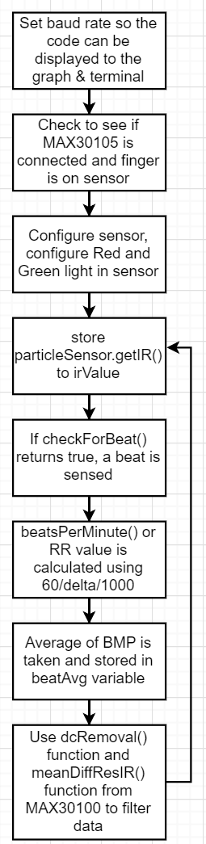
Code Development
Flow chart for data collection:

Slide 9
DEMO SNAPSHOT/VIDEO
Snapshots: https://drive.google.com/drive/folders/17_apV_VEeNWnyZdA0hA20NXEYDBeLiA-
Project Implementation: https://youtu.be/GIjEE2mk8kM
Video Presentation: https://youtu.be/Co3Kc_-ELfg

