Slide 1

ISD 528 Team 17
Final Presentation
Skyler Do, Rachel Schillmoeller, Izzral Darwish Zulkifli, Ross Maynard, Walter LaMar, Jacob Rainey
Notes:
Hi, we’re Team 17 and today we’re going to discuss our DFM project, which is making improvement on a standard toolbox.

Slide 2
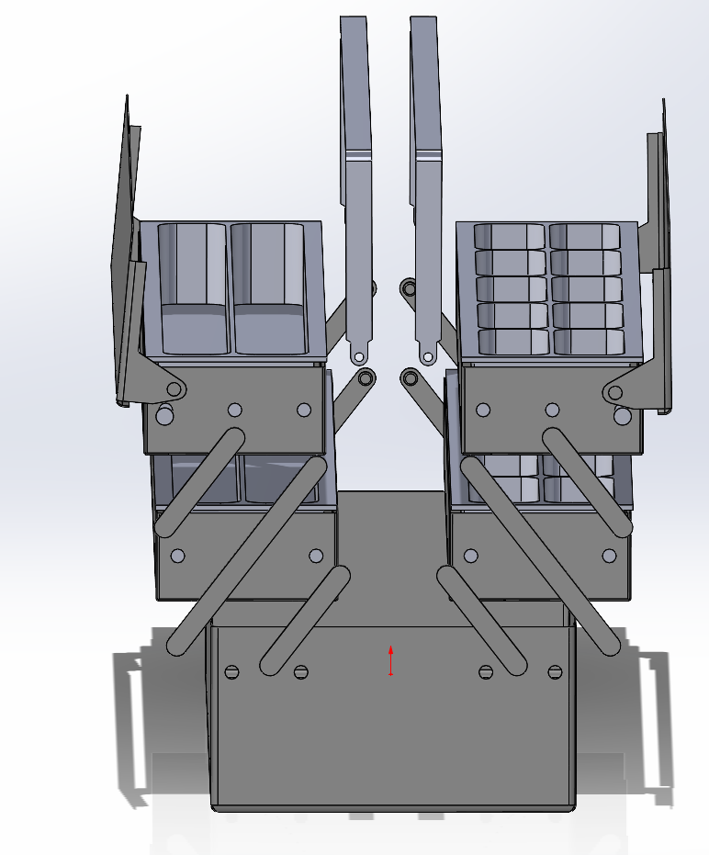
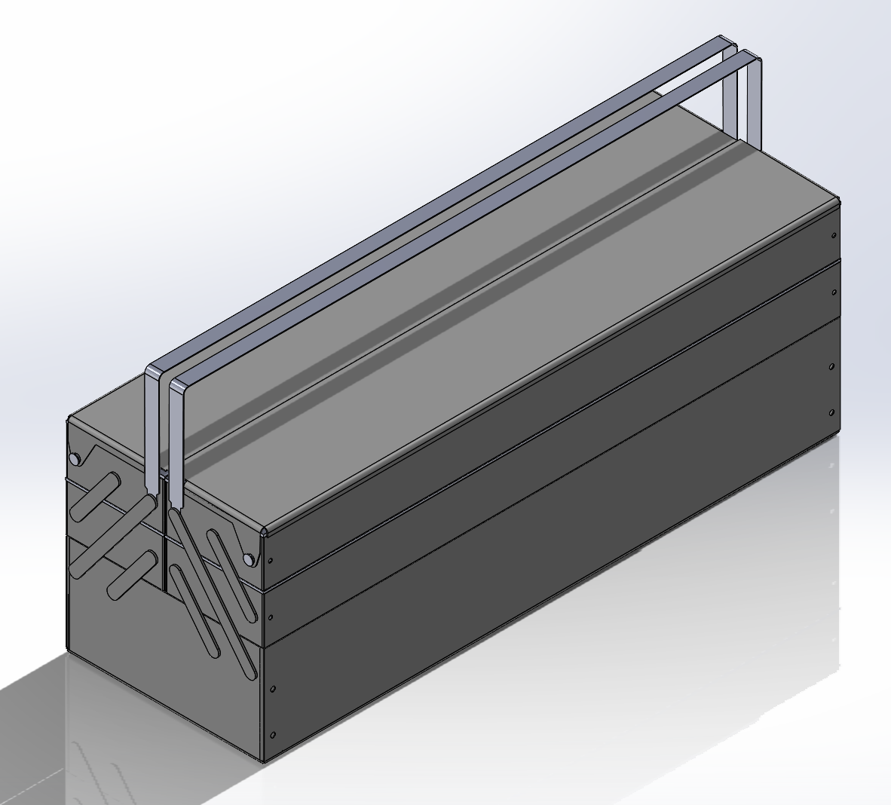
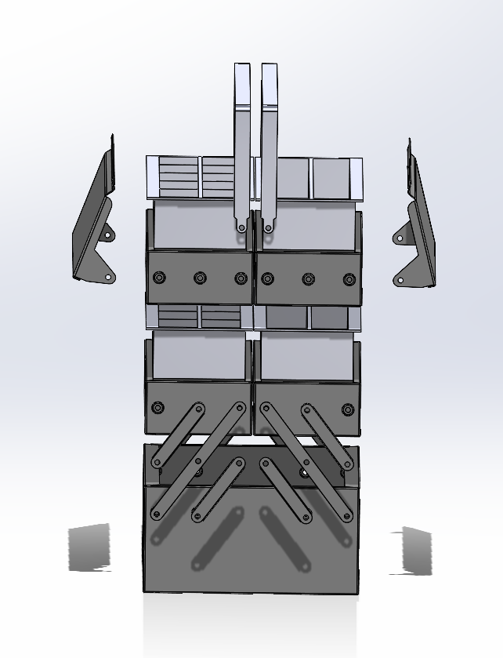
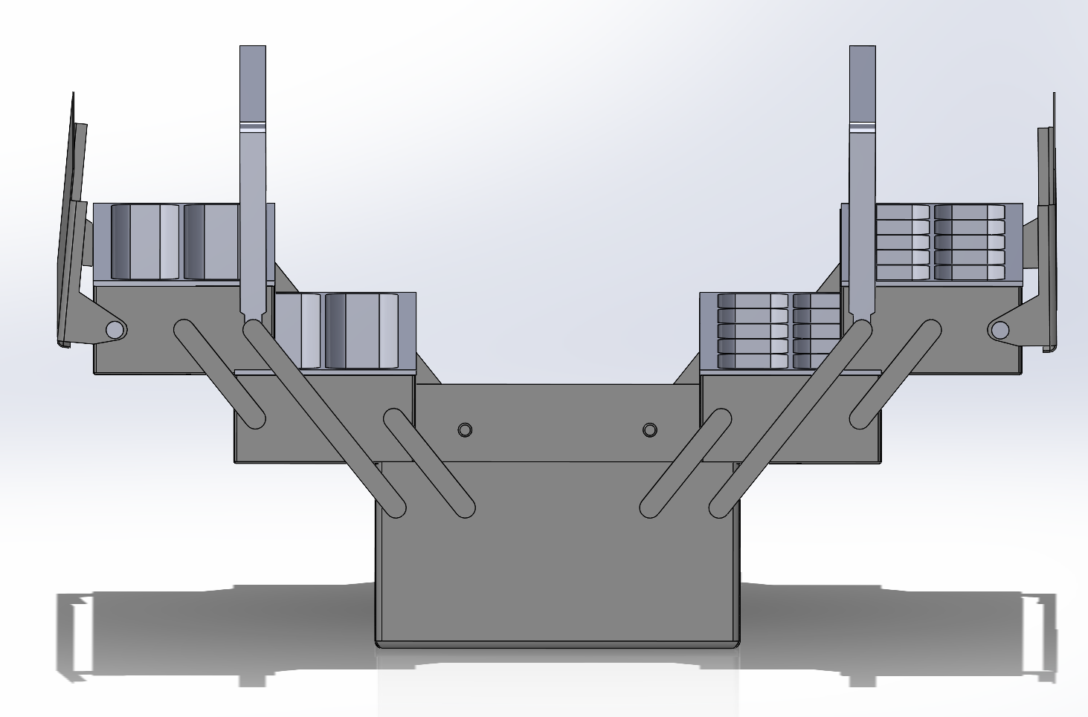
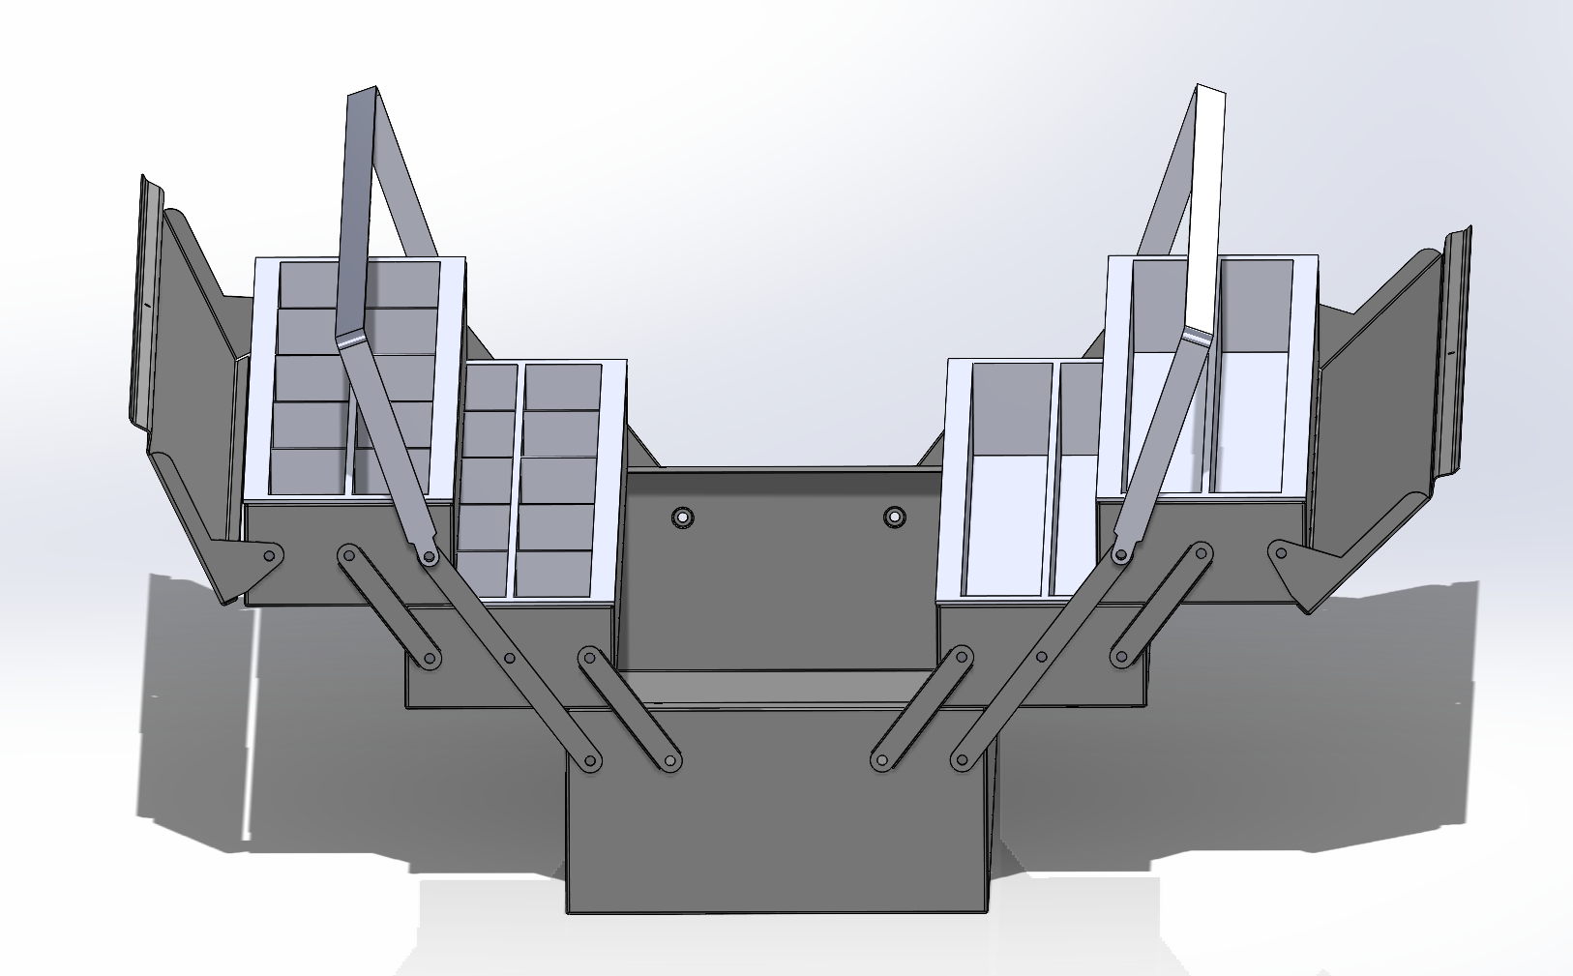
Product Description
Multi-tiered, collapsible toolbox with compartments
Exploded View
Production Volume: ~14,000 (per month) x 12 (months per year) = 168,000 per year
Source: Amazon sales numbers
Notes:
The toolbox that we have chosen for our project is a multi-tiered, collapsible container with injection molded compartments within it to hold various types of tools or crafting equipment. As shown in the middle picture, when the tool box is fully opened, there are 3 levels total, consisting of a base layer and 2 collapsible levels with different sized compartments that can be modified to the preference of the user. Overall, our predicted production volume falls at around 168,000 toolboxes per year, which comes from our benchmarking of similar products on Amazon.

Slide 3




Primary/Secondary Customers
Primary: “Blue collar” line of work (ex. mechanic, electrician, construction worker, plumber)
Traditional toolbox use
Secondary: People who enjoy crafting,
Store craft supplies such as beads, yarn, knitting needles, etc.
Notes:
We have 2 types of customers that this toolbox can be marketed to. The primary customer for this product are mechanics, construction workers, and other professionals that are typically known for needing a mobile toolbox to bring with them to different sites.
The secondary customer for this product would be people who enjoy crafting, and this toolbox would be used to store craft supplies such as beads, yarn, knitting needles, etc. While the exterior of the product would largely remain the same, the interior would have separate adjustable compartments that would allow for optimal size depending on the customer’s crafting needs.

Slide 4
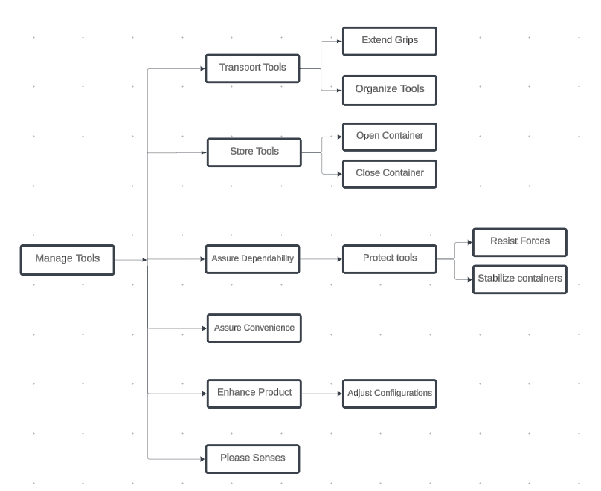
Product Analysis:
FAST Diagram

Slide 5
Product Analysis: FCMM
Functions
 | Extend Handle | Open Container | Organize Tools | Close Container | Resist Forces | Stabilize Containers | Assure Convenience | Adjust Configurations | Please Senses
Base |  |  |  |  | x | x |  |  | x
Small Link |  | x |  |  | x | x |  |  | x
Big Link |  | x |  |  | x | x |  |  | x
Supporting Tray |  |  | x |  |  |  |  | x | x
Divider A |  |  | x |  |  |  |  | x | x
Divider B |  |  | x |  |  |  |  | x | x
Flaps |  |  |  | x | x | x |  |  | x
Handles | x |  |  |  | x |  | x |  | x

Slide 6
Product Family Design: CCT
Shared Components Between Product A & B | Different Components between Product A & B
Small Link Big Link Handles Flaps Supporting Trays Base | Dividers

Slide 7
Product Family Design: FDT
Shared Functions between Product A & B | Functional Differences between Product A & B
Organize Tools Store Tools Access tools Separate tools/hardware Display Labels Open housing Expand levels | Adjust Configuration Prevent damage

Slide 8
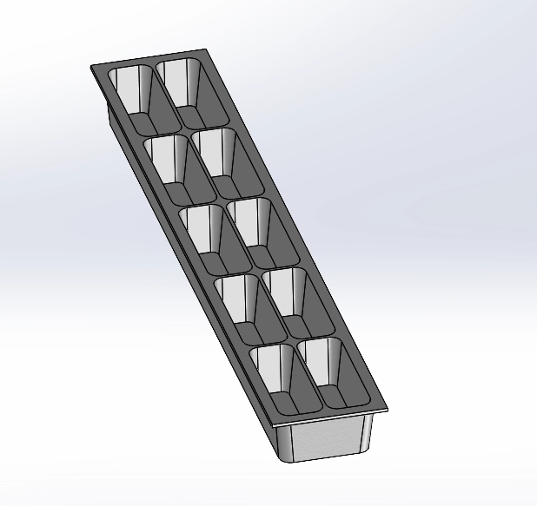
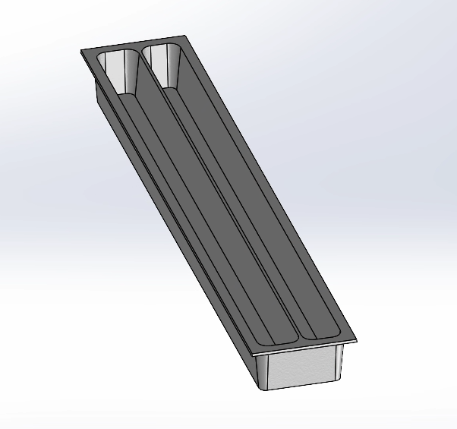
Product Family Design: CAD Modules: Primary and Secondary Customers
Side By Side Comparison of Trays A & B Highlighting different compartments

Slide 9
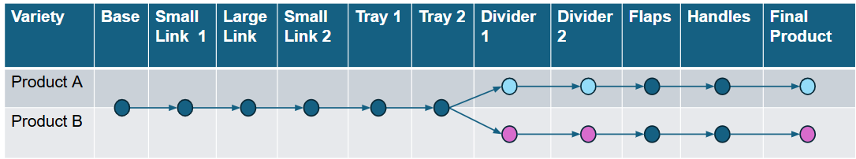
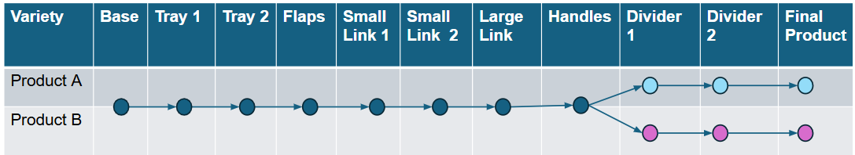
Product Family Design: PFAD
Original:
Improved:

Slide 10
Design For Manual Assembly: Part Selection
The manually oriented and assembled parts are our targets for redesign.
Part No. | Name | Quantity
1 | Base | 1
4 | Supporting Tray | 4
5 | Divider A | 2
6 | Divider B | 2
7 | Flaps | 2

Slide 11
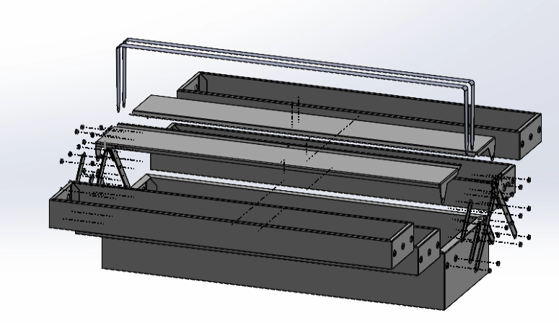
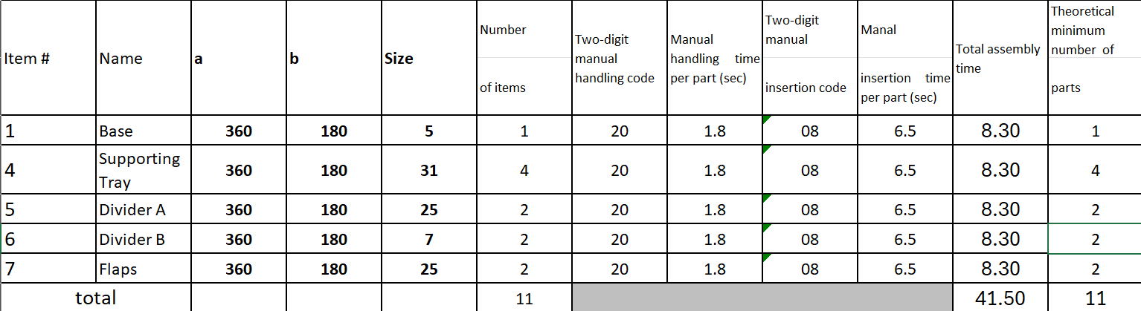
Design For Manual Assembly: Before
DFA-6: Increase Part Symmetry
DFA-10: Adding features for easy insertion
DFA-12: Z Assembly

Slide 12
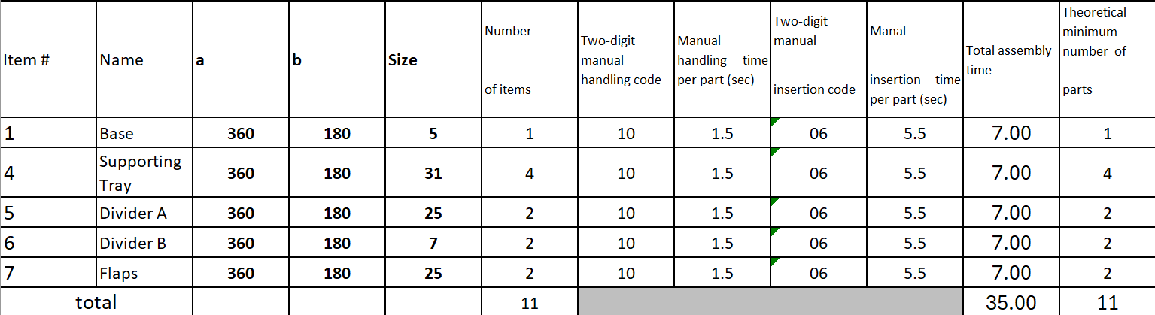
Design For Manual Assembly: After

Slide 13
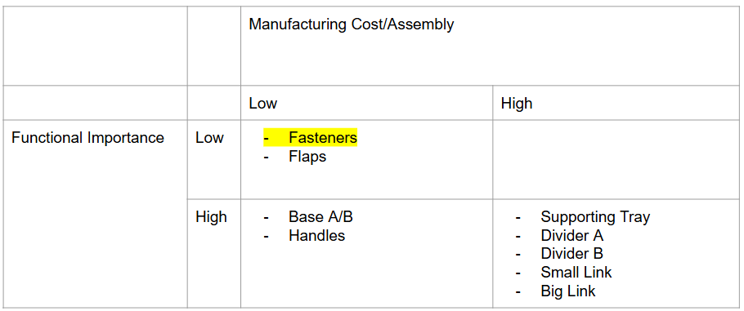
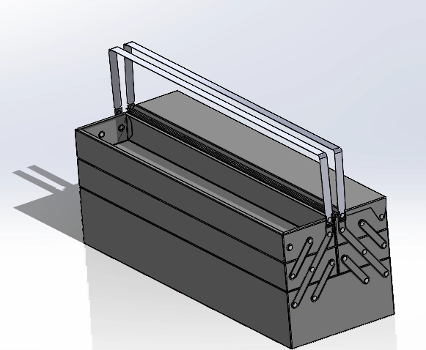
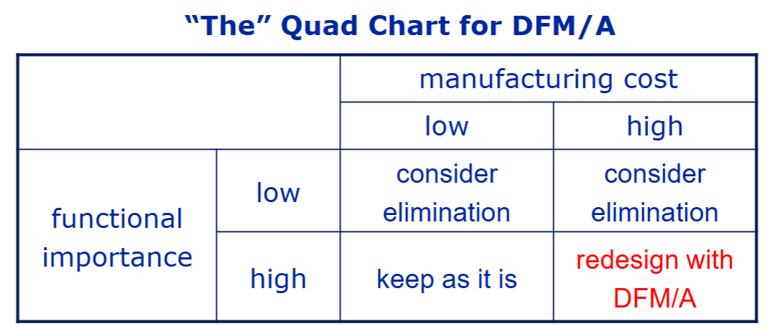
Design For Automated Assembly: Subassembly Selection

Slide 14
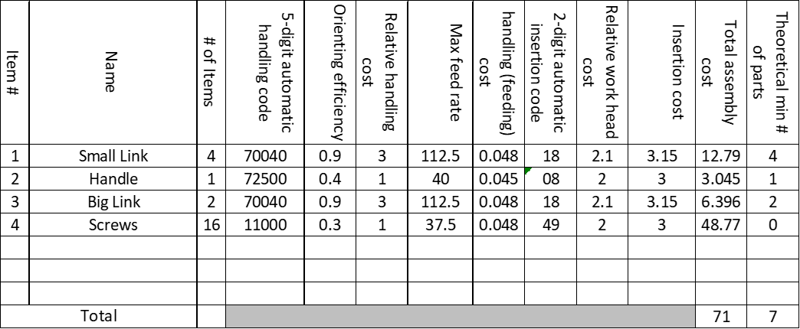
Design For Automated Assembly: Before
DFA Principles considered:
-DFA-1: Reduce Part count
-DFA-2: Reduce fasteners
-DFA-11: Provide locating features

Slide 15
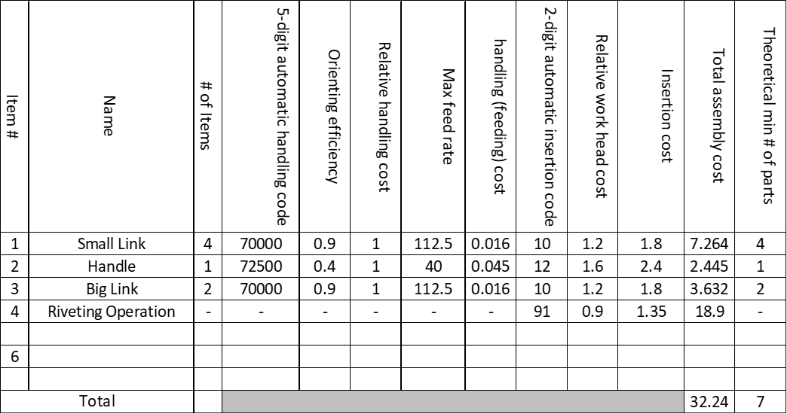
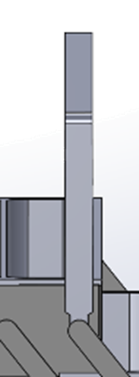
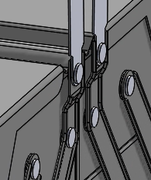
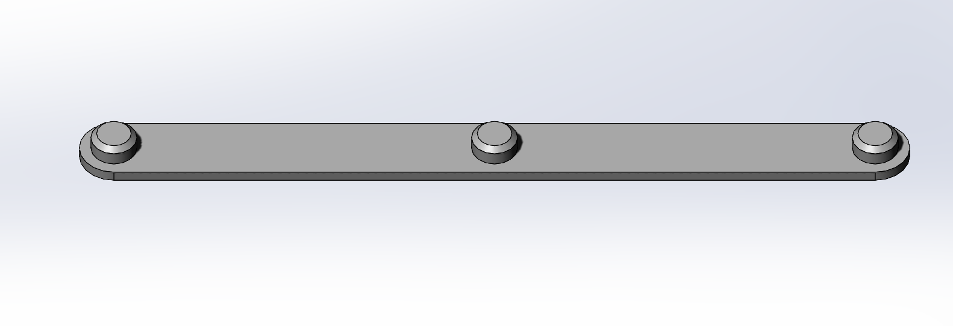
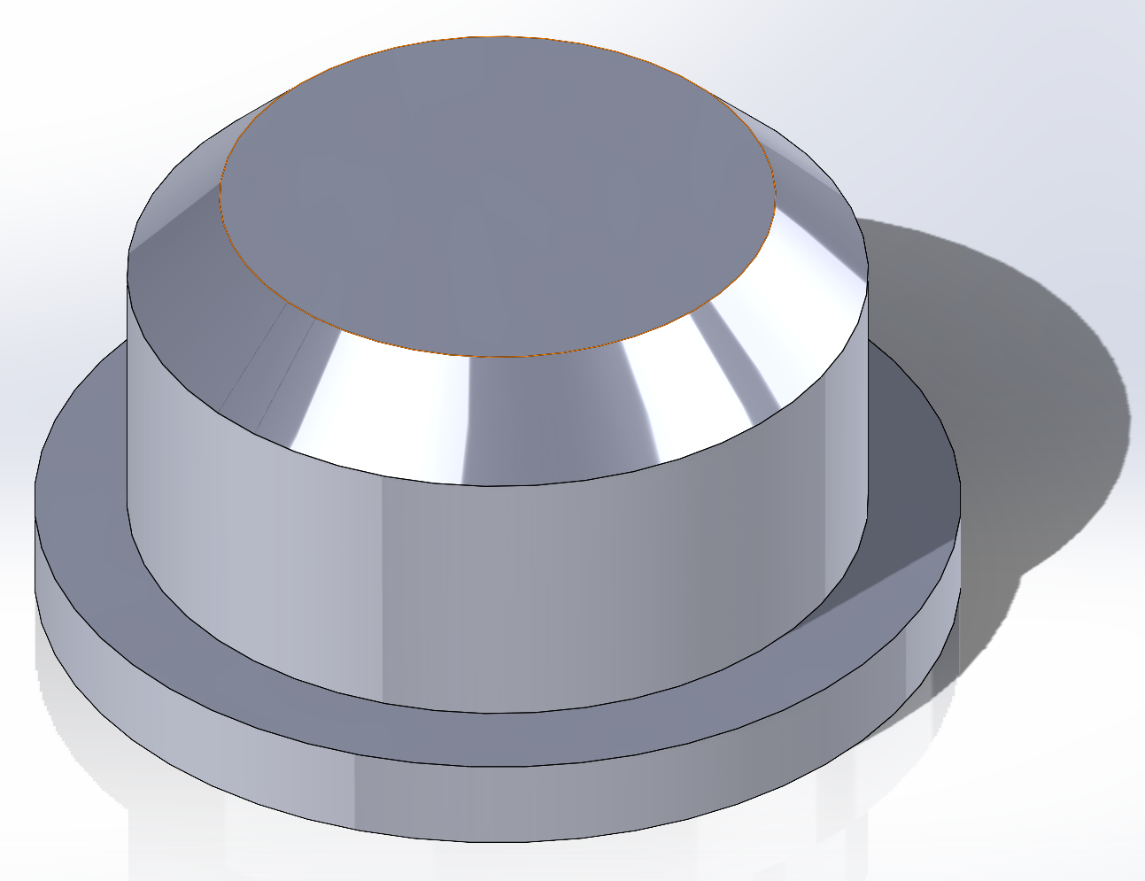
Design For Automated Assembly: After
Feature 2:
Riveting features on pins
Feature 1:
Locating pins
Feature 3:
Combine hole/rivet for handle and big link

Slide 16
Design for Manufacturing: Process Selection
Aluminum Metal (non ferrous) | Folded Sheet Metal | 1.64 kg | 0.5 mm | 0.1 mm | Not Strict | 168 000
Process Compatible with Material | Shape | Mass | Section Thickness | Tolerance | Surface Roughness | Economic Batch Size
Sand Casting | Fails
Die Casting | Fails
Investment Casting | Fails
Centrifugal Casting | Fails
Forging | Fails
Extrusion | Fails
Sheet forming | Capable | Capable | Capable | Capable | Capable | Capable
Powder methods | Fails
Electro-Machining | Capable | Capable | Capable | Fails
Machining | Capable | Capable | Capable | Capable | Capable | Capable

Slide 17
Design for Manufacturing: Process Selection
Thermoplastics ABS | Prismatic (non circular) | 2.14kg | 3 mm | 0.5 mm | Not Strict | 168 000
Process Compatible with Material | Shape | Mass | Section Thickness | Tolerance | Surface Roughness | Economic Batch Size
Machining | Capable | Capable | Capable | Capable | Capable | Capable
Injection moulding | Capable | Capable | Capable | Capable | Capable | Capable
Blow moulding | Fails
Compression moulding | Fails
Rotational moulding | Fails
Thermoforming | Fails
Additive manufacture | Fails

Slide 18
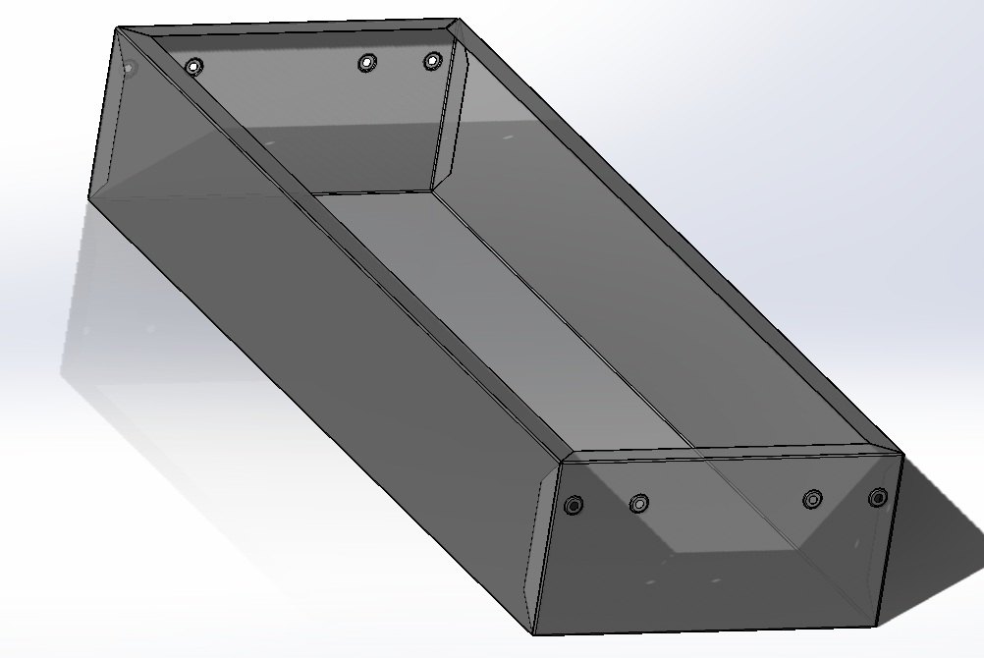
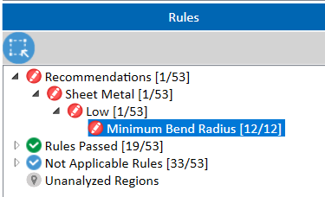
Design for Sheet Metal Manufacturing (Original)
Material Cost | $0.61/part
Operational Cost | $1.16/part
Mold Cost | $0.14/part
Total Cost per Part | $1.91/part

Slide 19
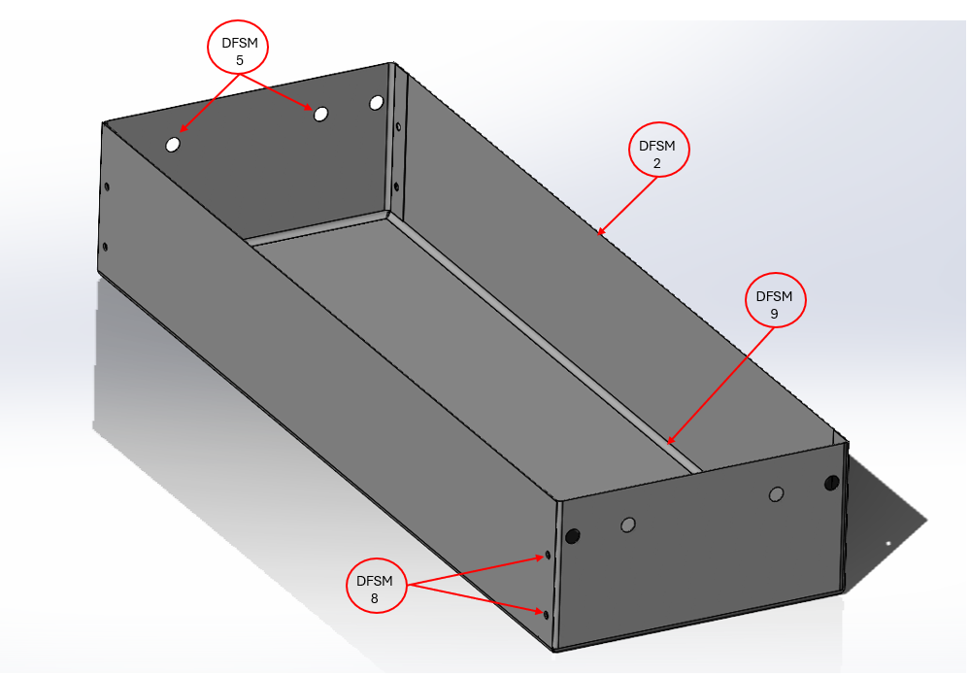
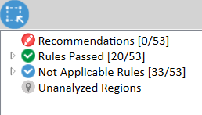
Design for Sheet Metal Manufacturing (Redesigned)
DFSM Principles Applied:
DFSM 2: Minimize setups and steps
DFSM 5: Allow the use of Standard Punches
DFSM 8: Avoid too small and close holes
DFSM 9: Avoid sharp bends
 | Analytical | Hubbs
Original Part | $1.91 | N/A
Redesigned Part | $1.67 | $30.87
% Improvement | 12.5% | Infinite

Slide 20

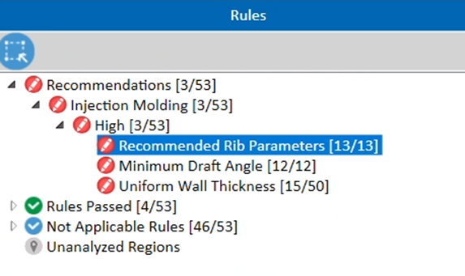
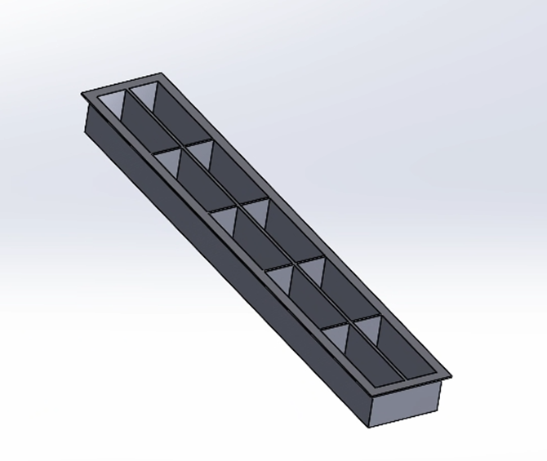
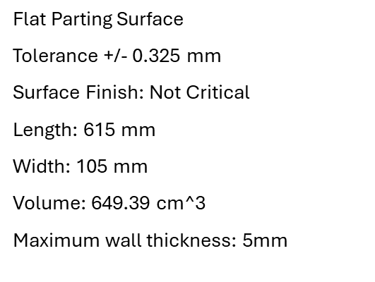
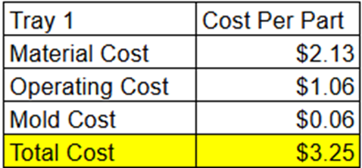

Slide 21

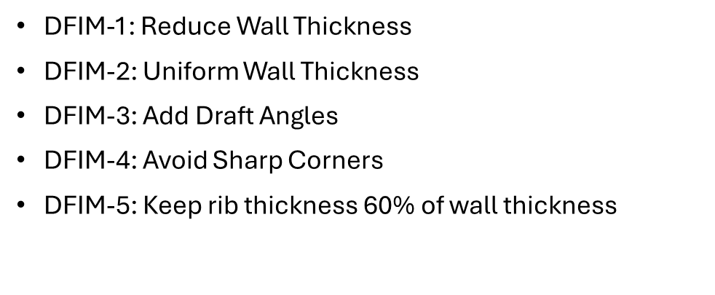
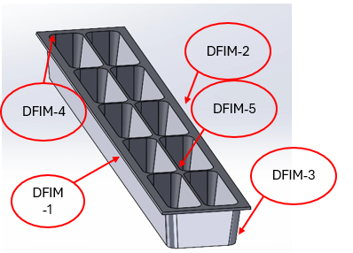
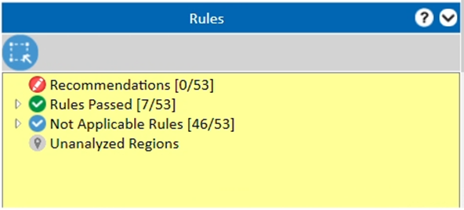
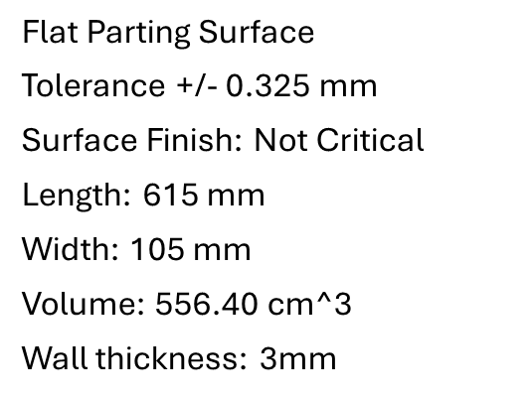
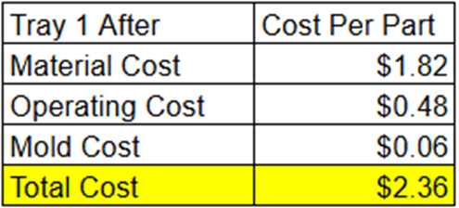

Slide 22
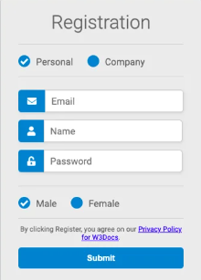
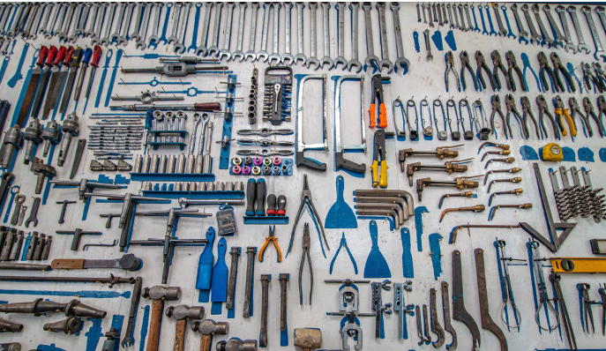
Product Service System
Borrow-a-tool Service:
Offers members access to niche, job specific tools
Users purchase our toolbox, register the product online, and create a borrow-a-tool account
Members borrow tool for a period of time and return at no cost aside from membership fee
Toolbox owner receive first year free

Slide 23
Conclusion/Design Critique
BEFORE
Overall Design
  Opportunity to add kickstands on the far end bases for balance & support
  Modify link geometry to prevent upper-most tray from obstructing lower-most tray
DFA (Automated)
  Pro: cost reduction by ~$40
  Con: Production volumes and majority of component sizes don’t justify automated assembly
DFM (Base)
  Pro: Simplified geometry and reduced cost by $0.24/part
  Con: Not particularly aesthetic, still required fasteners to hold geometry
DFM (Divider A&B)
  Pro: Cost Reduction by ~$0.90 per part
  Con: Minor loss in storage volume due to draft angles
AFTER

