Slide 1



Adaptive Price Forecasting
for Crypto Asset Trading:
Tree-Based, Recurrent and Hybrid Models
with Multimodal Features
Authors: Artem Rudyi, Yana Mudruk
Supervisor: PhD (Phys.-Math.) T.O. Filimonova
Program: Master of Science in Computer Science
December 2025

Slide 2

Research Motivation
Rapid growth in the role of cryptocurrencies
High volatility and complex market dynamics
Need for robust forecasting and trading methods
Models are evaluated mostly by statistical metrics
Lack of real-world utility metrics for models
1

Slide 3
Problem Statement
Short-term price direction forecasting
Use of multimodal features
Unified protocol for evaluating financial performance in realistic conditions
Comparison of ML and DL models and development of a hybrid model
1

Slide 4
Goal, Object, Subject
Goal: creation and validation of an adaptive crypto price forecasting system
Object: crypto asset price forecasting.
Subject: ML/DL/hybrid models with multimodal features and subsequent trading.
1

Slide 5


Expected Results
Assembly of a multimodal dataset
Training of ML and DL models
Development of a hybrid model
Evaluation of statistical model quality
Financial performance evaluation (backtest)
3

Slide 6

Multimodal Data
Market data (Binance)
Technical and structural indicators
On-chain data (CoinMetrics)
Macroeconomic events (Investing)
Behavioral signals (Fear&Greed)
4

Slide 7
Data Parameters
BTC/USDT 1h: 10.2019 — 11.2025
Regime-sensitive train/val/test split
Train/val/test = 80% / 10% / 10%
Causal synchronization
Scale invariance via ATR_200; standardization after split
5

Slide 8
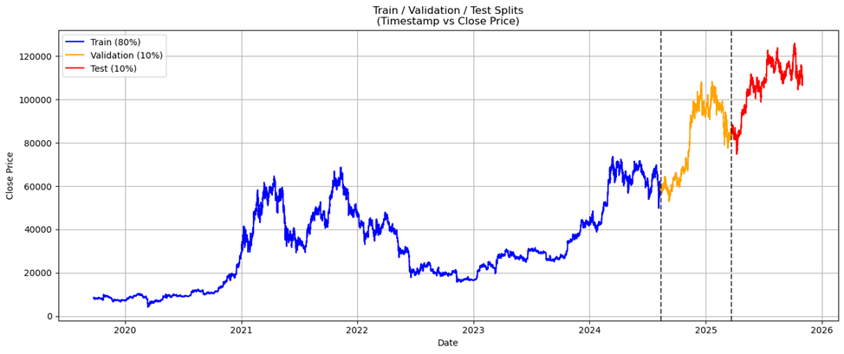
Sample Distribution
6

Slide 9
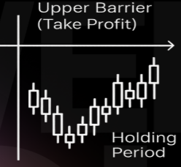
Target Variable
Triple Barrier -
upper/lower/time barriers
up / down / hold = 6 ATR / 2 ATR / 2 weeks
Binarization (TP / not TP)
5

Slide 10
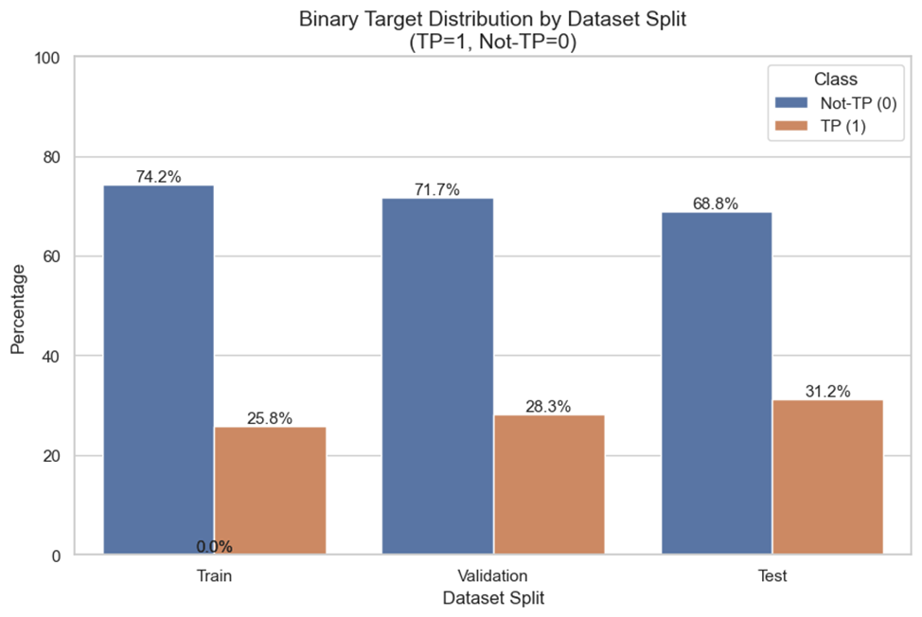
Class Distribution in Samples
7

Slide 11
Models and Metrics
ML: CatBoost, LightGBM, XGBoost + ensemble
DL: LSTM, GRU, BiLSTM, BiGRU
Hybrid: DL-encoder → ML-classifier
Stat. Metrics: TP-Precision, TP-Recall, Macro-F1, BSS
Fin. metrics: Total return, MDD, Sharpe, Calmar, Martin
8

Slide 12

Trading System
Long-only
$\hat{p}≥p_{BE}+p_{premium}$ → position entry
Optimization $p_{premium}$ on val set
Accounting for trading fees / slippage
8

Slide 13
Working Pipeline
Data Preparation
Training
Optimization
Test
Data acquisition
Feature generation and normalization
Target variable generation
Train/val/test split and standardization
Early stopping on val set
DL: Adam, Brier ES
Hyperparameter optimization on val set
Trading parameter optimization on val
Test set
Classification metrics
Financial metrics (backtest)
8

Slide 14
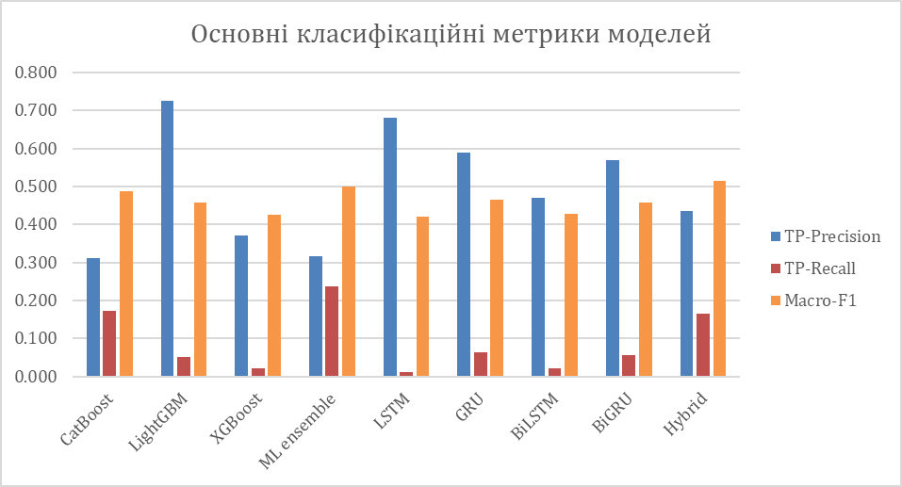
Classification Results
10

Slide 15
Financial Results
Model | Sharpe | Calmar | Martin | Total return (%) | MDD | Win-rate | Trade Count
CatBoost | 1.58 | 3.63 | 4.80 | 25.28 | −0.141 | 0.313 | 147
LightGBM | −0.46 | −0.76 | −5.41 | −5.92 | −0.139 | 0.253 | 83
XGBoost | 1.85 | 4.28 | 6.57 | 28.69 | −0.137 | 0.325 | 126
ML Ensemble | 0.38 | 0.56 | −3.95 | 3.32 | −0.110 | 0.281 | 96
LSTM | 2.47 | 7.44 | 20.27 | 33.90 | −0.105 | 0.359 | 92
GRU | 3.08 | 10.11 | 20.90 | 45.19 | −0.107 | 0.382 | 89
BiLSTM | 2.05 | 6.58 | 9.95 | 29.95 | −0.103 | 0.333 | 117
BiGRU | 3.50 | 14.59 | 31.35 | 52.66 | −0.089 | 0.405 | 84
Hybrid | 1.55 | 3.49 | 4.36 | 22.50 | −0.141 | 0.313 | 134
Buy-n-hold | - | - | - | 27.71 | -0.171 | - | -
12

Slide 16
Feature Importance
Excluded Feature Block | Feature Count | ΔMacro-F1 | ΔBSS | ΔTotal Return
ATR Levels | 96 | −0.079 | −0.022 | −9.37
Core Trend Mom | 84 | −0.063 | 0.011 | −15.80
Fractal regime | 79 | −0.089 | −0.025 | −13.80
Macro onchain | 97 | 0.004 | 0.022 | −14.65
Patterns ICT | 79 | −0.014 | 0.037 | −12.95
Time PDA | 93 | −0.079 | −0.039 | −6.67
Volume/VWAP/session | 96 | −0.016 | 0.060 | −2.271
12

Slide 17
Cross-Asset Transfer to ETH/USDT
Classification Results
Model | TP-Precision | TP-Recall | Macro-F1 | BSS
GRU | 0.329 | 0.238 | 0.503 | −0.093
BiGRU | 0.334 | 0.229 | 0.504 | −0.085
Hybrid | 0.336 | 0.289 | 0.512 | −0.137
Financial Results
Model | Sharpe | Calmar | Total return (%) | MDD | Win-rate | Trade Count
GRU | 3.63 | 12.06 | 52.91 | -0.115 | 0.408 | 76
BiGRU | 3.26 | 10.95 | 45.68 | -0.106 | 0.390 | 77
Hybrid | 3.31 | 15.04 | 45.66 | -0.077 | 0.400 | 75
13

Slide 18
Research Conclusions
Hybrid — best classification performance;
GRU, BiGRU – best return/risk ratio
Statistical accuracy ≠ financial result → backtesting is required
Combining features improves results
Models trained on BTC also work on ETH
14

Slide 19
Directions for Future Research
Tests on other assets / market regimes
Probability calibration
Development of deeper hybrid architectures
Adding short-strategy
Portfolio combination of assets and models
15

Slide 20

QUESTIONS
16

Slide 21
THANK YOU
17

