Slide 1

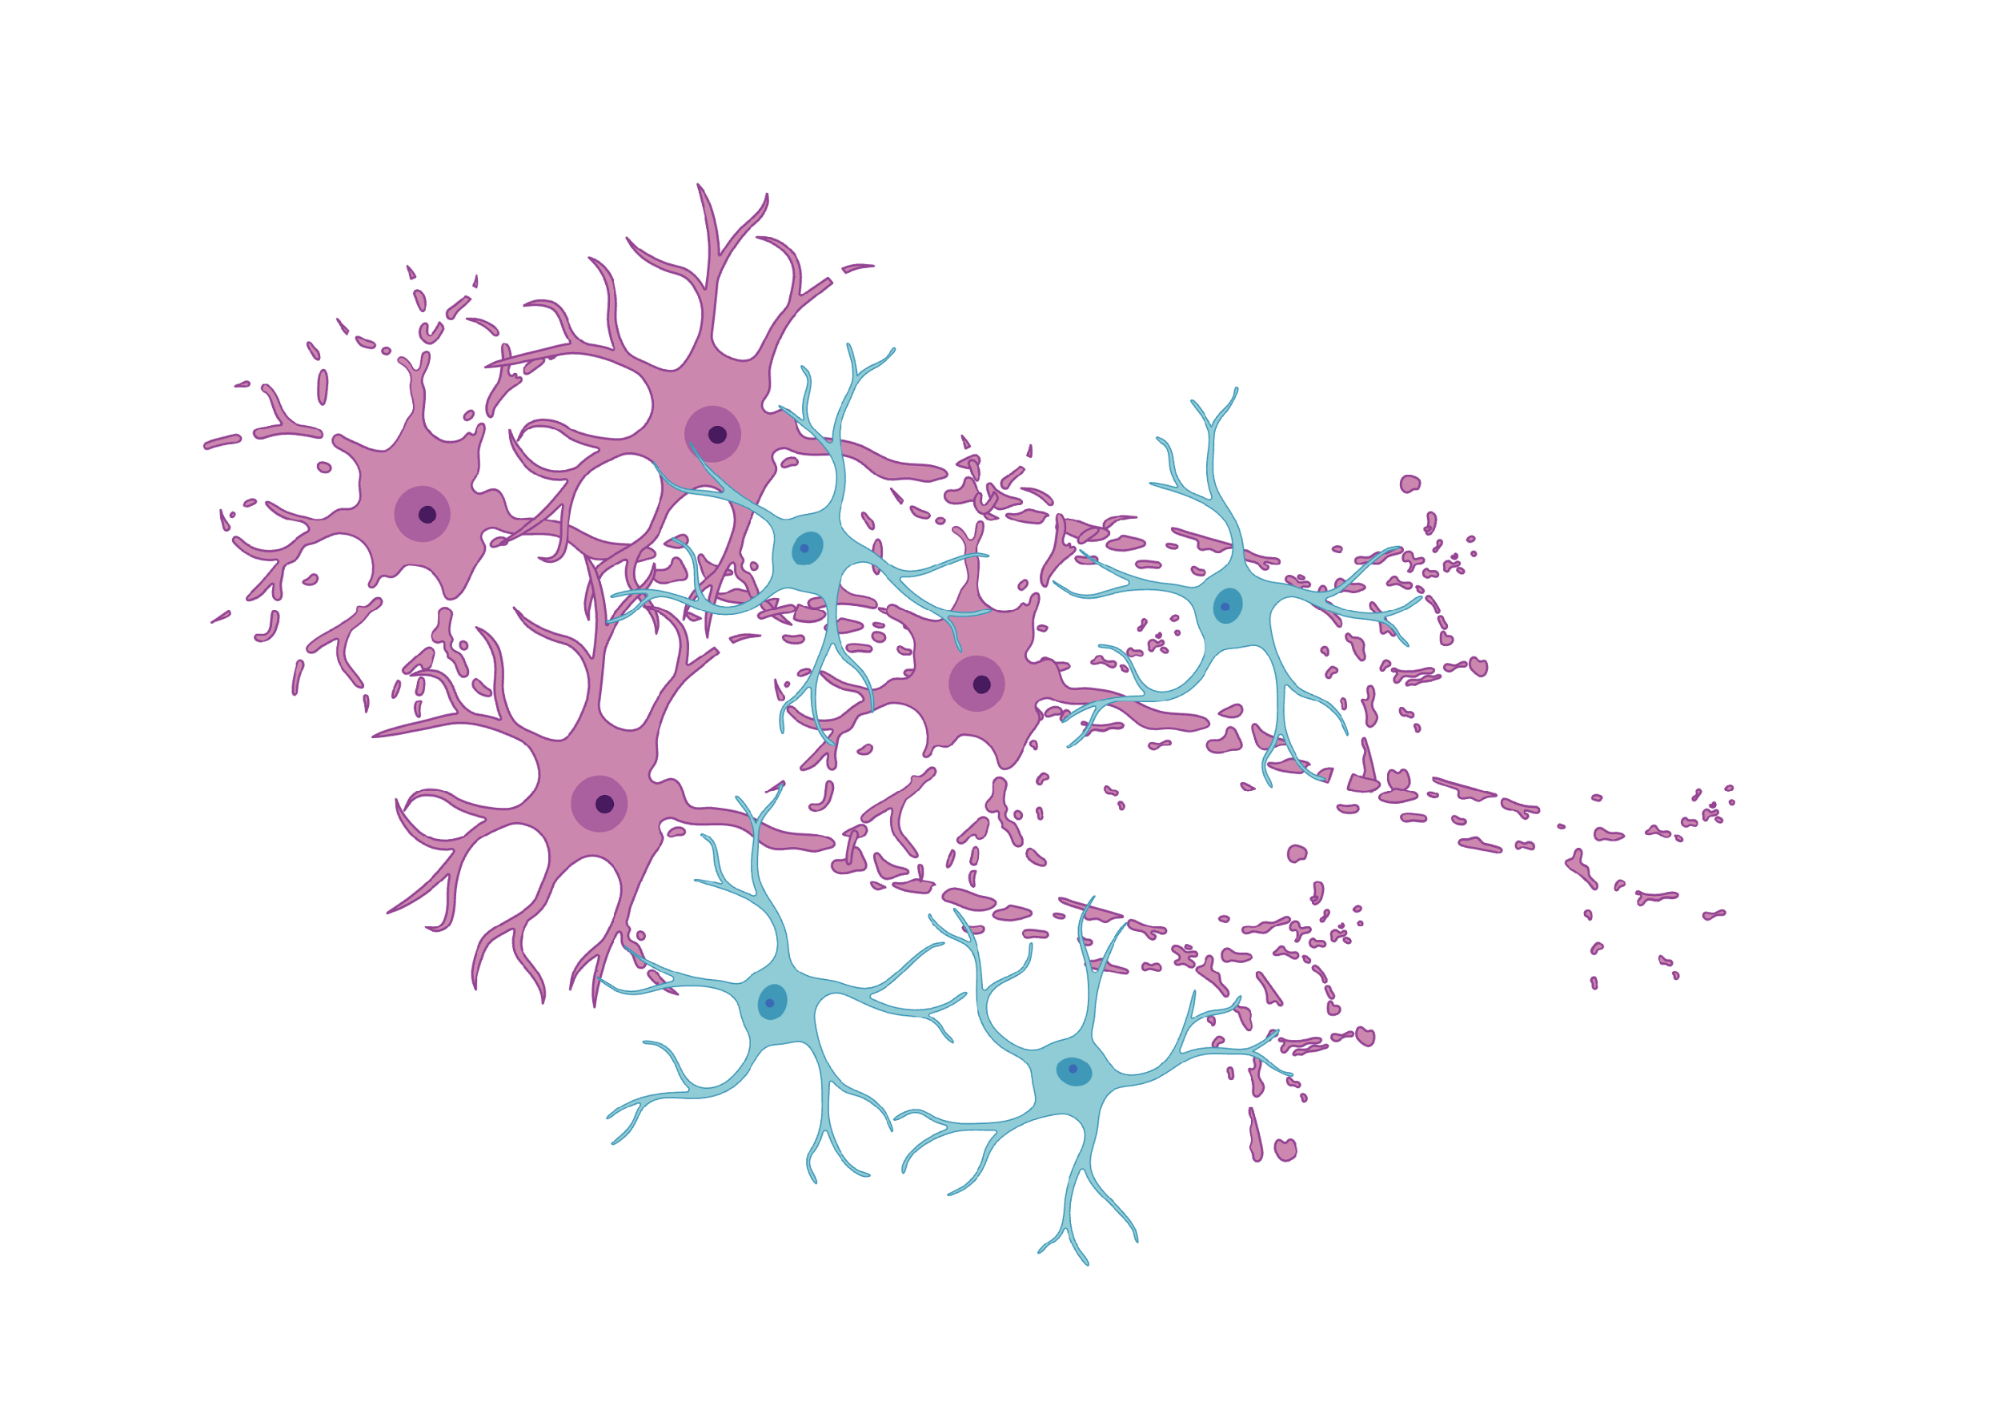

University of Pisa
Department of Information Engineering Artificial Intelligence and Data Engineering
CogniPredictAD
Francesco Panattoni
Project for Data Mining and Machine Learning

Slide 2
Table of Contents
I
Motivations and Clinical Background
II
Dataset ADNI
III
Preprocessing
IV
Classification & Results
V
Application & Conclusions

Slide 3
Motivations and Clinical Background

Slide 4
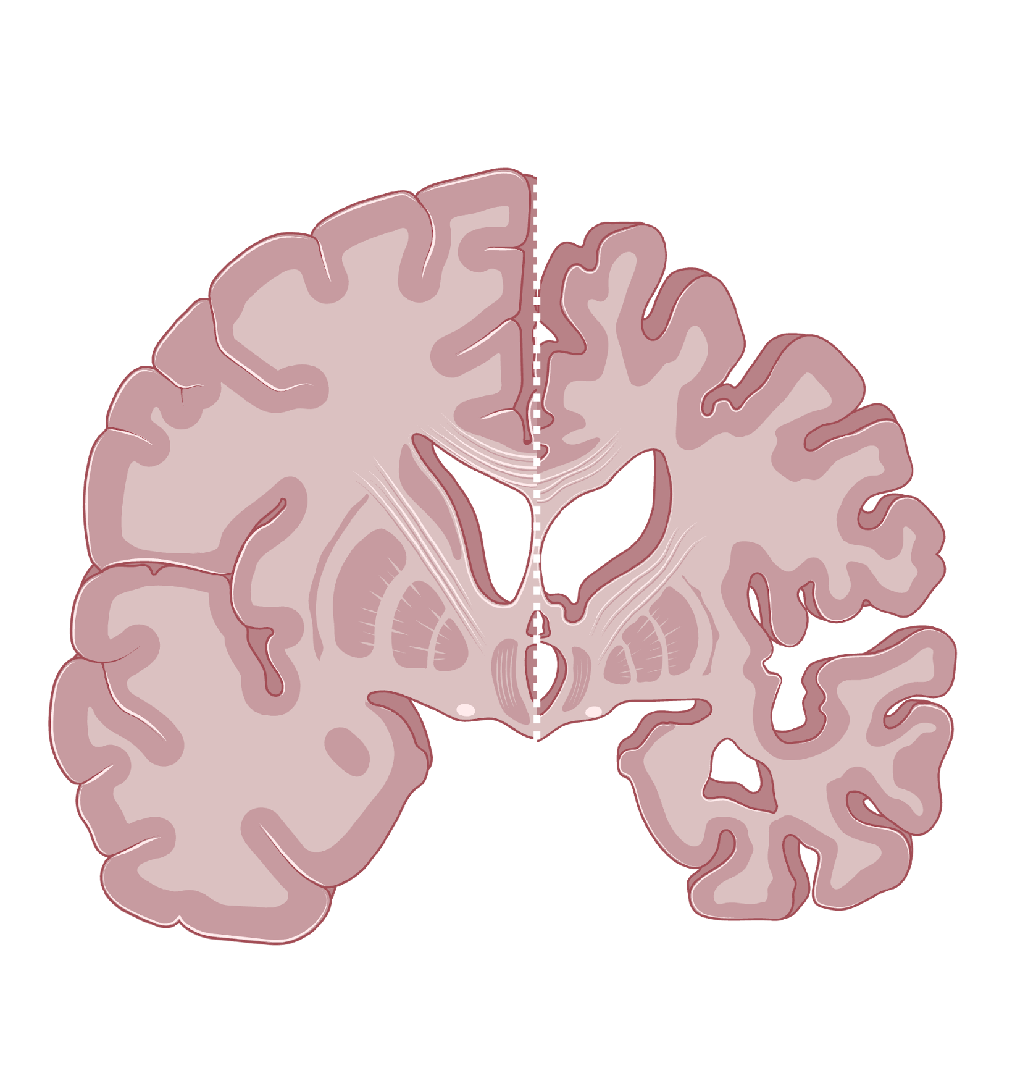
I
Motivations and Clinical Background
Alzheimer’s Disease
Alzheimer’s Disease is a progressive neurodegenerative disease that affects memory, cognitive function, and daily living skills. It is the most common form of dementia and has no definitive cure.
It primarily affects the elderly and its incidence is increasing as the population ages. It has a significant social, family, and economic impact, requiring long-term care.
Early diagnosis is difficult but crucial for slowing the progression of the disease and improving quality of life.

Slide 5

I
Motivations and Clinical Background
So why Machine Learning?
Machine Learning models could support doctors in diagnosis by analyzing large amounts of data, identifying hidden patterns, and improving accuracy and speed.
Alzheimer's disease is multifactorial. Machine Learning helps integrate complex and nonlinear information.
They help personalize clinical pathways and identify at-risk patients before the most serious symptoms appear.

Slide 6
Dataset ADNI

Slide 7
II
Dataset ADNI
ADNIMERGE.csv
The Alzheimer's Disease Neuroimaging Initiative (ADNI) is a longitudinal, multicenter, observational study involving over 60 clinical sites in the United States and Canada.
Launched in 2004 and divided into the following phases: ADNI1 (2004–2009), ADNIGO (2009–2010), ADNI2 (2011–2016), and ADNI3 (2016–2022).
ADNI4, the most recent phase of the study, was initiated in 2022.
16,421 rows x 116 columns. The columns are divided into current visit columns and baseline visit columns (with the "_bl" suffix) to aid quick comparison.
Obtained from the fusion of clinical data collected during phases ADNI1, ADNIGO, ADNI2 and ADNI3. Unfortunately, the ADNI4 data has not yet been merged.
The dataset contains numerous visits from different patients, with associated diagnoses.

Slide 8
II
Dataset ADNI
Features of ADNIMERGE.csv
Diagnosis (target): DX, DX_bl
Administrative: RID, COLPROT, ORIGPROT, PTID, SITE, VISCODE, update_stamp
Timestamps: EXAMDATE
Demographics: AGE, PTGENDER, PTEDUCAT, PTETHCAT, PTRACCAT, PTMARRY, APOE4
PET Imaging: FDG, PIB, AV45, FBB
CSF Biomarkers: ABETA, TAU, PTAU
Clinical Scores: CDRSB, ADAS11, ADAS13, ADASQ4, MMSE, RAVLT_immediate, RAVLT_learning, RAVLT_forgetting, RAVLT_perc_forgetting, LDELTOTAL, DIGITSCOR, TRABSCOR, FAQ, MOCA
ECog (self-report): EcogPtMem, EcogPtLang, EcogPtVisspat, EcogPtPlan, EcogPtOrgan, EcogPtDivatt, EcogPtTotal
ECog (informant-report): EcogSPMem, EcogSPLang, EcogSPVisspat, EcogSPPlan, EcogSPOrgan, EcogSPDivatt, EcogSPTotal
MRI Imaging: FLDSTRENG, FSVERSION, IMAGEUID, Ventricles, Hippocampus, WholeBrain, Entorhinal, Fusiform, MidTemp, ICV
Composite Scores: mPACCdigit, mPACCtrailsB
Baseline Values: all variables with the suffix _bl
Time Measures: Years_bl, Month_bl, Month, M

Slide 9
II
Dataset ADNI
Strengths and Weaknesses of ADNIMERGE.csv
Strengths
It groups demographic, cognitive, imaging (MRI, PET) and CSF biomarker data into a single large dataset, useful for integrated analyses.
Rigorous post-data acquisition correction procedures, which reduce technical variability and increase the statistical reliability of the features;
One of the most widely used datasets in Alzheimer's disease research, with well-documented protocols and support for harmonization and comparative studies.
Weaknesses
Many variables have numerous missing values, and the missingness varies depending on the diagnosis or phase of the visit, so it is not Missing Completely at Random.
Participants are predominantly white, highly educated, motivated, and married, reducing their representativeness of the general population.
Many features are highly correlated or duplicated, increasing computational complexity and the risk of overfitting in ML models.

Slide 10
Preprocessing

Slide 11
III
Preprocessing
Preprocessing Pipeline
I
Data Preparation:
This phase involves building the dataset from the original ADNI files. All the preprocessing operations that prevent data leakage from the training dataset to the testing dataset are implemented. In fact, it is precisely here that we split the ADNIMERGE.csv dataset into train and test datasets.
II
Data Preprocessing:
This phase involves transforming the dataset to make it suitable for Machine Learning. These operations would risk data leakage if evaluated on the entire dataset. Therefore, they are performed on the train dataset, and the test dataset is modified accordingly to make it consistent, before evaluating the models built on the train. It is divided into Data Cleaning, Data Transformation, Outlier Detection, and Data Reduction.

Slide 12
III
Preprocessing
Data Preparation
1
2
3
4
Selection of baseline visits only
SMC diagnosis management
Consolidating baseline columns
Error Handling
Only baseline visits were considered (VISCODE == 'bl'), so as to predict the diagnosis based on the information from the first visit.
SMC (Subjective Memory Concern) subjects were realigned with DX and finally reclassified as CN, ensuring consistency with objectively defined diagnostic categories.
Clean up duplicates and merge ”baseline” values into visit columns.
Deleted the row with RAVLT perc forgetting = -316.667 and RAVLT forgetting = -19.
5
6
7
8
Text Category Cleaning
Encoding of categorical variables
Preliminary Feature Reduction
Splitting train/test
Features representing ethnicity and social status have been standardized for better readability and to avoid inconsistencies.
One-hot encoding (PTMARRY), binary mapping (PTGENDER: Male=1, Female=0) and ordinal encoding for DX (CN=0, EMCI=1, LMCI=2, AD=3).
Removal of columns not relevant to the diagnosis.
Separation into training and test datasets while avoiding leakage.

Slide 13
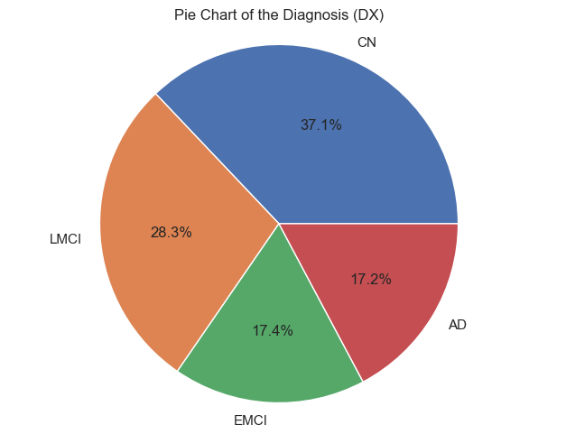
III
Preprocessing
Multiclass Problem: DX and DX_bl
DX_bl has 5 possible values:
CN: Cognitively Normal
SMC: Subjective Memory Concern
EMCI: Early Mild Cognitive Impairment
LMCI: Late Mild Cognitive Impairment
AD: Alzheimer’s Disease
DX has 3 possible values:
CN: Cognitively Normal
MCI: Mild Cognitive Impairment
Dementia: Alzheimer’s Disease
We create a new DX as our target with this 4 classes:
CN: Cognitively Normal
EMCI: Early Mild Cognitive Impairment
LMCI: Late Mild Cognitive Impairment
AD: Alzheimer’s Disease

Slide 14
Data Cleaning
III
Preprocessing
Data Transformation
Handling missing values: Identifying percentages of missing values and using KNN Imputer for continuous variables.
Numeric Value Conversion: Converted nearly all cognitive scales and age from float to int, correcting approximations to imputation or format errors.
Creation of new CSF metrics: TAU/ABETA and PTAU/ABETA ratios more predictive than single measures according to the literature.
MRI normalization to ICV: Necessary to correct for differences due to gender and cranial size.

Slide 15
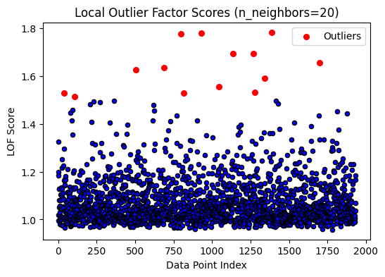
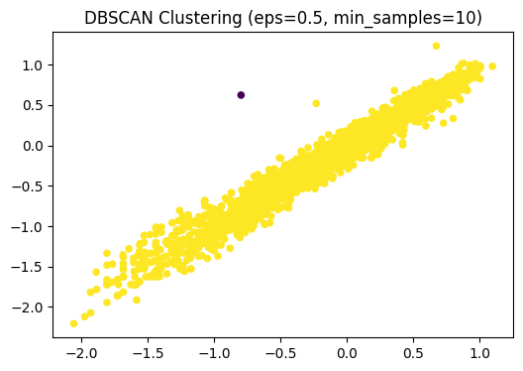
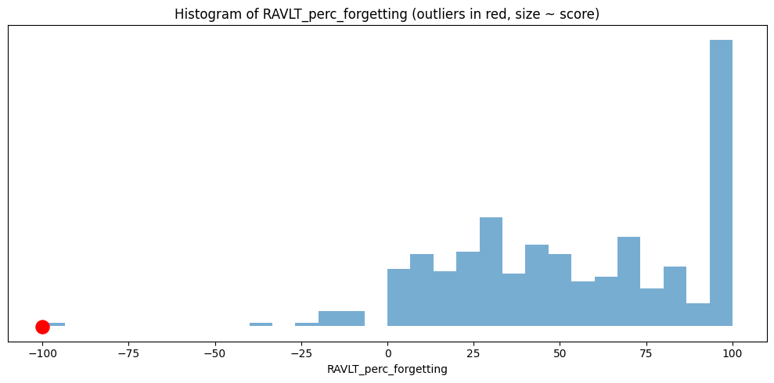
III
Preprocessing
Outlier Detection
Univariate Analysis: use IQR and Z-score for each column to find outliers.
Multivariate Analysis: create groups of variables (EcogPt, EcogSP, Neuropsych, MRI, MRI/ICV, CSF, CSF/ABETA, mPACC), apply LOF and DBSCAN on the normalized data (RobustScaler).
Problematic outlier removal: high unlikely values ​are replaced with the mean by class.
Use the Resource section to swap this figure

Slide 16
Univariate Analysis
III
Preprocessing
Multivariate Analysis
Univariate Analysis takes a single feature from the dataset and uses the parametric IQR and Z-score threshold. It combines the indices reported by both and builds a summary table for each index with a value, IQR flag, Z-score flag, and a score that is the sum of the two flags (0, 1, or 2). Points with a score of 2 are considered "robust" univariate outliers. Those with a score of 1 are considered weaker signals. All are evaluated on a case-by-case basis in the notebook.
Multivariate analysis works on a group of features. The data is first scaled using a RobustScaler. The function calls LOF (saving the LOF scores, where a higher score indicates greater local anomaly) and DBSCAN (points labeled −1 are considered noise). It aggregates the indices returned by LOF and DBSCAN, calculates a LOF/DBSCAN flag and a score for each index (always 0, 1, or 2, given by the sum of the flags), stores the maximum LOF_score among the tested configurations, and builds a summary. Only points reported by both methods and with a LOF_score above 2 are considered outlier worthy of analysis.

Slide 17

III
Preprocessing
Data Reduction
Removal of redundant features: ADAS11, ADASQ4, EcogPtTotal, EcogSPTotal, mPACCtrailsB, and TAU were removed because they had a high correlation with other features and their informative value was low.
Attribute Subset Selection: Four complementary methods were used: Pearson correlation (|r|≥0.6), Mutual Information (top 25), SelectKBest (Kruskal–Wallis, k=25), and RFE (Recursive Feature Elimination with Random Forest) to capture linear, nonlinear, univariate, and model-based relationships. For each method, a list of top features was obtained and the number of occurrences of each was counted. Variables selected by at least three methods were retained as “core” variables because they were more robust and less dependent on a single criterion. Additionally, some clinical variables deemed important for interpretability were deliberately preserved.

Slide 18
Classification & Results

Slide 19
IV
Classification & Results
Model Selection
We selected the following classification models:
Decision Tree
Random Forest
Extra Trees
XGBoost
LightGBM
CatBoost
Multinomial Logistic Regression
Bagging

Slide 20
IV
Classification & Results
Hybrid Sampling
To overcome class imbalance, we used a combination of:
Random Under-Sampling (RUS) to reduce the number of instances in the majority classes (CN and LMCI), preventing the dataset from becoming excessively biased toward synthetic examples;
Synthetic Minority Over-Sampling Technique for Nominal and Continuous features (SMOTENC) to generate new synthetic examples of the minority classes (EMCI and AD).

Slide 21
IV
Classification & Results
The problem with CDRSB, LDELTOTAL, and mPACCdigit
The CDRSB, LDELTOTAL, and mPACCdigit cognitive scores show significantly higher predictive power than other variables.
This can improve model accuracy, but creates the risk of feature dominance, where a few variables excessively influence predictions.
This imbalance can cause local overfitting: excellent performance on ADNI but possible loss of accuracy on external or more heterogeneous populations.
It is not possible to definitively determine whether these variables are simply very strong predictors of Alzheimer's disease diagnosis.
We divided the pipeline into datasets with CDRSB, LDELTOTAL and mPACCdigit and without CDRSB, LDELTOTAL and mPACCdigit.

Slide 22
IV
Classification & Results
Classification Pipeline
All subsequent operations will be the same, but will be executed separately within 4 distinct pipelines, corresponding to the 4 types of datasets generated.
DS1
DS2
DS3
DS4
Dataset without Sampling and with CDRSB, LDELTOTAL, and mPACCdigit
Dataset with Sampling and with CDRSB, LDELTOTAL, and mPACCdigit
Dataset without Sampling and without CDRSB, LDELTOTAL, and mPACCdigit
Dataset with Sampling and without CDRSB, LDELTOTAL, and mPACCdigit

Slide 23
IV
Classification & Results
Model Construction
1
2
3
4
Hyperparameter Tuning
Model Building
Explainability
Models Final Evaluation
To optimize the performance of the classifiers, a Grid Search procedure with 5-fold-cross validation was adopted.
We built the models on the training dataset.
We used SHAP Summary Plots on all models to identify which features were most important overall and by class. Built trees and rules for Decision Trees.
We evaluated the models on the train dataset, using 5-fold cross-validation, and on the test dataset, as well as using the explainability results. The evaluations primarily considered the statistics on the test dataset.

Slide 24
IV
Classification & Results
DS1
TEST DATASET | Accuracy | Balanced Accuracy | Precision (weighted) | Recall (weighted) | F1 Score (weighted) | F1 Score (macro) | ROC AUC (macro)
MODEL
Random_Forest1 | 0.925620 | 0.919814 | 0.927101 | 0.925620 | 0.925820 | 0.916918 | 0.986475
Extra_Trees1 | 0.923554 | 0.918812 | 0.924969 | 0.923554 | 0.924003 | 0.914303 | 0.986232
XGBoost0 | 0.927686 | 0.916805 | 0.928391 | 0.927686 | 0.927514 | 0.918030 | 0.987596
Random_Forest0 | 0.929752 | 0.916327 | 0.930994 | 0.929752 | 0.929415 | 0.920545 | 0.983876
XGBoost1 | 0.923554 | 0.915250 | 0.924380 | 0.923554 | 0.923706 | 0.913798 | 0.986799
Extra_Trees0 | 0.923554 | 0.913191 | 0.924021 | 0.923554 | 0.923567 | 0.913565 | 0.988441
CatBoost1 | 0.919421 | 0.912752 | 0.920484 | 0.919421 | 0.919728 | 0.910155 | 0.987497
LightGBM1 | 0.919421 | 0.911565 | 0.920235 | 0.919421 | 0.919545 | 0.909524 | 0.987098
CatBoost0 | 0.921488 | 0.908992 | 0.921941 | 0.921488 | 0.921237 | 0.910847 | 0.988699
LightGBM0 | 0.919421 | 0.904757 | 0.920713 | 0.919421 | 0.918885 | 0.907530 | 0.984300
Bagging0 | 0.919421 | 0.904077 | 0.922416 | 0.919421 | 0.919240 | 0.907923 | 0.984449
Bagging1 | 0.904959 | 0.895301 | 0.906196 | 0.904959 | 0.905261 | 0.892969 | 0.983476
Decision_Tree1 | 0.898760 | 0.893037 | 0.901509 | 0.898760 | 0.899541 | 0.886243 | 0.980261
Multinomial_Logistic_Regression1 | 0.878099 | 0.873117 | 0.883112 | 0.878099 | 0.878508 | 0.862857 | 0.980601
Decision_Tree0 | 0.876033 | 0.872226 | 0.881332 | 0.876033 | 0.877111 | 0.861493 | 0.974606
Multinomial_Logistic_Regression0 | 0.873967 | 0.871962 | 0.881084 | 0.873967 | 0.874781 | 0.859787 | 0.981506
Model Evaluation 1
“…0”
“…1”
DS2

Slide 25
IV
Classification & Results
DS3
TEST DATASET | Accuracy | Balanced Accuracy | Precision (weighted) | Recall (weighted) | F1 Score (weighted) | F1 Score (macro) | ROC AUC (macro)
MODEL
XGBoost1 | 0.735537 | 0.720959 | 0.745818 | 0.735537 | 0.739242 | 0.717172 | 0.907103
Extra_Trees0 | 0.737603 | 0.717186 | 0.738250 | 0.737603 | 0.736785 | 0.714046 | 0.909280
LightGBM1 | 0.725207 | 0.716317 | 0.740019 | 0.725207 | 0.730068 | 0.709832 | 0.908058
Extra_Trees1 | 0.719008 | 0.706432 | 0.728482 | 0.719008 | 0.721057 | 0.698828 | 0.906806
Bagging1 | 0.725207 | 0.705921 | 0.728153 | 0.725207 | 0.725832 | 0.704301 | 0.903807
Multinomial_Logistic_Regression0 | 0.719008 | 0.699875 | 0.718814 | 0.719008 | 0.717156 | 0.697048 | 0.907081
XGBoost0 | 0.739669 | 0.699017 | 0.728746 | 0.739669 | 0.731404 | 0.703253 | 0.912593
Random_Forest0 | 0.716942 | 0.697227 | 0.717294 | 0.716942 | 0.715909 | 0.691878 | 0.905293
Multinomial_Logistic_Regression1 | 0.708678 | 0.695913 | 0.715986 | 0.708678 | 0.709280 | 0.689989 | 0.903669
CatBoost1 | 0.706612 | 0.692950 | 0.717981 | 0.706612 | 0.710555 | 0.689426 | 0.909166
Random_Forest1 | 0.702479 | 0.686877 | 0.711632 | 0.702479 | 0.704450 | 0.680898 | 0.904030
LightGBM0 | 0.729339 | 0.682113 | 0.712688 | 0.729339 | 0.715176 | 0.682723 | 0.912346
Bagging0 | 0.723140 | 0.673841 | 0.713842 | 0.723140 | 0.713053 | 0.682405 | 0.903966
CatBoost0 | 0.723140 | 0.673356 | 0.708919 | 0.723140 | 0.710123 | 0.678616 | 0.909338
Decision_Tree1 | 0.640496 | 0.652118 | 0.688104 | 0.640496 | 0.652207 | 0.635709 | 0.856708
Decision_Tree0 | 0.661157 | 0.646413 | 0.690373 | 0.661157 | 0.672628 | 0.654678 | 0.837981
Model Evaluation 1
“…0”
“…1”
DS4

Slide 26
IV
Classification & Results
Model Choosing
With CDRSB, LDELTOTAL, and mPACCdigit: (DS1, DS2) Random Forest1 was chosen as the main model and Decision Tree1 as the XAI, due to the best metrics (Balanced Accuracy, F1, ROC-AUC).
Without CDRSB, LDELTOTAL, and mPACCdigit: (DS3, DS4) XGBoost1 was chosen as the main model and Decision Tree1 as the XAI, based on testing performance.
The saved models are Model1.pkl (1/RandomForest1), XAIModel1.pkl (1/Decision Tree1), Model2.pkl (2/XGBoost1), and XAIModel2.pkl (2/Decision Tree1).

Slide 27
Applications & Conclusions

Slide 28

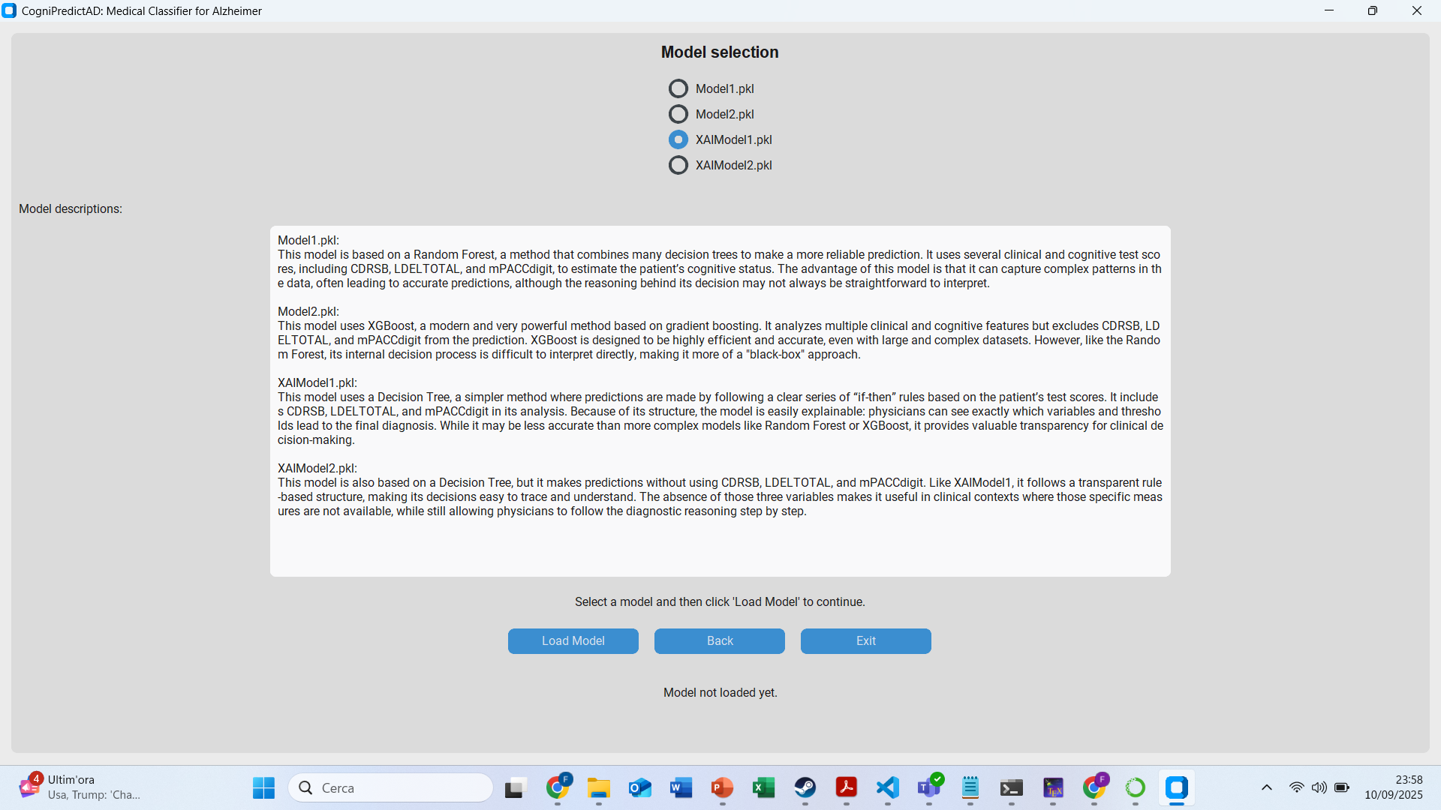
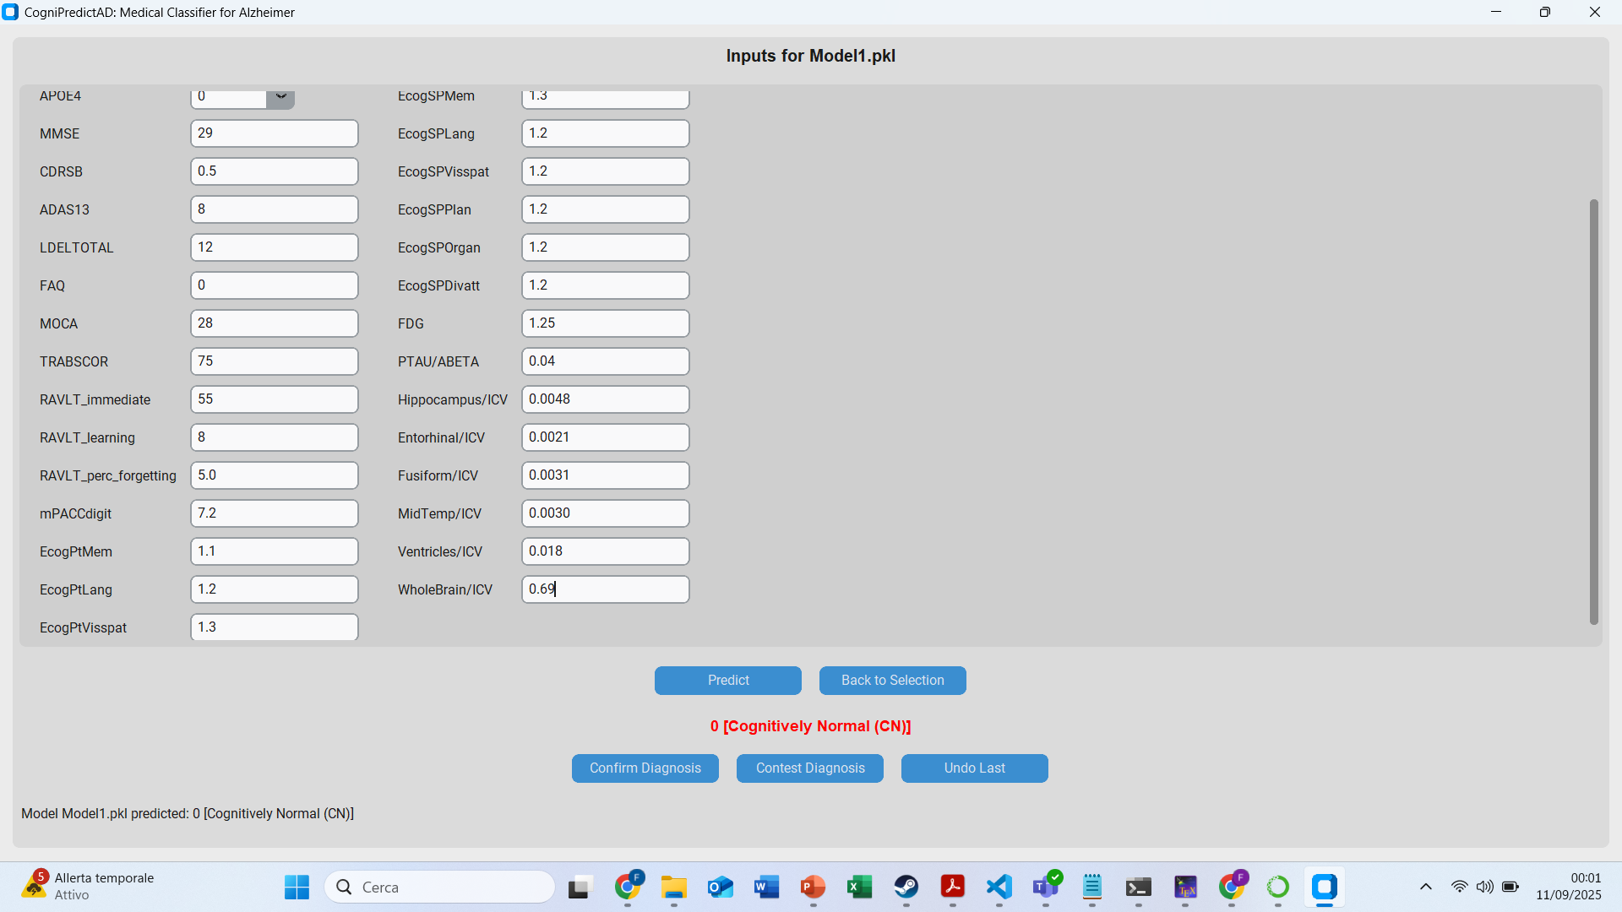
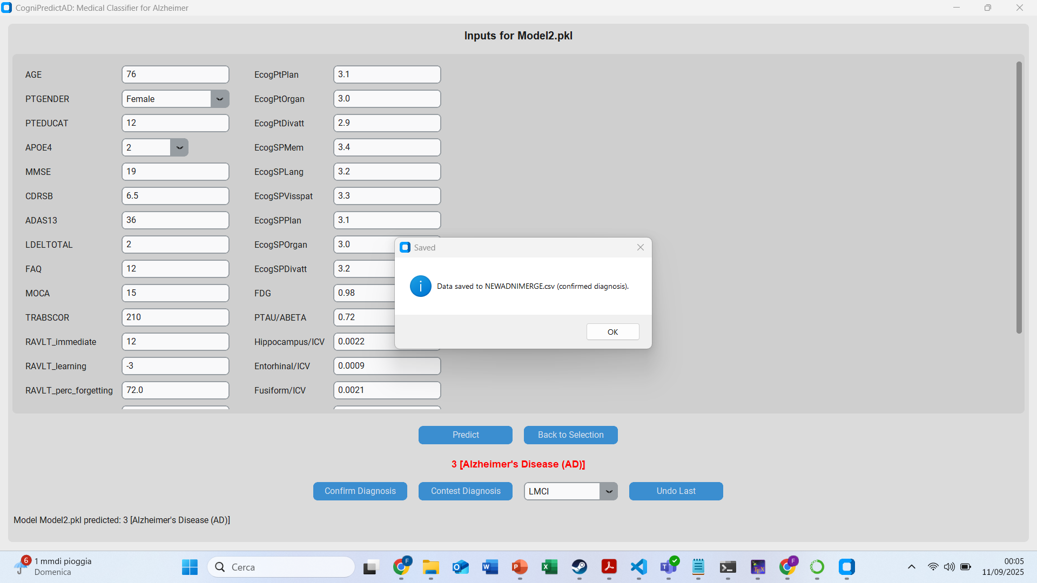
V
Applications & Conclusions
App

Slide 29
V
Applications & Conclusions
Conclusions
Dataset limitations: only 2,429 patients, many missing values ​​(CSF, PET), strong dependence on three cognitive scores. Risk of local overfitting, dataset bias, and imputations increasing noise. External validation required.
Model Performance: The models perform well overall, especially Model1. Furthermore, XAIModel1 and XAIModel2 are easily interpretable. If the three features prove unpredictable in external validation, Model2 and XAIModel2 can be used instead.
State of the Art: Although it was not possible to make a precise state of the art due to the lack of similar studies, the statistics make it a solid project.
Application value: Useful as a support (screening, risk stratification), but obviously does not replace clinical evaluation.
Future developments: Expand cohorts (ADNI4, external), integrate with similar datasets, and include geographic area as a feature.

Slide 30
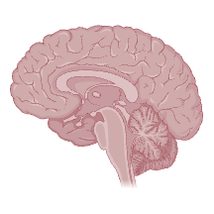
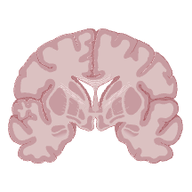
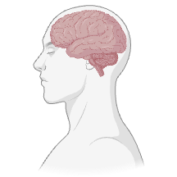
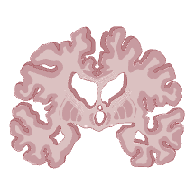
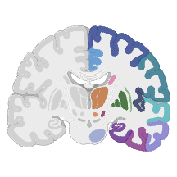
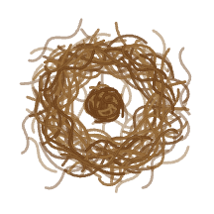
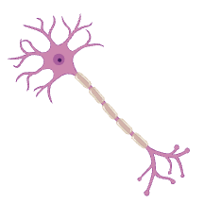
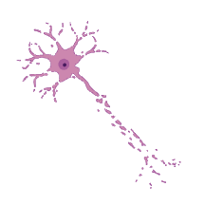
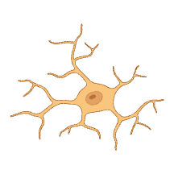
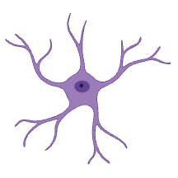

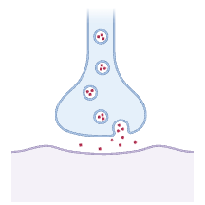
Thanks for your attention!
Brain
(sagittal cut)
Brain
(coronal cut)
Brain
(lateral)
Brain with Alzheimer’s
Brain with regions
(coronal cut)
Amyloid-beta plaque
Myelinated motor neuron
Degenerating motor neuron
Microglia
Astrocyte
Dynamic line neurons
Synaptic cleft

