Slide 1
UNIVERSITY OF PISA | DEPARTMENT OF INFORMATION ENGINEERING
SyncFlow
Automated Project Schedule Management & Operational Control
A full-stack, zero-cost web platform implementing PMI PMBOK® Chapter 6 standards through deterministic Operations Research algorithms, live time-tracking control, and schema-enforced Generative AI.
Author: Francesco Panattoni
Business and Project Management | Master's Degree in AI & Data Engineering | A.Y. 2025/2026
PMBOK 6 (6.1–6.6)
Critical Path (CPM)
PERT Beta Risk
DCMA 14-Point Quality
EVM Banana Envelope
Gemini Flash NLP

Slide 2
PROJECT OVERVIEW & PROBLEM STATEMENT
Bridging the Divide in Schedule Management
The Project Management Software Dilemma
Lightweight Task Boards (Trello, Asana): Excel at daily coordination and Kanban cards, but offer zero Operations Research rigor. They cannot detect circular dependency loops, compute critical path margins, or model probabilistic schedule risk.
Monolithic Desktop Suites (MS Project, Primavera P6): Provide formal scheduling math, but suffer from steep learning curves, expensive licensing (€30–€125/user/month), desktop-bound silos, and total disconnection from frontline workers.
The Real-World Consequence: Organizations face stale schedules, manual progress guesswork, uncontrolled project delays, and a complete lack of automated plan quality verification.
SyncFlow's Integrated Value Proposition
Full PMBOK® Chapter 6 Coverage: End-to-end implementation of all 6 Schedule Management processes: Plan (6.1), Define (6.2), Sequence (6.3), Estimate (6.4), Develop (6.5), and Control (6.6).
Dual-Engine Web Architecture: Pairs exact, deterministic Python Operations Research algorithms (CPM, PERT, DCMA audit) with schema-constrained Google Gemini Flash NLP assistants.
Role-Separated User Workspaces: Gives Project Managers governance tools (calendars, baselines, EVM curves) while frontline contributors execute tasks using live stopwatch timers.
Triple Constraint Governance: Scope fixed strictly to PMBOK Chapter 6, Budget fixed at €0, and Timeline executed across a 53-day calendar window without quality compromises.

Slide 3
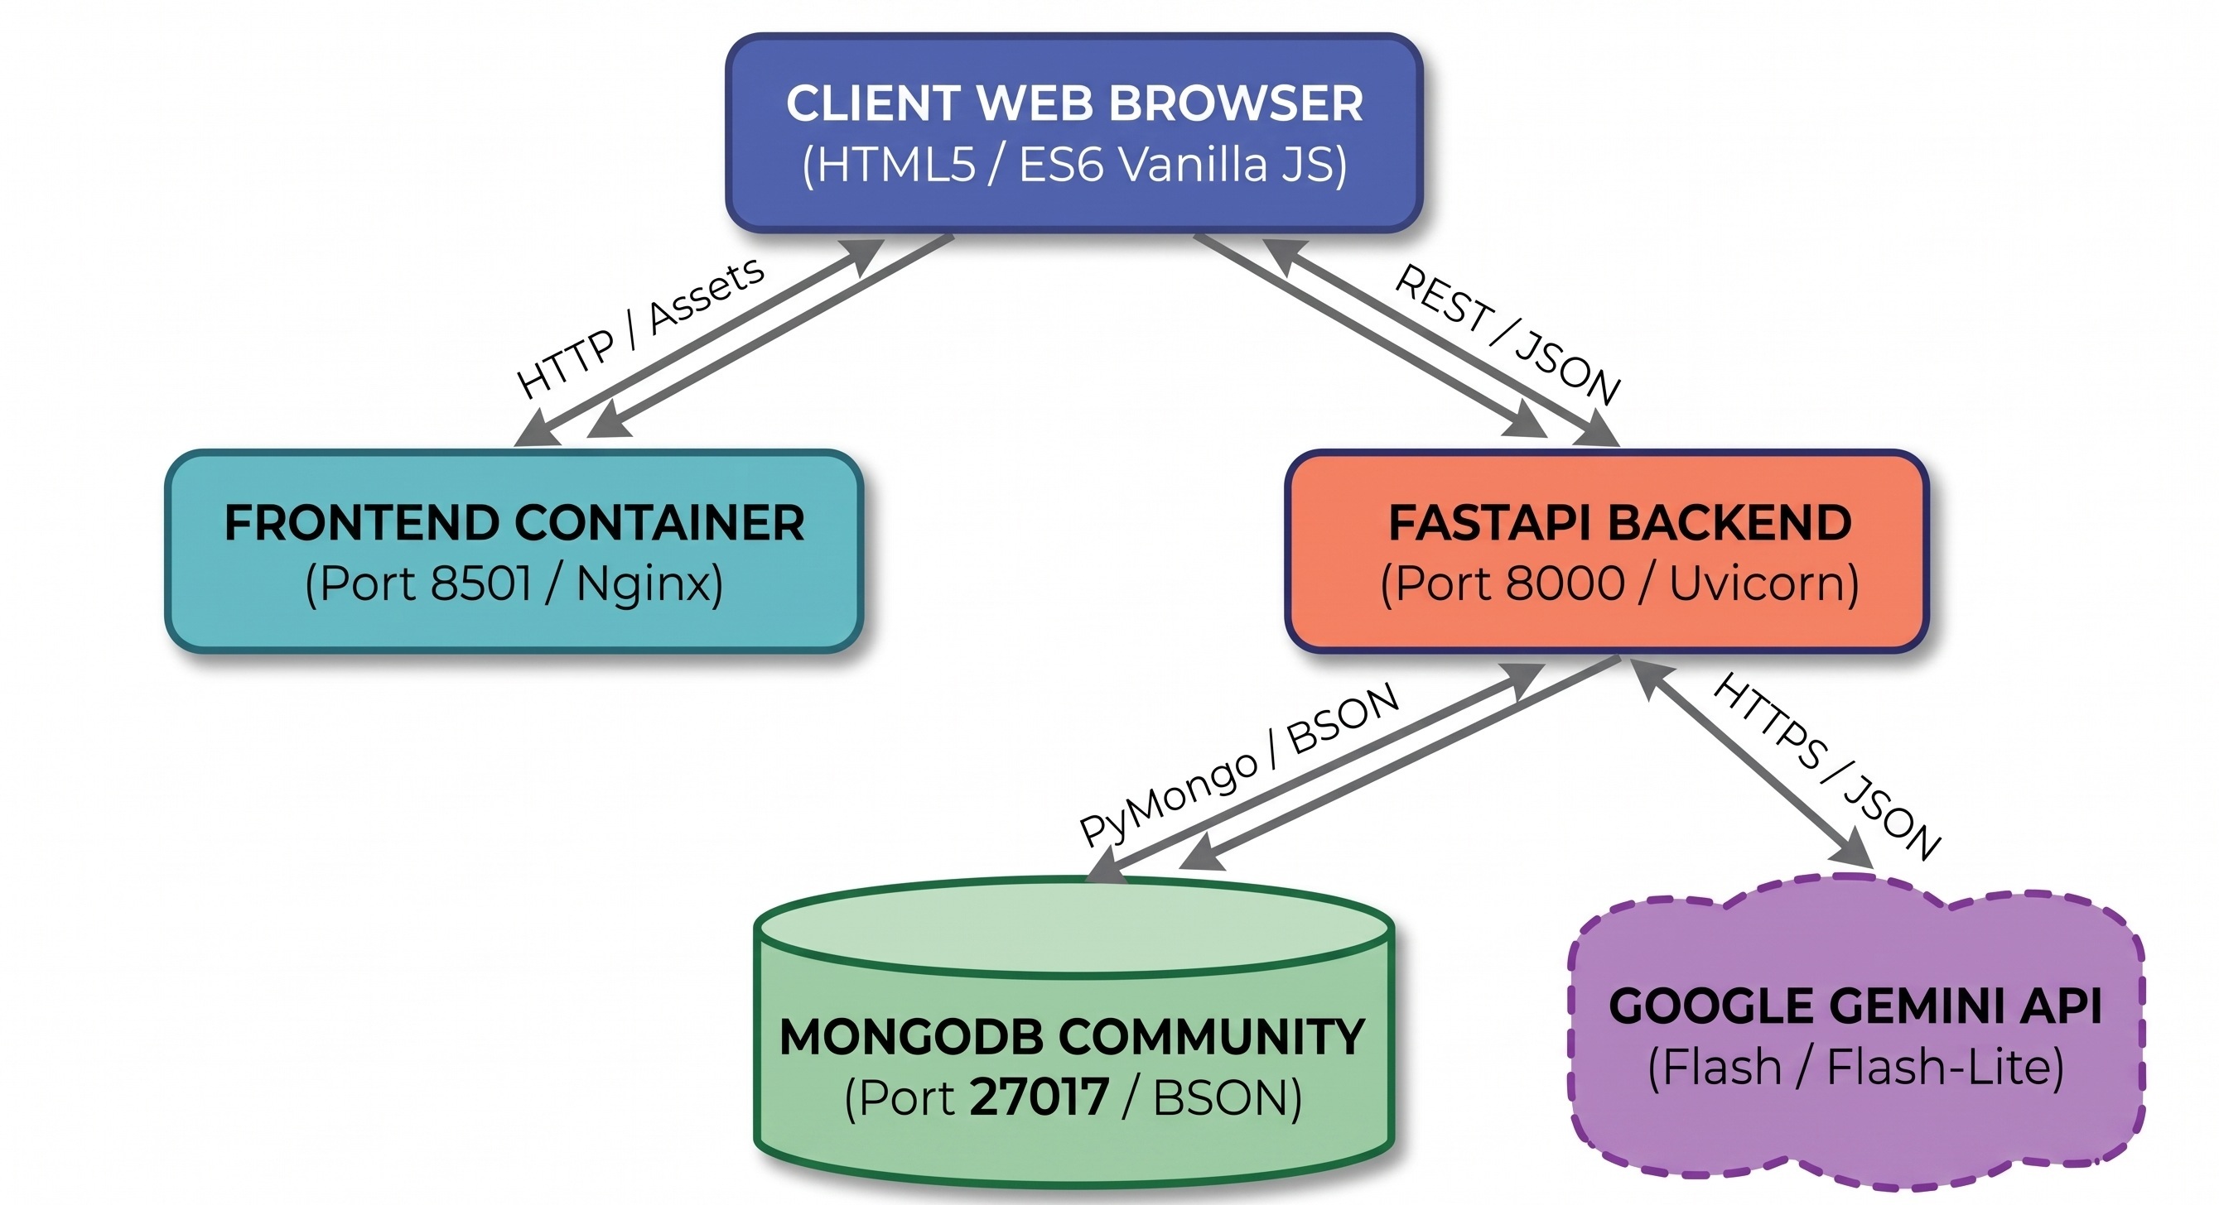
TECHNICAL ARCHITECTURE & INFRASTRUCTURE
Decoupled Multi-Container System Architecture
Three-Tier Containerized Topology
Database (MongoDB 7.0 - :27017): Persisted via named Docker volumes. Enforces strict server-side $jsonSchema rules and atomic arrayFilters ($[act]) updates for concurrent task edits.
Backend API (FastAPI / Py 3.12 - :8000): 55 RESTful endpoints across 6 domain routers. Uses Pydantic payload models, Bcrypt password hashing (rounds=12), and thread-safe in-memory LRU caching with automated write invalidation.
Frontend Server (Vanilla Web - :8501): Lightweight ES6 JavaScript modules, HTML5, and CSS3. Zero npm/bundler dependencies. Employs vis-network for interactive DAGs and Chart.js for EVM S-curves.
SERVICE ISOLATION & ZERO OVERHEAD
Three isolated Docker containers on 'syncflow-network' bridge.
Independent frontend HTTP server prevents UI stalling during heavy backend CPM/AI calculations.
Figure: Multi-Container Service Topology & Data Flow across Docker bridge network.

Slide 4
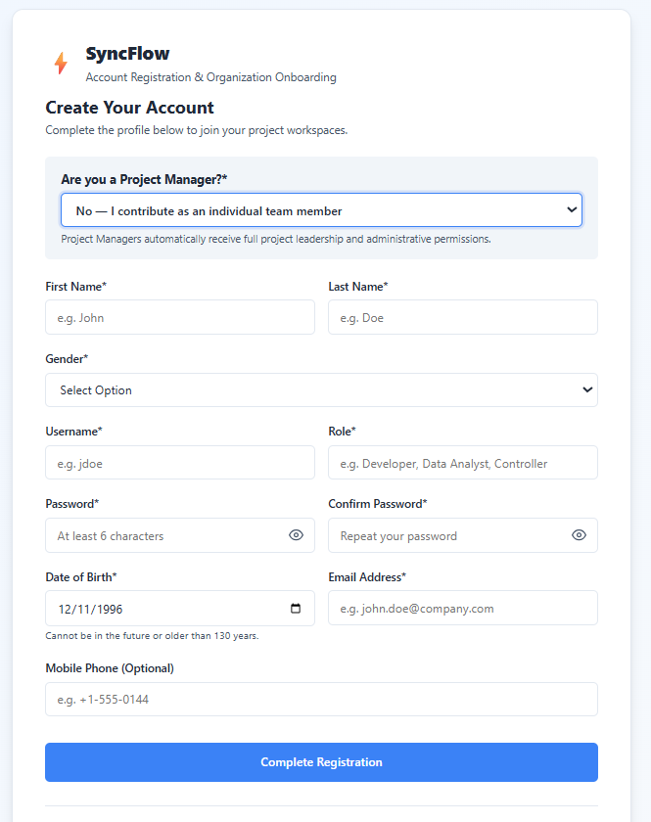
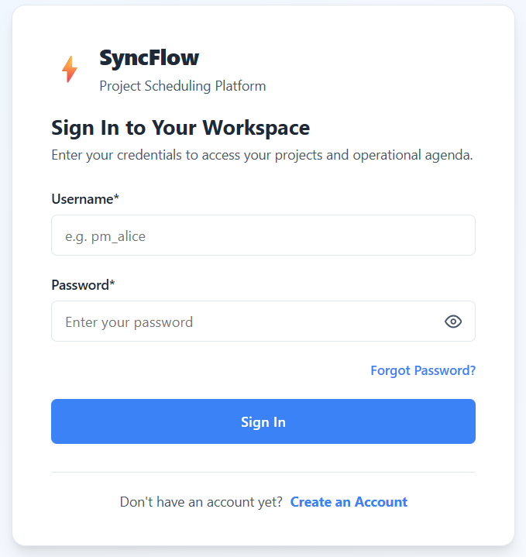
ACCESS & ONBOARDING | USER AUTHENTICATION
Login & User Registration Portal

Slide 5
KEY FEATURES & IMPLEMENTATION | SCHEDULING MATHEMATICS
The Deterministic Scheduling Engine: What the Values Represent
1. Graph Integrity & Cycles
Why Graph Integrity Matters: Real-world projects consist of strictly ordered handoffs. If circular dependencies occur (Task A waiting for B, while B waits for A), planning becomes logically impossible.
Topological Ordering: Determines the exact, unambiguous linear sequence of execution so that no task starts before all its required technical prerequisites are met.
Three-Color Cycle Flagging: Traverses the network like a state machine (Unvisited -> Active -> Completed). Catching an active node immediately flags deadlocks, rejecting corrupted links on the fly.
2. CPM Dates & Float Cushions
Early Dates (ES / EF): Represent the earliest possible calendar boundaries a task can begin and finish based strictly on predecessor completions.
Late Dates (LS / LF): Represent the latest permissible boundaries a task can slide before directly delaying the final delivery date of the entire project.
Total Float (Schedule Leeway): The spare cushion of time an activity can be delayed without moving the final deadline. Identifies where managers have operational flexibility.
The Critical Path (Zero Float): The contiguous chain of bottleneck tasks with zero float cushion. Any single delay here pushes the project delivery date back day-for-day.
3. PERT Risk & Confidence
Three-Point Estimating: Replaces single-number guesses with a realistic uncertainty range: Optimistic (best-case), Most Likely (standard), and Pessimistic (severe setbacks).
Expected Duration & Volatility: Calculates the weighted average duration and standard deviation, quantifying the mathematical uncertainty of every individual work package.
Target Deadline Confidence: Translates critical path uncertainty into an exact percentage probability of meeting client deadlines, with interactive P50, P80, and P90 confidence thresholds.

Slide 6
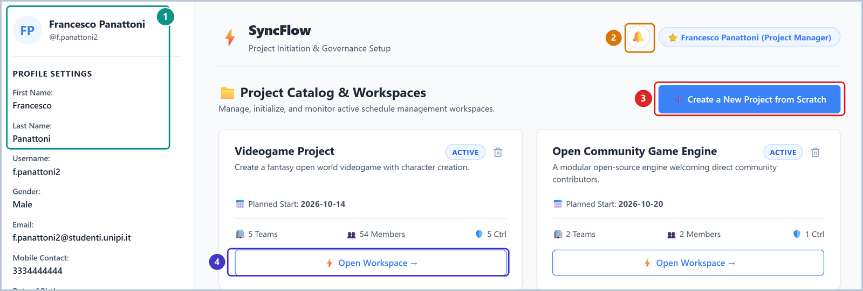
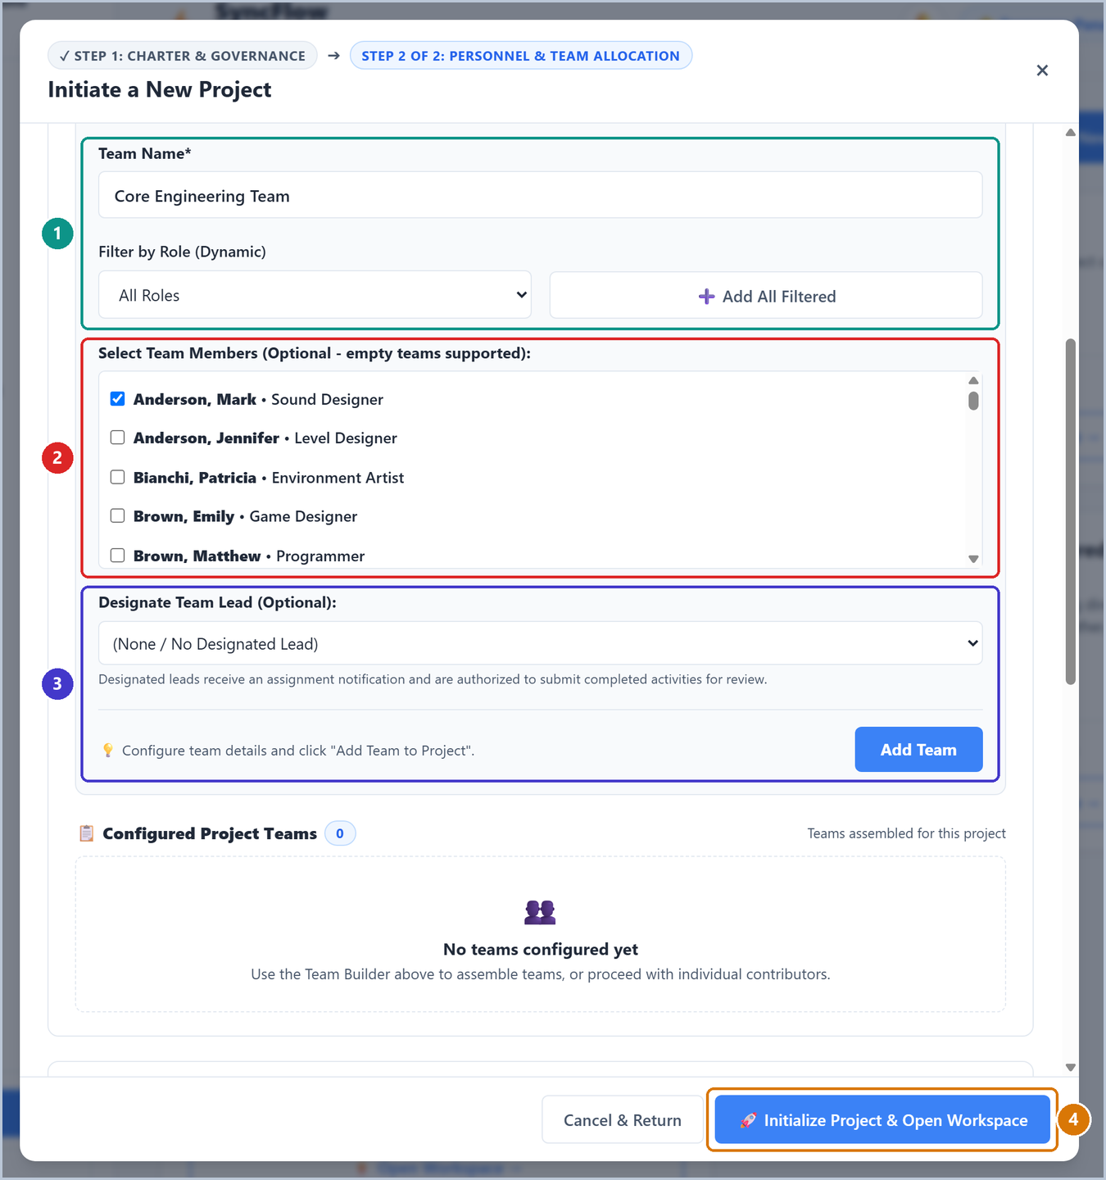
APPLICATION IN ACTION | PROJECT MANAGER WORKSPACE
Project Governance: Portfolio Dashboard & Team Setup
EXECUTIVE PORTFOLIO DASHBOARD
Active project cards, team member counts, and unread notification center.
Enables rapid project switching, instant join request resolution, and one-click workspace launching.

Slide 7
PM WORKSPACE EXPLANATION | POLICIES & ORGANIZATIONAL GOVERNANCE
Process 6.1: Plan Schedule Management & Governance
Project Charter & Enrollment Governance
Project Charter Scope Statement: Establishes project objectives, boundaries, and baseline start date, serving as the central reference for all subsequent scheduling passes.
Single-Team vs Multi-Team Structure: Configures whether activities are shared across a single unified unit or distributed among specialized cross-functional groups (e.g. Core Engineering, QA).
Open vs Approval-Gated Membership: Open projects allow immediate self-enrollment. Approval-gated projects route contributor applications to the PM's notification center for formal review.
Custom Working Calendar: Defines active business days (Mon–Fri default), daily shift hours, and non-working calendar holidays, preventing tasks from scheduling on non-working days.
Four-Tier Personnel Governance Model
1. Project Manager (Governance Lead): Holds full administrative rights: creates charters, freezes baselines, configures dependencies, runs quality audits, and monitors EVM S-curves.
2. Team Leads (Operational Coordinators): Designated within functional teams to coordinate local tasks and submit completed deliverables on behalf of their team members.
3. Team Members (Frontline Contributors): Assigned to concrete activities. Track daily execution through live stopwatch timers and submit evidence proof upon completion.
4. Project Controllers (Quality Guardians): Independent reviewers who inspect submitted deliverable proof and verify activities before Earned Value is officially credited.

Slide 8
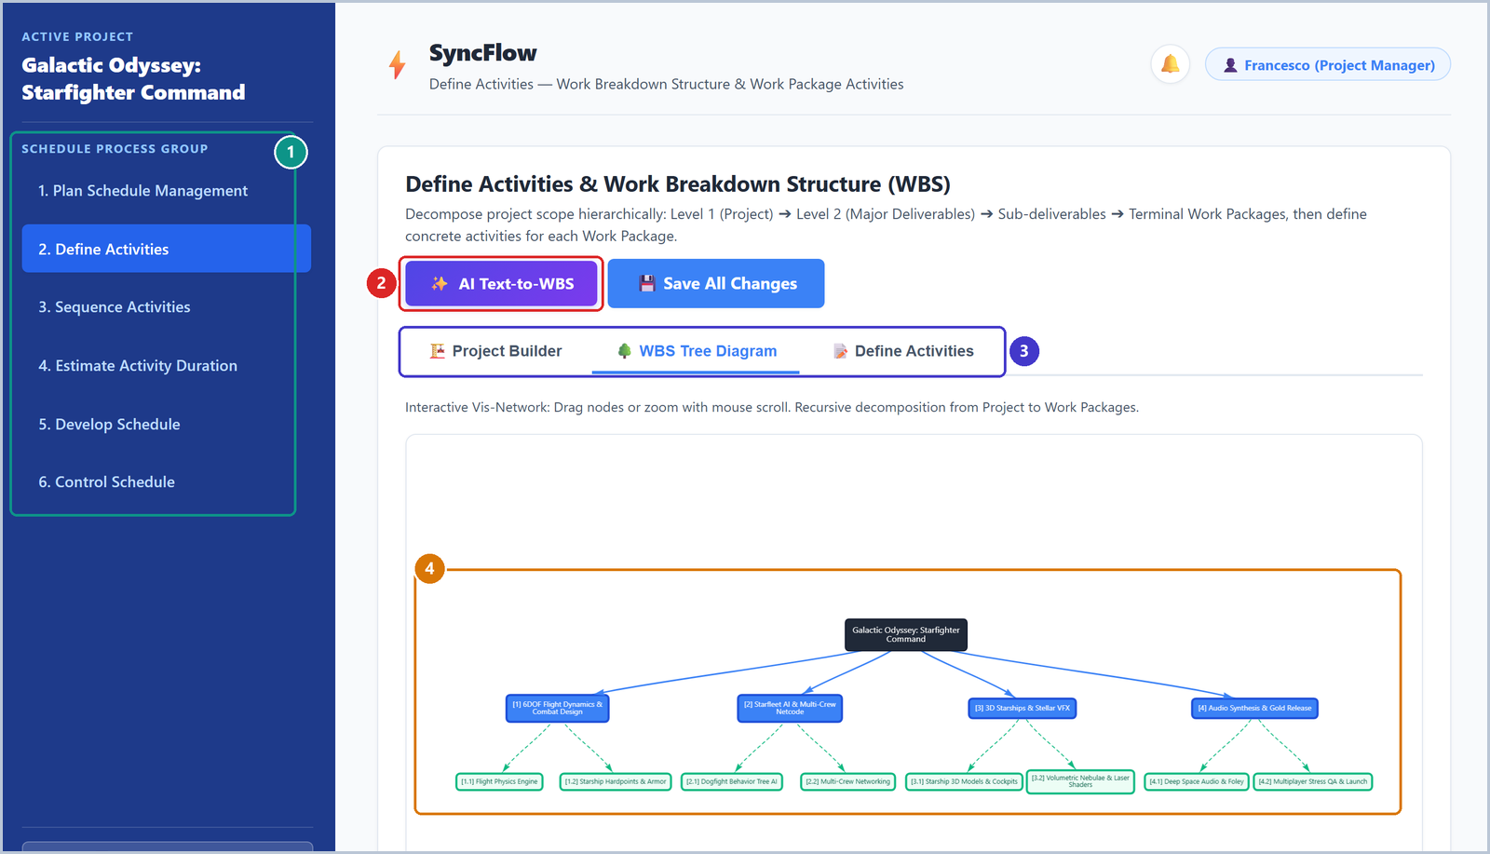
APPLICATION IN ACTION | PROCESS 6.2: DEFINE ACTIVITIES
Work Breakdown Structure (WBS) & Define Activities
PMBOK 100% DECOMPOSITION RULE IN VIS-NETWORK
Top-down hierarchy: Root Project branches into blue Major Deliverables, which decompose into terminal green Work Packages.
Schedulable tasks and zero-day milestones belong exclusively to terminal Work Packages, with instant AI Text-to-WBS generation available.

Slide 9
SPECIAL FOCUS & DEEP DIVE | NATURAL LANGUAGE PROCESSING (NLP)
Process 6.2 & Special Focus: Schema-Enforced Generative AI
The PMBOK 100% Rule & Activity Decomposition
The 100% Rule Foundation: The Work Breakdown Structure encompasses 100% of the work defined by the project scope, with zero unassigned work and zero duplicated effort.
Hierarchical Breakdown: Project -> Major Deliverables -> Sub-deliverables -> Work Packages. Schedulable activities and milestones exist exclusively inside terminal green Work Packages.
Activity Attributes: Each discrete activity defines assignees, milestone flags, duration estimation models, checklists, and active stopwatch effort history.
Triple Interactive Sub-Views: Switch seamlessly between Project Builder (manual card creation), WBS Tree Diagram (visual canvas), and Define Activities (adding work items).
Special Focus: 4-Stage Guarded AI Pipeline
Why Free-Form Chat Fails: Standard LLMs generate unstructured text prone to hallucinations and syntax slips, which crash deterministic CPM/PERT scheduling engines.
1. Guided Prompts: Embeds active project context and grammar rules (imperative 'Verb + Noun' for activities, domain noun phrases for deliverables).
2. Schema-Constrained Decoding: Compiles Pydantic models directly into Gemini Flash decoding schemas (temperature=0.2, application/json), guaranteeing valid JSON output.
3. Regex Title Repair: Strips stray markdown, regex rules (_is_generic_name) detect generic placeholders ('Deliverable 1') and synthesize rich titles from child elements.
4. Mathematical Validation: Validates IDs against valid_act_ids, strictly enforces PERT ordering (0.5 <= a < m < b <= 44d), and checks Kahn cycle limits before DB writes.

Slide 10
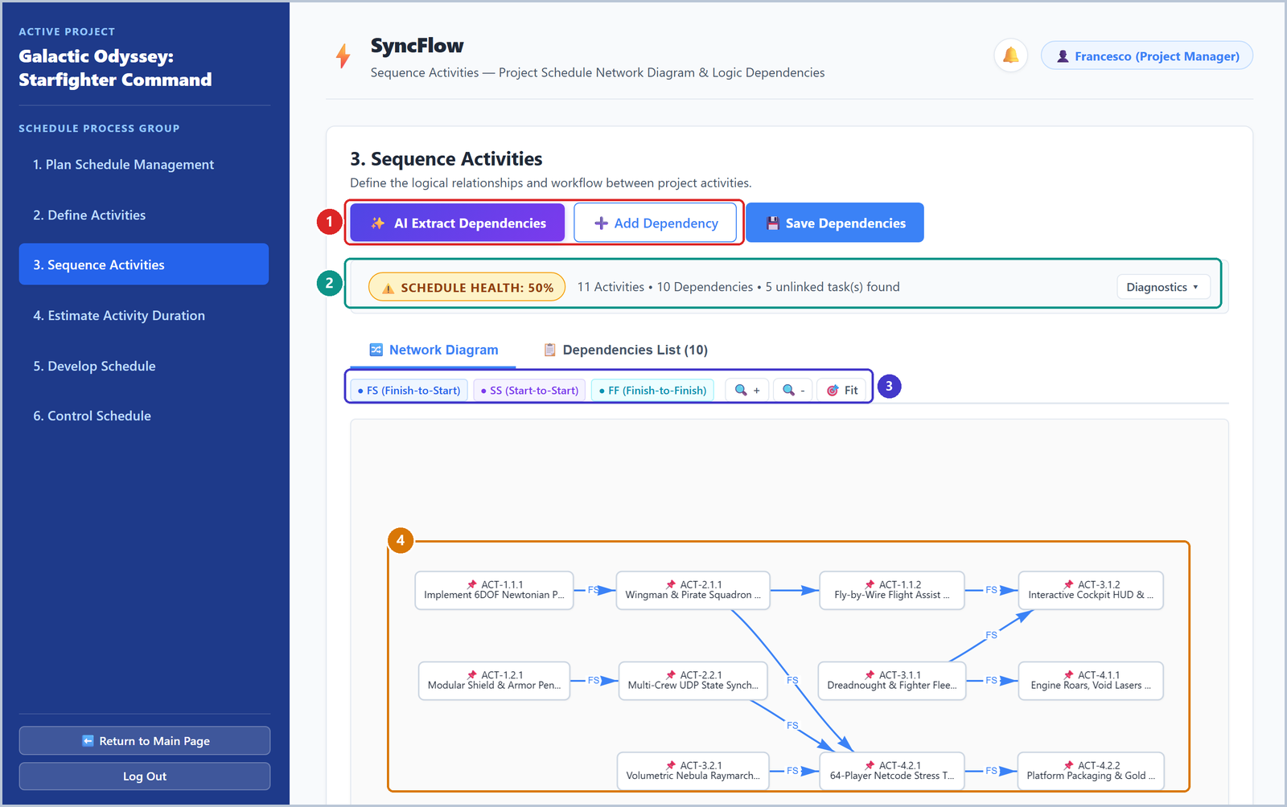
APPLICATION IN ACTION | PROCESS 6.3: SEQUENCE ACTIVITIES
Precedence Diagramming Method (PDM) Network Canvas
INTERACTIVE PDM DEPENDENCY NETWORK & TOPOLOGY INTEGRITY
[1] AI dependency extraction & link creation | [2] Real-time schedule health strip (11 tasks, 10 links, unlinked alerts)
[3] PDM relation legend (FS, SS, FF, SF) & zoom | [4] Vis-Network DAG canvas with automated cycle rejection

Slide 11
PM WORKSPACE EXPLANATION | PROCESS 6.3: PRECEDENCE LOGIC & AI EXTRACTION
Process 6.3: Dependency Network Topology & AI Dependency Extraction
Precedence Diagramming Method (PDM)
Four PDM Relationship Types: Supports Finish-to-Start (FS), Start-to-Start (SS), Finish-to-Finish (FF), and Start-to-Finish (SF) with customizable positive lags and lead days.
Kahn's Topological Sorting: Computes dependency order via an in-degree queue, instantly detecting cycle loops before running schedule calculations.
Lead & Lag Precision: Enforces positive lags (wait times) and controlled negative leads (acceleration), auditing against DCMA lead thresholds.
Immutable Planned Baselines: Sequence logic locks into project snapshots, enabling historical drift analysis across execution cycles.
Generative AI Dependency Extraction
Unstructured Workflow Parsing: Google Gemini Flash NLP extracts dependencies from meeting transcripts, project charters, or milestone handoffs.
Regex Link Normalization: Cleans text into typed tuples (predecessor_id, successor_id, type, lag) strictly adhering to schema bounds.
Cycle Rejection Gate: Automatically rejects AI-suggested links that create topological cycles or reference non-existent activity IDs.
Human-in-the-Loop Validation: Project Managers review, adjust, and approve AI-extracted dependency links before committing to MongoDB.

Slide 12
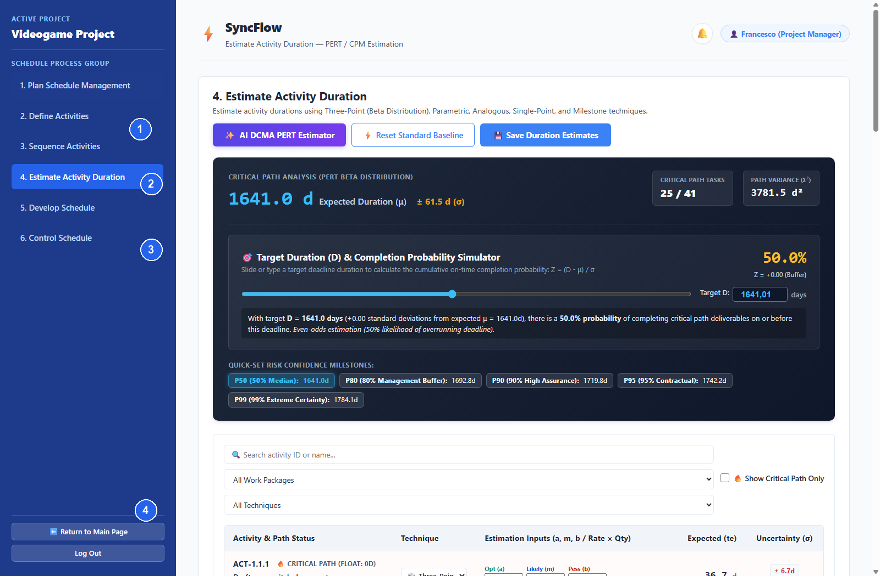
APPLICATION IN ACTION | PROCESS 6.4: ESTIMATE ACTIVITY DURATION
Multi-Technique Estimation & PERT Simulator
PROJECT VIDEOGAME: PERT SCHEDULE RISK & MULTI-TECHNIQUE ESTIMATION
[1] AI DCMA PERT synthesis & action center | [2] Critical Path Analysis: 1641.0d ± 61.5d across 25 critical activities (variance 3781.5d²)
[3] Target duration risk simulator with P50/P80/P90 presets | [4] Multi-Technique table (Three-Point Beta, Single-Point, Parametric, Analogous, Milestone)

Slide 13
PM WORKSPACE EXPLANATION | PROCESS 6.4: DURATION ESTIMATION TECHNIQUES & PERT SIMULATOR
Process 6.4: PMBOK Estimation Models & Probabilistic Risk Analysis
Multi-Technique Duration Estimation (PMBOK 6.4)
Three-Point Beta Distribution: Computes expected duration te = (a + 4m + b) / 6 and variance σ² = ((b - a) / 6)² from optimistic (a), most likely (m), and pessimistic (b) inputs.
Five Estimation Techniques: Supports Three-Point Beta (risk-adjusted), Single-Point (deterministic), Parametric (unit metrics), Analogous (historical), and Milestone (0-day anchor).
Dynamic Workday Rounding: Converts fractional duration estimates into discrete working day increments based on the project's customized calendar.
Live Interactive Grid: Real-time table editing allows PMs to filter by deliverable, inspect estimation techniques, and update activity parameters on the fly.
PERT Risk Simulator & Critical Chain Confidence
Central Limit Theorem: Along the critical path of 25 activities, expected duration sums to μ = 1641.0d with combined path variance σ² = 3781.5d² (σ = 61.5d).
Confidence Z-Score & Probability: Evaluates Z = (Td - μ) / σ via normal CDF Φ(Z), displaying real-time probability of finishing within target deadline Td.
Confidence Level Presets: Quick-jump buttons for P50 (median, 1641d), P80 (1693d), P90 (1720d), P95 (1742d), and P99 (1784d) risk milestones.
AI DCMA PERT Estimator: Leverages Gemini Flash to synthesize realistic three-point (a, m, b) durations conforming to DCMA dispersion guidelines (b ≤ 3m).

Slide 14
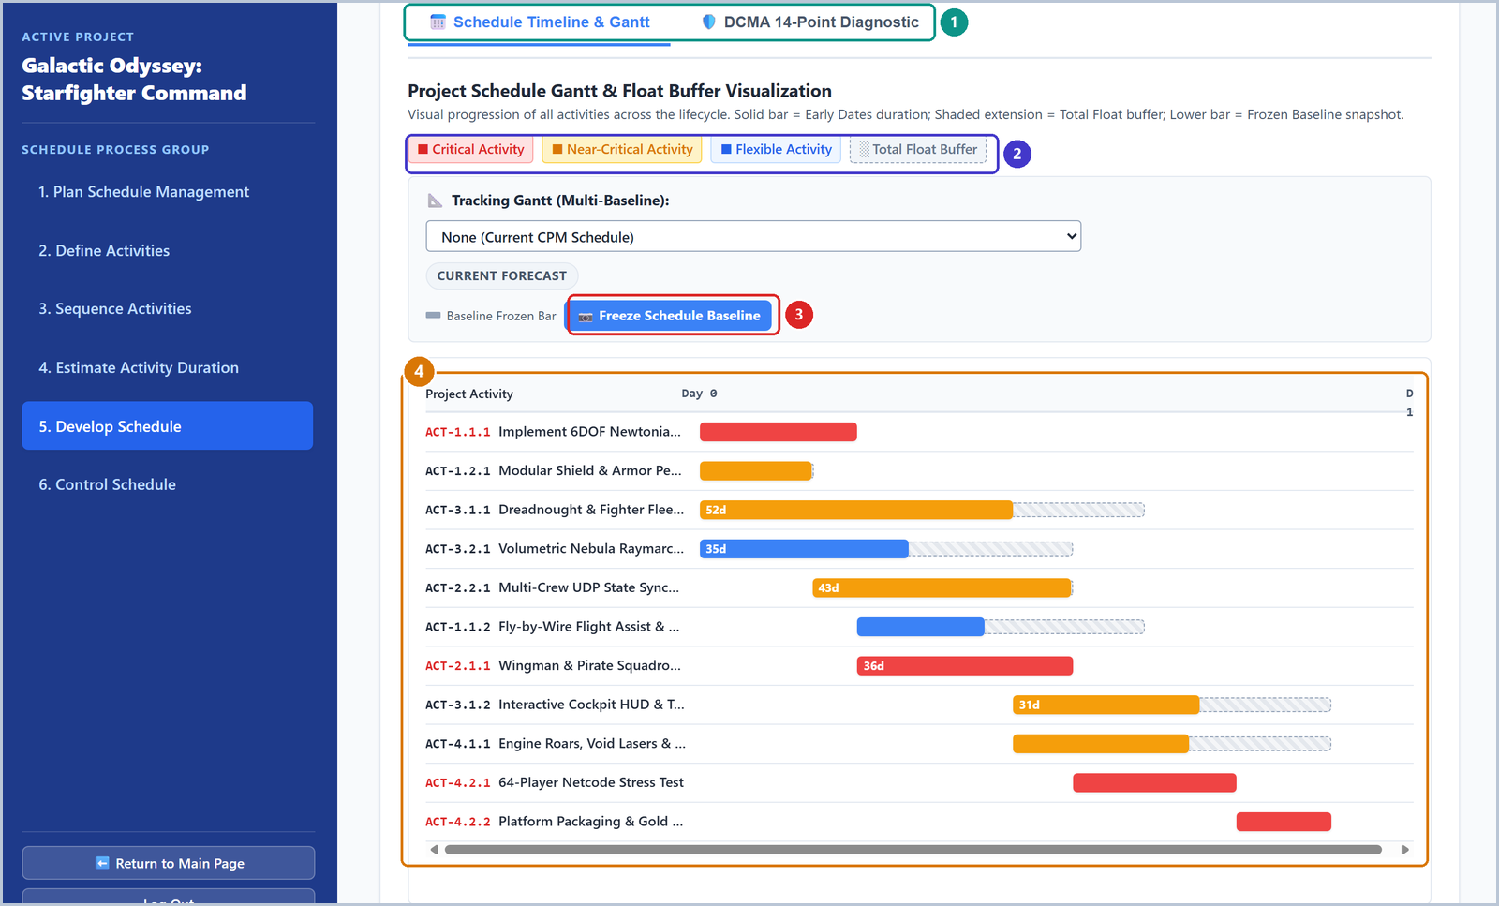
APPLICATION IN ACTION | PROCESS 6.5: DEVELOP SCHEDULE
Interactive Critical Path Gantt & Schedule Baseline Freezing
CPM CRITICAL PATH GANTT & DCMA SCHEDULE DIAGNOSTIC
[1] View switcher: Gantt Timeline vs DCMA 14-Point Diagnostic | [2] Color legend: Critical (Red), Near-Critical (Orange), Float (Blue)
[3] Freeze baseline reference snapshot button | [4] Visual timeline showing early/late bar spreads and float buffer cushions

Slide 15
PM WORKSPACE EXPLANATION | PROCESS 6.5: CPM ENGINE & DCMA 14-POINT AUDIT
Process 6.5: Critical Path Passes, Float Analysis & Defense Quality Standards
CPM Scheduling Engine & Float Analysis
Forward Pass (Early Dates): Iterates topologically to calculate Early Start (ES = max(EF_pred) + lag) and Early Finish (EF = ES + te).
Backward Pass (Late Dates): Computes Late Finish (LF = min(LS_succ) - lag) and Late Start (LS = LF - te) from target project completion.
Total & Free Float: Computes Total Float (TF = LS - ES) and Free Float (FF = min(ES_succ) - EF), isolating activities with zero slippage tolerance.
Imposed Deadline & Project Float: Measures contractual cushion against external client deadlines (PF = T_deadline - T_project).
Automated DCMA 14-Point Quality Diagnostic
Defense-Grade Framework: Implements Defense Contract Management Agency (DCMA-INST 102) schedule health standards directly on the network.
14 Automated Metrics: Audits Logic Open Ends (≤5%), Negative Lags (0%), Positive Lags (≤5%), FS Dominance (≥90%), Hard Constraints (≤5%), High/Negative Float, and Invalid Dates.
Critical Path Continuity & CFIX: Verifies unbroken critical path continuity, Critical Float Index (CFIX ≥ 0.95), and Schedule Performance Index (SPI ≥ 0.95).
Letter Grade & Remediation: Computes an aggregate health grade (A–F) with an itemized culprit table for immediate PM corrective action.

Slide 16
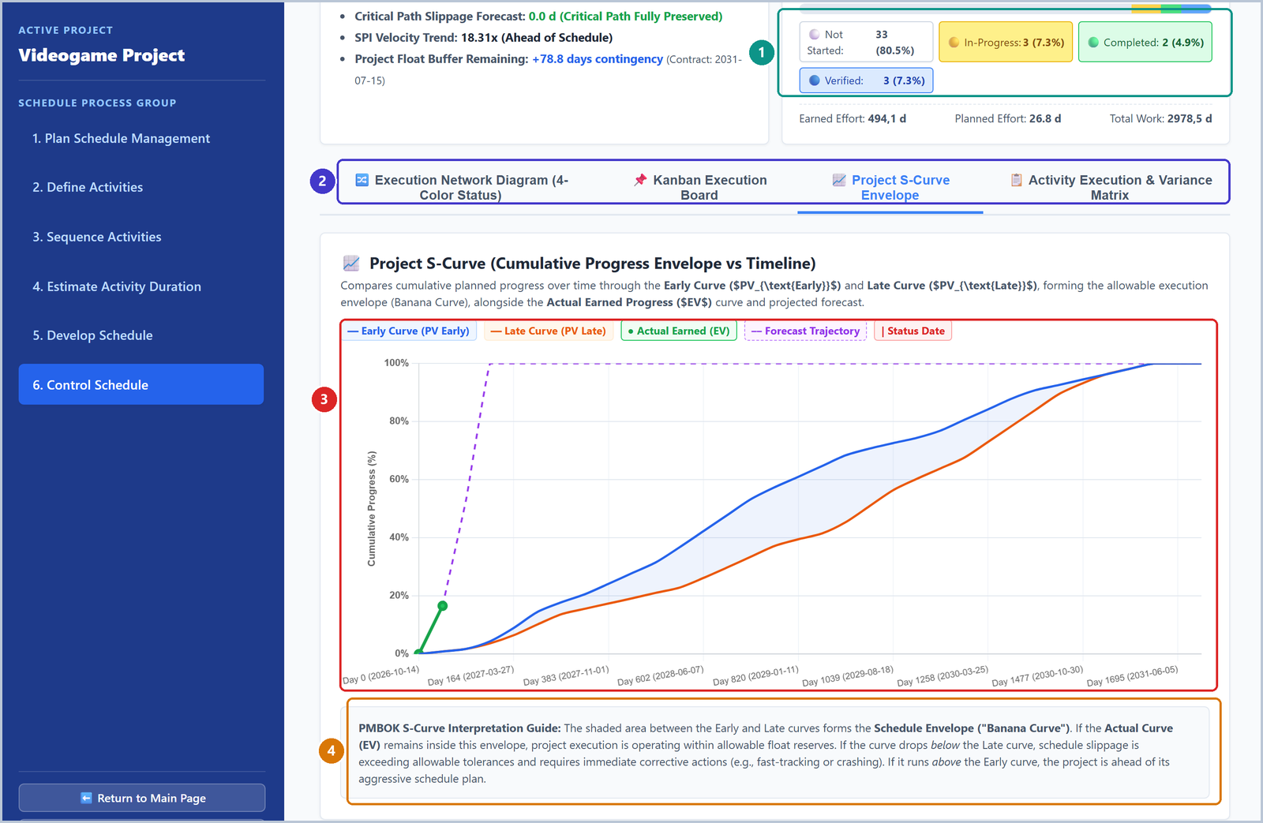
PM WORKSPACE EXPLANATION | OPERATIONAL MONITORING & EARNED VALUE
Process 6.6: Control Schedule & The S-Curve Banana Envelope
Operational Schedule Control & EVM
4-Tier Execution Pipeline: Tracks activities through Not Started (Gray) -> WIP (Yellow) -> Completed Pending Review (Green) -> Verified by Controller (Blue).
Time-Based EVM Metrics: Computes Planned Value (PV), Earned Value (EV), Schedule Variance (SV = EV - PV), and Schedule Performance Index (SPI = EV / PV) dynamically.
The 'Banana Envelope' Principle: Plots Early Planned Value (PV_Early) against Late Planned Value (PV_Late). Slipping below PV_Late triggers immediate schedule compression alerts.
Completion Forecast (EAC_t): Calculates projected project finish dates based on current velocity, enabling early corrective action before deadlines are breached.
EVM BANANA ENVELOPE DIAGNOSTIC
Real-time Earned Value (green line) monitored within Early and Late Planned bounds.
As long as EV remains inside the Banana Envelope, delays are safely absorbed by non-critical float.

Slide 17
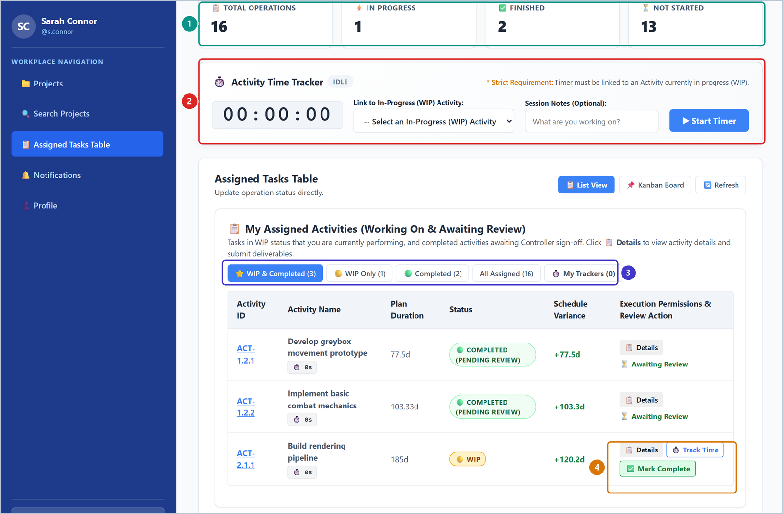
PERSONA WORKSPACE | STANDARD TEAM MEMBER EXECUTION
Frontline Contributor Workspace & Live Stopwatch Timer
Distraction-Free Frontline Execution
Personal Workload Dashboard: Summary cards show total assigned items, active WIP tasks, completed deliverables, and pending reviews without cognitive overload.
Integrated Live Stopwatch: Contributors start an active stopwatch directly bound to their WIP task. Eliminates retrospective timesheet guessing and logs exact effort to MongoDB atomically.
Task Filtering & Kanban Board: Filter between active WIP assignments, all assigned tasks, and personal logs, or switch to the visual execution Kanban board.
Deliverable Proof Submission: Clicking 'Mark Complete' opens a submission modal where contributors attach deliverable links or notes, triggering alerts for the Project Controller.
SUB-SECOND STOPWATCH PRECISION
Live in-browser stopwatch logs effort directly to MongoDB atomically.
Zero math clutter: frontline contributors focus purely on execution and deliverable proof submission.

Slide 18
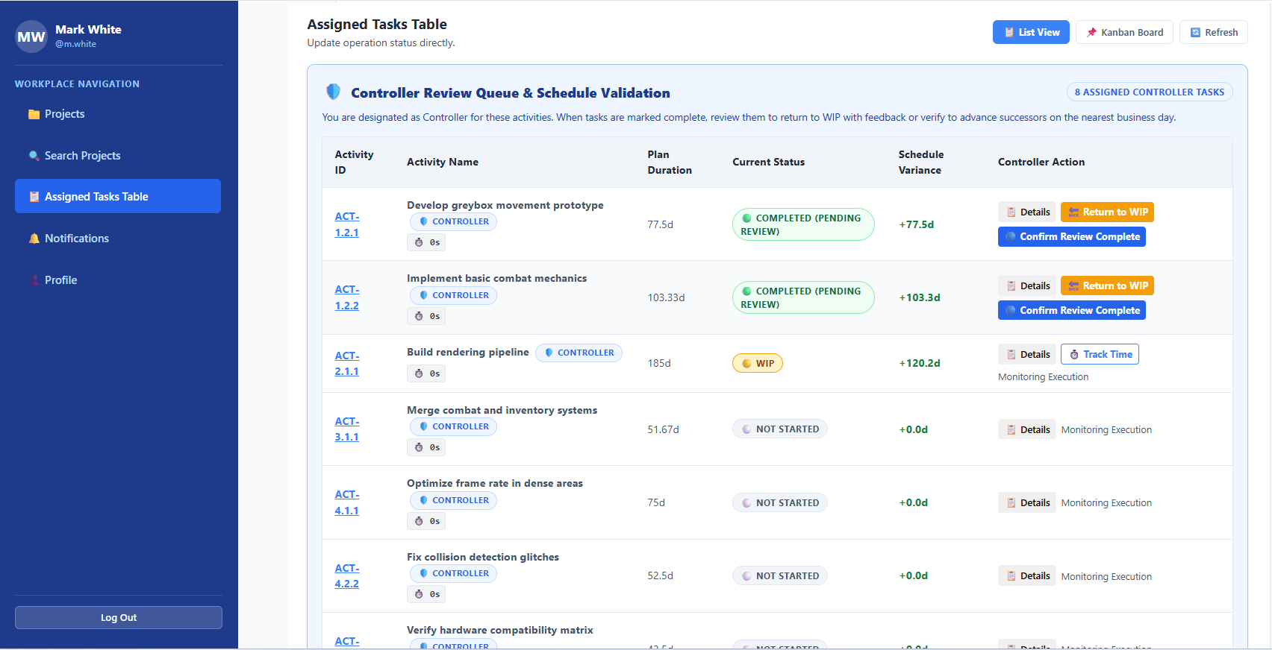
PERSONA WORKSPACE | INDEPENDENT DELIVERABLE VERIFICATION
The Project Controller Role & Quality Verification Gate
The Controller Role & EV Reporting Integrity
The Controller Persona (Quality Guardian): Designated by the Project Manager to act as an independent review authority. Solves the flaw where workers arbitrarily mark tasks 'Done' to inflate progress.
Evidence-Based Verification: When a team member finishes work, they must attach auditable proof (code commit, documentation link, test benchmark). Earned Value is credited ONLY upon Controller approval.
Itemized Acceptance Checklist: Controllers audit work against structured acceptance criteria before confirming Controlled (Blue) status in the system.
Corrective Feedback Loop: If deliverable quality is insufficient, the Controller rejects verification and returns the activity to WIP (Yellow) with actionable revision notes.
Guaranteed EVM Integrity: Prevents premature progress credit, ensuring S-Curve Banana Envelopes and SPI metrics reflect genuine, verified engineering progress.
Figure: Controller Activity Review Modal with proof audit and acceptance checklist.

Slide 19
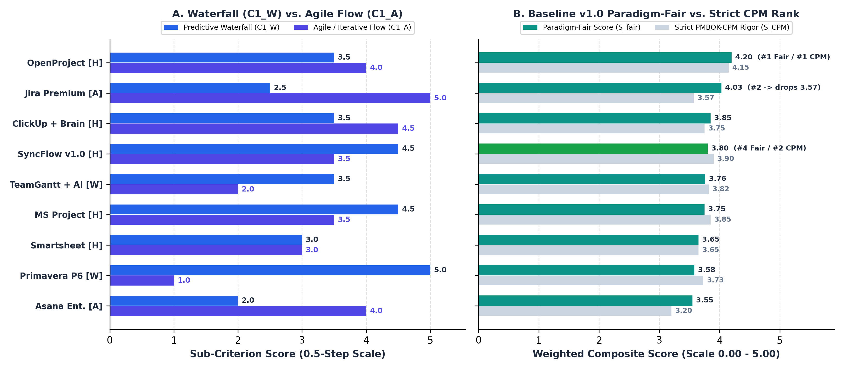
VENDOR ANALYSIS | BASELINE RANKING & CAPABILITY AUDIT (1 OF 2)
Market Benchmarking: SyncFlow 1.0 (Baseline) Evaluation
SyncFlow 1.0 Baseline Findings
Audited Against 9 Market Leaders: Benchmarked against MS Project, Primavera P6, Jira, Asana, ClickUp, Smartsheet, OpenProject, TeamGantt, and Trello across a 25-user enterprise baseline.
Operations Research Excellence (C_1W = 4.5): SyncFlow 1.0 matches or exceeds commercial platforms in predictive rigor via native Three-Point PERT, Banana Envelopes, and DCMA audits without expensive plugins.
Baseline Market Standing: SyncFlow 1.0 secures Rank #2 in Strict CPM (3.90) and Rank #4 Fair (3.80), outperforming generic trackers (Asana, Smartsheet) while matching core MS Project math.
Audited v1.0 Operational Deficits: Today, SyncFlow 1.0 lacks monetary Cost budgets, Risk registers, automated HTTPS defaults, SMTP password recovery, and vendored JS bundles.
SYNCFLOW 1.0 BASELINE: RANK #2 STRICT CPM
SyncFlow 1.0 scores 3.90 in Strict CPM (Rank #2) and 3.80 Fair (Rank #4).
Deterministic OR engine matches commercial giants, but operational maturity gaps constrain overall rank.

Slide 20
FUTURE DEVELOPMENTS | ARCHITECTURAL & FUNCTIONAL EVOLUTION
Future Developments: Bridging Operational Gaps Toward SyncFlow 2.0
Core Scheduling & Project Extensions (PMBOK)
Cost Management Integration (PMBOK 7): Implement monetary Earned Value Management (Budget at Completion BAC, Actual Cost AC, Cost Variance CV, CPI, and monetary EAC forecasting).
Risk Management & Monte Carlo (PMBOK 11): Introduce formal Risk Register with probability-impact scoring, and whole-network Monte Carlo simulation (Beta/Triangular distributions, 10,000 runs).
Agile & SCRUM Workflow Integration: Hybrid schedule management featuring Sprint backlogs, Planning Poker story-point estimation, and burnup/burndown charts tied to CPM milestones.
Schedule Interchange & Interoperability: Bidirectional MS Project XML (.xml/.mpp) and structured CSV import/export, plus downloadable PDF executive audit packs.
Enterprise Architecture & Multimodal AI Ingestion
Multimodal Document Ingestion: Expand Gemini Flash NLP pipeline to parse uploaded PDF charters, spreadsheet logs, and whiteboard photos directly into WBS hierarchies and PDM networks.
Production Security & Zero CDN Dependencies: Vendor all external JS libraries locally (eliminating CDN failure modes) and deploy Caddy 2 for automated Let's Encrypt HTTPS certificates.
High-Throughput Time-Tracking Partitioning: Partition sub-second stopwatch audit logs into dedicated collections, eliminating MongoDB 16MB document size boundaries.
Air-Gapped Sovereign AI Deployment: Optional on-premise 14B vLLM / Ollama instance for defense and enterprise installations requiring 100% data confidentiality.

Slide 21
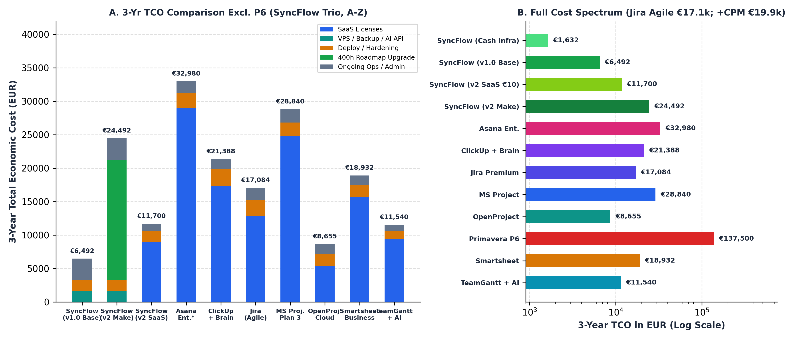
VENDOR ANALYSIS | STRATEGIC ROADMAP & TRANSFORMATION TO V2.0 (2 OF 2)
Future Developments: The Strategic Evolution to SyncFlow 2.0
The 3-Phase Roadmap to SyncFlow 2.0
Phase 1: Production Hardening (M 1–2): Vendor JS libraries locally, deploy Caddy 2 for automated ACME HTTPS, integrate transactional SMTP, and partition time logs to eliminate 16MB BSON limits.
Phase 2: Core Expansion (M 3–4): Add monetary EVM (BAC, AC, CV, CPI), Monte Carlo risk simulations, interactive milestone locks in DCMA audit, bidirectional MS Project XML interchange, and Agile Scrum boards.
Phase 3: Continuity & Local AI (M 5–6): Comprehensive CI/CD regression suites and optional on-premise 14B vLLM deployment for air-gapped data sovereignty.
Impact: Ascent to Rank #1 in Strict CPM: Elevates SyncFlow to Rank #1 in Strict CPM (4.19) and Rank #2 Fair (4.19) at €24,492 fully costed Make TCO, decisively outperforming commercial suites.
16-FOLD TCO ADVANTAGE OVER COMMERCIAL GIANTS
SyncFlow 1.0 baseline: €6,492 (€1,632 cash) vs €28,840 MS Project and €137,500 Primavera P6.
Planned v2.0 upgrades achieve Rank #1 Strict CPM (4.19) at €24,492 full internal Make TCO.

Slide 22
CONCLUSION & STRATEGIC TAKEAWAYS
SyncFlow: The Future of Transparent Project Governance
1. Rigorous Yet Accessible
PMBOK 6 Integrity: Delivers deterministic CPM passes, cycle checks, PERT probability, and DCMA audits.
Bifurcated UX: Protects contributors from math clutter while giving PMs complete analytical power.
Controller Quality Gate: Guarantees EV reporting integrity through mandatory deliverable verification.
2. Grounded Generative AI
No Free-Form Hallucinations: AI operates as a constrained parser strictly bound by Pydantic JSON decoding schemas.
Automated Resilience: Regex repair rules, strict PERT ordering, and Kahn cycle validation protect the database.
Human-in-the-Loop: PMs maintain final approval over generated WBS trees, estimates, and dependencies.
3. Sovereign & Cost-Effective
Zero Commercial Royalties: Eliminates SaaS licensing overhead with an audited 3-year TCO of just €6,492.
Clear Roadmap to #1: Disciplined 3-phase roadmap elevates SyncFlow v2.0 to Rank #1 Strict CPM across the market.
Complete Sovereignty: Full source code custody, on-premise deployment, and data privacy without cloud lock-in.
Thank you! Open for Questions and Discussion.

