Slide 1
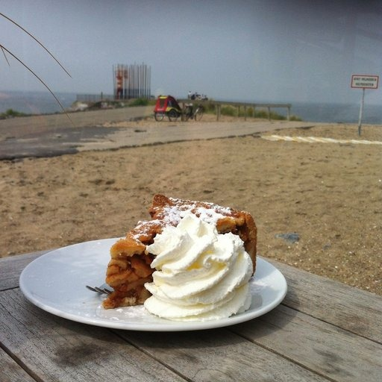
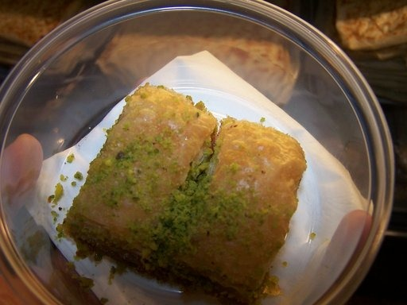
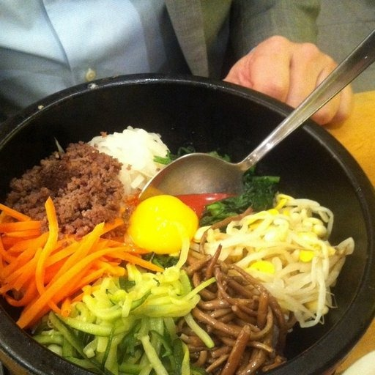
COMPUTER VISION
BiteID
Smart Food Recognition
APPLE PIE
Can a model recognize a dish from pixels—reliably, quickly, and transparently?
BAKLAVA
TEAM TENSOR-TRIO
Madhur Modi • Srikar Josyam • Samuel Pradeep
BIBIMBAP
Food image → predicted dish category

Slide 2
02 / DATA SOURCE
Dataset: Food-101 via TensorFlow Datasets
101,000
75,750 / 25,250
tfds.load("food101", as_supervised=True)
images • 101 categories
official train / validation split
BUNDLED SAMPLE RECORDS
ACCESS & REPRODUCIBILITY
• Source: TensorFlow Datasets / Food-101
• Loaded by the data pipeline; download/cache through jupyter notebook
• Labels are class indices mapped to saved class_names.json
• Seed: 42
apple_pie
baklava
bibimbap
13

Slide 3
03 / DATA PIPELINE
EDA & preprocessing: standardize inputs, preserve variation
750 images per class
RAW IMAGE
RESIZE
FLOAT32
BATCH
MODEL-SPECIFIC
variable sizes
224 × 224 RGB
pixel scale 0–255
batch size 32
scaling
TRAINING AUGMENTATION
KEY PREPROCESSING DECISION
Horizontal flip
Rotation ±10%
Zoom ±10%
Keep pixels on [0,255] in the shared loader; scaling is handled according to the chosen backbone’s input convention.
14

Slide 4
04 / MODEL ARCHITECTURE
Two model paths: a CNN baseline and transfer learning
BASELINE • CUSTOM CNN
ADVANCED • TRANSFER MODEL
Conv 32 + Pool
ImageNet backbone
EfficientNetB0 or MobileNetV2
Conv 64 + Pool
Global average pooling
Compact feature vector
Conv 128 + Pool
Dropout 0.3
Regularization
Flatten → Dense 256
Dense softmax
101-class scores
Softmax → 101 classes
Two phases: freeze backbone for feature extraction → unfreeze top 20 layers for fine-tuning.
15

Slide 5
05 / EXPERIMENTS
Experiment design: controlled choices and saved history
DATA
INPUT
BACKBONE
TRAINING
Food-101
224 × 224
EfficientNetB0
15 + 10 epochs
101 classes
RGB • batch 32
Alt: MobileNetV2
feature + fine-tune
OPTIMIZATION
TRACKING & MODEL SELECTION
• Adam: 1e−3 head / initial training
• Adam: 1e−5 fine-tuning
• Sparse categorical cross-entropy
• Fine-tune top 20 backbone layers
• JSON history: loss + accuracy by epoch
• Checkpoint best val_accuracy
• Early stopping on val_loss, patience 4
• Final model chosen by best validation accuracy
16

Slide 6
06 / EVALUATION
Evaluation: report measured performance, then explain errors
RECORDED VALIDATION
EVALUATION SCRIPT REPORTS
Top-1 • Top-5 • Macro F1 • per-class precision/recall/F1 • confusion matrix • latency
74.65%
Final validation accuracy in saved training history
ERROR ANALYSIS WORKFLOW
01
Rank top confused class pairs
NOT TEST ACCURACY
02
Inspect high-confidence wrong predictions (>85%)
03
Review true label vs predicted label
17

Slide 7
07 / DEPLOYMENT
Deployment demo: saved model → Streamlit prediction
1
INPUT
2
PREPROCESS
3
INFERENCE
4
OUTPUT
STREAMLIT
Upload / sample / failure
Resize to 224 × 224
Load .keras model
Ranked class scores
localhost:8501
LOCAL RUN
DEPLOYMENT NOTES
pip install -r requirements.txt
streamlit run app/app.py
• Model and class_names.json loaded from disk
• Inference does not retrain
• Docker Compose supports containerized deployment
Live demo: upload image → inspect top predictions → open a saved failure case → explain the error.
18

Slide 8
08 / RESPONSIBLE AI
Risks, responsible use & next enhancements
MODEL RISKS
RESPONSIBLE USE
FUTURE WORK
•
Visually similar dishes
Chocolate related images are especially problematic
•
Confidence ≠ certainty
•
Need test accuracy
Evaluate on real-world photos
•
Lighting, occlusion, camera angle
•
No calorie or nutrition claims
•
Calibrate confidence + monitor drift
•
Domain shift beyond Food-101
•
Do not use for medical decisions
•
Optimize latency and deployment
Priority: generate reliable held-out metrics, inspect failures, then validate on images outside the training domain.
Scope remains food-category recognition only; nutrition and health inference are explicitly excluded.
19

Slide 9
01 / THE CHALLENGE
The problem: recognize a dish from pixels
One image in. A ranked prediction out.
MODEL PREDICTION
IN SCOPE
The model maps an RGB food photo to one of 101 Food-101 categories.
Dish-category classification
Pizza
Top class • confidence
OUT OF SCOPE
Illustrative UI
Calories • nutrition • medical advice
INPUT
Top-5 labels
for useful alternatives
SUCCESS = USEFUL + REPRODUCIBLE
02

Slide 10
02 / DATA
Dataset: diversity is the learning signal
101,000
101
INPUT PIPELINE
images in Food-101
food categories
01
RGB image
02
Resize 224 × 224
03
Augment training data
04
Tensor input
PIZZA
SALAD
SOUP
DISH
Training augmentation helps with variation; it does not eliminate real-world domain shift.
03

Slide 11
03 / MODEL
Model strategy: reuse learned visual features
Transfer learning reduces the need to learn visual features from scratch.
01
02
03
04
OUTPUT
101
classes
PRETRAINED
BACKBONE
FEATURE
EXTRACTION
FINE-
TUNING
CLASS
PROBABILITIES
Saved artifacts: best_transfer_model.keras + class_names.json
Baseline: custom CNN • Transfer model: pretrained backbone + fine-tuning
04

Slide 12
04 / TRAINING
Training evidence — and what it does not prove
RECORDED VALIDATION
What it says
The model learned useful visual patterns.
1
74.65%
What it doesn't
It is not a fresh held-out test result.
2
Final validation accuracy
from saved training history
Next evidence
Run evaluation and report real metrics.
NOT TEST ACCURACY
3
Keep validation, test, and production performance clearly separated.
05

Slide 13
05 / APPLICATION
Streamlit: three ways to test the model
BiteID / Smart Food Recognition
DEMO STORY
Choose an input mode
Input
Photo enters the app
Upload image
Bring your own photo
01
Inference
Saved model predicts
Sample image
Repeatable demo input
Explanation
02
Ranked labels + confidence
Known failure
Inspect a misclassification
Learning loop
03
Failures inform improvement
No retraining during app use.
06

Slide 14
06 / QUALITY
Evaluation: measure more than one number
TOP-1
TOP-5
MACRO F1
LATENCY
Exact top prediction
Correct class in top five
Class-balanced performance
Time per inference
CONFUSION MATRIX (ILLUSTRATIVE)
WHY FAILURE ANALYSIS MATTERS
90%
7%
3%
0%
A single accuracy score hides which classes are confused — and where confidence is misplaced.
10%
70%
15%
5%
2%
12%
78%
8%
Illustrative values only • replace with generated evaluation_results/
3%
8%
17%
72%
07

Slide 15
07 / ERROR ANALYSIS
Failure cases turn errors into engineering work
DEBUGGING LOOP
✓
Inspect image quality
✓
Review confusion pairs
✓
Check class imbalance
GROUND TRUTH
MODEL PREDICTION
✓
Compare confidence
Pizza
Salad
✓
Add targeted examples
Example is schematic, not a recorded model error. Use a real saved failure image in the viva.
08

Slide 16
08 / ENGINEERING
System architecture: train once, evaluate, then serve
FOOD-101
DATA
TRAINING
PIPELINE
SAVED MODEL
+ LABELS
STREAMLIT
INFERENCE
EVALUATION PIPELINE
SAVED RESULTS
Metrics • confusion matrix • failures
evaluation_results/
Reproducibility principle: evaluation artifacts are generated ahead of time and mounted/read by the app.
09

Slide 17
09 / CONCLUSION
What we learned — and what comes next
01
02
03
VALIDATE
UNDERSTAND
IMPROVE
Generate held-out metrics and capture real app screenshots.
Group errors by class, confidence, and image conditions.
Compare backbones, tune augmentation, measure latency.
BiteID = image classification + measurable evaluation + an iterative error-analysis loop.
Discussion: How would you trade off Top-1 accuracy, Top-5 usefulness, inference latency, and generalization?
10

