Slide 1

1. What AI Is (and Isn't)
Course introduction, definitions, and the big picture
Week 1 · CE/ARCE 2XX AI Literacy for Civil and Architectural Engineering
Notes:
Welcome everyone. Today: why this course exists, what AI actually is (and isn't), the map we will use all semester, and how the course works. Our first lab is on this week's lab day.

Slide 2
Agenda
Today's plan
1
Welcome: why this course, and who we are
2
Three AI applications in CE and ARCE — before any definition
3
Defining AI: why it is hard, and a definition that works
4
Talking about AI precisely (quiz: Yes / No / Kind of)
5
The big-picture map of AI
6
How this course works: format, grading, AI use
7
This week's lab day: your Python on-ramp
Notes:
Walk through the plan. Stress that this is NOT a general computer-science AI course: every idea comes with a civil or architectural engineering example, and you will run real models in Python.

Slide 3
01
Welcome
Why an AI course for civil and architectural engineers?
Notes:
Section 1: welcome and motivation.

Slide 4
Welcome
Why this course?
1
AI is already in your field
2
Employers expect AI literacy
3
Engineers stay responsible
Drones find cracks, software forecasts building energy, contractors track sites with cameras, and chat assistants draft reports.
Interns and new engineers are asked to use AI tools well — and to know when not to trust them.
A licensed engineer signs the drawings, not the software. You must be able to check what AI produces.
Notes:
Three reasons. (1) AI is already used across the life cycle of infrastructure and buildings. (2) Employers increasingly ask about AI skills. (3) Most importantly: public safety. The engineer of record is responsible for the work, whatever tools were used. AI literacy = understanding + using + verifying + using responsibly.

Slide 5
Welcome
Who I am
Dr. Liang Zhang
What I work on
Civil & Architectural Engineering & Mechanics (CAEM)
Office: Civil Engineering 220F
Email: liangzhang1@arizona.edu
Office hours: see the syllabus
AI and data for buildings and infrastructure
Turning sensor and simulation data into better design and operation decisions
Teaching engineers to use AI with judgment
Notes:
Introduce yourself: background, research, why you care about AI in CE/ARCE. Optional: add one or two photos of your lab or projects on the right.

Slide 6
Welcome
Who are you, and how do you use AI?
Answer the two poll questions on your phone or on paper
Turn to a neighbor: share one time an AI tool helped you and one time it was wrong
A few pairs share with the class
4
min
Think · Pair · Share
Poll: (1) How often do you use AI tools — never, monthly, weekly, daily? (2) For what — homework help, writing, coding, images, other?
Notes:
Optional icebreaker. Use a quick poll (Brightspace, Poll Everywhere, or show of hands). Collect 2-3 'AI was wrong' stories; you will refer back to them in Weeks 7, 8 and 12.

Slide 7
02
What is AI?
Three examples before the definition
Notes:
We start with examples, not definitions.

Slide 8
What is AI?
Three examples before the definition
Artificial intelligence, or AI, means different things to different people, at different times, for different tasks
Before we define it, we will look at three real applications in civil and architectural engineering
Hold one question in mind: what do these three have in common?
Notes:
Set up the question. Students will answer it in a pair activity after the three examples.

Slide 9
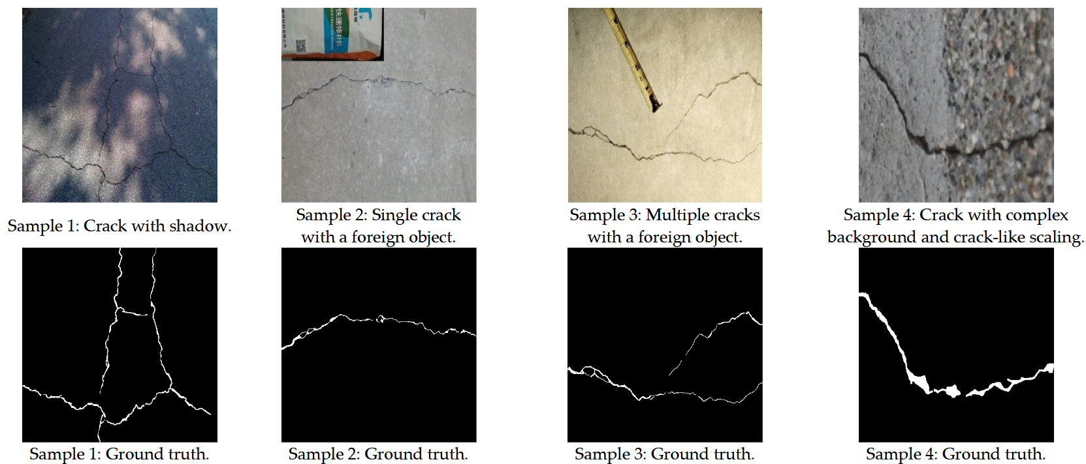
Application 1
Image processing for inspection
Recognition: AI finds cracks, corrosion, spalling, and thermal bridges in photos from drones or phones
Implications: faster inspections, earlier warnings, safer inspectors (fewer people on ropes or lifts)
CE tie-in: structural and infrastructure asset management
Same technology elsewhere: face recognition, obstacle detection, counting wildlife
Crack photos and the cracks a model detected
Notes:
Computer vision. The model takes a photo (pixels) and outputs where the cracks are. In Lab 1 you will run a pretrained vision model on concrete photos yourself, and in Lab 6 you will train one.

Slide 10
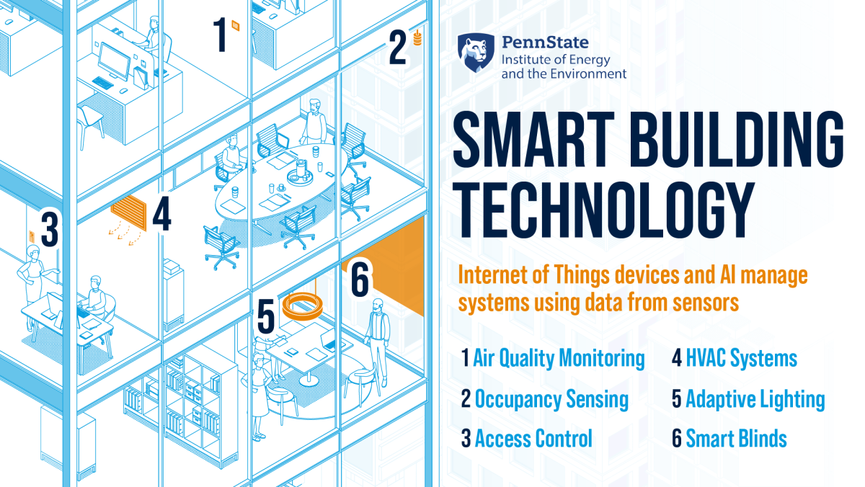
Application 2
Smart buildings and energy management
AI turns building operation data into decisions: forecast demand, optimize HVAC and lighting, detect faults early, learn occupancy patterns
Implications: energy savings, comfort, decarbonization
ARCE tie-in: a core architectural engineering area
Technique cluster: prediction + optimization + decisions under uncertainty
Smart building systems (Penn State IEE)
Notes:
Buildings use roughly 40% of U.S. energy (EIA). Sensors + data + AI = buildings that forecast and adapt. Week 5 lab uses a building energy dataset; your project could too.

Slide 11
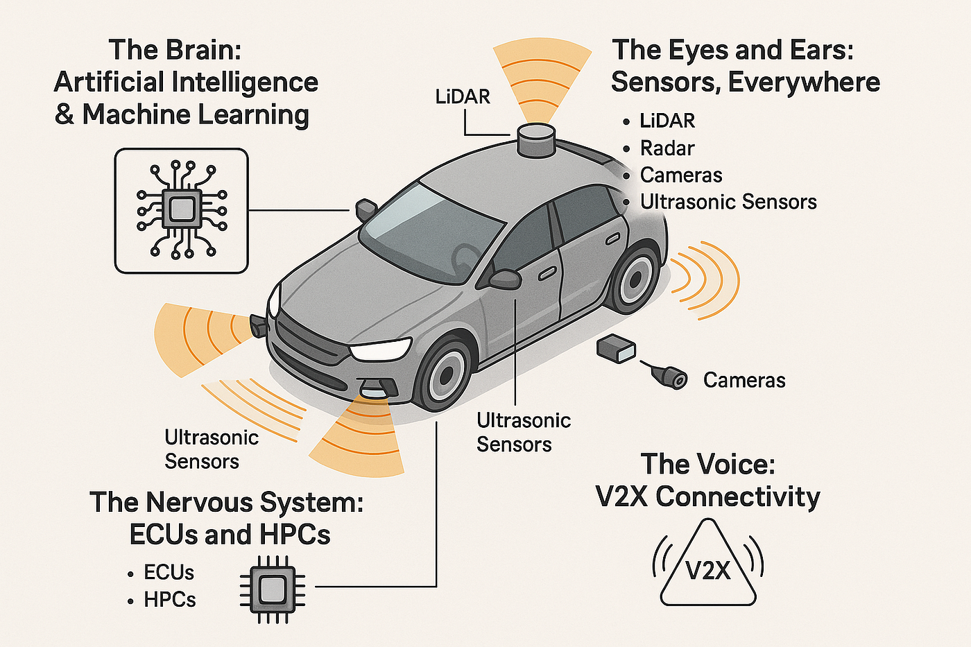
Application 3
Self-driving vehicles
A combination of AI techniques: search and planning, computer vision, control under uncertainty — to cope with a complex, changing environment
Implications: potential safety gains if reliability exceeds human drivers; more efficient logistics
CE tie-in: transportation engineering — roads, signals, and traffic will change
Same technology: delivery robots, drones, autonomous ships
Camera and lidar perception in an autonomous vehicle
Notes:
A self-driving car is many AI methods working together, plus lots of non-AI engineering. Ask: who is responsible when it fails? We return to that in Weeks 13-14.

Slide 12
What is AI?
What do the three have in common?
With a neighbor, list what the three applications share
Think about: inputs (what they sense), outputs (what they decide or do), and how they got good
Be ready to share one word or phrase
3
min
Think · Pair · Share
Crack detection · Smart building control · Self-driving vehicle → ?
Notes:
Expected answers: they take in data from the world (images, sensors); they make predictions or decisions; they act with some independence; they improve from data/experience. These lead directly to the definition: autonomy + adaptivity.

Slide 13
03
Defining AI
Why it is hard, and a definition that works
Notes:
Now the definitions.

Slide 14
Defining AI
No single agreed definition
COINED “AI” IN 1955
TEXTBOOK
John McCarthy
Russell & Norvig (1995)
“The science and engineering of making intelligent machines.” (2007)
An agent that perceives its environment and takes actions that maximize its chance of achieving its goals.
DICTIONARY
POLICY
Oxford Languages
European Commission (2018)
Computer systems able to perform tasks that normally require human intelligence.
Systems that show intelligent behavior by analyzing their environment and taking actions — with some autonomy — to achieve goals.
Notes:
Four definitions from four communities: the founder, the main textbook, the dictionary, and a regulator. Notice the shared ideas: perceive, decide/act, goals, some autonomy. Notice the problem: 'intelligence' is itself hard to define, and 'tasks that require human intelligence' keeps changing (a calculator once counted).

Slide 15
Defining AI
Four ways to think about AI
Like a human
Rationally (ideally)
Thinking
Thinking humanly
Thinking rationally
Cognitive modeling
Laws of thought (logic)
Acting
Acting humanly
Acting rationally
The Turing Test (1950)
Rational agents — most engineering AI
Notes:
The classic 2x2 from Russell & Norvig. Rows: thinking vs acting. Columns: like a human vs rationally (ideally). Engineering AI mostly lives in 'acting rationally': we care whether the system makes good decisions, not whether it thinks like a person.

Slide 16
Defining AI
A more useful definition: autonomy + adaptivity
Two properties of AI
Autonomy — the ability to perform tasks in complex environments without constant guidance by a user.
Adaptivity — the ability to improve performance by learning from experience.
Elements of AI, University of Helsinki & MinnaLearn
Rather than one rigid definition: the more a system shows both, the more it counts as AI
Notes:
This is the working definition we use all semester. It turns a yes/no question into a matter of degree, which is more honest.

Slide 17
Defining AI
The autonomy–adaptivity map
High autonomy · low adaptivity
High autonomy · high adaptivity
Autonomy
Rule-based building automation
Scripted traffic signals
Self-driving car
Self-learning HVAC control
Low autonomy · low adaptivity
Low autonomy · high adaptivity
Spreadsheet load calculator
Fixed-timer thermostat
Energy forecast run by an engineer
Crack detector with human review
Adaptivity →
Notes:
Place examples on the map. Bottom-left: a spreadsheet load calculator or fixed-timer thermostat (neither). Top-left: rule-based building automation — acts alone but never learns. Bottom-right: an energy-forecast model that an engineer runs — learns from data but does not act alone. Top-right: a self-driving car or self-learning HVAC — both, so 'most AI-like'. Ask students to place their own examples.

Slide 18
Talking about AI
“A pinch of AI” — and how to talk about it
AI is not a clean yes/no. Many methods have just “a pinch of AI,” like a pinch of salt — think in terms of “AI-ness,” not a hard line
AI is a discipline, like mathematics or biology — not a countable object
So don't say “an AI”; say “an AI method” or “an AI system” (you would never say “a biology”)
Speaking about AI precisely is the start of AI literacy — a core goal of this course
Notes:
Language matters. Headlines say 'an AI decided...'. Engineers should say what the system is: 'a neural network trained on 5 years of sensor data predicted...'. Precision makes it possible to ask the right follow-up questions: trained on what? tested how? how wrong can it be?

Slide 19
Quiz
Yes, No, or Kind of? Is it AI?
# | System | Your answer
1 | A spreadsheet that sums member weights to get total structural load
2 | Predicting a building's future energy use by fitting a curve to past consumption data
3 | A navigation app that finds the fastest route across a city's road network
4 | A building system that learns occupants' comfort preferences from past thermostat adjustments
5 | A cloud database that stores years of sensor data and streams it to many dashboards
6 | Adjusting brightness and contrast of a drone photo with predefined filters
7 | A deep-learning model that automatically detects and highlights cracks in every inspection photo
Notes:
Give students 3 minutes alone, then 2 minutes with a neighbor. Then reveal answers on the next slide. Use the autonomy + adaptivity lens; there is room for argument on #2 and #3, which is the point.

Slide 20
Quiz
Answers — and the reasoning that matters
# | Answer | Why
1 | No | Fixed formulas; no learning, no autonomy
2 | Kind of | Learns from data (curve fitting = simple machine learning), but no autonomy
3 | Kind of | Classic AI search and planning; acts on your behalf, but does not learn
4 | Yes | Learns from experience and adjusts the system on its own
5 | No | Important infrastructure for AI, but it only stores and moves data
6 | No | Predefined filters; nothing is learned
7 | Yes | Learned from labeled images; works without a person drawing each crack
Notes:
Emphasize the reasoning, not the label. #2 is the bridge to Weeks 3-4: fitting a line to data is the simplest machine learning. #3 shows AI is broader than machine learning: route-finding is search, one of the oldest AI methods. #7 is Yes because it runs on every new photo with no person drawing each crack; if a person must review every single result, it moves toward Kind of — the autonomy–adaptivity map is a matter of degree.

Slide 21
04
The big picture
A map of AI we will use all semester
Notes:
Now the map.

Slide 22
The big picture
The nested map: AI ⊃ ML ⊃ DL ⊃ GenAI
Artificial intelligence
AI beyond machine learning:
Machine learning
Search & planning
route finding, scheduling
Deep learning
Logic & rules
expert systems, code checking
Generative AI
ChatGPT · image generators · code assistants
Optimization
design optimization, dispatch
Robotics & control
drones, site robots
Notes:
Nested sets. AI is the whole field. Machine learning (ML) is the part where systems learn from data instead of following hand-written rules. Deep learning (DL) is ML with many-layered neural networks. Generative AI is DL that creates new content: text, images, code. Outside ML, AI also includes search and planning, logic and rules, optimization, and robotics. Weeks map onto this picture: Weeks 3-4 ML, 5-6 DL, 7-8 GenAI, 10 agents.

Slide 23
The big picture
A very short history of AI
1950s
1960s–80s
1990s–2000s
2010s
2020s
Turing's test (1950)
“AI” coined in the 1955 Dartmouth proposal; workshop in 1956
Logic, search, expert systems
Two “AI winters” of lost funding
Machine learning grows
Deep Blue beats Kasparov (1997)
Deep learning: images (2012), Go (2016)
Transformer (2017)
ChatGPT (2022) brings GenAI to everyone
AI agents and AI policy
Notes:
Big swings of hype and disappointment. Each wave was driven by new methods plus more data and compute. Lesson for engineers: be skeptical of both hype and dismissal.

Slide 24
Myths
What AI is not
Myth
Reality
AI understands the world the way people do
AI is objective because it is math
If it sounds confident, it is right
AI will replace engineers
It finds patterns in data; it can be fluent without understanding
It inherits the gaps and biases of its data and its designers
Generative AI can be confidently wrong (“hallucination”)
It changes engineering tasks; engineers stay responsible for safety
vs
AI literacy = know how it works, use it well, verify it, and use it responsibly
Notes:
Each myth is a week of the course: how models learn (Weeks 3-6), hallucination (7-8), bias and reliability (13), professional responsibility (14).

Slide 25
05
This course
What we will cover, and how it works
Notes:
Course logistics.

Slide 26
This course
The course map
WEEKS 1–2
WEEKS 3–6
WEEKS 7–10
WEEKS 11–15
Foundations
How machines learn
Generative AI and agents
AI in practice
What AI is
Machine learning, deep learning, generative AI
Python and data
Linear regression, cost, gradient descent
Neural networks
CNNs and sequence models
How LLMs work
Prompting and retrieval (RAG)
AI agents
Applications across CE and ARCE
Choosing and verifying AI tools
Responsible AI, policy, ethics
Notes:
Four modules plus a team project. Midterm in Week 7 covers Weeks 1-6. The final project starts in Week 10 and is presented in finals week.

Slide 27
This course
What this course is — and is not
This course IS
This course is NOT
AI literacy for engineers: concepts, hands-on use, judgment
Hands-on Python in Google Colab — no installation, no prior coding
Real CE and ARCE data: concrete, buildings, bridges, traffic
Verification, responsible use, ethics, and policy
A computer-science course in AI theory or heavy math
A software-engineering or app-building course
A tour of every AI product on the market
A course where AI does the work for you
Notes:
Set expectations. You will write and run code, but we focus on understanding, not programming skill. Math is at the level of 'slope' and 'average'.

Slide 28
This course
A typical week
Lecture day
Lab day
Homework
Project
Concepts with CE/ARCE examples
Short quiz on last week
In-class activities
Guided Colab notebook
Bring a laptop
Exit ticket at the end
About every two weeks
Individual work
Due Sunday 11:59 pm
Teams of 3–4 from Week 10
Present in finals week
Notes:
Two 75-minute meetings per week: a lecture day and a lab day. Labs are graded on completion and the exit ticket. Five homework assignments, lowest dropped.

Slide 29
This course
How you are graded
Component | Weight | Notes
Computer labs | 25% | Completion + exit ticket; lowest lab dropped
Homework (5) | 20% | Individual; lowest homework dropped
Midterm exam | 20% | Week 7 lab day; closed book; formula sheet provided
Final project | 25% | Team application of AI to a CE/ARCE problem + presentation
Participation & quizzes | 10% | Short concept quizzes and activities; lowest two dropped
Notes:
A ≥ 90, B ≥ 80, C ≥ 70, D ≥ 60. Clear cut-offs: 89.99 is a B.

Slide 30
This course
Using AI in this course: three labels
Every assignment shows its label. When in doubt, ask.
✕
AI-Free
~
AI-Assisted
✓
AI-Required
Do not use AI to produce what you submit. Example: quizzes, exam, exit tickets, some homework parts.
AI help is allowed (explaining, debugging, brainstorming). Add an AI-use acknowledgment. You own every line.
Using AI is part of the task — e.g., testing an LLM's answers. Document your prompts and outputs.
Notes:
This course is about AI, so sometimes you must use it, sometimes you may, sometimes you must not. Acknowledgment template: 'I acknowledge the use of [tool] to [specific use]. Prompts included [...].' Undisclosed use on an AI-Free item is an academic integrity issue.

Slide 31
This course
Where everything lives
GitHub (course home)
Google Colab
Brightspace (D2L)
1
2
3
Slides, lab notebooks, homework, project guide, datasets. Link on Brightspace and on the last slide.
Run every lab in your browser. Free; needs a Google account. Open notebooks from the GitHub links.
Submit work, see grades and announcements, take quizzes.
Notes:
Show the GitHub page live. Bookmark it. Everything is linked from the README.

Slide 32
Lab 01
Lab day: Python on-ramp
Open Google Colab and run your first notebook
Python basics: variables, lists, loops, functions — just enough for this course
Activity 1: run a pretrained vision model on concrete photos — can it tell cracked from intact?
Activity 2: run a small language model from Python — and catch it making a mistake
Exit ticket: three short questions
LAB
01
Bring a charged laptop
Open the notebook from the course GitHub page
Notes:
No coding experience needed. Bring a charged laptop and make sure you can sign in to a Google account.

Slide 33
Wrap-up
Key takeaways
AI is already used across the life cycle of infrastructure and buildings
1
There is no single definition; use autonomy + adaptivity as a lens, and think in degrees
2
Say “an AI method,” and be specific about what it learned from and what it does
3
AI ⊃ machine learning ⊃ deep learning ⊃ generative AI — plus search, logic, optimization, robotics
4
AI literacy = understand it, use it, verify it, and use it responsibly
5
Notes:
Recap. Next week: zoom into machine learning, deep learning and generative AI.

Slide 34
Learn more
Readings and resources
Elements of AI (free online course) — Chapter 1 — read before next week
Course GitHub: github.com/TensorBuildLab/AI-Literacy-CE-ARCE — all materials, datasets, and lab links
Google Colab — sign in and open a new notebook before lab day
Russell & Norvig, Artificial Intelligence: A Modern Approach — Chapter 1 for the curious (optional)
Notes:
Reading for next week: Elements of AI chapter 1. It matches today's definitions and takes about an hour.

