Slide 1

2. Zooming In: Machine Learning, Deep Learning, and Generative AI
How machines learn from data, and the three big families
Week 2 · CE/ARCE 2XX AI Literacy for Civil and Architectural Engineering
Notes:
Welcome back. Last week we asked what AI is. Today we zoom in on the part of AI that drives almost everything you hear about: machine learning, deep learning, and generative AI. We start with the short quiz on Week 1.

Slide 2
Agenda
Today's plan
1
Quiz on last week (5–8 min)
2
From rules to learning: what a model is
3
Three ways machines learn — with CE and ARCE examples
4
Deep learning, why now, and generative AI
5
Data is a design material
6
Lab day: working with data; Homework 1
Notes:
Hand out the Week 1 quiz first: 5 questions, about 6 minutes, AI-Free, closed notes. Collect it and then walk through the plan. Today is mostly vocabulary and mental models, with two short activities. Everything today shows up again in Weeks 3 to 8.

Slide 3
Recap
Last week in 60 seconds
1
No single definition
2
Talk precisely
Use two properties as a lens: autonomy and adaptivity. AI is a matter of degree.
Say “an AI method” or “an AI system” — and say what it learned from.
3
The nested map
4
AI literacy
AI ⊃ machine learning ⊃ deep learning ⊃ generative AI, plus search, logic, optimization, robotics.
Understand it, use it, verify it, and use it responsibly.
Notes:
Sixty-second recap. The autonomy and adaptivity lens is our working definition. Today we zoom into the right half of the map, adaptivity: systems that learn from data. Ask one student to name a system that is adaptive but not autonomous (example: an energy-forecast model an engineer runs by hand).

Slide 4
Learning objectives
By the end of today, you can…
Contrast traditional programming (rules + data → answers) with machine learning (data + answers → rules)
✓
Identify the features X and the target y in an engineering dataset
✓
Tell supervised (regression, classification), unsupervised, and reinforcement learning apart
✓
Explain what makes deep learning and generative AI different, and why they took off now
✓
Judge whether a dataset is good enough — quality, quantity, representativeness
✓
Notes:
Read the objectives aloud. The second one is the most practical: in this week's lab you will load a real concrete dataset and decide which columns are X and which is y. The last one is about engineering judgment, not code.

Slide 5
01
From rules to learning
What changes when a computer learns from examples
Notes:
Section 1: the big flip from writing rules to learning them.

Slide 6
From rules to learning
Machine learning flips traditional programming
Traditional programming
Rules
Computer
Answers
Data
e.g., Beam formula M = qL²/8 (q = load, kN/m) + span and load → maximum moment
Machine learning
Data
Learning algorithm
Rules (a model)
Answers
e.g., 1,030 mixes + their measured strengths → a strength-prediction model
Notes:
This is the single most important picture today. In traditional programming an engineer writes the rules, for example M = qL²/8 for a simply supported beam (q = distributed load in kN/m; we save the letter w for model weights next week), and the computer applies them to data to get answers. In machine learning we give the computer data AND the answers — say, 1,030 concrete mixes and their measured strengths — and it produces the rules: a model. Then we use that model on new data, exactly like a formula. Point out that the output of learning is itself a program.

Slide 7
From rules to learning
Write the rules — or learn them from data?
Write the rules when…
Learn from data when…
The physics or the code provision is known (beam moment, Manning's equation)
You must explain and certify every step
There are few examples, or none
The relationship is too complex to write down (strength from 8 ingredients and age)
You have many examples with known answers
Patterns are hard to describe in words (what a crack “looks like”)
vs
Most real engineering tools combine both: physics and rules, plus learned parts
Notes:
Machine learning is not always better. If the rule is known and reliable, use it: nobody should train a neural network to compute qL²/8. Learning pays off when the rule is unknown or too complicated, and you have plenty of examples. Real tools mix both, for example a physics energy model whose uncertain parameters are calibrated from meter data.

Slide 8
From rules to learning
Rules or learning? You decide
For each task: write the rules or learn from data? Why?
1. Check that a steel beam's bending stress is below the allowable value
2. Estimate the energy use of a new design from 10,000 past simulations
3. Find cracks in 5,000 drone photos of a parking garage
4. Compute peak stormwater runoff with the rational method, Q = CiA
3
min
Think · Pair · Share
Ask yourself: Do we know the rule? Can we write it down? Do we have many examples with known answers?
Notes:
Give 90 seconds alone and 90 seconds in pairs, then cold-call. Expected answers: (1) rules — the stress check is a code provision; (2) learning is reasonable — many examples, complex relationship (this is called a surrogate model); (3) learning — 'what a crack looks like' is hard to write as rules; (4) rules — the rational method is a known formula. Accept good arguments either way on (2).

Slide 9
From rules to learning
A model is a function that turns inputs into a prediction
Model
A model maps inputs to an output: ŷ = f(x). In machine learning, the numbers inside f (its parameters) are learned from data, not written by hand.
x = inputs (features) · ŷ (“y-hat”) = the prediction · y = the true answer
Example: f(mix proportions, age) → predicted strength in MPa
“All models are wrong, but some are useful” — statistician George Box
Notes:
Define the notation we use all semester. x is what goes in, y-hat is what the model predicts, y is the measured truth. Learning means adjusting the parameters until y-hat is close to y on the examples we have. Next week f becomes a straight line, f(x) = w·x + b, and w and b are the parameters. Box's quote reminds us every model simplifies reality.

Slide 10
From rules to learning
Features X go in; the target y comes out
Features X — 8 inputs (kg/m³, except age)
Target y
Cement
Slag
Fly ash
Water
Super-plast.
Coarse agg.
Fine agg.
Age (days)
Strength (MPa)
540
0
0
162
2.5
1040
676
28
79.99
540
0
0
162
2.5
1055
676
28
61.89
332.5
142.5
0
228
0
932
594
270
40.27
332.5
142.5
0
228
0
932
594
365
41.05
198.6
132.4
0
192
0
978.4
825.5
360
44.30
… 1,030 rows in total (m = 1,030 examples)
One row = one example · columns we know = features · the column we predict = target (or label)
Notes:
These are five real rows from the concrete dataset you will open on lab day. Each row is one example: one concrete mix tested at one age. The first eight columns are the features, X — the things we know before testing. The last column, compressive strength, is the target y — what we want to predict. Ask: why is age a feature and not the target? Because we choose when to test; strength is the unknown result.

Slide 11
02
Three ways machines learn
Supervised, unsupervised, and reinforcement learning
Notes:
Section 2: the three families. The difference is what kind of feedback the learner gets.

Slide 12
Three ways machines learn
The difference is the feedback the learner gets
LEARN FROM ANSWERS
FIND STRUCTURE
LEARN BY TRIAL
Supervised
Unsupervised
Reinforcement
Examples come with the right answer (label)
Learns to predict y from X
CE: strength from mix; crack or no crack
Examples come without answers
Finds groups and unusual cases
ARCE: group buildings by energy use
Acts, then gets a reward or penalty
Learns a strategy over time
CE: traffic-signal timing; HVAC control
Notes:
Supervised learning is like studying with an answer key. Unsupervised is like sorting a pile of rock samples into groups without being told the rock names. Reinforcement learning is like learning to ride a bike: try, fall, adjust. Most engineering ML today is supervised, and it is what we study in Weeks 3 to 6.

Slide 13
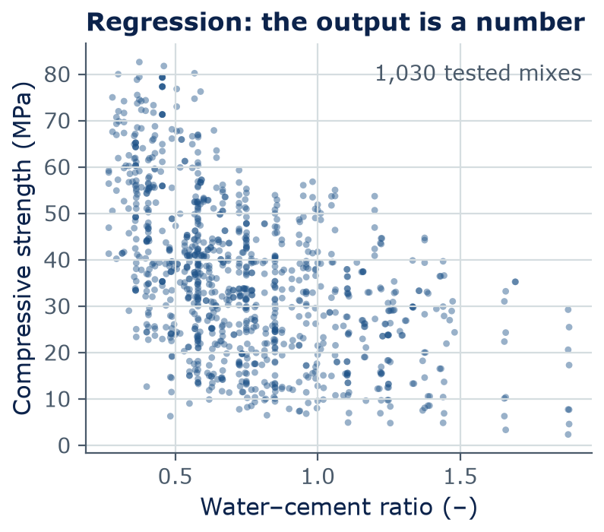
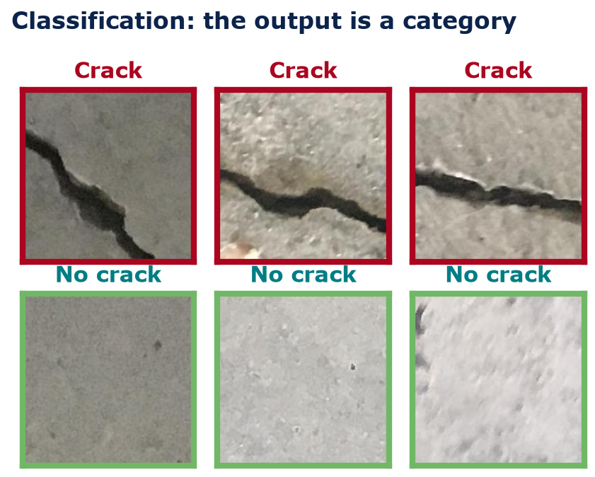
Supervised learning
Supervised learning: regression predicts numbers, classification predicts categories
Data: Yeh (1998) concrete dataset; Özgenel (2019) crack images, CC BY 4.0 — both in the course data folder
Notes:
Both are supervised: every training example has the right answer. Left: regression. Each dot is a real concrete mix; the answer is a number, strength in MPa. Notice the trend — more water per unit of cement, weaker concrete — and the scatter around it. Right: classification. Each photo has a label, crack or no crack, and the model learns to assign labels to new photos. You ran a model like this in Lab 01.

Slide 14
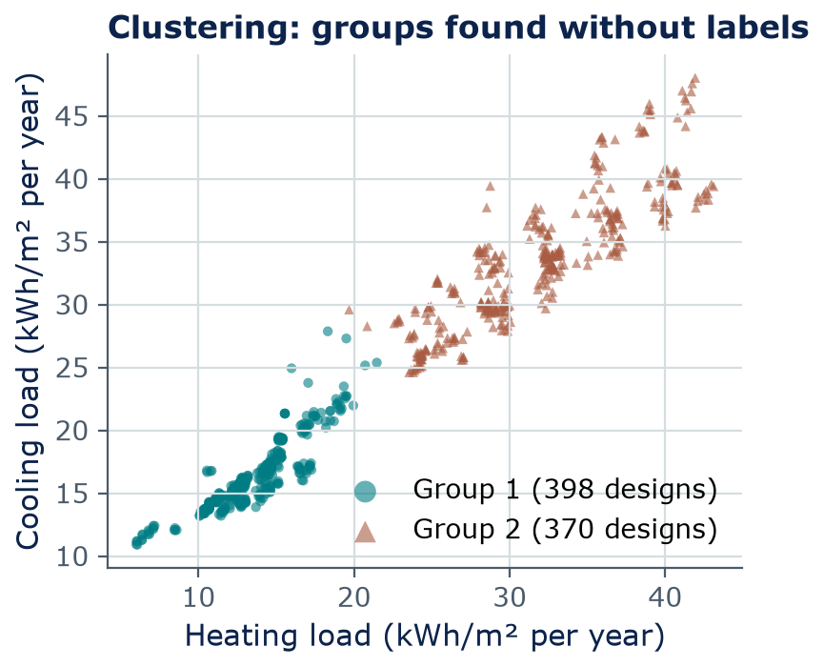
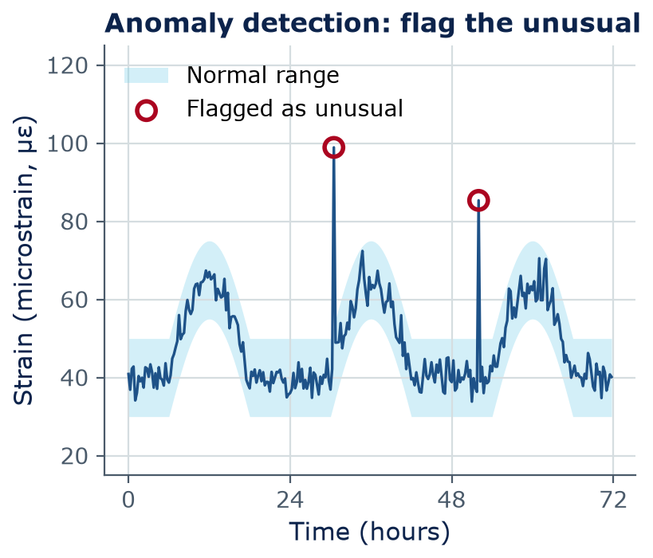
Unsupervised learning
Unsupervised learning finds structure nobody labeled
Left: Tsanas & Xifara (2012) building energy data, k-means with 2 groups. Right: simulated signal, for illustration only.
Notes:
Left, real data: 768 simulated building designs, plotted by heating and cooling load. We gave the k-means clustering algorithm only these two numbers and asked for two groups — no labels. Afterwards we checked: the groups almost exactly match building height, 3.5 m versus 7 m (all 370 designs in group 2 are 7 m tall; group 1 holds all 384 short designs plus 14 tall ones). The algorithm found it; an engineer explained it. Right, an illustration with simulated numbers: a bridge strain gauge follows a daily traffic pattern, and an anomaly detector flags readings that do not fit — maybe an overweight truck, maybe a faulty sensor. Either way, a person must investigate.

Slide 15
Reinforcement learning
Reinforcement learning: act, get a reward, improve
HVAC control (ARCE)
Agent
the controller
State: room temperatures, occupancy, weather, energy price
Action: heating and cooling setpoints
Reward: low energy cost, comfortable people
state +
reward
action
Traffic-signal timing (CE)
Environment
building or intersection
State: queue length on each approach
Action: which phase gets green, and for how long
Reward: less total delay
Notes:
Reinforcement learning, RL, learns a strategy by trial and error. The agent observes the state, takes an action, and receives a reward. For HVAC: the state is temperatures, occupancy, weather and electricity price; the action is the setpoint; the reward is low cost with comfortable occupants. For traffic signals: the state is queue lengths, the action is which approach gets green and for how long, the reward is low total delay. Honest note: in practice most buildings and intersections still use rule-based control; RL is mainly trained in simulators and tested in pilots, because trial and error on a real building or intersection can be costly or unsafe.

Slide 16
Three ways machines learn
Side by side: three ways to learn
 | Supervised | Unsupervised | Reinforcement
Data | Examples with answers (X and y) | Examples without answers (X only) | Experience: states, actions, rewards
Learns | A function: X → y | Groups, patterns, the unusual | A strategy: what to do when
Typical output | A number or a category | Group labels, anomaly scores | Actions
CE/ARCE example | Concrete strength; crack detection | Building energy groups; sensor anomalies | Signal timing; HVAC control
In this course | Weeks 3–6, most labs | Mentioned; HW1 | Concept only; Week 10 agents
Notes:
Use this table as the summary of the section. A common confusion: unsupervised does not mean 'no data' — it means no answers in the data. Another: reinforcement learning is not the same as getting a teacher's feedback on each example; the reward may come late and only says how good, not what the right action was.

Slide 17
Concept check
Which kind of learning is this?
Traffic engineers have one year of hourly counts from 400 road sensors — no labels. They want to discover groups of sensors with similar daily patterns. This is…
Supervised learning — regression
Supervised learning — classification
A
B
Unsupervised learning — clustering
Reinforcement learning
C
D
Notes:
Give 60 seconds; students vote with fingers (1–4) or a poll. The key word is 'no labels'. If many pick classification, point out that classification needs examples whose class is already known.
Answer: C. No answers (labels) are given, and the goal is to find groups → unsupervised clustering.

Slide 18
Concept check
Which kind of learning is this? — answer
Traffic engineers have one year of hourly counts from 400 road sensors — no labels. They want to discover groups of sensors with similar daily patterns. This is…
Supervised learning — regression
Supervised learning — classification
A
B
Unsupervised learning — clustering
Reinforcement learning
C
D
No answers (labels) are given, and the goal is to find groups → unsupervised clustering.
Notes:
Answer: C. No answers (labels) are given, and the goal is to find groups → unsupervised clustering.

Slide 19
03
Deep learning and generative AI
Learned features, why now, and models that create
Notes:
Section 3: zoom further in on the map: deep learning, then generative AI.

Slide 20

Deep learning
Deep learning learns its own features
Classic machine learning
Engineer designs features
dark-pixel fraction, edge length
Simple model
e.g., a line or a decision rule
crack / no crack
Deep learning
Layer 1
edges
Layer 2
textures
Layer 3+
crack-like shapes
crack / no crack
Notes:
Classic machine learning needs a person to design the features: for a crack photo, maybe the fraction of dark pixels or the length of straight edges. That works, but it is slow and the engineer may miss what matters. Deep learning uses a neural network with many layers — that is what 'deep' means — and lets the layers learn the features: early layers respond to edges, middle layers to textures, later layers to crack-like shapes. The price: it needs much more data and computing. We build this up in Weeks 5 and 6.

Slide 21
Why now?
Deep learning took off when three things came together
≈1.28 M
2 GPUs
2017
Data: labeled training images in the 2012 ImageNet challenge (1,000 categories)
Compute: graphics cards trained the 2012 AlexNet image model in about a week
Algorithms: the transformer design appears — the basis of today's large language models
Sources: Russakovsky et al., IJCV 2015; Krizhevsky, Sutskever & Hinton, NeurIPS 2012; Vaswani et al., NeurIPS 2017
Notes:
Neural networks are an old idea, from the 1950s to the 1980s. They took off in the 2010s because of three things. Data: the internet made huge labeled datasets possible, like ImageNet. Compute: graphics cards (GPUs), built for video games, turned out to be ideal for the math of neural networks; AlexNet in 2012 was trained on two of them in five to six days and won the ImageNet challenge by a wide margin. Algorithms: better training tricks, and in 2017 the transformer, which powers ChatGPT-style models. Today's largest models train on thousands of GPUs.

Slide 22
Generative AI
Generative AI creates new content instead of a label or a number
Predictive AI
Generative AI
Input → a number or a category
Strength of this mix: 42 MPa
This photo: crack
Checked against a known answer
Prompt → new text, images, code, or designs
Draft a method statement for a pour
Concept images of a shaded façade
Python code to plot sensor data
vs
Generated content is plausible, not verified — an engineer must check it
Notes:
Generative AI is deep learning that produces new content: text, images, code, even layout options. It learns the patterns of its training data well enough to produce new examples that look like them. That is also why it can be confidently wrong: it produces what is likely, not what is checked. Weeks 7 and 8 explain how large language models and image generators work.

Slide 23
Generative AI
Foundation models: train once on broad data, adapt to many tasks
Chat assistant
answers, drafts
Broad data
web text, books, code, images
Foundation
model
Coding assistant
writes and explains code
pre-training
Document Q&A
specs, codes (Week 8)
Image understanding
read photos, drawings
Adapted by fine-tuning or by prompting
Notes:
A foundation model is a very large model pretrained on broad data — web text, books, code, images — and then adapted to many tasks, by fine-tuning or just by prompting. The term comes from a 2021 Stanford report. Examples as of 2026: the models behind ChatGPT, Claude, Gemini, and open models such as Llama and Qwen — Qwen is the small model you ran in Lab 01. Engineering implication: one general model is reused for many jobs, so its strengths and its blind spots show up everywhere it is used.

Slide 24
Generative AI
Same idea, different inputs and outputs: eight CE and ARCE tasks
Task | Input | Output | Type of learning or task
Predict concrete strength | Mix proportions, age | Strength (MPa) | Supervised · regression
Detect cracks in photos | Photo (pixels) | Crack / no crack | Supervised · classification
Estimate a design's heating load | Shape, glazing, height | kWh/m² per year | Supervised · regression
Group buildings by energy use | Hourly meter data | Group number | Unsupervised · clustering
Flag unusual bridge readings | Strain, vibration data | Normal / unusual | Unsupervised · anomalies
Time traffic signals | Queue lengths | Green time per phase | Reinforcement learning
Draft a daily site report | Notes, photos | Report text | Generative AI
Make façade concept images | Text prompt | Images | Generative AI
Notes:
Walk through two or three rows. The habit to build: for any AI tool, ask 'what goes in, what comes out, and what kind of learning produced it?' That tells you what data it needed and how it can fail. A regression model can be off by some MPa; a classifier can miss a crack; a generative model can invent a fact.

Slide 25
Activity
Sorting activity: what kind of learning or task?
Estimate footing settlement (mm) from soil test results
Label drone photos of roofs “hail damage” or “no damage”
4 min · pairs
1
2
A · Supervised · regression
Find groups of similar trips in a year of unlabeled bike-share data
A crane controller improves load placement by trial and error in a simulator
B · Supervised · classification
3
4
C · Unsupervised
Write a first-draft specification section from an engineer's bullet notes
Predict tomorrow's city water demand (m³/day) from the weather forecast
5
6
D · Reinforcement learning
Spot water-main pressure readings that look unlike any normal day
Predict whether a bridge deck will be rated “poor” at the next inspection
7
8
E · Generative AI (task)
Notes:
Give 4 minutes in pairs. Each pair writes eight answers like '1-A'. Then reveal on the next slide and discuss the ones people disagree on. Watch for two common confusions: anomaly detection is unsupervised, and 'predict whether a deck will be rated poor' is classification even though condition ratings are numbers, because we predict a category.

Slide 26
Activity
Sorting activity: answers
# | Answer | The clue
1 | A · regression | Output is a number (mm), learned from past cases with measured settlement
2 | B · classification | Output is one of two labels
3 | C · unsupervised | No labels; the goal is to find groups (clustering)
4 | D · reinforcement | Learns from trial, error, and a reward
5 | E · generative | Creates new text
6 | A · regression | Output is a number (m³/day)
7 | C · unsupervised | No labels; find the unusual (anomaly detection)
8 | B · classification | Output is a category (poor / not poor) — you will do this in Lab 11
Notes:
Note that E is different: generative AI is a kind of task or output, not a fourth way of learning. Large language models are trained by self-supervised learning: the next word in the text is the label, so no person has to label anything (Week 7). Discuss items 7 and 8, the usual sources of disagreement. Item 7 could become supervised if someone had labeled past readings as 'leak' or 'no leak' — the same task can use different kinds of learning depending on the data you have. That is a good segue to the last section: data.

Slide 27
04
Data is a design material
Quality, quantity, and representativeness
Notes:
Section 4: data. In machine learning, the data plays the role that the design code plays in traditional engineering — it defines what the model knows.

Slide 28
Data is a design material
Check your data the way you check your concrete
1
Quality
2
Quantity
Errors, wrong units, missing values, duplicate rows. Garbage in, garbage out.
Enough examples to cover the variety you care about — including rare cases like failures.
3
Representativeness
4
Labels
Does the data look like where the model will be used? Climate, materials, sensors, neighborhoods.
Who labeled it, how consistently? Two inspectors may rate the same deck differently.
Notes:
An engineer would never design with untested concrete; do not train with unchecked data. Quality: a kip-versus-kN unit mix-up ruins a model silently. Quantity: bridge failures are rare, so there are few examples to learn from. Representativeness: a model trained on Minnesota buildings may not work in Tucson. Labels: human ratings vary, so the 'truth' itself has error. We return to this in Week 13 on responsible AI.

Slide 29
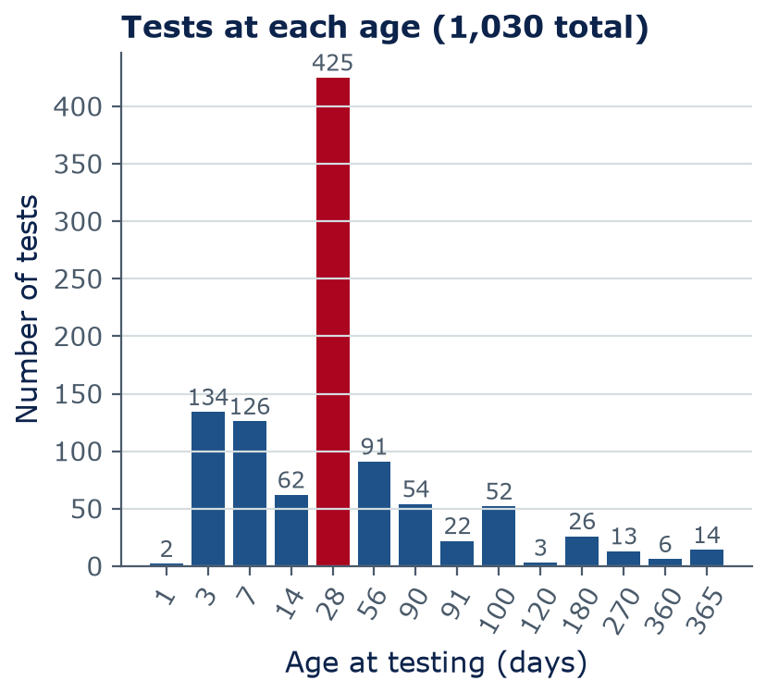
Data is a design material
A model only knows the range of data it has seen
Our concrete data: 425 of 1,030 tests are at 28 days, but only 14 at 365 days
Cement ranges from 102 to 540 kg/m³ — outside that range, a model is guessing
Laboratory mixes compiled for a 1998 study: field concrete (placement, curing, weather) can differ
Before trusting a model, ask: what data, from where, covering what range?
Data: Yeh (1998), UCI concrete dataset
Notes:
This is a real property of the dataset you will use on lab day. Most tests are at 28 days, the standard test age, so a model will be best there and weakest at one year. The data are laboratory mixes, so we should be careful applying a model to field concrete. In the lab you will make this histogram yourself with one line of code.

Slide 30
Concept check
Will the crack detector still work?
A crack detector scores very well on test photos of clean, dry campus walls. You want to use it on wet, shadowed bridge piers. What is the main concern?
It has too many parameters to run on a laptop
The new photos may not look like the training photos, so performance may drop
A
B
A high test score guarantees it works on any concrete
Crack detection should use reinforcement learning
C
D
Notes:
This is the representativeness idea in one question. Our crack photo dataset really does come from campus buildings at one university, so this is not hypothetical. The fix is to collect and label some photos of bridge piers and test on them before relying on the model.
Answer: B. Representativeness: test on photos like the ones you will really use before trusting it.

Slide 31
Concept check
Will the crack detector still work? — answer
A crack detector scores very well on test photos of clean, dry campus walls. You want to use it on wet, shadowed bridge piers. What is the main concern?
It has too many parameters to run on a laptop
The new photos may not look like the training photos, so performance may drop
A
B
A high test score guarantees it works on any concrete
Crack detection should use reinforcement learning
C
D
Representativeness: test on photos like the ones you will really use before trusting it.
Notes:
Answer: B. Representativeness: test on photos like the ones you will really use before trusting it.

Slide 32
Lab 02
Lab day: working with real engineering data
Load concrete_strength.csv with pandas: head, shape, describe
Select, filter, sort, and group the tests by age; add a water–cement ratio column
Plot with matplotlib: a histogram and scatter plots of strength vs cement, age, and w/c
Name X and y, spot outliers, write short observations
Exit ticket: 3 short questions you answer alone, without AI, at the end of lab
LAB
02
Bring a charged laptop
Open the notebook from the course GitHub page
Notes:
This lab is where data stops being abstract. You will make today's charts yourself. Pandas is the Python library for tables — think of it as a spreadsheet you control with code. No new math; just careful looking at data.

Slide 33
Homework 1
Homework 1 is posted: AI or not? Exploring engineering data
Due end of Week 3 — Sunday 11:59 pm on Brightspace. Handout on GitHub.
AI-FREE
AI-FREE
Part A
Part B
Place 8 systems on the autonomy–adaptivity map, with reasons
Classify 6 tasks as supervised, unsupervised, or reinforcement learning
AI-ASSISTED
AI-FREE
Part C
Part D
Explore the building energy dataset with pandas and plots
A short reflection on AI in your own studies or future work
Notes:
Homework 1 is individual and uses today's ideas plus this week's lab skills. Parts A and B are AI-Free: answer from your own understanding. Part C is AI-Assisted: you may use AI for help, with an acknowledgment. Part D, the reflection, is AI-Free: your own words. Start Part C after the lab, since it uses the same pandas commands.

Slide 34
Wrap-up
Key takeaways
Machine learning flips programming: give it data + answers, and it produces the rules (a model)
1
Features X go in, the target y comes out; one row of data = one example
2
Supervised (regression, classification) · unsupervised (groups, anomalies) · reinforcement (rewards)
3
Deep learning learns its own features; generative AI creates content; foundation models are reused
4
A model is only as good as its data: quality, quantity, labels, and representativeness
5
Notes:
Recap the five ideas. Next week we open the box of supervised learning: the simplest model, a straight line, and the cost function that measures how wrong it is.

Slide 35
Learn more
Readings and resources
Elements of AI, Chapter 4, Section I: The types of machine learning — about 20 min
Google: Introduction to Machine Learning — what ML is and its types, about 20 min
3Blue1Brown: But what is a neural network? — video, 19 min — a preview of Week 5
Course GitHub: Week 2 README — key terms and check-yourself questions
Notes:
Elements of AI chapter 4 matches today's lecture closely. The 3Blue1Brown video is optional but the best visual introduction to neural networks.

