Slide 1

3. How Machines Learn, Part 1
Linear regression and the cost function
Week 3 · CE/ARCE 2XX AI Literacy for Civil and Architectural Engineering
Notes:
Today we open the box of supervised learning. We build the simplest machine-learning model there is — a straight line — and the cost function that measures how wrong it is. Start with the quiz on Week 2.

Slide 2
Agenda
Today's plan
1
Quiz on last week (5–8 min)
2
The problem: predict concrete strength from the water–cement ratio
3
The simplest model: a straight line, and its notation
4
Measuring error: the cost function J(w, b)
5
The cost landscape: a bowl, and its bottom
6
How good is the fit? MAE and R² — and the lab
Notes:
Hand out the Week 2 quiz first (about 6 minutes, AI-Free). Today has more math than the first two weeks, but it is all averages and squares. Remind students that Homework 1 is due this Sunday at 11:59 pm.

Slide 3
Recap
Last week in 60 seconds
1
Rules → learning
2
X and y
Machine learning takes data + answers and produces the rules: a model, ŷ = f(x).
Features X go in; the target y comes out. One row = one example.
3
Three ways to learn
4
Data is a design material
Supervised (regression, classification), unsupervised, reinforcement.
Quality, quantity, labels, representativeness.
Notes:
Quick recap. Today is supervised learning, regression flavor: the target is a number, compressive strength in MPa. Ask: in the concrete data, what are X and y? (Eight ingredients and age; strength.)

Slide 4
Learning objectives
By the end of today, you can…
Write a linear model ŷ = w·x + b and explain w and b in engineering units
✓
Use the notation x⁽ⁱ⁾, y⁽ⁱ⁾, m, and ŷ to describe a dataset
✓
Compute the squared-error cost J(w, b) by hand for a few points
✓
Read a cost curve and a contour map, and say where the best (w, b) is
✓
Judge a fit with MAE (in MPa) and R², and name the limits of a straight line
✓
Notes:
These map directly onto Lab 03 on lab day: you will write predict(), compute_cost(), plot the cost bowl, and search for the best w and b.

Slide 5
01
The simplest model
A straight line through concrete data
Notes:
Section 1: the problem and the model.

Slide 6
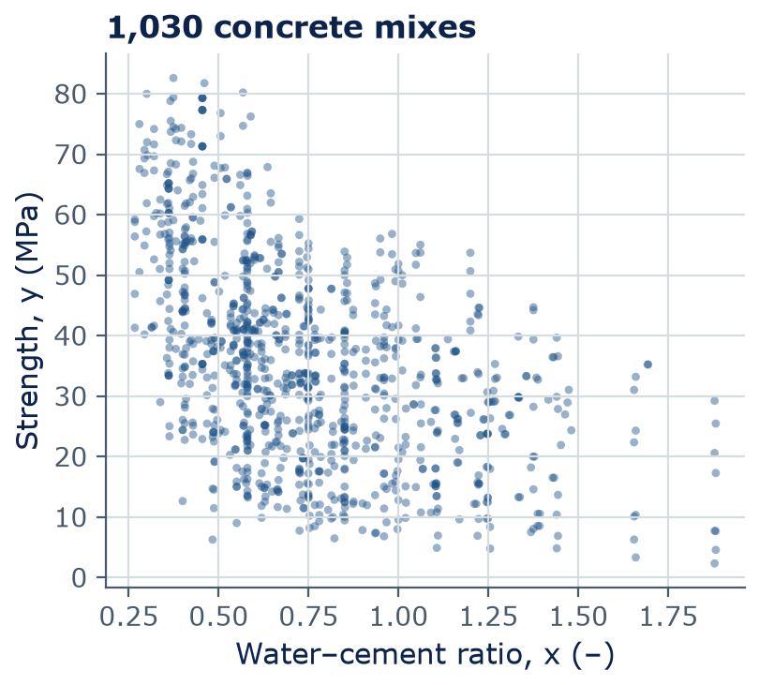
The problem
Can we predict strength from the water–cement ratio?
Water–cement ratio (w/c) = water ÷ cement, both in kg/m³
Engineers have known for a century: more water per kg of cement → weaker concrete
Each dot = one mix from our 1,030-mix dataset
Goal: a model that turns x = w/c into a predicted strength ŷ in MPa
Data: Yeh (1998), UCI concrete dataset (course data folder)
Notes:
This is the running example for two weeks and for Labs 3 and 4. The trend is clear: as the water-cement ratio rises, strength falls. But the cloud is wide, because age and the other ingredients also matter. Our first model uses only one input, so it cannot explain everything. Ask: what strength would you guess for w/c = 0.5? People will say about 40 to 45 MPa. That guess is a model.

Slide 7
Notation
Notation: one row of data = one example (x⁽ⁱ⁾, y⁽ⁱ⁾)
i
Water (kg/m³)
Cement (kg/m³)
x⁽ⁱ⁾ = w/c
y⁽ⁱ⁾ (MPa)
x
input (feature): here the w/c ratio
1
162
540
0.300
79.99
y
target: measured strength, MPa
2
162
540
0.300
61.89
3
228
332.5
0.686
40.27
ŷ
prediction (“y-hat”), MPa
4
228
332.5
0.686
41.05
m
number of examples (1,030)
…
…
…
…
…
m = 1,030
x⁽ⁱ⁾, y⁽ⁱ⁾
the i-th example — (i) is an index, not a power
Notes:
We need a shared language. m is the number of examples: 1,030. The superscript in parentheses is an index, not a power: x-superscript-1 is the first mix's w/c ratio. Look at rows 1 and 2: the same w/c, 0.300, but strengths of 80 and 62 MPa. No line can hit both. That is why every model will have some error — and why we need a way to measure it.

Slide 8
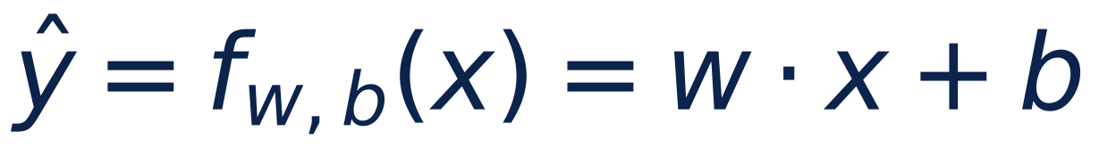
The model
The model is a straight line with two parameters, w and b
x
input: water–cement ratio (no units)
ŷ
predicted compressive strength (MPa)
w
weight = slope: change in ŷ per 1.0 change in x (MPa)
b
bias = intercept: ŷ when x = 0 (MPa)
w, b
the parameters — the numbers the machine learns
Notes:
This is the simplest machine-learning model. f with subscript w, b means: a function whose behavior is set by w and b. w is the slope — we expect it to be negative, because more water per cement means lower strength. b is where the line crosses x = 0; it is not a physical concrete, just where the line sits. Learning means finding good values of w and b from the data. Every bigger model in this course — neural networks, LLMs — is the same idea with more parameters.

Slide 9
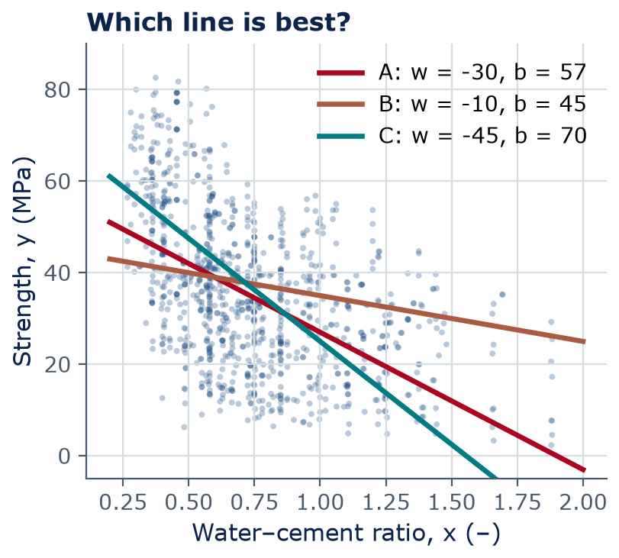
The model
Different w and b give different lines — which is best?
Each pair (w, b) is a different line — a different model
Change w → the line tilts. Change b → the line moves up or down.
By eye, A looks best: B is too flat, C is too steep
Engineers need more than “by eye” — we need a number that scores each line
Notes:
Show how the line moves when w and b change. Increasing w makes the line less steep (w is negative here); increasing b lifts the whole line. In this week's lab you will move these lines yourself with sliders or by changing numbers. The question for the next section: how do we score a line with one number?

Slide 10
The model
Quick calculation: use a model
Use line A: ŷ = −30·x + 57 (MPa)
Predict the strength of a mix with x = 0.45
Then a mix with x = 0.70. Which is stronger, and by how much?
2
min
Solo · then compare
Check: ŷ(0.45) = −13.5 + 57 = 43.5 MPa · ŷ(0.70) = −21 + 57 = 36 MPa · difference 7.5 MPa
Notes:
Show the prompt box only after students try (cover it, or reveal verbally). This makes the point that a model is just a formula you can apply to new mixes. Ask: is 43.5 MPa believable for w/c 0.45? Look back at the scatter — yes, it is in the middle of the cloud for that w/c.

Slide 11
02
Measuring error
The cost function J(w, b)
Notes:
Section 2: one number that scores a line.

Slide 12
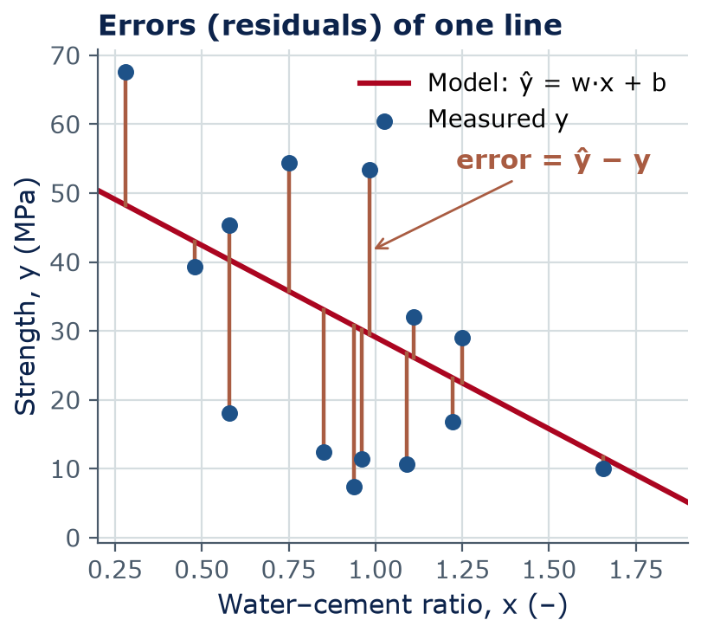
Measuring error
For every example, the error is prediction minus truth
Error (residual) of example i: ŷ⁽ⁱ⁾ − y⁽ⁱ⁾, in MPa
Positive → the model over-predicts (unsafe side for strength!)
Negative → the model under-predicts
A good line keeps all the vertical gaps small — but there are 1,030 of them
Notes:
Each vertical segment is one error. Some points are above the line, some below. Point out the engineering meaning: over-predicting strength is on the unsafe side. We need to combine all the errors into one number. Ask: why not just add them up? Because positives and negatives cancel — a terrible line could have a total error of zero.

Slide 13
Measuring error
Why we square the errors
No canceling
Big misses count more
A smooth bowl
1
2
3
Squares are never negative, so errors of +5 and −5 MPa cannot cancel out.
A 10 MPa miss costs 100; two 5 MPa misses cost 50. Large errors are punished.
Squared error makes a smooth cost curve with one bottom — easy to find with calculus (next week).
Notes:
Squaring is a choice, not a law of nature. It has three nice properties. An alternative is the absolute error, which we will use as a metric (MAE) later today. In engineering terms, squared error is like a penalty that grows quickly for large misses — appropriate when big errors are much worse than small ones.

Slide 14
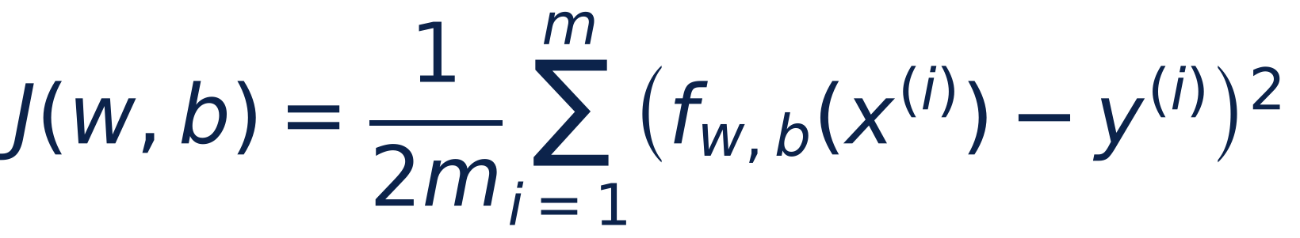
Measuring error
The cost function: the average squared error, halved
f(x⁽ⁱ⁾)
the prediction ŷ⁽ⁱ⁾ for example i
− y⁽ⁱ⁾
minus the measured value → the error
( )²
squared, so every error counts as positive
Σ
add up over all m examples
1/(2m)
average; the ½ makes next week's math simpler
Notes:
Read the formula from the inside out: prediction, minus truth, squared, summed, averaged. The extra one-half does not change which line is best; it just cancels a 2 when we take the derivative next week. Units: MPa squared. A smaller J means a better line. J equals zero only if every prediction is exactly right.

Slide 15
Measuring error
Your turn: compute J by hand for two lines
Mix
x = w/c
y (MPa)
For each line and each mix: compute ŷ
Error = ŷ − y; then square it
Add the three squares
Divide by 2m = 6 → J
Which line is better?
4
min
A
0.4
50
B
0.6
38
C
0.8
30
Pairs
Line 1: ŷ = −50·x + 70
Line 2: ŷ = −30·x + 60
Notes:
Give 4 minutes; pairs can split the work, one per line. Three mixes, values rounded to match the dataset's averages. Walk around and check that students divide by 2m = 6, not by 3. Reveal the answer on the next slide.

Slide 16
Measuring error
Answer: line 1 has the lower cost, so it fits better
Mix | x | y (MPa) | ŷ, line 1 | (ŷ − y)² | ŷ, line 2 | (ŷ − y)²
A | 0.4 | 50 | 50 | 0 | 48 | 4
B | 0.6 | 38 | 40 | 4 | 42 | 16
C | 0.8 | 30 | 30 | 0 | 36 | 36
Sum |  |  |  | 4 |  | 56
J = sum / 6 |  |  |  | 0.67 MPa² |  | 9.33 MPa²
Notes:
Line 1 misses only mix B, by 2 MPa, so J = 4/6 = 0.67 MPa squared. Line 2 misses all three, and the 6 MPa miss on mix C dominates: 36 of the 56. That is the 'big misses count more' property. Homework 2 Part A asks you to do exactly this kind of hand calculation, AI-Free.

Slide 17
03
The cost landscape
Every line is a point on a bowl
Notes:
Section 3: visualize J for all possible lines at once.

Slide 18
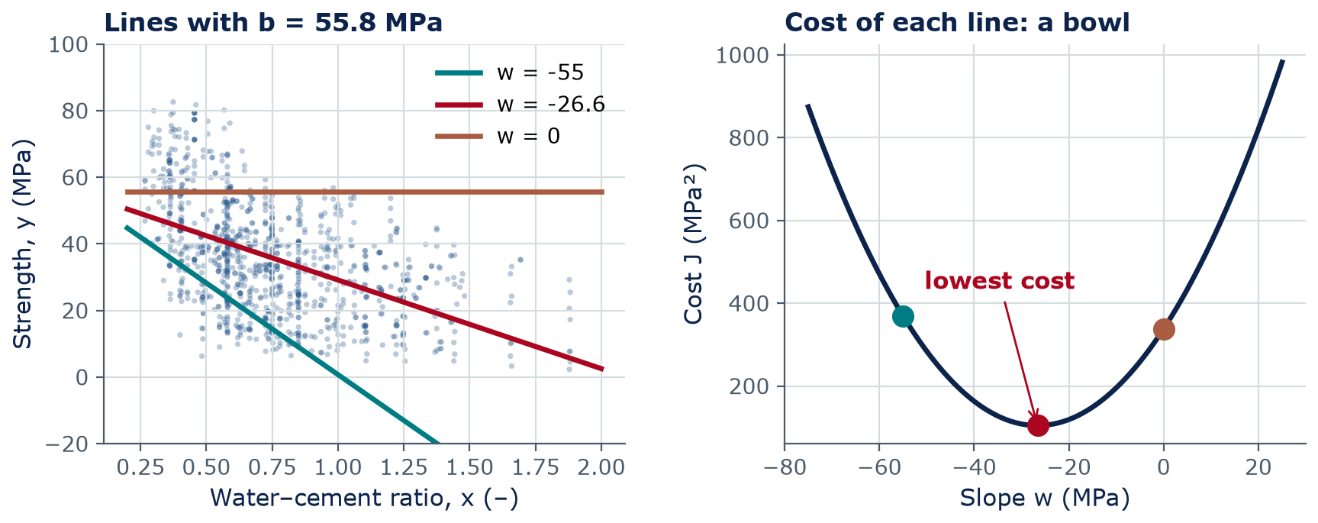
The cost landscape
Each line has a cost; plotting the cost against w gives a bowl
Left: three lines with the same b. Right: J for every w — the red line (w = -26.6 MPa) sits at the bottom.
Notes:
Hold b fixed and change only w. Each line on the left becomes one dot on the right. Too flat (w = 0) or too steep (w = −55) gives a high cost. The best slope sits at the bottom of the bowl. Key idea: we turned 'find the best line' into 'find the lowest point of a curve' — a problem calculus knows how to solve.

Slide 19
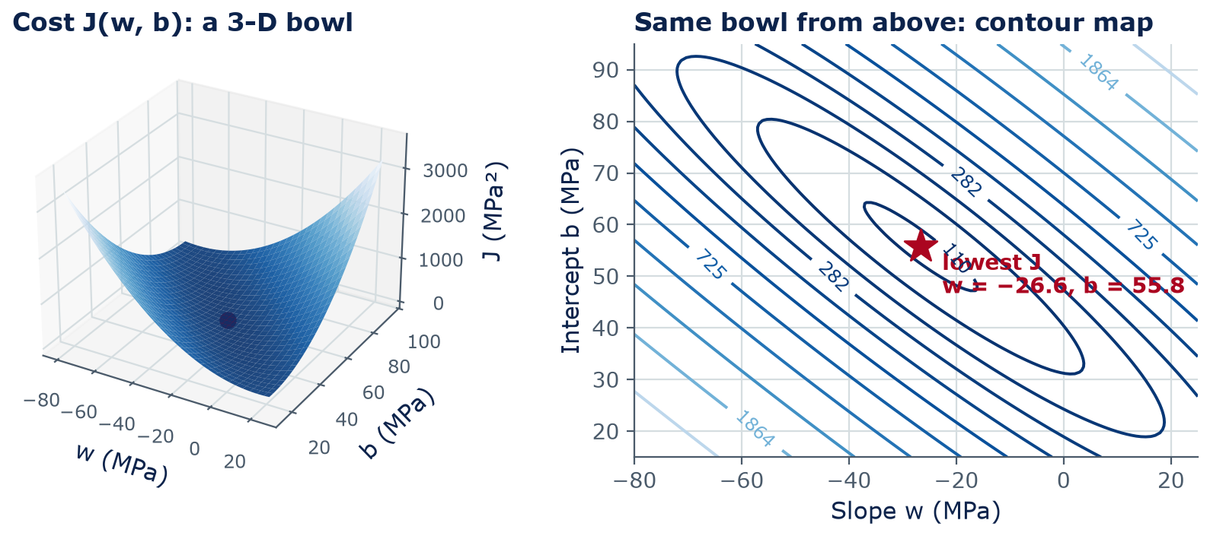
The cost landscape
With two parameters, the cost is a bowl over the (w, b) plane
A contour map is like a topographic map: each ring joins (w, b) pairs with the same cost. The red star is the bottom.
Notes:
Now let both w and b vary. The cost becomes a surface — a long, narrow bowl. On the right, the same bowl seen from above as a contour map, like the topographic maps from surveying class: each ring is a line of equal cost. The rings are stretched ellipses because w and b trade off: a steeper line can be compensated by a higher intercept. The red star is the lowest point. In the lab you will make both plots.

Slide 20
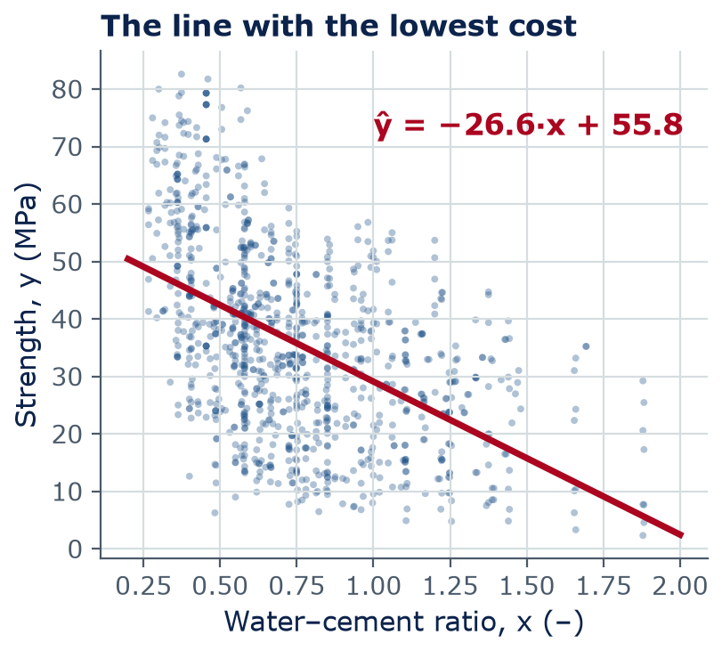
The cost landscape
The bottom of the bowl is the best-fit line
Bottom of the bowl: w ≈ −26.6 MPa, b ≈ 55.8 MPa (J ≈ 104 MPa²)
Each +0.1 in w/c → about 2.7 MPa less strength
At w/c = 0.5: ŷ = −26.6 × 0.5 + 55.8 ≈ 42 MPa
Found here by least squares (numpy.polyfit); next week by gradient descent
Notes:
These are real numbers from the full dataset. The slope says each 0.1 increase in w/c costs about 2.7 MPa of strength on average. For a straight line there is a formula for the bottom (least squares, what numpy.polyfit does). For bigger models there is no formula, so next week we learn the general method, gradient descent. In Lab 03 you will check your own search against polyfit.

Slide 21
Concept check
What happens to J?
Suppose every error of a model doubled (each ŷ⁽ⁱ⁾ − y⁽ⁱ⁾ became twice as large). What happens to the cost J?
J doubles
J becomes 4 times larger
A
B
J stays the same
J is cut in half
C
D
Notes:
Give 60 seconds and vote. This checks whether students understand that J squares the errors. Follow-up: what if every error were zero? J = 0, the bottom of any bowl.
Answer: B. J averages squared errors: (2e)² = 4e², so J becomes 4 times larger.

Slide 22
Concept check
What happens to J? — answer
Suppose every error of a model doubled (each ŷ⁽ⁱ⁾ − y⁽ⁱ⁾ became twice as large). What happens to the cost J?
J doubles
J becomes 4 times larger
A
B
J stays the same
J is cut in half
C
D
J averages squared errors: (2e)² = 4e², so J becomes 4 times larger.
Notes:
Answer: B. J averages squared errors: (2e)² = 4e², so J becomes 4 times larger.

Slide 23
04
How good is the fit?
Metrics in engineering units — and the limits of a line
Notes:
Section 4: J is good for training, but engineers want errors in MPa.

Slide 24
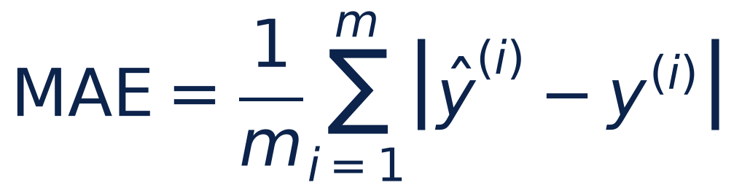
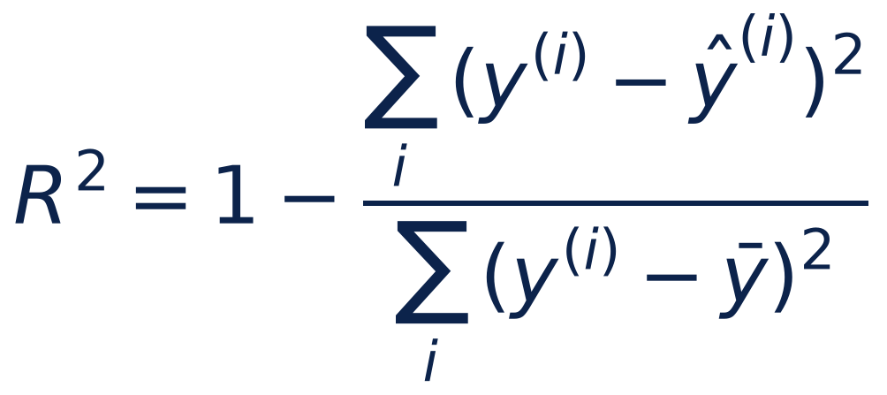
How good is the fit?
Two metrics engineers can read: MAE and R²
MAE: mean absolute error
The average size of a miss, in MPa
Smaller is better; 0 = perfect
R²: coefficient of determination
Share of the variation in y the model explains
1 = perfect · 0 = no better than the average ȳ
Notes:
J is in MPa squared, which nobody can picture. Two more readable metrics. MAE, mean absolute error: the average size of a miss, in MPa — directly comparable to a strength specification. R-squared: the fraction of the variation in strength that the model explains. 1 is perfect; 0 means no better than always predicting the average strength. Next week we add RMSE, the root of the mean squared error.

Slide 25
How good is the fit?
Our best line (all data): right trend, but large errors
11.9 MPa
0.25
2 of 8
MAE (all data): the average miss over all 1,030 mixes
R² (all data): the line explains about 25% of the variation in strength
Inputs used: w/c uses only water and cement — age, slag, fly ash… are ignored
Typical specified concrete strengths are roughly 20–40 MPa, so a 12 MPa average miss is too large to design with.
Notes:
Real numbers for the best line. An average miss of 12 MPa is large compared with typical specified strengths. R² of about 0.25 says the w/c ratio explains a quarter of the variation; the rest comes from age, the other ingredients, and test scatter. The w/c ratio combines only 2 of the 8 input columns into one number, so most information is unused. Next week we use all eight features and the test R² jumps to about 0.6.

Slide 26
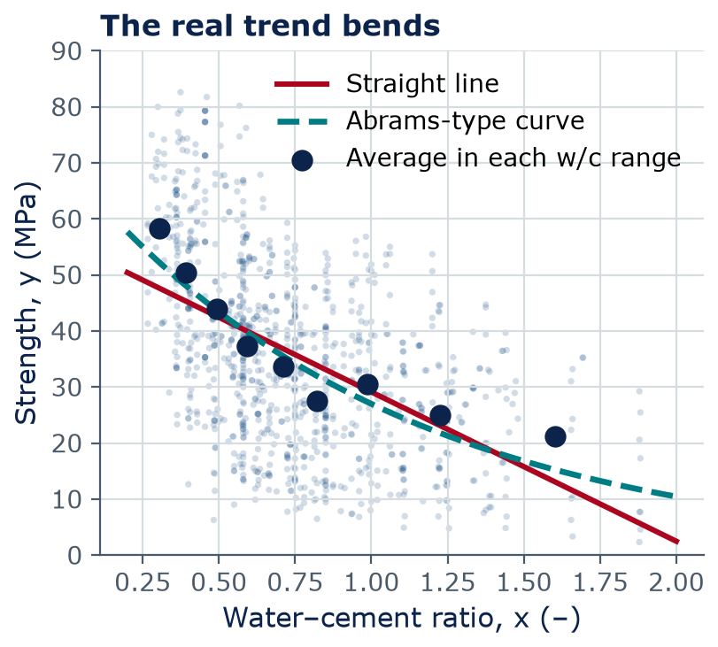
How good is the fit?
The real relationship is curved — a line is an approximation
Abrams' law (1918): strength = A / B^(w/c), with A and B fitted to the materials
Averages (navy dots) fall steeply at low w/c and flatten at high w/c
The line under-predicts at both ends and over-predicts in the middle
Fixes: more features (Week 4) and more flexible models (neural networks, Week 5)
Curve: A = 70 MPa, B = 2.58 (R² 0.28 vs 0.25)
Notes:
Duff Abrams published the water-cement ratio law in 1918 at the Lewis Institute in Chicago. Strength falls roughly exponentially with w/c, so the true trend bends. Our straight line cannot bend, so it is systematically wrong at the ends — a pattern in the errors, not just noise. This is the motivation for more flexible models later in the course. Engineering lesson: always look at the pattern of errors, not just one score.

Slide 27
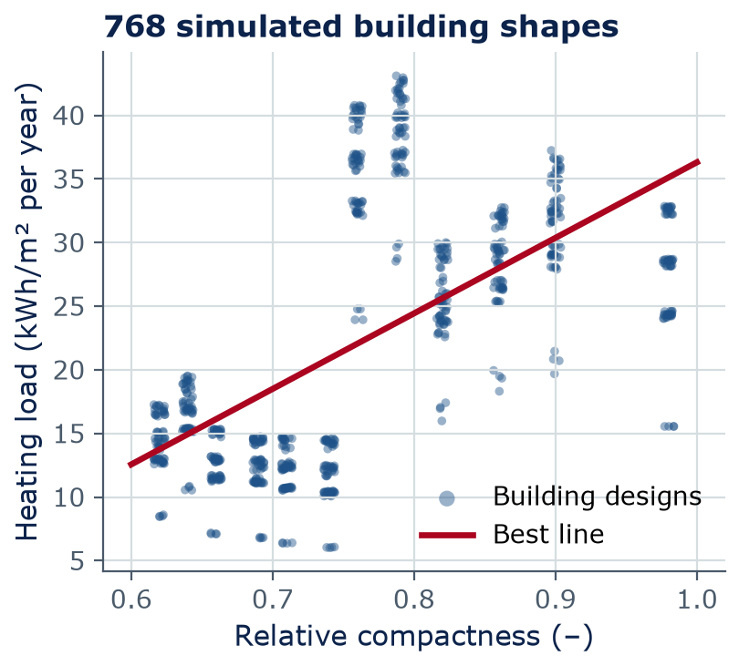
Same recipe, ARCE data
Same recipe on building data: look before you trust a line
x = relative compactness (–), y = annual heating load (kWh/m²)
Best line: ŷ = 59.4·x − 23.1
R² = 0.39, MAE = 6.1 kWh/m²
But look: the points form two separate groups — one line hides that
Why two groups? HW1 Part C6 asks you to find out. Always plot first.
Data: Tsanas & Xifara (2012), UCI energy-efficiency dataset
Notes:
The same model and cost work on any one-feature problem. Here, 768 simulated building shapes. The line 'fits' with R² about 0.39, but the plot shows two separate groups with a gap between them. Do not explain the groups yet: HW1 Part C6 (due Sunday) asks students to color this plot by building height and explain the pattern, so let students wonder; the explanation is in the HW1 key (instructor files), and HW2 Part B5 returns to it. The lesson: plot the data before trusting one number.

Slide 28
The recipe
The machine-learning recipe, so far
1 · Model
2 · Cost
3 · Optimize
4 · Evaluate
Choose a form:
ŷ = w·x + b
Score it with
J(w, b) — average squared error
Find the w, b with the lowest J
(next week: gradient descent)
MAE, R², plots
Would an engineer trust it?
The same four steps train neural networks and large language models — only the model gets bigger
Notes:
This recipe is the backbone of the course. Today we did steps 1, 2 and 4, and step 3 only by searching or by a formula. Next week, step 3 in general: gradient descent. In Weeks 5 to 7 the model changes, but the recipe stays the same.

Slide 29
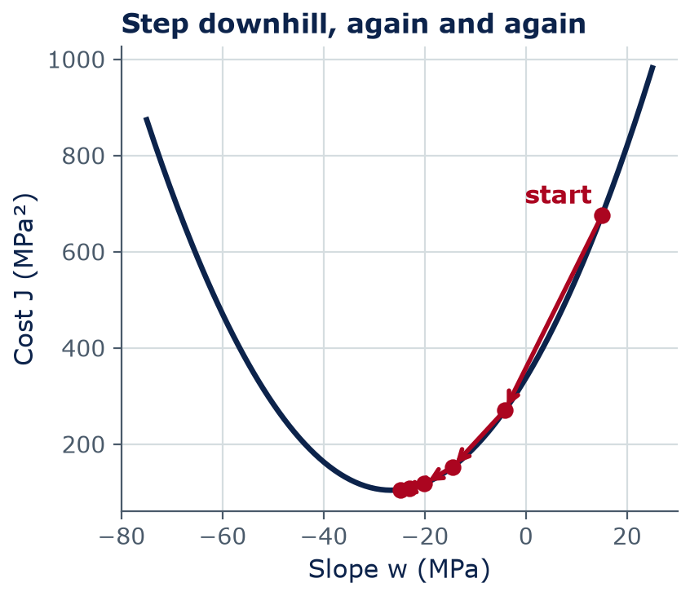
Next week
Preview: find the bottom by walking downhill
Bigger models have no formula for the bottom of the bowl
Instead: start anywhere, check the slope, take a step downhill
Repeat until the cost stops falling
That is gradient descent — how almost every modern AI model is trained
Notes:
Teaser for Week 4. The slope of the cost curve, the derivative, tells you which way is downhill. If you know calculus, this is the derivative of J with respect to w; if not, think of feeling the ground with your foot in fog. This week's lab sets you up for it by plotting the bowl.

Slide 30
Lab 03
Lab day: model representation and cost
Plot strength vs w/c; write predict(x, w, b) and watch the line move as you change w and b
Write compute_cost(x, y, w, b) — today's J, in code
Plot the cost bowl and contour map; search for the best (w, b); check with numpy.polyfit
Exit ticket: 3 short questions you answer alone, without AI, at the end of lab
LAB
03
Bring a charged laptop
Open the notebook from the course GitHub page
Notes:
Everything on today's slides becomes a few lines of Python. Reminder: Homework 1 is due Sunday at 11:59 pm on Brightspace.

Slide 31
Wrap-up
Key takeaways
The simplest model is a line: ŷ = w·x + b; learning = choosing w and b
1
Error = ŷ − y. The cost J(w, b) = average squared error ÷ 2 — one number per line
2
Plotting J over w and b gives a bowl; the bottom is the best-fit line
3
Our concrete line (all data): MAE ≈ 12 MPa, R² ≈ 0.25 — right trend, big errors
4
The real trend is curved (Abrams' law): a line is an approximation — always plot your data
5
Notes:
Five ideas. Homework 1 due Sunday. Next week: gradient descent, more features, and how to check that a model works on data it has never seen.

Slide 32
Learn more
Readings and resources
Google ML Crash Course: Linear regression — the Linear regression and Loss pages (whole module about 80 min)
Elements of AI, Chapter 4, Section III: Regression — short reading with exercises, about 15 min
Course GitHub: Week 3 README — key terms and check-yourself questions
Abrams, D. A. (1918), Design of Concrete Mixtures — Lewis Institute Bulletin 1 — the origin of the w/c law (for the curious)
Notes:
The Google Crash Course module covers exactly today's content with interactive widgets. Its notation is close to ours; note that they call J the 'loss'.

