Slide 1

4. How Machines Learn, Part 2
Gradient descent and generalization
Week 4 · CE/ARCE 2XX AI Literacy for Civil and Architectural Engineering
Notes:
Last week: a model, a cost, and a bowl. Today: how the machine actually finds the bottom of the bowl — gradient descent — and how we check that a model works on data it has never seen. Start with the quiz on Week 3.

Slide 2
Agenda
Today's plan
1
Quiz on last week (5–8 min)
2
Gradient descent: walking downhill, and the learning rate
3
More features, and why we scale them
4
Will it work on new data? Train/test, under- and overfitting, metrics
5
From scratch to scikit-learn — and the recipe behind all modern AI
6
This week's lab day, and Homework 2
Notes:
Hand out the Week 3 quiz first (about 6 minutes, AI-Free). Today is the most important lecture of the first half: gradient descent and generalization are how every model in the rest of the course is trained and judged.

Slide 3
Recap
Last week in 60 seconds
1
A model
2
A cost
A line ŷ = w·x + b, with parameters w and b.
J(w, b) = average squared error ÷ 2. Lower is better.
3
A bowl
4
A verdict
J over all (w, b) is a bowl; the best line is at the bottom.
Best w/c line (all data): MAE ≈ 12 MPa, R² ≈ 0.25 — right trend, big errors.
Notes:
Recap the four ideas. Ask: what are the units of J? (MPa squared.) What did R² of 0.25 tell us? (The w/c ratio alone explains about a quarter of the variation.) Today we fix both problems: how to find the bottom in general, and how to use more information.

Slide 4
Learning objectives
By the end of today, you can…
Explain gradient descent in words and apply the update rule w ← w − α·∂J/∂w
✓
Choose a learning rate α by reading a learning curve
✓
Use several features at once and explain why we scale them
✓
Split data into training and test sets, and spot underfitting and overfitting
✓
Report MAE, RMSE, and R², and fit a model in a few lines of scikit-learn
✓
Notes:
Lab 04 on lab day does each of these in code: you will write gradient descent from scratch, then use scikit-learn on all eight concrete inputs.

Slide 5
01
Gradient descent
Walking downhill in the fog
Notes:
Section 1: how to find the bottom of the bowl without a formula.

Slide 6
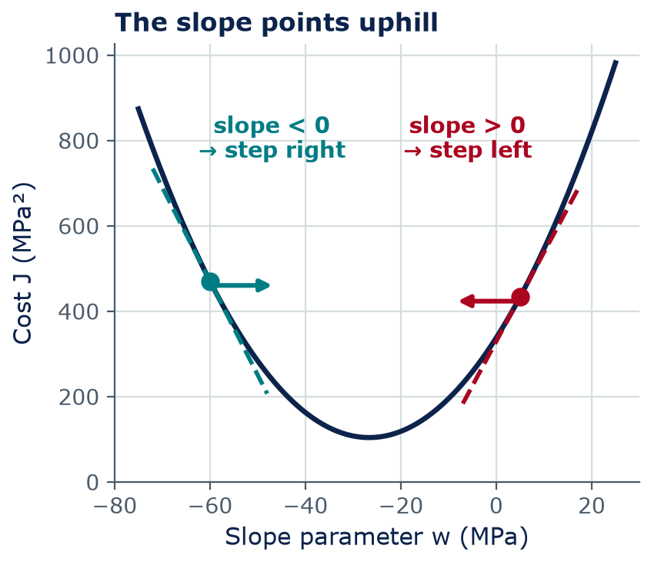
Gradient descent
Walking downhill in the fog: the slope tells you which way to go
You stand on a foggy hillside and want the valley floor. You can only feel the ground under your feet.
Feel the slope, take a step downhill, repeat
The slope of the cost curve is its derivative ∂J/∂w
Slope > 0 → decrease w. Slope < 0 → increase w. Slope = 0 → you are at the bottom.
Notes:
This is the intuition. If you have had calculus, the slope is the derivative of J with respect to w. If not, think of it as 'how much does the cost go up if I nudge w a little to the right?' The rule is simply: move against the slope. Note the symbol ∂ — a 'partial' derivative — just means 'the slope in the w direction, holding b fixed'.

Slide 7
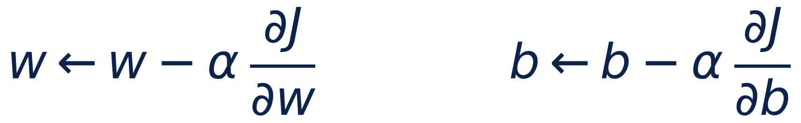
Gradient descent
The update rule: step against the slope, scaled by α
←
“becomes”: replace the old value with the new one
α
learning rate (alpha): how big each step is
∂J/∂w
slope of the cost in the w direction
∂J/∂b
slope of the cost in the b direction
both
compute both slopes first, then update w and b together
Notes:
This one line is how almost every modern AI model is trained, from our two-parameter line to language models with billions of parameters. Minus sign: we go against the slope, downhill. Alpha sets the step size. Important detail: update w and b simultaneously — compute both slopes with the old values first, then change both.

Slide 8
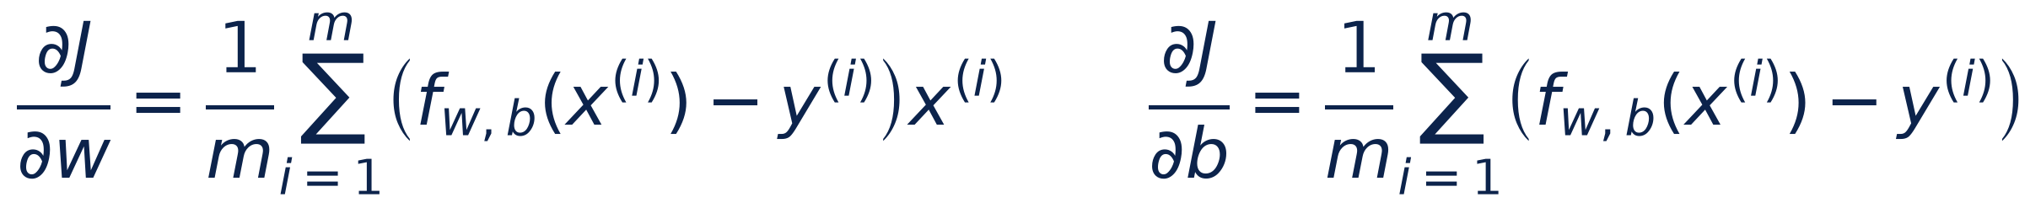
Gradient descent
For a line, the slopes are averages of the errors
∂J/∂b = the average error. If the line predicts too high on average, lower b.
∂J/∂w = the average error × x. Errors at large x push w the most.
You do not need to derive these — the ½ in J makes them simpler. You will code them in Lab 04.
Notes:
These are given, not derived, in this course. Read them in words. The b-slope is just the average error: if predictions are too high on average, it is positive and b goes down. The w-slope weights each error by its x, so mixes with large w/c ratios pull hardest on the slope. The one-half in J cancels the 2 from differentiating the square — that is why we put it there last week.

Slide 9
Gradient descent
Gradient descent from scratch: ten lines of NumPy
# x: w/c ratios (m values), y: strengths in MPa
w, b = 0.0, 0.0 # start anywhere
alpha = 0.5 # learning rate
for step in range(400):
y_hat = w * x + b # predictions (MPa)
err = y_hat - y # errors (MPa)
dj_dw = np.mean(err * x) # slope in w
dj_db = np.mean(err) # slope in b
w = w - alpha * dj_dw # update both,
b = b - alpha * dj_db # using old slopes
print(w, b)
Each loop = one iteration (one step downhill)
np.mean does the (1/m) Σ part
Both slopes are computed before w and b change
After 400 steps: w ≈ −26.6, b ≈ 55.8 — the best line from last week
Notes:
This is essentially what you write in Lab 04. Walk through it line by line. The loop runs 400 times; each time it computes predictions, errors, the two slopes, and takes a step. The result after 400 steps is close to the least-squares answer from last week. More steps get closer.

Slide 10
Gradient descent
One step of gradient descent, by hand
Two mixes: A x = 0.5, y = 44 MPa · B x = 1.0, y = 32 MPa
Start at w = 0, b = 40, learning rate α = 0.5
Compute both errors ŷ − y, then ∂J/∂w and ∂J/∂b (m = 2)
Update w and b. Did the cost J go down?
4
min
Pairs
Check: errors −4 and +8 → ∂J/∂w = (−4·0.5 + 8·1.0)/2 = 3, ∂J/∂b = (−4 + 8)/2 = 2 → w = −1.5, b = 39 → J falls from 20 to about 15.8 MPa²
Notes:
Cover the check box until pairs are done. Common mistakes: forgetting to multiply by x for the w-slope; dividing by 2m instead of m (the ½ is already used up); updating b with the new w. Point out that w moved negative — the right direction, since strength falls as w/c rises. One step does not reach the bottom; the computer simply repeats this thousands of times.

Slide 11
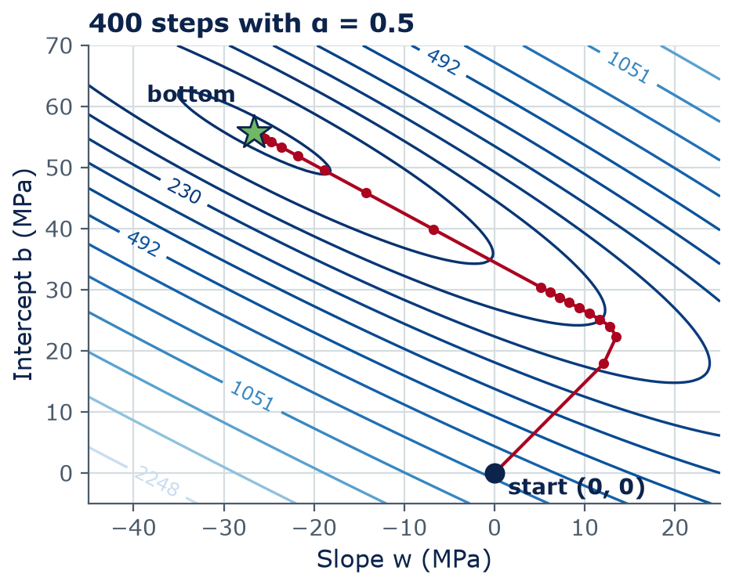
Gradient descent
On the contour map, gradient descent walks to the bottom
Each dot = (w, b) after one step; the path starts at (0, 0)
Steps are big where the bowl is steep, small near the bottom
The path bends: it first drops into the long valley, then crawls along it
Lab 04: you will draw this path for your own learning rates
Notes:
Real data, real algorithm, alpha = 0.5. The first few steps are large because the cost is steep there. Then the path reaches the valley floor and moves slowly along it, because the valley is long and flat in one direction. That slow crawl is a hint about feature scaling, coming up in Section 2.

Slide 12
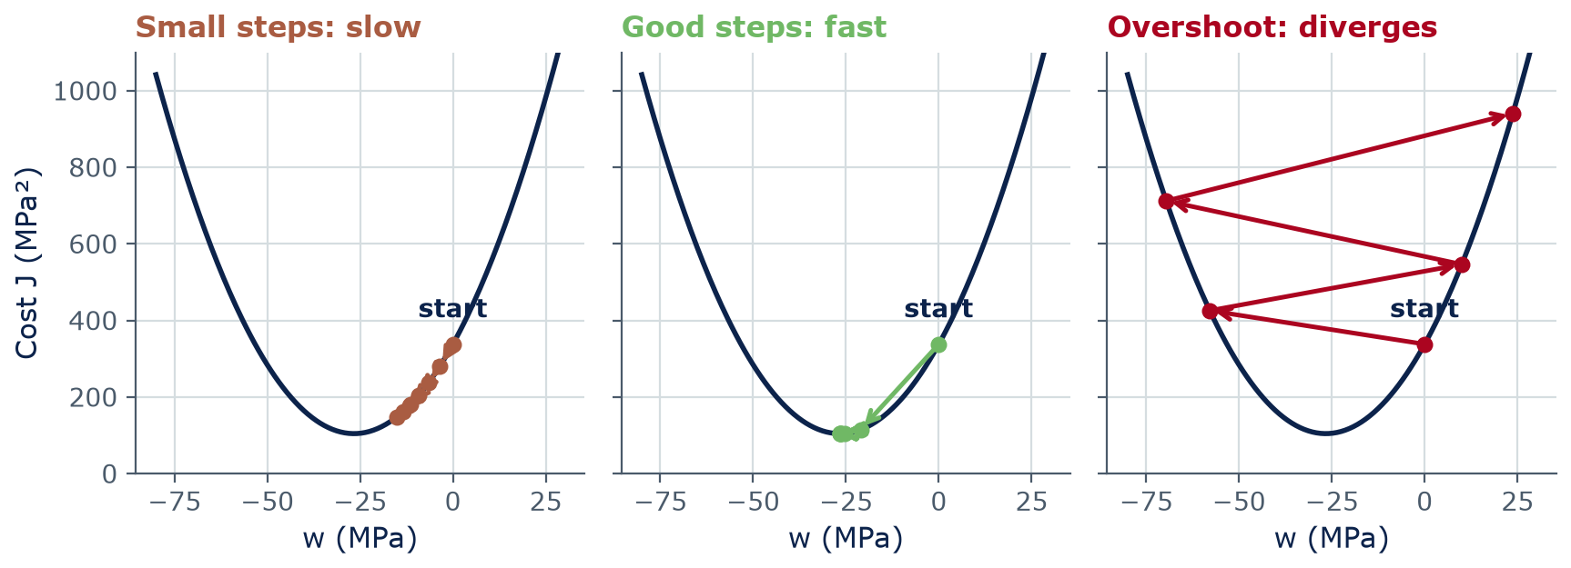
Learning rate
The learning rate α sets the step size: too small, about right, too large
Cost J vs w with b held fixed (6 steps from w = 0). When w and b both move (Lab 04), the limit on this data is ≈1.25.
Notes:
Same bowl, three step sizes. Small steps: safe but slow — after six steps we are still far up the side. Good steps: reach the bottom in a few steps. Overshoot: each step jumps past the bottom to a higher point on the other side, and the cost grows — divergence. Important: this picture holds b fixed so we can draw J as a curve (here α = 0.2, 1.2 and 3.3; with b fixed the limit is about 3.0). When w and b both move, as in Lab 04 and HW2, the bowl is steeper in one direction and the limit on this data is about 1.25 — which is why α = 1.3 diverges on the next slide. The safe values always depend on the data, so we try several (0.001, 0.01, 0.1, 1) and read the learning curve.

Slide 13
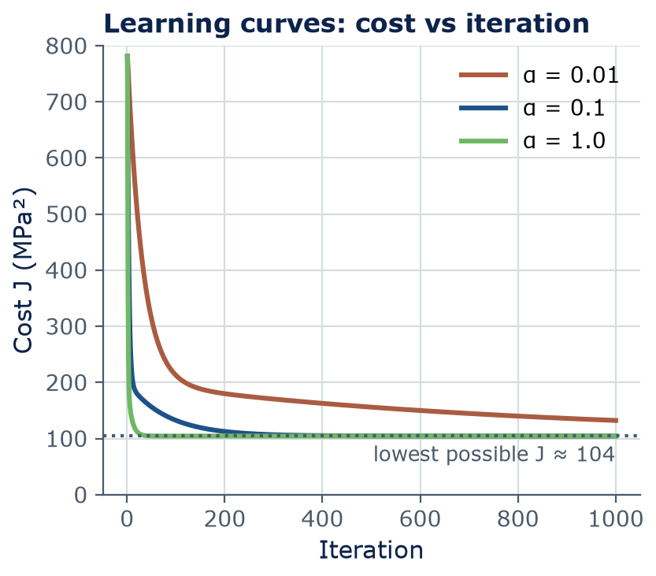
Learning rate
A learning curve shows whether training is working
Plot cost J after each iteration — it should go down and flatten
α = 0.01: still falling slowly after 1,000 steps
α = 1.0: flat within about 100 steps → converged
α = 1.3 (w and b both moving): J explodes — over a billion MPa² after 100 steps
Rule of thumb: try α = 0.001, 0.01, 0.1, 1 and keep the fastest one that still goes down
Notes:
The learning curve is the main diagnostic for any training run, including neural networks in Week 5. Going down and flattening means converged. Going down slowly means alpha is too small or you need more iterations. Going up, or showing 'nan' or 'inf' in the output, means alpha is too large. The dotted line is the lowest possible cost for a straight line on this data.

Slide 14
Concept check
Read the learning curve
You run gradient descent and the cost J gets LARGER every iteration. What should you do first?
Run more iterations
Make the learning rate α smaller
A
B
Make the learning rate α larger
Add more features
C
D
Notes:
Vote with fingers. More iterations would only make it worse. A larger alpha makes it diverge faster. This exact situation happens in Lab 04 when you try a learning rate that is too big.
Answer: B. A rising cost means each step overshoots the bottom: reduce α (e.g., by a factor of 10).

Slide 15
Concept check
Read the learning curve — answer
You run gradient descent and the cost J gets LARGER every iteration. What should you do first?
Run more iterations
Make the learning rate α smaller
A
B
Make the learning rate α larger
Add more features
C
D
A rising cost means each step overshoots the bottom: reduce α (e.g., by a factor of 10).
Notes:
Answer: B. A rising cost means each step overshoots the bottom: reduce α (e.g., by a factor of 10).

Slide 16
02
More features
Using all eight inputs — and scaling them
Notes:
Section 2: one feature explained only a quarter of the variation. Use more information.

Slide 17
More features
With many features, each one gets its own weight
x₁ … x₈
the 8 inputs: 7 ingredients (kg/m³) and age (days)
w₁ … w₈
one weight per feature (MPa per unit of that feature)
w · x
dot product: multiply matching pairs and add them up
b
bias (intercept), MPa
same recipe
same cost J, same gradient descent — one slope per weight
Notes:
Bold x is now a list (vector) of eight numbers, one row of the concrete table. Bold w is a list of eight weights. The dot product is just multiply-and-add. Nothing else changes: the cost is still the average squared error, and gradient descent updates all nine parameters at once, each with its own slope.

Slide 18
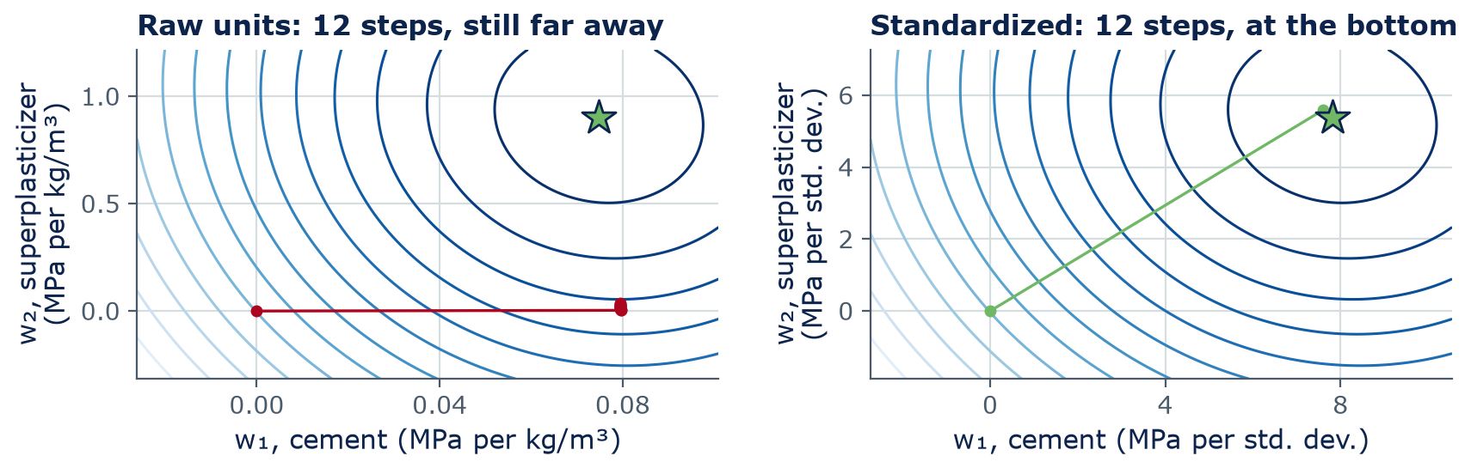
More features
Features on very different scales slow gradient descent down
Standardize each feature:
z = (x − mean) ÷ standard deviation
scikit-learn: StandardScaler
fit it on the training data only
Notes:
Real data, two features: cement (102 to 540 kg/m³) and superplasticizer (0 to 32 kg/m³). Each panel shows 12 gradient-descent steps from (0, 0) with the largest learning rate that does not bounce. In raw units the cement weight is very sensitive and the superplasticizer weight is not, so the bowl is a long, narrow trough: the safe step size is set by the steep direction, and progress along the flat direction is painfully slow — after 12 steps the path is still far from the star. After standardizing, both features have the same scale, the bowl is round, and 12 steps reach the bottom. Fit the scaler on training data only, so no information leaks from the test set. Lab 04 shows the same speed-up on the w/c ratio.

Slide 19
03
Will it work on new data?
Train/test splits, underfitting, overfitting, metrics
Notes:
Section 3: the question every engineer should ask about any model.

Slide 20
Generalization
Hold back data the model never sees: the test set
All 1,030 concrete mixes, shuffled at random
Training set · 80% · 824 mixes
the model learns w and b from these
Test · 20%
206 mixes
1 · Fit
2 · Tune
3 · Test once
Learn the parameters on the training set only
Pick settings (α, degree) with a validation set carved from training
Report errors on the test set — the honest estimate
Never train on the test set: grading a model on its own homework flatters it
Notes:
A model that does well on the data it trained on may still fail on new mixes. So we hide some data. Here 80 percent, 824 mixes, is for training; 20 percent, 206 mixes, is the test set, used once at the end — like a final exam you have not seen. When we also need to choose settings such as the learning rate or polynomial degree, we carve a validation set out of the training data, so the test set stays untouched. random_state=42 makes the random split repeatable, so your lab numbers match mine.

Slide 21
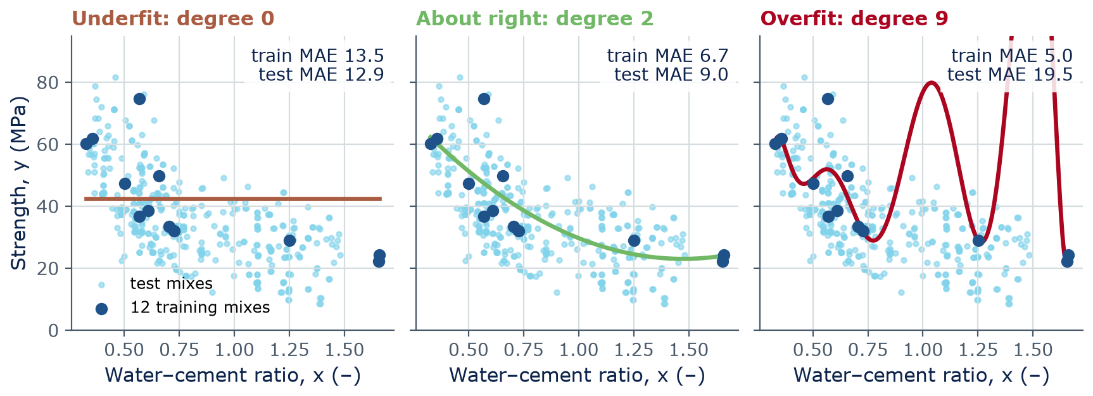
Generalization
Too simple underfits; too flexible overfits
Polynomials in w/c fitted to 12 random 28-day mixes (dark dots); light dots are other 28-day mixes used as a test set. Errors in MPa.
Notes:
Real concrete data, 12 training mixes. Left: a constant ignores w/c completely — high error everywhere: underfitting. Middle: a gentle curve follows the trend. Right: a degree-9 polynomial bends to pass near all 12 points, so its training error is the smallest (5.0 MPa), but between the points it swings wildly and its test error is 19.5 MPa. It memorized noise. That is overfitting.

Slide 22
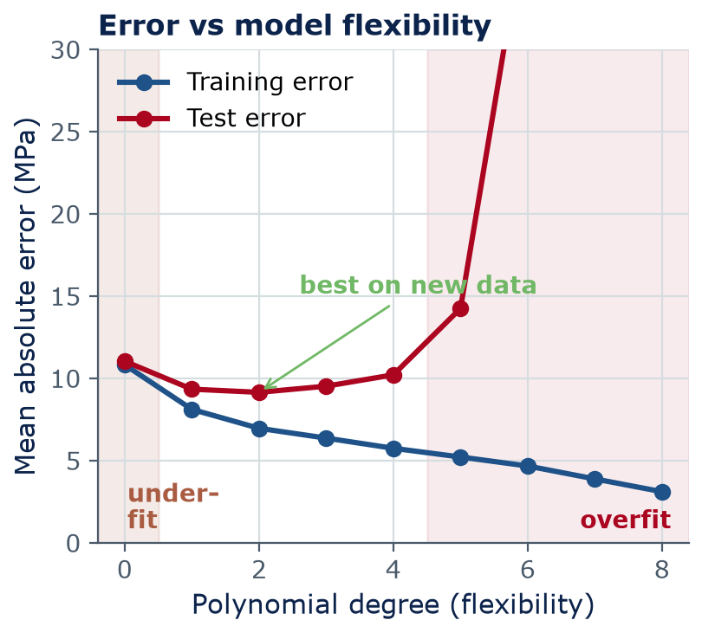
Generalization
Training error always falls with flexibility; test error does not
Underfitting: high error on training and test — the model is too simple
Overfitting: low training error, high test error — the model memorized noise
The sweet spot is where test error is lowest
Fixes for overfitting: more data, a simpler model, regularization, early stopping (Week 5)
Average of 100 random draws of 12 training mixes
Notes:
Averaged over 100 random training sets of 12 mixes, so it is not luck. Training error always goes down as the model gets more flexible — that is why training error alone is misleading. Test error first falls, then rises. With only 12 points, the best is a low degree. With more data, more flexible models can pay off — which is why big neural networks need big datasets.

Slide 23
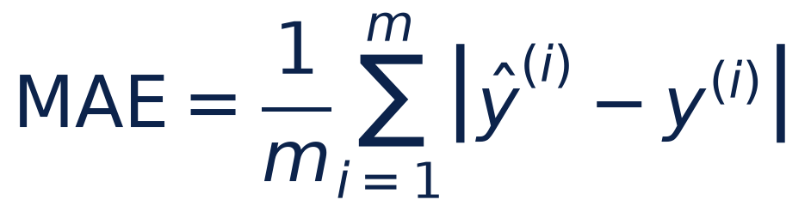
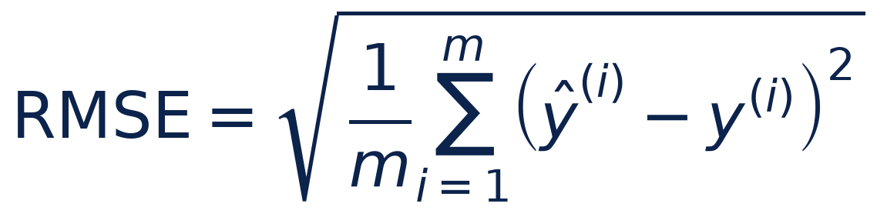
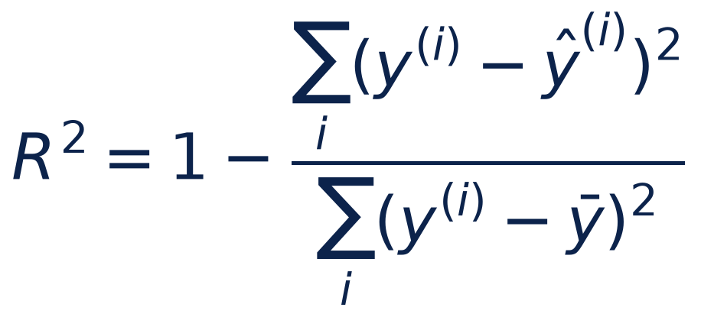
Metrics
Three numbers to report: MAE, RMSE, and R²
MAE (MPa)
Typical size of a miss
RMSE (MPa)
Like MAE, but big misses count more
R² (no units)
1 = perfect; 0 = baseline (always predict the average)
Notes:
MAE is the average size of a miss, in MPa. RMSE squares first, averages, then takes the root: also in MPa, but larger misses weigh more, so RMSE is always at least as large as MAE. A big gap between them means a few large misses. R² is the share of variation explained: 1 is perfect, 0 is no better than a baseline — the simplest possible model, which always predicts the average strength of the training mixes. Every model should beat its baseline. Always report errors on the test set, in engineering units.

Slide 24
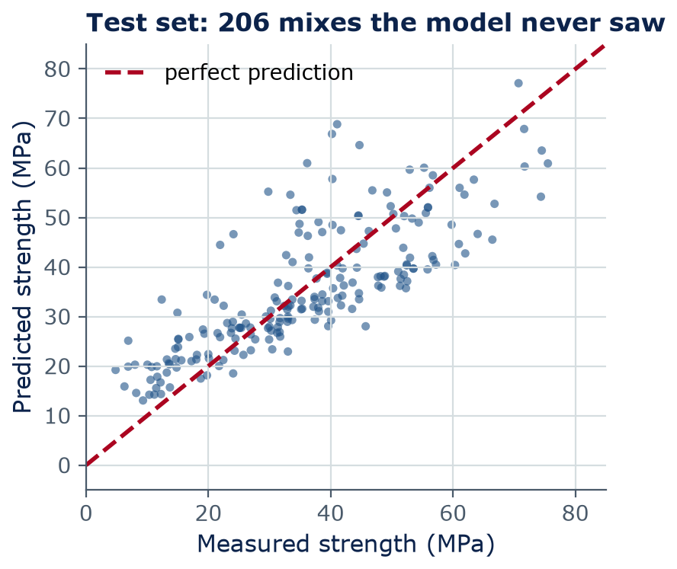
Metrics
All eight features: test error drops by a third
Test set (206 unseen mixes): MAE 7.7 MPa, RMSE 9.8 MPa, R² 0.63
w/c ratio alone (same test set): MAE 11.3 MPa, RMSE 13.7 MPa, R² 0.27
Training R² 0.61 ≈ test R² 0.63 → no sign of overfitting
Points spread widely around the diagonal: still not good enough to replace cylinder tests
Notes:
These are the numbers you should get in Lab 04 with test_size=0.2 and random_state=42. Using all eight inputs cuts the average miss from about 11 to about 8 MPa and lifts R² from about 0.27 to 0.63. Training and test scores are similar, so this simple model is not overfitting; if anything it underfits, because strength depends on the inputs in curved ways, like age. Neural networks next week do better on this same data. Note: last week's MAE of 11.9 MPa and R² of 0.25 for the w/c line were on all the data; today's 11.3 MPa and 0.27 are on the 206 test mixes only, so they differ slightly.

Slide 25
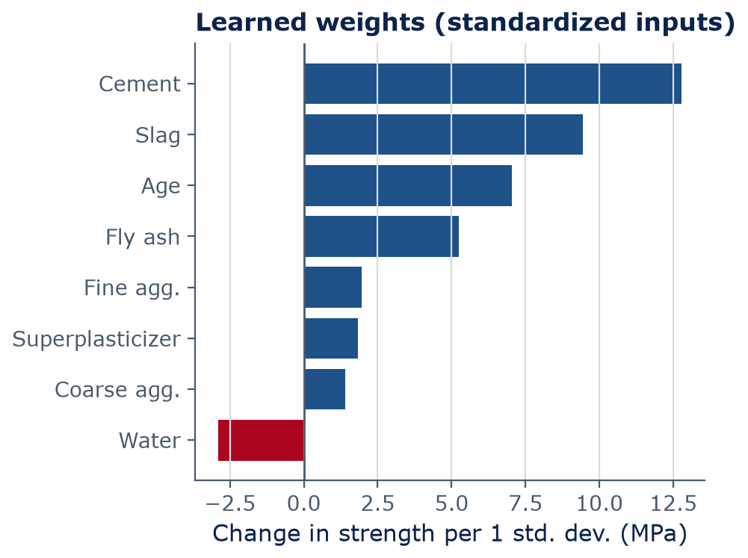
Metrics
Read the learned weights — carefully
Each bar = change in strength (MPa) when that input rises by one standard deviation, others fixed
Cement, slag, and age push strength up the most — as engineers expect
Water's bar is short (-2.9 MPa per SD) because water varies little here (SD ≈ 21 kg/m³ vs 107 for cement); per kg, its effect matches Abrams' law
These are associations in this dataset, not proven causes
Notes:
This is Lab 04 section 6.4, 'interpret with care'. Because the inputs were standardized, each weight is the change in predicted strength (MPa) when that input rises by one standard deviation while all the other inputs stay the same. Cement, slag (a cement-like binder), and age dominate. Water's bar is short because water varies little in this dataset (SD ≈ 21 kg/m³ vs ≈ 107 for cement). Per kg, water's effect is about -0.14 MPa per kg/m³, as large as cement's (+0.12) and in the opposite direction — consistent with Abrams' law. Caveats: these are associations in this dataset, not proven causes. Ingredients that tend to appear together share credit: water is correlated with superplasticizer (r ≈ -0.66) and fine aggregate (r ≈ -0.45), though hardly with cement (r ≈ -0.08). And 'all other inputs fixed' is impossible at constant volume. Never read a regression weight as a physical law without engineering judgment.

Slide 26
Metrics
Would you sign off on this model?
A supplier proposes: use the 8-feature model (test MAE ≈ 8 MPa) instead of 28-day cylinder tests on a parking garage
With a partner: list two reasons to say no and one good use of the model
Be ready to share
4
min
Think · Pair · Share
Think about: the size of the error vs the specified strength · mixes outside the data range · who is responsible if the slab is weak
Notes:
Expected answers. Reasons to say no: an average miss of about 8 MPa (and larger worst cases) is too big compared with specified strengths of roughly 20 to 40 MPa; the data are laboratory mixes from one 1998 study, not this supplier's materials; the engineer of record is responsible, and codes require acceptance testing. Good uses: screening trial mixes before testing, flagging suspicious test results, planning. Tie back to Week 1: engineers stay responsible.

Slide 27
04
From scratch to scikit-learn
…and the recipe behind neural networks and LLMs
Notes:
Section 4: the professional tools, and the big picture.

Slide 28
scikit-learn
The whole workflow in scikit-learn: split, scale, fit, score
from sklearn.model_selection import train_test_split
from sklearn.preprocessing import StandardScaler
from sklearn.linear_model import LinearRegression
from sklearn.metrics import mean_absolute_error, r2_score
feature_cols = ["cement_kg_m3", "slag_kg_m3", "fly_ash_kg_m3", "water_kg_m3",
"superplasticizer_kg_m3", "coarse_agg_kg_m3", "fine_agg_kg_m3", "age_days"]
X, y = df[feature_cols], df["strength_mpa"] # 8 features; target (MPa)
X_train, X_test, y_train, y_test = train_test_split(
X, y, test_size=0.2, random_state=42)
scaler = StandardScaler().fit(X_train) # learn mean and std (training only)
model = LinearRegression().fit(scaler.transform(X_train), y_train)
y_pred = model.predict(scaler.transform(X_test))
print("MAE:", mean_absolute_error(y_test, y_pred), "MPa") # about 7.7 MPa
print("R2: ", r2_score(y_test, y_pred)) # about 0.63
Notes:
This is the industry-standard library for classic machine learning, and it is the same code as Lab 04 Part 6. Read it in four moves: split first, then scale (fit the scaler on the training set only), then fit, then score on the test set. Every scikit-learn model has the same fit and predict pattern: .fit() learns, .predict() uses what was learned. We list the 8 input columns explicitly, as the lab does, because the lab's table also has a w/c column that must not sneak in as a ninth input. Output: MAE about 7.7 MPa and R² about 0.63. Note: LinearRegression finds the exact bottom with linear algebra, no gradient descent needed; scikit-learn's SGDRegressor uses gradient descent. We wrote gradient descent by hand because it is the method that scales to neural networks.

Slide 29
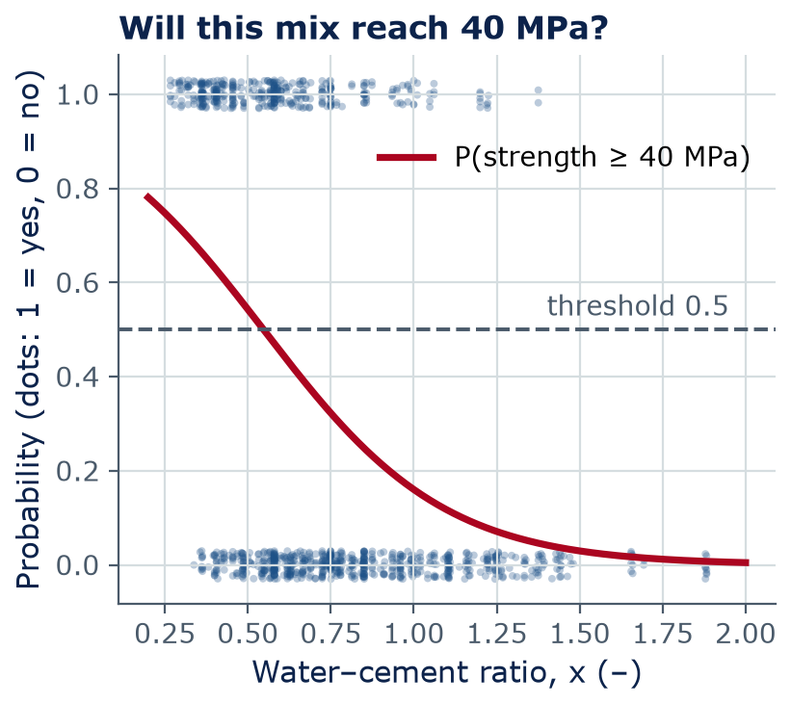
Classification (if time)
From numbers to yes/no: logistic regression in one slide
Same weighted sum z = w·x + b, squeezed by the sigmoid σ(z) = 1 / (1 + e⁻ᶻ) into 0 to 1
Output = a probability; a threshold (often 0.5) turns it into yes/no
Here: P(mix reaches 40 MPa) falls as w/c rises; it crosses 0.5 at w/c ≈ 0.55
Trained the same way: a cost (log loss) + gradient descent
Uses: crack / no crack, poor / fair deck rating (Lab 11)
Notes:
IF TIME (about 3 minutes): skip this slide if the lecture is running late — Week 6 returns to classification with a confusion matrix, precision, and recall. Classification in one slide. Label each mix 1 if strength is at least 40 MPa (about 37% of mixes) and 0 otherwise. Logistic regression computes the same weighted sum as linear regression, then squeezes it through the S-shaped sigmoid so the output is a probability. The cost is different (log loss, which punishes confident wrong answers), but it is still minimized by gradient descent. The threshold is an engineering choice: for safety you might require 0.9, not 0.5. Despite its name, logistic regression is a classification method.

Slide 30
The big picture
The same recipe trains neural networks and large language models
 | Linear regression (Weeks 3–4) | Neural network (Weeks 5–6) | Large language model (Weeks 7–8)
Model | ŷ = w·x + b | Layers of weighted sums + nonlinear functions | A transformer that predicts the next word piece
Parameters | 2 to 9 | Hundreds to millions | Billions (Qwen2.5-0.5B: about 0.5 billion)
Cost | Squared error | Squared error or log loss | Log loss on the next word piece
How it learns | Gradient descent | Gradient descent + backpropagation | Gradient descent + backpropagation, on many GPUs
Notes:
This is the punchline of Weeks 3 and 4. Model, cost, gradient descent: the same recipe trains the small model you ran in Lab 01 and the chat assistants you use. What changes is the size of the model and the data. Backpropagation, in Week 5, is just an efficient way to compute all the slopes at once. When someone says an AI was 'trained', you now know what that means: a cost was pushed downhill, step by step.

Slide 31
Lab 04
Lab day: gradient descent, from scratch and with scikit-learn
Code the gradients and the descent loop for one feature (w/c ratio)
Plot the path and learning curves; try α = 0.001, 0.01, 0.1, 1.0, and 1.3; scale features
All 8 concrete inputs with scikit-learn and a train/test split
MAE, RMSE, R² against a baseline (always predict the average); predicted vs actual; weights
Exit ticket: 3 short questions you answer alone, without AI, in the last 10 minutes of lab
LAB
04
Bring a charged laptop
Open the notebook from the course GitHub page
Notes:
Everything from today. The from-scratch part is short, maybe ten lines; the scikit-learn part is the same as the code slide. Your test numbers should match today's slides because we use the same split.

Slide 32
Homework 2
Homework 2 is posted: Fit, Measure, Descend
Due end of Week 5 — Sunday 11:59 pm on Brightspace. Individual.
AI-FREE
AI-ASSISTED
Part A — By hand
Part B — From scratch
Cost J and one gradient-descent step for three concrete mixes
Heating load from relative compactness; a learning-rate experiment
AI-ASSISTED
AI-ASSISTED
Part C — scikit-learn
Part D — Memo
8 design features, train/test split; MAE, RMSE, R²
Can a quick model replace a full energy simulation at the concept stage?
Notes:
Homework 2 uses the building energy dataset, so it is the same recipe on new data. Part A (cost and one descent step by hand, calculator only) is AI-Free and is good exam practice. The rest is AI-Assisted: you may use AI for help with code, with an acknowledgment, and you are responsible for every line. Start after this week's lab day.

Slide 33
Wrap-up
Key takeaways
Gradient descent: step downhill with w ← w − α·∂J/∂w (same for b), and repeat
1
The learning rate α must be tuned: too small is slow, too large diverges — check the learning curve
2
Several features: ŷ = w·x + b with one weight each; standardize features so descent is fast
3
Judge a model on a held-out test set: watch for underfitting and overfitting; report MAE, RMSE, R²
4
Model + cost + gradient descent is the recipe behind neural networks and LLMs
5
Notes:
Five ideas that carry the rest of the course. Next week: neural networks — the model changes, the recipe does not.

Slide 34
Learn more
Readings and resources
Google ML Crash Course: Gradient descent (and the Hyperparameters page after it) — interactive, about 30 min
Google ML Crash Course: Datasets, generalization, and overfitting — read “Dividing the original dataset” and “Overfitting”
3Blue1Brown: Gradient descent, how neural networks learn — video, 21 min — a bridge to Week 5
scikit-learn user guide: Linear models — reference for the lab
Notes:
The 3Blue1Brown video shows gradient descent on a neural network; watch it before next week.

