Slide 1

5. Neural Networks, Part 1
Neurons, layers, and training
Week 5 · CE/ARCE 2XX AI Literacy for Civil and Architectural Engineering
Notes:
Welcome back. Start with the 6-minute quiz on Week 4 (gradient descent and generalization). Today we take the straight line from Weeks 3 and 4 and turn it into a neural network: neurons, layers, the forward pass, and how training works. On lab day: your first neural network on building-energy data.

Slide 2
Agenda
Today's plan
1
Quiz on last week (Week 4)
2
From a line to a neuron
3
Layers and the forward pass
4
How networks learn
5
Case study: heating load of buildings
6
Lab 05 preview and wrap-up
Notes:
Hand out the quiz first (5-8 minutes, closed notes, AI-Free). Then four sections. The whole lecture builds on one idea from Weeks 3 and 4: a model with weights, a cost, and gradient descent. Neural networks use exactly that recipe with many more weights. Reminder: HW2 is due this Sunday.

Slide 3
Recap
Last week in 60 seconds
1
Walk downhill
2
Learning rate α
Gradient descent repeats w ← w − α·∂J/∂w (and the same for b) until the cost J stops falling.
Too small: painfully slow. Too big: the steps overshoot and the cost blows up.
3
Test on unseen data
4
Overfitting
Train on one part of the data; report MAE, RMSE, and R² on a test set the model never saw.
A model that fits the training data too closely does worse on new data. Simple models can underfit.
Notes:
Ninety-second recap. Ask: what does the minus sign in the update rule do? (It moves w opposite to the slope, i.e., downhill.) Keep these four ideas in view: today every one of them comes back, just with more weights.

Slide 4
Learning objectives
By the end of today, you can…
Explain a neuron as a weighted sum plus an activation, and why the activation must be nonlinear
✓
Compute a forward pass by hand for a tiny network and count its parameters
✓
Describe training in words: loss, gradient descent, backpropagation, epochs, and batches
✓
Recognize overfitting in a learning curve and explain early stopping
✓
Compare a neural network with linear regression on building heating load
✓
Notes:
These five objectives map onto Lab 05 and Part A of HW3 (forward pass and parameter count by hand). Objective 2 is a likely midterm question, so we will practice it in class.

Slide 5
01
From a line to a neuron
Week 3's straight line, plus one bend
Notes:
Section 1, about 15 minutes. We build a neuron from what students already know.

Slide 6
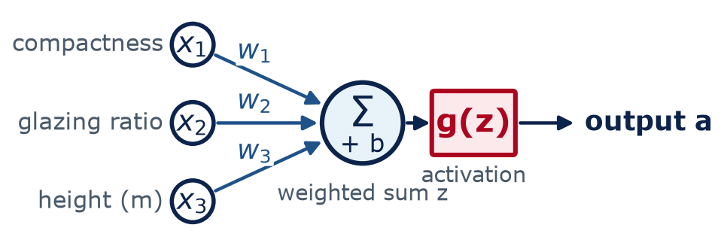
From a line to a neuron
A neuron is Week 3's line plus one extra step
Same as Week 3
Weighted sum of the inputs plus a bias: z = w₁x₁ + w₂x₂ + w₃x₃ + b
New: an activation
g(z) bends the result before it is passed on
Many neurons
Connected in layers, neurons form a neural network
Notes:
Point at the diagram from left to right. Inputs could be features of a building: compactness, glazing ratio, height. Each input is multiplied by its weight, the products are added together with a bias - that is exactly linear regression from Week 3. The only new part is the red box: an activation function that bends the result. Neural networks were loosely inspired by brain cells, but downplay the analogy: a neuron here is a few lines of arithmetic, nothing mysterious.

Slide 7
From a line to a neuron
One neuron, in two short formulas
z
weighted sum — the same thing as Week 3's ŷ = w·x + b
w₁ … wₙ
weights: how strongly each input pushes the output
b
bias: shifts the result up or down
g
activation function: adds a bend (next slides)
a
the neuron's output, passed on to the next layer
Notes:
Read the formula in words: multiply each input by its weight, add them up, add the bias, then apply g. If g did nothing (g(z) = z), a neuron would be exactly the linear regression model from Week 3. The weights and bias are what training adjusts - the network 'learns' by changing these numbers, nothing else.

Slide 8
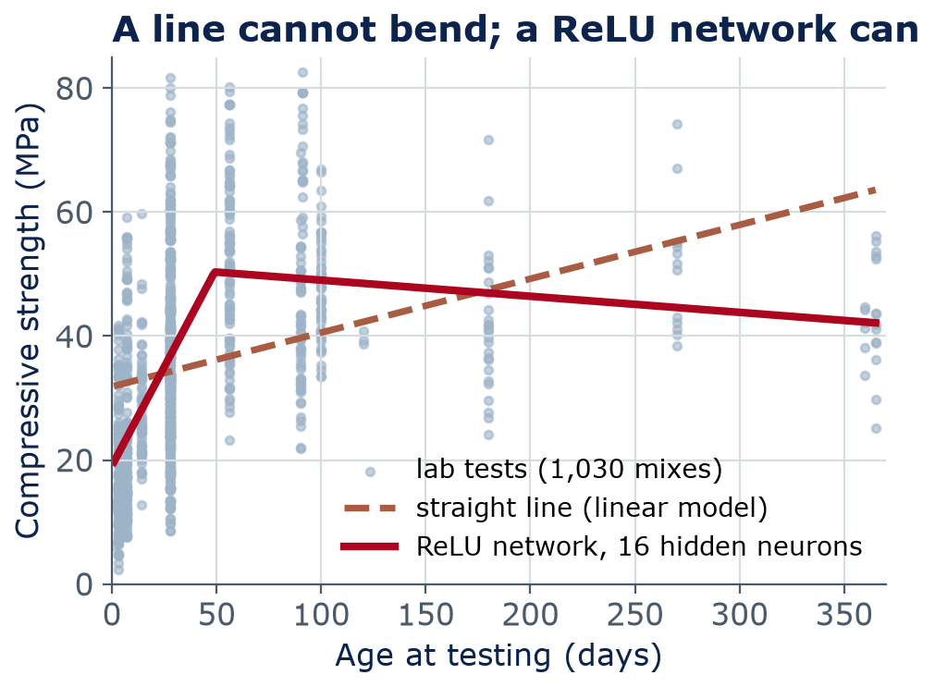
From a line to a neuron
Without a bend, stacked layers collapse into one straight line
Two linear layers, no bend:
Layer 1: h = 2x + 1
Layer 2: ŷ = −0.5h + 3
Combine: ŷ = −0.5(2x + 1) + 3
= −x + 2.5 → still a line
Put a nonlinear activation (like ReLU) between layers, and the network can bend to fit curves.
Notes:
Work the algebra on the left slowly. Two linear layers: h = 2x + 1, then y-hat = -0.5h + 3. Substitute and you get y-hat = -x + 2.5, another straight line. Ten linear layers would still be one line, so depth buys nothing. The chart is real data: 1,030 concrete tests. A straight line (dashed) cannot follow the fast early strength gain; a ReLU network with 16 hidden neurons bends to follow it. The slight dip after about 50 days is NOT concrete losing strength - different mixes were tested at different ages. A model only learns what the data contains, a point we return to in Week 13.

Slide 9
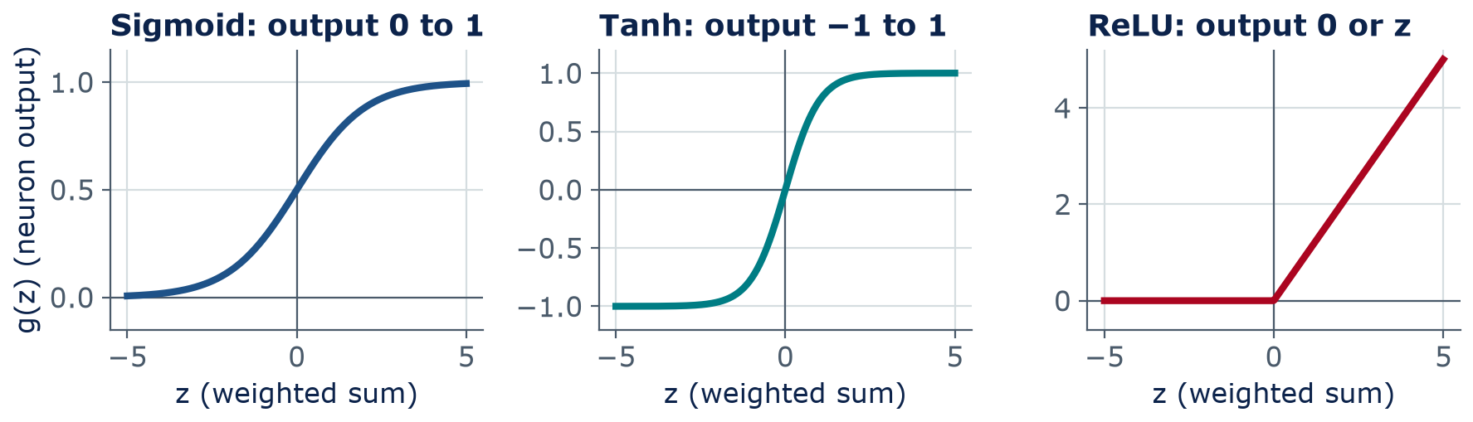
From a line to a neuron
Activation functions add the bend — ReLU is today's default
Sigmoid
Squashes to 0–1. Used for probabilities (Week 4's logistic regression).
Tanh
Squashes to −1 to 1, centered at zero.
ReLU
max(0, z): negative → 0, positive passes. Simple and fast.
Notes:
Three common activation functions. Sigmoid squashes any number into 0 to 1 - it is the function from Week 4's logistic regression, handy when the output is a probability. Tanh squashes into -1 to 1. ReLU, the rectified linear unit, is the simplest: negative numbers become 0, positive numbers pass through unchanged. Most modern networks use ReLU in hidden layers because it is fast and trains well. For a regression output like heating load, the output neuron usually has no activation at all (linear).

Slide 10
Concept check
What can a stack of linear layers represent?
A network has three layers, but NO activation functions — each neuron just computes w·x + b. What can it represent?
Any curve, if the layers are wide enough
Only a straight-line (linear) relationship
A
B
Only on/off step functions
Nothing — it cannot be trained
C
D
Notes:
Give 60 seconds; students vote with fingers (1-4) or a poll. Common wrong answer: A - students assume more neurons always means more power. Point back to the algebra slide.
Answer: B. A line of a line is still a line: the layers collapse into one linear model. The activation is what lets a network bend.

Slide 11
Concept check
What can a stack of linear layers represent? — answer
A network has three layers, but NO activation functions — each neuron just computes w·x + b. What can it represent?
Any curve, if the layers are wide enough
Only a straight-line (linear) relationship
A
B
Only on/off step functions
Nothing — it cannot be trained
C
D
A line of a line is still a line: the layers collapse into one linear model. The activation is what lets a network bend.
Notes:
Answer: B. A line of a line is still a line: the layers collapse into one linear model. The activation is what lets a network bend.

Slide 12
02
Layers and the forward pass
Multiply, add, bend — layer by layer
Notes:
Section 2, about 20 minutes, including a hand calculation.

Slide 13
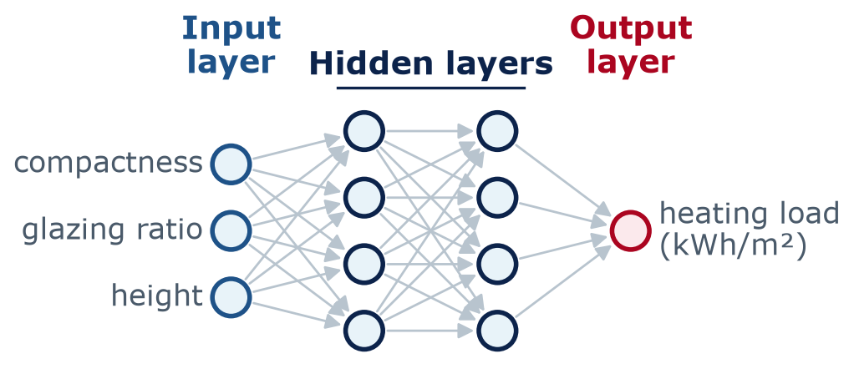
Layers and the forward pass
Neurons are organized in layers
Input layer: the features — nothing is computed here
Hidden layers: build new combinations of the inputs
Output layer: the prediction (kWh/m²)
Each neuron connects to all neurons in the layer before: a multilayer perceptron (MLP)
Deep learning = many hidden layers
A 3–4–4–1 network for heating load
Notes:
Name the layers. 'Hidden' only means we do not observe those values in the data - the network invents them. Every arrow is one weight. This picture is what scikit-learn calls MLPRegressor, which you will train on lab day. 'Deep' has no strict cut-off; in practice it means several or many hidden layers.

Slide 14
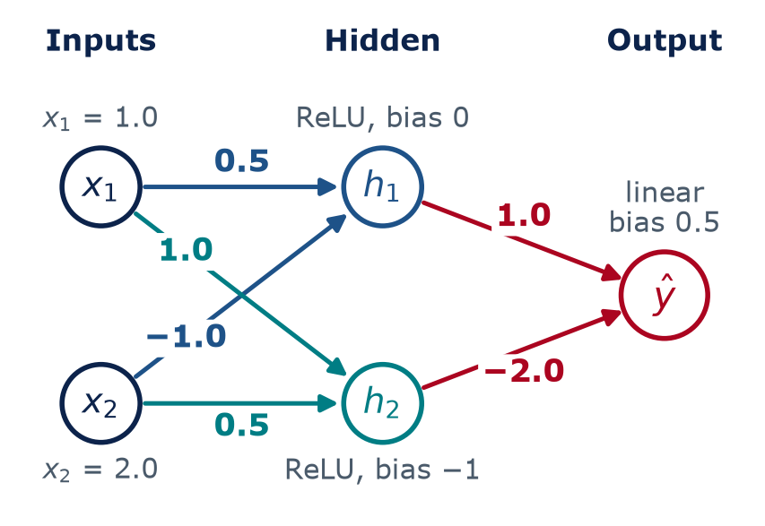
Layers and the forward pass
Your turn: run a tiny network by hand
3
min
Work in pairs. Compute, in order:
1. h₁ = ReLU(0.5·x₁ − 1.0·x₂ + 0)
2. h₂ = ReLU(1.0·x₁ + 0.5·x₂ − 1)
3. ŷ = 1.0·h₁ − 2.0·h₂ + 0.5
ReLU(z) = z if z > 0, otherwise 0. The output neuron is linear: no ReLU.
Notes:
Activity, 3 minutes, in pairs. Students compute h1, h2, and y-hat with the numbers on the diagram. Remind them: ReLU(z) = z if z > 0, otherwise 0; the output neuron is linear (no ReLU). Walk around and look for the two classic mistakes: forgetting the bias of -1 on neuron 2, and applying ReLU to the output. Answer on the next slide: y-hat = -1.5. Lab 05 repeats exactly this network in NumPy, and HW3 Part A asks for one like it.

Slide 15
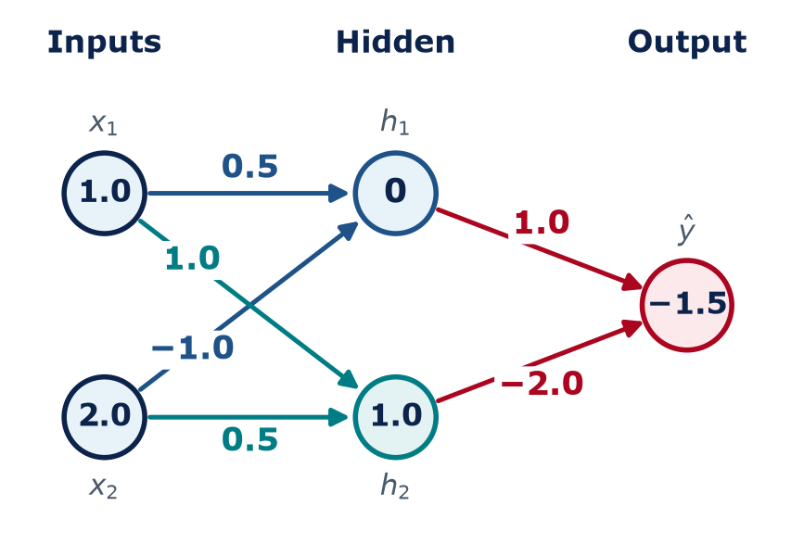
Layers and the forward pass
The forward pass: multiply, add, bend — one layer at a time
Hidden neuron 1
z₁ = 0.5·1.0 − 1.0·2.0 + 0 = −1.5
h₁ = ReLU(−1.5) = 0
Hidden neuron 2
z₂ = 1.0·1.0 + 0.5·2.0 − 1 = 1.0
h₂ = ReLU(1.0) = 1.0
Output (linear)
ŷ = 1.0·0 − 2.0·1.0 + 0.5
ŷ = −1.5
h₁ = 0 means neuron 1 is “off” for this input.
Notes:
Reveal the answer step by step. Hidden neuron 1: 0.5 times 1 minus 1.0 times 2 plus 0 is -1.5; ReLU turns it into 0, so this neuron is 'off' for this input. Hidden neuron 2: 1 + 1 - 1 = 1.0; ReLU keeps it. Output: 1.0 times 0 minus 2.0 times 1.0 plus 0.5 = -1.5. That is a forward pass: data flows left to right, and every prediction a neural network makes - from heating load to ChatGPT's next word - is a (much bigger) version of this.

Slide 16
Layers and the forward pass
Counting parameters: weights + biases, layer by layer
Each layer: (inputs × neurons) weights + one bias per neuron
Network or layer | Weights | Biases | Parameters
Our tiny network: hidden layer (2 neurons × 2 inputs) | 2 × 2 = 4 | 2 | 6
Our tiny network: output layer (1 neuron × 2 inputs) | 2 × 1 = 2 | 1 | 3
Our tiny 2–2–1 network, total | 6 | 3 | 9
Linear regression with 8 building inputs | 8 | 1 | 9
Heating-load network 8 → 32 → 16 → 1 (today's case study) | 784 | 49 | 833
Two outputs (heating + cooling): 4 → 3 → 3 → 2 = 15 + 12 + 8 | 27 | 8 | 35
Small language model from Lab 01 (Qwen2.5-0.5B) |  |  | ≈ 0.5 billion
Notes:
Parameters are the numbers training adjusts. Count layer by layer: each neuron has one weight per input plus one bias. Tiny network: 4 + 2 = 6 in the hidden layer, 2 + 1 = 3 in the output, total 9. The heating-load network: 8 x 32 + 32 = 288, 32 x 16 + 16 = 528, 16 x 1 + 1 = 17, total 833. Networks can have several outputs: a 4-3-3-2 network predicting heating AND cooling load has (4 x 3 + 3) + (3 x 3 + 3) + (3 x 2 + 2) = 15 + 12 + 8 = 35 - each output neuron has its own weights and bias. Language models have hundreds of millions to hundreds of billions of parameters - same arithmetic, vastly more of it. More parameters means more flexibility, and more risk of memorizing the data.

Slide 17
Concept check
Count the parameters
A network has 3 inputs, one hidden layer with 4 neurons, and 1 output neuron. How many parameters (weights + biases) does it have?
12
16
A
B
20
21
C
D
Notes:
Quick calculation, 90 seconds, then vote. 16 is the trap: hidden layer only, or no biases at all; 12 = hidden weights only; 20 = forgot the output bias. This is the same skill as HW3 Part A.
Answer: D. Hidden: 3 × 4 weights + 4 biases = 16. Output: 4 weights + 1 bias = 5. Total = 21.

Slide 18
Concept check
Count the parameters — answer
A network has 3 inputs, one hidden layer with 4 neurons, and 1 output neuron. How many parameters (weights + biases) does it have?
12
16
A
B
20
21
C
D
Hidden: 3 × 4 weights + 4 biases = 16. Output: 4 weights + 1 bias = 5. Total = 21.
Notes:
Answer: D. Hidden: 3 × 4 weights + 4 biases = 16. Output: 4 weights + 1 bias = 5. Total = 21.

Slide 19
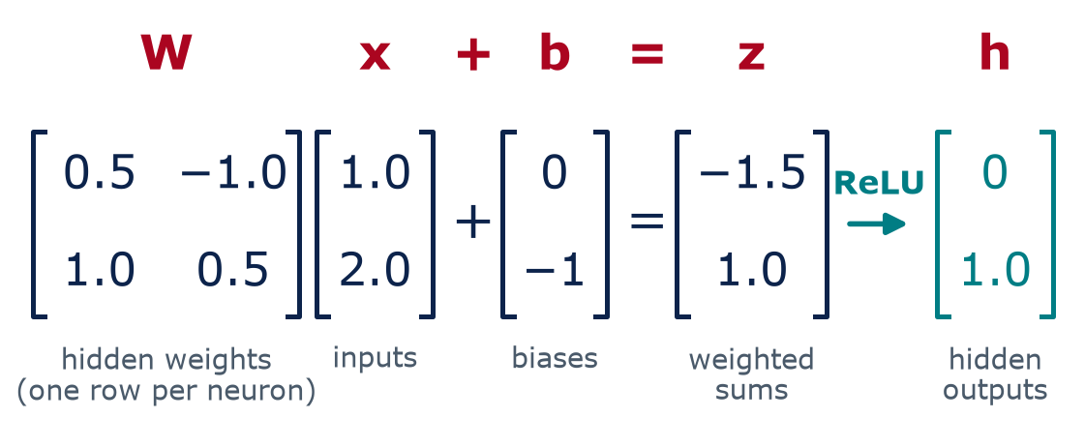
Layers and the forward pass
The matrix view: a whole layer in one line
A layer = h = ReLU(W x + b) — one row of W per neuron
Graphics processors (GPUs) do millions of these multiply-adds at once
Notes:
Same numbers as the hand calculation, written as matrices. Each row of W holds one neuron's weights. Multiply W by the input vector, add the bias vector, apply ReLU to every entry: that is the entire hidden layer. You do not need linear algebra for this course - the point is that a layer is one matrix multiplication, which computers (especially GPUs) do extremely fast. That speed is one reason deep learning took off after about 2012.

Slide 20
Layers and the forward pass
The same forward pass in NumPy (Lab 05)
import numpy as np
x = np.array([1.0, 2.0]) # inputs
W1 = np.array([[0.5, -1.0], # hidden neuron 1
[1.0, 0.5]]) # hidden neuron 2
b1 = np.array([0.0, -1.0]) # hidden biases
w2 = np.array([1.0, -2.0]) # output weights
b2 = 0.5 # output bias
z = W1 @ x + b1 # weighted sums -> [-1.5, 1.0]
h = np.maximum(0, z) # ReLU -> [ 0.0, 1.0]
y_hat = w2 @ h + b2 # output -> -1.5
print(y_hat)
@ means matrix multiply: all weighted sums at once
np.maximum(0, z) is ReLU for every neuron
Same numbers as the hand calculation: ŷ = −1.5
In Lab 05 you change a weight and predict what happens
Notes:
Show that the code is a line-by-line copy of the math. Students do not need to memorize NumPy syntax; they should be able to read this and point to the weights, the biases, and the activation. In the lab they will run it and then change one weight to see the effect on y-hat.

Slide 21
03
How networks learn
Same recipe as Week 4: loss + gradient descent
Notes:
Section 3, about 20 minutes including the Playground demo.

Slide 22
How networks learn
Training a network uses the same recipe as Week 4
Predict
Loss
Blame
Update
Repeat
Forward pass: run the training examples through the network to get predictions
Measure the error, e.g., average squared error J (Week 3)
Backprop finds ∂J/∂w: how much is each weight to blame?
Step every weight downhill with Week 4's rule: w ← w − α·∂J/∂w
Many passes (epochs) until the validation error stops improving
Model + cost + gradient descent — the network just has more weights to adjust
Notes:
Nothing in this loop is new except step 3. Steps 1, 2 and 4 are Week 3 and Week 4: predict, measure the cost, step downhill. With linear regression we had formulas for the two slopes. With 833 or a billion weights we need an efficient way to get every slope - that is backpropagation, next slide. Starting weights are small random numbers, which is why results change slightly with the random seed. Unlike Week 3's single bowl, a network's cost landscape has many valleys; different random starts land in different, usually similar, ones.

Slide 23
How networks learn
Backpropagation passes the blame backward, layer by layer
→ Forward pass: inputs flow to a prediction and a loss
Inputs
x
Hidden layer
h
Output
ŷ
Loss
J: compare ŷ with y
← Backward pass: the error flows back as “blame” (∂J/∂w) for each weight
Chain rule, in words
Engineering analogy
Blame on a hidden weight = (blame on ŷ) × (how much ŷ depends on h) × (how much h depends on that weight)
Over budget? Ask each subcontractor: if your part changed a little, how much would the overrun change? That sensitivity is the blame — it can say “do more”, not only “do less”.
Notes:
Intuition only, no heavy math. After the forward pass we know the error at the output. Backpropagation asks: how much did each weight contribute to that error? It starts at the output and works backward, using the chain rule from calculus: the blame on an early weight is the blame at the output times how strongly each later step passed the effect along. Analogy: a project finishes over budget; the owner asks each subcontractor: if your part changed a little, how much would the overrun change? That sensitivity is the blame (dJ/dw). It can be negative - meaning 'do more', not only 'do less' - and the blames do not have to add up to the total. Every weight gets its slope in one backward sweep, which is what makes training big networks feasible.

Slide 24
How networks learn
You choose the knobs; training chooses the weights
MAX_ITER
BATCH_SIZE
LEARNING_RATE_INIT
Epoch
Batch
Learning rate α
One full pass through all training examples. Training usually takes many epochs.
A small group of examples (e.g., 32 buildings) used for one update step.
Step size, exactly as in Week 4: too big diverges, too small crawls.
HIDDEN_LAYER_SIZES
HIDDEN_LAYER_SIZES
ACTIVATION
Width
Depth
Activation
Neurons per hidden layer. More = more flexible, slower, easier to overfit.
Number of hidden layers. (32, 16) means two hidden layers.
ReLU in hidden layers by default; a linear output for regression.
Notes:
These settings are called hyperparameters: you choose them, while training chooses the weights. The small tags are the matching scikit-learn MLPRegressor arguments you will see on lab day. Batches: instead of computing the slope on all 614 training buildings, we use a few dozen at a time - noisier steps, but many more of them, which is faster overall. One epoch = enough batches to see every example once.

Slide 25
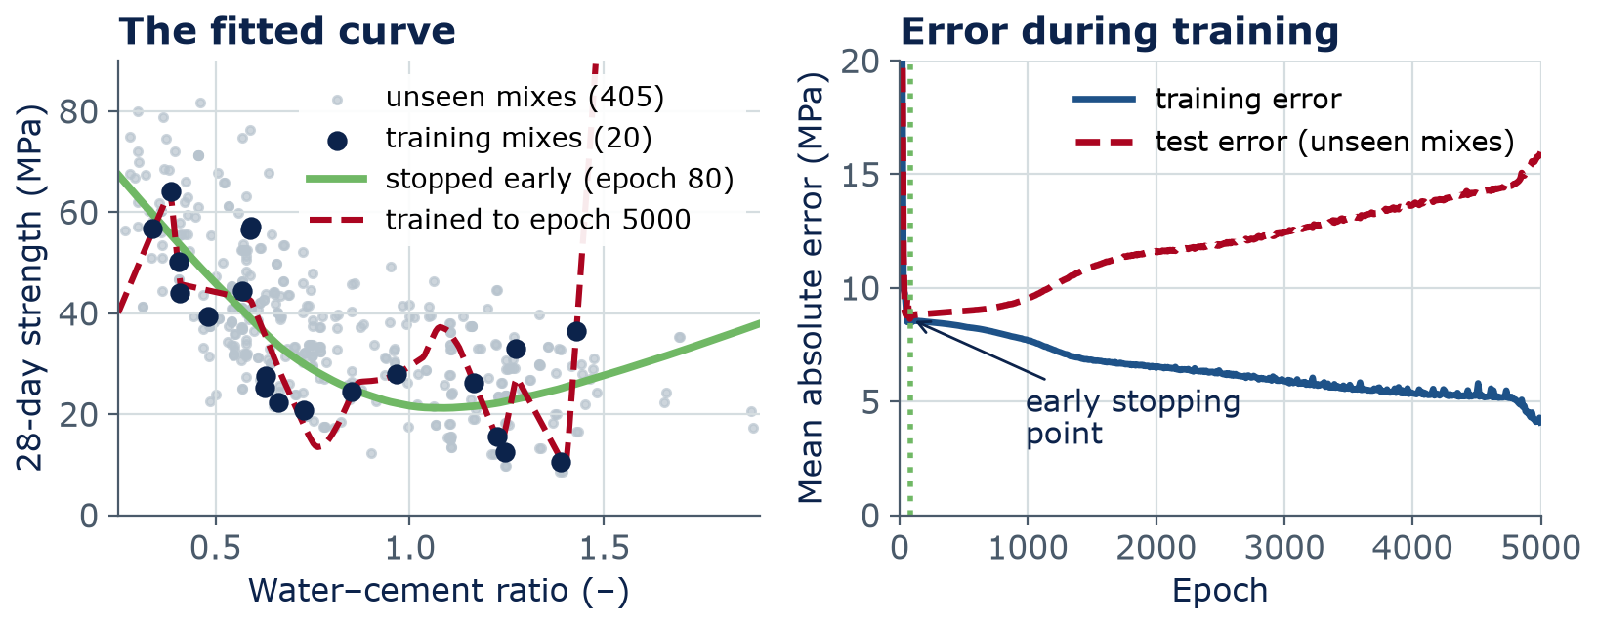
How networks learn
Overfitting: the network starts memorizing — so stop early
Fixes: stop early · use a smaller network · get more data · penalize large weights (regularization)
Notes:
Real concrete data: only 20 training mixes (28-day strength vs water-cement ratio) and a big network with about 17,000 parameters. Left: the green curve is the network after 80 epochs - smooth, sensible. The red dashed curve after 5,000 epochs zig-zags through every training point and shoots off between them. Right: training error keeps falling (to about 4 MPa) while the test error on unseen mixes bottoms out near 8.6 MPa at epoch 80 and then climbs to about 16 MPa. Early stopping keeps the weights from the best point. In practice you watch a separate validation set, not the final test set - scikit-learn's early_stopping=True does this for you.

Slide 26
How networks learn
TensorFlow Playground: train a network in your browser
Open playground.tensorflow.org (laptop or phone)
Circle data, 0 hidden layers, press play. Can a straight boundary separate the dots?
Add 1 hidden layer with 4 ReLU neurons. What changes?
Try the spiral with 2–3 hidden layers; watch the test loss
Set training data to 10% and noise to 50: compare training and test loss
7
min
Demo · Pairs
Report back: the smallest network that solves the circle, and what happened to the test loss with very little training data.
Notes:
Do the first two steps live on the projector, then let pairs explore for 5 minutes. Playground is free and runs in the browser (Apache-2.0 open source from the TensorFlow team). It shows classification (orange vs blue dots) rather than regression, but the machinery is identical. Teaching points: with no hidden layer, only a straight boundary is possible - unless you tick the hand-made features X1-squared and X2-squared, which is feature engineering. A hidden layer learns its own features. With 10% training data and high noise, training loss drops while test loss stays high or rises: overfitting. Lab 05 starts with a guided version of this.

Slide 27
04
Case study: heating load
Predicting a building's heating demand from its shape
Notes:
Section 4, about 10 minutes. This is exactly what Lab 05 does.

Slide 28
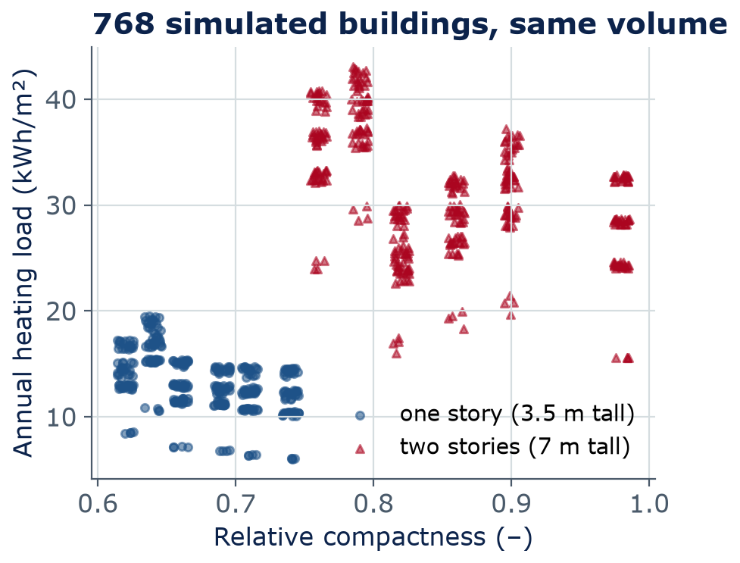
Case study: heating load
Can a network predict heating load from building geometry?
Data: 768 building shapes simulated with energy software (Tsanas & Xifara, 2012)
Same volume and materials; only shape, glazing, and orientation change
Inputs (8): compactness, surface, wall and roof areas, height, orientation, glazing area and layout
Target: annual heating load (kWh/m²)
Loads form clusters and steps, not one straight trend
Notes:
Why this matters in ARCE: early in design, an architect wants a quick estimate of heating demand for many massing options without running a full energy simulation each time. A model trained on simulations is called a surrogate model - we revisit surrogates in Week 11. The data come from simulated buildings, not measured ones, so the model learns the simulator, including its assumptions. The two clusters are building height: one-story versus two-story.

Slide 29
Case study: heating load
Training the network takes a few lines of scikit-learn
from sklearn.neural_network import MLPRegressor
from sklearn.preprocessing import StandardScaler
from sklearn.model_selection import train_test_split
df = pd.read_csv(get_data("building_energy_efficiency.csv"))
y = df["heating_load_kwh_m2"]
X = df.drop(columns=["heating_load_kwh_m2",
"cooling_load_kwh_m2"])
X_tr, X_te, y_tr, y_te = train_test_split(
X, y, test_size=0.2, random_state=42)
sc = StandardScaler().fit(X_tr) # scale features
net = MLPRegressor(hidden_layer_sizes=(32, 16),
max_iter=3000, random_state=42)
net.fit(sc.transform(X_tr), y_tr)
Same split and scaling as Week 4
(32, 16): two hidden layers, 32 and 16 neurons
max_iter: the maximum number of epochs
fit runs forward pass, backprop, and updates for you
Notes:
Walk through the code top to bottom. Everything before the last three lines is Week 4: load, choose X and y, split 80/20, scale. Scaling matters even more for networks than for linear regression, because unscaled inputs (areas in hundreds of m2 next to ratios below 1) make gradient descent struggle. The fit call hides the whole training loop from the previous section.

Slide 30
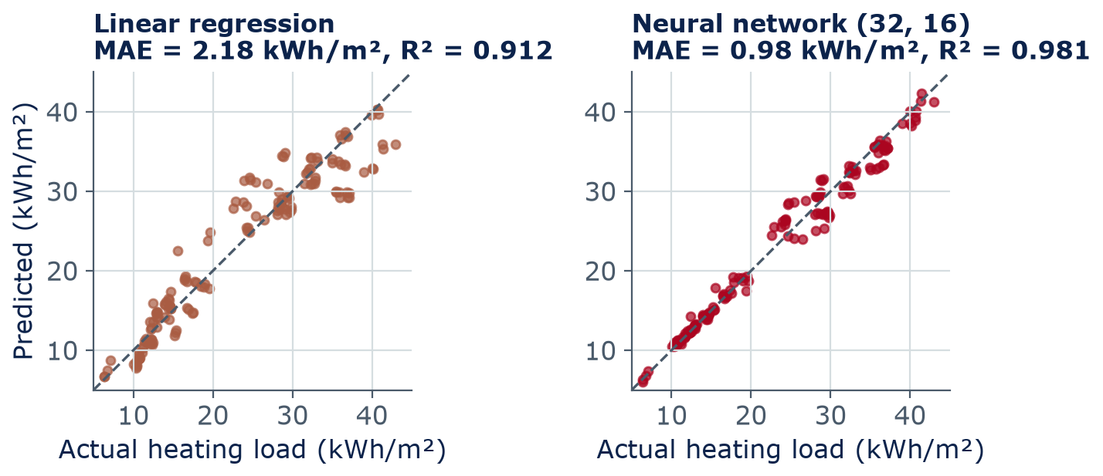
Case study: heating load
On unseen buildings, the network cuts the error by more than half
Same data, same split. Linear regression: 9 parameters. Network: 833 parameters — more flexible, harder to explain.
Notes:
Each dot is one of the 154 test buildings the models never saw; the dashed line is a perfect prediction. Linear regression: MAE 2.18 kWh/m2, R2 0.912. The (32, 16) network: MAE 0.98 kWh/m2, R2 0.981. The average heating load is about 22 kWh/m2, so the network's typical error is around 4-5 percent. Training MAE for the network (0.87) is close to its test MAE, so it is not badly overfitting. Your numbers in Lab 05 may differ a little with other settings or seeds.

Slide 31
Case study: heating load
Use a neural network only when a simple model is not enough
A network is a good fit
Think twice
Nonlinear relationships and interactions
Hundreds or thousands of examples
Many inputs, or raw data like images and signals
Accuracy matters more than a readable formula
Small datasets (tens of points)
A physics equation already works (heat loss = U·A·ΔT)
You must explain every coefficient to a reviewer
Predictions far outside the training data
?
Always compare with a baseline (the simplest sensible model, e.g., linear regression) on test data
Notes:
This is the engineering judgment part, and an HW3 question. A network is not automatically better. With 20 data points it memorizes (we just saw it). If a validated physics equation exists, use it - or use the network only to correct its errors. If a client or code official needs to understand why, a linear model's coefficients are easier to defend. And no model should be trusted far outside the range it was trained on.

Slide 32
Lab 05
Lab day: your first neural network
TensorFlow Playground: guided experiments, answers recorded in the notebook
Today's 2–2–1 forward pass in NumPy — check that you get ŷ = −1.5
Train MLPRegressor on heating load and compare it with linear regression
Vary layers and neurons; plot the loss curve; compare train and test error
Exit ticket (3 AI-Free questions, last 10 min) · HW2 due Sunday 11:59 pm
LAB
05
Bring a charged laptop
Open the notebook from the course GitHub page
Notes:
Lab 05 follows today's lecture closely. Remind students that HW2 (Fit, Measure, Descend) is due Sunday at 11:59 pm on Brightspace, and that next week's lecture starts with a quiz on today.

Slide 33
Wrap-up
Key takeaways
A neuron = weighted sum + activation; a network = layers of neurons
1
Without a nonlinear activation, any stack of layers is still one straight line
2
Forward pass: multiply, add, bend, layer by layer. Parameters = weights + biases
3
Training = loss + gradient descent; backpropagation passes blame backward via the chain rule
4
Watch train vs. test error, stop early, and always compare with a simple baseline
5
Notes:
Recap the five ideas. Next week: networks with built-in assumptions - convolutional networks for images (cracks!) and recurrent networks for time series (traffic, building loads).

Slide 34
Learn more
Readings and resources
3Blue1Brown — But what is a neural network? — video, 19 min: neurons, layers, and weights, beautifully animated
3Blue1Brown — Backpropagation, intuitively — video, 13 min: the 'passing blame backward' idea in pictures
Google ML Crash Course — Neural networks — about 1 hour, with interactive exercises
TensorFlow Playground — keep experimenting after class
scikit-learn user guide — Neural network models — reference for MLPRegressor (Lab 05)
Notes:
Assign the first 3Blue1Brown video before the lab (19 minutes). The backpropagation video is optional but helps a lot for HW3.

