Slide 1

6. Neural Networks, Part 2
Seeing and remembering: CNNs and sequence models
Week 6 · CE/ARCE 2XX AI Literacy for Civil and Architectural Engineering
Notes:
Start with the quiz on Week 5 (6 minutes). Today: why different kinds of data need different network designs. Images: convolutional networks (CNNs). Time series: recurrent networks. And a first look at attention, the idea behind ChatGPT-style models, which we open up next week. On lab day: crack detection with a pretrained CNN.

Slide 2
Agenda
Today's plan
1
Quiz on last week (Week 5)
2
Architecture = built-in assumptions
3
Seeing: convolution and CNNs
4
Transfer learning and vision in CE/ARCE
5
Remembering: sequences and time series
6
Attention, and choosing an architecture
7
Lab 06, HW3, and the midterm
Notes:
Quiz first (AI-Free). Then five short sections. Logistics at the end matter this week: HW3 goes out today, and next week's lab day is the midterm exam on Weeks 1-6.

Slide 3
Recap
Last week in 60 seconds
1
Neuron
2
Forward pass
Weighted sum plus an activation: z = w₁x₁ + w₂x₂ + … + b, then a = g(z). ReLU is the default bend.
Multiply, add, bend, layer by layer. Our 2–2–1 example gave ŷ = −1.5 with 9 parameters.
3
Training
4
Overfitting
Loss + gradient descent. Backpropagation passes the blame backward to every weight.
Training error falls while test error rises: stop early, simplify, and compare with a baseline.
Notes:
Ninety seconds. Ask one student to recount the parameters of the 2-2-1 network (4 + 2 + 2 + 1 = 9). Today's networks reuse every one of these ideas; what changes is how the neurons are wired.

Slide 4
Learning objectives
By the end of today, you can…
Explain why a network's architecture is a set of built-in assumptions about the data
✓
Describe how convolution, pooling, and stacked layers let a CNN find cracks in photos
✓
Explain transfer learning and why it suits small engineering datasets
✓
Turn a time series into training examples with a sliding window; say what an RNN or LSTM adds
✓
Choose a suitable architecture — MLP, CNN, RNN, or transformer — for a CE/ARCE task
✓
Notes:
Objectives 2, 3 and 5 are midterm material. Objective 2 and 3 are exactly Lab 06.

Slide 5
01
Architecture = assumptions
Different data, different wiring
Notes:
Section 1, about 8 minutes.

Slide 6
Architecture = assumptions
A network's architecture is a set of built-in assumptions
Like a structural system: a truss assumes axial forces, a moment frame assumes bending
TABLES OF NUMBERS
IMAGES AND GRIDS
TIME SERIES
TEXT, LONG SEQUENCES
MLP
CNN
RNN / LSTM
Transformer
Any input may matter to any neuron; the order of the columns means nothing.
Nearby pixels belong together; a crack looks like a crack anywhere in the photo.
Order matters; the recent past helps predict the next step.
Anything may relate to anything; learn which parts to pay attention to.
Notes:
Key idea of the day. Last week's MLP treats its inputs as an unordered list. That is fine for 8 building features, but wasteful for a photo, where neighboring pixels obviously belong together. Engineers do the same thing when choosing a structural system: the right assumptions make the design efficient; the wrong ones make it fail or waste material. Good assumptions also mean the network needs less data to learn.

Slide 7
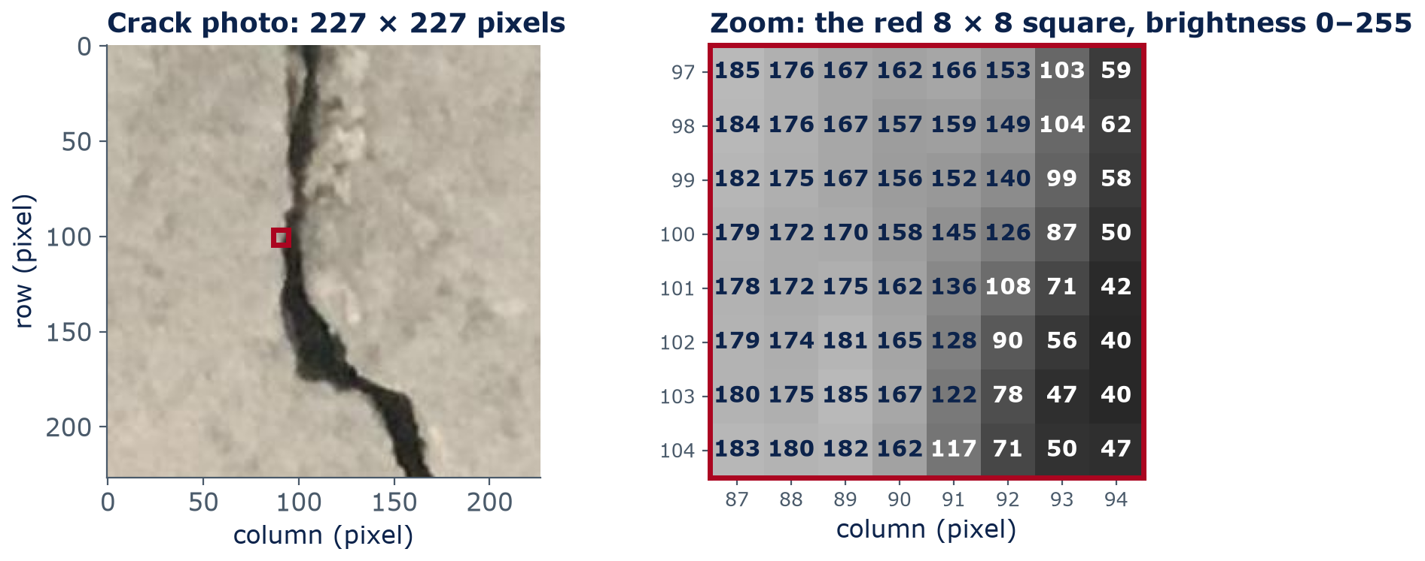
Architecture = assumptions
To a computer, a photo is just a grid of numbers
A color photo = 3 grids (red, green, blue): 227 × 227 × 3 = 154,587 numbers
Notes:
This is a real photo from the dataset you will use in Lab 06 (Özgenel 2019, Middle East Technical University campus buildings). On the right is the red 8 x 8 square, pixel by pixel. Each number is a brightness from 0 (black) to 255 (white). Left columns are bright concrete (around 170-185); the right columns fall to around 40-60 inside the crack. A color photo stores three such grids: red, green, and blue. Everything a vision model does starts from these numbers.

Slide 8
Architecture = assumptions
Feeding raw pixels to an MLP explodes the number of weights
154,587
≈ 155 million
27 + 1
numbers in one 227 × 227 color photo
weights for just ONE hidden layer of 1,000 neurons on those inputs
weights + bias in one 3 × 3 color filter, reused at every position
154,587 × 1,000 = 154.6 million. Fewer weights → less data needed and less overfitting.
Notes:
Do the arithmetic with the class: 227 x 227 x 3 = 154,587 inputs. A fully connected layer with 1,000 neurons needs one weight per input per neuron: about 155 million weights, before the network has learned anything. A convolutional filter is tiny - 3 x 3 pixels x 3 colors = 27 weights plus a bias - and the same filter is reused across the whole photo. This weight sharing is the CNN's built-in assumption: a crack edge looks the same wherever it appears.

Slide 9
02
Seeing: convolution and CNNs
Small filters that slide across the image
Notes:
Section 2, about 20 minutes.

Slide 10
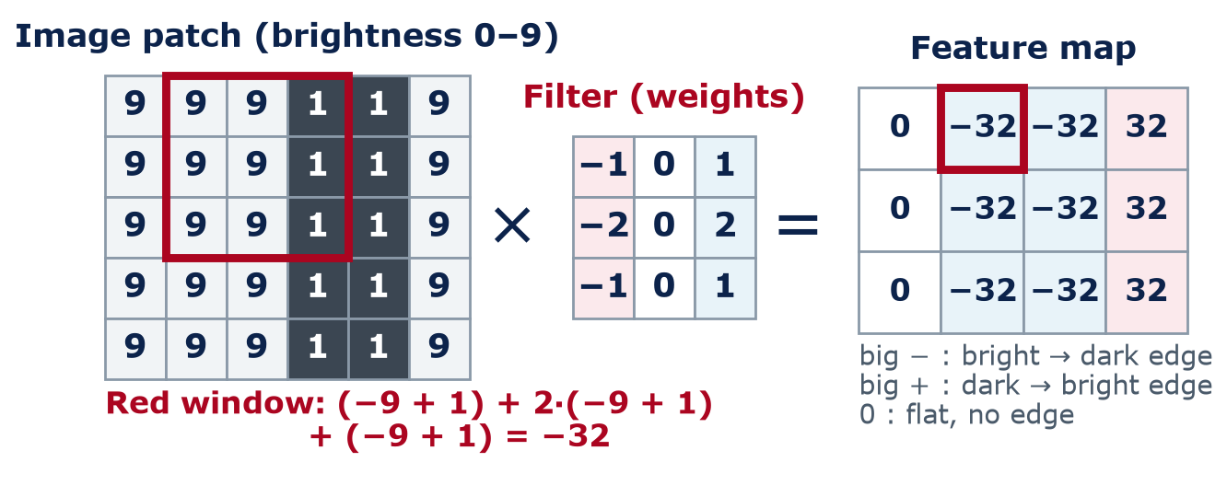
Seeing: convolution and CNNs
Convolution: slide a small filter over the image, multiply, add
The sign tells the direction of the change; the size tells the edge strength. In a CNN the filter's numbers are weights learned by training.
Notes:
Toy numbers so we can do it by hand: brightness 0-9, with a dark vertical crack (the 1s). The filter is the Sobel vertical-edge filter used in Lab 06 and HW3: -1, 0, +1 in each row, with the middle row counted twice. Put it on the red window, multiply each pixel by the weight underneath, add the nine products: (-9 + 1) + 2 x (-9 + 1) + (-9 + 1) = -32. Then slide one column right and repeat. Ask the class to compute the last column before you point at it: (-1 + 9) x 4 = +32. Big negative = bright-to-dark edge (left to right), big positive = dark-to-bright edge, zero = flat. The sign tells the direction of the change; the size tells the edge strength. In a CNN, these nine numbers are weights that training learns, exactly like last week's weights.

Slide 11
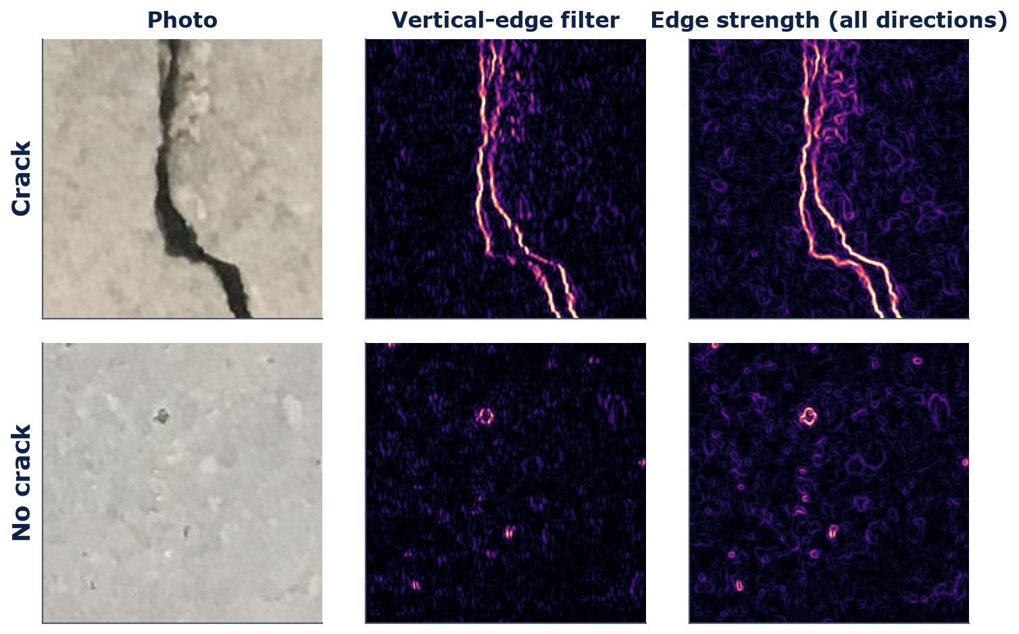
Seeing: convolution and CNNs
On a real crack photo, an edge filter lights up the crack
A 3 × 3 edge filter, applied to real photos (computed with SciPy)
Crack: both crack edges light up brightly
No crack: only pores and spots respond, weakly
The output is a feature map: where this pattern appears
A CNN learns dozens to hundreds of filters per layer
Notes:
These maps were computed for this slide with SciPy using Sobel edge filters, the same kind of hand-made filter you will apply in Lab 06. The crack photo produces two bright lines (the two edges of the crack). The intact photo produces only faint speckle, plus small rings around pores: an edge filter cannot tell a pore from a short crack. That is why a CNN stacks many layers - later layers combine edges into longer, crack-like shapes.

Slide 12
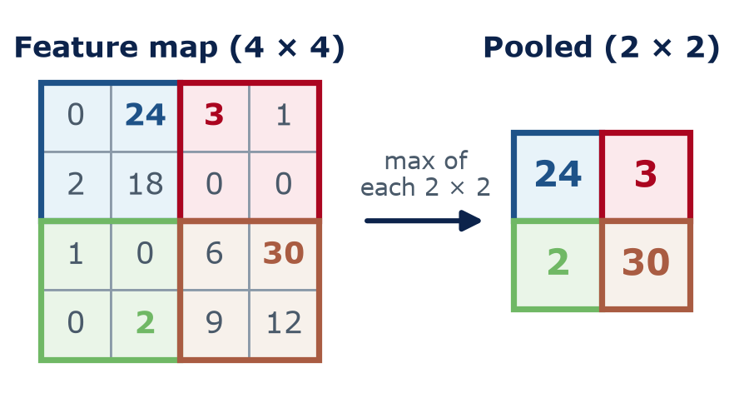
Seeing: convolution and CNNs
Pooling keeps the strongest signal and shrinks the map
Max pooling: keep the largest value in each 2 × 2 block
Keeps the evidence that “there is an edge around here”
Tolerates the crack shifting by a pixel or two
4× fewer numbers for the next layer to process
Notes:
Pooling is simple: split the feature map into 2 x 2 blocks and keep the largest number in each. The map gets four times smaller, so later layers are cheaper, and each later neuron 'sees' a larger part of the original photo. We lose the exact position, which is usually fine: 'there is a strong edge in this region' is what matters for deciding crack or no crack. Pooling has no weights to learn.

Slide 13
Seeing: convolution and CNNs
A CNN stacks convolution and pooling, then a small classifier
Photo
Conv + ReLU
Pool
Conv + ReLU
Pool
Dense layers
Output
227 × 227 × 3
many 3 × 3 filters
2 × 2 max
more filters
2 × 2 max
an MLP
P(crack)
Feature extractor: learned filters
Classifier
Notes:
Read the picture left to right. A photo goes in. Convolution layers with ReLU produce many feature maps (one per filter). Pooling shrinks them. Repeat: each round the maps get smaller but there are more of them, describing more complex patterns. At the end, the maps are flattened into one long list of numbers and passed to an ordinary MLP like last week's, which outputs a probability of 'crack'. The whole stack is trained end to end with backpropagation. The output is one number, the probability of a crack (for example 0.97).

Slide 14
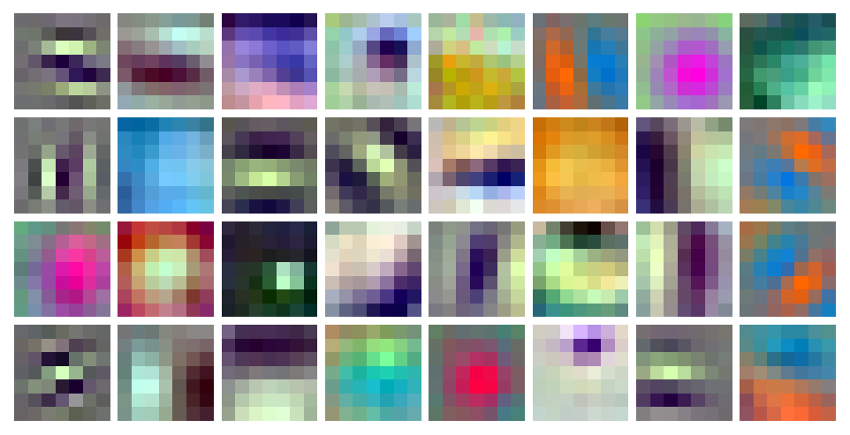
Seeing: convolution and CNNs
Layers learn a ladder: edges → textures → parts
Early layers
Edges and color contrasts at every angle
Middle layers
Textures and patterns: pores, aggregate, rebar mesh, crack segments
Late layers
Parts and objects: a spall, a window, a hard hat
32 of the 64 real first-layer filters of ResNet-18, learned from ImageNet photos
Notes:
Left: real filters, not a drawing. These are 32 of the 64 first-layer filters of ResNet-18, read from the pretrained weights you will download in Lab 06 and shown as tiny 7 x 7 color images. Nobody designed them: training on ImageNet produced edge detectors at many angles and color-contrast blobs, much like our hand-made edge filter. Studies that visualize deeper layers (for example Zeiler & Fergus, 2014) find textures in the middle layers and object parts later on. Treat the ladder as a typical pattern, not a guarantee for every network.

Slide 15
Concept check
Why does a CNN need so few weights?
Compared with an MLP on the same photo, why does a CNN need far fewer weights?
It ignores the color channels
It reuses the same small filters at every position in the photo
A
B
It only looks at the center of the photo
It uses ReLU instead of sigmoid
C
D
Notes:
One minute, then vote. A is false (color filters are 3 x 3 x 3). C is false (the filter slides everywhere). D is true of many CNNs but has nothing to do with the number of weights. This is also a likely midterm question.
Answer: B. Weight sharing: one 3 × 3 filter slides over the whole image instead of one weight per pixel per neuron.

Slide 16
Concept check
Why does a CNN need so few weights? — answer
Compared with an MLP on the same photo, why does a CNN need far fewer weights?
It ignores the color channels
It reuses the same small filters at every position in the photo
A
B
It only looks at the center of the photo
It uses ReLU instead of sigmoid
C
D
Weight sharing: one 3 × 3 filter slides over the whole image instead of one weight per pixel per neuron.
Notes:
Answer: B. Weight sharing: one 3 × 3 filter slides over the whole image instead of one weight per pixel per neuron.

Slide 17
03
Transfer learning and CE vision
Reuse what a network already learned
Notes:
Section 3, about 15 minutes.

Slide 18
Transfer learning
Transfer learning: reuse a network pretrained on millions of photos
Step 1 — done once by researchers
ImageNet: ≈ 1.28 million labeled photos
Everyday photos
ResNet-18
11.7 million weights
1,000 categories
(dog, car, bridge…)
Step 2 — Lab 06, on a laptop
Only the head is trained
Crack photos
600 on CPU (of 1,200)
Same layers, FROZEN
11.2 M weights → 512 features
New small head
513 weights → crack?
Like hiring an experienced inspector and teaching only the specifics of your structure
Notes:
Training a big CNN from scratch needs a huge labeled dataset and lots of computing. ResNet-18 (He et al., 2016) was trained on ImageNet: about 1.28 million everyday photos in 1,000 categories. Its early and middle layers learned general edges and textures that are useful for concrete too. Step 2 is what you do on lab day: chop off the 1,000-category output layer (about 0.5 million weights), keep the remaining 11.2 million weights frozen, run each crack photo through to get 512 numbers, and train only a small logistic-regression head (512 weights + 1 bias) on our photos - 1,200 in the dataset; Lab 06 uses 600 on a CPU. That takes seconds, not days. Analogy: hire an experienced inspector and teach them the specifics of your bridge, rather than training someone from zero.

Slide 19
Transfer learning
The Lab 06 recipe: pretrained features + a small head
import torch
from torchvision.models import resnet18, ResNet18_Weights
from sklearn.linear_model import LogisticRegression
weights = ResNet18_Weights.DEFAULT # ImageNet-trained
model = resnet18(weights=weights).eval()
model.fc = torch.nn.Identity() # drop last layer
prep = weights.transforms() # resize, normalize
with torch.no_grad(): # no training here
x = torch.stack([prep(im) for im in photos])
F = model(x).numpy() # 512 numbers/photo
head = LogisticRegression(max_iter=1000).fit(F, labels)
Pretrained layers stay frozen: never trained
Each photo → 512 numbers describing edges and textures
Only the head learns: 512 weights + 1 bias
Lab 06: accuracy, confusion matrix, and the mistakes
Notes:
Students do not need to write PyTorch. They should be able to point to the three ideas: load pretrained weights, remove the last layer, train a small head. `photos` is a list of PIL images and `labels` is 1 for crack and 0 for no crack; Lab 06 processes them in batches of 32. The head is last week's logistic regression - a single neuron with a sigmoid.

Slide 20
Transfer learning
Computer vision is already at work on bridges, sites, and satellites
Application | Input | Output | Task type
Crack and spall detection | Drone or phone photos of bridges, tunnels, walls | Crack yes/no, or its outline | Classification, segmentation
Post-disaster damage | Aerial or satellite images before and after an event | Damage level for each building | Classification
Construction-site safety | Site camera frames | Boxes around workers missing hard hats or vests | Object detection
Land use from satellites | Satellite image tiles | Roof, road, vegetation, water per pixel | Segmentation
Pavement condition | Road images from survey vans | Crack type and severity | Detection, classification
Notes:
Three task types. Classification: one label per photo (crack / no crack). Object detection: boxes around things (each worker, each hard hat). Segmentation: a label for every pixel (crack pixels; impervious roof and pavement area for stormwater runoff calculations). All of them are CNN-based or, increasingly, transformer-based vision models, usually built with transfer learning. Public research datasets exist for most of these, e.g., xBD for building damage after disasters.

Slide 21
Transfer learning
Would you deploy it on Arizona bridges?
A crack classifier was trained on 1,200 close-up photos of walls on one university campus
It scores very well on its own test set
An agency wants to run it on drone photos of Arizona bridge decks
List three things that could make it fail — and one test you would run first
4
min
Think · Pair · Share
Think about: sun and shadows, stains, joints and saw cuts, camera distance, dust, a different concrete texture, and the cost of a missed crack.
Notes:
Think 1 minute, pair 2 minutes, share 1 minute. Expected answers: distribution shift (different concrete, harsh Arizona sun, shadows, drone altitude and blur); look-alikes such as joints, saw cuts, form lines, tire marks and stains; very different crack widths. A missed crack (false negative) costs much more than a false alarm. First test: label a few hundred local drone photos and measure accuracy and recall there before trusting it. This previews Week 13 (stress-testing models) and is a midterm-style question.

Slide 22
Evaluating a classifier
Reading a confusion matrix: accuracy, precision, and recall
Model says →
Accuracy = (TP + TN) / all
share of all photos labeled correctly: 188/200 = 94%
Crack
No crack
Actually crack
92
true positive (TP)
8
false negative (FN): missed crack
Precision = TP / (TP + FP)
of the photos flagged “crack”, how many really are? 92/96 ≈ 96%
Actually no crack
4
false positive (FP): false alarm
96
true negative (TN)
Recall = TP / (TP + FN)
of the real cracks, how many did we catch? 92/100 = 92%
Example test set: 100 crack + 100 no-crack photos
Screening → recall matters most. A missed crack can hide damage; a false alarm costs a second look. A lower threshold (flag if P(crack) > 0.3, not 0.5) raises recall but adds false alarms.
1-minute check: a bridge deck has 50 cracked photos. The model flags 40 photos; 30 of them are real cracks. Precision? Recall? Which worries you?
Notes:
How do we measure 'very well'? A confusion matrix counts the four outcomes on a test set. The numbers here are an example: 100 crack and 100 no-crack test photos. Rows are the truth, columns are the model's answer. Accuracy = all correct / all = 188/200 = 94%. Precision asks: of the photos the model flagged as cracks, how many really are? 92/96, about 96%. Recall asks: of the real cracks, how many did the model catch? 92/100 = 92%. For screening bridges, recall matters most: a missed crack may hide real damage, while a false alarm only costs an inspector a second look. Link to Week 4: the classifier outputs a probability, and we call it 'crack' above a threshold (usually 0.5). Lowering the threshold catches more cracks (higher recall) but raises more false alarms (lower precision). One-minute check, answers: precision = 30/40 = 75%; recall = 30/50 = 60%, so 20 real cracks were missed - recall is the worry. Lab 06 computes these from your own confusion matrix; HW3 Part D and the midterm use them.

Slide 23
04
Remembering: sequences
When the order of the data matters
Notes:
Section 4, about 12 minutes.

Slide 24
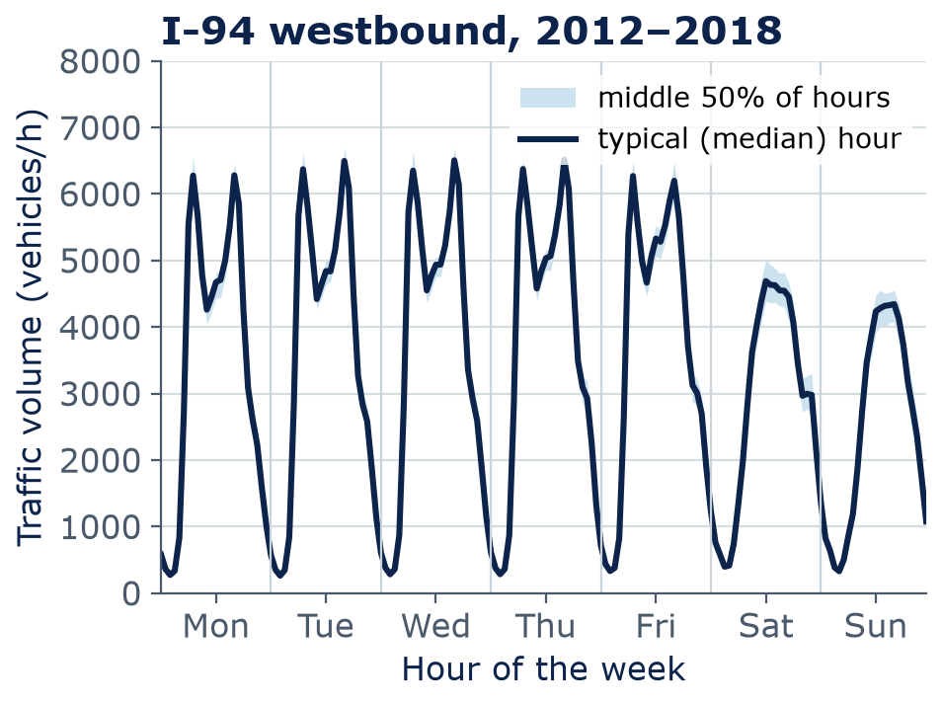
Remembering: sequences
Many engineering signals are sequences with strong patterns
In a sequence, the order of the values carries information
Weekdays: morning and evening rush hours. Weekends: one midday hump
The last few hours, and the same hour last week, help predict the next hour
Same idea for building loads, river flow, and bridge vibration sensors
Notes:
Real data: hourly westbound traffic on I-94 between Minneapolis and St. Paul, 2012-2018, about 40,000 non-holiday hours (MnDOT station via UCI). The dark line is the typical (median) volume for each hour of the week; the light band covers the middle half of all weeks. Weekday peaks reach about 6,500 vehicles per hour; nights drop to a few hundred. A forecaster that knows the time and the recent past is already very good - which is why a simple 'same hour last week' baseline is hard to beat.

Slide 25
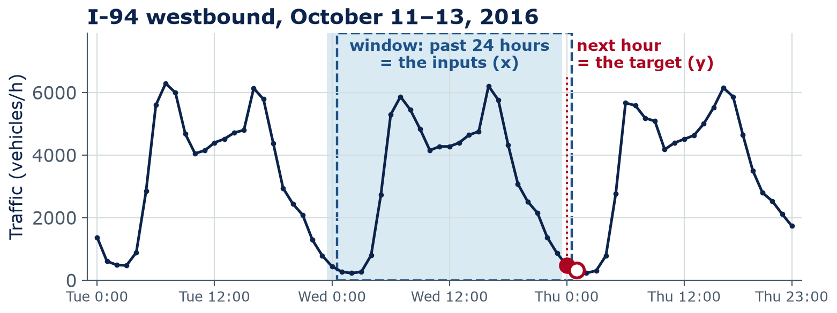
Remembering: sequences
A sliding window turns a time series into training examples
Inputs x: the 24 hourly volumes before time t
Target y: the volume at hour t (vehicles/h)
Slide 1 hour: → a new example; repeat thousands of times
Notes:
To use supervised learning on a time series, we cut it into examples. Take the 24 hours before a time as the inputs x and the next hour as the target y. Slide the window forward by one hour and you get the next example. Three years of hourly data gives tens of thousands of examples. Any model can use these rows - even last week's MLP. The last part of Lab 06 (now required, about 10 minutes) does exactly this and compares it with a 'same hour last week' baseline. Always test on later dates than you trained on: no peeking at the future.

Slide 26
Remembering: sequences
Recurrent networks read one step at a time and carry a memory
forecast 10:00
Reads in order, one step at a time
Carries a hidden state h: a running summary
Reuses the same weights at every step
LSTM: gates decide what to keep and forget → longer memory
RNN cell
same weights
h
RNN cell
same weights
h
RNN cell
same weights
h
RNN cell
same weights
x at 6:00
vehicles/h
x at 7:00
vehicles/h
x at 8:00
vehicles/h
x at 9:00
vehicles/h
Red arrows: the hidden state h — the network's memory
Notes:
An RNN, or recurrent neural network, reads a sequence one step at a time. At each hour it combines the new input with its hidden state - a running summary of everything so far - and passes the updated state to the next step. The same weights are reused at every step, the way a CNN reuses its filter at every position. Plain RNNs forget quickly. The LSTM (long short-term memory, Hochreiter & Schmidhuber, 1997) adds gates: small learned switches that decide what to keep, what to forget, and what to output, so it can remember patterns over longer stretches.

Slide 27
Remembering: sequences
Sequence models forecast traffic, building loads, and river flow
TRANSPORTATION
BUILDING SYSTEMS (ARCE)
WATER RESOURCES
Traffic volume
Building load
River flow
Next-hour or next-day volumes on a corridor
Inputs: past volumes, time, weather, events
Uses: signal timing, travel-time information
Tomorrow's hourly heating, cooling, or electric load
Inputs: past load, weather forecast, schedule
Uses: HVAC scheduling, demand response
Streamflow from rainfall and past flows
Inputs: precipitation, temperature, past flow
Uses: flood warning, reservoir operation
Notes:
Three CE/ARCE uses with the same structure: past values plus known drivers predict the next values. For river flow, research has shown LSTMs trained on hundreds of U.S. basins competing well with traditional hydrological models (Kratzert et al., 2018). In all three, a sensible baseline - persistence ('same as the last hour') or 'same time last week' - is the first thing to beat. Today, transformers are also used for time series.

Slide 28
05
Attention and the big picture
The bridge to generative AI
Notes:
Section 5, about 10 minutes.

Slide 29
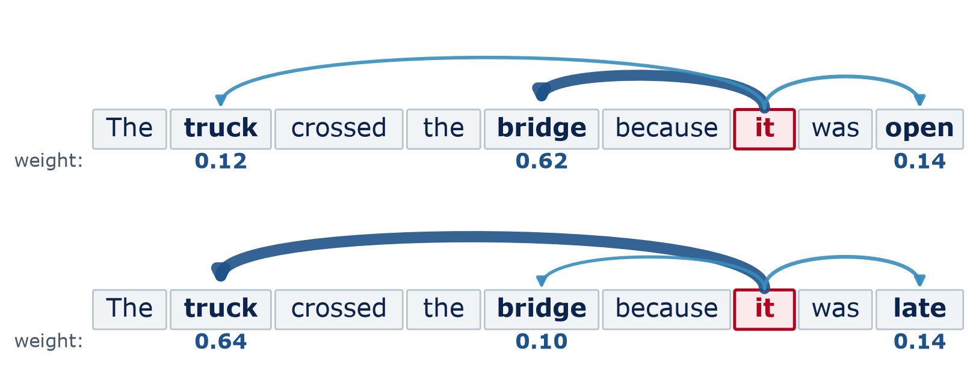
Attention and the big picture
Attention lets each word look at the words that matter
Illustrative, made-up weights for the word “it”. Two-way attention, as in BERT-style encoders; ChatGPT-style models only look back — next week: “open” looking back at “bridge”.
Attention
Each word scores every other word and mixes in the most relevant ones
Transformer
Layers of attention + small MLPs; the engine of ChatGPT-style models (Week 7)
Notes:
Preview of next week. Read both sentences. In the first, 'it' means the bridge (the bridge was open); in the second, 'it' means the truck (the truck was late). One changed word at the end flips the meaning. Attention computes, for each word, how much to 'look at' every other word, and mixes in their information accordingly. The weights on this slide are made up to show the idea. Note the direction: here 'it' also looks ahead to 'open' and 'late'. That is two-way attention, as in BERT-style encoders. ChatGPT-style models only look back, never ahead - next week we see 'open' looking back at 'bridge'. Unlike an RNN, attention connects distant words directly and processes the whole sequence at once, which suits modern GPUs.

Slide 30
Attention and the big picture
Choose the architecture that matches your data
Architecture | Data it suits | Built-in idea | CE/ARCE example
MLP | Tables of numbers | Every input can combine with every other | Heating load from 8 geometry inputs; concrete strength from a mix
CNN | Images, grids, maps | Local patterns, same filter everywhere | Crack detection; hard hats on site; land use from satellites
RNN / LSTM | Time series, sequences | Read in order, carry a memory | Next-hour traffic; tomorrow's building load; river flow
Transformer | Text, long sequences (also images) | Attention: anything can relate to anything | Searching specs and codes; engineering assistants (Weeks 7–10)
Notes:
This table is the summary of Weeks 5 and 6 and a good midterm study sheet. Emphasize: the training recipe is the same for all four - loss, backpropagation, gradient descent. What differs is the wiring, which encodes assumptions about the data. Boundaries blur in practice: transformers now handle images and time series too, and many strong tabular models are not neural networks at all.

Slide 31
Attention and the big picture
Pick the architecture
1. Predict a bridge's deck condition rating from age, traffic, and material
2. Find spalling in drone photos of a parking garage
3. Forecast tomorrow's hourly chiller load from the last two weeks of data
4. Answer questions about a 300-page project specification
5. Spot workers without hard hats in site video
4
min
Pairs · Vote
For each task: MLP, CNN, RNN/LSTM, or transformer? Name the input and the output. Bonus: where might a simple non-neural model be enough?
Notes:
Give 3 minutes in pairs, then vote task by task. Answers: 1 - tabular, so an MLP, but a simpler model (logistic regression, or a random forest - many decision trees that vote) may be as good; that is Lab 11 with the Arizona bridge data. 2 - CNN (classification or segmentation of photos). 3 - sequence model (RNN/LSTM or transformer), or an MLP on sliding windows; beat a 'same day last week' baseline first. 4 - transformer (a large language model, with retrieval - Week 8). 5 - CNN-based object detection on video frames.

Slide 32
Lab 06
Lab day: crack detection with a CNN
Unzip the concrete photos; view them as grids of numbers
Apply hand-made edge filters and look at the feature maps
Transfer learning: ResNet-18 features + a small logistic-regression head
Confusion matrix, accuracy, precision, recall — and the mistakes
Short required part: forecast next-hour I-94 traffic with a sliding window
LAB
06
Bring a charged laptop
Open the notebook from the course GitHub page
Notes:
Lab 06 downloads about 45 MB of ResNet-18 weights the first time. Model downloads happen on Google's computers, not on your laptop or phone data plan. A Colab T4 GPU makes feature extraction much faster but is not required. The photos come from one campus, so think about what that means for the accuracy you will see. The traffic sliding-window part at the end is now required (about 10 minutes), so everyone runs a sequence model once.

Slide 33
Coming up
HW3 is posted today, and next week's lab day is the midterm
HW3 — Neural Networks on Engineering Data
Midterm exam — Week 7 lab day
Posted today; due end of Week 8 (Sunday 11:59 pm)
Part A (AI-Free): forward pass and parameter count by hand
MLP vs. linear regression on concrete strength; overfitting study
Confusion matrix, feature maps, and when NOT to use a network
75 minutes, Weeks 1–6
Closed book, formula sheet provided, calculator allowed
Practice exam and formula sheet: course GitHub, exams/ folder
Next week's lecture (how LLMs work) is still on as usual
Notes:
HW3 parts B to E are AI-Assisted with an acknowledgment; Part A is AI-Free. The midterm is AI-Free and closed book. Point students to the practice midterm and its solutions. The quiz on today's material is given at the start of next week's lecture day — a warm-up two days before the exam, which is in next week's lab slot.

Slide 34
Wrap-up
Key takeaways
Architecture = built-in assumptions about the data; match the network to the data type
1
CNNs: small filters slide over the image (convolution), pooling shrinks; layers learn edges → parts
2
Transfer learning: reuse a pretrained network and train only a small head — ideal for small datasets
3
Sequences: sliding windows make examples; RNNs/LSTMs carry a memory from step to step
4
Attention lets every element look at every other — the core of transformers and LLMs (Week 7)
5
Notes:
Recap. Next week: generative AI, part 1 - how large language models work, built on today's attention idea. Then the midterm in the lab slot.

Slide 35
Learn more
Readings and resources
3Blue1Brown — But what is a convolution? — video, 23 min: convolution with pictures
CNN Explainer (Georgia Tech) — interactive: watch filters, ReLU, and pooling inside a small CNN
Google ML Crash Course — neural network and embedding modules (about 1 hour each)
Hugging Face — Computer vision course — Unit 2 on CNNs and transfer learning (optional, deeper)
Course practice midterm — study for next week
Notes:
CNN Explainer is the best 15 minutes students can spend before the lab. The practice midterm is the priority for next week.

