Slide 1

7. Generative AI, Part 1
How large language models work
Week 7 · CE/ARCE 2XX AI Literacy for Civil and Architectural Engineering
Notes:
Welcome back. Today we open the generative-AI unit: how a large language model like the one behind ChatGPT actually works, from tokens to attention to training, and why it can be fluent and wrong at the same time. We start with the short Week 6 quiz (a good warm-up for the midterm on lab day this week); exam logistics come at the end.

Slide 2
Agenda
Today's plan
1
Quiz on Week 6 (warm-up for the midterm)
2
From predicting to generating: the next-token idea
3
Inside the model: tokens, embeddings, attention
4
How an LLM is trained — and why scale matters
5
Generating text — and why LLMs hallucinate
6
Lab day: midterm exam logistics
Notes:
Start with the 6-minute Week 6 quiz (CNNs, transfer learning, sequence models) — it doubles as midterm review. Then four sections and exam logistics. Today's material is not on the midterm, but it is the foundation for Week 8, HW4, and Week 10's agents. Timing: quiz 6, recap 3, sections 10 + 16 + 7 + 22 minutes, exam logistics 5, wrap-up 3.

Slide 3
Recap
Last week in 60 seconds
1
Convolution
2
CNN stack
A small filter slides over an image and lights up at edges and patterns — the feature map.
Conv → pool → … → dense. Early layers find edges; later layers find parts like cracks or spalls.
3
Transfer learning
4
Sequences
Reuse a network pretrained on millions of images; train only a small head (Lab 06's crack detector).
RNNs and LSTMs carry a memory along a time series. Attention lets every element look at every other — today.
Notes:
Sixty-second recap of Week 6. Architecture is a built-in assumption: CNNs assume nearby pixels matter together; RNNs assume order matters. We ended with a preview of attention, which is the heart of today's lecture. Ask one student to explain transfer learning in one sentence.

Slide 4
Learning objectives
By the end of today, you can…
Explain language modeling as next-token prediction, and how repeating it generates text
✓
Describe tokens and embeddings, and why “superplasticizer” becomes four tokens
✓
Explain in plain words what attention does and what a transformer block contains
✓
Describe the training stages — pretraining, instruction tuning, preference tuning — and the role of scale
✓
Explain how temperature and the context window shape output, and why LLMs hallucinate
✓
Notes:
Read these quickly. Emphasize that the goal is a correct mental model, not equations: by the end you should be able to explain to a project manager why an LLM can write a convincing paragraph that cites a code section that does not exist.

Slide 5
01
Predicting the next token
The one idea behind every large language model
Notes:
Section 1, about 10 minutes. One idea: predict the next piece of text.

Slide 6
Next-token prediction
Generative models create new content instead of one label
Predictive models (Weeks 3–6)
Generative models (Weeks 7–8)
Input: a concrete mix → output: strength in MPa
Input: a photo → output: crack / no crack
One answer per input; easy to score right or wrong
Input: a prompt → output: new text, code, or images
Built piece by piece; many plausible answers
Hard to score: “fluent” is not the same as “correct”
vs
Surprise: underneath, an LLM is a classifier — at each step it picks the next token from ~150,000 classes
Notes:
Contrast with everything so far. Regression and classification give one output per input. A generative model produces new content: text, code, images. The twist: an LLM is still built from the same pieces as the classifiers you know. At each step it solves a classification problem whose classes are all the tokens in its vocabulary, about 150,000 for Qwen. Generation is just doing that classification over and over. (2 min)

Slide 7
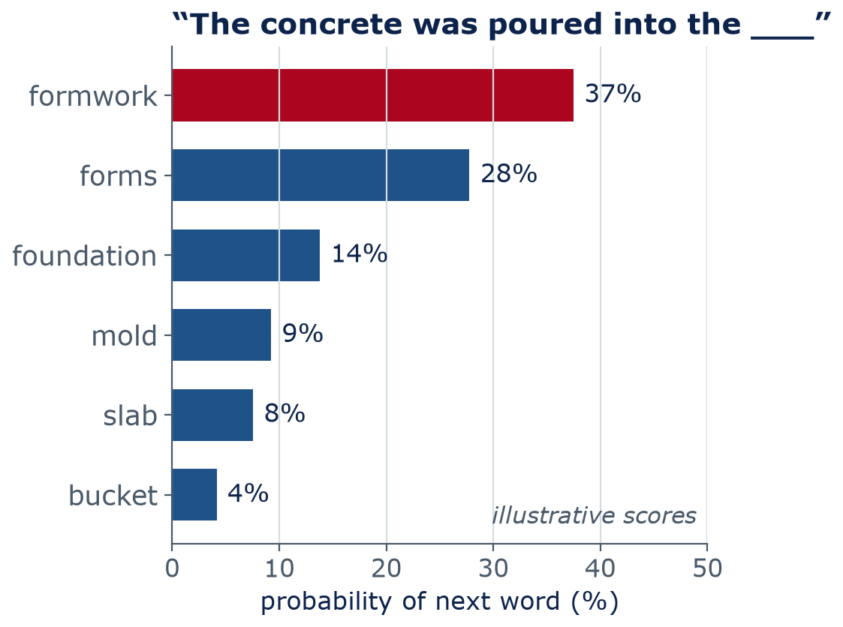
Next-token prediction
A language model gives a probability to every possible next token
Language model: given the text so far, a probability for each possible next token
It learns these probabilities from enormous amounts of text
“formwork” and “forms” are likely; “bucket” is possible; “banana” is near zero
Everything an LLM writes — answers, code, essays — comes from repeating this one prediction
Notes:
A language model is a probability machine for text. Show the chart: for this prompt, 'formwork' gets about 37% and 'forms' about 28%. These numbers are illustrative, not from a real model; in Lab 08 you will print the real top-5 probabilities from Qwen. Note that a word like 'banana' is not impossible, just extremely unlikely. Your phone's autocomplete is a tiny language model; an LLM is the same idea with billions of parameters and a much longer view of the text. (3 min)

Slide 8
Next-token prediction
Generating text = predict, pick, append, repeat
1 Text so far
2 Model scores
3 Probabilities
4 Pick one
split into tokens
every token in the vocabulary
scores → chances that add to 100%
most likely, or sample at random
append the token, then repeat
Step 1 The concrete was poured into the → formwork
Step 2 The concrete was poured into the formwork → and
Step 3 … poured into the formwork and → left
… and so on, until an end-of-text token or a length limit
Notes:
This loop is all an LLM does when it writes. (1) Take the text so far as tokens. (2) The network computes a score for every token in its vocabulary, about 150,000 of them. (3) Scores become probabilities. (4) Pick one token, append it, and run the whole thing again with the longer text. It stops at a special end-of-text token or a length limit. Key consequence: the model commits to each word before it knows how the sentence will end, and nothing in this loop checks facts. (3 min)

Slide 9
Next-token prediction
Be the language model
Write the next word for each sentence below — and how sure you are (%)
Compare with a neighbor: where did you agree? Where did you not?
Which sentence has one obvious answer, and which has many?
3
min
Think · Pair · Share
(1) Simply supported beam, uniform load q (kN/m): M = qL² divided by ___
(2) Concrete compressive strength is usually specified at ___ days
(3) The building's HVAC system failed because ___
Notes:
Give 1 minute alone, 1 minute with a neighbor, 1 minute to share. Expected: (1) '8' with near-100% confidence; (2) '28' with high confidence; (3) many plausible answers: a refrigerant leak, a failed fan motor, a controls error. Point: you just acted like an LLM. Sometimes one token is almost certain; sometimes many are plausible, and the model has to pick one. You knew '8' because you learned mechanics, not because it was the most frequent word; an LLM only has the frequency-like part. Real result from Lab 08: after '... w L squared divided by', the 0.5B Qwen model's top token is '4' (34%); the correct '8' is only fourth (14%).

Slide 10
02
Inside the model
Tokens, embeddings, and attention
Notes:
Section 2, about 16 minutes: what happens between the text and the probabilities.

Slide 11
Tokens
A tokenizer cuts text into pieces called tokens
Text
Qwen2.5 tokens (· = a space)
Count
“concrete”
concrete
1 token
“superplasticizer”
super
pl
astic
izer
4 tokens
“cross-laminated timber”
cross
-l
amin
ated
timber
5 tokens
“photovoltaic”
phot
ovolta
ic
3 tokens
“29 CFR 1926.652”
·
2
9
CFR
·
1
9
2
6
.
6
5
2
13 tokens
Common word → 1 token · rare term → several pieces · number → 1 token per digit
Notes:
These splits come from the real tokenizer of Qwen2.5-0.5B-Instruct, the model we use in labs. A common word like 'concrete' (with its leading space) is one token. Rarer technical words are built from pieces: 'superplasticizer' is four. Numbers are split one digit per token in this tokenizer, so ' 29 CFR 1926.652' in the middle of a sentence becomes 13 tokens (12 at the very start of a text, without the leading space), and the model never sees '1926' as one number. All rows are counted mid-sentence, with their leading space. Fun detail: at the very start of a text, 'concrete' without a space splits into 'con' + 'crete'. Ask: why would a model that sees digits one by one make arithmetic slips? (2 min)

Slide 12
Tokens
Why tokens matter to an engineer
Cost and limits are in tokens
Numbers are split into digits
$
#
Prices, speed, and context limits count tokens. OSHA Subpart P: 11,089 words → 14,891 Qwen tokens.
4000 psi → 4 | 0 | 0 | 0 | psi. The model never sees “4000” as one quantity — one reason arithmetic slips.
Jargon is built from pieces
Each model has its own tokenizer
Aa
≈
Rare terms are assembled from fragments; the model saw them less often in training, so it knows them less well.
The same text gives different counts in different models. Rule of thumb for English: 1 token ≈ ¾ of a word.
Notes:
Four practical consequences. One: commercial APIs charge per token, and context limits are in tokens; the whole OSHA excavation subpart is 11,089 words but 14,891 tokens with Qwen's tokenizer, about 0.75 words per token, matching the usual rule of thumb. Two: digits are split, which helps explain arithmetic errors. Three: rare technical words are assembled from pieces. Four: token counts are model-specific. In Lab 08 you will count tokens yourself. (2 min)

Slide 13
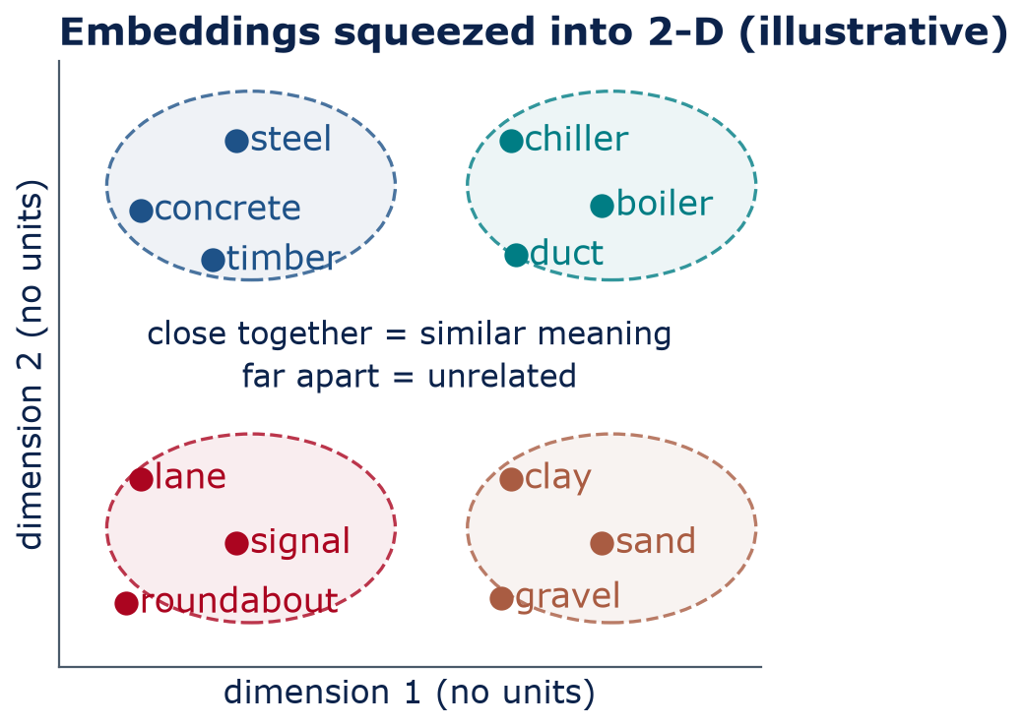
Embeddings
Embeddings turn each token into a list of numbers
Embedding: a vector (a list of numbers) that represents a token
Learned in training: tokens used in similar contexts get nearby vectors
Inside an LLM every token gets one: 896 numbers in Qwen2.5-0.5B (the plot squeezes this to 2-D)
For search, a sentence model like MiniLM (Lab 08) gives one 384-number vector per passage
Notes:
Neural networks need numbers, so each token ID is mapped to a vector, its embedding. Nobody writes these by hand: they are learned during training, and words used in similar contexts drift close together. That is why 'concrete' and 'steel' are neighbors and 'roundabout' is far away. This plot is a hand-drawn illustration; real embeddings have hundreds or thousands of dimensions (896 in Qwen2.5-0.5B), and squeezing them into 2-D loses a lot. Next week we use the angle between vectors, cosine similarity, to find relevant passages in documents. Bridge to Lab 08: inside an LLM every token gets its own vector; a sentence-embedding model like MiniLM produces one 384-number vector per passage, which is what search compares. (3 min)

Slide 14
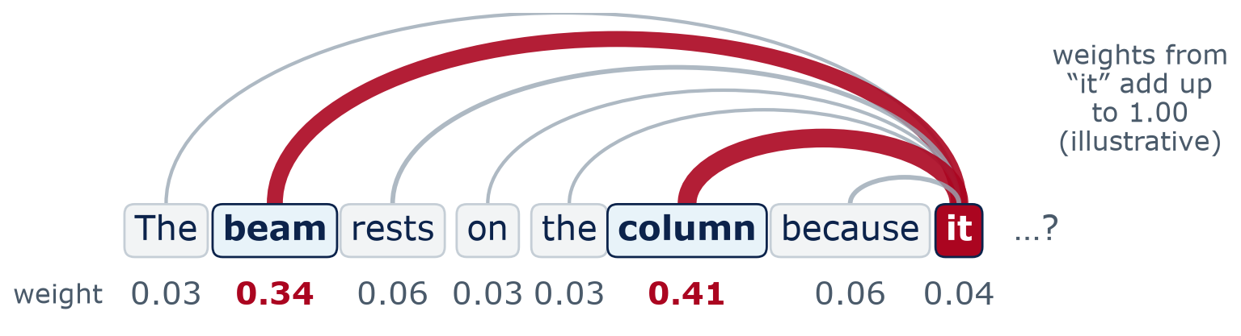
Attention
Attention: each token looks back at the others to decide what matters
1 Score
2 Weigh
3 Blend
“it” scores how relevant each earlier token is. The scoring rule is learned in training — nobody programs “pronouns look at nouns”
Softmax turns scores into weights that add up to 1 (the many-class cousin of Week 4's sigmoid)
“it” takes a weighted mix of their information — now it carries “beam” and “column”
Notes:
Context changes meaning. When the model reaches 'it', which earlier words matter? Attention answers in three steps. Score: 'it' compares itself with every earlier token. Weigh: the scores become weights that add to 1. The function that does this is softmax, the many-class cousin of Week 4's sigmoid; it is also how next-token scores become probabilities. Blend: 'it' takes a weighted mix of the other tokens' information. Here most weight goes to 'beam' and 'column'; when later words arrive ('...because it is strong enough' vs '...because it needs support'), those tokens look back and settle which one 'it' means. In GPT-style models a token can only look back, never ahead. Many attention 'heads' run in parallel in every layer. How does 'it' know to look at 'beam'? The scoring rule is learned in training from billions of sentences; nobody programs 'pronouns look at nouns'. The weights here are illustrative. (4 min)

Slide 15
Inside the model
A transformer stacks the same block many times
Output: a probability for every token in the vocabulary (~151,000)
Attention mixes information between tokens
Feed-forward (an MLP, like Week 5) transforms each token on its own
Shortcut connections and normalization keep a deep stack trainable
Roughly: early blocks track local patterns; later blocks, more abstract meaning
Qwen2.5-0.5B: 24 blocks, 14 attention heads, 896 numbers per token
Transformer block × 24
Feed-forward network
each token processed on its own
Attention
tokens share information
Input: text → tokens → embeddings + position
Notes:
Read the diagram bottom to top. Text becomes tokens, each token becomes an embedding vector, and position information is added so the model knows word order. Then the same block repeats: attention lets tokens share information; a feed-forward network, the same kind of MLP you built in Week 5, then processes each token on its own. Qwen2.5-0.5B repeats this block 24 times. At the top, an output layer turns the last token's vector into a score for every token in the vocabulary. 'Transformer' comes from the 2017 paper 'Attention Is All You Need' (Vaswani et al.). (3 min)

Slide 16
03
How an LLM is trained
Same recipe as Week 3 — at enormous scale
Notes:
Section 3, about 7 minutes. Two extra slides (the cost formula and a compute calculation) are in the backup section at the end if students ask.

Slide 17
Training
Three training stages turn a text predictor into an assistant
Pretraining
Instruction tuning
Preference tuning (RLHF)
Data: trillions of tokens of web text, books, code
Self-supervised: the next word is the label
Result: a base model that continues text
Data: prompts paired with good answers written by people
Goal: imitate those answers
Result: follows instructions, chats
Data: people rank pairs of answers
Goal: produce answers people prefer
Result: more helpful, polite, cautious
Each stage uses the same engine: a cost function + gradient descent (Weeks 3–4)
Notes:
Pretraining is by far the biggest stage: the model reads trillions of tokens and learns to predict the next one. This is called self-supervised learning: the next word in the text is the label, so no person has to label anything. The cost measures how surprised the model was by the true next token (cross-entropy; formula on a backup slide), and gradient descent lowers it, exactly as in Week 3. The result, a base model, continues text but is not a helpful assistant; ask it a question and it may continue with more questions. Instruction tuning (also called supervised fine-tuning) shows it many prompt-answer pairs. Preference tuning, often RLHF (reinforcement learning from human feedback), uses people's rankings of answers to push the model toward answers people prefer. Exact recipes vary by company and change often. (3 min)

Slide 18
Training
Tuning teaches the model to answer — and to please
Instruction tuning
Preference tuning (RLHF)
People write example prompts with ideal answers
e.g., “Summarize this RFI (request for information) in 3 bullets”
The model learns the chat format and to follow instructions
Same cost as pretraining, on a much smaller, curated set
The model writes two answers; a person picks the better one
A reward model learns to predict those choices
The LLM is tuned to earn higher reward
Side effect: it can learn to sound confident and agreeable, not just correct
Notes:
Left: instruction tuning, imitation of good examples. An RFI is a request for information on a construction project. Right: preference tuning. People compare answers; a second model learns to predict their preferences; the LLM is then optimized to score well. This is why chat assistants are polite and helpful, but it also creates a risk: people tend to prefer confident, agreeable answers, so the model can learn to please. Next week we call that sycophancy. Many labs now also use AI-generated feedback and other variants; details change quickly. (2 min)

Slide 19
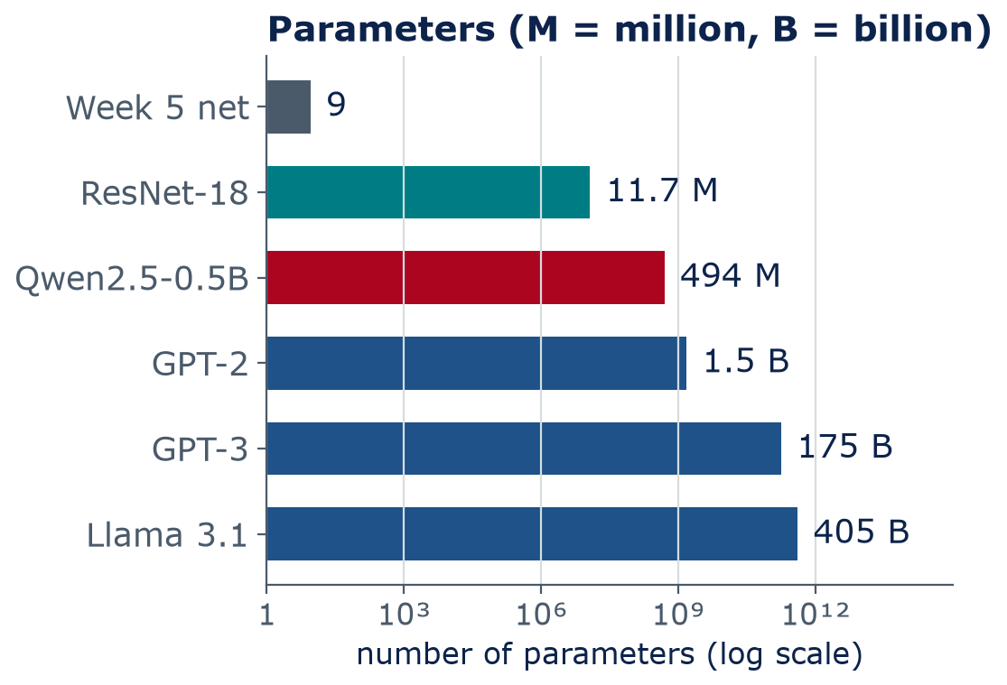
Scale
Bigger models trained on more text are usually more capable
Three things grow together: parameters, training tokens, compute
Qwen2.5-0.5B: 494 million parameters, pretrained on up to 18 trillion tokens
Some skills seem to appear only at large scale; researchers debate how sudden this is
Many commercial models no longer publish their size (as of 2026)
Notes:
Put the Week 5 network on the same axis as LLMs: 9 parameters versus hundreds of billions; the axis is logarithmic, each tick is 1,000 times the last. Sources: GPT-2 (Radford et al., 2019), GPT-3 (Brown et al., 2020), Llama 3.1 (Meta, 2024), Qwen2.5 technical report (2024, 18 trillion pretraining tokens). Larger models generally do better on many tasks. Some abilities, like multi-step instructions, seem to 'emerge' with scale, though Schaeffer et al. (2023) argue part of that is how we measure. Frontier companies often do not disclose sizes, so be skeptical of numbers you see online. (2 min)

Slide 20
04
Generating text
Temperature, the context window — and why LLMs hallucinate
Notes:
Section 4, about 22 minutes: the knobs you can turn, then the most important practical lesson today: plausible text is not verified fact.

Slide 21
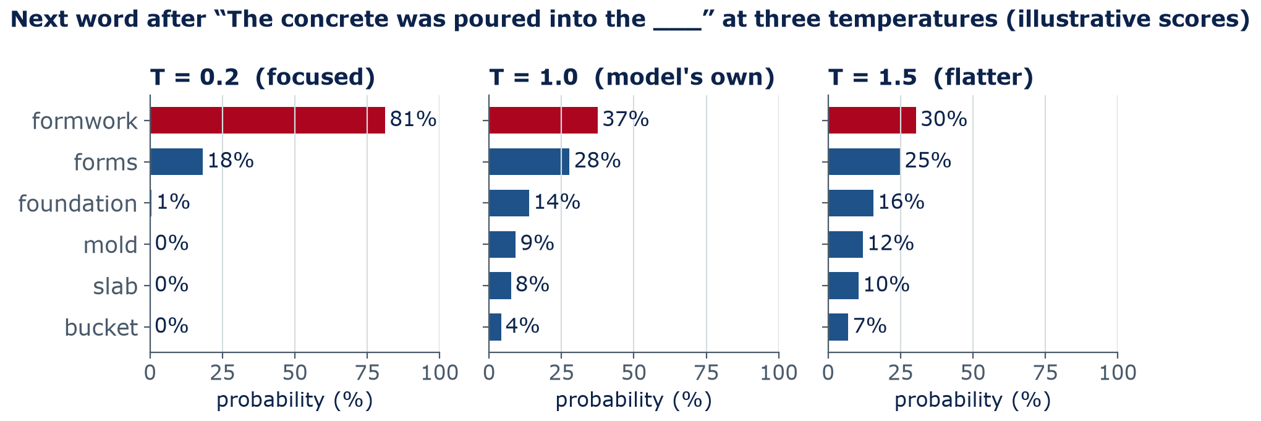
Generation
Temperature: low is focused, high takes chances
Temperature T divides every score before softmax: T < 1 sharpens (repeatable), T > 1 flattens (varied). T → 0 always picks the top token — our labs' do_sample=False.
Notes:
Same six scores, three temperatures. Temperature T divides every score before softmax, the function that turns scores into probabilities (the many-class cousin of Week 4's sigmoid). Small T exaggerates differences: at 0.2, 'formwork' is chosen about 81% of the time, repeatable and predictable. T = 1 uses the model's own probabilities. At 1.5 the distribution flattens and 'bucket' gets picked about 7% of the time. High temperature can help brainstorm design options; low temperature is better for extracting values or writing code. Our labs use do_sample=False, which always takes the top token (like T near 0). Chat products also use related settings such as top-p. Key point: temperature changes how random the output is, not how true it is. (3 min)

Slide 22
Generation
Concept check: pick the temperature
You use an LLM to pull the specified concrete strength from 200 spec sheets into a table. Which setting makes the most sense?
Temperature near 0, for repeatable output
Temperature 1.5, so it considers more options
A
B
Temperature doesn't affect the output
As high as possible, to improve accuracy
C
D
Notes:
Give 30 seconds, then a show of hands or a poll. The trap is option D: temperature has nothing to do with accuracy. Low temperature also does not make a wrong answer right; it makes the same answer come out every time, which is what you want for extraction, and it makes errors easier to audit.
Answer: A. Low T gives consistent, repeatable output — not guaranteed-correct output. Still spot-check values against the sheets.

Slide 23
Generation
Concept check: pick the temperature — answer
You use an LLM to pull the specified concrete strength from 200 spec sheets into a table. Which setting makes the most sense?
Temperature near 0, for repeatable output
Temperature 1.5, so it considers more options
A
B
Temperature doesn't affect the output
As high as possible, to improve accuracy
C
D
Low T gives consistent, repeatable output — not guaranteed-correct output. Still spot-check values against the sheets.
Notes:
Answer: A. Low T gives consistent, repeatable output — not guaranteed-correct output. Still spot-check values against the sheets.

Slide 24
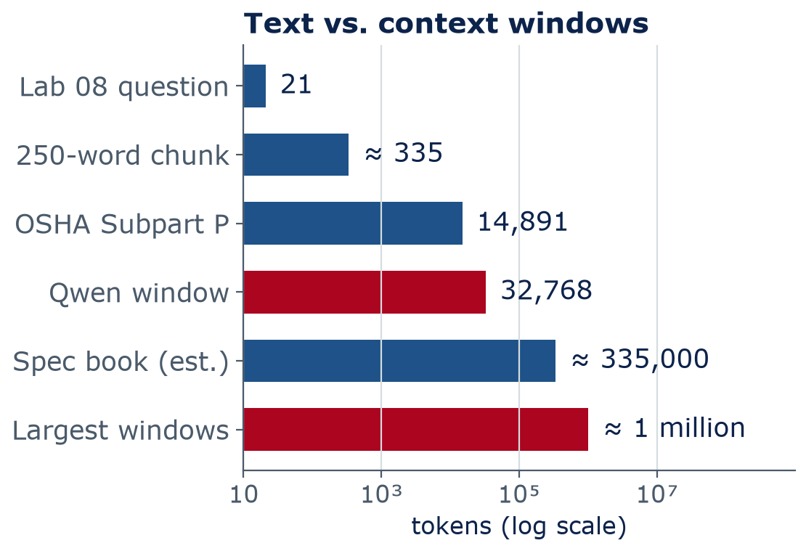
Generation
The context window is everything the model can see at once
Context window: the most tokens the model can consider — prompt, pasted documents, and its answer
Text outside the window is simply not seen; chat apps drop or summarize old turns
Long inputs cost more, run slower, and details in the middle can be missed
No memory between chats except what is put back into the window
Notes:
The context window is the model's working memory. Qwen2.5-0.5B can take 32,768 tokens, so all of OSHA Subpart P (14,891 tokens) would fit, but a full project specification book (about 335,000 tokens by a rough estimate: 500 pages x 500 words x 1.34 tokens per word) would not. Some commercial models offered windows near a million tokens in 2025-26; check current numbers. Even when text fits, models tend to use information at the start and end of a long context better than the middle (Liu et al., 2023, 'Lost in the Middle'). 'Memory' features in chat apps work by inserting saved text back into the window. This motivates next week's retrieval. (3 min)

Slide 25
Hallucination
LLMs generate plausible text — nothing checks it against facts
Hallucination
When a model produces fluent, confident output that is false or not supported by any source.
Why: training rewards likely text, not true text; nothing looks facts up
Gaps: rare specifics, like a clause number, get filled with a plausible pattern
Pressure: tests often reward a confident guess over “I don't know”
Notes:
Connect the dots from today. The model is trained to predict likely text; the loop picks tokens one at a time; nothing in either step consults a code book or a calculator. For common facts, likely text and true text usually agree. For rare specifics, like a section number or a value from a table, the model has seen the pattern ('Section 4.3.2.1 requires...') far more often than the specific fact, so it fills in a plausible pattern. A 2025 analysis by OpenAI researchers (Kalai et al., 'Why Language Models Hallucinate') argues that benchmarks which score 'I don't know' as wrong also reward guessing. Some people prefer the word 'confabulation' (used by NIST). (3 min)

Slide 26
Hallucination
What hallucinations look like in engineering work
Invented code citations
Unit slips
Backwards physics
§
u
↺
A real-looking section or table number that doesn't exist — or a real one quoted wrongly
“4000 psi ≈ 4000 MPa”; mixing kN·m and kip·ft. (4000 psi ≈ 27.6 MPa)
Lab 01: the small model said more water per unit cement makes stronger concrete — the opposite is true
Arithmetic drift
Fake references
Out-of-date facts
÷
?
!
Multi-step numbers go wrong quietly. Check qL²/8 = 54 kN·m with a calculator, not the chat
Plausible paper titles, authors, and DOIs that were never published
Training stops at a cutoff date; it may quote a superseded code edition
Notes:
Six patterns you will meet. The w/c example is real: Lab 01's Qwen model claimed the opposite of the water-cement law. 4000 psi is about 27.6 MPa (multiply by 0.006895). The beam number is from Lab 01 too: 12 kN/m over 6 m gives 54 kN·m. For citations: never trust a section number you have not opened and read. In HW4 you will audit an LLM on 10 engineering questions with known answers. (3 min)

Slide 27
Hallucination
Spot the errors in this AI answer
Read the answer below (a constructed example, written to look like a chat reply)
With a partner, find three errors
For each error: how would you verify it without asking the AI?
4
min
Pair work
“For a simply supported beam spanning 6 m with a uniform load of 12 kN/m, the maximum bending moment is M = qL²/4 = 108 kN·m (q = load), which occurs at the supports. For the slab, f′c = 4,000 psi, or about 400 MPa.”
Notes:
Answers: (1) wrong formula: the maximum moment for a uniformly loaded simply supported beam is qL²/8 = 54 kN·m; (2) wrong location: it occurs at midspan, and the moment at the supports is zero; (3) wrong conversion: 4,000 psi is about 27.6 MPa, not 400. Point out the sneaky part: 12 x 36 / 4 really is 108, so the arithmetic is correct and the formula is wrong. Verification: a statics textbook or your own free-body diagram, and a unit conversion by hand (1 psi = 6.895 kPa). (4 min)

Slide 28
Strengths and limits
Use LLMs for drafts and ideas; verify anything that goes into a decision
Usually good at
Often weak at
Drafting and rewriting: emails, reports, meeting notes
Summarizing long documents you provide
Explaining concepts at different levels
Writing and explaining short code
Brainstorming options and checklists
Exact arithmetic and unit conversions
Exact code clauses, table values, citations
Recent facts and current code editions
Knowing what it doesn't know
Taking responsibility — that stays with you
vs
Rule of thumb: the more a wrong answer would cost, the more you must check it yourself
Notes:
A balanced picture. LLMs are useful: they draft, summarize, explain, and write code fast. They are weak exactly where engineering is strict: exact numbers, exact citations, current editions, and self-awareness. Next week: prompting, retrieval, and evaluation reduce, but do not remove, these weaknesses. In Week 12 we build a full verification workflow. Ask: name one task in your own classes where an LLM is a good helper and one where it would be risky. (3 min)

Slide 29
Midterm exam
Lab day: midterm exam on Weeks 1–6
MIDTERM
What it covers
Bring · rules
75
Weeks 1–6: AI map, regression and cost, gradient descent, neural nets, CNNs, sequences
Not today's LLM material
Calculator and pencil
Closed book · AI-Free
No phones or laptops
Formula sheet provided
minutes · 20%
When: lab day
Study: GitHub exams/ folder
Format
Multiple choice + short answer
Short calculations: a cost value, one gradient-descent step, a tiny forward pass, a parameter count
Reading a learning curve or a confusion matrix
Notes:
Exam logistics. The midterm is in our usual room during this week's lab slot: 75 minutes, closed book, AI-Free. A formula sheet is provided, and it is already posted with the study guide and a practice exam with answers in the exams folder on the course GitHub, so practice with the same sheet. It covers Weeks 1 to 6 only; today's LLM material is not on it. Expect multiple choice, short answers, and short calculations like the ones we did in class: a cost value, one gradient-descent step, a tiny forward pass, counting parameters, and reading a learning curve or a confusion matrix. Bring a calculator; phones and laptops stay in your bag. Adjust the room and calculator rules to your syllabus. Take questions for the last few minutes.

Slide 30
Wrap-up
Key takeaways
An LLM is a next-token predictor: predict, pick, append, repeat
1
Text → tokens → embeddings; similar meanings get nearby vectors
2
Attention lets tokens share information; a transformer stacks attention + feed-forward blocks
3
Trained with the Week 3 recipe — a cost + gradient descent — at huge scale, then tuned to follow instructions
4
Output is plausible, not verified; temperature sets randomness, not truth — check numbers and citations
5
Notes:
Recap the five ideas. Next week: how to get better answers with prompting and retrieval (RAG), how image generators work, and how to evaluate outputs. Good luck on the exam on lab day.

Slide 31
Learn more
Readings and resources
3Blue1Brown — Large Language Models explained briefly — REQUIRED (8 min) — the whole lecture in one short video
3Blue1Brown — Transformers (Deep Learning Ch. 5) and Attention (Ch. 6) — optional, ≈ 27 min each; visual intuition
Jay Alammar — The Illustrated Transformer — optional, ≈ 30 min read; attention step by step
Google ML Crash Course — Intro to Large Language Models — optional; tokens, transformers, and limits
Transformer Explainer (interactive) — optional; type a prompt, watch probabilities and temperature
Notes:
Only the 8-minute 3Blue1Brown video is required this week (it is midterm week, and HW3 is open); everything else is optional. The Transformer Explainer from Georgia Tech runs a small GPT-2 in your browser and shows the temperature effect live. All links are free.

Slide 32
Backup slides
For questions after class — not presented live
Notes:
Backup slides. Use them only if students ask how the pretraining cost works or how much compute training takes.

Slide 33
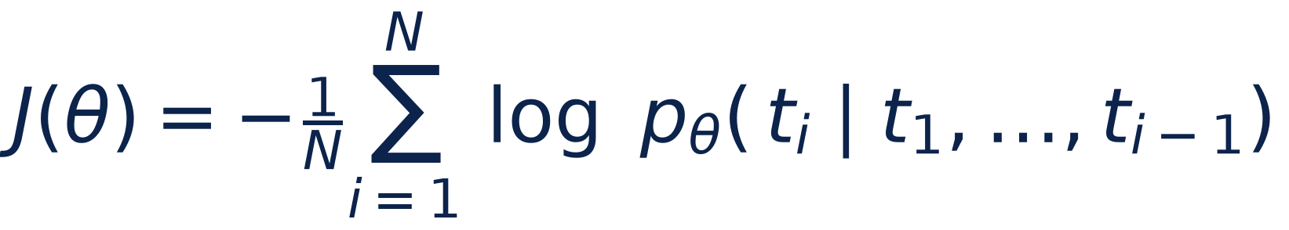
Backup
Pretraining minimizes a cost: surprise at the true next token
J(θ)
cost (cross-entropy) — lower is better, like J(w, b) in Week 3
θ
all the parameters (weights) of the network
tᵢ
the token that actually came next in the training text
p
the probability the model gave to that true token
N
number of tokens averaged over
Notes:
Backup slide. Formula in words: J = minus the average, over all N training tokens, of the log of the probability the model gave to the true next token. This is the same recipe as Week 3: define a cost, then reduce it with gradient descent. For each position in the training text, look at the probability the model gave to the token that really came next. If it gave 100%, minus log of 1 is zero: no cost. If it gave 1%, minus log of 0.01 is about 4.6: a big cost. Average over all positions, compute the gradient by backpropagation, and nudge every parameter downhill. Nothing in this cost rewards being true, only predicting what text usually says, which is why hallucinations happen.

Slide 34
Backup
Quick calculation: GPT-3 on your laptop?
Rule of thumb: training compute ≈ 6 × N × D operations (N = parameters, D = training tokens)
GPT-3: N = 175 billion, D = 300 billion tokens. Compute the operations
A laptop does about 10¹² operations per second (generous). How many years?
Use 1 year ≈ 3.15 × 10⁷ s
4
min
Self-check
Work in three steps: operations → seconds → years
Answer: ≈ 3 × 10²³ operations → ≈ 3 × 10¹¹ s → ≈ 10,000 years on one laptop
Notes:
Backup slide. Answer: 6 × 1.75e11 × 3e11 = 3.15e23 operations, which matches the 3.14e23 reported in the GPT-3 paper (Brown et al., 2020). Divided by 1e12 per second gives 3.15e11 s; divided by 3.15e7 s per year gives about 10,000 years. The 6ND rule is from scaling-law papers (Kaplan et al., 2020). Data centers finish in weeks by running thousands of GPUs, each far faster than a laptop, in parallel. Link to Week 13: that compute means energy and water in data centers, a real issue in Arizona.

