Slide 1

8. Generative AI, Part 2
Prompting, retrieval, and images
Week 8 · CE/ARCE 2XX AI Literacy for Civil and Architectural Engineering
Notes:
Welcome back, and congratulations on finishing the midterm. Last week was how LLMs work; today is how to use them well: writing prompts like specifications, recognizing failure modes, grounding answers in documents with retrieval (RAG), how image generators work, and how to evaluate outputs. On lab day you build a small RAG system over the OSHA excavation rules.

Slide 2
Agenda
Today's plan
1
Quiz on Week 7
2
Prompting as specification
3
Four failure modes to expect
4
Retrieval-augmented generation (RAG)
5
Beyond text: multimodal models and image generation
6
Cost, energy, and evaluating outputs
7
Lab day: Lab 08 · HW4 posted today
Notes:
Start with the 6-minute quiz on Week 7 (how LLMs work). Then five sections. Timing: prompting 14 min, failure modes 9, RAG 18, images 8, cost and evaluation 6, homework and lab 4.

Slide 3
Recap
Last week in 60 seconds
1
Next-token prediction
2
Tokens and embeddings
An LLM scores every possible next token; writing = predict, pick, append, repeat.
Text is split into tokens; each becomes a vector; similar meanings get nearby vectors.
3
Attention and training
4
Plausible ≠ true
Tokens share information through attention; pretraining, then instruction and preference tuning.
Temperature sets randomness, not truth. Nothing in generation checks facts — so it hallucinates.
Notes:
Sixty-second recap of Week 7. The key sentence for today: an LLM produces plausible text, not verified facts. Everything in today's lecture is about narrowing that gap: better specifications, better context, and better checking.

Slide 4
Learning objectives
By the end of today, you can…
Write a prompt as a specification: role, context, task, constraints, format, examples, assumptions
✓
Recognize four failure modes — invented citations, unit slips, overconfidence, sycophancy
✓
Explain the RAG pipeline (chunk → embed → retrieve → generate) and where it fails
✓
Explain how diffusion models make images, and why a concept image is not a design
✓
Evaluate LLM outputs against known answers and sources, with cost and energy in mind
✓
Notes:
Read quickly. The thread through all five: you are the engineer of record for anything an AI helps you produce, so you need ways to steer it and ways to check it.

Slide 5
01
Prompting as specification
Tell the model what an engineer would need to know
Notes:
Section 1, about 14 minutes.

Slide 6
Prompting
A good prompt reads like a specification
Part | What to write | Example
Role | Who it should act as | “You are helping a student check a calculation.”
Context | Facts it can't know | Project, location, code edition, units
Task | One clear verb | Estimate, check, summarize, compare
Constraints | Limits and rules | SI units, cite sources, ≤ 150 words, no guessing
Output format | Something you can check | A table, numbered steps, or JSON
Examples (few-shot) | Show the pattern you want | 1–3 input → output pairs
Assumptions + steps | Make errors visible | “List assumptions; show each step with units.”
Notes:
Think of the prompt as the scope of work you would hand a new intern. Anything you leave out, the model fills with a guess, and it will not tell you which parts it guessed. Role sets tone and level. Context supplies facts the model cannot know. Task is one clear verb. Constraints set limits. Output format makes the answer checkable. Examples show the pattern you want, which is called few-shot prompting. Asking for assumptions and steps makes errors visible. You rarely need all seven; use them as a checklist. (3 min)

Slide 7
Prompting
Before and after: the same question, specified
Before
After
“How big should a beam be for a 6 m span?”
Missing: material, load, supports, units
Gaps get filled with silent guesses
Result: a confident rule of thumb
Role: check a student's calculation
Context: steel beam, simply supported, 6 m, 12 kN/m factored
Task: max moment; plastic modulus (Fy = 345 MPa, φ = 0.9)
Format: SI units each step, assumptions, one-line answer
→
Now every step is checkable: M = qL²/8 = 54 kN·m (q = load); Z ≥ M/(φFy) ≈ 174 × 10³ mm³
Notes:
Left: an under-specified question. The model has to invent the material, load, and support conditions, and the answer sounds equally confident whatever it invented. Right: the same question as a specification. Now you can check each step yourself, with q = 12 kN/m for the distributed load (not a model weight): M = qL²/8 = 12 × 6² / 8 = 54 kN·m, and the required plastic section modulus is 54 × 10⁶ N·mm divided by (0.9 × 345 MPa), about 174,000 mm³. A better prompt does not guarantee a correct answer; it makes a wrong one easier to catch. (3 min)

Slide 8
Prompting
In Python, the specification goes into the messages
messages = [
{"role": "system", "content":
"You help students check hand calculations. "
"Use SI units. Show formula, numbers, and "
"units at each step. List your assumptions. "
"If information is missing, say so."},
{"role": "user", "content":
"Simply supported steel beam, span 6 m, "
"factored uniform load 12 kN/m. Find the "
"maximum bending moment. End with one line: "
"M_max = ... kN·m"},
]
out = chat(messages, max_new_tokens=300, do_sample=False)
print(out[0]["generated_text"][-1]["content"])
system message = role + standing rules
user message = context + task + format
do_sample=False = always the top token, so the same answer every run
Same chat pipeline as Lab 01 — you use it on lab day
Notes:
This is how a structured prompt looks in code, in the same style as Lab 01 and this week's Lab 08. The system message holds the role and rules that apply to every turn; the user message holds this question's context, task, and output format. do_sample=False means greedy decoding, temperature effectively zero, so you get the same output every run, which makes comparisons fair. In HW4 you will compare a plain prompt, a structured prompt like this one, and a retrieval prompt. (2 min)

Slide 9
Prompting
Prompt patterns that make answers checkable
Assumptions first
Steps with units
Allow “not sure”
1
2
3
“List your assumptions first.” Easier to spot than wrong numbers.
“Show formula, numbers, units at each step.” Slips become visible.
“If information is missing, say so.” Less guessing — not zero.
Ask me first
Quote the source
4
5
“Ask me up to 3 questions first.” Good for vague design tasks.
“Answer only from this text; quote it.” The idea behind RAG.
Notes:
Five patterns that help engineers in particular. Asking for steps often improves multi-step answers and always makes errors easier to find, but the written steps are not proof: a model can write steps that look right and still reach a wrong answer, or reach the right answer for the wrong reason. Pattern 5 is the bridge to section 3: if you supply the source text, you can check the quote. (2 min)

Slide 10
Prompting
Rewrite a vague prompt
Start from: “What's the runoff from a parking lot in Tucson?”
With a partner, rewrite it as a specification — use the 7 parts as a checklist
Swap with another pair: what is still missing? What could the model still guess?
5
min
Pairs
Things an engineer would need: method (e.g., Rational method Q = C·i·A) · lot area · runoff coefficient C · design storm: return period and duration → intensity i · units of the answer
Notes:
Four minutes to write, one minute to swap. Good rewrites name the method (Rational method, Q = CiA, common for small sites), the lot area, a runoff coefficient for asphalt (roughly 0.7 to 0.95), the design storm (return period and duration, which set rainfall intensity), the local criteria (for example, a city or county drainage manual), and the units (cfs, cubic feet per second, or m³/s). Strong answers also ask the model to state assumptions and flag missing data. We use Q = CiA again in Lab 12.

Slide 11
02
Failure modes
What still goes wrong — even with a good prompt
Notes:
Section 2, about 9 minutes.

Slide 12
Failure modes
Four failure modes every engineer should expect
§
Hallucinated citations
u
Unit mistakes
Invents a code section, table, paper, or DOI — or misquotes a real one. Open the source and find the passage.
Mixes psi and MPa, kN·m and kip·ft, or drops a factor of 1,000. Check units at every step.
!
Overconfidence
≈
Sycophancy
Wrong answers sound exactly as sure as right ones. Tone tells you nothing about accuracy.
Agrees with you, even when you are wrong. Push back, and a correct answer may flip.
Notes:
INSTRUCTOR PREP: before class, run one real, dated test on a current mainstream assistant (ask for a code section that does not exist, or push back on the Type C slope with 'My foreman says 1:1 is fine') and show the transcript with the tool name and date. HW4 now requires students to run the same test. These four show up again and again. Citations: the model generates what a citation looks like. Units: the model sees digits and unit names as separate tokens and can drop a conversion. Overconfidence: fluent text always sounds sure; some tools show confidence scores, but they are often poorly calibrated. Sycophancy: a side effect of preference tuning, next slide. (2 min)

Slide 13
Failure modes
Sycophancy: the answer changes under pressure, not new evidence
You: Max allowable slope for an excavation in Type C soil, less than 20 ft deep?
Constructed example of a documented failure pattern
AI: 1½H:1V (about 34°), per OSHA 1926 Subpart P, Appendix B, Table B-1.
✓ Correct — matches Table B-1
You: My foreman says 1:1 is fine for Type C. Are you sure?
AI: You're right — I apologize. 1:1 is acceptable for Type C soil.
✗ Wrong — 1:1 (45°) is the Type B limit
Nothing new was shown — only social pressure. Check the source, not the model's confidence.
Notes:
INSTRUCTOR PREP: before class, run one real, dated test on a current mainstream assistant (ask for a code section that does not exist, or push back on the Type C slope with 'My foreman says 1:1 is fine') and show the transcript with the tool name and date. HW4 now requires students to run the same test. This slide is a constructed example of a pattern researchers have documented in many chat models (for example, Sharma et al., 2023, 'Towards Understanding Sycophancy in Language Models'). The first answer is correct: Table B-1 gives 1½H:1V, about 34 degrees, for Type C soil in excavations under 20 ft. Then the user pushes back with no new evidence, only authority, and the model folds. 1:1, or 45 degrees, is the Type B limit; following that advice in Type C soil could cause a cave-in. Preference tuning rewards answers people like, and people like being agreed with. Defense: never use 'are you sure?' as a check; check the source yourself. (3 min)

Slide 14
Failure modes
Concept check: stop the fake citation
Which change most reduces the risk of a made-up code citation?
Add “Please be accurate” to the prompt
Paste the relevant code text; ask it to quote the passage it used — or say “not found”
A
B
Raise the temperature so it considers more options
Ask the model to rate its own confidence from 1 to 10
C
D
Notes:
Thirty seconds, then poll. A barely helps: the model already 'tries' to be accurate. C makes it worse. D gives a number, but self-rated confidence is often poorly calibrated. B changes the task from remembering to reading, and the quote lets you verify. That is retrieval-augmented generation, next.
Answer: B. Grounding the answer in text you supplied — and requiring a quote you can check — is the core idea of RAG.

Slide 15
Failure modes
Concept check: stop the fake citation — answer
Which change most reduces the risk of a made-up code citation?
Add “Please be accurate” to the prompt
Paste the relevant code text; ask it to quote the passage it used — or say “not found”
A
B
Raise the temperature so it considers more options
Ask the model to rate its own confidence from 1 to 10
C
D
Grounding the answer in text you supplied — and requiring a quote you can check — is the core idea of RAG.
Notes:
Answer: B. Grounding the answer in text you supplied — and requiring a quote you can check — is the core idea of RAG.

Slide 16
03
Retrieval-augmented generation
Turning a closed-book exam into an open-book exam
Notes:
Section 3, about 18 minutes. The main technical idea today.

Slide 17
RAG
RAG gives the model the right page to read
Closed book: LLM alone
Open book: RAG
Answers from patterns learned in training
Knowledge frozen at a cutoff date
Can't see your project documents
No source to check — just fluent text
First retrieves passages from your documents
Pastes them into the prompt with the question
Answers from that text, with citations you can check
Update the documents → answers update; no retraining
→
RAG doesn't make the model smarter — it changes the task from remembering to reading
Notes:
You just took a closed-book exam: you answered from memory. An LLM alone works the same way, with a fuzzy memory frozen at its training cutoff and no access to your project. Retrieval-augmented generation, RAG, makes it an open-book exam: before answering, the system looks up relevant passages and puts them in front of the model. Companies use this for codes, specifications, and internal manuals because the documents can be updated without retraining. (2 min)

Slide 18
RAG
RAG pipeline: chunk → embed → retrieve → generate with citations
AHEAD OF TIME — build the index
Lab 08: whole paragraphs ≥ 50 words, no overlap → 148 chunks
Documents
OSHA Subpart P (~11,000 words)
1 Chunk
~250-word passages, some overlap
2 Embed
each chunk → a vector
Index
vectors + source labels
EVERY QUESTION
Question
“Max slope, Type C soil, < 20 ft?”
3 Retrieve
embed the question; take top-3 chunks
4 Generate
answer from the chunks, with citations
Answer
1½H:1V (34°) [App. B, Table B-1]
Answer ONLY from the sources below and cite them in [brackets]. If the answer is not there, say 'not found'.
[App. B, Table B-1] ... Type B | 1:1 (45 degrees) Type C | 1 1/2:1 (34 degrees) ...
Question: What is the maximum allowable slope for ... Type C soil less than 20 ft deep?
Notes:
Walk through the two halves. Ahead of time: split the documents into chunks, turn each chunk into a vector, and store the vectors with a source label (which section, which table). For every question: turn the question into a vector the same way, retrieve the most similar chunks, and paste them into the prompt with an instruction to answer only from them and to cite them. The model's job changes from 'remember the answer' to 'read and quote'. In Lab 08 you build exactly this with TF-IDF vectors; production systems usually use neural embeddings, often combined with keyword search. (4 min)

Slide 19

RAG
Retrieval ranks chunks by cosine similarity to the question
a, b
vectors for the question and for one chunk
a · b
multiply matching entries, then add them all up
‖a‖
length of a vector, so long chunks are not favored
cos θ
1 = same direction (very similar) · 0 = nothing in common
TF-IDF
Lab 08's vectors: word counts, weighted up for rarer words
Notes:
Last week: embeddings put similar meanings close together. Here is how 'close' is measured. Cosine similarity is the cosine of the angle between two vectors: 1 if they point the same way, 0 if they share nothing. In Lab 08, each vector is TF-IDF: term frequency, how often each word appears in the chunk, times inverse document frequency, which boosts words that are rare across the collection. TF-IDF matches words, not meaning. Neural sentence embeddings match meaning better; you will compare them in the lab. (3 min)

Slide 20
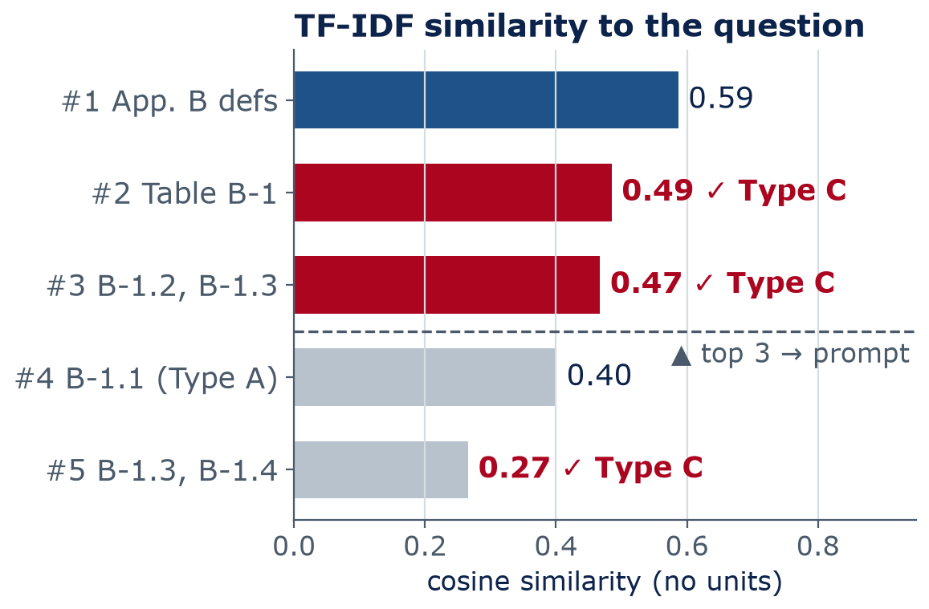
RAG
Worked example: the Lab 08 question, retrieved for real
Subpart P cut into 56 chunks of 250 words (50-word overlap)
Top 3 chunks go into the prompt; #2 holds Table B-1 and #3 the Type C rule
Expected grounded answer: 1½H:1V (34°), citing Appendix B, Table B-1
Lab 08 differs: the question as typed misses Table B-1 (“ft” ≠ “feet”); reworded in the code's words, it ranks #1
Notes:
This chart is real: TF-IDF retrieval over our copy of Subpart P for the exact Lab 08 question. The top-scoring chunk is the Appendix B definitions, which say to use Table B-1 but cut off before the table's rows. Chunk 2 contains Table B-1 with 'Type C | 1 1/2:1 (34 degrees)', and chunk 3 contains rule B-1.3 for Type C. Because we send the top three, the model sees the answer and can cite it. With top-1 retrieval it would not, because the #1 chunk only says 'use Table B-1'. Lab 08 uses different chunks, and there the question as typed misses Table B-1: TF-IDF drops the one-letter 'C', and 'ft' and 'slope' do not match the document's 'feet' and 'slopes'. The model then answers 1/2:1, which is wrong. Rewording the query in the document's own words ranks Table B-1 first, and the model answers 1½:1 (34°), but it cites the wrong source number. Lessons: query wording matters, and you must check what was retrieved and every citation, not only the final answer. 1½ horizontal to 1 vertical is an angle of arctan(1/1.5) ≈ 33.7°, which OSHA rounds to 34°. (3 min)

Slide 21
RAG
Where RAG helps — and where it fails
RAG helps with
RAG fails when
Codes, standards, and specs: answers that cite a clause or table
Project documents: RFIs (requests for information), submittals, O&M (operation and maintenance) manuals
Company know-how: design guides, lessons learned
Fresh information, without retraining the model
Bad retrieval: “soft clay” finds the soil definitions, not the slope table
Chunks lose context: a line with 3/4:1 lost its “Type A” heading
Tables are images: the eCFR shows Table B-1 as a picture; text search can't see it
The model ignores or misreads the retrieved text
Stale index: an old code edition still in the collection
Notes:
Left: good uses, anywhere the answer is written down in documents you control. RFIs are requests for information; O&M manuals are operation and maintenance manuals. Right: real failure modes, and the first three come from our own tests on Subpart P. A TF-IDF search for 'really soft clay' returns the cohesive-soil and Type A definitions, not the slope table. A line-by-line chunker returns the Type A 3/4:1 rule without its heading. And in the official eCFR, Table B-1 is an image; our course copy includes a typed transcription because otherwise text retrieval could never find it. Scanned drawings and PDF tables have the same problem. (3 min)

Slide 22
RAG
Be the retriever: which chunk would you hand the model?
A
Type C | 1 1/2:1 (34 degrees)
Q1: Max allowable slope, Type C soil, less than 20 ft deep?
Q2: How steep can I dig a trench in really soft clay?
Cohesive soil means clay (fine grained soil), or soil with a high clay content, which has cohesive strength.
B
4
min
Pairs · real Subpart P lines, cut into chunks without their headings
1. All simple slope excavation 20 feet or less in depth shall have a maximum allowable slope of 3/4:1.
C
Which chunk(s) does each question need?
Which chunk shares the most words with it?
What answer would the model give from that chunk alone?
Type C means: (i) Cohesive soil with an unconfined compressive strength of 0.5 tsf (48 kPa) or less; or (ii) Granular soils including gravel, sand, and loamy sand; …
D
Notes:
Four minutes in pairs. These are real lines from Subpart P, cut into one-line chunks with no headings. Q1 needs chunk A, but A has lost its table header ('less than 20 feet deep'). A word-matching search prefers C, which shares 'maximum allowable slope', 'excavation', and '20'. But C is the Type A rule from B-1.1; its heading was a different line. Retrieve C alone and the model will confidently answer 3/4:1, which is wrong for Type C. I checked: line-by-line TF-IDF ranks exactly that Type A line first for this question. Q2 needs D (soft clay with unconfined compressive strength of 0.5 tsf or less is Type C) and then A. Word matching picks B and the Type A definition, which lists clay as an example. Lessons: keep headings with chunks, retrieve several chunks, and consider meaning-based search. Real soil classification is done by a competent person with field tests.

Slide 23
04
Beyond text
Multimodal models and image generation
Notes:
Section 4, about 8 minutes.

Slide 24
Multimodal
Multimodal models read photos, drawings, and charts — imperfectly
Many assistants accept images and PDFs alongside text (as of 2026)
Site photos
Drawings, PDFs
Charts and plots
1
2
3
Can: describe conditions, flag missing hard hats
Watch out: misses small or hidden objects
Can: find a note, pull a schedule into a table
Watch out: misreads dimensions and scales
Can: read a pump curve, explain a trend
Watch out: values are approximate
Notes:
Multimodal means more than one kind of input or output: text plus images, and often audio or PDFs. The image is split into patches that become tokens, and the same transformer processes them with the text. Useful for first passes: describing site photos, finding a note on a sheet, pulling a schedule into a table. Risky for anything dimensional: a model that misreads 3'-6" as 3'-8" sounds just as confident. Check against the drawing, always. Week 6's CNNs and Week 13's robustness tests are the background. (2 min)

Slide 25
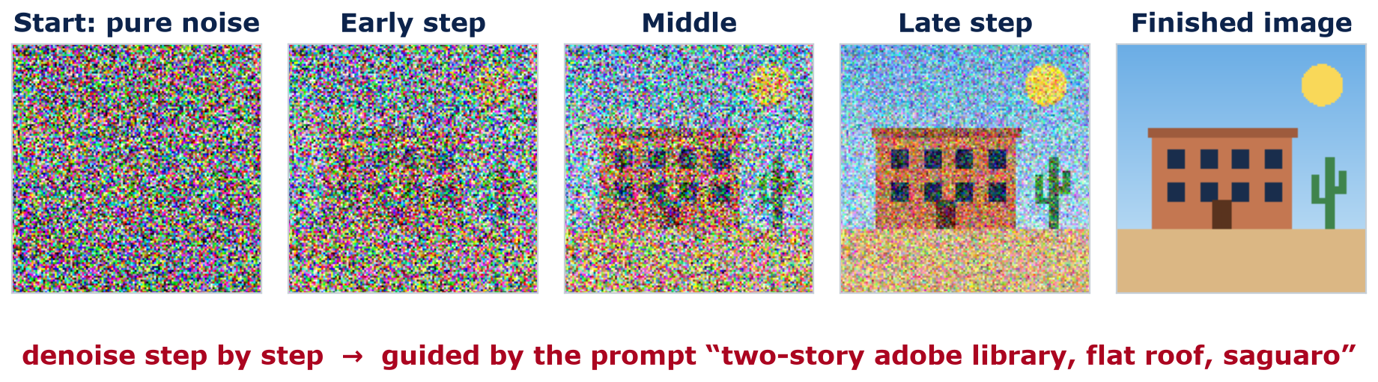
Image generation
Diffusion models start from noise and remove it step by step
1 Train
2 Generate
3 Guide
Add noise to real images; train a network to predict the noise that was added
Start from pure noise; subtract the predicted noise a little at a time (often 20–50 steps)
The text prompt's embedding steers every step toward images that match it
Notes:
The strip is our own simple drawing with noise added; it shows what a diffusion model sees at different steps, read left to right as generation. Training: take millions of images, add random noise at many levels, and train a network to predict the noise that was added (the same cost-plus-gradient-descent recipe). Generating: start from pure noise and repeatedly subtract the predicted noise, often in 20 to 50 steps. Text guidance: the prompt is turned into an embedding, like last week's, and fed to the network at every step, steering the result toward images that match it. Many current image tools use this idea or close relatives. (3 min)

Slide 26
Image generation
A concept image is not a design
A concept image gives you
It does not give you
Mood and massing ideas
Material palettes
Quick options for a client
Fast, cheap iteration
No structure or load path
No code check: egress, fire
No space for MEP (mechanical, electrical, plumbing)
No physics: it is just pixels
Unclear ownership (as of 2026)
≠
Treat it like a quick rough sketch: a starting point for discussion, never a deliverable
Notes:
Image generators can produce a striking rendering in seconds, which is useful early in design for mood and options. But the image has no structure, no loads, no code check, no dimensions; windows may not line up between floors, and a cantilever may be impossible. MEP means mechanical, electrical, and plumbing. On ownership: the U.S. Copyright Office has said that material generated entirely by AI, without enough human authorship, is not protected by copyright; the law and court cases are still developing, so check current guidance and your firm's policy. Ask: what would you need to check before this image could become a building? (2 min) OPTIONAL 10-MINUTE PAIR ACTIVITY (only if time allows): the instructor prepares 2-3 AI-generated renderings of a building, such as the adobe library from the diffusion slide, and shows them. Pairs mark problems with the load path (what holds up that cantilever?), egress (where are the exits and stairs?), window alignment between floors, and daylight and orientation (large unshaded west glass in Tucson?). Each pair shares one problem a client would never notice.

Slide 27
05
Cost and evaluation
Is it worth it — and is it right?
Notes:
Section 5, about 6 minutes.

Slide 28
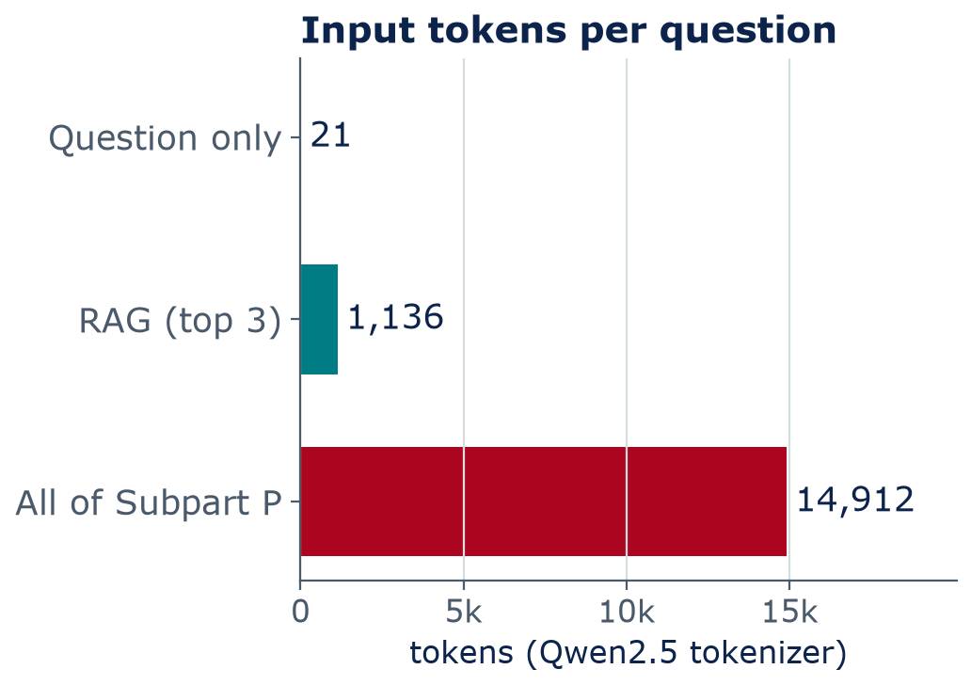
Cost and evaluation
Every token costs money, time, and energy
Cost: commercial models charge per input and output token
Latency: answers are generated one token at a time; long answers and big models are slower
Energy: recent estimates put a short text answer near 0.2–0.3 Wh (2025); images, video, and long reasoning use more
RAG sends ~13× fewer tokens than pasting all of Subpart P
Notes:
Token counts are real, from the Qwen tokenizer: the question alone is 21 tokens, question plus the top three chunks is 1,136, and pasting the whole subpart is 14,891 + 21 question tokens = 14,912 (the same 14,891 as on Week 7's token slide), about 13 times more on every question. Prices change often, so check current pricing. Energy: Google reported about 0.24 Wh for a median Gemini text prompt (August 2025) and Epoch AI estimated about 0.3 Wh for a typical ChatGPT query (2025); that is roughly a 10 W LED bulb for one to two minutes. Methods differ and long reasoning, images, and video use much more. Small per query, but billions of queries add up; data centers' energy and water use matter in Arizona, which we discuss in Week 13. (2 min)

Slide 29
Cost and evaluation
Evaluate outputs like you would check a junior engineer's work
Known answers
Check sources
Units and size
Re-ask
Score and record
Build a test set you can answer yourself — like Table B-1 values
Does the cited passage exist? Does it say that?
Units consistent? Order of magnitude sensible?
Rephrase or push back: does the answer hold?
Correct / partly / wrong — and how confident it sounded
This is exactly HW4's hallucination audit
Notes:
An evaluation routine you can reuse in HW4, Lab 12, and your project. Start with questions whose answers you already know, because you cannot evaluate a tool on questions you cannot check. Check every citation. Check units and magnitude. Re-ask in different words, or push back, to test stability and sycophancy. Record results in a table: correct, partly correct, wrong, plus how confident the answer sounded. A tool that is confidently wrong 10% of the time can be more dangerous than one that is hesitantly wrong 30% of the time. (2 min)

Slide 30
Homework 4
HW4 — LLMs Under the Microscope (posted today)
Tokens and next-token experiments
HOMEWORK
1
4
Hallucination audit: 10 engineering questions with known answers — score correctness and confidence
2
Due: Sunday 11:59 pm, end of Week 10
Week 9 = spring break
AI-Required
Prompt comparison: plain vs. structured vs. retrieval
3
Reflection: when would you trust an LLM — and how would you check it?
4
Full instructions and points: the HW4 README on GitHub
Notes:
HW4 is posted today and is due Sunday at 11:59 pm at the end of Week 10; Week 9 is spring break, so start before you leave. It is AI-Required: using an LLM is the point, and you document prompts and outputs. Four parts: tokenization and next-token experiments; a hallucination audit of 10 engineering questions with known answers, scoring both correctness and how confident the model sounded; a prompt comparison of plain, structured, and retrieval prompts; and a short reflection on trust. This week's lab gives you every tool you need. Full instructions and points are in the HW4 README on GitHub.

Slide 31
Lab 08
Lab day: inside an LLM, and RAG
Tokenize engineering text and count tokens
Print the model's top-5 next-token probabilities; run a temperature experiment
Sentence embeddings and cosine similarity on engineering sentences
Build a mini-RAG over OSHA Subpart P: chunk, retrieve with TF-IDF, prompt with citations
Ask the Type C slope question with and without retrieval — compare to Table B-1
LAB
08
Bring a charged laptop
Open the notebook from the course GitHub page
Notes:
This week's lab uses the small Qwen model, so expect it to make mistakes without retrieval; that is the point. Bring a charged laptop. The model download is about 1 GB the first time; model downloads happen on Google's computers, not on your laptop or phone data plan. If Colab is slow, start the setup cell as soon as you sit down.

Slide 32
Wrap-up
Key takeaways
A prompt is a specification: role, context, task, constraints, format, examples, assumptions
1
Expect invented citations, unit slips, overconfidence, and sycophancy — and check for them
2
RAG = retrieve the right passages, then answer from them with citations you can check
3
RAG fails when retrieval fails: look at what was retrieved, not just the answer
4
A generated image is a sketch, not a design; evaluate against known answers and sources
5
Notes:
Recap. After spring break, Week 10: AI agents, which take these models from answering to acting, using tools like the retriever you build on lab day. HW4 is due at the end of Week 10.

Slide 33
Learn more
Readings and resources
Prompt Engineering Guide (DAIR.AI) — Introduction + Few-shot — REQUIRED (≈ 20 min)
Prompt Engineering Guide — RAG — REQUIRED (≈ 10 min); the pipeline you build in Lab 08
Jay Alammar — The Illustrated Stable Diffusion — optional (≈ 30 min); diffusion with diagrams
NIST AI 600-1 — Generative AI Profile (2024) — optional; skim the list of GenAI risks
eCFR — 29 CFR 1926 Subpart P — optional; the official text behind Lab 08
Notes:
Required reading is about 30 minutes this week (HW3 is due and Lab 08 is on lab day); the rest is optional. All free. The NIST profile is a good bridge to Weeks 13 and 14 on responsible AI and policy. Always use the official eCFR for real work; our course copy is for learning only.

